Slide 1

Response to OECD presentation on long-term macroeconomic trends for Europe
Country Perspective: KAZAKHSTAN
Ainur Aiypkhanova, MHA

Slide 2
HEALTH OUTCOMES: “typical country-in-transition”: gradual improvement
Life Expectancy at Birth
Maternal mortality
Infant mortality
2014
71,5
2014
11,7
2014
9,7
2015
72
2015
12,5
2015
9,3
2016
72,4
2016
12,7
2016
8,6
2017*
11,6
2017*
8,14
Prevalence (per 100 000 people)
Cardiovascular
Cancers
Tuberculosis
Traumas & Accidents
2014
2394,7
2014
198,7
2014
66,4
2014
3493,2
2015
2429,7
2015
207,7
2015
58,5
2015
3270,4
2016
2413
2016
199,1
2016
52,7
2016
2936,9
2017*
2387,15
2017*
191,71
2017*
53,7
2017*
3174,66
Mortality (per 100 000 people)
Cardiovascular
Cancers
Tuberculosis
Traumas & Accidents
2014
207,2
2014
93,2
2014
4,9
2014
87,6
2015
193,8
2015
92,0
2015
4,1
2015
82,5
2016
179,8
2016
88,8
2016
3,4
2016
76,5
2017*
180,23
2017*
84,57
2017*
2,8
2017*
70,74
* Данные за 9 месяцев 2017 года
3

Slide 3

Health expenditure trends: growth, composition
Total spending on health in local currency (bln ₸)
Gov’t spending on health will rise by 93% from 2014 till 2030 (from 857 bln ₸ to 1656 bln ₸)
955,9
2011
1165,6
2012
GDP on Health
Health spending per person
1281,5
2013
1433,1
2014
KZ: 3,6%
ОECD: 8,9%
KZ: 381 US$ (122 тыс ₸)
ОECD: от 941 US$ (302 тыс ₸)
1484,8
2015
HEALTH EXPENDITURES WILL GROW CONTINUOUSLY
Ratio of PRIVATE (left) vs PUBLIC (right)
health spending
PRIVATE SPENDING COMPOSITION
2011
31%
68%
SUPPLIES, DEVICES
2012
33%
66%
HOSPITAL
2013
35%
64%
KZ (blue)
2,5%
2014
15,3%
PHARMACEUTICALS
37%
62%
37,8%
39%
61%
26,3%
2015
OECD (red)
27,3%
72,7%
DENTAL
DUE TO SHRINKING GOV’T SPENDING, PRIVATE SPENDING REACHED 39% IN KZ
THE LEADING ITEM IN PRIVATE SPENDING IS PHARMACEUTICALS (DRUGS)

Slide 4


HEALTH EXPENDIRURE COMPOSITION: redistribution from INP. to OUTP.
SPENDING ON INFECTIOUS DISEASES (BLN ₸)
SPENDING ON CHRONIC NON-INFECTIOUS DISEASES (BLN ₸)
KEY POINTS:
11,6
2010
213,5
2010
Infectious diseases comprise 4-5% of total health spending
NCD expenses grow and are 95-96% of total health spending
Share of HOSPITAL spending is higher in KZ than in OECD, with a trend to decrease
WORLD: CONSTANT GROWTH OF NCDs
15,1
2011
268,5
2011
17,5
2012
360,1
2012
18,5
2013
397,3
2013
18
2014
373,6
2014
19,1
2015
414,7
2015
Health spending composition: KZ & OECD
KZ
OECD
DAY CARE
DAY CARE
3%
1%
OUTPATIENT
OUTPATIENT
48%
49%
37%
62%
HOSPITAL
HOSPITAL

Slide 5
Health financing trend (PUBLIC vs PRIVATE) in KAZAKHSTAN
Health Financing: actual and forecast
KEY POINTS:
1. DECREASING share of government spending on health as a share of GDP
from 2,6% in 2009 to 1,9% in 2017
2. GROWING SHARE OF PRIVATE SPENDING ON HEALTH from 30% in 2010 up to 39% in 2015.
PRIVATE EXPENSES OVER 20%: RISK OF INSUFFICIENT ACCESS TO HEALTHCARE.
Raise GDP% on health from 3,4% in 2017 tо 3,7% by 2025
Decrease burden on gov’t spending (cost sharing)
Control rapid growth of private OUT OF POCKET (OOP) spending
WHY NAT’L HEALTH INSURANCE:
2009
2017
2025
Total Health Spending, % of GDP
Share of government spending on health in % GDP
Share of gov’t spending on health in % GDP after Nat’l Insurance
Private OOP spending on health, after Nat’l Health Insurance
Private OOP spending on health, if No Nat’l Insurance

Slide 6
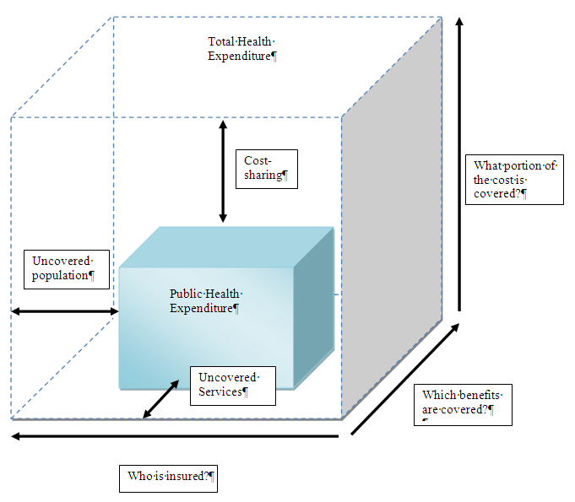
Health financing REFORM in KAZAKHSTAN
low healthcare expenditure in KZ (did not exceed 4.5% of GDP since 1995)
low share of gov’t spending on health out of total health spending (61% in 2015 in Kazakhstan; 80% OECD average),
overall government spending on health out of all government spending was 11% in 2015 in Kazakhstan, close to 15% OECD average
Mandatory (Universal) Social Health Insurance Reform
2015-2017 adopted new laws & regulations
Started in 2018 (employer contributions)
Full launch postponed till 2020
Redefine State Obligations (“the box”)
Shrink the list of free health services (regardless MHSI contributions)
Clarify state-paid health package (“all specialized outpatient care is free” -> “a patient in diabetes disease management program, gets free annual ophthalmologist visits”)
+ deregulation
+ digitalization

Slide 7
INEQUALITIES: Gini index decreasing over time but inequalities exist still
GINI index in Kazakhstan = 26.5 in 2015, decreased from 30 in 2004*
Income share held by lowest 10% in Kazakhstan = 4.3 %
Income share held by highest 10% in Kazakhstan = 22.3 %
Poverty headcount ratio at national poverty line (% of population) = 2.7%
VALUES & POLICIES still centered around social redistribution
Historical influence of communistic regime “Government should provide free healthcare”, “Right to State-Paid Health Services”, “Health is a gov’t obligation”
Growing resistance “to pay for free-riders” – why Health Reform Delayed till 2020
UNIVERSAL HEALTH COVERAGE, MDGs, SDGs…
Healthcare:
Accessible
Affordable
Sensitive
Effective
Efficient
…
?
*Source: https://tradingeconomics.com/kazakhstan/gini-index-wb-data.html

Slide 8
EXTERNAL INFLUENCES: EEU (Russia), OIC (Arab world), Silk Road (China)
EURASIAN ECONOMIC UNION
Russian dominance in regulatory framework for 5 member-states
# drug registration, medical devices,
ORGANIZATION ISLAMIC COOPERATION
KZ leads OIC-health agenda on Health Systems Strengthening (50+ member states), see http://www.oic-health.kz/index.php/en/
ONE ROAD, ONE BELT INITIATIVE
KZ part on cultural, trade, industrial cooperation with China
# August 18, 2018, Beijing High Level Meeting of Health Ministers (55+ participating countries), loose collaboration agreements
“Fused” geopolitical borders – implications for health systems:
Technologies (4th Industrial revolution – WEF, Klaus Schab)
Artificial Intelligence; Internet of things & devices; Blockchain tech; Drones (carry medicines); Precision Medicine; Digital trade
Mobility (medical tourism)
Shifting generational preferences (behaviors, choices - diseases)
Environmental challenges (pollution, scarce resources)

Slide 9

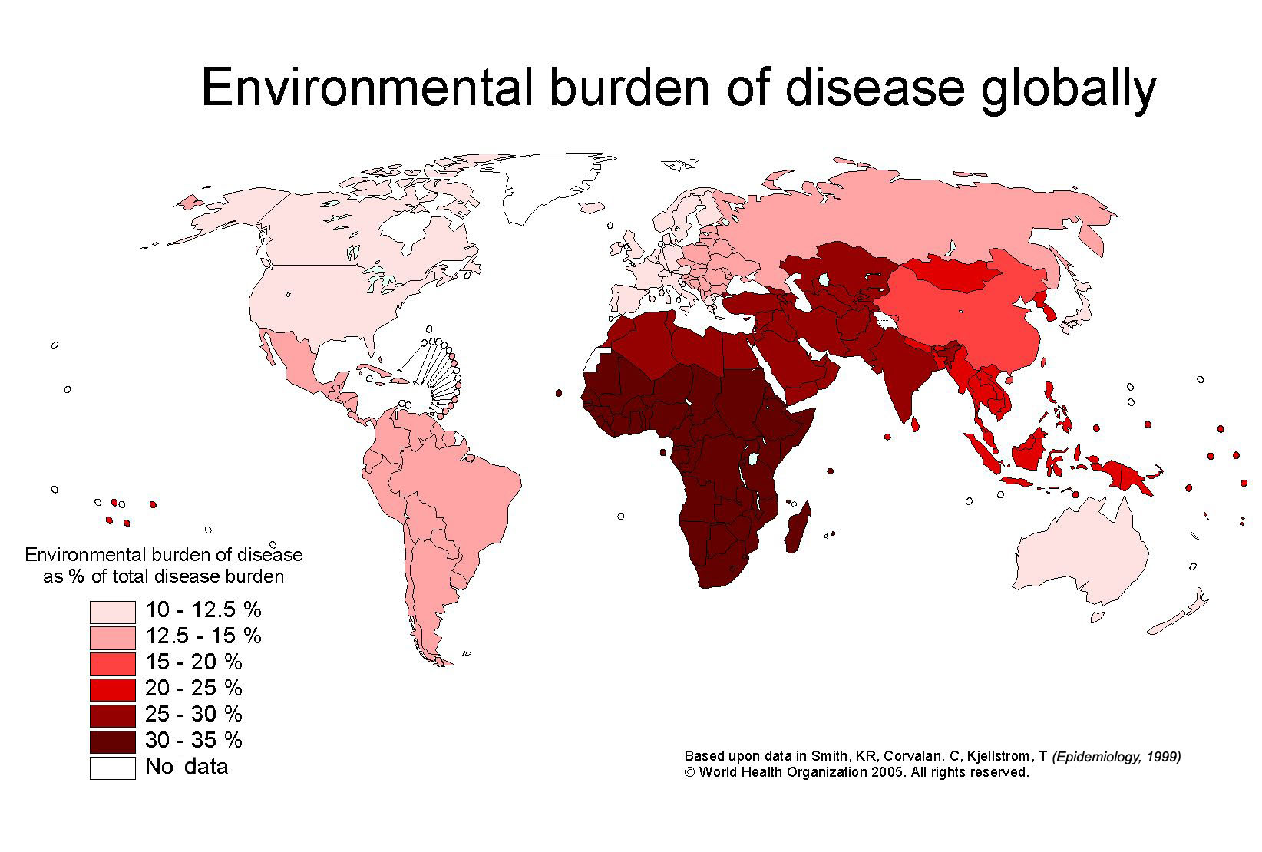
Example #environmental burden of disease
-Urban air pollution
-Acute poisonings/
toxic chemicals
-Climate change
Source: http://www.who.int/bulletin/volumes/88/10/10-021010/en/

Slide 10
Solution # “greening” health sector
Energy use reduction
# LED surgical lighting
# occupancy sensors
# reduce air exchanges per hour in operating rooms for non-surgical periods
Less waste
# single-use device reprocessing
# prevent food waste in cafeteria
# bag waste reduction
Source: https://climatecouncil.noharm.org/

Slide 11
Keep in mind… the determinants of health
social environment
economic environment
physical environment
individual behaviors
& characteristics (diseases)
Outside HC
HEALTHCARE
SYSTEM
Source: WHO http://www.who.int/hia/evidence/doh/en/

