Slide 1
Foresight Group meeting - 07. Feb. 2018
WHO/Europe
Dr. Clemens Martin Auer
Director General
Federal Ministry of Labour, Social Affairs,
Health and Consumer Protection

Slide 2
Macroeconomic situation in Austria
GDP 2016: 353.30 bn Euro
Expenditure on health 2015: 37.578 bn Euro (10.9 % of GDP)
Public expenditure on health (incl. LTC): 75.6 % (27.870 bn Euro)
Source: Statistics Austria; WIFO, Dec. 2017

Slide 3
Rational for changing the health governance Characteristics
Highly fragmented health care system
Strong focus on hospital services, underutilized outpatient sector
Financial situation back in 2012:
Public Health expenditure growth 1990-2010: 5.2 %, higher than GDP growth
Projections showed a growing gap in the medium term:

Slide 4
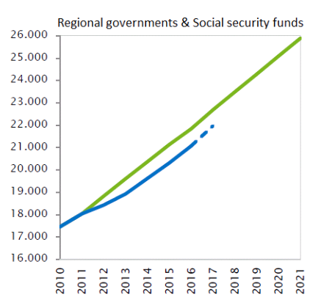
Target-based health governance Austria's take on innovating its health governance
Management by objectives
Partners: federal government, regional governments and social health insurance
Framework to identify, prioritize and implement common objectives
Financial long-term perspective: public health expenditure remains stable at approximately 7% of GDP
Comprehensive monitoring of the achievement and progress of the objectives
Mio. Euro
Expenditure ceilings
Actual expenditure according to monitoring

Slide 5
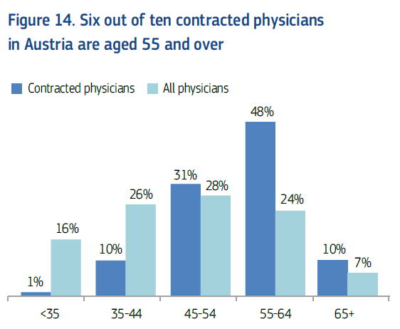
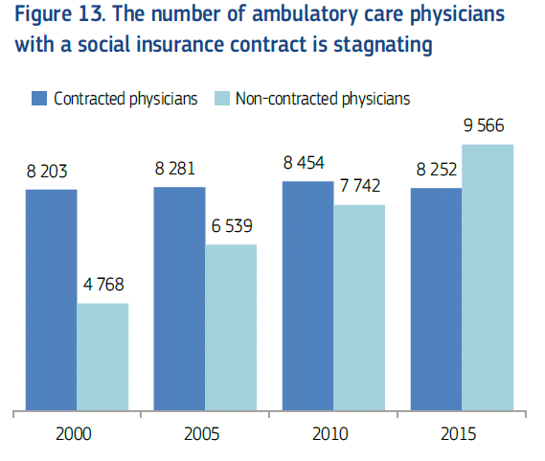
Challenges for the Austrian Health Care System
Health workforce
Ageing of the health workforce
Attractiveness of the public health system
Innovation
Investment backlog and the need to better align funding with public health priorities (e.g. unmet therapeutic needs)
Assessment and appraisal of innovation
New medicines challenging the financial sustainability of publicly funded health care systems
Health care provision in rural areas
Source: OECD/European Observatory Austria: Country Health Profile 2017

Slide 6
How we tackle these challenges Improving overall efficiency in the health care sector
Strategic investment for the future of health care
Strengthening primary health care
Digital infrastructure
Fostering coordination and cooperation
Joint planning of the health care system
Health work force planning
Joint provision and procurement of pharmaceuticals
Further strengthening of the public health system

