Slide 1
Macro –Economic Outlook for Europe A patient perspective on moving forward
Nicola Bedlington
Secretary-General, European Patients’ Forum
European Health Systems Foresight Group Meeting 2
Copenhagen, 7 February 2018

Slide 2

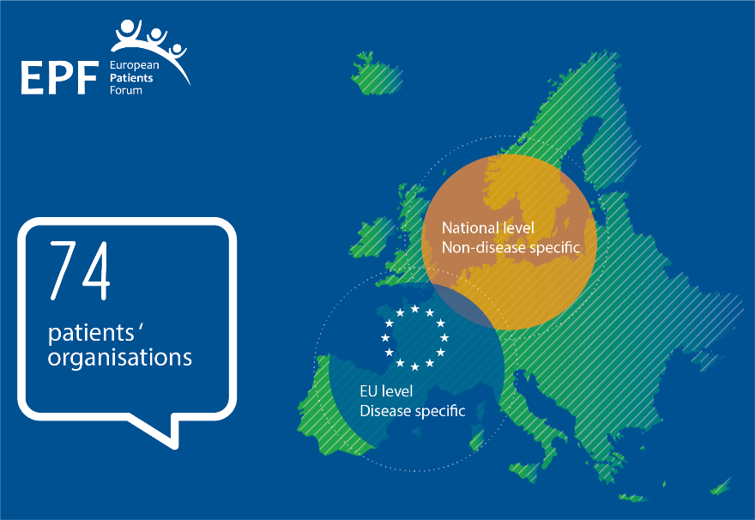

About EPF
European Patients’ Forum
Umbrella organisation
Active since 2003
Independent & non-governmental
EU patients’ voice
Our Vision!
“All patients with chronic conditions in Europe have equal access to high quality, patient-centred health and related care.”
Our Mission!
“to be the collective, influential patient voice in European health and related policies and a driving force to advance patient empowerment and patient access in Europe.”

Slide 3

Macroeconomic outlook bleak …
Fundamental change : health systems sustainability and our values base at risk – health a political choice
Countries where more investment needed, but
Policy-makers: chronic disease burden, new technologies, changing patient needs, prevention residual problems
Patients: systems do not cope optimally with chronic conditions – does not meet patients’ needs … residual problems
Less about money – 20% waste ! much more about the way healthcare is delivered and services organised?
High-value in all its guises means focus on the person not disease; patients as “co-producers” and partners

Slide 4

“high value” from the patient perspective?
“New” =/= better per se
For patients innovation(therapeutic, technological, systems, social) is something which also brings concrete benefits – improvement in health or quality of life – over what exists
Critical challenges:
Bridging the gap between priorities – patients, policy, researchers, corporate, regulators
Agreeing common understanding of high versus low value
Breaking organisational and financial silos that prevent accurate assessments of value
Innovation on what matters most for patients
Right priorities / needs
Maximum impact & added value
Benefit for public health

Slide 5
Measures of success for person-centred systems
Outcome measures should be defined by patients - what outcomes they find most important
PROMs need to be validated by patients
Future outcome measures should be “patient-designed”, “patient-relevant” and “patient-prioritised”
Need to move beyond dichotomy of “clinical” vs. “PROM” / “quality of life”
Source: “What can journals do to
promote clinical trials?” presentation by Dr. Wim Weber, European research editor, BMJ
ECRAN European Clinical Trials Day, 20 May 2014

Slide 6
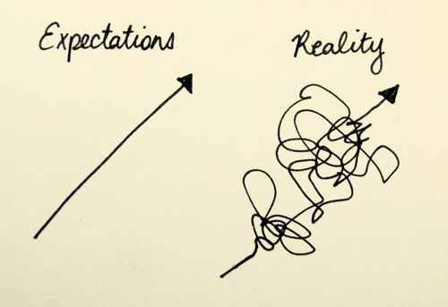
The patient experience matters
Patient experience =/= “satisfaction”
Comparative PaRIS indicators can be potentially important in driving change
But patient experience cannot be captured in indicators – critical to also have real engagement with patients
Participation should be designed in at all levels in the healthcare system – channels for feedback, and structural and institutional opportunities for involvement – redundancies/ waste
Public reporting and transparency
Feedback followed by action!

Slide 7


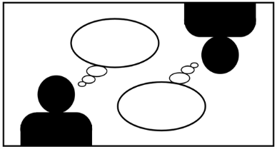

What is patient empowerment?
“A process that helps patients gain control over their lives, increasing their capacity to act on issues that they themselves define as important” (Adapted from JA-PaSQ, 2012)
Capacity to draw on personal resources → live well with chronic condition(s) in daily life
Navigate the health care environment
Aspects of empowerment include: self-efficacy, self-awareness, confidence, coping skills, health literacy
A process: non-binary, non-linear
Cannot be imposed top-down
Individual + Collective
Notes:
A process – non-binary, non-linear
Cannot be imposed from top-down – needs changes at all levels
Individual but also collective (patient community)
What it is not: shifting responsibility on to patients inappropriately
An empowered patient has control over the management of their condition in daily life. They take action to improve the quality of their life and have the necessary knowledge, skills, attitudes and self-awareness to adjust their behaviour and to work in partnership with others where necessary, to achieve optimal well-being.
Differentiation with patient involvement
Empowerment interventions aim to equip patients (and their informal caregivers whenever appropriate) with the capacity to
participate in decisions related to their condition to the extent that they wish to do so;
become “co-managers” of their condition in partnership with health professionals;
develop self-confidence, self-esteem and coping skills to manage the physical, emotional and social impacts of illness in everyday life.

Slide 8

EMPATHIE study: 3 facets of empowerment
MACRO level
Patient
rights-laws
Normative standards
Health literacy
Information, data, ICT tools, system factors…
Self-management
Skills, behaviours, self-efficacy, psychological-emotional support…
Shared decision-making
Relationship
Decision aids
Communication
HCP skills, attitudes…
MESO level
Monitoring performance
Curricula models
Good practices
standards
Virtual
communities
MICRO level
Incentive based
systems
Strategies of PE addressed to
PROFESSIONALS
Strategies of PE addressed to
PATIENTS
Providing information
Group information
sessions
HEALTH LITERACY
Web based
Interventions
Communication
skills
Multidisciplinary teams
Virtual personalized
support
SELF-MANAGEMENT
SHARED TREATMENT DECISION MAKING
Technical skills
Patient-professional
relationship interventions
Behavioral change support
Self-efficacy interventions
Decision aids
Emotional and psychological support
EMPATHIE study, final report (2014) available at http://ec.europa.eu/health//sites/health/files/patient_safety/docs/empathie_frep_en.pdf

Slide 9
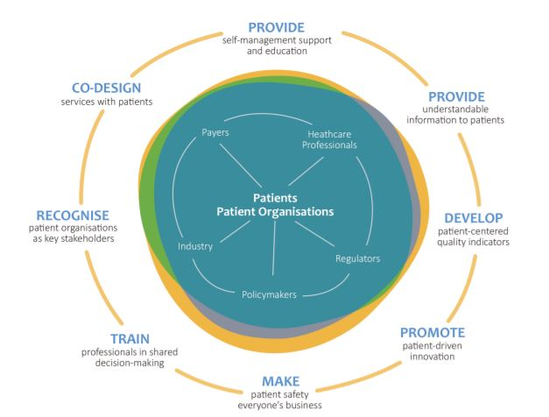

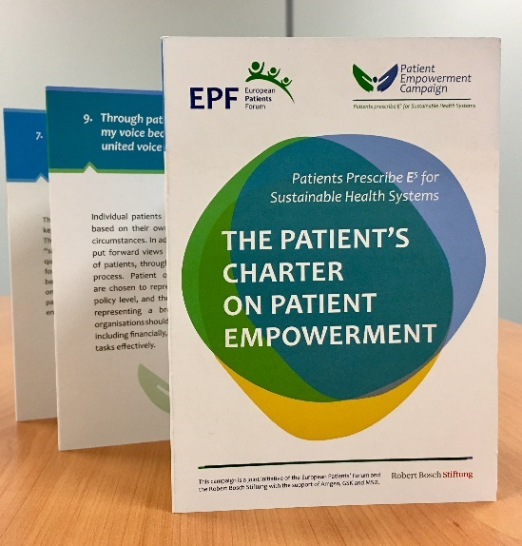
Empowerment Campaign outputs
The Patient’s Charter on Patient Empowerment
10 fundamental principles of patient empowerment
Can be applied to local context or national healthcare system
Roadmap for Action
Proposes concrete actions for different stakeholders
Supported by:
and by unrestricted grants from GSK, Amgen and MSD.

Slide 10
The Roadmap for action
Identifies priority areas for further action…
Direction and inspiration, rather than prescription
Long-term view
Who should act? All relevant stakeholders in each area
Need to develop a new, collaborative mind-set to cut through existing “silos” and develop solutions together – always with patient organisations as partners
Health literacy & information
Professional training & skills
Self-management support
Patient-driven technology solutions
Patient involvement in patient safety
Patient centredness in healthcare
Patient involvement across the R&D lifecycle
Patient involvement in health policy
→ Guiding our work for the next years !

Slide 11

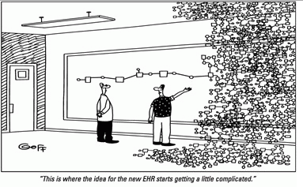
Technology: empowering patients
To fulfil the promise, digital health needs to be embedded in mainstream care
Patients and professionals need (digital) health literacy
Technology as an enabler to enhance human contact
To ensure it adds value – patient involvement at every level → technology becomes patient-driven not technology-driven

Slide 12
The patient’s voice in structural and operational reform
Patient insight paramount, also reflecting preferences, patient- relevant outcomes – underused resource
Healthcare work force : planning, forecasting reflecting on efficient use of resources – primary/ community care.
Patient safety – core issue requiring cross institutional cooperation - patient competences
Addressing waste per se – avoiding duplication, redundancies in the system
Integrated care- vertical and horizontal – and the nexus between health and social care

Slide 13
Prevention.. the panacea ?
No, but…..
Prevention , health promotion and patient centred chronic disease management as part of one continuum – not contradictory, or in competition
EPF -secondary and tertiary prevention, also in the area of psycho-social care.
As we grow both in outreach and advocacy impact, responsibilities in the wider public health arena
Ex : dedicated initiatives in the specific fields of vaccines hesitancy and nutrition among patients with chronic diseases.

Slide 14


SDGs + Universal Health Coverage
EPF call on decision makers to commit to a long-term vision where equity of access and universal health coverage are a reality for all patients in the EU
Raising awareness about the gaps and barriers patients face in accessing healthcare;
Fostering more EU cooperation and political commitment;
Access Roadmap: key political actions towards achieving UHC for all patients in the EU by 2030
CORE MESSAGE : if we do not get it right on SDG 3 on health – many other SDGs are at risk to fail….
Parallel with future of health collaboration at EU level – if we do not have a dedicated, focussed Directorate and Programme on health … ‘ bigger’ economic and societal aspirations for Europe will also fail
Notes:
Strategic objective of the campaign is: a target of the third UN Sustainable Development Goal on ensuring healthy lives.
Roadmap objective: to also advise the European Commission’s mid-2018 implementation strategy for the SDGs (called on by the June 2017 Council)

Slide 15

EPF’s commitment
We channel our members’ expertise & connect patient organisations and other stakeholders
Link the “reform agenda” with “empowerment agenda” → towards health(care) policy that is needs-driven, a patient-led framework on good practice in patient involvement – what “good” looks like, also in the wider Europe – Institutional cooperation
Health system: service co-design / evaluation, health research, patient-driven technology solutions…
Patient engagement in pharmaceutical R&D – a life cycle approach leading to better and more cost effective drugs
Continued patient empowerment – as a core pillar for sustainability and quality
Back-drop – Universal Health Coverage

