Slide 1
3rd National Hepatitis C Elimination Workshop 6-8 April Tbilisi, Georgia

Slide 2
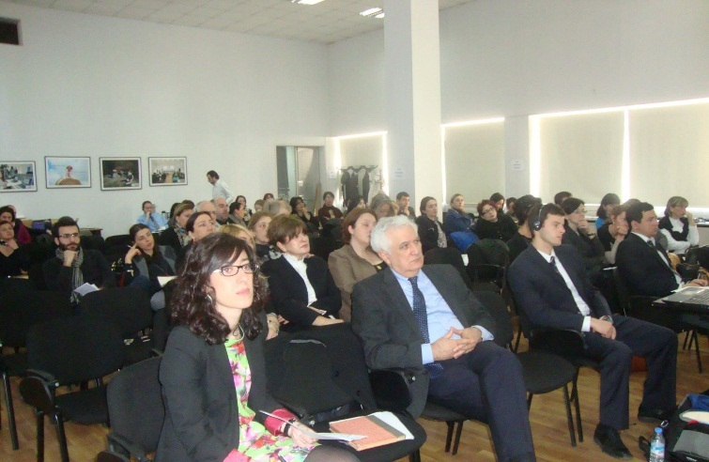
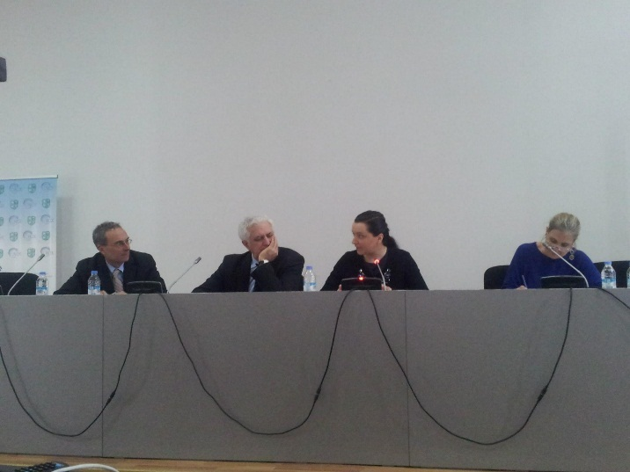
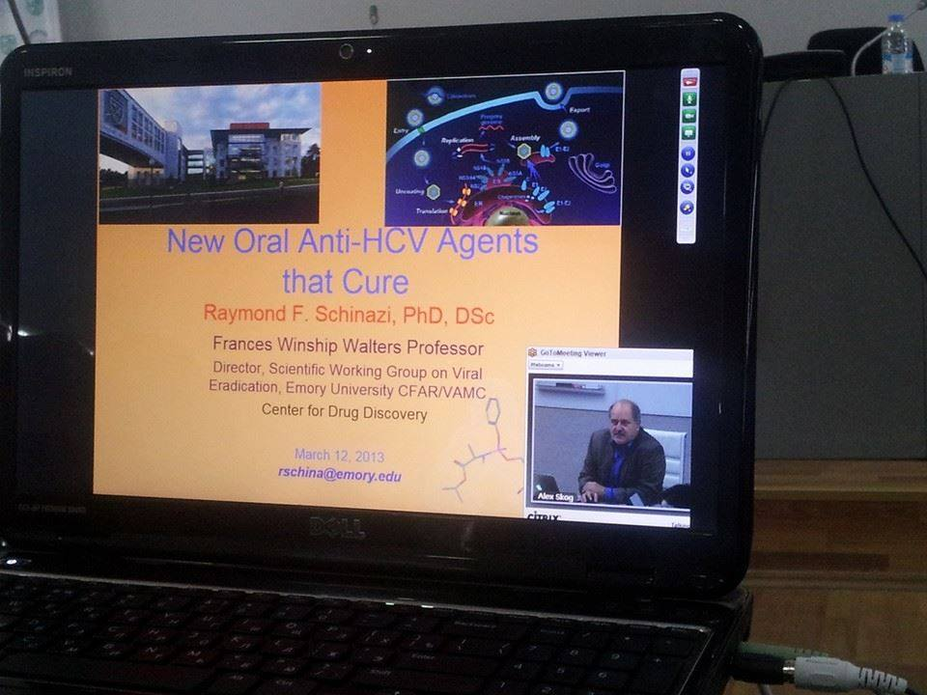
Georgian 1st National Workshop on Hepatitis C, March 12-14, 2014

Slide 3
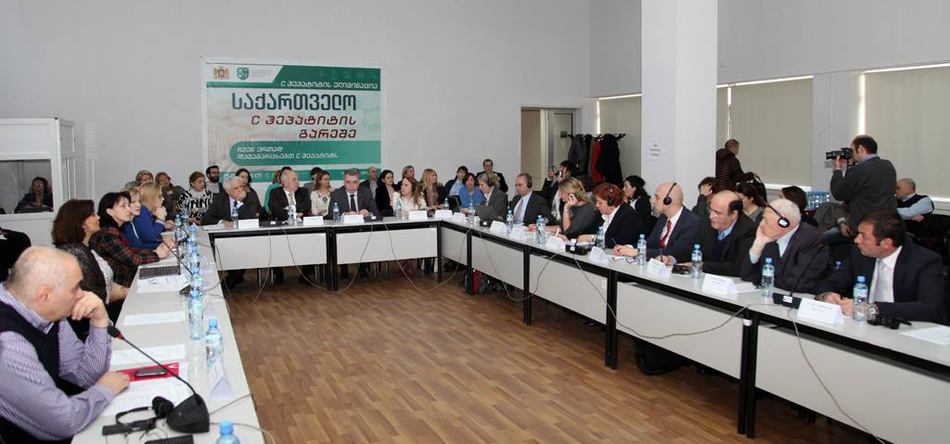
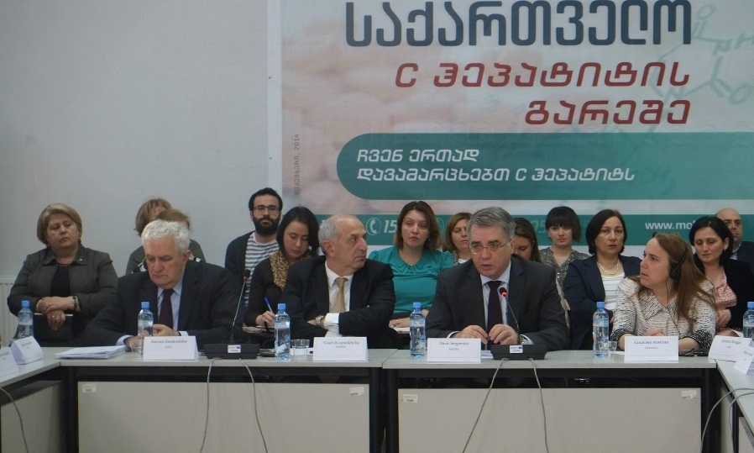
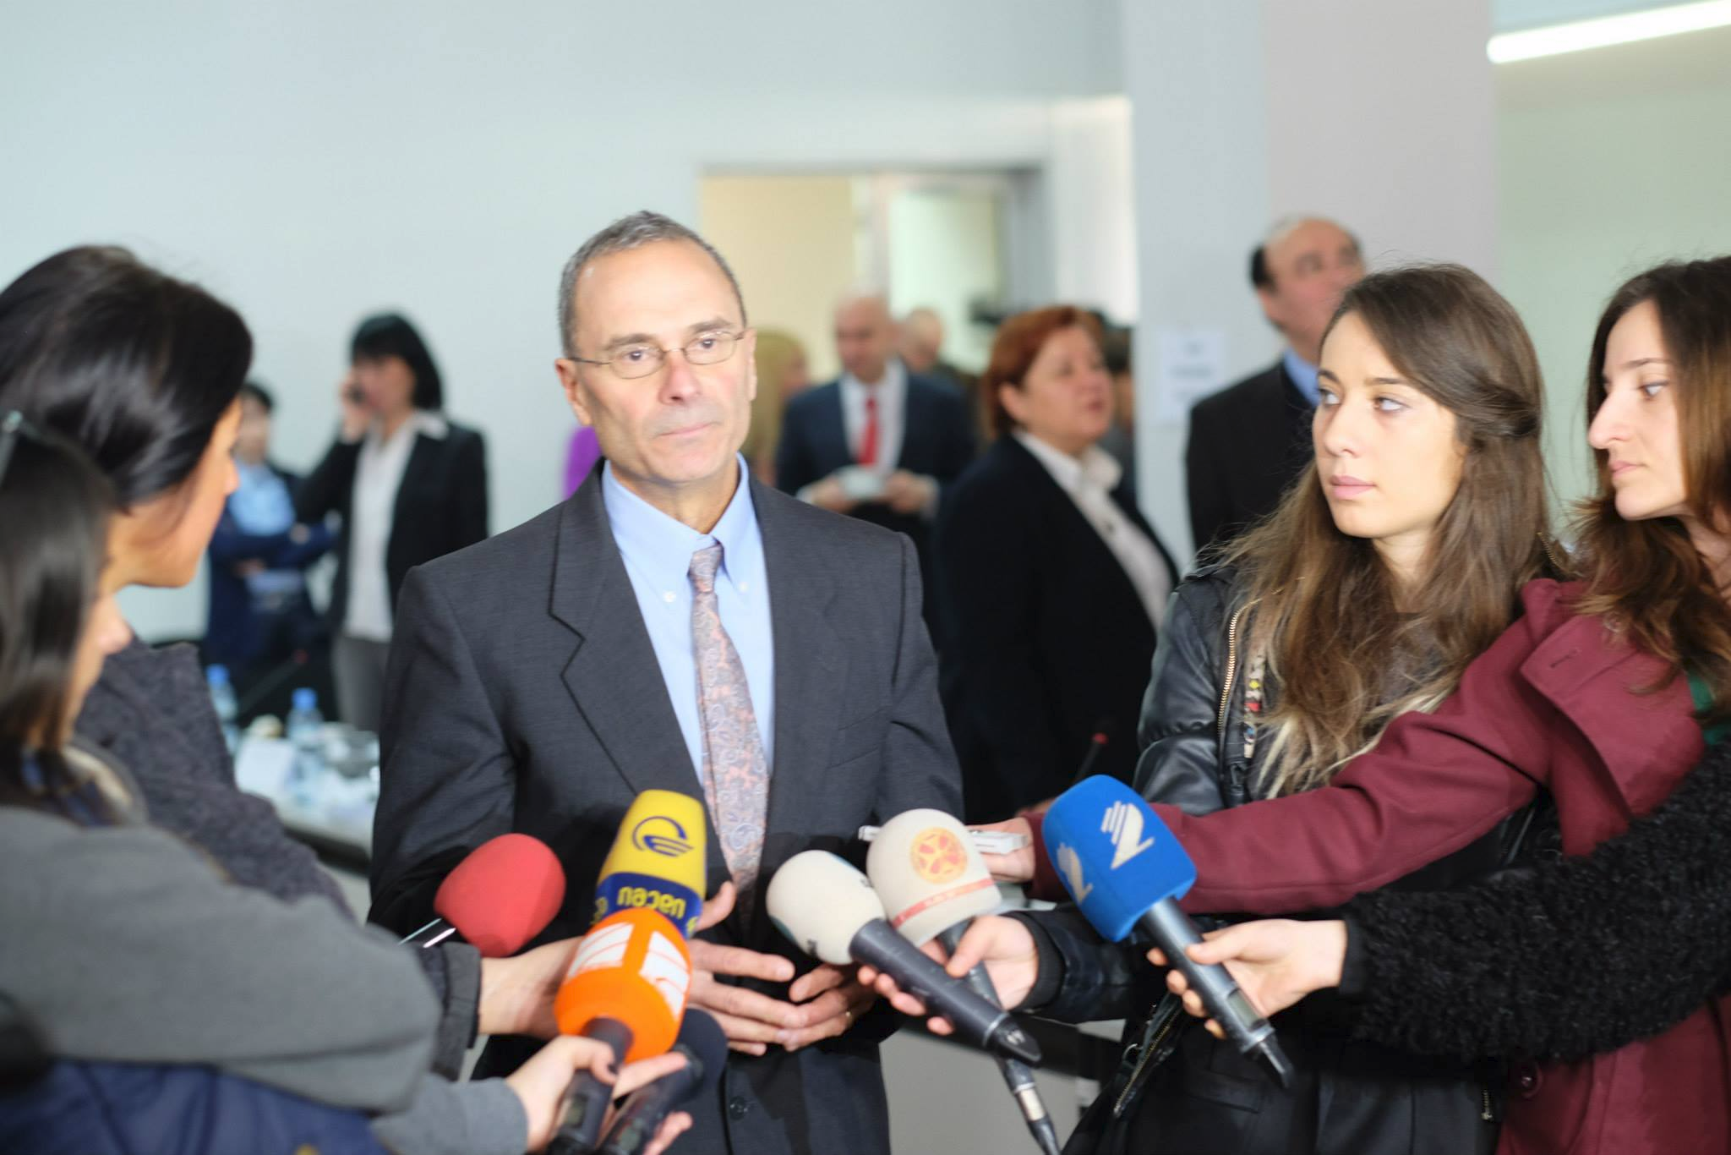
Georgian 2nd National Workshop on Hepatitis C, March 26-27, 2015
Notes:
The Memorandum of Understanding between the Government of Georgia and US pharmaceutical company Gilead was officially signed on April 21, 2015, that marked the launch of the first phase of elimination program.

Slide 4
Georgian 3rd National Workshop on Hepatitis C, April 6-8, 2016
Results of Population-based seroprevalence survey of hepatitis B and C
Phase 1 of hepatitis C elimination program
Hepatitis C elimination strategy, 2016-2020

Slide 5
April 6, 2016
9:00-9:30 | Welcome and Opening Remarks | Dr. Davit Sergeenko, Minister of Labour, Health and Social Affairs (MoLHSA) Mr. Ian C. Kelly, U.S. Ambassador in Georgia, Mr. Valeri Kvaratskhelia, MoLHSA
9:30-10:00 | Press conference/Coffee Break
10:00-10:10 | Review agenda | Dr. Amiran Gamkrelidze, NCDC Dr. Francisco Averhoff, CDC
10:10-10:40 | Final results of serosurvey | Paata Imnadze/Ana Kasradze, NCDC
10:40-10:50 | Results of NCDC screening | Maia Alkhazashvili, NCDC
10:50-11:00 | Phase 1 of elimination program - overview | Eka Adamia, MoLHSA
11:00-11:10 | Cascade of care | Lia Gvinjilia, CDC
11:10-11:25 | Informatics current status and challenges (Patient flow, database, etc.) | Leslyn McNabb, CDC
11:25-11:55 | Care and treatment | Tengiz Tsertsvadze, IDACIRC
11:55-12:15 | Discussion, Q&A
12:15-13:10 | Lunch
13:10-13:25 | LIFER/ECHO project role | Project ECHO participants (Lali Sharvadze, Davit Metreveli, Vakhtang Kerashvili, Giorgi Kamkamidze, Davit Baliashvili)
13:25-13:35 | Drug logistics | Tamar Kavteladze, Social Service Agency
13:35-13:45 | Laboratory monitoring | Gia Kamkamidze, Health Research Union (HRU)
13:45-14:00 | Patient financial and stigma challenges | Koka Labartkava, Georgian Community Advisory Board (GeCAB)
14:00-14:30 | WHO Launch of M&E Framework and Surveillance Guidelines | Yvan Hutin, WHO
14:30-15:00 | Discussion, Q&A
15:00-15:20 | Coffee Break
15:20-16:20 | Elimination plan overview, including TAG recommendations highlights 1. Awareness raising 2. Surveillance 3. Laboratory 4. Safe Blood 5. Infection control 6. Harm reduction 7. Care and treatment 8. Financing | Amiran Gamkrelidze, NCDC working group members (5-7 minutes each) 1. Maia Shishniashvili, NCDC 2. Maia Butsashvili, HRU 3. Gia Kamkamidze, HRU 4. Eka Kavtaradze, NCDC 5. Giorgi Chakhunashvili, NCDC 6. Paata Sabelashvili, State Committee 7. Nikoloz Chkhartishvili, IDACIRC 8. Ketevan Goginashvili, MoLHSA
16:20-17:00 | Discussion, Q&A
17:00-17:15 | Closing remarks Overview of the second day agenda | MoLHSA
19:30 | Reception in Youth Palace. Address: 6, Rustaveli ave., Tbilisi
Notes:
We will start Day 1 by presenting results of serosurvey, then we will move to presentations and discussion related to phase I of elimination. Dr Yvan Hutin will give a presentation and officially launch WHO’s M&E framework and surveillance guidelines. In the last session of the day, we will present general overview of the elimination strategy

Slide 6
April 7, 2016
9:00-9:15 | Opening Remarks, Review Day 1 | MoLHSA
9:15-9:30 | Awareness raising, reducing stigma, harm reduction | Natalia Podogova, Eurasian Harm Reduction Network (EHRN)
9:30-11:30 | Session on Harm Reduction | EHRN
11:30-11:50 | Coffee Break
11:50-12:05 | Screening and Linkage to Care: Monitoring the Care Cascade | Claudia Vellozzi, CDC
12:05-12:20 | Data requirements for Care Cascade | Susan Hariri, CDC
12:20-12:35 | Monitoring HCV Elimination among PWID | Margaret Hellard, Burnet Institute, Australia
12:35-12:50 | Lab Priorities | Jan Drobeniuc, CDC
12:50-13:05 | Surveillance and Burden Assessment | Scott Holmberg, CDC
13:05-14:00 | Lunch
14:00-14:15 | Infection Control | Yvan Hutin, WHO
14:15-14:30 | Modeling Progress in HCV Elimination: data needed | Peter Vickerman, University of Bristol
14:30-14:45 | Research Considerations for HCV Elimination | Francisco Averhoff, CDC
14:45-15:00 | M & E: Considerations for HCV Elimination | Jim Emshoff, CDC
15:00-15:10 | Instructions for working group session: Implementation of Elimination Plan 2016-2017 Focus on Indicators for Monitoring Outcomes | MoLHSA/CDC
15:10-15:30 | Coffee Break
15:30-17:50 | Working group session
17:50-18:00 | Wrap up working group session | MoLHSA
Notes:
We will start day 2 with harm reduction session, then we will have several presentations our international experts on several aspects related to HCV elimination, after that participants will split into working groups

Slide 7
April 8, 2016
9:00-9:15 | Opening Remarks, Review Day 2
9:15-10:45 | Working group session
10:45-11:00 | Coffee break
11:00-12:30 | Working Groups presentations Surveillance Screening and linkage to care Care and treatment
12:30-13:30 | Lunch
13:30-15:00 | Working Groups presentations Harm reduction and awareness raising Infection control Laboratory Safe blood
15:00-15:30 | Sum-up and closing remarks
Notes:
Working groups will continue on the second day and after that they will present outcomes of the working group discussions based on the template that will be given to each group in advance.

Slide 8
Acknowledgments
Georgian Ministry of Labour, Health and Social Affairs
Centers for Disease Control and Preventions
World Health Organization
Gilead Sciences, inc.
Eurasian Harm Reduction Network
State committee on hepatitis C
Elimination strategy working group

Slide 9
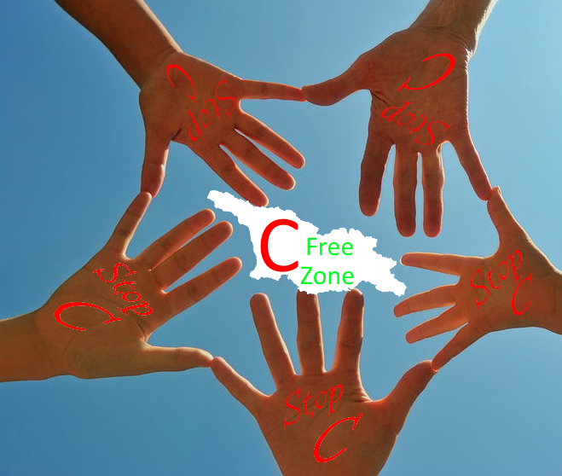
Thank you

