Slide 1
Hepatitis C Elimination Strategy 2016–2020
Overview
Amiran Gamkrelidze
Maia Tsereteli
Davit Baliashvili
National Center for Disease Control and Public Health

Slide 2
Why is elimination of hepatitis C in Georgia feasible and achievable?
High prevalence of HCV infection in general population
Small size of the country (69,700 km2) with population of 3.7 million people
Strong Governmental commitment towards elimination of HCV
Availability of all modern HCV diagnostic and treatment methods and strong human resource capacity in the field of viral hepatitis
Existence of effective systems for implementing large-scale national and international health programs, including through multi-sectoral approach (e.g. universal access to antiretroviral therapy)
Availability of logistic and control mechanisms within existing national HIV/AIDS, Tuberculosis and hepatitis C treatment programs that effectively prevent leakage of medicines
Adherence to principles of evidence-based medicine for hepatitis C as evidenced by the availability of national guidelines for many years

Slide 3
Overall Goal
Elimination of HCV by ensuring prevention, diagnostics and treatment of the disease

Slide 4
4 Strategic Goals of the Elimination Strategy
Goal 1:
Raise awareness of viral hepatitis
Goal 2:
Monitor health sector response to hepatitis
Goal 3:
Prevent transmission of viral hepatitis
Goal 4:
Reduce new infections and deaths due to viral hepatitis through expanded screening and treatment

Slide 5

The document is based on the recent WHO manual

Slide 6
Elaboration of the HCV Elimination Strategy
Intersectoral working group coordinated by NCDC
Financial estimations
Surveillance
Laboratory
Infection control
Safe Blood
Communi-cation
Harm reduction
HCV screening, treatment and care
Monitoring and Evaluation
Technical Advisory Group (TAG) of international experts reviewed and discussed the draft strategy and recommendations from the TAG were incorporated in the strategy
Notes:
Overall process is supported by the US CDC and WHO

Slide 7
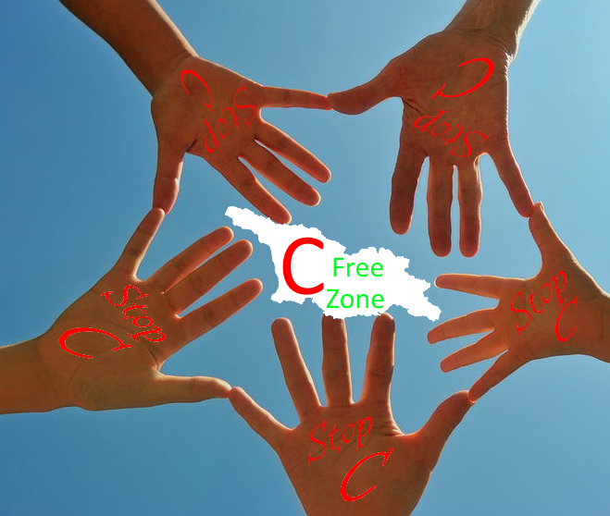
Thank you
Notes:
Now each section of the elimination strategy will be presented by representatives of working groups. Each presentation will take from 5 to 7 minutes

