Slide 1
Emergency/first phase measures of State Plan in elimination of C Hepatitis Medication Logistics Tamar Kavteladze

Slide 2

Program Executer LEPL Social Service Agency

Slide 3
Providing patients with
C Hepatitis treatment pharmaceutical products
Patient registration
commission
involvement in the treatment

Slide 4
Providing patients with
C Hepatitis treatment pharmaceutical products
Purchase of Pegylated
Interferon and Ribavirin
Providing with Sofosbuvir (Sovaldi)/Sofosbuvir/Ledispavir (Harvoni)
According to the Law of Georgia on ,,Procurement ,,
Is carried out with the support of
corresponding donor

Slide 5
Providing patients with
C Hepatitis treatment pharmaceutical products
Customs clearance at the border
Receiving/Inspection of pharmaceutical
drug products (quantity, packaging / labeling, expiry date)
Transportation to the
warehouse area

Slide 6


Transportation-Stock Placement
Sofosbuvir/Ledispavir/
Sofosbuvir Transportation escorted by Security Police

Slide 7
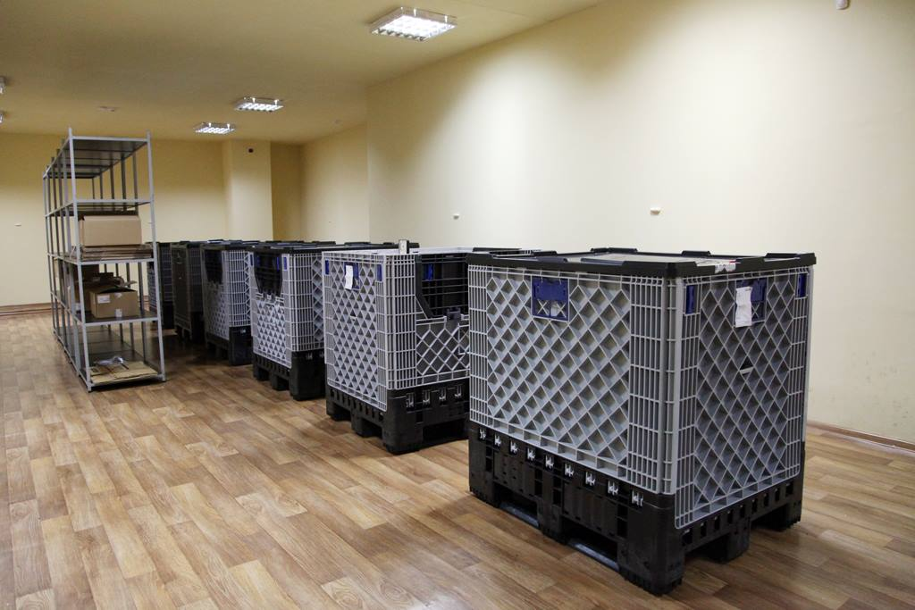
Warehouse is provided with the appropriate storage conditions, maximum control of temperature and video control
„Medpharma Plus“ Ltd
„ Center for Mental Health and Prevention of Addiction “ Ltd

Slide 8
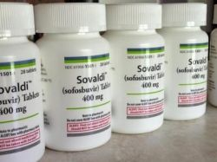
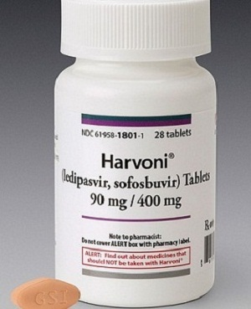
Providing patients with
C Hepatitis treatment pharmaceutical products
The number of patients involved in the program by the Commission
Working Group
Number of medication to be delivered
Put on a pack of C Hepatitis treatment medication (Sofosbuvir / Harvoni) and its packaging „barcodes“ and „sticker“ with the name and surname of the patient.

Slide 9
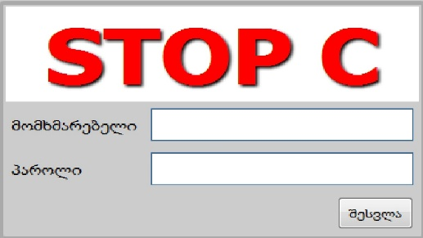
Providing patients with
C Hepatitis treatment pharmaceutical products
Display of received medications in the
Electronic program
Distribution and preparation of medicines in the warehouse
Program Supplier (Tbilisi-Rustavi-Gori-Kutaisi-Zugdidi-Batumi)

Slide 10

Medical Institutions will be supplied with medicines for
For the patients involved in the program once in 28 days
The number of medicines to be supplied is constantly changed on the basis
of documented information by the doctor (regime, dose change…)

Slide 11
Drug issue rule in providing institutions
Pegylated Interferon and Ribavirin
2 weeks supply according to the treatment scheme
1 bottle of Sofosbuvir / Harvoni
(28 Tablets)
The bottle must be opened in place and the patient takes the first pill in the presence of medical staff and camera

Slide 12
The patient involved in the treatment must:
At the end of the second week
of the treatment
Evidence of the bottle,
Barcode and remaining amount
of medicine in the bottle in front of the camera
Hand in the empty bottle on the 29th day
Take the next bottle

Slide 13

Patient involved in the treatment is not allowed to:
Give/sale/sell the medicine
Damage, falsify packaging (box, bottle, sticker barcode) of the medicine
Failure to appear at the end of the second week for drug fixing

Slide 14
The treatment regime and mandatory conditions would be violated if:
The patient did not appear at the end of the second week for fixing a drug
Did not hand in an empty bottle for getting the next bottle
HCV RNA inappropriate/doubtful indicant by the fourth week of treatment
Was late for getting the next bottle
In case of rule breaking the drug distribution will be carried out on the principle of DOT!

Slide 15
Drug distribution rule for prisoners in penitentiary system
Interferon
According to the treatment scheme
Ribavirin
1 week supply
Sofosbuvir
DOT principle, daily

Slide 16

The treatment regime and mandatory conditions would be violated:
HCV RNA inappropriate/doubtful indicant by the fourth week of treatment
Drug arbitrary termination
In case of rule breaking anti-viral treatment is discontinued!

Slide 17
Supplier institution must:
Fix the medicine distribution in the electronic program
Ensure the storage of medicine supply in safe/refrigerator
In case of death of the patient or discontinuation of treatment take back the medicine and store on site

Slide 18

LEPL Social Service Agency
Register medicine in the electronic program at regular intervals
Supervision of Service provider institution
Control of drug turnover in the institutions (quantity, residual)

Slide 19
Number of patients’ applications according to the commission held from May 2015 to March 2016
(15 commission meetings)

Slide 20
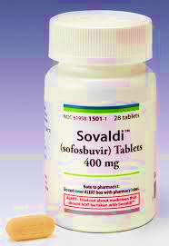
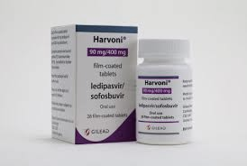
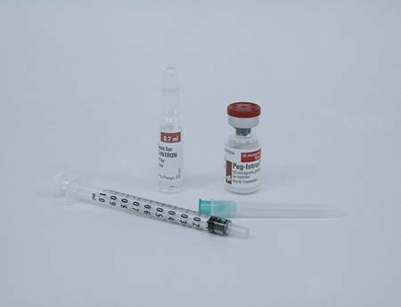
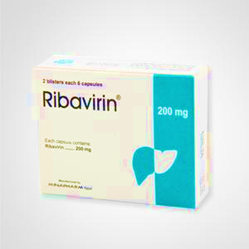
C Hepatitis treatment medicines given to the patients involved in the treatment component
01.05.2015-31.03.2016
Sofosbuvir
813372 pills /29049 boxes/
Sofosbuvir/Ledipasvir
(Harvoni)
22344 pills /798 boxes/
Interferon
34246 phials
Ribavirin
4585974 Tablets

Slide 21

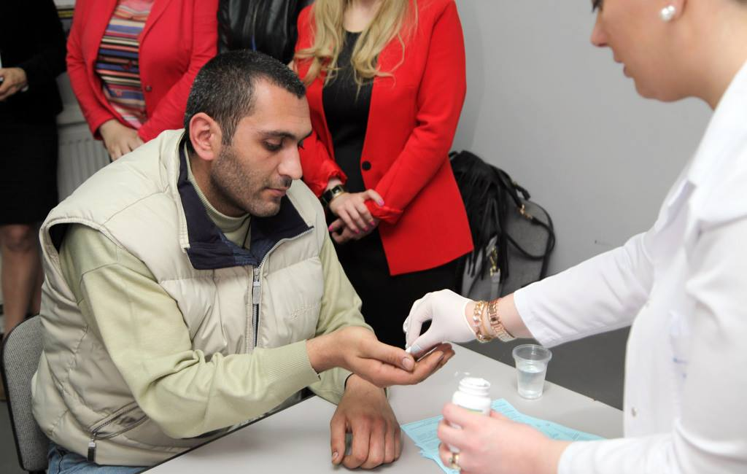
May 2015- March 2016 15 Commission meetings
8593
applications/medical documentations
7281 patients with C Hepatitis have been provided with treatment medicines

Slide 22
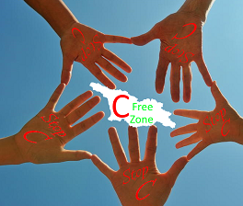
The second phase aims to involve 20000 patients in the treatment.
Georgia is the first country who will be able to eliminate the hepatitis C virus.

Slide 23

Thank you for your attention!

