Slide 1
Hepatitis C Screening
National Hepatitis C Workshop
6 April, 2016
Tbilisi, Georgia
Maia Alkhazashvili. MD
National Center for disease control and public Health

Slide 2
Importance of wide-scale HCV screening in successful implementation of HCV Elimination program
The main challenge for the successful implementation of the National Hepatitis C Elimination Program is identification of people living with HCV.
Successful implementation of screening component will require multisectoral engagement, including health sector, governmental entities and civil society. Involvement of the latter will be especially important for supporting identification of patients and their linkage to clinical services. Integration of related programs (e.g. HIV/AIDS screening programs) should be sought to make screening most efficient.

Slide 3
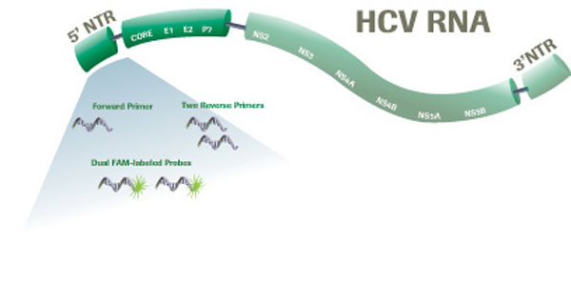
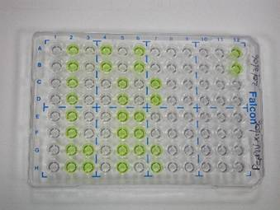
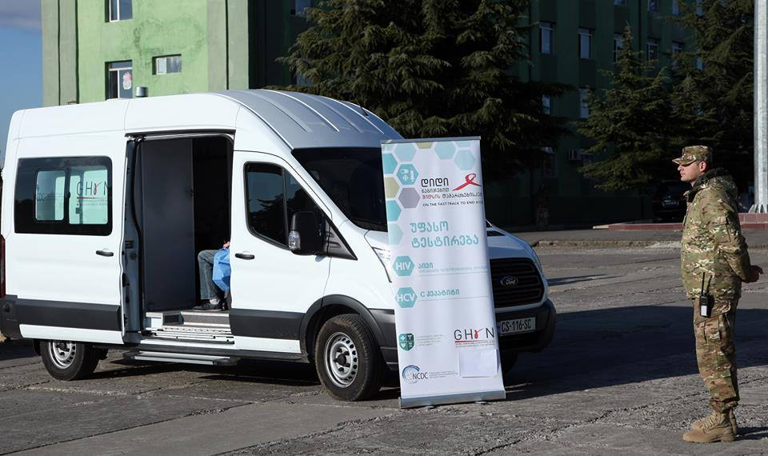
Diagnostic Capacity and Screening Methods
  Georgia has well-developed diagnostic capacity, well- equipped and staffed public health laboratory infrastructure; Lab Network has a significant outreach to every corner of the country, it should be effectively used to conduct screening.
  All modern diagnostic methods, including high-technology molecular diagnostic methods, such as qualitative and quantitative polymerase chain reaction (PCR), including real-time PCR and HCV genotyping available.
  By supporting Global found available 8 mobile labs for screening

Slide 4

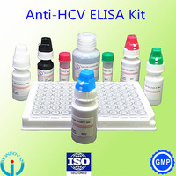
Screening Methods
  Currently used Method for screening - Rapid diagnostic test for anti HCV (Biotech)
  National Safe blood program – Elisa test kits by different vendors
  Plans:
  Georgian Government should make a choice between the laboratory suppliers for long-term partnership
  Elaborate national HCV screening guidelines (including testing algorithm for providers to diagnose current HCV infection)

Slide 5
Currently funded Programs Covering HCV Screening
  National Safe blood program since 1997
  Mother and Children Care State program since November 1, 2015
  Tbilisi municipality Hepatitis C Diagnostic Program since May 20
  National HIV/AIDS treatment and care program since 1997
  The hepatitis C program in the penitentiary system since 2014
  Global Fund program since 2011

Slide 6
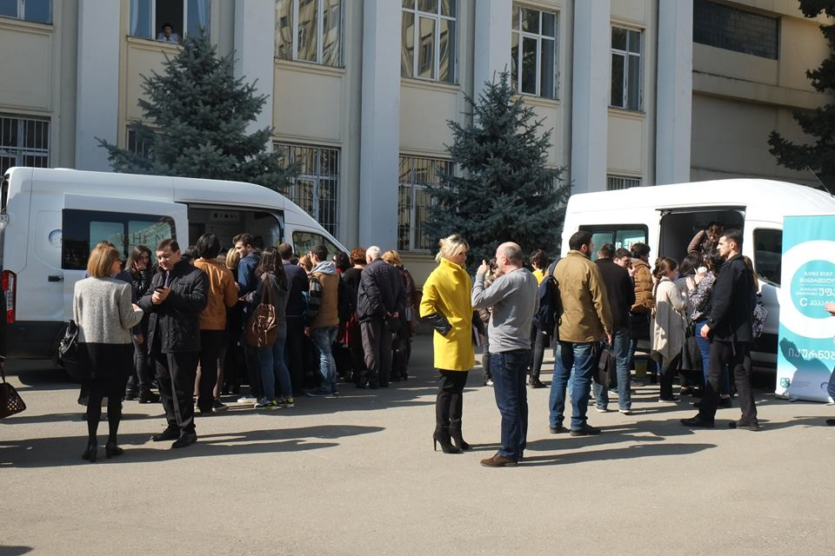
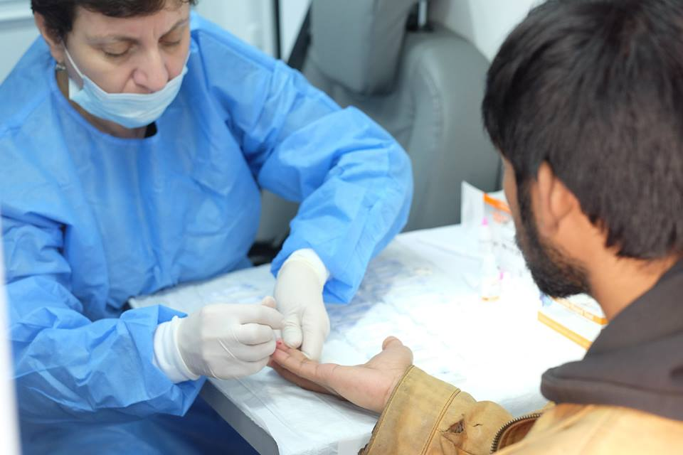
Hepatitis C Screening
mobile units
      NCDC held two free HCV screening events in Tbilisi (May 26-June2, 2015) and one week event in regions(starting on World Hepatitis Day); Screened 10,034 person (1,991 positive, 20%)
  In November 2015 NCDC launched routine voluntary HCV screening program at NCDC public health network, and mobile units for screening available in 2 regions, supported by Global fund and harm reduction network
  For today 30 0000 people (14% positive) are screened throughout Georgia

Slide 7
Increase proportion of people diagnosed with chronic hepatitis
This main objective will be achieved through implementation of HCV screening in clinical settings to improve to access to testing
Population | Baseline 2015 | Plans for 2016-2020
HIV/AIDS patients | 814 | 700/800 per year
TB patients | 744 | 4000 per year
STI patients | - | 15 000 per year
Prisoners and previously incarcerated persons | 13 500 | 30 000 in 5 years
Persons who have received blood transfusions | Unavailable | 4000 per year
Patient on Hemodialysis | Unavailable | 4000 per year
a) Implement HCV screening programs for relevant groups per WHO recommendations.

Slide 8
B) Implement testing in public health sector
Importance of this activity:
NCDC public health laboratory network has a significant coverage of the country; thus implementing screening in those laboratories will likely make testing more accessible and reduce wait times.
In addition, standardization of diagnostics will be achieved along with assurance of quality through conducting centralized procedures for test validation, and reduced cost and sustainable access of diagnostic through centralized procurement of reagents at a fixed rate reimbursement system.
In 2015 NCDC screened about 40 000 people free of charge
In 2016 NCDC will continue voluntary screening

Slide 9
C) HCV testing integration into the established community-based programs that serve key populations
  The screening program will cover the populations with a high HCV prevalence or with high risk exposure or behavior. HCV testing will be integrated into the established community-based programs that serve key populations:
      People who inject drugs
      Men who have sex with men
      Sex workers (SW)
  Global Fund program covered HCV screening for people who inject drugs since 2011
  Baseline: in 2015 screened about 13 456 people;
  Global fund continue covering screening of 32 000 persons in 2016, and 33 500 in 2017

Slide 10
d) Implement HCV testing in the following special groups
Law enforcement personal
Nowadays:
  All military people go through the routine medical checkup including HCV testing first time before contracting and than once in every 4 years.
  All young Recruits are undergoing Medical examination including HCV screening.
HCV screening programs will be implemented within the relevant ministries and will be linked to elimination program
Students
  Tbilisi State Medical University just started free of charge HCV screening of medical students, and for today 457persons( HCV positive were 6) are tested.
  In addition, outreach using mobile units will be organized to screen students at other higher educational institutions (e.g. Universities)
Healthcare workers
Screening of this high risk group will be mandatory
All persons referred to healthcare facilities
Nowadays, most of the clinics do screening of hospitalized people, but data on HCV screening from self-referrals among people who paid out of pocket at facilities, not supported by specific HCV-related programs are not available.

Slide 11
DIAGNOSTIC YIELD WITHIN HCV SCREENING PROGRAM AMONG DIFFERENT TARGET GROUPS
Currently approximately 175 000 people are screened since January 2015, and about 18% are positive
Notes:
Total - 175 000 , 18% HCV positive

Slide 12


Thank you for your attention!
National Center for Disease Control & Public Health
www.ncdc.ge

