Slide 1
Progress of Hepatitis C Elimination Program
Amiran Gamkrelidze
Director General
National Center for Disease Control and Public Health

Slide 2
Disease Burden – different groups
Georgia is among the countries with the highest hepatitis C prevalence
Prevalence among general population – 6.7% (population-based survey in the capital city Tbilisi, 2000-2002)
Prevalence among different population groups:
    PWID: 66.2% (Bio-Behavioral Surveillance Survey, 2015)
    TB Patients: 21% (Lomtadze et al, 2013)
    MSM: Tbilisi – 7.1%, Batumi – 18.9% (BSS, 2015)

Slide 3
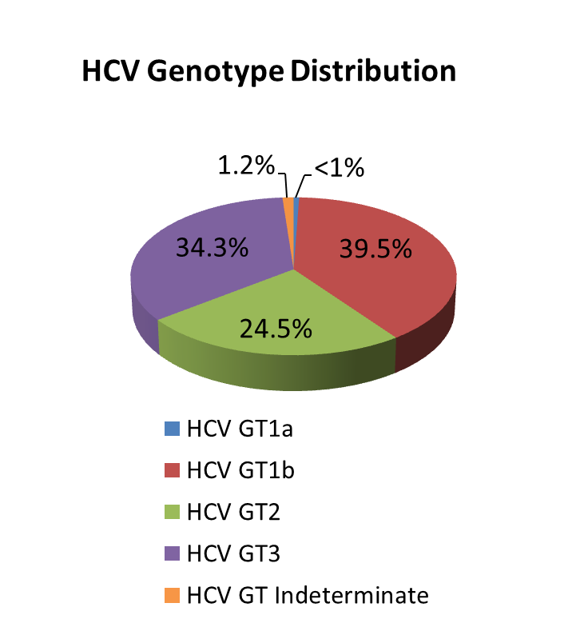
National Population-based seroprevalence survey 2015
Conducted by NCDC and CDC, Atlanta
Total number of interviews – 6330
(90% response rate)
Total number of blood samples – 6011
(86% response rate)
Characteristic | n | % | Estimated # nationwide ≥18 years
Anti-HCV+ | 425 | 7.7% | 208,800
HCV RNA+ | 311 | 5.4% | 150,300
Notes:
2015 National survey conducted by NCDC and CDC revealed that ~150 thousand people are infected with active HCV infection and need to be treated. The most prevalent genotype nationwide is genotype 1 (appx. 40%) followed by genotype 3 and 2.

Slide 4
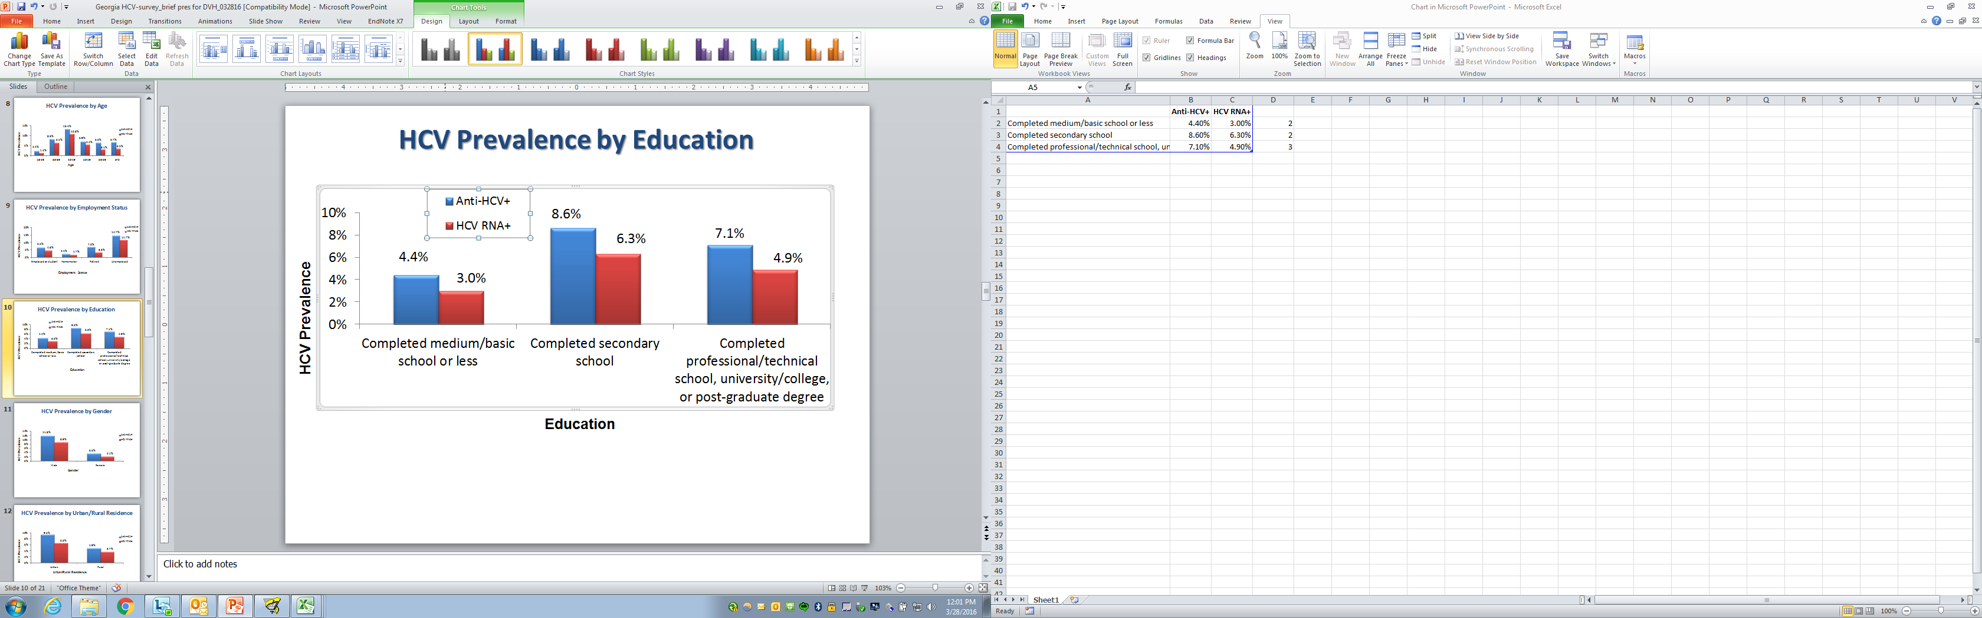
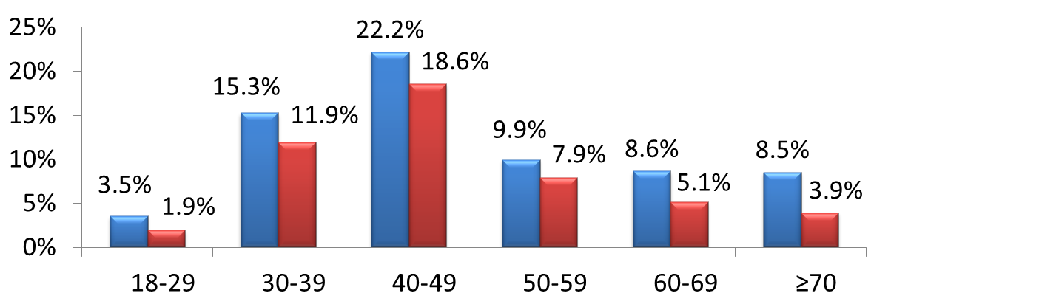
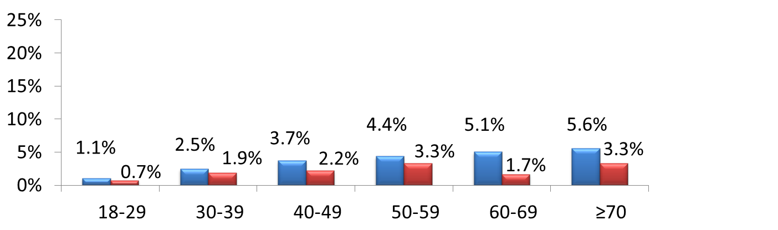
HCV Prevalence by Age and Gender
HCV Prevalence
Females
(n=3,662)
Males
(n=2,334)

Slide 5
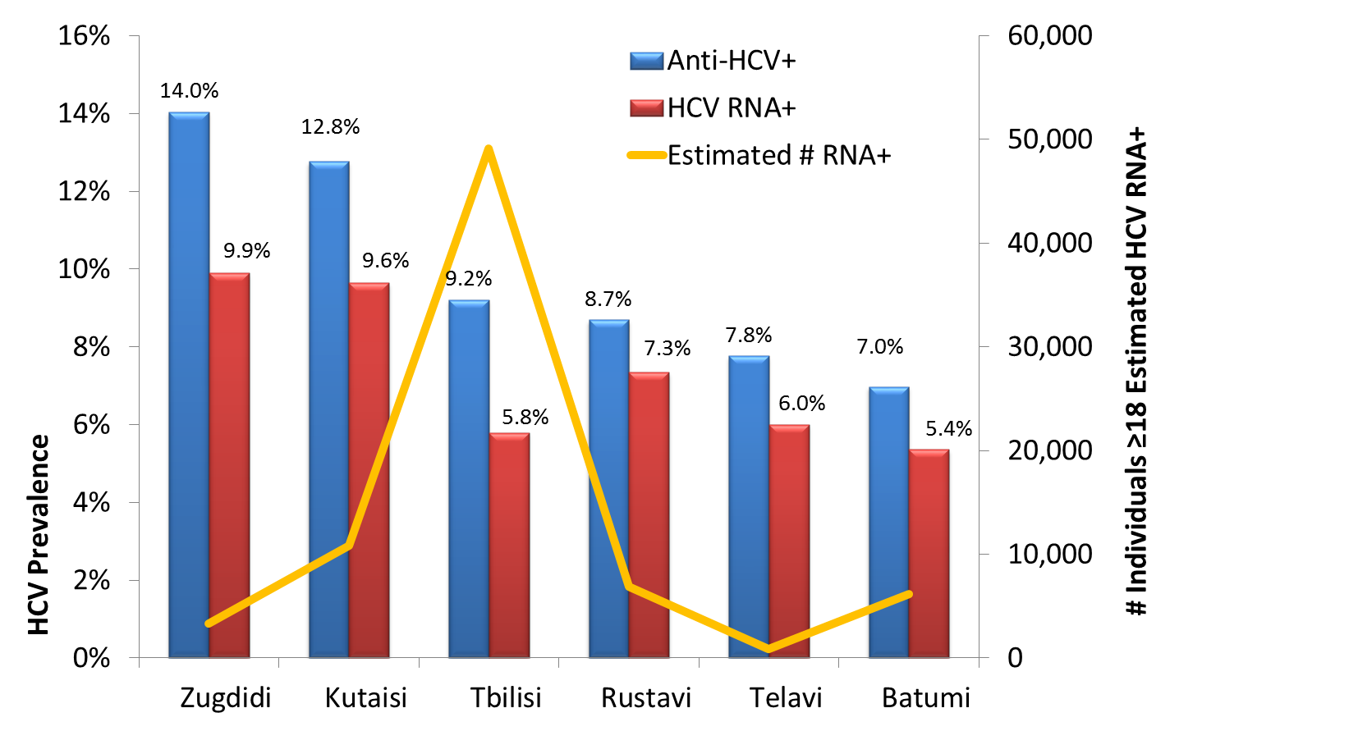
  HCV Prevalence and Estimated # RNA+ by City
(n=2,414)

Slide 6
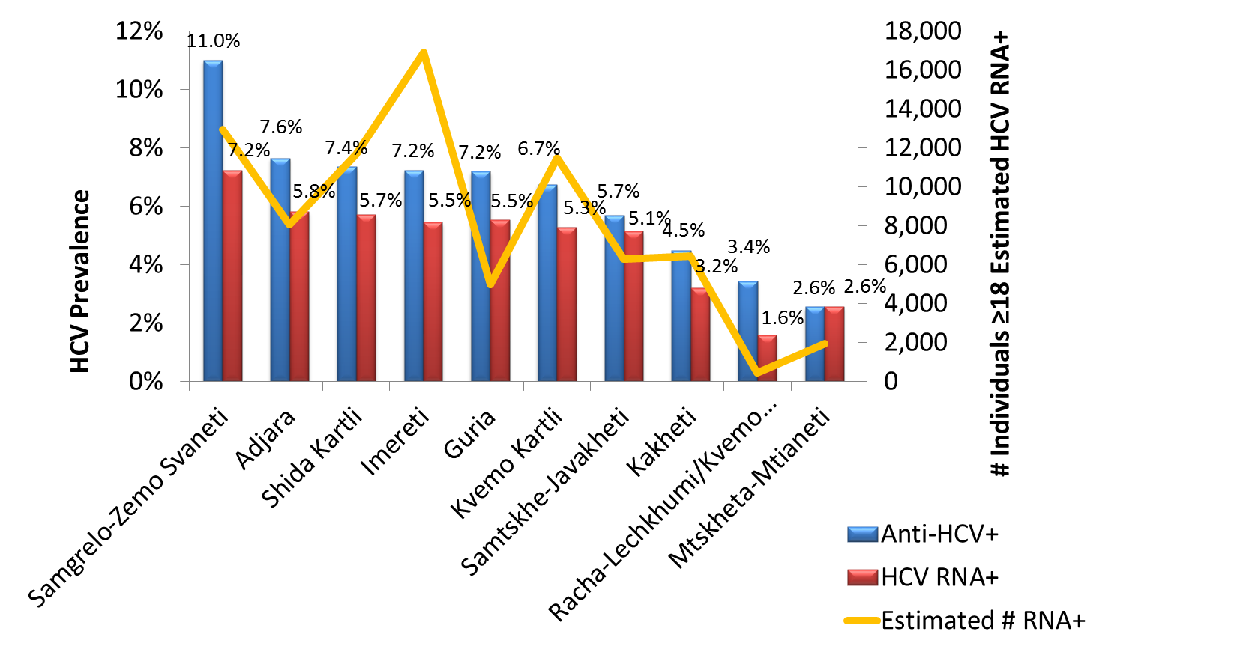
  HCV Prevalence and Estimated # RNA+ by Region
(n=3,582)
Note: Regions above do not include 6 major cities

Slide 7
Road to HCV Elimination Program
60% Discount program for civilians
Negotiations with CDC, Gilead and other US partners
1st
National workshop
National program for short-term/urgent measures of HCV elimination action plan
World Hepatitis Summit
2nd National workshop
2015
Free of Charge Hep C treatment with peg/riba regimens for prisoners
TAG
Free of Charge Hep C treatment with peg/riba regimens for HIV/HCV co-infected patients with Peg/Riba
2014
2013
Long-term elimination plan
2016-2020
National Commission
2011 - 2012
Memorandum of Understanding between Georgian Government and Gilead
Additional 10,000 treatments with peg/riba regimens with price reduction for civil population
HCV elimination perspectives - annual meeting of the EASL London

Slide 8
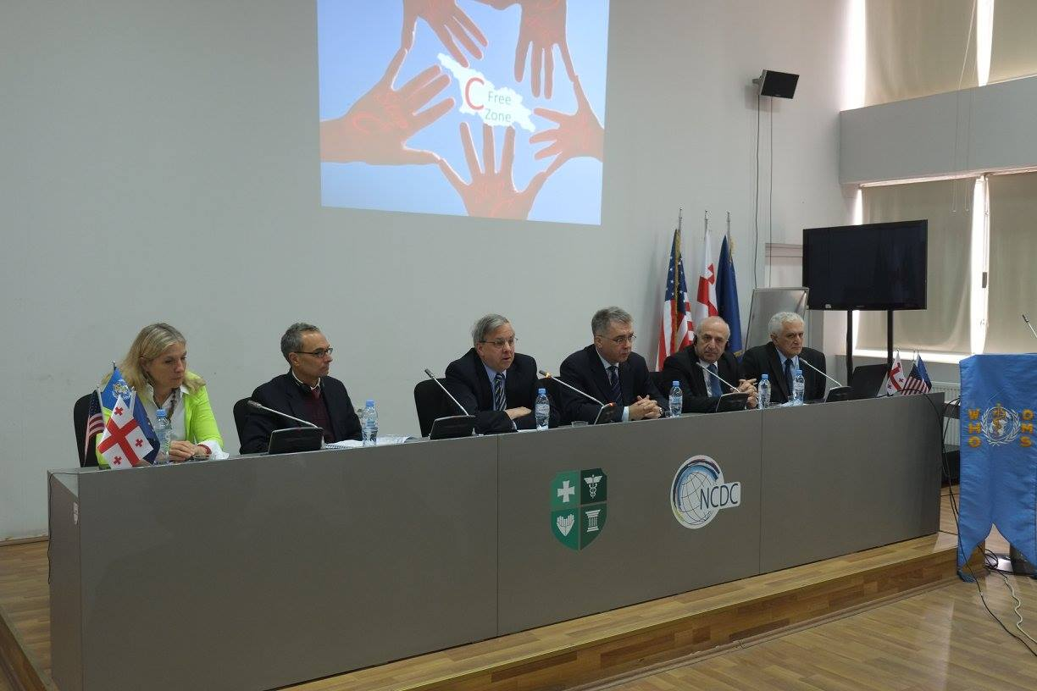
Georgian 3rd National Workshop on Hepatitis C, April 6-8, 2016
Results of Population-based seroprevalence survey of hepatitis B and C
Overview of Phase 1 of hepatitis C elimination program
Hepatitis C elimination strategy, 2016-2020

Slide 9
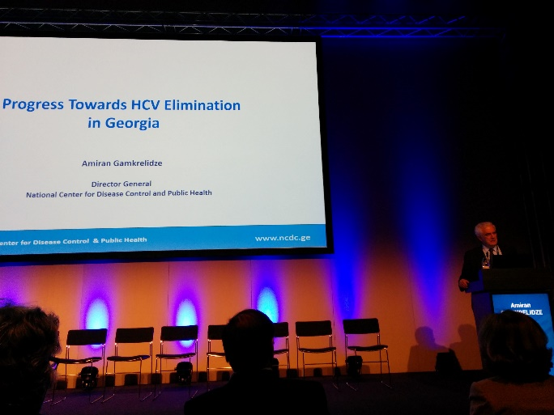

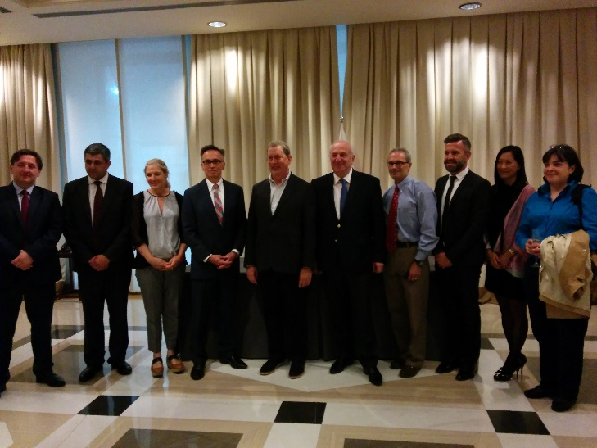

EASL congress 2016
Barcelona, Spain

Slide 10
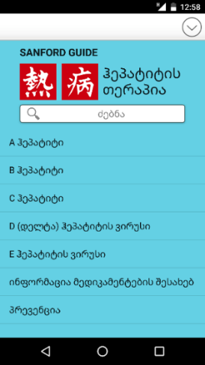

World Hepatitis Day, 2016
Scale-up of free HCV screening announced
  Additional 150 000 tests purchased by the Ministry
Sanford’s Guide to Hepatitis Therapy Launched
  Web-page: ka.sanfordguide.ge
  Mobile app

Slide 11
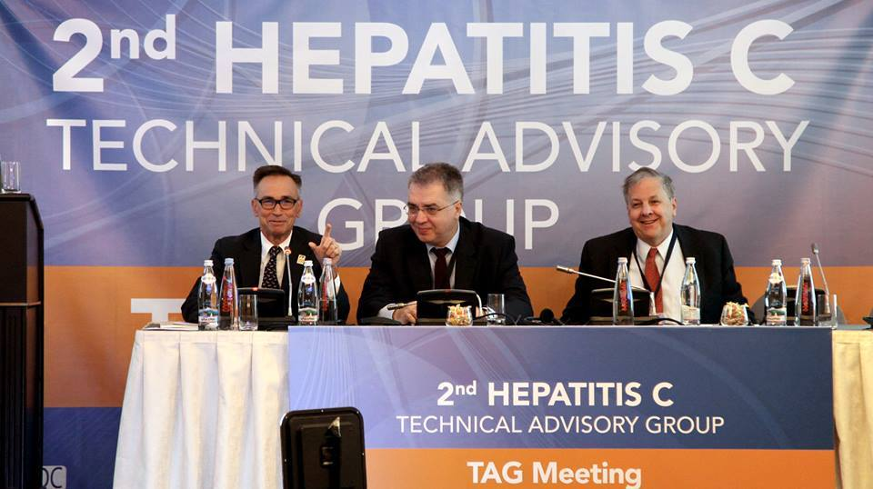
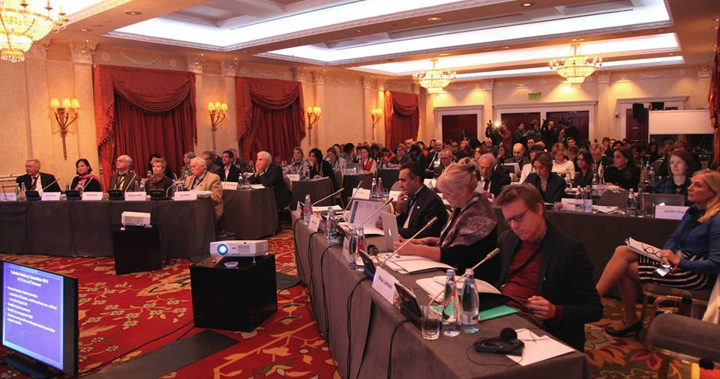
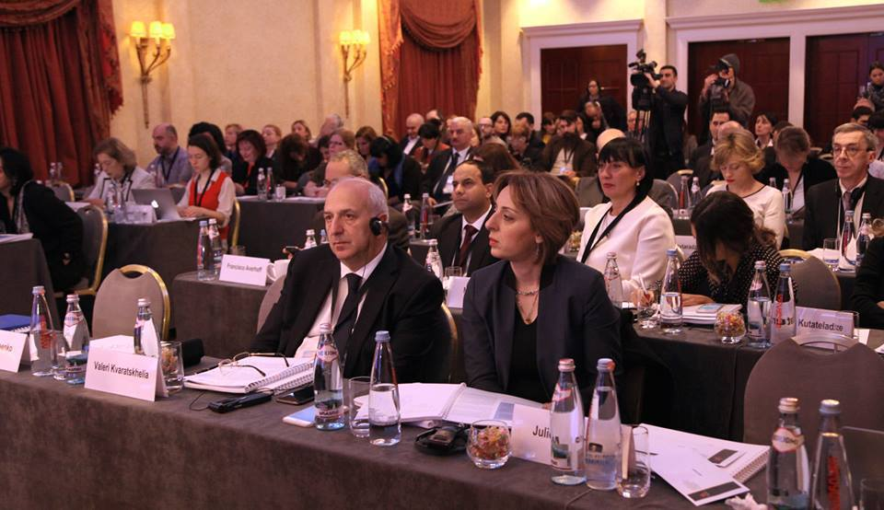
2nd Technical Advisory Group Meeting
October 24-25, 2016
Final elimination strategy and M&E indicators discussed
Notes:
TAG recommendations will be reviewed by Francisco

Slide 12
Targets
Georgia HCV Elimination Strategy
2016-2020
Goal
Elimination of HCV by ensuring prevention, diagnostics and treatment of the disease
90-95-95
By 2020
90% of people living with HCV are diagnosed
95% of those diagnosed are treated
95% of those treated are cured

Slide 13
4 Strategic Goals of the Elimination Strategy
Goal 1:
Raise awareness of viral hepatitis
Goal 2:
Monitor health sector response to hepatitis
Goal 3:
Prevent transmission of viral hepatitis
Goal 4:
Reduce new infections and deaths due to viral hepatitis through expanded screening and treatment
Raise awareness in general population and high-risk groups
Reduce HCV-associated stigma
Strengthen surveillance of viral hepatitis
Safe Blood
Infection control in medical and non-medical facilities
Decrease HCV incidence in PWID
Screening
Care and treatment
Estimate the national burden due to chronic hepatitis
Modern system of laboratory diagnosis
Notes:
The total funding required for HCV elimination during these 5 years amounts to 116 million US dollar. This amount does not include the cost of donated medications that are courtesy of Gilead and is free for Georgia. Out of 116 million US dollars, about 49% is planned to be spent from state budget, 16-18% donor funding and appx. 33% co-payment (mainly for diagnostic and treatment monitoring procedures). However, part of this co-payment is funded by local governments. In addition, considering rapid scientific, technologic and pharmaceutical progress in the field, it is expected that the costs of these activities will be reduced.

Slide 14
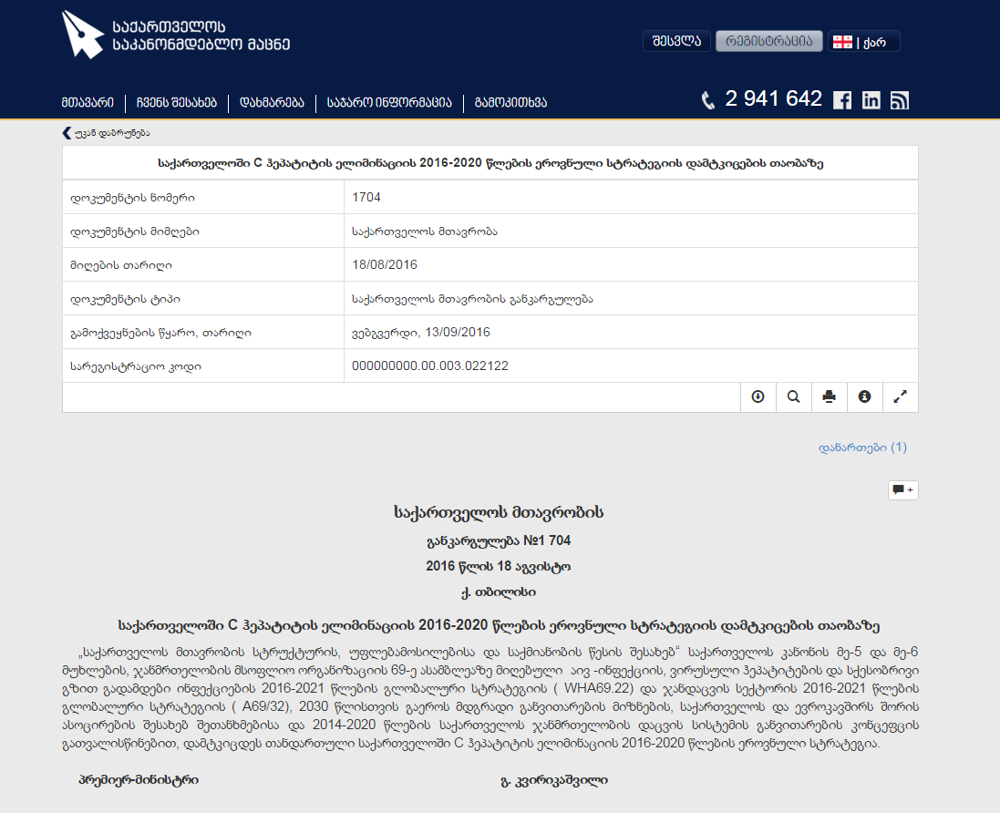
4 Strategic Goals of the Elimination Strategy
Goal 1:
Raise awareness of viral hepatitis
Goal 2:
Monitor health sector response to hepatitis
Goal 3:
Prevent transmission of viral hepatitis
Goal 4:
Reduce new infections and deaths due to viral hepatitis through expanded screening and treatment
Raise awareness in general population and high-risk groups
Reduce HCV-associated stigma
Strengthen surveillance of viral hepatitis
Safe Blood
Infection control in medical and non-medical facilities
Decrease HCV incidence in PWID
Screening
Care and treatment
Estimate the national burden due to chronic hepatitis
Modern system of laboratory diagnosis
Approved August 18, 2016
Notes:
The Georgian version of elimination strategy that was approved on August 18, 2016, was developed in accordance to the government format and included sections about funding and other programmatic details. In order to present the strategic document to the international society (including TAG) our colleagues from CDC developed an updated, English version of the strategy, with further modified and refined M&E framework.

Slide 15

HCV Elimination Strategy (Modified English Version)
Strategy 1 – Promote Advocacy, Awareness and Education, and Partnership for HCV-associated resource mobilization
Strategy 2 – Prevent HCV Transmission
Strategy 3 – Identify Persons Infected with HCV
Strategy 4 – Improve HCV Laboratory Diagnostics
Strategy 5 – Provide HCV Care and Treatment
Strategy 6 – Improve HCV Surveillance
To review and monitor the status of activities and targets set by the elimination strategy, quarterly meetings of Elimination Strategy working group are held at NCDC
Notes:
Considering importance of the topics, Screening and Laboratory diagnostics parts were moved as separate strategic directions. All the activities remained the same. The English version of the

Slide 16
Scale-up of HCV Screening Programs
HCV Screening protocol developed
HCV screening of Hospitalized patients
Outpatient service providers received HCV tests from NCDC free of charge
*data are available through September 30, 2016

Slide 17
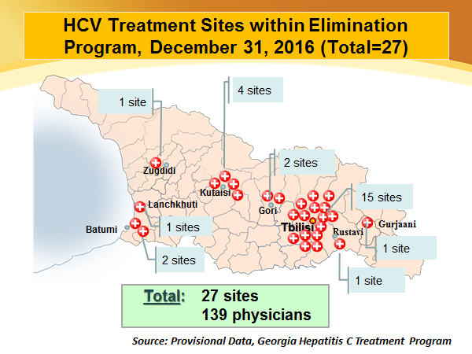
Scale-up of HCV Care and Treatment

Slide 18
Acknowledgements
Ministry of Labour, Health and Social Affairs
US Centers For Disease Control and Prevention (CDC)
CDC South Caucasus Office
WHO HQ, European and Country office
Gilead Sciences, Inc.
TAG Members
All institutions involved in the Hepatitis C Elimination Program

