Slide 1

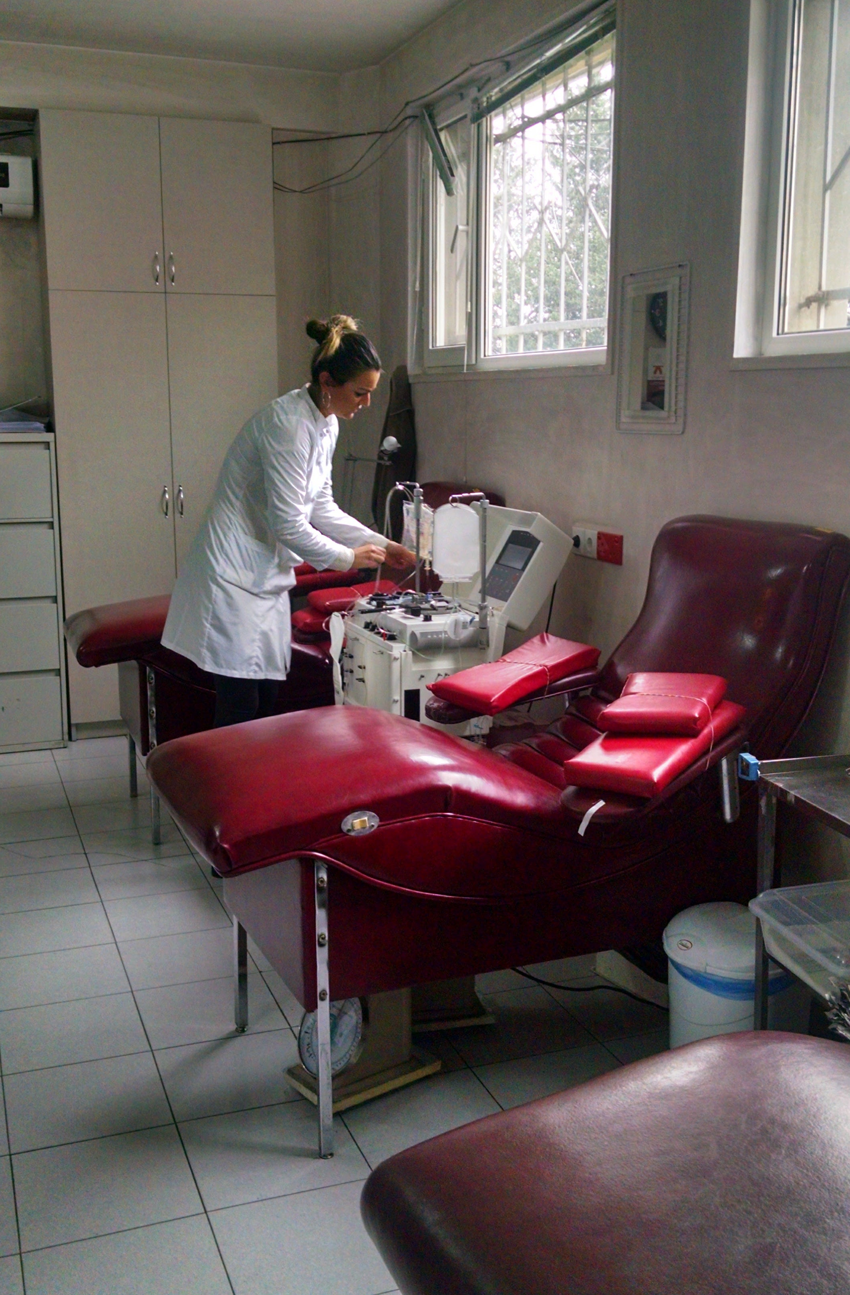
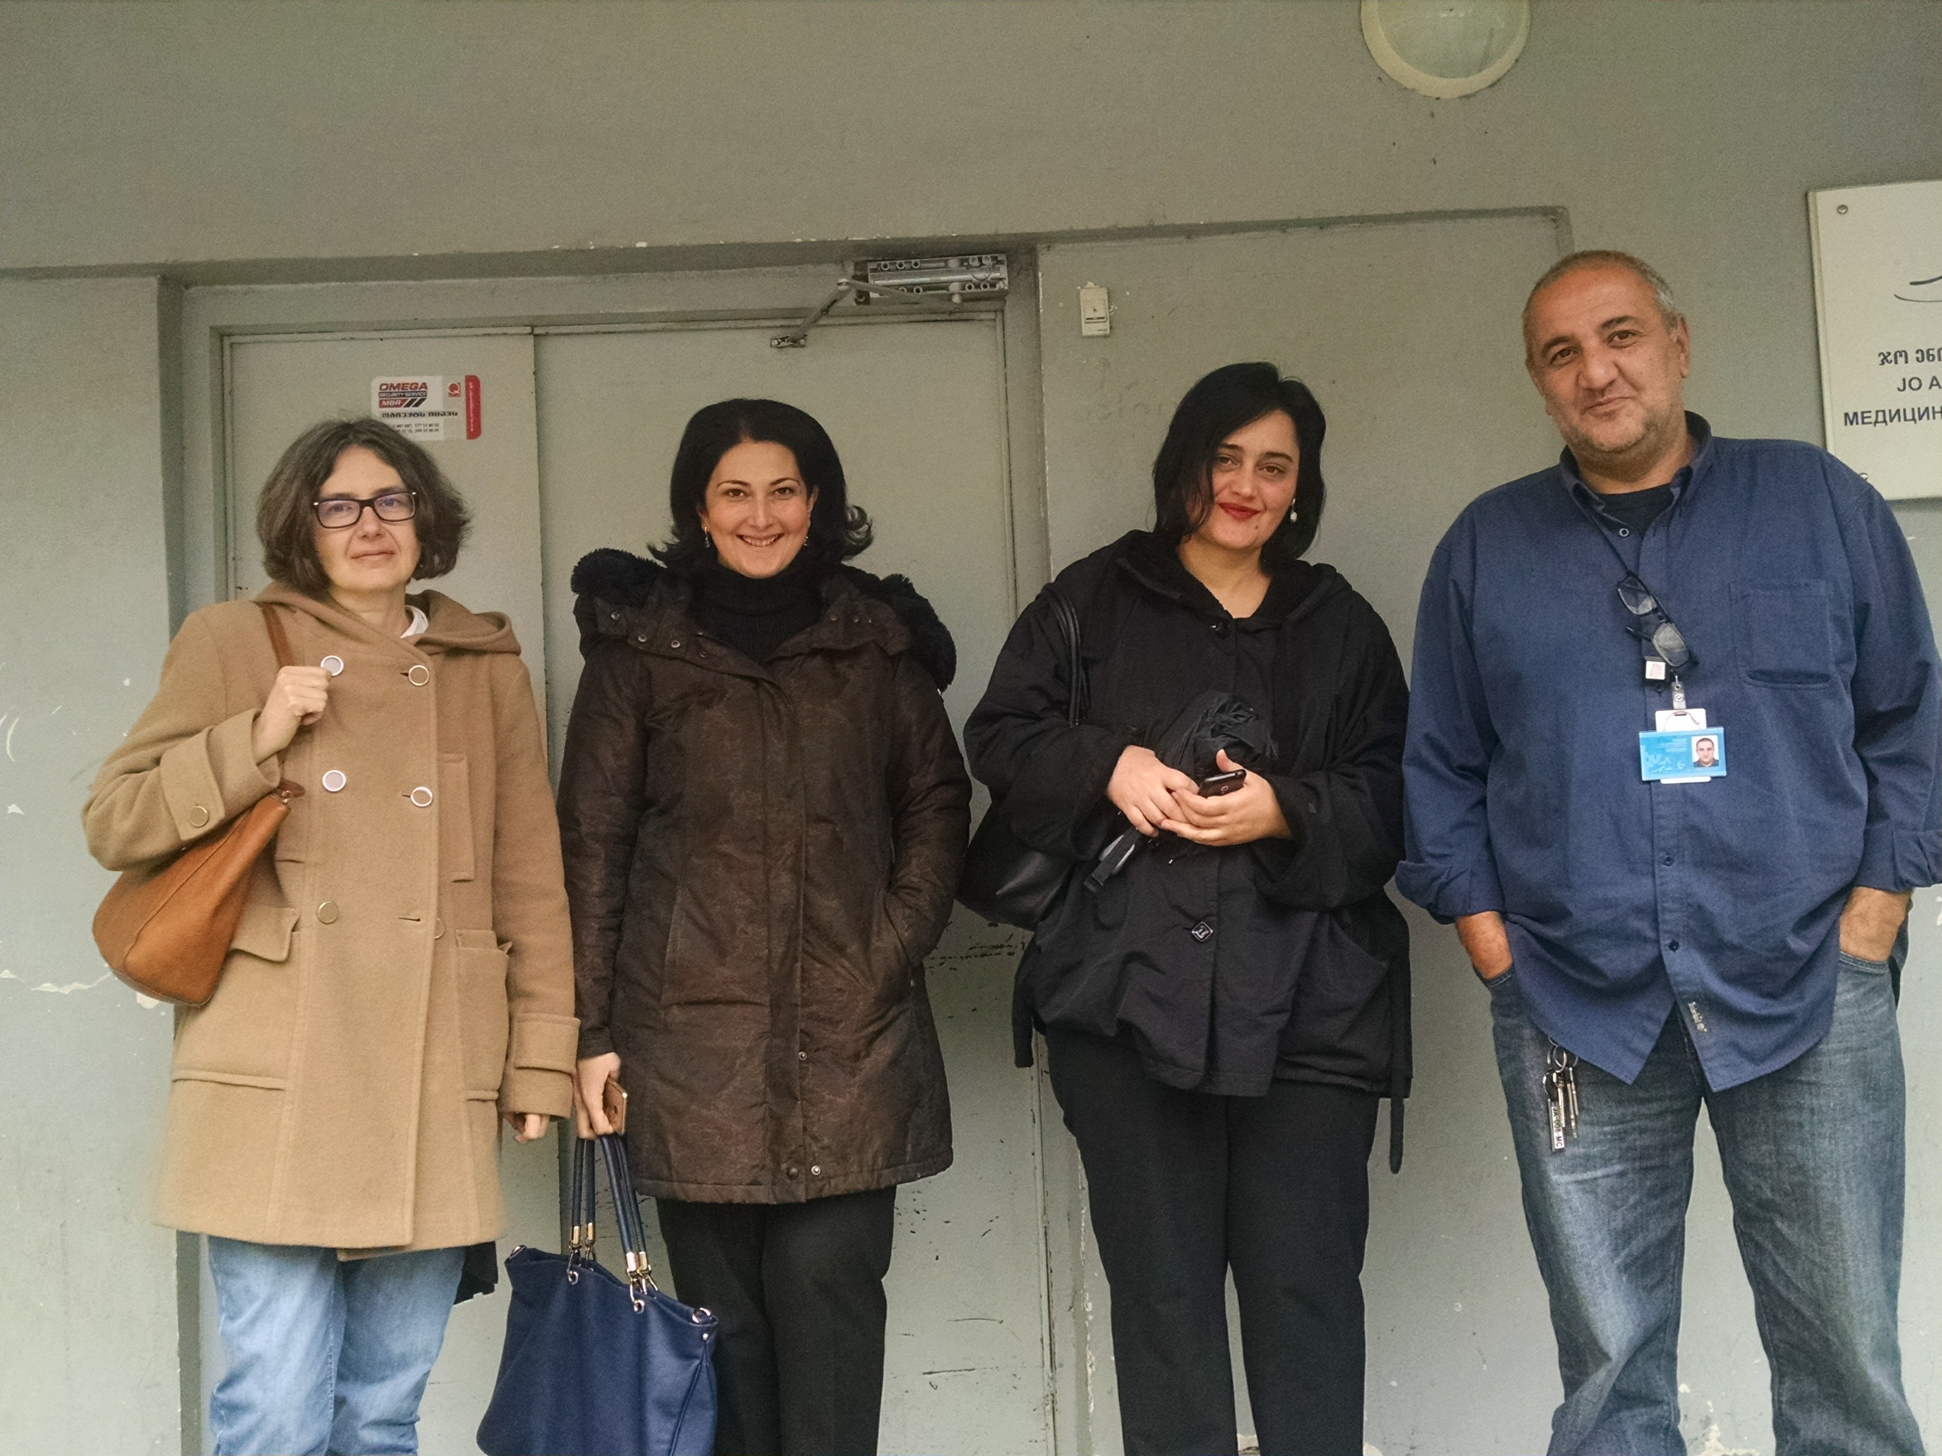
An Introduction to Blood Safety in Georgia
Sheila Keating
Eteri Kipiani
Babilina Turkia
Ketevan Shermadini
29 October 2016

Slide 2
Introduction
To observe blood banking in Georgia
To determine overt strengths and weaknesses
To define changes that should be made and can be achieved

Slide 3
Observations
Space, light and cleanliness
Rooms for registering, interviewing and collections
Laboratories for manufacturing/processing and testing
Products used for collection and processing
Validated diagnostics used for testing for HIV, HBV, HCV
Source of donations – volunteer, paid and replacement donors

Slide 4
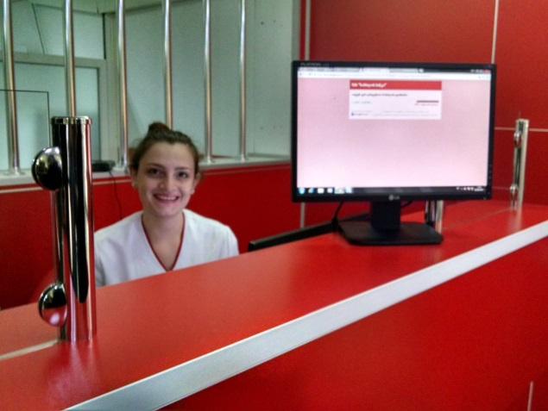
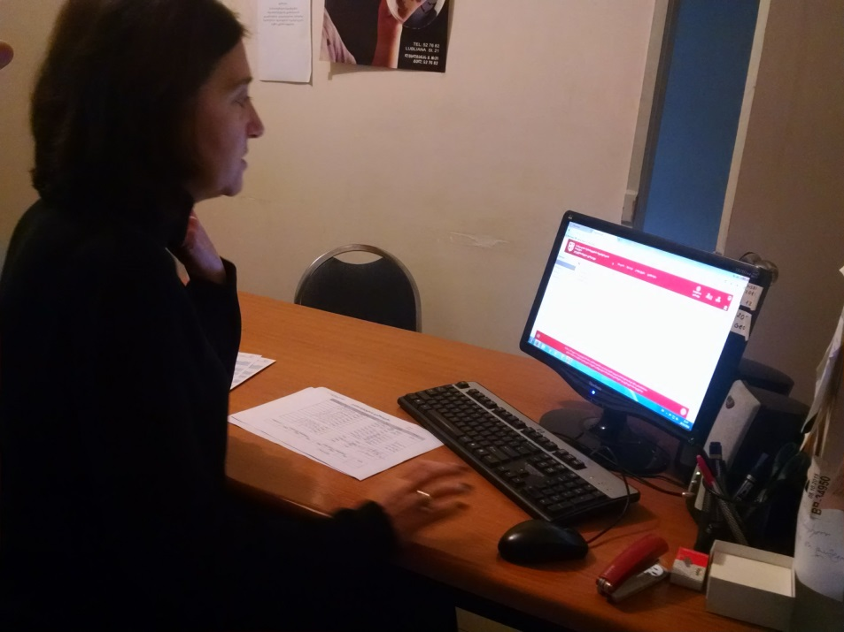
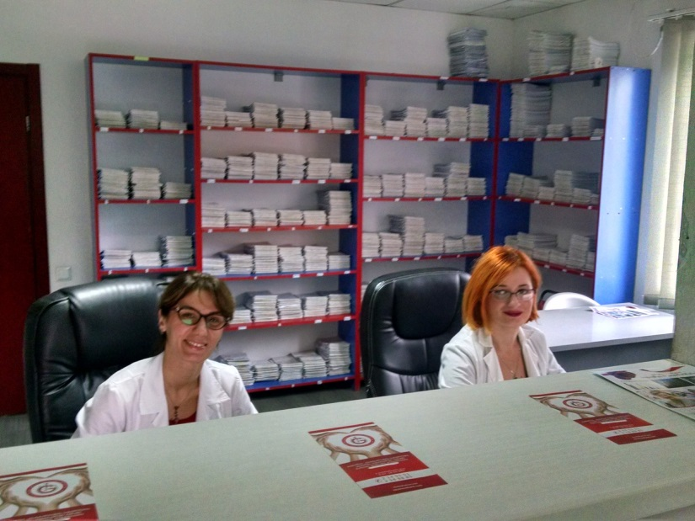
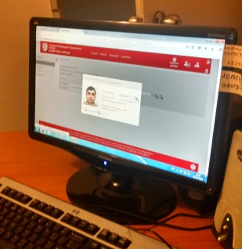
Registration

Slide 5
Registration
Written questionnaires should not have examples on how to answer the answers correctly
Interview rooms should be private spaces that will allow for unbiased answers to risk assessments

Slide 6

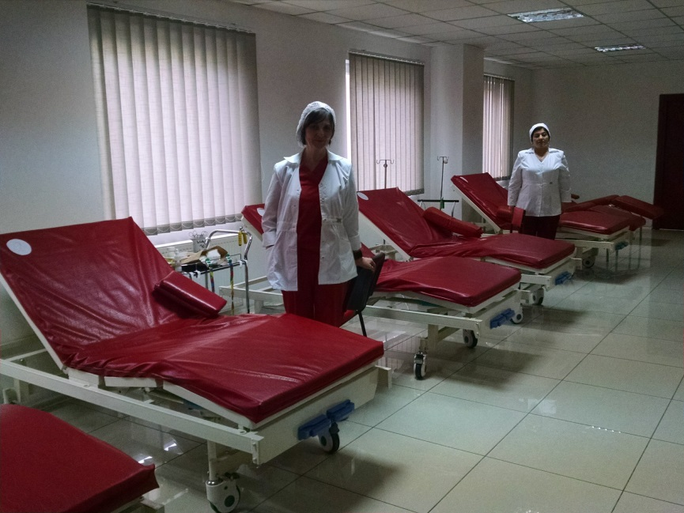
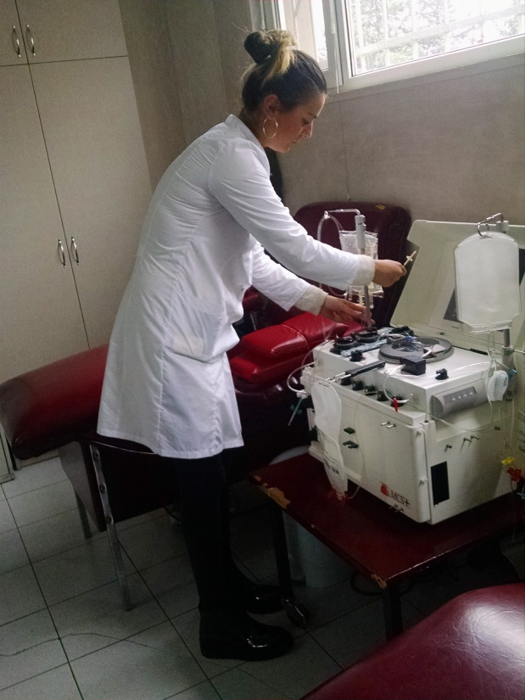
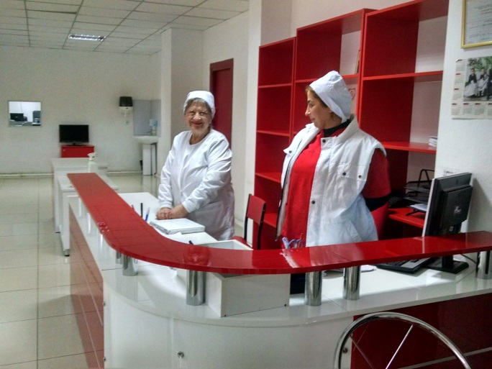
Blood Donation

Slide 7
Blood Donation
Donors were paid, replacement and volunteer
Haemonetics machines were used in all labs for apheresis
Varying products were used for collections
Leukoreduction filters are used

Slide 8
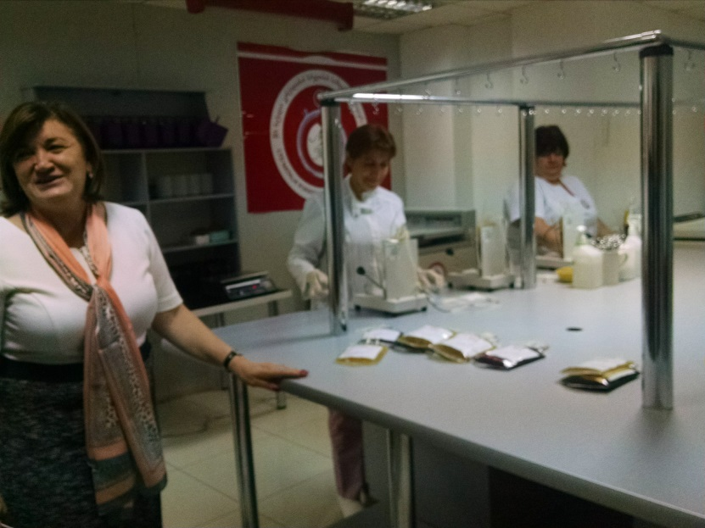
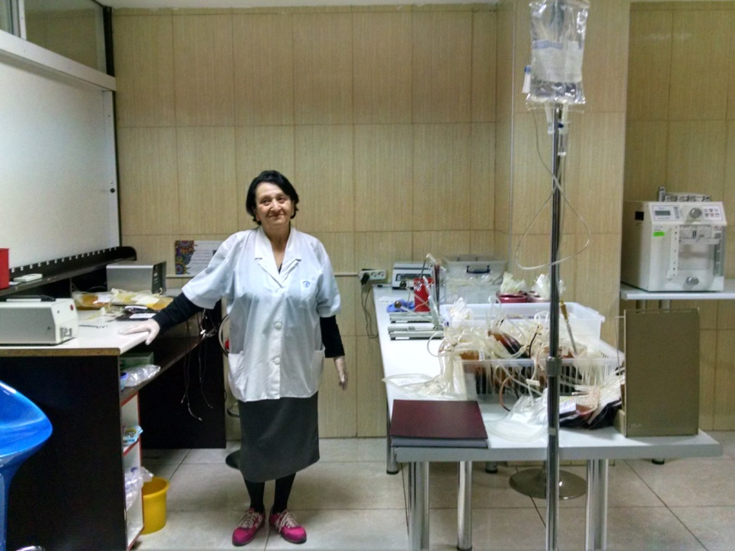
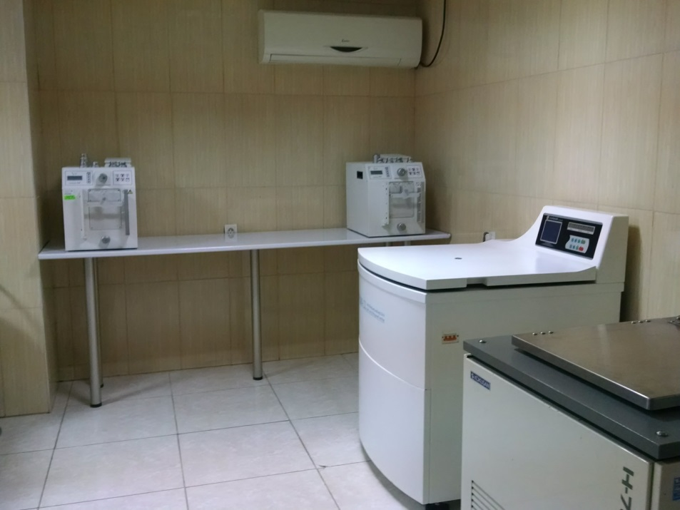
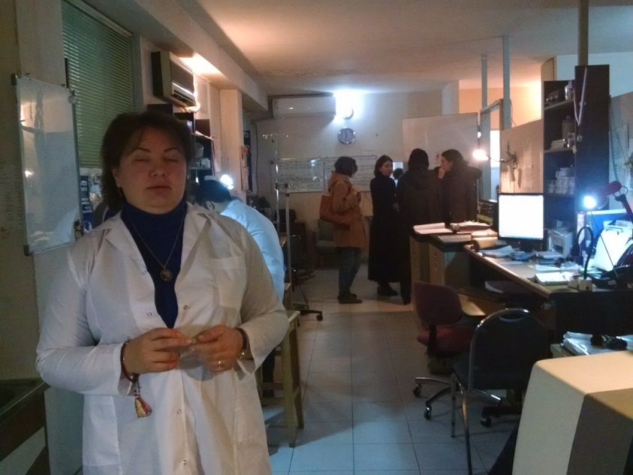
Processing

Slide 9
Processing
Space needs to be clean and clutter free
Biohazard training and disposal
Documentation and labeling is mostly done by hand – barcode labeling is novel

Slide 10
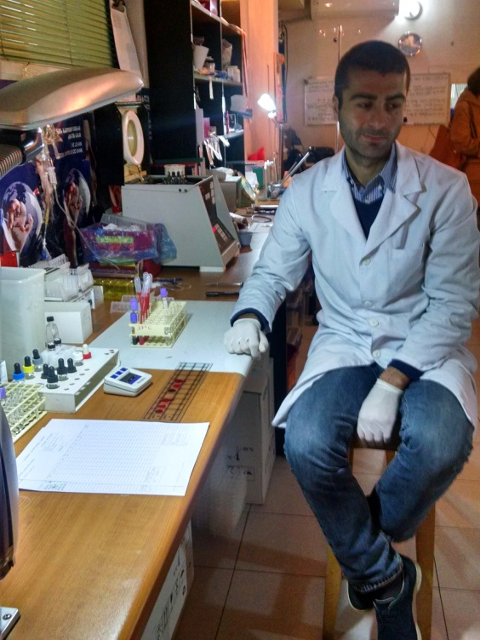
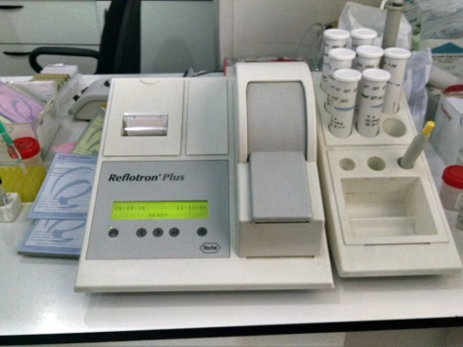
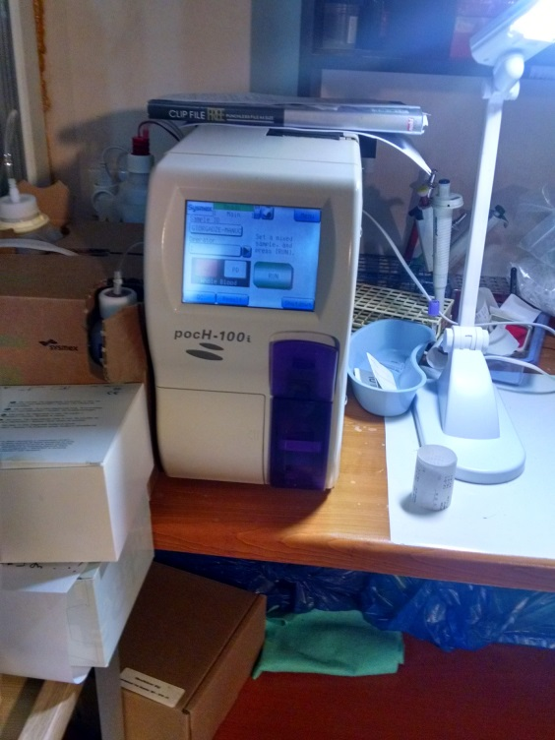
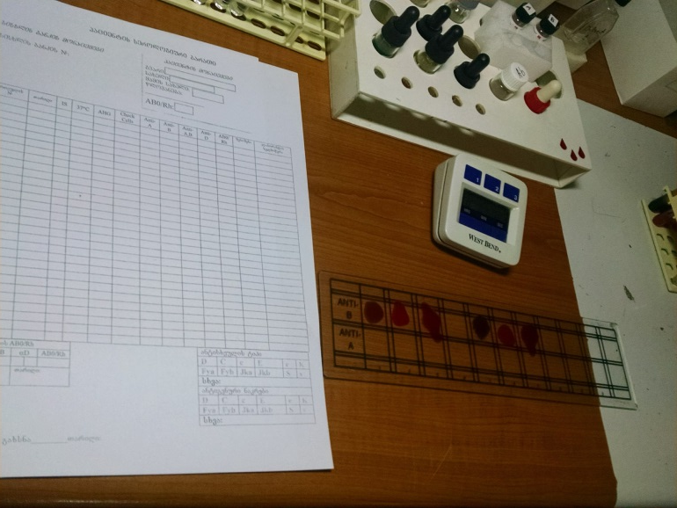
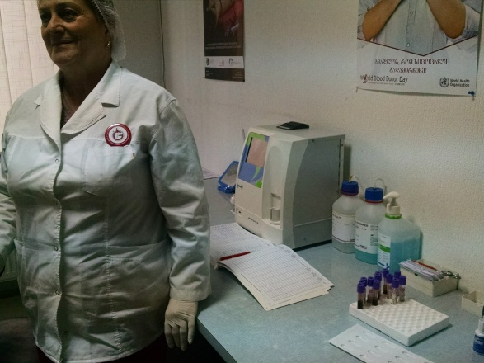
HLA and CBC Testing

Slide 11
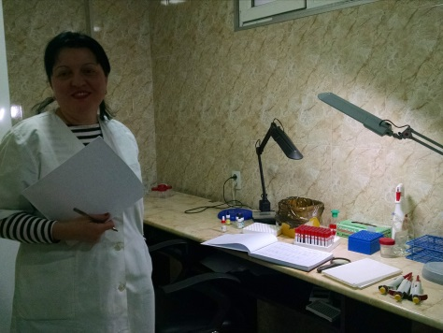
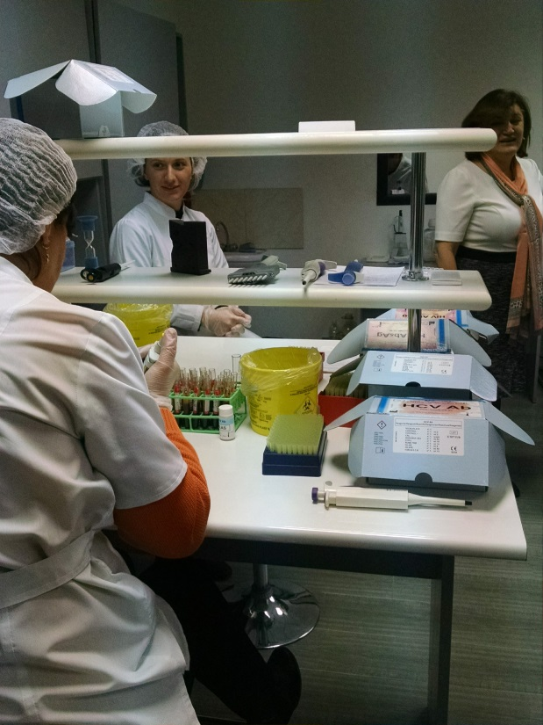
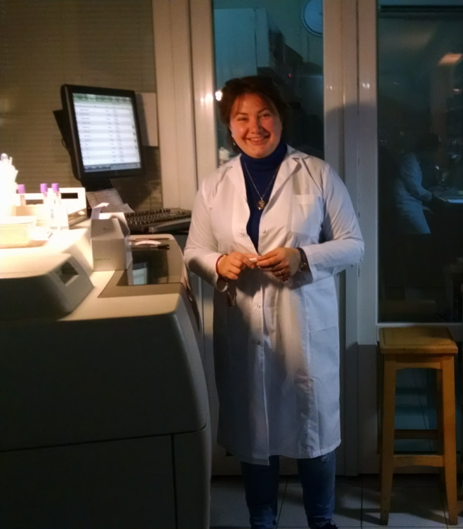
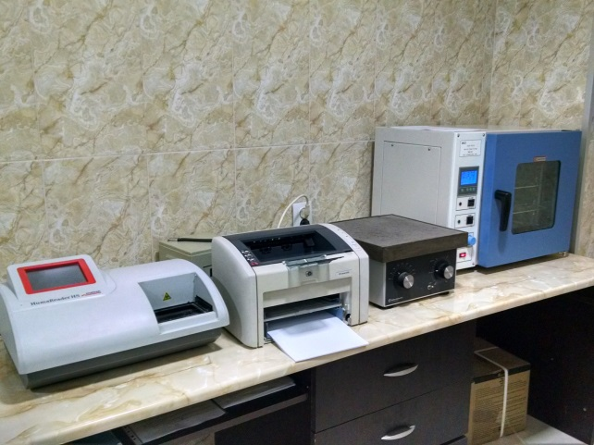
Transfusion Transmitted Infection (TTI) Testing

Slide 12
Observation
The donor database is an essential part of reducing the risk of TTI. Are individuals identified as being infected linked to chronic testing and treatment programs?
Registration and risk assessment needs to be rigorous and private to screen out high risk donors
Currently all documentation for collection and testing is done by hand
Different assays for TTI are done at each blood bank and these assays may not be validated; in Georgia, registration of the lab test used only requires certificate of origin and the information from the manufacturer on validation done in house

Slide 13
Observation
For profit blood banks have little incentive to use more expensive internationally validated assays
There is no hemovigilence program to monitor for adverse reactions in blood recipients and to link blood products to this outcome. Without this link, there is no accountability to the blood bank if there is a reaction or TTI resulting from transfusion.
It was not clear if TTI testing was being performed at all blood banks, a more rigorous review of records would be required

Slide 14
Questions for all Blood Banks
What are the QA/QC methods in place including standard operating procedures for all aspects of donor screening, blood production, processing, testing and storage (etc)?
What are the testing algorithms that blood banks use for screening and confirming TTI?
What are the statistics on the QAQC coming from the Lugar Center? How are the Blood Banks performing?
A survey of all blood banks to answer these and other questions will be necessary.

Slide 15
Guidance
Not to impose unachievable regulations but to identify methods to bring all blood banks to the same excellent standard

Slide 16
Questions
THANK YOU

