Slide 1
Advocacy, Awareness,
Education and Partnerships
Maia Shishniashvili, MD, MS
4th Annual Hepatitis C Elimination Workshop
Tbilisi, Georgia
10 March 2017

Slide 2
Goals of Educational, awareness raising activities, 2016
To increase awareness and mobilize community on rational and benefits of HCV diagnosis, treatment and prevention.
To encourage persons who are at high risk for exposure to Hepatitis C to seek counseling about high-risk behaviors
To study hepatitis C related awareness, stereotypes, stigma and discrimination.

Slide 3

Educational, awareness raising activities, 2016
Social media educational campaign
  Posts, blogs, visual materials, surveys, video ads
Dissemination printed educational materials
  Development, testing, printing, translating, dissemination materials to target groups
TV Public Service Announcements
  central and regional TV channels,
  covering 7 regions of Georgia

Slide 4
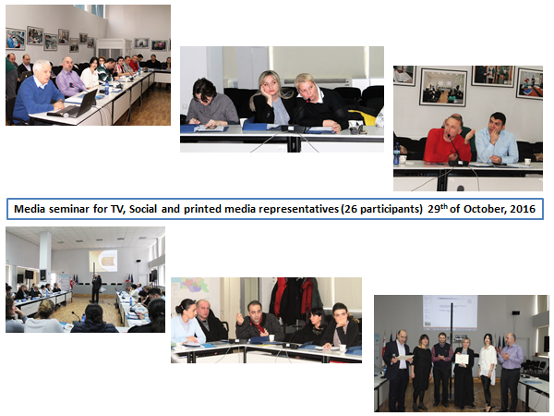
Educational, awareness raising activities, 2016
Web Banners
  4 million views, encouraging screening
Media Seminars
  TV, Radio, Print media representatives, regional media
TV media
  TV shows with invited program
  beneficiaries.

Slide 5
Current Status
Revised State programme, 2017
  Objectives and activities, communication strategy
To increase awareness and mobilize community on rational and benefits of HCV diagnosis, treatment and prevention.
To encourage people to participate in testing, treatment
To study hepatitis C related awareness, stereotypes, stigma and discrimination.
    7 focus group discussions and 8 in-depth interviews

Slide 6
Current Status
Activities:
  Trainings for Public Health Practitioners
  Education risk groups
  Mobilization public for screening
  Video (real, storytelling)
  ToR revision – professionalism, experience, deep understanding Hep C

Slide 7
Main Gaps
Decreased financing for communication
Intensity of the campaign
Effectiveness of the campaign
Need of additional resources

Slide 8
TAG Recommendations (cont.)
TAG Recommendations | Implementation Status | Strategy Timeline
Revise the public-awareness campaigns to reflect changes in screening recommendations and locations of treatment facilities | In progress | 2017
Campaign should incorporate messages recognizing the synergistic effect of alcohol and hepatitis C infection to cause liver damage | In progress | 2017

Slide 9
TAG Recommendations (cont.)
TAG Recommendations | Implementation Status | Strategy Timeline
To incorporate messages that help PWID recognize their risk or HCV and come forward to accept harm reduction, testing and treatment services. The social stigma and threat of incarceration associated with injection drug must be eliminated. Mass media campaign should incorporate messages to improve public understanding of injection drug use and addiction. Drug addiction should be addressed as a health issue and not as a crime. | In progress _ _ _ _ _ _ | 2017 2018
TAG strongly encourages government agencies to collaborate and find a path toward the removal of legislation that penalizes drug use. | _ _ _ | 2017

Slide 10
Thank you!

