Slide 1
Burden of HCV and Evolution of Elimination Program in Georgia EASL side meeting 14 April, 2016
Amiran Gamkrelidze
Director General
National Center for Disease Control and Public Health

Slide 2
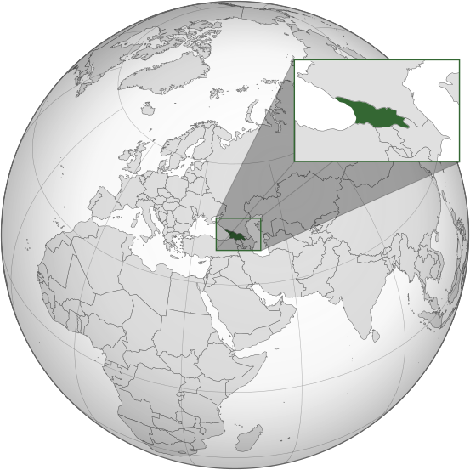
Georgia – Country Background
 | 2011-2012 | 2013 | 2014
GDP per capita (USD) | 3231-3523 | 3,600 | 3,681
Government expenditure on health as % of GDP | 1.7% | 2.1% | 2.7%
Birth Rate | 12.7 per 1000 | 12.9 per 1000 | 16.3 per 1000
Mortality Rate | 11.0 per 1000 | 10.8 per 1000 | 13.2 per 1000
Life Expectancy at Birth | 74.7 years | 75.2 years | 72.9 years
Maternal Mortality Rate per 100,000 live births | 22.8 | 27.7 | 31.3
Infant Mortality Rate per 1000 live births | 14.6 | 11.1 | 9.5
Under 5 Mortality Rate | 14.4 | 13.0 | 10.9
Picture retrieved from ka.wikipedia.org

Slide 3
Disease Burden
Georgia is among the countries with the highest hepatitis C prevalence
Prevalence among general population – 6.7% (population-based survey in the capital city Tbilisi, 2000-2002)
Prevalence among different population groups:
PWID: 66.2% (Bio-Behavioral Surveillance Survey, 2015)
TB Patients: 21% (Lomtadze et al, 2013)
MSM: Tbilisi – 7.1%, Batumi – 18.9% (BSS, 2015)

Slide 4
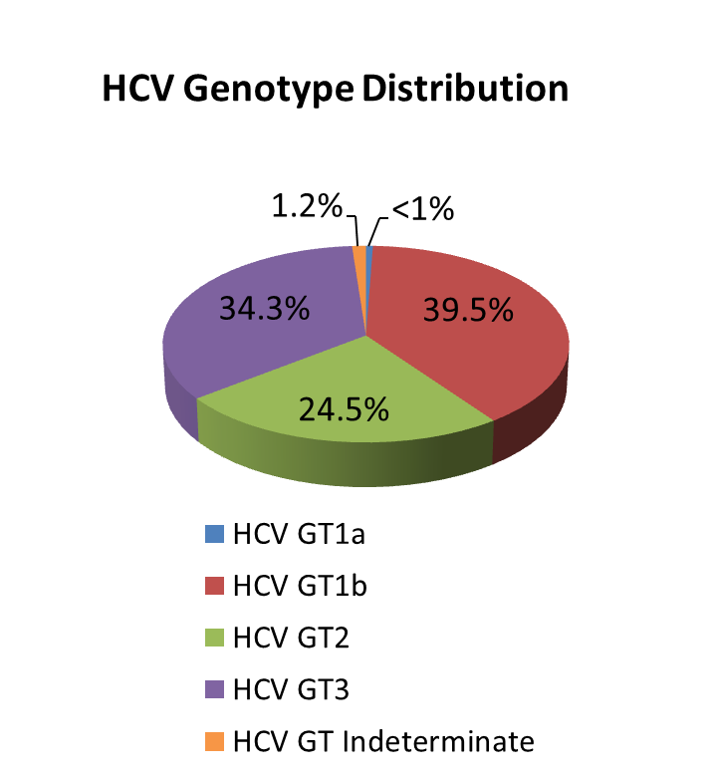
National Population-based seroprevalence survey 2015 Conducted by NCDC and CDC, Atlanta
Total number of interviews – 6330 (90% response rate)
Total number of blood samples – 6011 (86% response rate)
Characteristic | n | % | Estimated # nationwide ≥18 years
Anti-HCV+ | 425 | 7.5% | 208,800
HCV RNA+ | 311 | 5.3% | 147,552

Slide 5
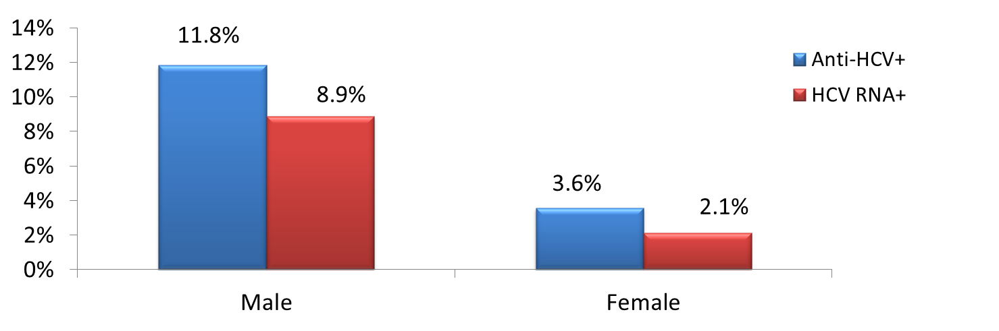
HCV Prevalence by Gender
HCV Prevalence
(n=5 996)

Slide 6
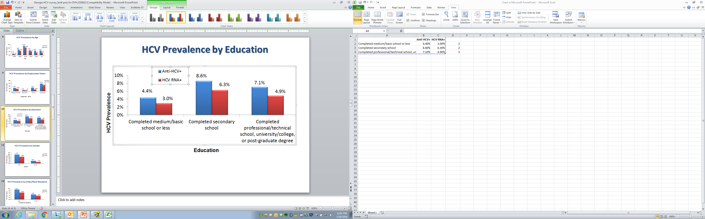
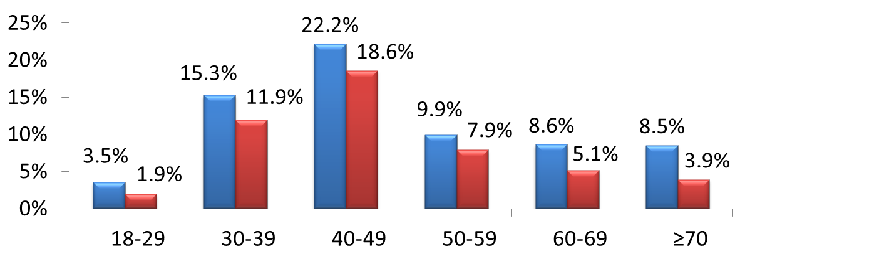
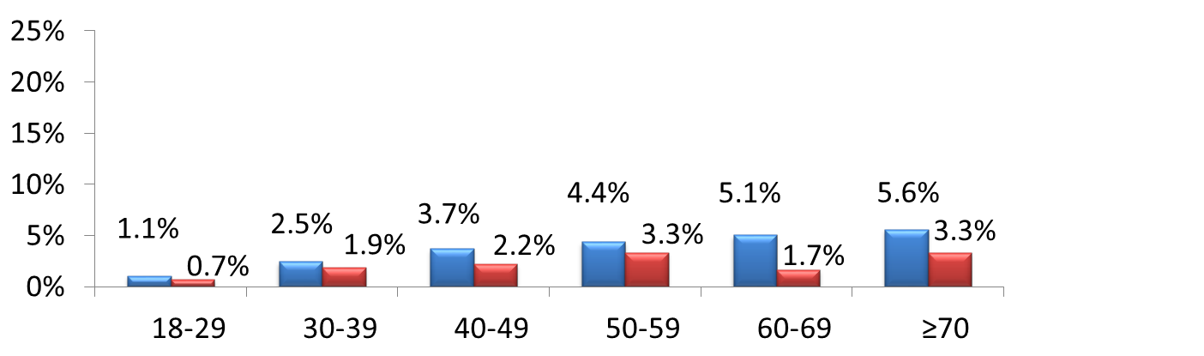
HCV Prevalence by Age and Gender
HCV Prevalence
Females
(n=3,662)
Males
(n=2,334)

Slide 7
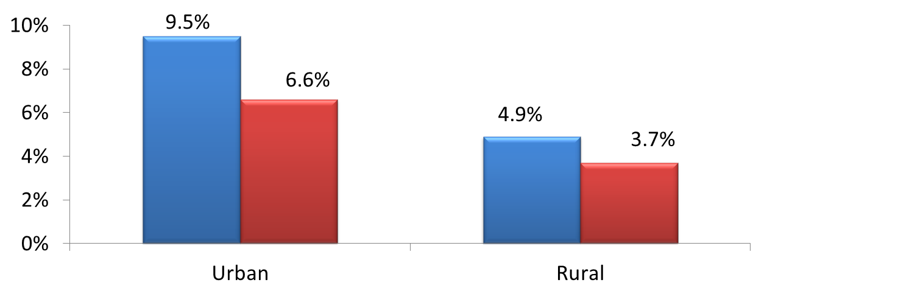
HCV Prevalence by Urban/Rural Residence
HCV Prevalence
(n=5 996)

Slide 8
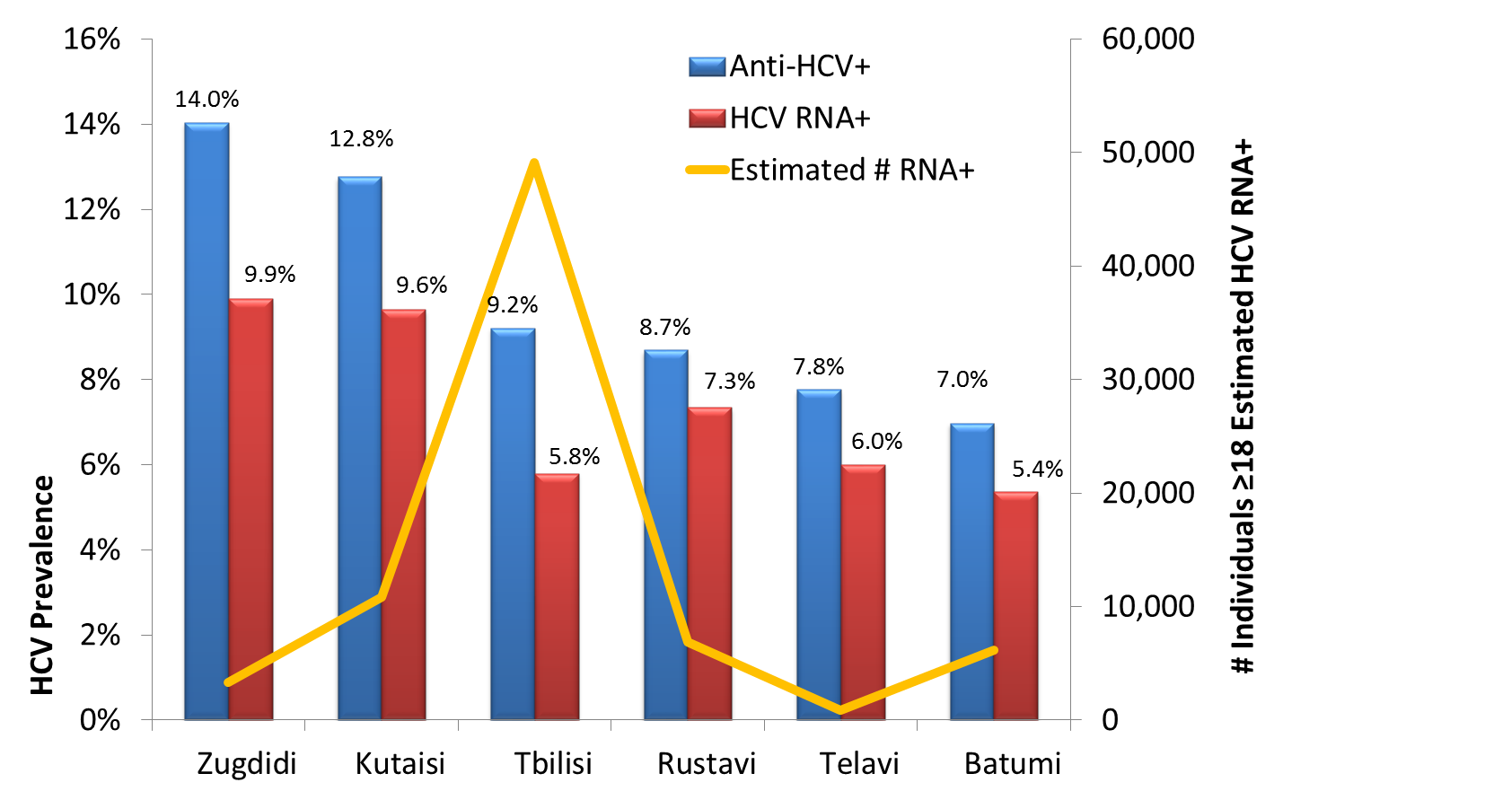
HCV Prevalence and Estimated # RNA+ by City
(n=2,414)

Slide 9
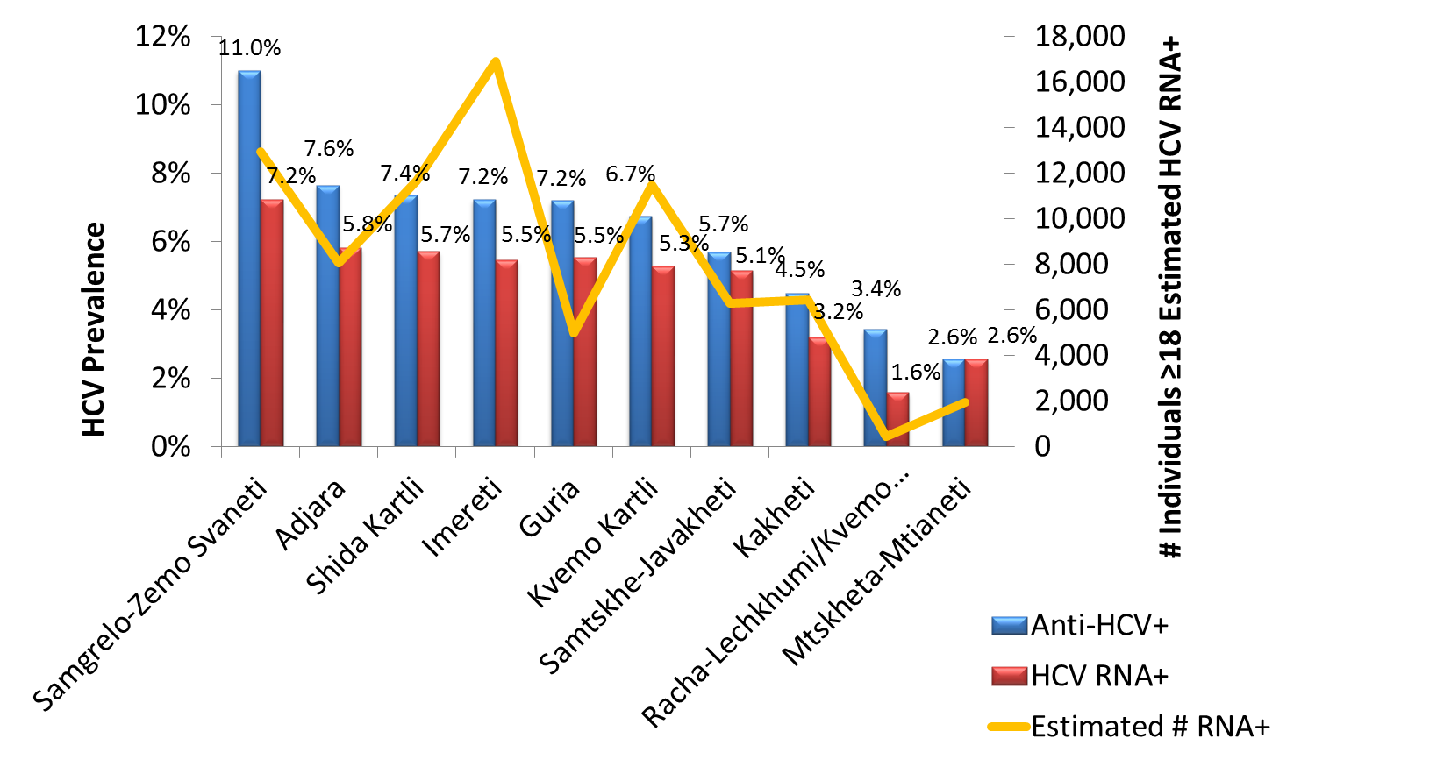
HCV Prevalence and Estimated # RNA+ by Region
(n=3,582)
Note: Regions above do not include 6 major cities

Slide 10
Characteristics associated with anti-HCV+ status in multivariable analysis
Characteristic | OR (95% CI) | AOR (95% CI)
Male gender | 3.62(2.58, 5.07) | 1.81 (1.29, 2.56)
Urban residence | 2.03 (1.51, 2.75) | 1.71 (1.24, 2.36)
Age
18-29 | 1 | 1
30-39 | 3.73 (2.07, 6.74) | 3.50 (1.55, 7.90)
40-49 | 6.42 (3.74, 11.03) | 4.16 (1.98, 8.73)
50-59 | 3.09 (1.61, 5.91) | 3.71 (1.68, 8.19)
60-69 | 2.91 (1.49, 5.67) | 3.96 (1.72, 9.12)
70+ | 2.99 (1.4, 6.35) | 5.14 (2.24, 11.80)
History of blood transfusion | 3.88 (2.64, 5.71) | 4.17 (2.50, 7.0)
History of injection drug use | 40.64 (25.34, 65.18) | 25.14 (14.36, 44.01)
History of incarceration | 11.07 (7.26, 16.88) | 3.88 (2.19, 6.89)
All variables control for all others in the model. Variables that were tested but were not significant in multivariable analysis: # tattoos, # piercings, # injections in last 6 months, # IV infusions in last 6 months, # lifetime sexual partners, frequency of dental cleanings, history of military service, history of STI, history of TB, education, income, employment status

Slide 11
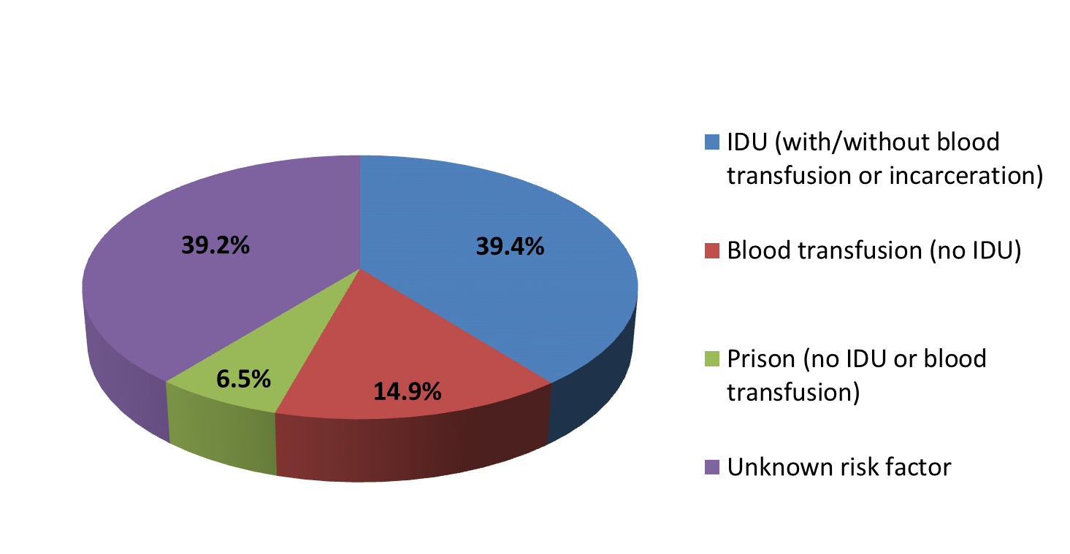
% Anti-HCV+ with Risk Factors Significant in Multivariable Analysis
39.2% of those anti-HCV+ do not report one of the risk factors that were significant in multivariable analysis

Slide 12
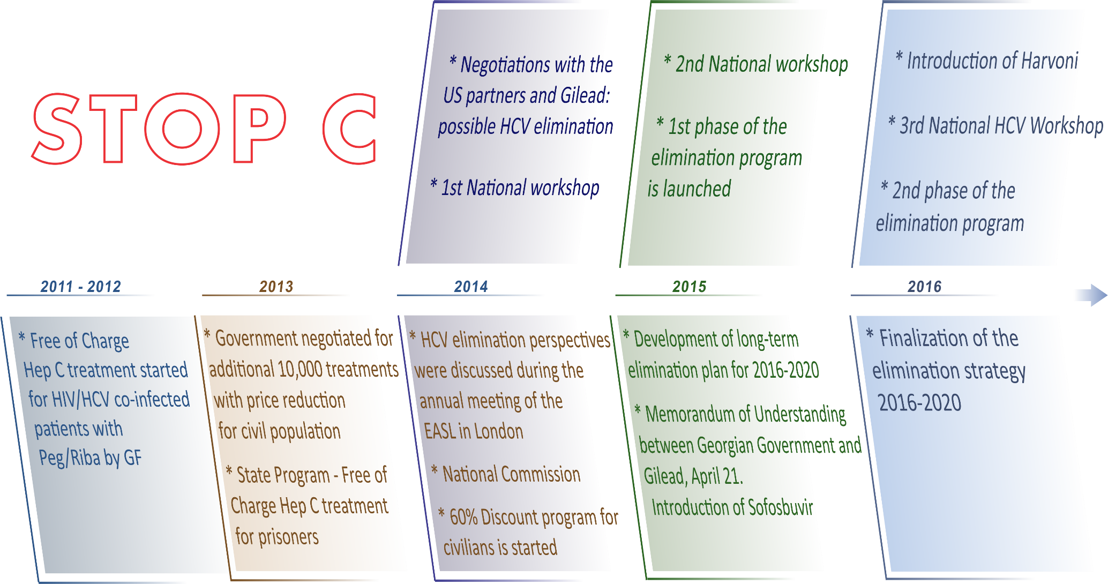
Recent Progress Against HCV in Georgia
Notes:
2016
Introduction of Harvoni
3rd National HCV Workshop
Finalization of the elimination strategy 2016-2020
Phase 2 of the elimination program
Over the past several years the Government of Georgia substantially stepped up its efforts against hepatitis C by implementing national programs such as free of charge hepatitis C treatment for HIV/HCV co-infection patients (funded under the Global Fund HIV Program since 2011); Free of charge hepatitis C treatment at the penitentiary system and 60% price reduction on combination of Pegilated Interferon and Ribavirin for the general population. In February 2014 MoLHSA initiated discussion regarding strengthening Hepatitis C response in the country with US partners. In March 2014 the national workshop on hepatitis C developed the first concept of hepatitis C elimination in Georgia. Under the MoLHSA, a special commission on HCV was established that is in charge of overall coordination of national HCV elimination movement. In addition, a working group of experts was created to elaborate national strategy and action plan for HCV elimination.
In 2014 the Georgian Government started negotiation with pharmaceutical company Gilead which is one of the global leaders in manufacturing potent DAAs, including Sofosbuvir and fixed-dose combination of Ledipasvir/Sofosbuvir regarding possible elimination of HCV in Georgia. 2015 national program on hepatitic C, regarded as 1st phase of elimination program, was discussed and finalized during the national workshop in March, 2015 and later was approved by the Georgian Government.

Slide 13
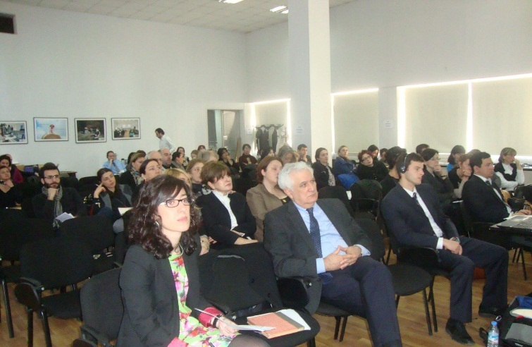
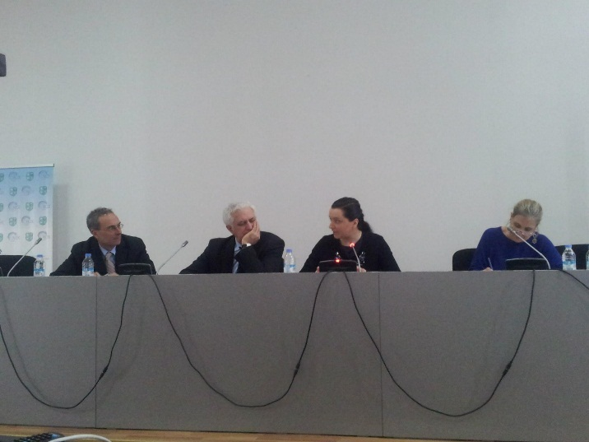
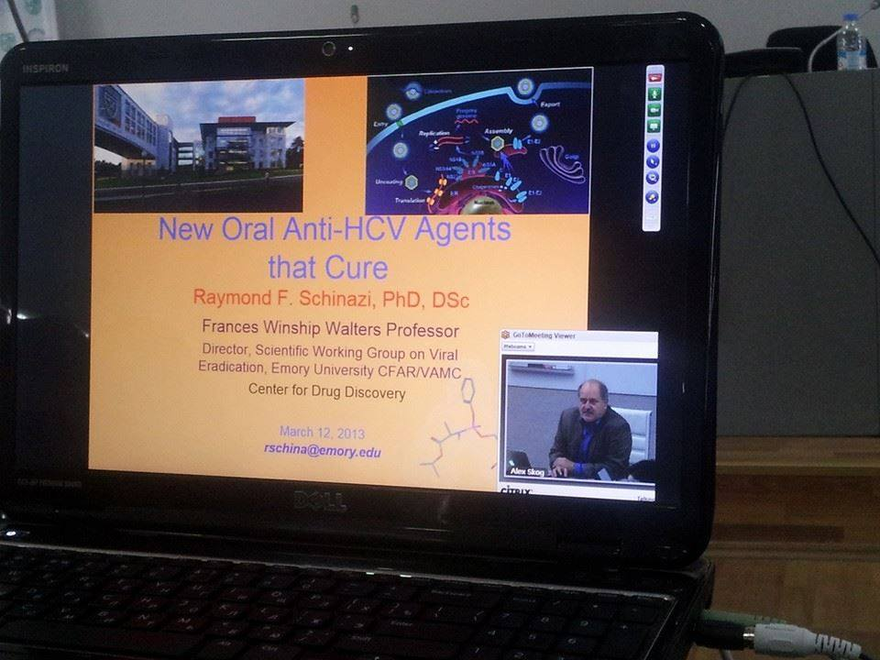
Georgian 1st National Workshop on Hepatitis C,
March 12-14, 2014

Slide 14
Why is elimination of hepatitis C in Georgia feasible and achievable?
High prevalence of HCV infection in general population
Small size of the country (69,700 km2) with population of 3.7 million people
Strong Governmental commitment towards elimination of HCV
Availability of all modern HCV diagnostic and treatment methods and strong human resource capacity
Existence of effective systems for implementing large-scale national and international health programs
Availability of logistic and control mechanisms within existing national HIV/AIDS, Tuberculosis and hepatitis C treatment programs
Adherence to principles of evidence-based medicine for hepatitis C

Slide 15
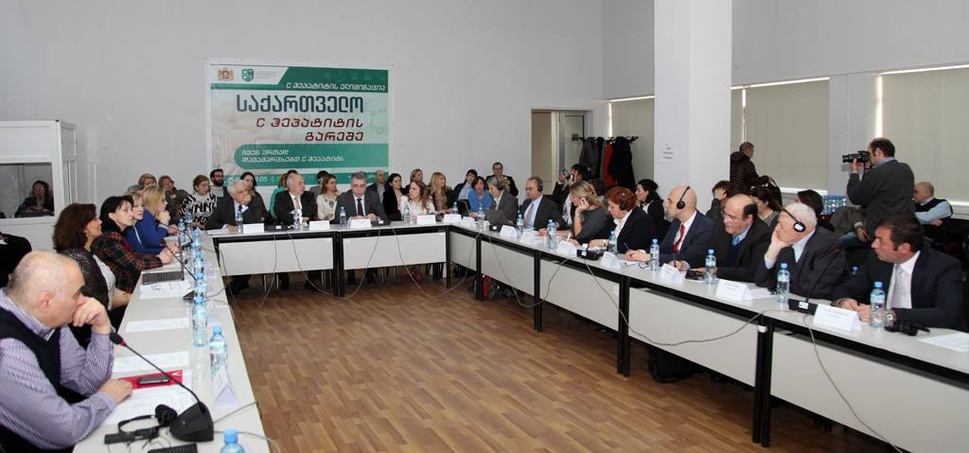
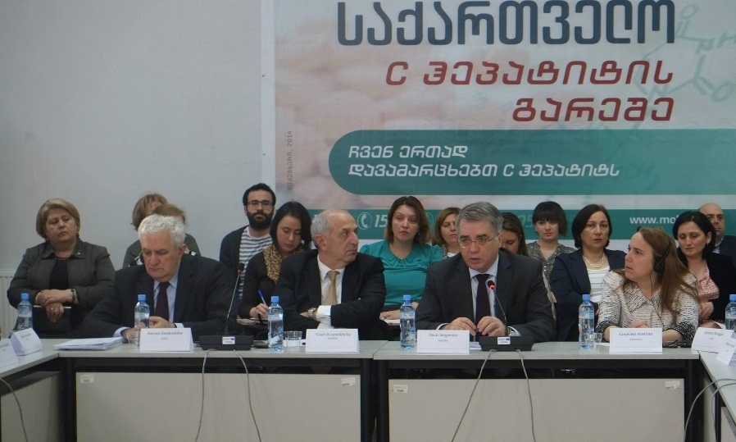

Georgian 2nd National Workshop on Hepatitis C,
March 26-27, 2015

Slide 16
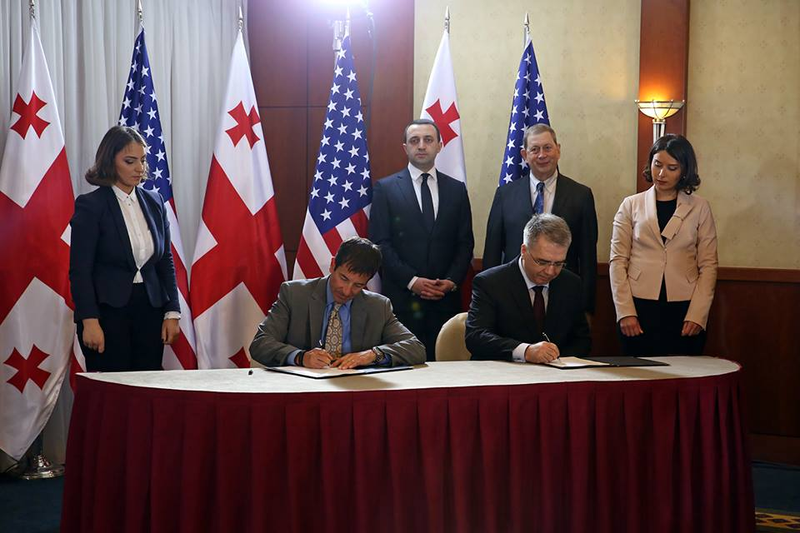
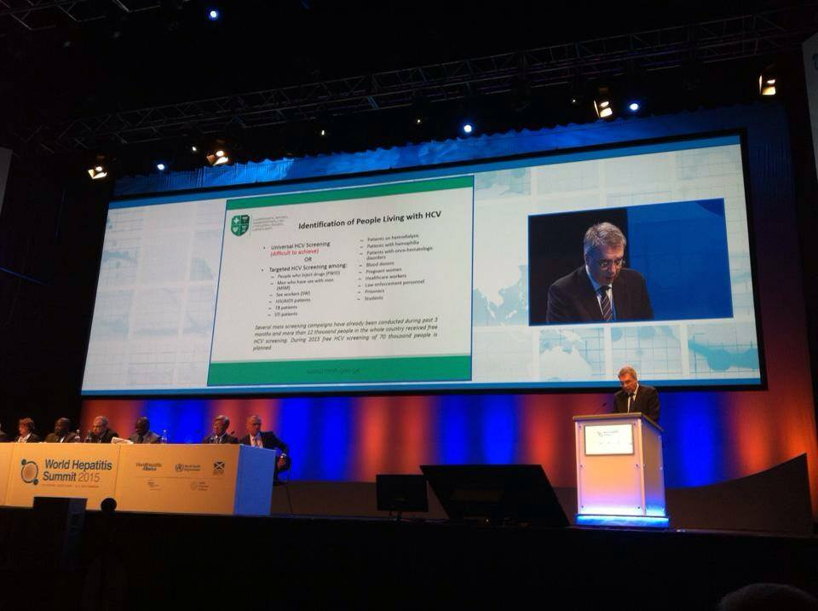
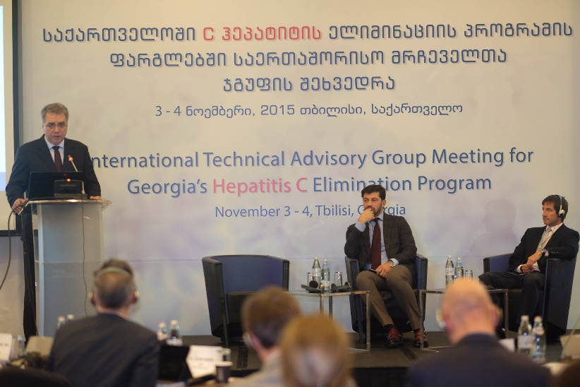
Memorandum of Understanding Official signing ceremony, April 21, 2015
Georgian Minister of Health, Labour and Social Affairs Davit Sergeenko at World Hepatitis Summit, 2-4 September, 2015
International Technical Advisory Group (TAG) Meeting for Georgia’s Hepatitis C Elimination Program
Notes:
The Memorandum of Understanding between the Government of Georgia and US pharmaceutical company Gilead was officially signed on April 21, 2015, that marked the launch of the first phase of elimination program.

Slide 17

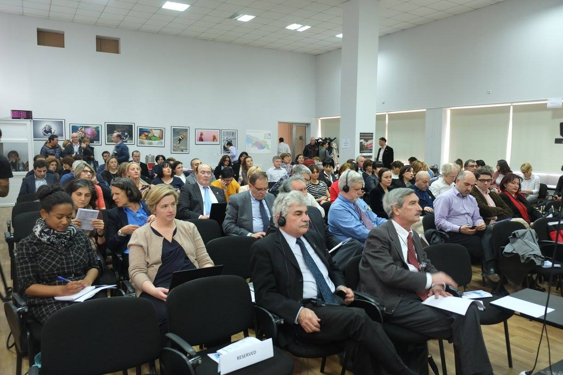

3rd National Hepatitis C Elimination workshop Finalizing elimination strategy April 6-8, 2016

Slide 18
Hepatitis C Elimination Strategy 2016–2020
Goal
Elimination of HCV by ensuring prevention, diagnostics and treatment of the disease

Slide 19

4 Strategic Goals of the Elimination Strategy
Goal 1:
Raise awareness of viral hepatitis
Goal 2:
Monitor health sector response to hepatitis
Goal 3:
Prevent transmission of viral hepatitis
Goal 4:
Reduce new infections and deaths due to viral hepatitis through expanded screening and treatment

Slide 20
Elaboration of the HCV Elimination Strategy
Intersectoral working group coordinated by NCDC
HCV screening, treatment and care
Awareness Raising
Safe Blood
Surveillance
Laboratory
Infection control
Harm reduction
Technical Advisory Group (TAG) of international experts reviewed and discussed the draft strategy and recommendations from the TAG were incorporated in the strategy
Cooperation with Project ECHO started
Notes:
Overall process is supported by the US CDC and WHO

Slide 21





Acknowledgments
Ministry of Labor, Health and Social Affairs
Centers for Disease Control and Prevention (CDC)
Gilead Sciences, Inc.
World Health Organization

Slide 22

Thank you

