Slide 1

HCV Elimination in Georgia: Progress and Challenges
EASL, Barcelona
14 April 2016
Francisco Averhoff, MD MPH
Division of Viral Hepatitis (DVH)
Centers for Disease Control and Prevention
National Center for HIV/AIDS, Viral Hepatitis, STD, and TB Prevention
Division of Viral Hepatitis

Slide 2
HCV Elimination Georgia*
Phase I:
  Free of charge treatment with SOF based regimens for first 5000 HCV infected patients citizens of Georgia with any of known advanced liver disease (Metavir F3/F4), extra-hepatic manifestations, HIV coinfection, other
Phase II:
  Development of an evidence based elimination plan (in progress)
  Implementation of prevention activities and surveillance
  Screening and expanded treatment for HCV infected patients (regardless of Metavir score) with free of charge SOF based regimens, SOF/LED regimens, and other regimens as available
* Currently transitioning from Phase I to Phase II

Slide 3

Eligibility for Phase I
Citizen of Georgia
Present to designated provider with evidence of HCV infection (minimally anti-HCV+ test)
  Workup (paid by patient or free based on ability to pay):
    RNA test to confirm infection, if positive
    Staging: FIB4 and/or Fibroscan,
      if consistent with F0 – F2, deferred to Phase II
      If consistent with F3/F4 eligible for Phase I: Genotyping and testing, recommended treatment regimen
      Records sent to Clinical Committee (CC) to approve or defer treatment (Phase II)
      Patient notified of CC decision and data entered into central database, “STOP-C”

Slide 4
HCV Treatment Capacity*
Clinical Sites
  Eligibility Criteria: assessed by a standard tool to assess capacity, including: clinical, laboratory, infrastructure
  Initially 4 sites (all in Tbilisi), expanded to 16 (including corrections, and clinic serving PWID)
Providers
  Currently 93 approved/certified designated providers for program (60% inTbilisi)
  Only specialists (Infectious Disease and Gastroenterology) eligible for participation (>600 nationwide)
* Clinical sites and providers are private sector only; no treatment capacity in public sector

Slide 5
Number of Persons with a Positive HCV Results Presenting to Clinical Site*, by Month, April 28, 2015–February 15, 2016
Data source: STOP-C system
* The number of clinical sites increased from 4 in April to 15 in February 2016
Notes:
Ant here is the same trend by each month The peak volume of Hepatitis C –infected persons seeking care occurred in May and thereafter stabilized at approximately 2300 people per month till September.
And starting from December the enrolment pace was slowed down.
and

Slide 6
Number of Persons Approved By Committee for Treatment and who Started Treatment, May 2015–February 15, 2016
Data source: STOP-C Database.
The first committee meeting was on May 7th and the first treatment start date was May 14, 2015
Notes:
Smooth, not a major lags
This slide demonstrates number of persons with current HCV-infection and indications for treatment, who were approved by the committee ,depicted in blue
and those who started treatment depicted in orange, by month
Initially in May and June proportionally a low percentage of patients eligible to start treatment were approved. However as the process was refined, in July and August larger proportion of patients started treatment.

Slide 7
Region of Residence for Persons Starting HCV Treatment, May – February 15,2016
Region | Total=5,955 (%) | Population (est.) 3,729,500 (%)
Tbilisi | 3549 (59.6) | 1,118,300 (30.0)
Imereti | 651 (10.9) | 535,700 (14.4)
Adjara | 455 (7.6) | 336,500 (9.0)
Samegrelo | 473 (7.9) | 330,900 (8.9)
Kvemo Kartli | 236 (3.9) | 425,000 (11.4)
Shida Kartli | 185 (3.1) | 264,700 (7.1)
Kakheti | 124 (2.1) | 318,900 (8.6)
Guria | 118 (1.9) | 113,100 (3.0)
Samtskhe-Javakheti | 45 (0.8) | 160,300 (4.3)
Mtskheta-Mtianeti | 46 (0.8) | 94,300 (2.5)
Racha | 40 (0.7) | 31,800 (0.9)
Abkhazia | 33 (0.6) | ----
Notes:
Estimates are based on the 2014 November Census preliminary data, per 1,000 person
Among patients who started treatment the majority resided in Tbilisi followed by Imereti and Adjara regions

Slide 8
Demographic Characteristics of Persons Starting HCV Treatment, Phase 1 Hepatitis C Elimination Program, May 14–February 15, 2016
 | Number of Persons | (%)
Total | 5,955 | 100
Sex
Male | 5,086 | 85.4
Female | 869 | 14.6
Median Age (range) | 51 (44-56)
Notes:
Here are the demographic characteristics of 5955 people who started treatment.
86% of patients were male. Median age was 51.

Slide 9
HCV screening program among select populations, Georgia, 2015 – 2016*
Over 170 000 tested, anti-HCV+ ≈ 19% are positive, but… linked to treatment??
* Data through March 2016
Notes:
Total - 175 000 , 18% HCV positive

Slide 10
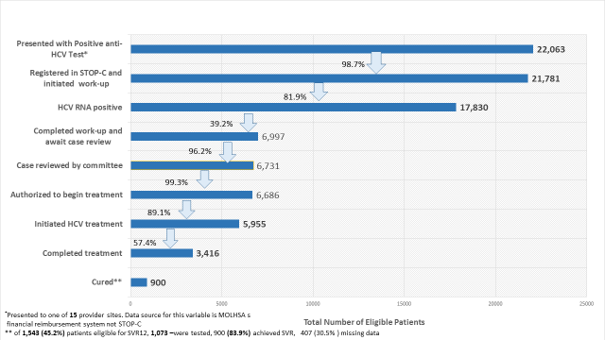
Hepatitis C Treatment, Care Cascade, Georgia, April 2015 – 15 February 2016

Slide 11
Level of Fibrosis Among Persons Starting HCV Treatment May 2015– February 15, 2016
Fibroscan Stage | Number of persons (N= 5,955) | %
F0-F1 | 28 | 0.5
F2 | 59 | 0.9
F3 | 1,491 | 25.0
F4 | 4,229 | 71.0
Missing | 148 | 2.5
Notes:
This slide shows staging based on fibroscan of patients who started treatment. The majority of patients , that is 96% had F3 –F4 . Of The remaining patients with F1 or F2 , nine had documented extrahepatic disease.

Slide 12
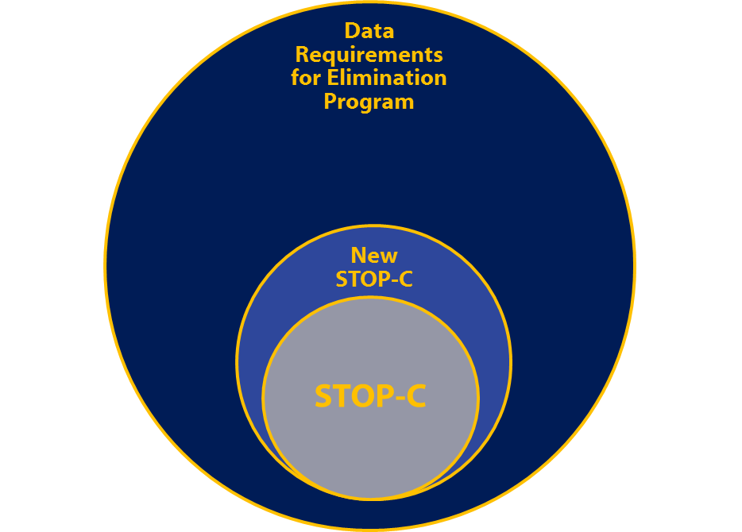
STOP-C: Data Management Challenges
Originally developed for INF Program
Expanded for the Phase I, and again for Phase II
Not meeting growing needs of Elimination Program:
Providers cannot access their data
Not linked to Laboratory
Missing key data in Cascade
No validation rules
Extensive cleaning required
Needed for > 100,000 patients

Slide 13
Additional Priorities/Activities
Laboratory Quality Assurance
  Need for Q/A and
  National Reference Laboratory
Infection Control
  Anecdotal data suggests transmission risk in health care settings
  Nearly 40% of HCV infections without identified Risk Factor
Blood Safety
  Transfusions identified as risk factor, including post 1997 (after HCV screening introduced)
  70% of transfusions unregulated

Slide 14
Additional Priorities/Activities (II)
Disease Burden/Surveillance
  Identification of Acute & Chronic HCV, risk factors
  Morbidity and Mortality (impact indicators)
Monitoring and Evaluation
  Development of a comprehensive program under development (focus of April 6 – 8 2016 Workshop in Tbilisi)
Modeling
  Preliminary analysis (P Vickerman et al):
    Over 1500 premature deaths averted among 6000 treated in Phase I
    Expanded Harm Reduction and Targeted Treatment of PWID needed to achieve goals

Slide 15
Research & Documenting HCV Elimination
Why? Worlds first HCV elimination program, serves as a model for the world
Answer critical questions
Document lessons learned
  What worked well
  What presented challenges
Document Success: was the elimination achieved?

Slide 16
Research Questions in HCV Elimination
Examples
  Impact of HCV treatment on morbidity and mortality?
  Why do a substantial proportion of patients not have SVR results?
  Is HCV incidence increasing or decreasing?
  Macro-economic impact of HCV treatment on Georgia?
  Effectiveness of screening and linkage to care strategies?
  Importance of intra-familial transmission in the HCV epidemic?
  Does HCV transmission cluster in villages? Why?
  Effectiveness of treatment strategies targeting high risk populations on transmission and prevalence?
  Effectiveness of primary care providers to deliver care and treatment for HCV (vs. specialists)
  Can monitoring of patients on treatment be simplified?
  Effectiveness (Cost) of HCV Core-Ag (vs. Anti-HCV + PCR)?

Slide 17
Conclusions
Phase 1 goal achieved; focus on treatment
  Majority of patients initiated treatment were with severe liver disease (F3/F4)
Male population disproportionally receiving HCV treatment
Enrollment slowing over time
  Screening and linkage to care of HCV infected not developed, data lacking
Barriers in progression in care cascade need to be studied and monitored:
  Cost of diagnostics? Access? Linkage to Care?
Information system needs attention

Slide 18
Next Steps
Priority for 2016 – 2017: Evidence Based Elimination Plan
Critical Areas to be enhanced/addressed to achieve elimination
  Robust information system
  Reduction of barriers to PWID including decriminalization and harm reduction scale-up
  Blood Safety Regulation
  Targeted, streamlined screening and linkage to care
  Surveillance for acute/chronic infections, incidence, risk factors, morbidity/mortality
  Research, Monitoring and Evaluation, and Modeling

Slide 19
Acknowledgements
Lia Gvinjilia
Eka Adamia
Maia Tsereteli
David Baliashvili
Maia Alkhazashvili
Leslyn McNabb
Sharmeen Hussain
Juliette Morgan
Amiran Gamkrekidze
Valeri Kvarackhelia
Others

