Slide 1

Georgian Health Care System Overview
Amiran Gamkrelidze, MD, PhD, Professor
Director General, NCDC, Georgia
National Center for Disease Control and Public Health
დაავადებათა კონტროლისა და საზოგადოებრივი ჯანმრთელობის ეროვნული ცენტრი
დაავადებათა კონტროლისა და საზოგადოებრივი ჯანმრთელობის ეროვნული ცენტრი
National Center for Disease Control & Public Health
www.ncdc.ge
www.ncdc.ge
www.ncdc.ge
www.ncdc.ge
Notes:
1

Slide 2
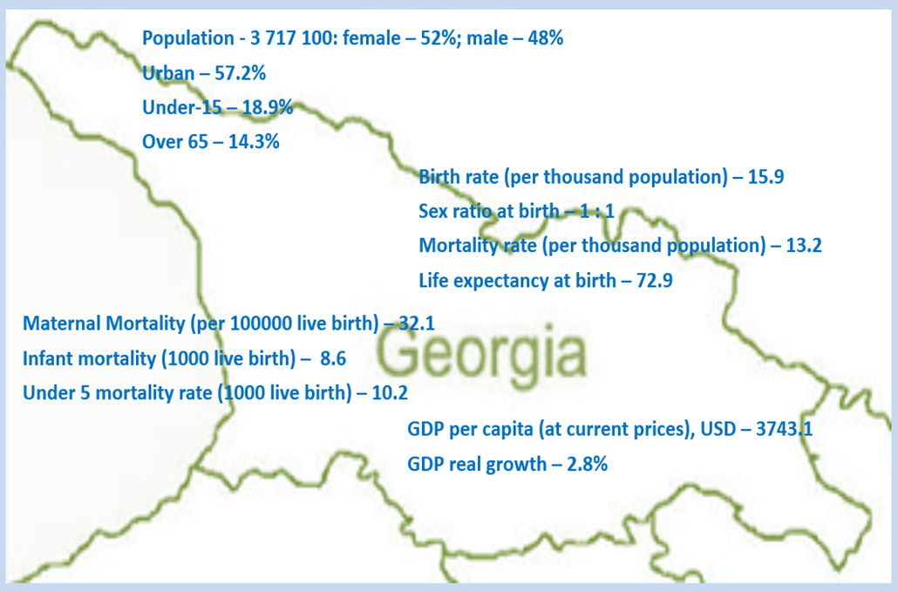
Demographic and socio-economic indicators, Georgia, 2015
Total Health expenditure per capita – 301 $US
Total Health expenditure as % of GDP –8.2%
Government expenditure on health per capita – 104 $US
Government expenditure on health as % of GDP – 2.8%
Government expenditure on health as % of State Budget – 8%
დაავადებათა კონტროლისა და საზოგადოებრივი ჯანმრთელობის ეროვნული ცენტრი
დაავადებათა კონტროლისა და საზოგადოებრივი ჯანმრთელობის ეროვნული ცენტრი
National Center for Disease Control & Public Health
www.ncdc.ge
www.ncdc.ge
www.ncdc.ge
Notes:
2

Slide 3
Health Priority directions for 2014-2020
Health in all policies – general state multi-sectoral approach
Development of the healthcare sector governance
Improvement of healthcare financing system
Development of quality medical services
Development of human resources in the healthcare sector
Development of health management information systems
Support of maternal and child health
Improvement of prevention and management of priority communicable diseases
Improvement of prevention and control of priority non-communicable diseases
Development of public health system
დაავადებათა კონტროლისა და საზოგადოებრივი ჯანმრთელობის ეროვნული ცენტრი
დაავადებათა კონტროლისა და საზოგადოებრივი ჯანმრთელობის ეროვნული ცენტრი
National Center for Disease Control & Public Health
www.ncdc.ge
www.ncdc.ge
www.ncdc.ge

Slide 4
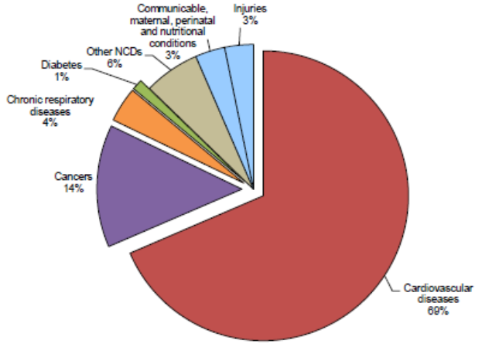
Mortality structure, Georgia
WHO estimates, 2014
National Center for Disease Control & Public Health
www.ncdc.ge

Slide 5
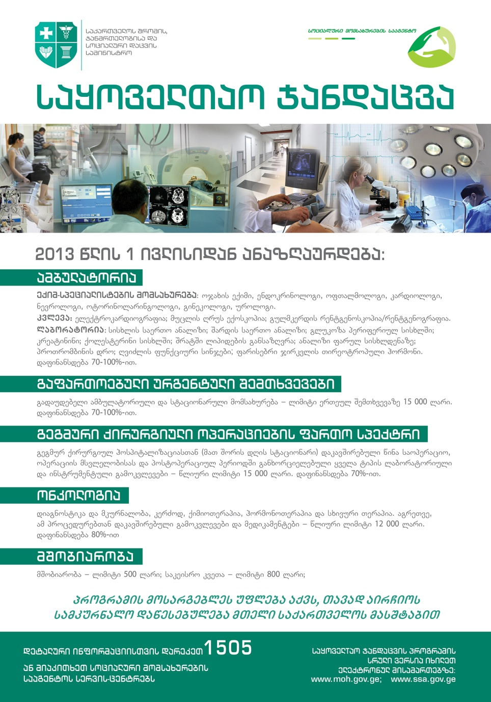
UNIVERSAL HEALTH CARE
Declared and Better Funded Priority of the Government
Unprecedented Expansion of State Budget for Health care
365 Million GEL in 2012 → 875 Millions in 2015
Launch of Universal Health Care Program in February 2013
All population of Georgia are covered by health services
  Among them ~ 500 000 have private health insurance
  Others are Universal health care Program Beneficiaries
დაავადებათა კონტროლისა და საზოგადოებრივი ჯანმრთელობის ეროვნული ცენტრი
დაავადებათა კონტროლისა და საზოგადოებრივი ჯანმრთელობის ეროვნული ცენტრი
National Center for Disease Control & Public Health
www.ncdc.ge
www.ncdc.ge
www.ncdc.ge

Slide 6
Protect what is working well: universality backed by public investment in health through general taxes brings Georgia closer to EU countries
დაავადებათა კონტროლისა და საზოგადოებრივი ჯანმრთელობის ეროვნული ცენტრი
დაავადებათა კონტროლისა და საზოგადოებრივი ჯანმრთელობის ეროვნული ცენტრი
National Center for Disease Control & Public Health
www.ncdc.ge
www.ncdc.ge
www.ncdc.ge

Slide 7
Out-of-Pocket payment (OOP) as % of Total Health Expenditure (THE)
დაავადებათა კონტროლისა და საზოგადოებრივი ჯანმრთელობის ეროვნული ცენტრი
დაავადებათა კონტროლისა და საზოგადოებრივი ჯანმრთელობის ეროვნული ცენტრი
National Center for Disease Control & Public Health
www.ncdc.ge
www.ncdc.ge
www.ncdc.ge

Slide 8
Coverage of Healthcare services
Services utilization
Hospitalization per 100 population
  UHC Program has led to a major expansion in population entitlement to publicly financed health services (HUES)
Ambulatory care visits per person per years
დაავადებათა კონტროლისა და საზოგადოებრივი ჯანმრთელობის ეროვნული ცენტრი
დაავადებათა კონტროლისა და საზოგადოებრივი ჯანმრთელობის ეროვნული ცენტრი
National Center for Disease Control & Public Health
www.ncdc.ge
www.ncdc.ge
www.ncdc.ge

Slide 9
Target Population
Current package caused by UHC
All citizens of Georgia
Stateless persons
Refugees
Persons with humanitarian status
Asylum-seekers
Social unprotected foreigners with permanent residence permit
  Evidence-based interventions at primary health care
  Urgent outpatient services –
  Intensive and Critical Hospital Care
  Elective Surgical Care
  Chemo-, radio- and hormonotherapy
  Maternity Services
დაავადებათა კონტროლისა და საზოგადოებრივი ჯანმრთელობის ეროვნული ცენტრი
დაავადებათა კონტროლისა და საზოგადოებრივი ჯანმრთელობის ეროვნული ცენტრი
National Center for Disease Control & Public Health
www.ncdc.ge
www.ncdc.ge
www.ncdc.ge

Slide 10
“Vertical” State Health Programs
Public health Programs
Early Detection and screening of Diseases
Immunization
Epidsurveillance
Blood safety
Prevention of occupational diseases
Management Infectious diseases
Management of TB
Management of HIV
Management of Hep C
Treatment of drug abuse
Maternal and Child health
Health promotion
Health Services in priorities areas
Mental Health
Management of Diabetes
Child onco-hematology
Dialysis and kidney transplantation
Palliative care of incurable patients
Treatment of rare diseases
Ambulance and emergency care
Rural doctors
Medical screening for army recruits
Referral (individual care)
დაავადებათა კონტროლისა და საზოგადოებრივი ჯანმრთელობის ეროვნული ცენტრი
დაავადებათა კონტროლისა და საზოგადოებრივი ჯანმრთელობის ეროვნული ცენტრი
National Center for Disease Control & Public Health
www.ncdc.ge
www.ncdc.ge
www.ncdc.ge

Slide 11
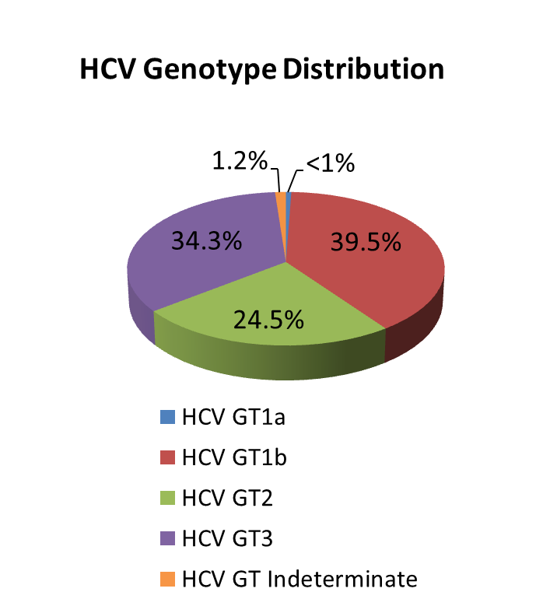
National Population-based seroprevalence survey 2015
Conducted by NCDC and CDC, Atlanta
Total number of interviews – 6330 (90% response rate)
Total number of blood samples – 6011 (86% response rate)
Characteristic | n | % | Estimated # nationwide ≥18 years
Anti-HCV+ | 425 | 7.7% | 208,800
HCV RNA+ | 311 | 5.4% | 150,300
დაავადებათა კონტროლისა და საზოგადოებრივი ჯანმრთელობის ეროვნული ცენტრი
დაავადებათა კონტროლისა და საზოგადოებრივი ჯანმრთელობის ეროვნული ცენტრი
National Center for Disease Control & Public Health
www.ncdc.ge
www.ncdc.ge
www.ncdc.ge
Notes:
2015 National survey conducted by NCDC and CDC revealed that ~150 thousand people are infected with active HCV infection and need to be treated. The most prevalent genotype nationwide is genotype 1 (appx. 40%) followed by genotype 3 and 2.

Slide 12
Targets
Goal
Elimination of HCV by ensuring prevention, diagnostics and treatment of the disease
90-95-95
Started treatment about 30000
Completed treatment about 20000
By 2020
90% of people living with HCV are diagnosed
95% of those diagnosed are treated
95% of those treated are cured
Sofosbuvir-based regimens
SVR achieved: 79.5%
Harvoni-based regimens
SVR achieved: 98.2%
დაავადებათა კონტროლისა და საზოგადოებრივი ჯანმრთელობის ეროვნული ცენტრი
დაავადებათა კონტროლისა და საზოგადოებრივი ჯანმრთელობის ეროვნული ცენტრი
National Center for Disease Control & Public Health
www.ncdc.ge
www.ncdc.ge
www.ncdc.ge

Slide 13
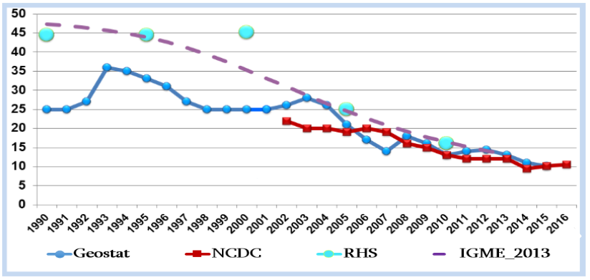
Maternal and Child Health
  Reach MDG4 – Under-5 mortality rate – 10.2
  Introduction of the “Birth Registry”
  Regionalization of MCH services
  National Protocols and Regulations
  Emergency obstetric and neonatal conditions
  C-section, Abortion
  Perinatal services standards
Folic Acid and Iron Supplements for Pregnant Women
Multiple Micronutrient Powder for 6-23 month children
Under-5 mortality rate per 1000 LB, Georgia
დაავადებათა კონტროლისა და საზოგადოებრივი ჯანმრთელობის ეროვნული ცენტრი
დაავადებათა კონტროლისა და საზოგადოებრივი ჯანმრთელობის ეროვნული ცენტრი
National Center for Disease Control & Public Health
www.ncdc.ge
www.ncdc.ge
www.ncdc.ge

Slide 14
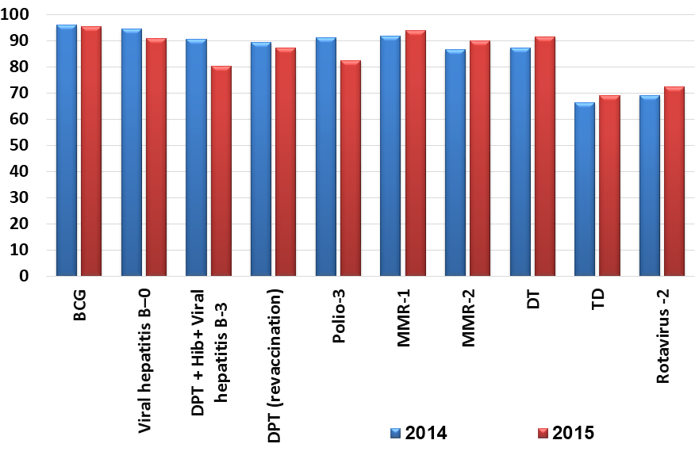
Immunization
Introduction of new vaccines in Georgia
Rotavirus vaccine – 2012
Pneumococcal vaccine – 2014
Combined hexavalent
(DPaT+HepB+Hib+IPV) vaccine - 2016
Vaccination coverage rates
 | DPT3 | OPV3 | MMR1 | MMR2
2015 | 94 | 91 | 96 | 91
2014 | 91 | 91 | 92 | 87
National Center for Disease Control and Public Health
www.ncdc.ge
Notes:
14

Slide 15



Health Promotion State Program
“Public Movement for Healthy Georgia” (2015)
Tobacco Control
Promoting healthy nutrition; public awareness rising on alcohol
Promoting physical activity
HCV prevention and promotion of public awareness
Popularization and strengthening of Health Promotion
დაავადებათა კონტროლისა და საზოგადოებრივი ჯანმრთელობის ეროვნული ცენტრი
National Center for Disease Control & Public Health
www.ncdc.ge
www.ncdc.ge

Slide 16
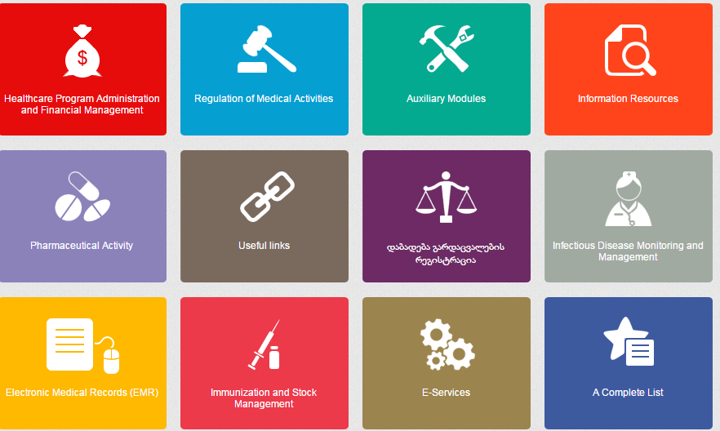

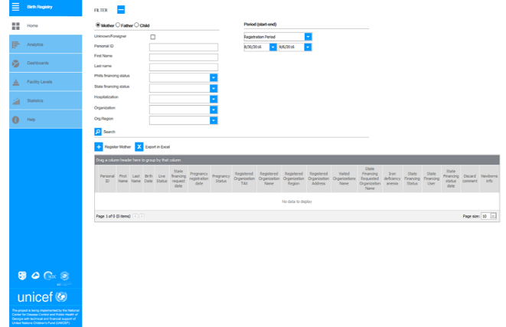
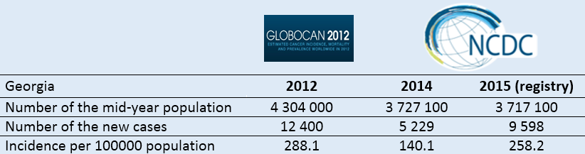
E-health
„Birth Registry”
„Cancer“ Registry
დაავადებათა კონტროლისა და საზოგადოებრივი ჯანმრთელობის ეროვნული ცენტრი
დაავადებათა კონტროლისა და საზოგადოებრივი ჯანმრთელობის ეროვნული ცენტრი
National Center for Disease Control & Public Health
www.ncdc.ge
www.ncdc.ge
www.ncdc.ge

Slide 17
MOLHSA
Multisectoral Supervisory Board:
MoLHSA, MoA, MoES, MIA, MoD, MoE, MoF
NCDC
(High-level Biomedical Research Center - Center of Excellence)
Lab Part
Richard G. Lugar Center
“One World – One Health”
Non-Lab/Office
Part of NCDC&PH
Immunization
Cold Chain Infrastructure
National Center for Disease Control & Public Health
www.ncdc.ge
Notes:
17

Slide 18
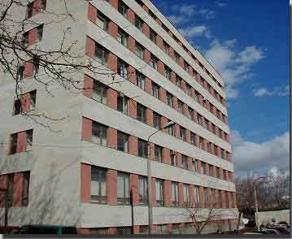
Non-Laboratory Part of NCDC
GF Programs Recipient
State Public
Health Programs:
- Immunization
- Blood Safety
- TB
- HIV/AIDS
- Screening
- Surveillance
- MCH
- Occupational
diseases
- Health promotion
- Screening HCV
Epid-surveillance of Infectious Diseases:
- VPD
- Diarrheal
- Vector borne
- Air borne
- EDP - Zoonoses
- STI/HIV/TB
Surveillance of NCD:
- CVD
- Cancer
- Diabetes
- CRD
- Risk factors
- Health promotion
- Behavioral Health
Environ-
mental Health
Public Health Preparedness and Response
Medical Statistics
Training Center
National Center for Disease Control & Public Health
www.ncdc.ge
Notes:
18

Slide 19
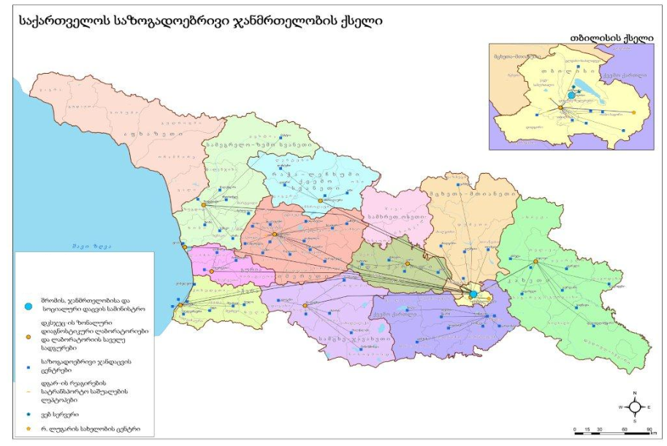
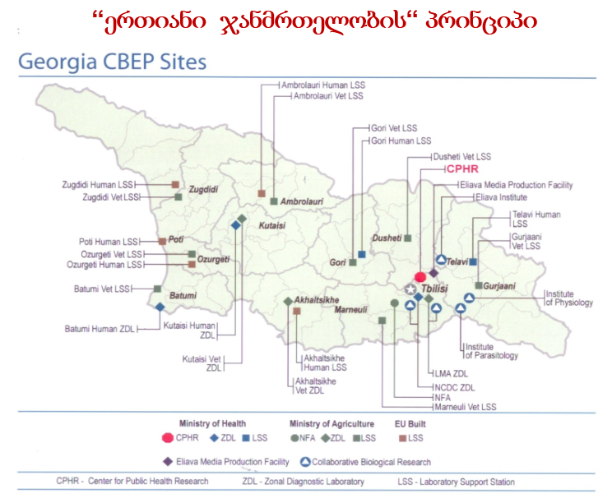
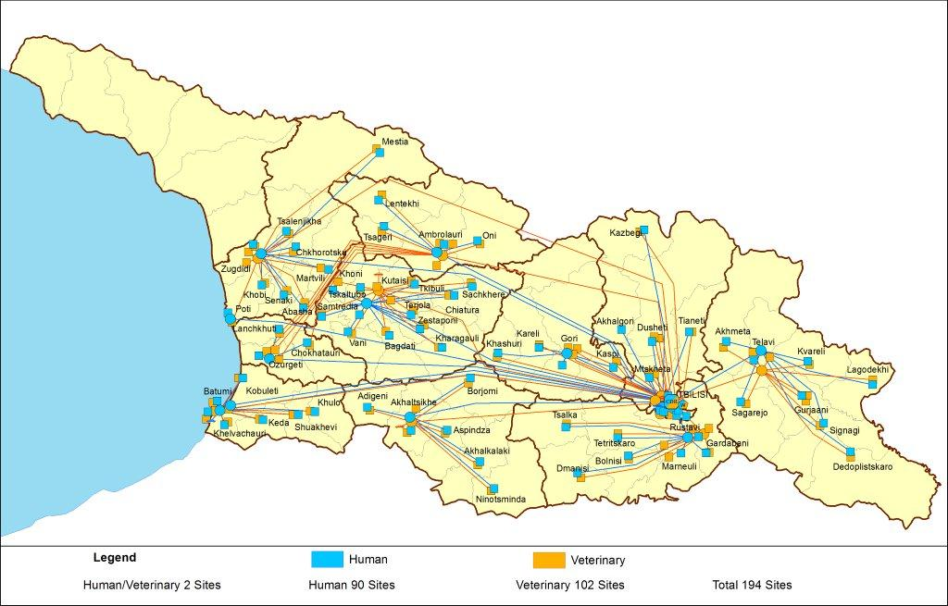
Unified Laboratory Network
Public Health Network
One Health
EIDSS
200 entry points
National Center for Disease Control and Public Health
www.ncdc.ge
Notes:
19

Slide 20
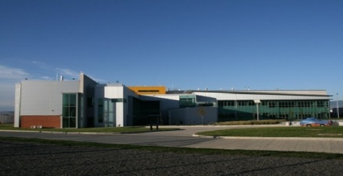
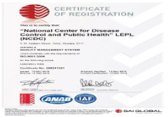
R. Lugar Center for Public Health Research
Accreditation & Certification –
NCDC / Lugar Center
Bio-safety and EDP Department
Virology, Molecular Biology and Genomic Department
Bio-Safety Division
Molecular Epidemiology / Genomics
  3 Labs accredited by WHO
    Polio
    Influenza
    Measles/Rubella
National Repository
Influenza and Respiratory Viruses Lab
EDP Lab
Polio and other Entero viruses lab
5 Labs Connected to WHO Lab Network with EQA
    Rota
    Invasive Meningitis
    Malaria
    Salmonelosis
    AMR
Zoo-Entomology Lab
Cell Culture Lab
Process to obtain
ISO 15189 accreditation
General Bacteriology Lab
Serology Lab – HCV Research Subunit
Vivarium
Sample Receiving group
National Center for Disease Control and
Public Health
www.ncdc.ge
Notes:
Fonts, mark the departments;

Slide 21
Mission and Main Functions of the Lugar Center
Country epidemiological security
Rapid detection of biological threats, confirmation and respond
Leading facility responsible for biological security
Participation in Global Health Security Agenda (GHSA) real-time bio-surveillance, laboratory and zoonotic diseases packages
EDPs consolidated in a secure place
Zoentomological surveillance
Provision of lab support to Public Health State Programs
Development of bio-medical research potential in the country
National Center for Disease Control and Public Health
www.ncdc.ge

Slide 22
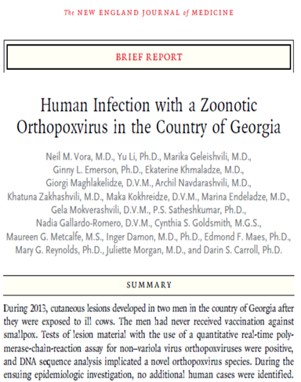
R. Lugar Center for Public Health Research
Significant achievements and discoveries
From patient’s clinical sample suspicious for Cat Scratch Fever, Bartonella strains was isolated which before was never described in scientific literature as pathogenic for humans
First time Janibacter spp. was isolated from the heart valve sample (during endocarditis)
First time was confirmed:
  CCHF case in West Georgia (Bagdati region)
  Existence of CCHF vector tick, Ripicephalus sanguineus, in Georgia
  Human Tularemia case in Tbilisi
  Existence of mosquito Aedes albopictus
First time in Georgia Ochrobactrum genus bacteria was described
First time in Georgia Parapox infection was diagnosed in Humans
Novel Orthopox virus specie was discovered
Second time for Georgian authors, and first time for NCDC scientists, article was published in the New England Journal of Medicine
First time in Georgia Whole Genome Sequencing of 4 Georgian strains of Brucella was conducted
Hanta virus detection with specific molecular markers was conducted for the first time (In collaboration with Bundeswehr Institute of Microbiology )
First study of Tick-Born Encephalitis (In collaboration with Bundeswehr Institute of Microbiology
National Center for Disease Control & Public Health
www.ncdc.ge
Notes:
22

Slide 23

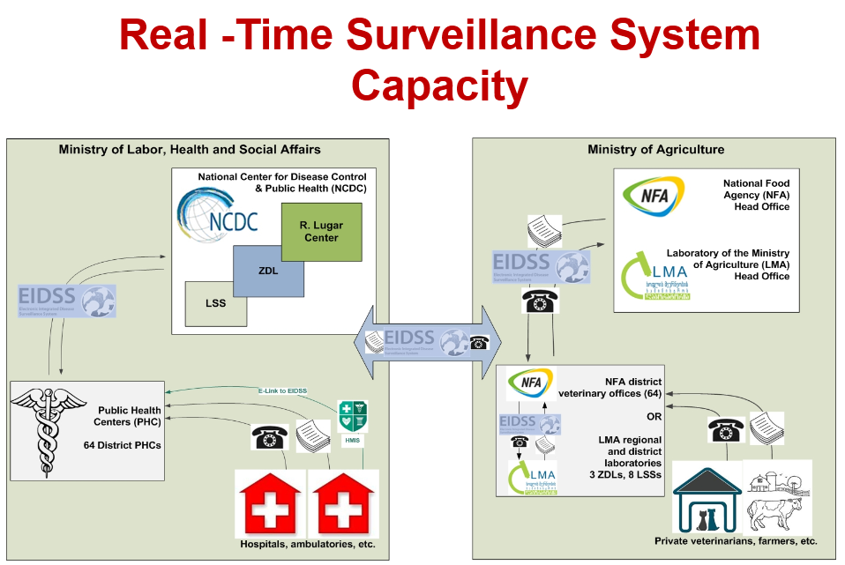
Global Health Security Agenda
Georgia, together with other countries is actively involved in support of the 11 Action Package objectives:
  Real-Time Surveillance - as a leading country
  National Laboratory System – as the contributing country
  Zoonotic Diseases – as the contributing country
On September 26, 2014 it was held the Global Health Security Summit in the White House, Washington DC under the US Political Leadership. On the Summit Georgia was nominated as one of the exemplary international partners
Election as the GHSA Assessment Alliance Advisory Group member
2015 - Conceptual Frame for Emergency Operation Center
National Center for Disease Control and Public Health
www.ncdc.ge
Notes:
23

Slide 24











WHO
CDC / Atlanta
DTRA
UNFPA
WRAIR
UNICEF
NIH
USAID
WB
NCDC
FOA / OIE
EU
GAVI
Principal Recipient of GFTAM Grants
Universities & Research Centers:
University of Florida, University of Maryland,
Emory University, Johns Hopkins University, North Arizona University, Bundeswehr Institute of Microbiology, University of Oslo, etc.
National Center for Disease Control & Public Health
www.ncdc.ge
Notes:
24

Slide 25
Research Projects of Public Health Importance at NCDC
As of Today NCDC has implemented more than 160 international projects and research grants within ~ 23 000 000 USD:
Tularemia Epidemiology and Ecology in Georgia GG 19
Poxvirus project: HDTRA1-15-1-006
Human diseases epidemiology and EDPs surveillance in Georgia CBR/DTRA, GG-21
Establishing enterovirus surveillance in Georgia (GDD)
Laboratory capacity building of molecular genotyping technology for surveillance improvement of vaccine preventable diseases (GDD)
Population-based sero-survey of Hepatitis C (CDC)
Strengthening surveillance to assess real burden of viral Hep in Georgia (GDD)
Genetic characteristic of hepatitis C virus in Georgia: implications for hepatitis C elimination program
Surveillance and Response to Avian and Pandemic Influenza (CDC)
Prevention of Amebiasis in Georgia (CDC)
National Center for Disease Control & Public Health
www.ncdc.ge
Notes:
25

Slide 26
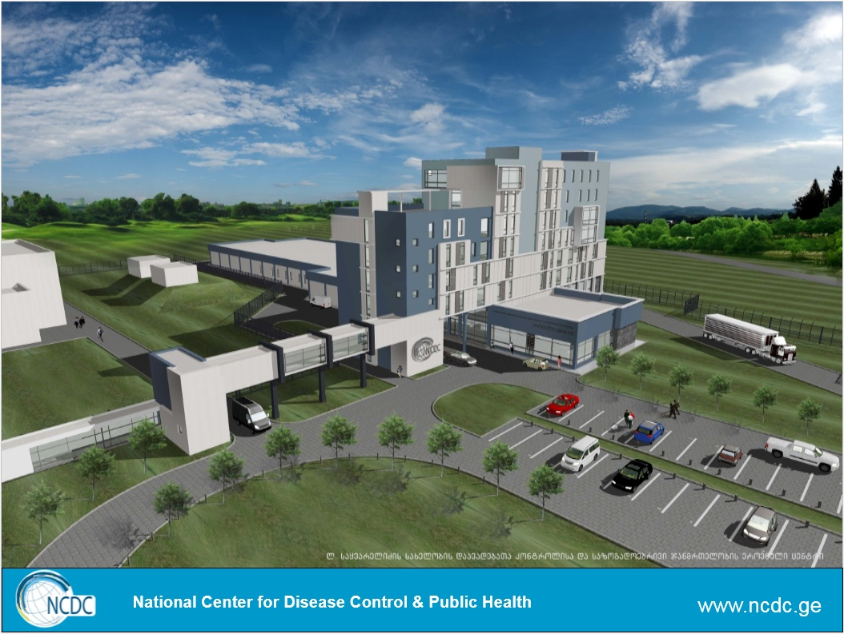
Thank you!
National Center for Disease Control and Public Health
დაავადებათა კონტროლისა და საზოგადოებრივი ჯანმრთელობის ეროვნული ცენტრი
www.ncdc.ge
www.ncdc.ge

