Slide 1
Burden of HCV and Use of National Seroprevalence Survey Findings for Developing Effective Screening Programs in Georgia
Amiran Gamkrelidze
Director General
National Center for Disease Control and Public Health

Slide 2
Dr. Amiran Gamkrelidze
FINANCIAL DISCLOSURE:
No relevant financial relationship exists

Slide 3
HCV Burden in Georgia - Background
Georgia is among the countries with the highest hepatitis C prevalence
Prevalence among different population groups:
    PWID: 66.2% (Bio-Behavioral Surveillance Survey, 2015)
    TB Patients: 21% (Lomtadze et al, 2013)
    MSM: Tbilisi – 7.1%, Batumi – 18.9% (BSS, 2015)
    Old Estimate of prevalence among general population – 6.7% (population-based survey in the capital city Tbilisi, 2001-2002)
Notes:
However, the previous estimate of the prevalence was outdated. The population-based national prevalence estimate was necessary in order to obtain baseline information at the beginning of elimination program

Slide 4
HCV Burden in Georgia
2015 National seroprevalence survey
Number of interviews - 6330
Number of blood samples - 6011
Characteristic | n | % | Estimated number of adults >18
Anti-HCV+ | 425 | 7.7% | 215,000
HCV RNA+ | 311 | 5.4% | 150,300

Slide 5
HCV Prevalence by Age and Gender
Females
HCV Prevalence
(n=3,662)
Males
(n=2,334)
Notes:
Age and gender distribution of HCV shows that HCV prevalence is higher among males, especially among age groups 30-39 and 40-49

Slide 6
  HCV Prevalence and Estimated # RNA+ by City
(n=2,414)
Notes:
The prevalence of HCV by region and different cities is very important for us, these data gives us possibility to direct our screening activities in the regions with the highest burden. Cities with highest HCV prevalence include capital Tbilisi, Kutaisi and Zugdidi. In absolute numbers, Tbilisi and Kutaisi have the highest number of persons with HCV infection.

Slide 7
  HCV Prevalence and Estimated # RNA+ by Region

Slide 8
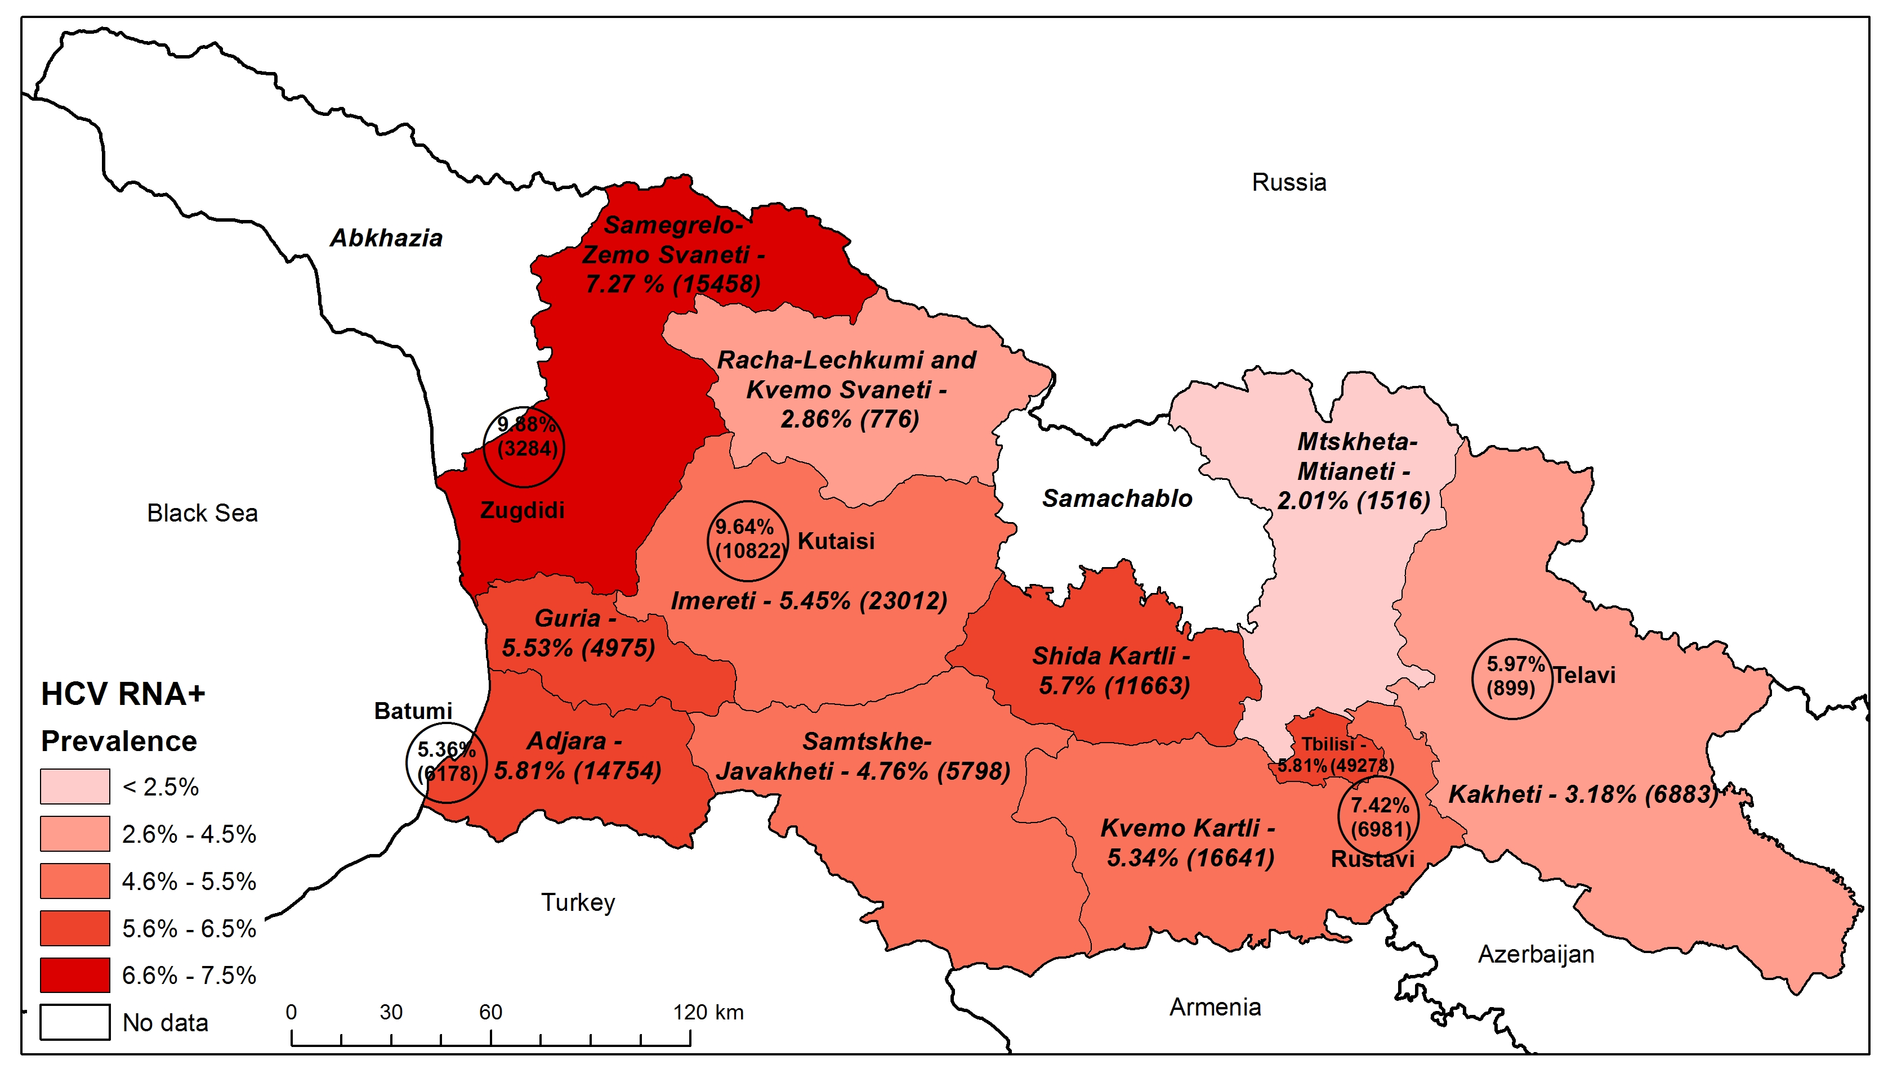
Prevalence and Estimated Number of HCV RNA+ Individuals by Regions and Cities
Note: Estimated numbers for regions include cities
Notes:
Estimates for Mtskheta-mtianeti, Samtskhe, Racha-Lechkhumi, Guria are indeterminate due to low sample size

Slide 9
  Anti-HCV risk factors

Slide 10
Self-reported HCV care among anti-HCV positive respondents
36.7%
32.1%
64%
18.8%
Notes:
As you see, by summer 2015, only about one third of anti-HCV positive individuals knew their status

Slide 11
Main Findings of Seroprevalence Survey for Screening Considerations
215,000 anti-HCV positive persons
IDU and Blood Transfusion – Most common risk factors
Men between 30-50 years old – Highest prevalence
Large proportion of individuals – unknown risk factors
Highest prevalence regions – Samegrelo, Achara, Imereti, Tbilisi
Only about 1/3 of anti-HCV positive persons knew their HCV status
Notes:
To Summarize the main findings of the survey that can inform our future screening activities are the following.

Slide 12
HCV Elimination Strategy
2016-2020
Strategy 1 – Promote Advocacy, Awareness and Education, and Partnership for HCV-associated resource mobilization
Strategy 2 – Prevent HCV Transmission
Strategy 3 – Identify Persons Infected with HCV
Strategy 4 – Improve HCV Laboratory Diagnostics
Strategy 5 – Provide HCV Care and Treatment
Strategy 6 – Improve HCV Surveillance
Notes:
Considering importance of the topics, Screening is set forward as a separate strategic directions.

Slide 13
HCV Screening – Current Status
*data are available through September 30, 2016
Raw data: November 2016 - February 2017s
Raw data: November 2016 - February 2017s
Since May, 2015, more than 550,000 tests were performed with 10% positivity rate

Slide 14
HCV Screening – Next Steps (1)
Large-scale information campaign about HCV screening targeted at general population
SMS notifications targeted to males above 30 years old
Piloting integrated HCV-HIV-TB Screening, diagnosis and treatment approach in Samegrelo-Zemo Svaneti region

Slide 15
HCV Screening – Next Steps (2)
Unified electronic screening module – screening data from different programs will be accumulated in one registry
Scale up screening in outpatient settings – incentivizing primary health care personnel
Target for 2017 – Screen 600 000 Individuals

Slide 16
Thank you for your attention
Questions?

