Slide 1
Progress in HCV Care and Treatment:
The Cornerstone of the Elimination Program
Progress Towards Hepatitis C Elimination
in the Country of Georgia
21 April 2017
Tengiz Tsertsvadze, MD, PhD
Director General, Infectious Diseases, AIDS and Clinical Immunology Research Center
Professor, Ivane Javakhishvili Tbilisi State University

Slide 2
The Goal of the National Hepatitis C Elimination Program
Elimination of HCV infection in the country
through identifying and treating all hepatitis C patients strengthened by effective prevention interventions
Detection
Treatment
Prevention
Reducing the HCV prevalence by 90% (to 0.5%) by 2020

Slide 3
Targets: 90-95-95
90%
95%
95%
Diagnosed
Treated
Cured

Slide 4
How Georgia Differs from Other Countries
Other countries
Georgia
No active case finding
Only those aware of their disease and referring to physicians are treated
Treatment prioritization
Active case finding
Treatment of all patients (including F0 fibrosis)
Widescale prevention programs

Slide 5
Treatment Protocols
April 2015 – March 2016 | Sofosbuvir (SOF)
 | IFN-containing and IFN-free SOF regimens recommended based on various clinical scenarios (genotype, cirrhosis, previous treatment experience)
Since March 2016 | Ledipasvir/Sofosbuvir (LDV/SOF)
 | LDV/SOF is recommended in all genotypes
 | Evidence supporting this recommendation included: High prevalence of 2k/1b recombinant in Georgia Results of some trials and observational studies indicating that LDV/SOF could be more effective that SOF alone EMA approval for cirrhotic and treatment experienced G3 patients

Slide 6
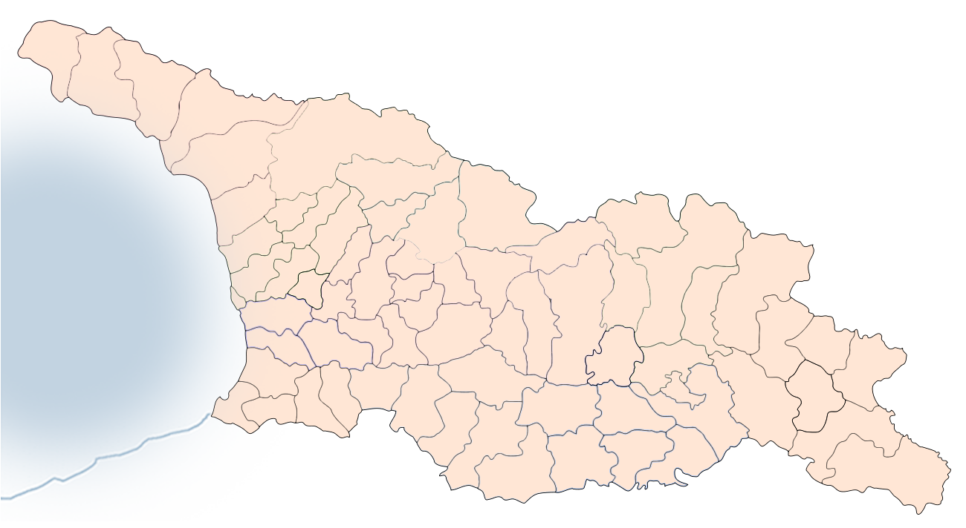

HCV Treatment Sites within Elimination Program, December 31, 2016 (Total=27)
4 sites
Increase from four (4) sites when program launched in April 2015
1 site
2 sites
Zugdidi
Kutaisi
15 sites
Lanchkhuti
Gori
1 site
Tbilisi
Gurjaani
Batumi
Rustavi
1 site
2 sites
1 site
Total: 27 sites
139 physicians
Source: Georgia’s HCV Elimination Program Treatment Database

Slide 7

HCV Care Cascade (December 31, 2016)
Sofosbuvir and Sofosbuvir/Ledipasvir based regimens
470 000*
screened for anti-HCV+
36 322
HCV RNA+
27 595
Started treatment
537
7280
19 778
Not completed
treatment
Ongoing
treatment
Completed
treatment
6 366
SVR Available
*Number of anti-HCV+ tests (NOT individuals) reported to NCDC during Jan 2015-Dec 2016
Source: Georgia’s HCV Elimination Program Treatment Database

Slide 8
Treatment Outcomes of
SOF-Based Treatment

Slide 9
Treatment Outcomes in Patients with Complete SVR Data Receiving Sofosbuvir-Based Regimens
Apr 28, 2015 – Dec 31, 2016 (n=4774)
 | SVR Rate
 | G1 | G2 | G3 | G4 | TOTAL
12 weeks IFN/SOF/RBV | 80.3% (724/902) | 95.4% (230/241) | 96.2% (1099/1143) | 66.7% (2/3) | 89.8% (2055/2289)
12 weeks SOF/RBV | 27.3% (3/11) | 77.3% (273/353) | 0% (0/1) | − | 75.6% (276/365)
20 weeks SOF/RBV | 33.3% (1/3) | 75.7% (296/391) | 0% (0/2) | − | 75% (297/396)
24 weeks SOF/RBV | 53.9% (382/709) | 36.4% (4/11) | 81.6% (579/710) | 50% (2/4) | 67.4% (967/1434)
48 weeks SOF/RBV | 61.2% (85/139) | 77.2% (44/57) | 73.4% (69/94) | − | 68.3% (198/290)
TOTAL | 67.8% (1195/1764) | 80.4% (847/1053) | 89.6% (1747/1950) | 57.1% (4/7) | 79.5% (3793/4774)
Source: Georgia’s HCV Elimination Program Treatment Database

Slide 10
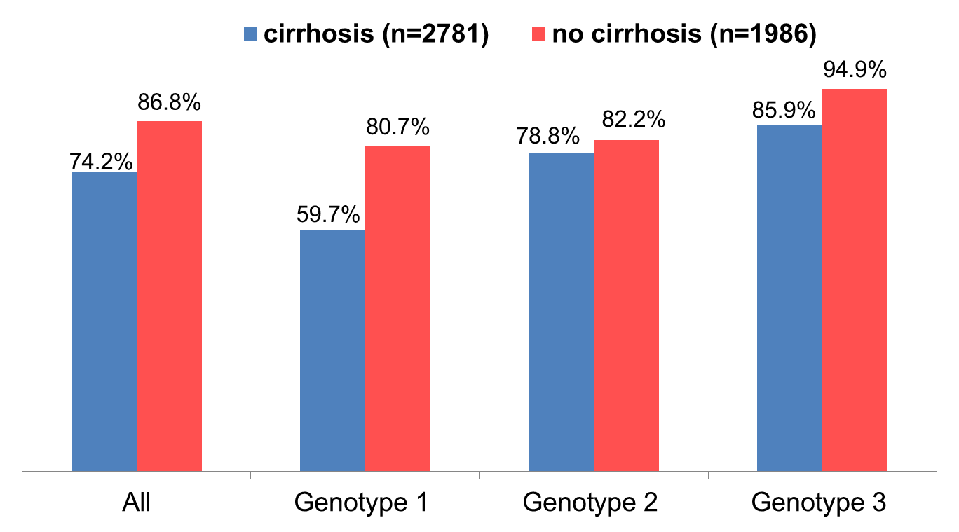
Treatment Outcomes of SOF-based Regimens by Cirrhosis Apr 28, 2015 – Dec 31, 2016
2065
2781
1724
1986
650
1089
545
675
427
542
420
511
988
1150
759
800
Total SVR: 79.5% 67.8% 80.4% 89.6%
Source: Georgia’s HCV Elimination Program Treatment Database

Slide 11
SVR in HCV G2 Patients by Regimen December 31, 2016 (n=1,053)
p<0.0001
230/241
273/353
296/391
Source: Georgia’s HCV Elimination Program Treatment Database

Slide 12
Impact of 2k/1b Recombinant on Treatment Outcomes (n=136)
2
2
14
14
3
4
13
13
16
18
22
39
19
24
22
22
97% 77% Total SVR
Karchava et al. Hepatol Res. 2017 Mar 4. doi: 10.1111/hepr.12890.

Slide 13
Treatment Outcomes of LDV/SOF-Based Treatment

Slide 14
Treatment Outcomes in Patients with Complete SVR Data Receiving Sofosbuvir/Ledipasvir Based Regimens
March, 2016 – December 31, 2016 (n=1592)
 | SVR Rate
 | G1 | G2 | G3 | G4 | TOTAL
12 weeks SOF/LDV | 98.5% (824/837) | 100% (8/8) | 100% (1/1) | − | 98.5% (833/846)
24 weeks SOF/LDV | 98.9% (88/89) | − | − | − | 98.9% (88/89)
12 weeks SOF/LDV/RBV | 95.3% (143/150) | 99.2% (248/250) | 97.5% (232/238) | 100% (4/4) | 97.7% (627/642)
24 weeks SOF/LDV/RBV | 100% (4/4) | − | 100% (11/11) | − | 100% (15/15)
TOTAL | 98.1% (1059/1080) | 99.2% (256/258) | 97.6% (244/250) | 100% (4/4) | 98.2% (1563/1592)
Source: Georgia’s HCV Elimination Program Treatment Database

Slide 15
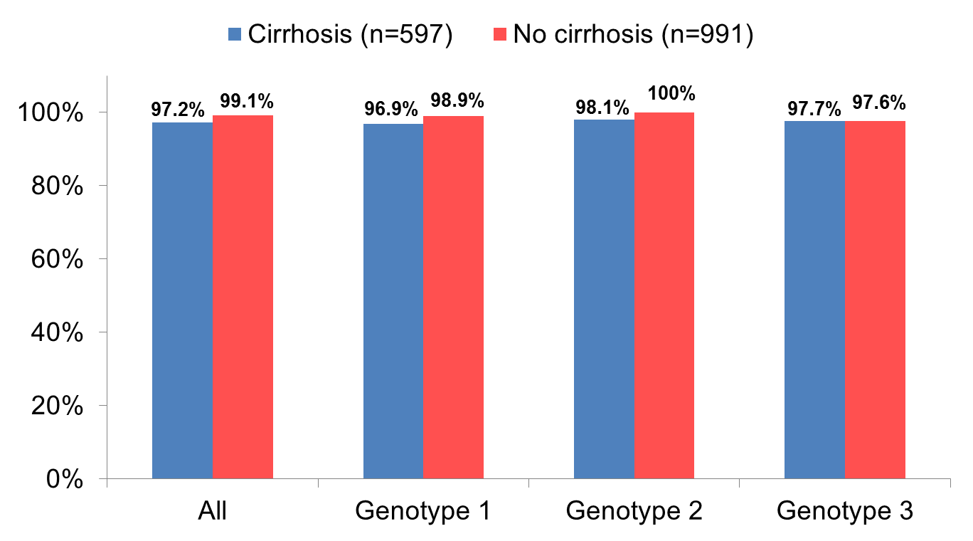
Treatment Outcomes of LDV/SOF-based Regimens by Cirrhosis
March, 2016 – December 31, 2016 (n=1588)
580
597
979
991
432
446
627
634
106
108
150
150
42
43
202
207
Total SVR 98.2% 98.1% 99.2% 97.6%
Source: Georgia’s HCV Elimination Program Treatment Database

Slide 16
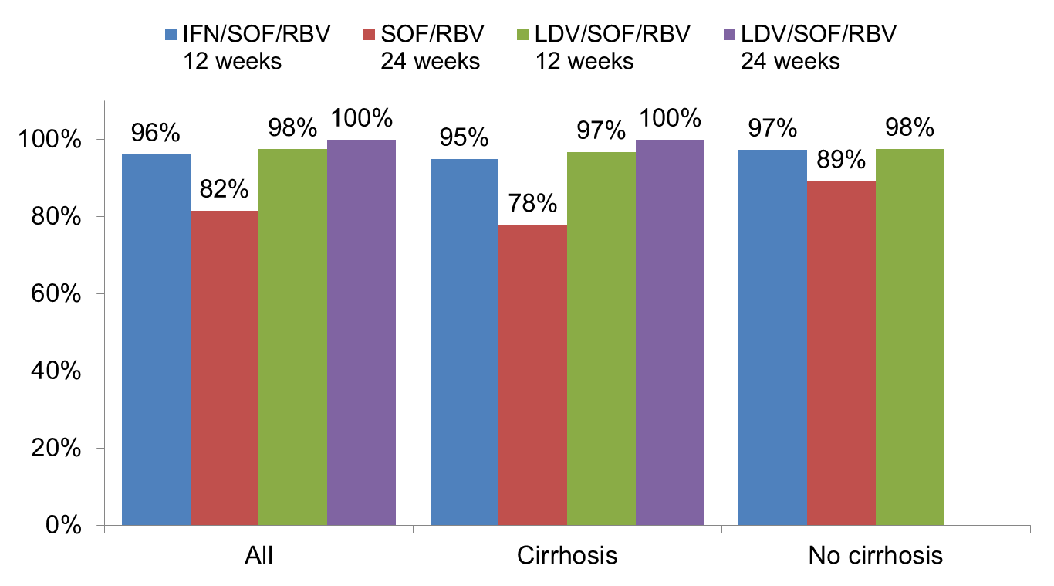
Comparing SOF and LDV/SOF Regimens in Genotype 3 Patients (n=2,102)
1099
1143
579
710
232
238
11
11
547
576
373
479
30
31
11
11
552
567
206
231
202
207
2
2
Source: Georgia’s HCV Elimination Program Treatment Database

Slide 17
Re-Treatment of patients with Ledipasvir/Sofosbuvir-based regimens who failed prior Sofosbuvir-based therapy
March, 2016 – December 31, 2016
808
Started re-treatment
23
307
478
Not completed
Ongoing
Completed
16
4
1
2
170
308
Death
Adverse
event
Self-
discontinuation
Other
SVR eligible
Not eligible for SVR
47
117
6
Source: Georgia’s HCV Elimination Program Treatment Database
Complete
SVR
No lab
12-24 wk
No lab
>24 wk
46
Achieved SVR (97.9%)

Slide 18
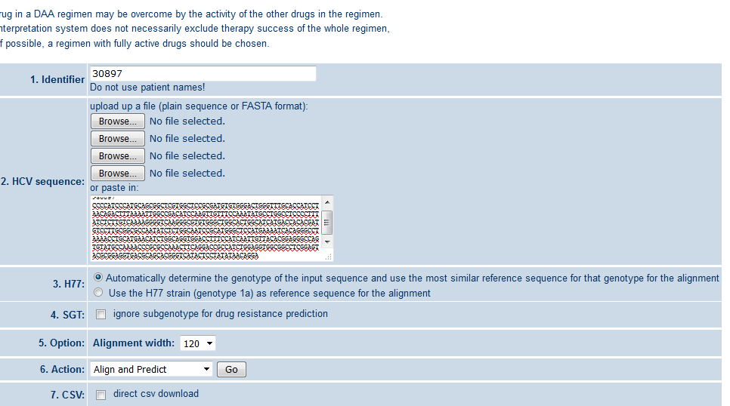
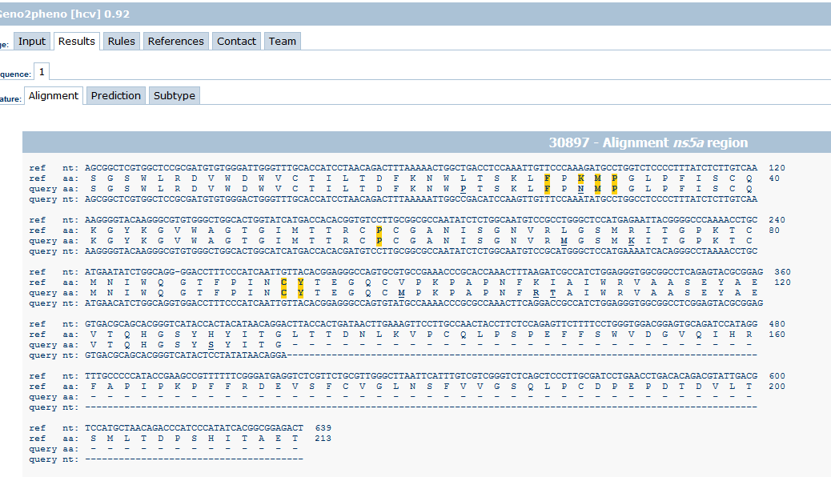
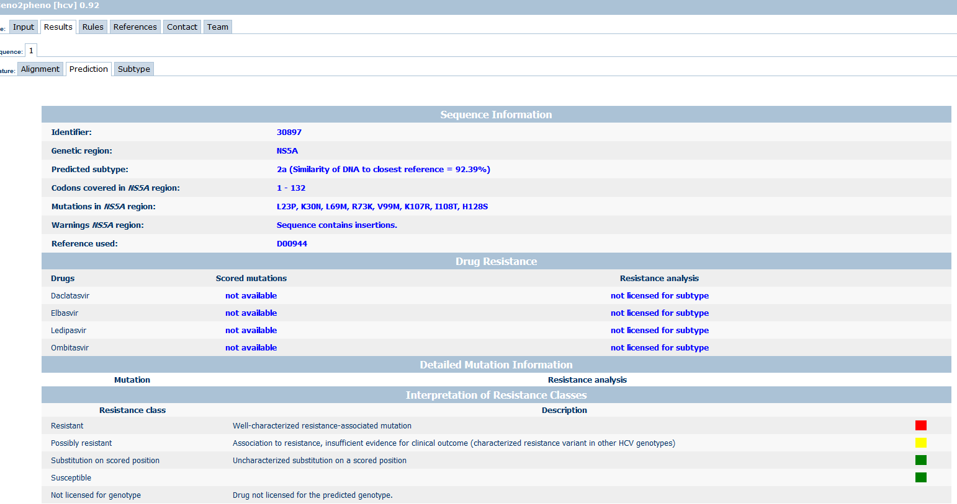
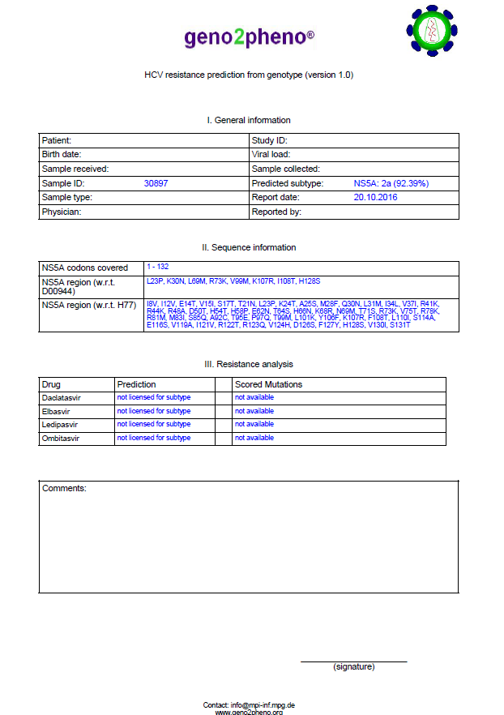
NS5A RAS Testing
Geno2pheno [HCV]

Slide 19
Overall NS5A resistance testing was performed among 27 patients failing on ledipasvir containing treatment regimens
G1b
11 patients
31M and/or 93H RAS
G2a
1 patient
no RAS detected
G3a
13 patient
30V RAS in 1 patient
2k/1b
2 patients
(31M RAS detected in
1 patient)

Slide 20
Elimination Goals
I
Cure 122,000 persons living chronic hepatitis C
II
Reduce prevalence of HCV infection by 90% (to 0.5%)

Slide 21






Acknowledgements
 | John Ward, Francisco Averhoff, Muazzam Nasrullah, Juliette Morgan, Lia Gvinjilia, Archil Kublashvili
 | John Martin, Greg Alton, Graeme Robertson
 | Nezam Afdhal, Stefan Zeuzem, Geoffrey Dusheiko
 | Sanjeev Arora, Karla Thornton
 | David Sergeenko, Valeri Kvaratskhelia, Multisectoral Commission on Hepatitis C
 | Amiran Gamkrelidze
 | All HCV Clinical Care Provider Clinics
 | Clinical Group and Scientific Committee of Elimination Program

