Slide 1
HEALTH SYSTEM ACHIEVEMENTS AND CHALLENGES GEORGIA
Ministry of Labor, Health and Social Affairs
November 2017
Notes:
Since 2013 the Government of Georgia has undertaken an important reforms to expand health care coverage to the entire population and improve health care services.

Slide 2
25 years: Collapse, Stabilization, Acceleration …
Civil war
Notes:
Georgia went through turbulent past 25 years that are characterized by collapse, stabilization, acceleration, crisis and rebound… During these 25 years the country went through two wars - civil war, conflicts in in Abkhazia and South Ossetia resulting in a large number of internally displaced persons, and in 2008 war between Georgia and Russia.
important landmarks: in 2012: Peaceful transfer of power (Georgia Dream Party), signing of the Association Agreement with the EU in 2014 and in 2017, visa free travel to the EU.
During these years Georgia’s health care system has undergone several reforms, in late 1990s moving strongly away from Semashko model and decentralization of the health care system, extensive privatization introduced by the reforms in 2007-2012 which were also characterized by deregulation and trust in market mechanisms. At that time most government spending on health was channeled through private health insurance. Following the extensive privatization, most providers are independent of government in terms of ownership and management.

Slide 3
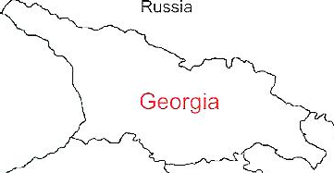
Demographic and Socio-Economic Situation, 2016
Population – 3 719 300
Birth rate (per thousand population) – 15.2
Mortality rate (per thousand population) – 13.7
Life expectancy at birth – 72.7
Maternal Mortality (per 100000 live birth) – 22.9
Infant mortality (per 1000 live birth) – 9.0
Under 5 mortality rate (per 1000 live birth) – 10.7
GDP per capita (at current prices), (2016) – 3852 $US
GDP real growth – 2.7%
Government expenditure on health per capita – 104 $US
Government expenditure on health as % of GDP – 2.8%
Government expenditure on health as % of State Budget – 8%
Government expenditure on health as % of GDP – 3%
General Government expenditure on health per capita (USD) – 102
Notes:
The population of Georgia has declined during the last 25 years, largely due to the outmigration and according to the census conducted in 2014, it is 3,7 mln.
Georgia has made a good progress in improving health outcomes. Life expectancy has increased by about 4 years over the few decades and currently is at 72.7 years.
Significant declines in under-five mortality and infant mortality
On-track for MCH-related MDGs

Slide 4
Economic Growth
3.5 %
Average GDP growth during 2014-2016, when most of Georgia’s neighbors were in or close to recession.
4.8 %
Average economic growth in 11 months of 2017
4.9 %
Average real GDP growth projection in 2018-2022, according to IMF
*growth - 11 months of 2017 (nominal GDP forecast - 2017)

Slide 5
Employment and Unemployment
2016
annual unemployment rate reached its lowest point in 13 years
2009-2016
Decreasing trend of unemployment rate

Slide 6




Foreign Direct investments
Top investor countries in 2017*
estimate
United Kingdom
175.0 mln USD
Turkey
259.2 mln USD
Azerbaijan
378.2 mln USD
In 9 months of 2017 FDI in Georgia amounted to 1,346.5 mln USD reaching record high
In the 3rd quarter of 2017 FDI increased by 17.6% and amounted to 594.5 mln USD
* 9 months of 2017

Slide 7


Poverty Indicators
In the recent period absolute poverty decreased and remains below the trend line
In 2016 Gini coefficient amounted to 0.4.

Slide 8





Sovereign Ratings
Reasons for upgrading sovereign rating
resilience to a significant economic, financial and exchange rate shock in the region in 2014-2016;
Stabile macroeconomic environment;
strength of institutions;
Economic Reforms.
Moody's Investors Service has upgraded Georgia’s sovereign rating to Ba2 from Ba3.
Ba2 Stable
უცხოური ვალუტა
სავალო ფასიანი ქაღალდების ჭერი გაიზარდა Ba1-დან Baa3-მდე;
უცხოური ვალუტის დეპოზიტების ჭერი Ba1-დან Ba3-მდე.
According to “Standard & Poor’s” and “Fitch”, Georgia maintains stable credit rating performance at “BB-” level.
₾
ეროვნული ვალუტა
BB- Stable
BB- Stable

Slide 9
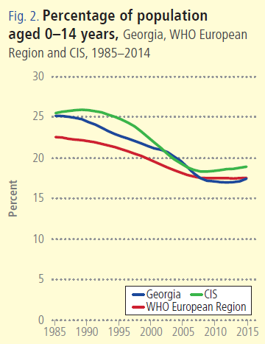
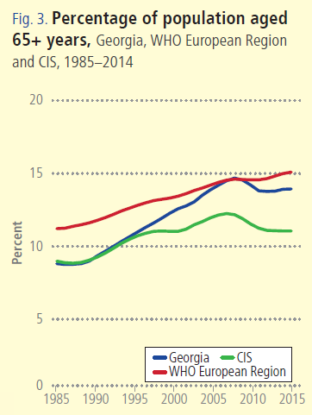
Notes:
Georgia, as many countries in the WHO European Region is facing a similar demographic challenges – ageing population and a declining birth rates.

Slide 10
Non-communicable diseases are the primary driver of overall disease burden
Cause of Burden of Disease (DALYs)
Injuries
Communicable
diseases
1990
2005
Non-communicable
diseases
2014
Notes:
If we look at the diseases burden, non-communicable diseases are the primary driver of overall diseases burden and it has been for a long time. The major causes of death in Georgia are related to non-communicable diseases, including cardiovascular diseases, cancer, diabetes and respiratory diseases, which together with injures make 94% of deaths.
The large share of premature deaths from NCDs are influenced by the health-related behaviors and risk-factors. STEPs survey results, population-based survey, which was conducted in Georgia second time to evaluate the trends in health related behaviors and risk-factors showed low physical activity, unhealthy diets, smoking and heavy alcohol consumption among the population.
An important breakthrough in this direction is an adoption of tobacco control law in May 2017, the law that is fully aligned with the WHO Framework Convention on Tobacco Control and is one of the strongest tobacco control laws in the European region. Large –scale antitobacco campaign and health promotion national programme with a strong tobacco control component will be implemented to strengthen tobacco control measures.
The primary concern of Georgia’s health system’s is the alleviation of the burden of NCDs and strengthening NCD control activities, including better management of chronic diseases at the primary health care level, improving health promotion and preventive measures is a priority.

Slide 11
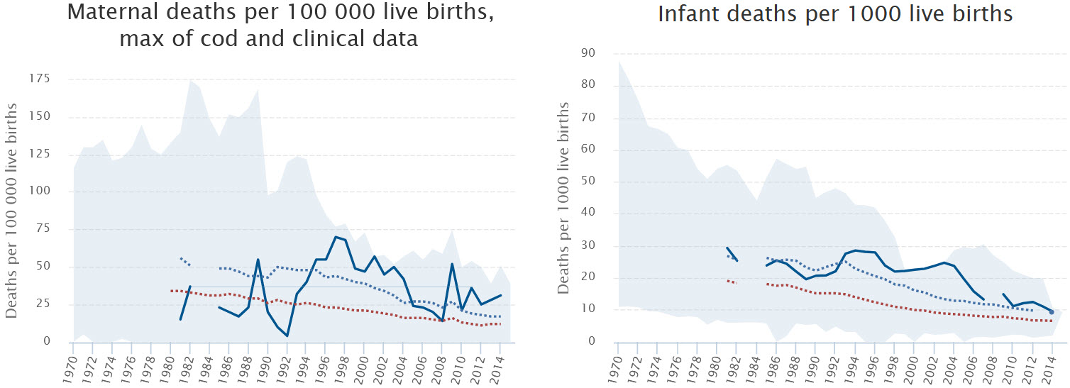
Notes:
The infant mortality rate and under five mortality rates have declined during the past several years, however, it is still higher than the Region’s average.
Maternal mortality has significantly fluctuated during the last decade. In 2016 we have seen a steep decline. Reproductive age mortality studies conducted to evaluate maternal mortality and completeness of the registration system revealed significant improvements in the deaths registration of women of reproductive age, determined at 98%.

Slide 12
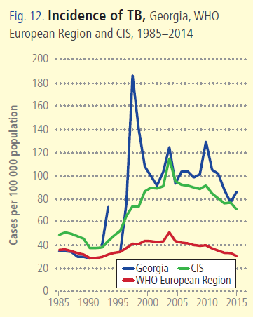
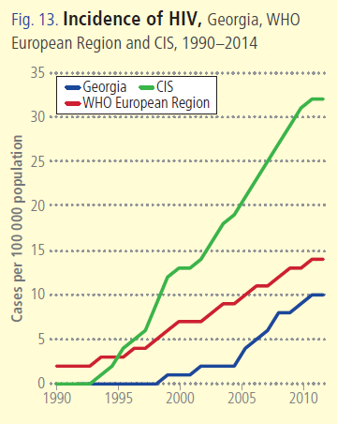

Notes:
There is a marked decreasing trend in notified TB cases over the past several years.
Tuberculosis remains a public health concern in Georgia, particularly, anti-TB drug resistance is a key challenge for the national TB programme.
The overall rate of newly diagnosed HIV infections in Georgia has increased over the last decade. The HIV epidemic is concentrated among key affected populations – MSM, people who inject drugs and female sexual workers.
We provide universal access to antiretroviral treatment. Since 2015 implemented Treat All strategy to all diagnosed people living with HIV despite their immune status.

Slide 13

Poverty Reduction and Shared Prosperity
Notes:
The main goal of the elected government in 2012 and re-elected in 2016, is the poverty reduction and socially oriented political platform. Political will to prioritize health for national development and fund the health sector accordingly was key for introduction of the universal health care program in 2012.
With introduction of the UHC program there has been a shift in how health care financed and services purchased in Georgia – Creation of a single pool (almost), single payer → purchasing agency to administer the UHC and vertical health programs.

Slide 14
Reforms have moved Georgia closer to universal health coverage
Better access to care
Better user experience
Better financial protection
Notes:
Although the health impact of the UHC program remained to be seen and will be apparent in the medium to long-term, very important achievements and results are already visible, specifically with respect to the financing scheme and greater equity in the health system. The notable aspects of UHC reform are:

Slide 15
Health sector expenditures
Source: Georgia NHA 2005 -2015 (MoLHSA, 2016)
Notes:
The UHC program was accompanied with a substantial increase in the governments budget allocations. From 2012 to 2016, the health budget more than doubled, as a percentage of GDP it increased from 1.7 percent to 3% in 2016.
The total level of health spending in Georgia at 8.5% of GDP is high compared with countries of similar level of income, however, despite recent increases, public health spending as a share of GDP remains lower than in many comparable countries in the European region.
Total Health expenditure (%) of GDP are relatively low in Georgia at 7.4% (2014). The WHO European Region average is at 8.2%. Average for CIS is at 6.6%.

Slide 16
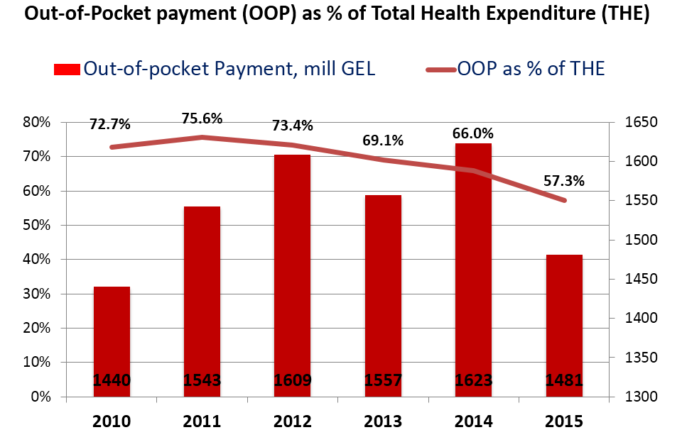
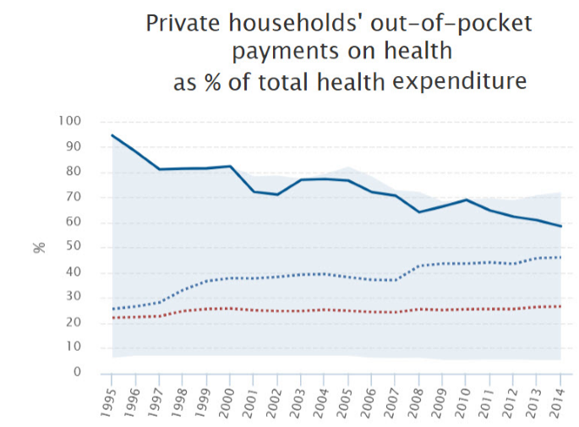
Out-of-pocket health expenditures
Source: Georgia NHA 2010-2015 (MoLHSA, 2016)
Notes:
Rising public spending on health resulted in reduction of out-of-pocket spending in the system. Out-of-pocket spending on health has declined after introducing universal health care in 2012, from 73% to 57% in 2015.
Despite the decrease, Georgia has still very high OOP expenditure as a share of total health spending – much higher than all comparator countries in the chart on the left. In the WHO European Region the average is at 26.6%. This is a challenge that will need to be addressed with putting mechanism that reduce reliance on OOP spending, and to reduce the risk of impoverishment and catastrophic health spending and improve access and affordability of care.
Behind high OOP spending on health is limited coverage of outpatient medicines, the main driver of OOPs and financial hardship for households Pharmaceutical expenditures are high, especially for people with chronic conditions / elderly.

Slide 17
Covering people: major increase population entitlement to publicly financed health services
Source: HUES 2007, 2010, 2014
Notes:
The coverage of population improved as demonstrated by the series of health care utilization and expenditures surveys. Over half of the population were covered first time.

Slide 18
Expanding benefits
I Phase - 28 February 2013 (minimum package)
- Planned ambulatory care
- Urgent outpatient and inpatient care
II Phase - July 1, 2013 (basic package)
- Planned ambulatory care
- Urgent outpatient services
- Urgent inpatient and critical are
- Elective surgical care
- Chemo-, hormone- and radiotherapy
- Maternity services
- Basic drugs for target groups
III Phase - May 1, 2017 - Service stratification according to revenue groups using “social justice approach”
- Outpatient drugs benefit for chronic conditions
Notes:
Under the UHC program, patients have almost unlimited choice of provider. In terms of the package of benefits, benefits have been gradually increasing.
From May 2017, the highest earners are excluded from the UHC programme and expected to purchase health insurance. This reduction in coverage is counterbalanced by an expansion in the benefits package for those living below the poverty line to cover the essential outpatient pharmaceuticals for four chronic conditions.

Slide 19
Number of ambulatory care visits per capita
Patterns of health care use:
health service utilization has been steadily increasing
Notes:
We have seen a surge in utilization of the health care services. Utilization of outpatient and inpatient care has almost doubled since the introduction of the UHC program.

Slide 20

Better user experience
80.3% beneficiaries satisfied with the outpatient service and 96.4% expressed satisfaction with hospital level emergency care
Over 77% of the population notes increased financial access to outpatient and inpatient services
Notes:
Overall satisfaction with the health system has increased and grown with the introduction of the UHC program, showed by the survey data.

Slide 21
2020 Targets: 90-95-95
Hepatitis C Elimination Program in Georgia
Results to date:
90% of people living with HCV are diagnosed
95% of those diagnosed are treated
95% of those treated are cured
Sofosbuvir-based regimens
SVR achieved: 82%
Harvoni-based regimens
SVR achieved: 98.2%
Notes:
Goal: Elimination of HCV by ensuring prevention, diagnosis and treatment of the disease
2015 National survey conducted by NCDC and CDC revealed that ~150 thousand people are infected with active HCV infection and need to be treated. The most prevalent genotype nationwide is genotype 1 (appx. 40%) followed by genotype 3 and 2.

Slide 22

Maternal and Child Health
Georgia Maternal & Newborn and Reproductive Health Strategy 2017-2030 and Action Plan 2017-2019
Regionalization of maternal and newborn health services
Congenital syphilis and mother-to-child transmission (MTCT) of HIV elimination plan
Universal newborn hearing screening program
Essential Nutrition Action Plan - folic acid and iron supplements for all pregnant women, breastfeeding promotion, multiple micronutrient supplementation for 6-23 months children
Notes:
Regionalization of maternal and newborn health services – right patient, right place, right time equal access to high-quality of care for every mother and newborn along with other new programs such as, universal newborn hearing screening, EMTCT of HIV/Syphils, Essential Nutrition Action Plan, etc are the major initiatives and programs implemented in MCH area since 2015.
The first comprehensive Maternal and Newborn and RH Strategy and Action Plan was developed and approved by the Cabinet in March 2017.

Slide 23

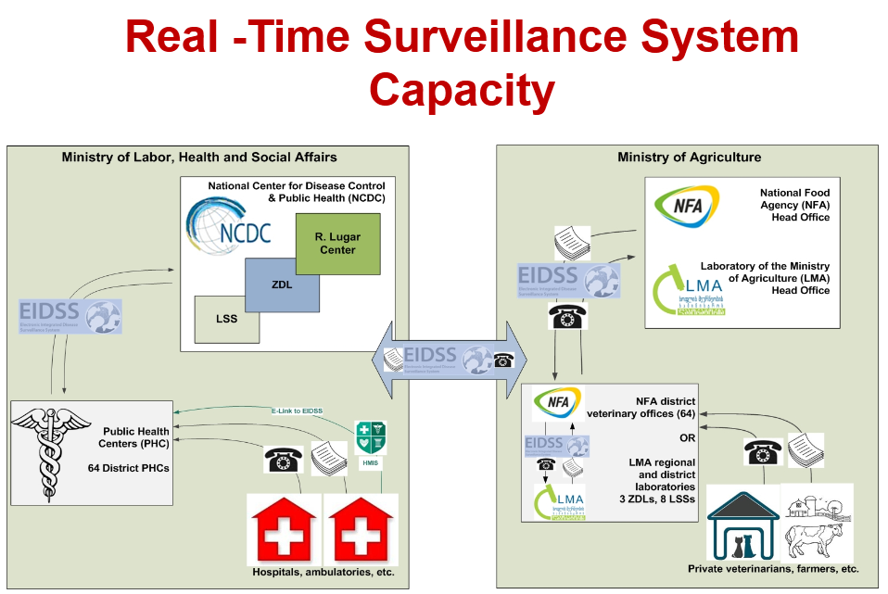
Global Health Security Agenda
Georgia, together with other countries is actively involved in support of the 11 Action Package objectives:
Real-Time Surveillance - as a leading country
National Laboratory System – as the contributing country
Zoonotic Diseases – as the contributing country
Notes:
23

Slide 24
Health management Information system
▪ Electronic system and regulatory mechanisms for vital events registration (since 2011)
▪ Electronic case-based reporting systems for in- and outpatients in health-care institutions (since 2014)
▪ Population-based cancer registry (since 2015)
▪ Birth registry - new electronic registration for antenatal and obstetric services and the surveillance of maternal and child health (since 2016)
▪ E-prescription (2017)
▪ Electronic health records (2017)

Slide 25
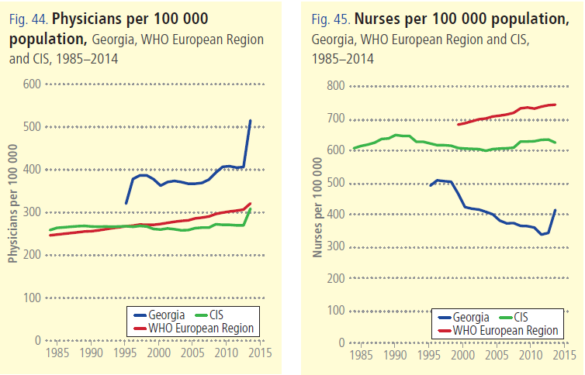

Slide 26
Human Resources
▪ HRH regulation and accreditation
- Medical specialties and sub-specialties aligned with EU
- Medical residency programs updated/prepared in 56
medical specialties
▪ Certification exam system revised
- New instrument for accreditation of continuous medical education
program developed
▪ Labor market analyses initiated
▪ Medical residency programs in several specialties funded by the
government
Notes:
The main goal is to transform professional, technical and vocational education and training and to optimize the performance, quality and impact of HRH through evidence-informed policies, contributing to healthy lives and well-being, effective universal health coverage, and resilient and strengthened health systems at all levels.
Initiated analysis of the labour market in order to develop appropriate policies and strategies; however, developing tools and plans that quantify health workforce needs, demand and supply for projected future scenarios will be needed to address HR needs and planning.
strengthening HRH information systems and other mechanisms for the effective collection, reporting and analysis of reliable HRH data, such as national health workforce registries and national health workforce accounts

Slide 27
Challenges ...
▪ Still very low public spending on health
▪ Still very high out-of-pocket payments
▪ Expenses on outpatient medications are high
▪ Service delivery model is biased towards
hospital/emergency services, and less primary care
centered
▪ Purchasing strategies are low effective at ensuring quality
and containing costs
Notes:
High OOP Payments are a Risk Factor for Impoverishment
Population ageing + weak management of NCDs + inefficient service delivery structure ➔ are the mix of cost drivers
40% of total health spending on pharmaceuticals and most of this is paid for out-of-pocket
We are not just looking at finding additional resources but also trying to understand constraints, and employ efficiency savings: get better value for money from existing resources.
SSA is a single purchaser and needs to fully exploit its purchasing power. Need to move away from passive purchasing: selective contracting, performance monitoring, make better use of information and health information systems broadly
Extend coverage of cost-effective outpatient medicines for better health, wealth and value

Slide 28
Under-5 mortality rate per 1000 live births

Slide 29
Infant mortality rate per 1000 live births

Slide 30
Maternal mortality ratio per 100 000 live births

Slide 31
Health Expenditures, Georgia
MoLHSA/NHA
WHO-EURO/HFA

Slide 32
Structure of Total Spending on Healthcare
MoLHSA/NHA

Slide 33
Out-of-Pocket payment (OOP) as % of Total Health Expenditure (THE)
MoLHSA/NHA

Slide 34
Health Priority Directions for 2014-2020
Health in all policies – general state multi-sectoral approach
Development of the healthcare sector governance
Improvement of healthcare financing system
Development of quality medical services
Development of human resources in the healthcare sector
Development of health management information systems
Support of maternal and child health
Improvement of prevention and management of priority communicable diseases
Improvement of prevention and control of priority non-communicable diseases
Development of public health system

Slide 35

Universal Health Care – Socially Oriented Political Platform
Unprecedented Expansion of State Budget for Health care
365 mill GEL in 2012 → 1090 Mill Gel in 2016
Launch of Universal Health Care Program in February 2013:
All Population are covered by health care:
539 000 – Private/corporate insurance
Other population - UHC

Slide 36
Coverage of Healthcare services
Services utilization
Hospitalization per 100 population
UHC Program has led to a major expansion in population entitlement to publicly financed health services (HUES)
Ambulatory care visits per person per years

Slide 37
“Vertical” State Health Programs
Public health Programs
Early Detection and screening of Diseases
Immunization
Epidsurveillance
Blood safety
Prevention of occupational diseases
Management Infectious diseases
Management of TB
Management of HIV
Management of Hep C
Treatment of drug abuse
Maternal and Child health
Health promotion
Health Services in priorities areas
Mental Health
Management of Diabetes
Child onco-hematology
Dialysis and kidney transplantation
Palliative care of incurable patients
Treatment of rare diseases
Ambulance and emergency care
Rural doctors
Medical screening for army recruits
Referral (individual care)

Slide 38
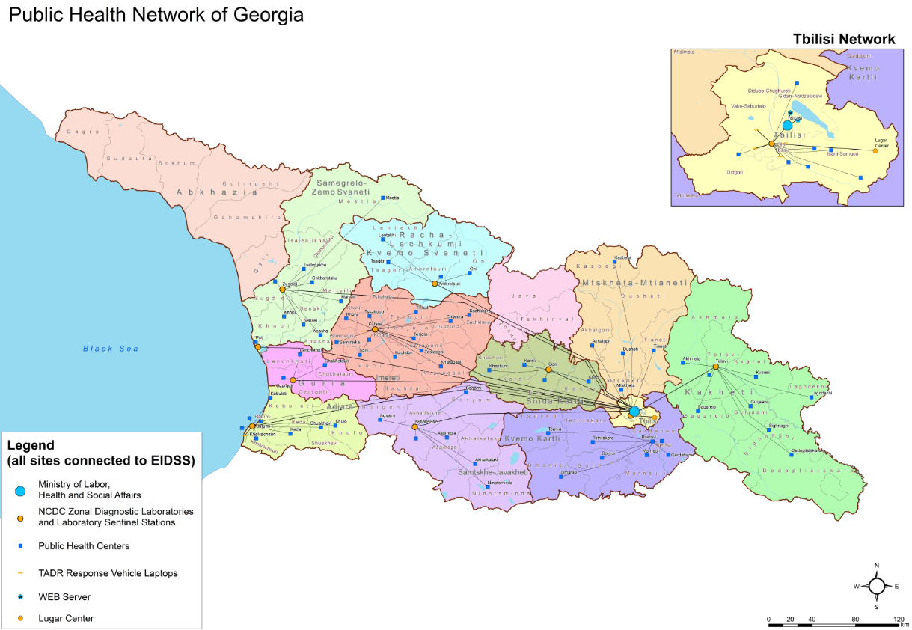
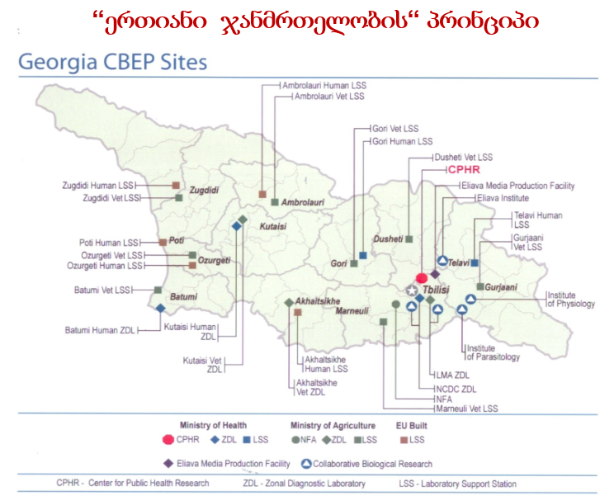
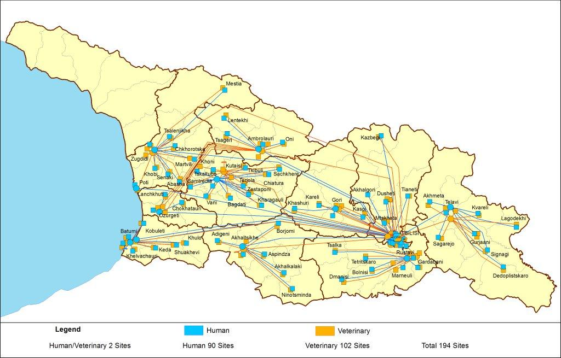
Unified Laboratory Network
Public Health Network
One Health
Electronic Integrated Disease Surveillance System (EIDSS)
72 notifiable diseases
200 entry points
61 territorial units
1020 personnel
Notes:
38

Slide 39
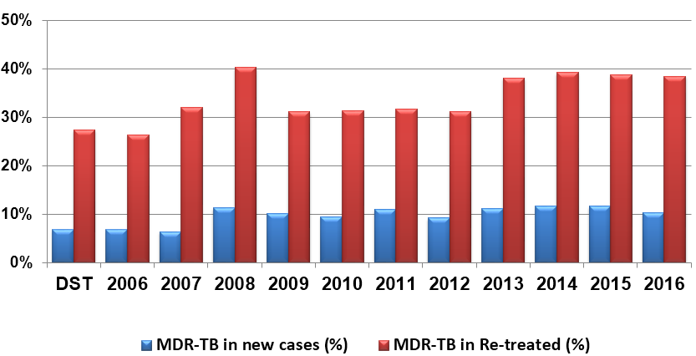
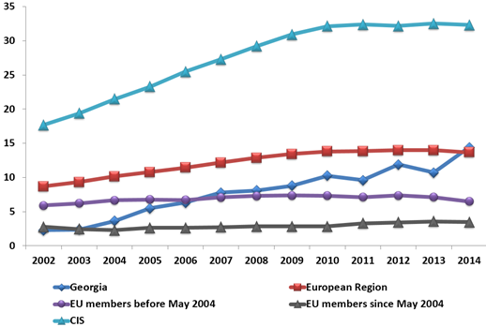
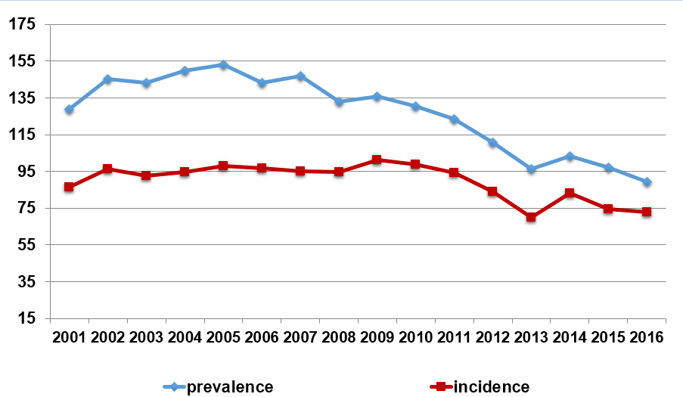
Tuberculosis
Tuberculosis morbidity rates per 100 000 population
Multidrug resistant tuberculosis

Slide 40
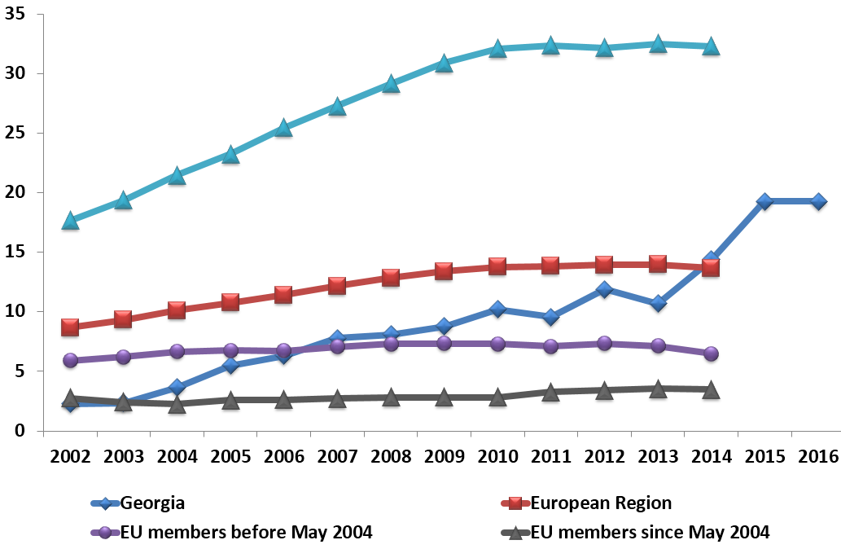
HIV/AIDS
2008 - National HIV/AIDS Surveillance Plan for Georgia was elaborated
2010 - Guidelines for HIV/AIDS surveillance were developed
2015 - 717 new cases of HIV (incidence per 100,000 population – 19.3) and 94 deaths attributed to AIDS
Universal access to retroviral treatment in Georgia
HIV incidence per 100000 population

Slide 41
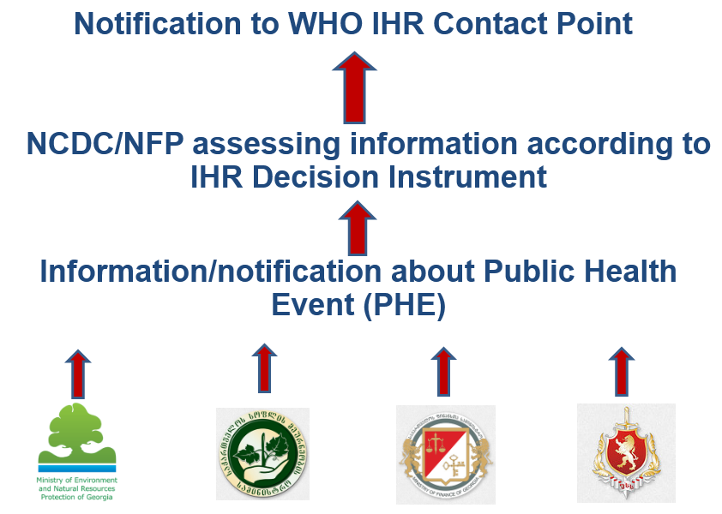
International Health Regulations
National Center for Disease Control and Public Health (NCDC) was designated as the IHR Focal Point
NFP is accessible at all times for communications with the WHO IHR Contact Points and with national surveillance and response system
24/7 Duty Officer System is at place
Communication list with contact details of all relevant institutions, organizations and persons on national, regional and local levels is prepared and updated regularly
Notes:
41

Slide 42
Global Health Security Agenda
Georgia, together with other countries is actively involved in support of the 11 Action Package objectives:
Real-Time Surveillance - as a leading country
National Laboratory System – as the contributing country
Zoonotic Diseases – as the contributing country
On September 26, 2014 it was held the Global Health Security Summit in the White House, Washington DC under the US Political Leadership. On the Summit Georgia was nominated as one of the exemplary international partners
Election as the GHSA Assessment Alliance Advisory Group member
2015 - Conceptual Frame for Emergency Operation Center
Notes:
42

Slide 43
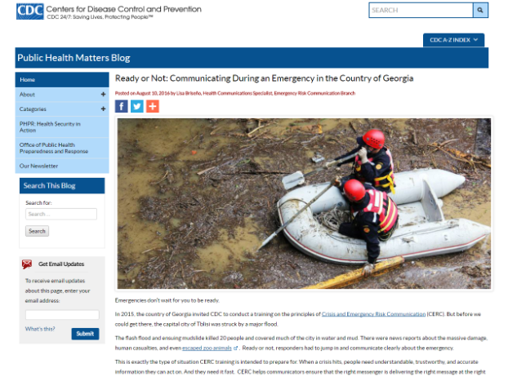
Public Health Preparedness and Response
Taking part in GHSA ministerial, which also included chairmanship of bilateral meeting on Real-time Surveillance Action Package
Developing the Five-year action plan
(Roadmap) with CDC
Taking part in GHSA Next Generation mentorship program
The meeting of Global Outbreak Alert and
Response Network (GOARN)
The revision of Epidemics, Pandemics and Biological Incidents Response Plan
Multisectoral risk communication training with experts from CDC
Developing Influenza Response Plan (short version)

