Slide 1
Use, harms and health responses to NPS in Europe: findings from a multi-method study
Danilo Ballotta, Alessandro Pirona
2016 Pompidou Group Symposium in NPS – Venice 15 November 2016
Notes:
More and more the Pompidou Group has developed in the last years the capacity to act timely and flexibly in those emerging topics that needs to have a spot light into it (that need to be addressed). So I congratulate the PG to have allocated in this symposium a session to demand and harms.
Health responses to NPS is one of those areas where information and research are small and limited. more are needed in this area. We hope that the European Commission and national agencies may dedicate funding to understand more the phenomenon under our eyes.
To day I will present our small contribution, our first (again small) analysis of the health responses to NPS, hoping to promote more research in the area.

Slide 2
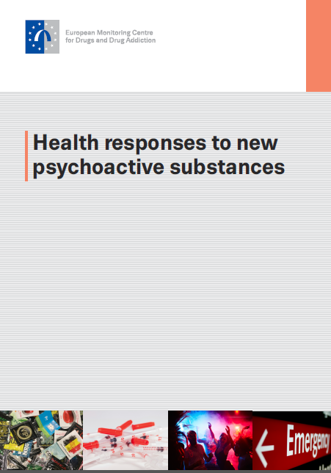
Study
Who is at risk?
In which settings?
How health services can respond?
Notes:
We looked into the literature available and we gathered experts working in health settings dealing also with NPS

Slide 3
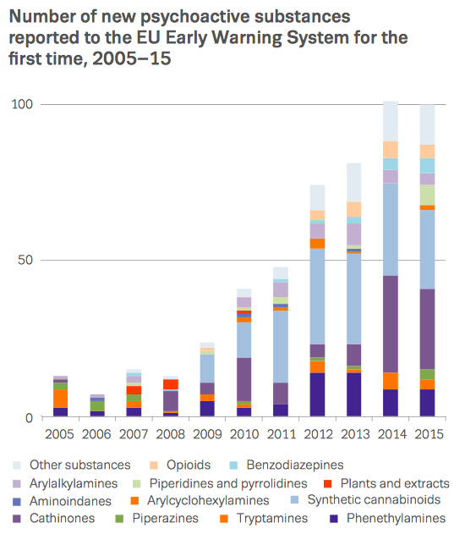
UNPRECENDENT RISE
Notes:
Over the last decade, there has been an unprecedented rise in the number of new drugs appearing on the global market. In Europe, around two new psychoactive substances (NPS) are detected every week, posing a major challenge to drug policy and practice. And the EWS monitors now about 600 new NPS – the UN conventions control 250.
Initial responses to new drugs in Europe have largely been regulatory, focusing on legislative tools to tackle supply.
But as the phenomenon evolves, it is critical that we formulate and implement effective public health responses to the
use of these substances.

Slide 4
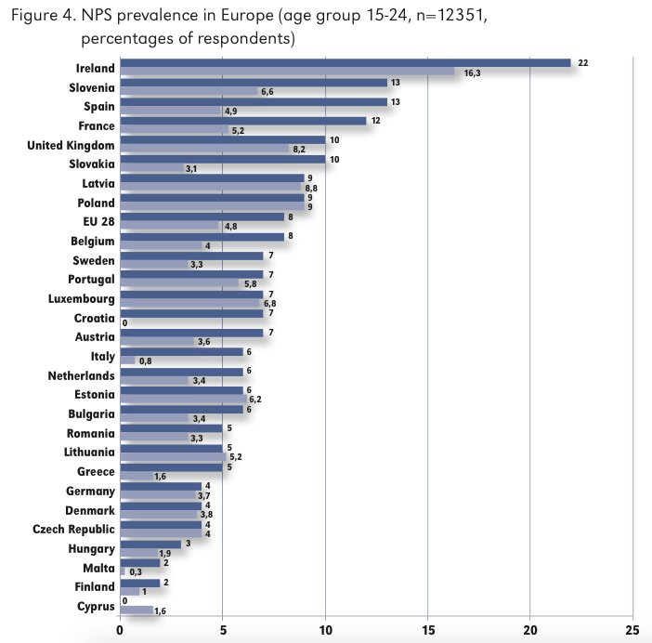
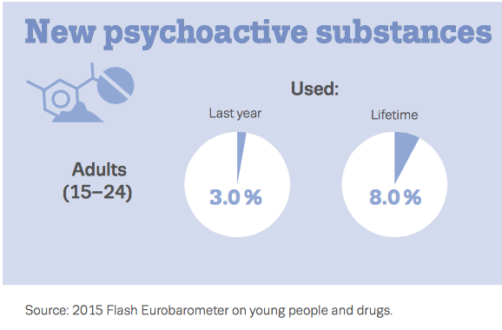

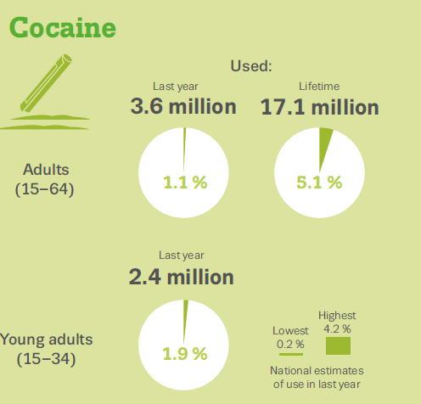
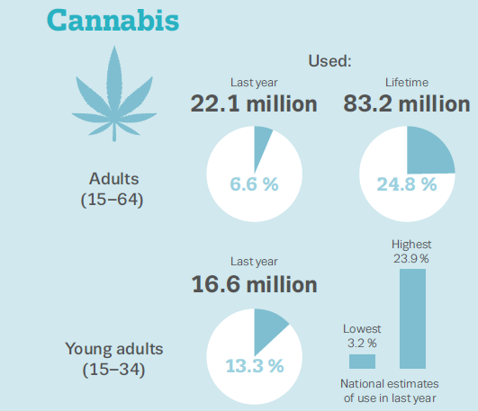
Notes:
NPS use in Europe remains relatively low. NPS prevalence
age group 15-24 N=12351 % of respondents
Introduce Comparison
But there are growing concerns over problematic forms of use and harms related to these drugs.
The study reviews, for the first time, health- and drug-related responses to these drugs now emerging in Europe.

Slide 5
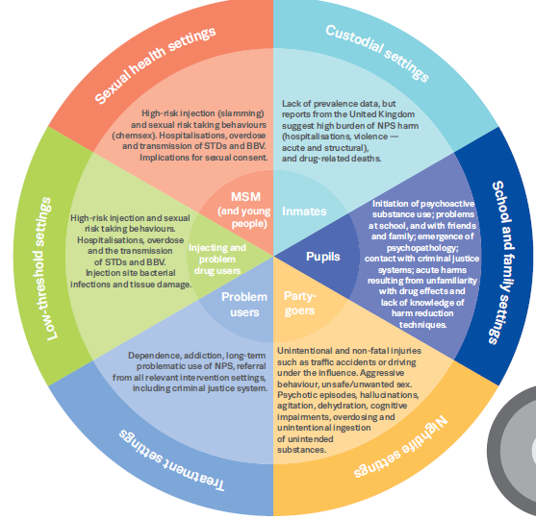
NPS who’s at risk and where?
Notes:
The study identifies key groups considered to be at particular risk of NPS use and harms.
These include, but are not limited to:
participants in nightlife events;
men who have sex with men (MSM);
individuals in custodial facilities;
and people who inject drugs (PWID).
young people;

Slide 6

1 Nightlife
Party goers
(GDS – 26000
young people)
General population
< Traditional drugs
Polydrug pattern (Moore et al., 2013)
Educational information,
outreach, drug testing
Notes:
Usually young people participating in nightlife settings such as bars, pubs, nightclubs, discotheques and music festivals and events high rates and frequency of drug use compared to the general population
use of NPS in nightlife settings is relatively low compared to traditional club drugs.
Health responses and interventions aimed at the use of established drugs and alcohol in nightlife settings are relevant and may be adapted to respond to NPS use and related harms

Slide 7

2 Men Sex Men (MSM)
Increasing evidence of MSM using synthetic cathinones
NPS in chemsex and
slamming practices
among MSM
high-risk sexual behaviours
sexually transmitted infections
Sharing of needles
Barriers in accessing health services
Grinder - CHEMSEX
Notes:
Increasing evidence is becoming available on how men who have sex with men (MSM) are using synthetic cathinones, such as mephedrone, alongside traditional stimulants, for sexual purposes (Bourne et al, 2014). This is often referred to as ‘chemsex’.
‘Chemsex’ is defined as sex between men that occurs under the influence of drugs taken immediately preceding and/or during the sexual session and is associated with high-risk sexual behaviours and sexually transmitted infections (Bourne et al., 2014). A survey of HIV-positive patients attending 30 HIV clinics in England and Wales, found that nearly a third (29 %) of MSM patients reported engaging in ‘chemsex’ in the past year and that one in ten reported ‘slamming’
Studies also report injection of cathinones (and other stimulants) among MSM during sexual practices known as ‘slamming’, with a high risk of infections of both HIV and Hepatitis C linked to sharing of injecting material.
There exist several barriers to MSM with drug problems accessing services. These include stigma, a lack of cultural competence among traditional drug service providers, MSM not self-identifying their drug use as problematic, a lack of awareness of available drug services among MSM, and a lack of specific services for the use of chemsex drugs. A preference for MSM to engage with sexual health services and a need for combined sexual health and drug interventions, has led some countries to focus on the development of joint drug and sexual health services targeted at this population.

Slide 8
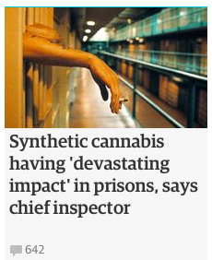
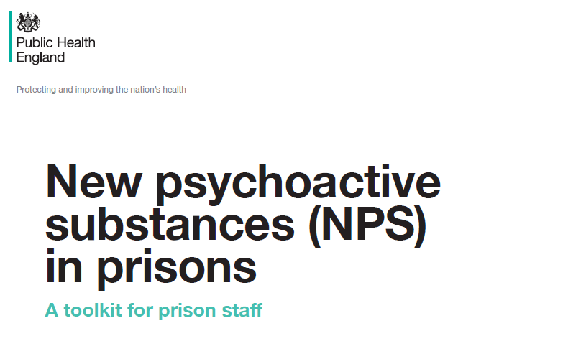
3 Prison
NPS in custodial settings (aggressiveness, agitation, violence)
Notes:
A recent survey in English prisons found that synthetic cannabinoids were reported by 10 % of surveyed inmates and as the second most commonly used drug while in prison, after herbal cannabis (13 %). The use of synthetic cannabinoids in prisons is reported to be associated with increasing medical emergencies, deaths, bullying, violence and debt (HM Inspectorate of Prisons, 2015a and b).
For NPS users who may also be consuming opioids and injecting NPS, existing evidence supports the prescription of opioid substitution treatment to reduce mortality and risky drug injecting behaviours in prison. Moreover, psychosocial treatment has been found to be effective in reducing reincarceration. However, due to an overall lack of research and information available on how to respond to NPS in custodial settings, it remains unclear as to whether such responses help prevent risky practices associated with NPS use in this setting.
Partnerships between prison health services and providers in the community may prove particularly important in supporting the delivery of health education and treatment interventions for NPS use and harms in prisons and in ensuring continuity of care upon prison entry and release.
A toolkit for prison staff on the management of NPS-related health problems has been developed in the UK.

Slide 9

4 INJECTORS
Changes in injecting practices
Greece, Romania, Ireland,
Wales, Slovenia, Hungary
HU >60% of Low Threshold Agencies visitors inject syn. Cathinones (Peterfi et al., 2014)
High frequency inject., more needle more needle sharing, groin injection (mortality artery shooting)
Localised HIV & HCV outbreaks (e.g. Hungary, Wales)

Slide 10

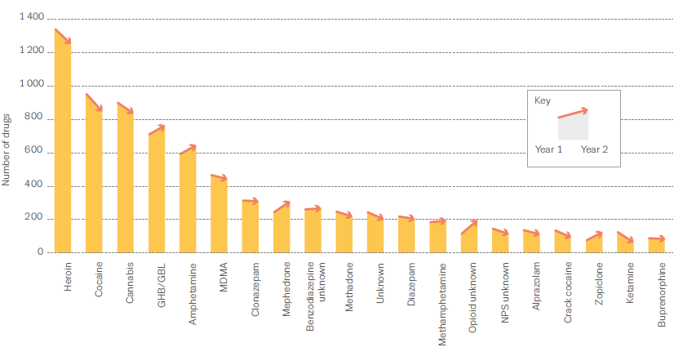
Hospitals and Emergency Services
Agitation Aggression
Anxiety Palpitations
Hallucinations
Symptomatic Management
Notes:
EURO-DEN study (Dines et al., 2015)
During 12 months the research team have analysed acute drugs intoxication in 16 hospitals of 10 countries.
Among the 5529 Acute drug toxicities NPS: were the 5.6% (mostly mephedrone)
Main symptoms…, and here enters the Diagnosis dilemma. People having used NPS are cured through their syntoms
Syntomatic management, beacuse the unknown composition of the chemicals assumed and their effects.
Add a brief on release – this should be done but RARE

Slide 11
Treatment services
Demand for specialist treatment (NPS) remains low (<2%) of 450.000 –
UK–PL (10-30%) (synthetic cathinones)
NL-UK GBL-GHB
UK-FR-ES-IT Ketamine
Notes:
Demand for specialist treatment related to NPS problems in Europe remains limited, below 2% potentially reflecting overall low prevalence levels.
However, increases in demands for specialist treatment related to problem use of synthetic cathinones are reported from France, Ireland, Poland, Romania and the United Kingdom
There are currently no maintenance or substitute pharmacotherapies available for people with problematic NPS use, and with the exception of GHB/GBL, few recommendations for specific pharmacological management of withdrawal have been developed.
Mephedrone top three drugs
Most countries no collaboartion between health treatment and sexuals helath clinics
Localised in urban area london amsterdam

Slide 12
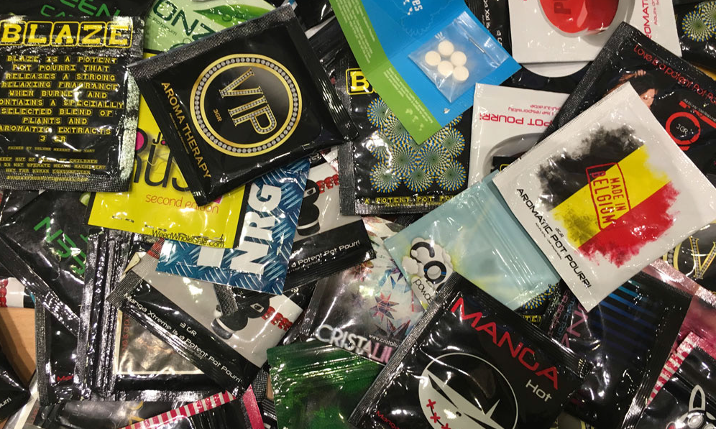
2
How health responses can address the phenomenon of NPS?
New services or old ones?

Slide 13

ADAPTATION
DIVERSIFICATION
QUALITY
Notes:
Adaptation is here the keyword recommended in our study. There is no need to reinvent the wheel, We do need to reinvent, we need to adapt. This is sees in our study as a more affordable and effective way to deal with the phenomenon. In many cases Existing services can be adequate, to adapt to NPS treatment and harm reduction
However there is a need to adapt taking into account 2 crucial factors: Diversification and Quality

Slide 14
ADAPTATION
DIVERSIFICATION
Adaptation to new population and settings (MSM, Inmates, PDU’s, Partygoers)
New collaborations among services needed (night industry, sex clinics, prisons)
Culturally changes and geographical challenges
Risk groups ‘off the radar’ (MSM, Prisons, Rural)
Notes:
DIVERSIFICATION
Services must adapt diversifying according to target population and settings
Opiate services needs to adapt to the culture aspect of the users: young party goers; MSM adaptation to culture population, prisoners.
Collaboration is needed between services health services, prisons, night industry and sex clinics. Collaboration that often need to be started from scratch on the issue of NPS
Limited availability of culturally competent services or even generic services
Generic services – to cover diffuse geographica problems – whit NPS internet consumo anche in parti riurali
Risk groups ‘off the radar’ monitoring- political
SMS
Prison
Rural
NPS brought to light these population even to us monitoring agencies, so we need to be more attentive

Slide 15
ADAPTATION
QUALITY
Transfers of evidence based knowledge
Dismiss bad practice (or ineffective)
Building skills – training
Robust evaluative framework
Notes:
We need to adapt and innovate on the base of the existing services and experience, however in this transition this work recommend to transfer only those interventions of proven effectiveness.
So it is hinted that services need to have the courage to dismiss what does not work. There is the need to prevent transferring ineffective practice
The approaches recommended in the study are therefore largely based on existing responses (e.g. counselling, needle- and syringe-exchange
programmes) but adapted to reflect: unique user group needs; the structural, cultural and social contexts of use and new opportunities for engaging recreational NPS user groups.
It adds: ‘Professionals’ lack of experience with NPS and lack of knowledge of their pharmacology does not mean that they do not have the skills to support the users of these drugs. A professionally competent workforce is likely to already possess the skills required to support health responses to NPS use.’
Finally, adapting existing interventions to respond to NPS ‘must proceed with caution and within a robust evaluative framework’.

Slide 16
HEALTH RESPONCES NPS – NEEDS
Risk information
(NEWS NPS risks platform)
Competence building
(training for professionals – tailor-made treatment – guideline and standards)
Substance identification
(drug checking – consumer protection)
Notes:
Risk information
Dissemination risk information for National EWS on the harms substance, alert systems
to professionals in treatment, professionals, health sex clinic, in prisons in all setting, low threshold – platform a network of sharing of relevant and adequet info also in the format
Competence building
Training for professionals, fear factor is blocking not properly addressed EK47,
The nature and intensity of the treatment offered should be related to the severity of the NPS problem with an assessment of the client’s health and other consequences of use. Some clients presenting to treatment services may benefit from low intensity brief interventions based on general or tailored advice and even those showing NPS-related harm may benefit most from self-help approaches rather than referral to a structured intervention. Where problematic or high risk NPS use has been identified, individual/ group-based behavioural and psychosocial approaches (e.g. cognitive behavioural therapy, motivational interviewing, community reinforcement, and contingency management) or formal psychological therapies, delivered as part of a staged or stepped care approach, may be effective.
It is also important that treatment provider competencies include the skills needed to screen, assess, and treat NPS problems; the provision of support to develop expertise on NPS (e.g. training on broad classes of drugs, effects, and harms); the development of ‘cultural competencies’ to work with a wide range of client groups; the identification of clear pathways to more specialised support for complex cases; and the establishment of networks to share evidence, develop guidelines, and facilitate professional development.
Clinical guidelines for professionals are also cited as important resources.
The NEPTUNE project is one example of European guidance material on NPS (6). http://neptune-clinical-guidance.co.uk
Substance identification
Drug testing – faster more reliable link to consumer protection
Among the health responses highlighted in the report are consumer-protection initiatives, such as drug checking and harm-reduction interventions, which provide opportunities to reduce and prevent severe health consequences.

Slide 17
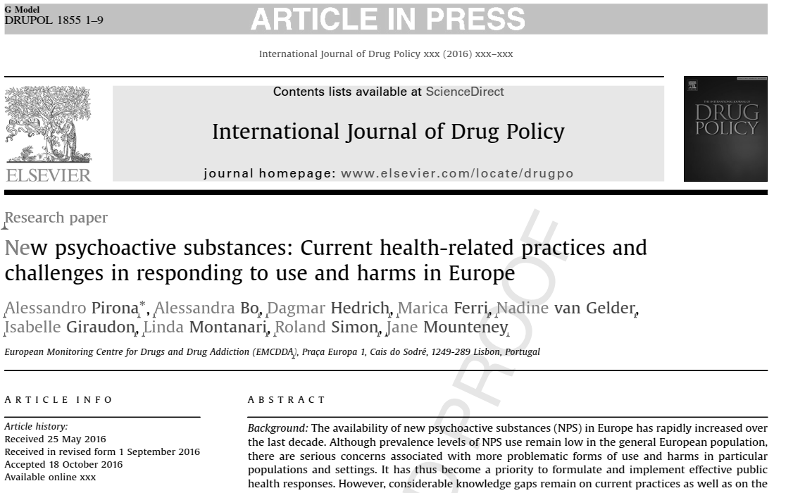
NEW publication today
NPS legislation and prosecution

