Slide 1
Tackling the challenge of NPS in Israel
Presented by: Mrs. Eti Kahana (Adv.) Head of Law Enforcement and Legislation Division, IADA
November, 2016

Slide 2
timeline
2010 Derivatives Law 1
Generic approach
Amphetamine,Methamphe-tamine, Cathinone, Methcathinone
2011
August 2013
2 Amino- indane
May 2013 Derivatives Law 2
Synthetic cannabinoids
NPS legislation (temporary for 3 yrs.)
August 2016
NPS legislation
(permanent)
2010
Specific law

Slide 3

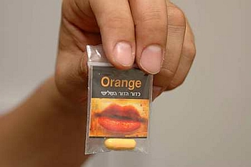
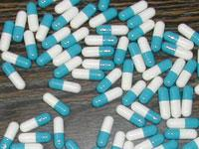
First step – generic approach “derivatives law 1”
Until 2010, the Israeli Dangerous Drugs Ordinance was a Specific Law – referred only to substances specifically listed in the Ordinance.
Amendment in 2010 to the Dangerous Drugs Ordinance – The first time to use a generic approach for derivatives of 4 groups:
amphetamines, methamphetamines, cathinones, methcathinones.
"Structural derivative": A substance in which there is a transformation (by substitution or replacement) or subtraction of one or more chemical groups on/from a chemical structure of a given substance.

Slide 4
First step – generic approach “derivatives law 1”
2011: 2-amino-indane was included
Dangerous substances from the above groups were automatically controlled by virtue of their being structural derivatives of controlled substances.
Led to a large decrease in the availability of these substances in the market.

Slide 5
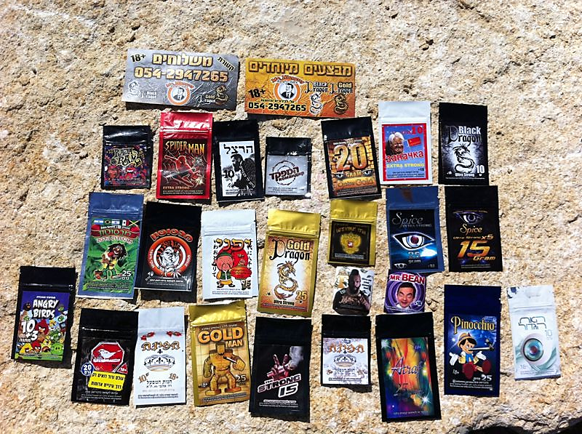
Synthetic Cannabinoids
Sold in Israel under different nicknames such as: "Mabsuton", "Mr. Nice Guy", "Spice", "Sabbaba“, "Lemon Grass“, “Drum”…
5

Slide 6
Second step – “Derivative Law 2”
May, 2013 – another amendment to legislation is passed and expanded the previous “Derivatives Law” to include families of synthetic cannabinoids.
Specific chemical structures from which the families are “built” were determined and the new substances derived were included in the Ordinance.
In addition, several popular synthetic cannabinoids which are widely distributed in the market were also included specifically.

Slide 7
Comprehensive Enforcement Model
National multi-disciplinary model of law enforcement to combat the selling of dangerous substances which are not yet controlled as drugs.
This model combines the law-enforcement powers of all relevant agencies:
Israel Police
Ministry of Health
(Dangerous substances)
Customs-
Tax Authority
(Taxes)
Municipalities (Business Licenses)
Israel Consumer Protection and Fair Trade Authority
(Labelling)

Slide 8
“The fight against the phenomenon of the use of dangerous substances law, 5773-2013”
A substance intended for the use of person and a reasonable assumption exists that its use is likely to lead to a breach of public order or a breach of the peace of the public, the security or health of the public, similarly to damage caused as the result of the use of a dangerous drug. | Definition of a dangerous substance
 | Presumption of danger
 | Authority to seize any dangerous substance
 | Destroying the substance
 | Criminal offense: Urgent declaration

Slide 9
“The fight against the phenomenon of the use of dangerous substances law, 5773-2013”
Substances intended for human consumption not accurately labeled (ingredients). Substances promoted as causing psychoactive effects similar to those caused by controlled drugs. | Definition of a dangerous substance
 | Presumption of danger
 | Authority to seize any dangerous substance
 | Destroying the substance
 | Criminal offense: Urgent declaration

Slide 10
“The fight against the phenomenon of the use of dangerous substances law, 5773-2013”
Enter the premises and conduct a search. Seize the substance including packaging | Definition of a dangerous substance
 | Presumption of danger
 | Authority to seize any dangerous substance
 | Destroying the substance
 | Criminal offense: Urgent declaration

Slide 11
“The fight against the phenomenon of the use of dangerous substances law, 5773-2013”
The person in possession of the substance has a right to a appear before a police officer to prove the substance is not dangerous. Police will destroy the substance if unconvinced or if person fails to come to the hearing. Person has the right to appeal to Court in a civil proceeding. Burden of proof is reversed Police doesn’t need to check substances in a lab. | Definition of a dangerous substance
 | Presumption of danger
 | Authority to seize any dangerous substance
 | Destroying the substance
 | Criminal offense: Urgent declaration

Slide 12
“The fight against the phenomenon of the use of dangerous substances law, 5773-2013”
Ministry of Health will have the authority to declare a substance as “prohibited to be distributed ” immediately , after consultation with representatives from IADA and the police. Temporary ban for a period of max. one year. Criminal offense: manufacturing, selling, importing, exporting, trafficking & possession of declared substances. Punishment: up to 3 yrs imprisonment 5 yrs if involving a minor | Definition of a dangerous substance
 | Presumption of danger
 | Authority to seize any dangerous substance
 | Destroying the substance
 | Criminal offense: Urgent declaration

Slide 13
“The fight against the phenomenon of the use of dangerous substances law, 5773-2013”
Fast response to address the sale of NPS in convenient stores/ kiosks.
Emphasis is put on dealers and distributors rather than users.
The law was originally a temporary law, for a period of 3 years. In 2016, an amendment has made the law permanent.
The police strives to apply the criminal sanctions in the law and to prosecute dealers and distributers.

Slide 14
Implementation of the law
Temporary ban: 8 urgent declarations – 67 substances
Substances are reviewed by the Psychoactive Substance Committee - a multi-ministerial multi-disciplinary expert committee with members from the Police, Forensics Laboratory, Ministry of Health: Division of Enforcement and Inspection, Competent Authority; Customs, Ministry of Environmental Protection, Ministry of Justice, Military Police, etc.
The committee makes recommendation to the Minster of Health regarding the inclusion of new substances in the Dangerous Drugs Ordinance.
Most declared substances were already reviewed and included.

Slide 15
Implementation of the law
Changes in the NPS market
Substances no longer openly sold
“Underground”
Through the internet
Over the telephone – “take away”
Decrease in the number of new substances entering the market
Fewer types of NPS in the market
NPS already controlled are returning to the market: α-PVP , XLR-11 , AB-CHMINACA

Slide 16
Implementation of the law
Court decisions:
Comparing NPS to drugs
In some cases - detention until the end of proceedings
Significant sentences with imprisonment (similar to controlled drugs)
Recent supreme court decision in a criminal appeal case emphasis the need for significant and deterrent punishment

Slide 17
The way forward/challenges
Controlling the use of plant base materials (such as Damiana leaves) for the production of NPS
Creating an international open library for law enforcement agencies for NPS detection (spectrum library for hand held devices)
Improving availability of certified reference standards for NPS

Slide 18

Thank You
www.antidrugs.gov.il

