Slide 1


NPS: evolution of a phenomenon
Prof. Dr. Jan TYTGAT
Toxicology & Pharmacology
University of Leuven (KU Leuven)
Belgium
Venice, Italy, 15 November 2016

Slide 2
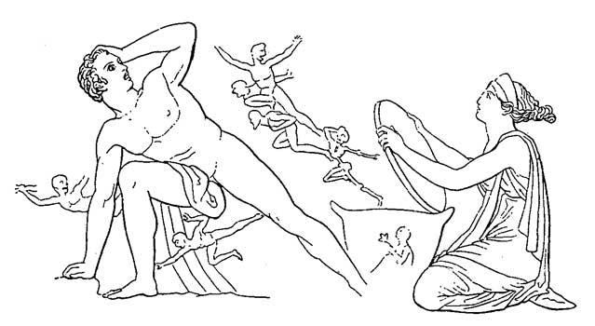
Greek mythology
Hephaestus, God of Fire, creates Pandora, the 1st woman.
Zeus, Upper God, decides to give Pandora true life and marry Epimetheus.
The couple receives the box of… Pandora.
Not be opened, but Pandora cannot resist.
Misfortune, setback, pain and evil happen.
But… as last feature also hope turns up!

Slide 3
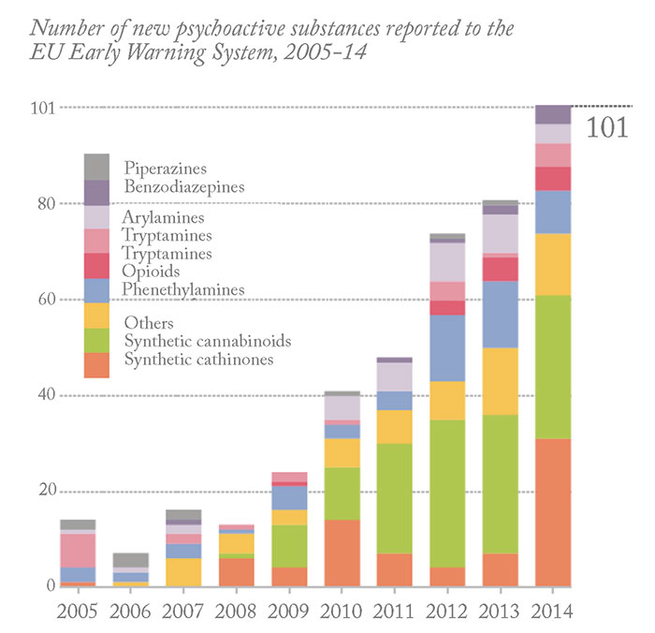
EMCDDA, March 2015

Slide 4
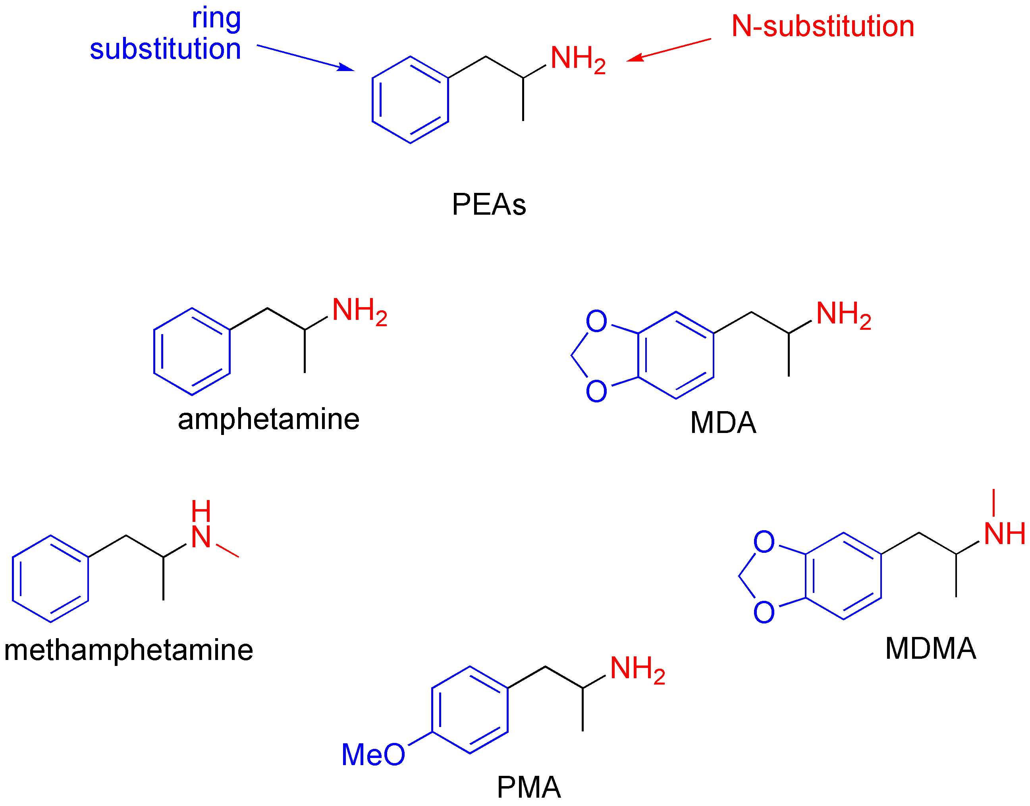

Slide 5
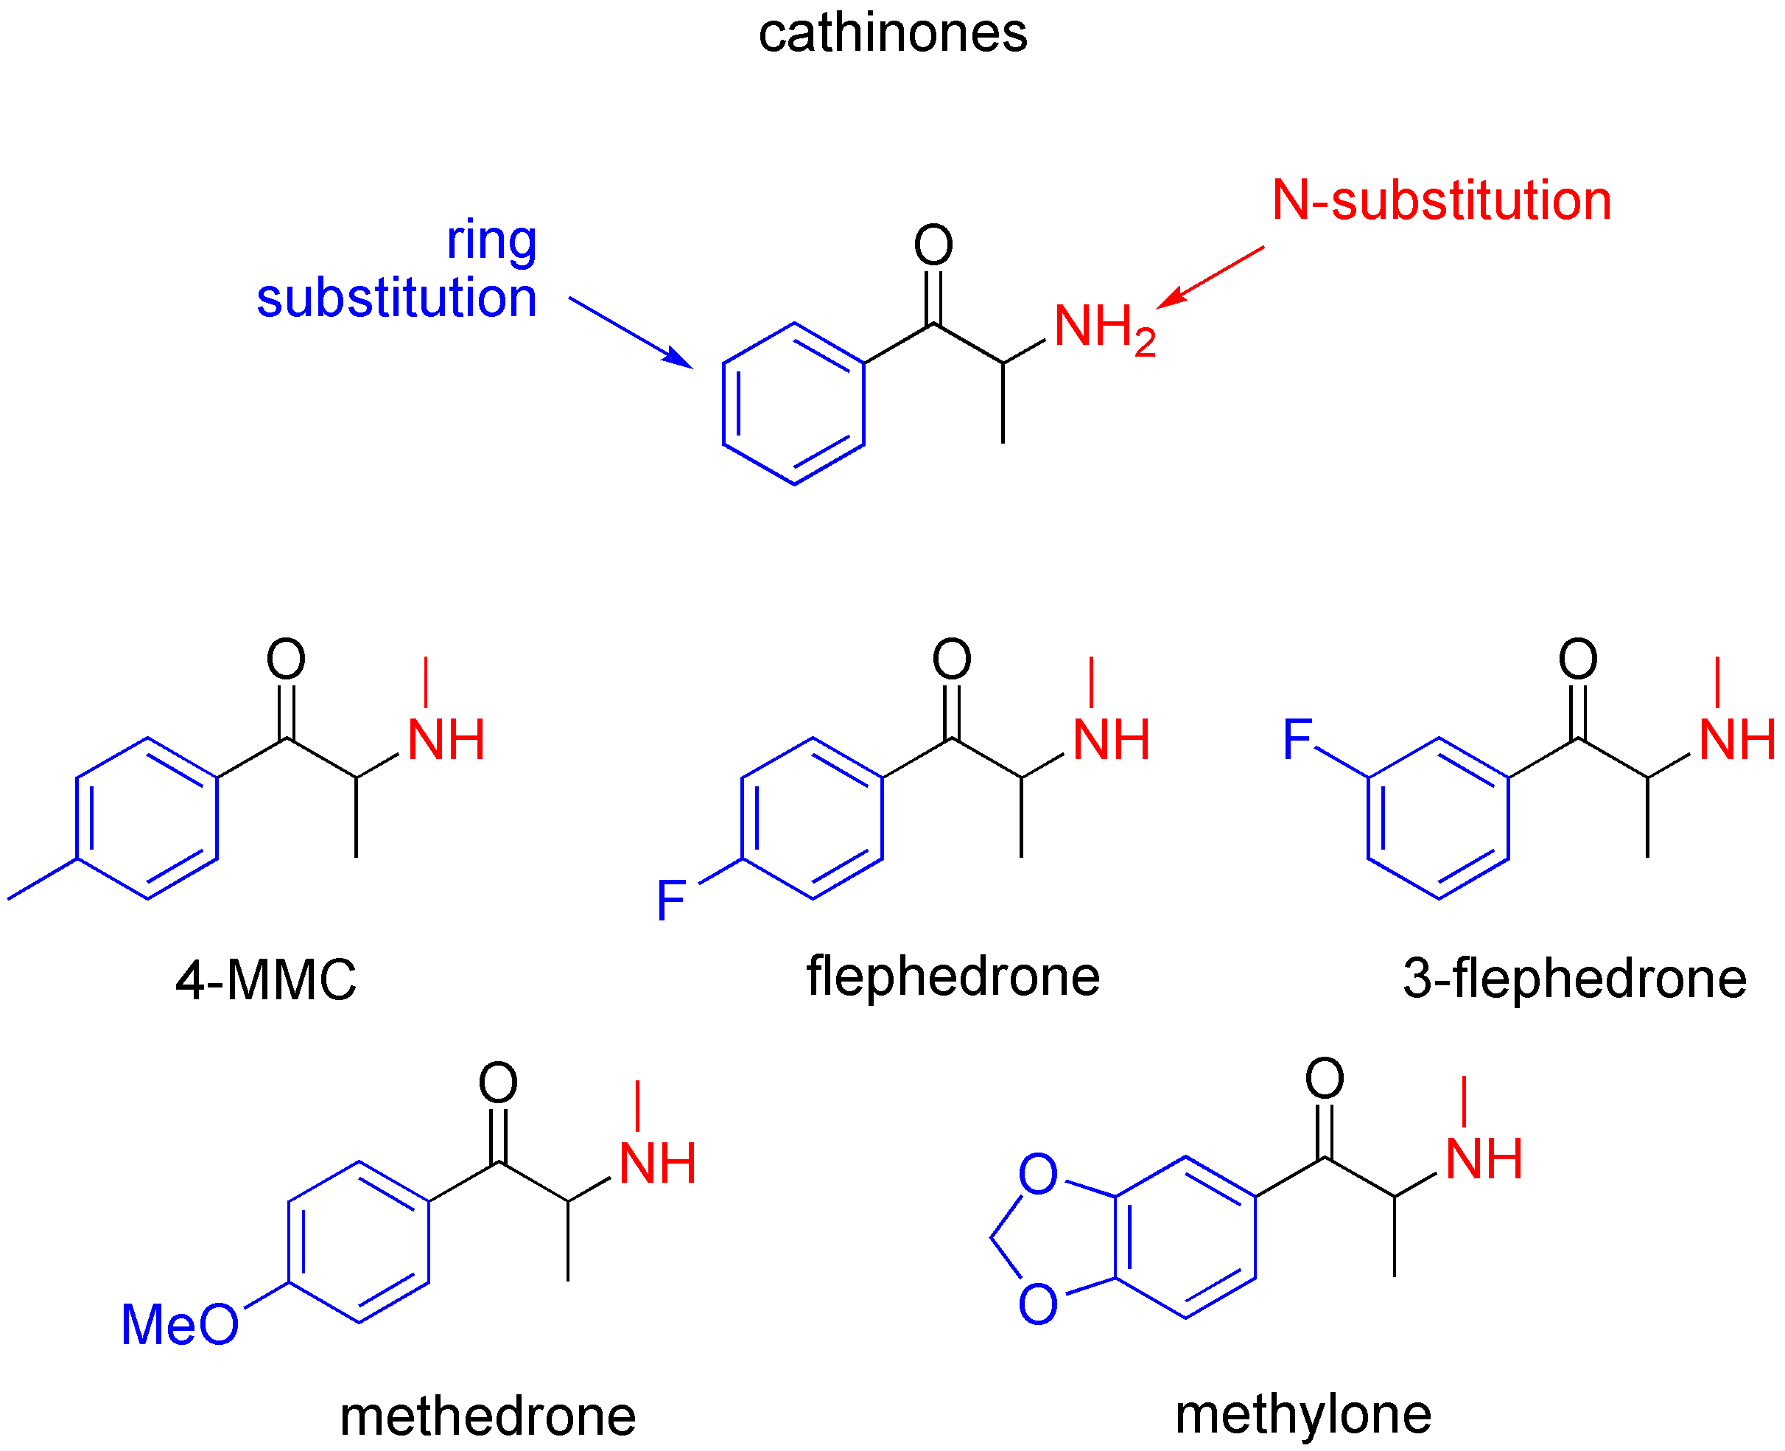

Slide 6
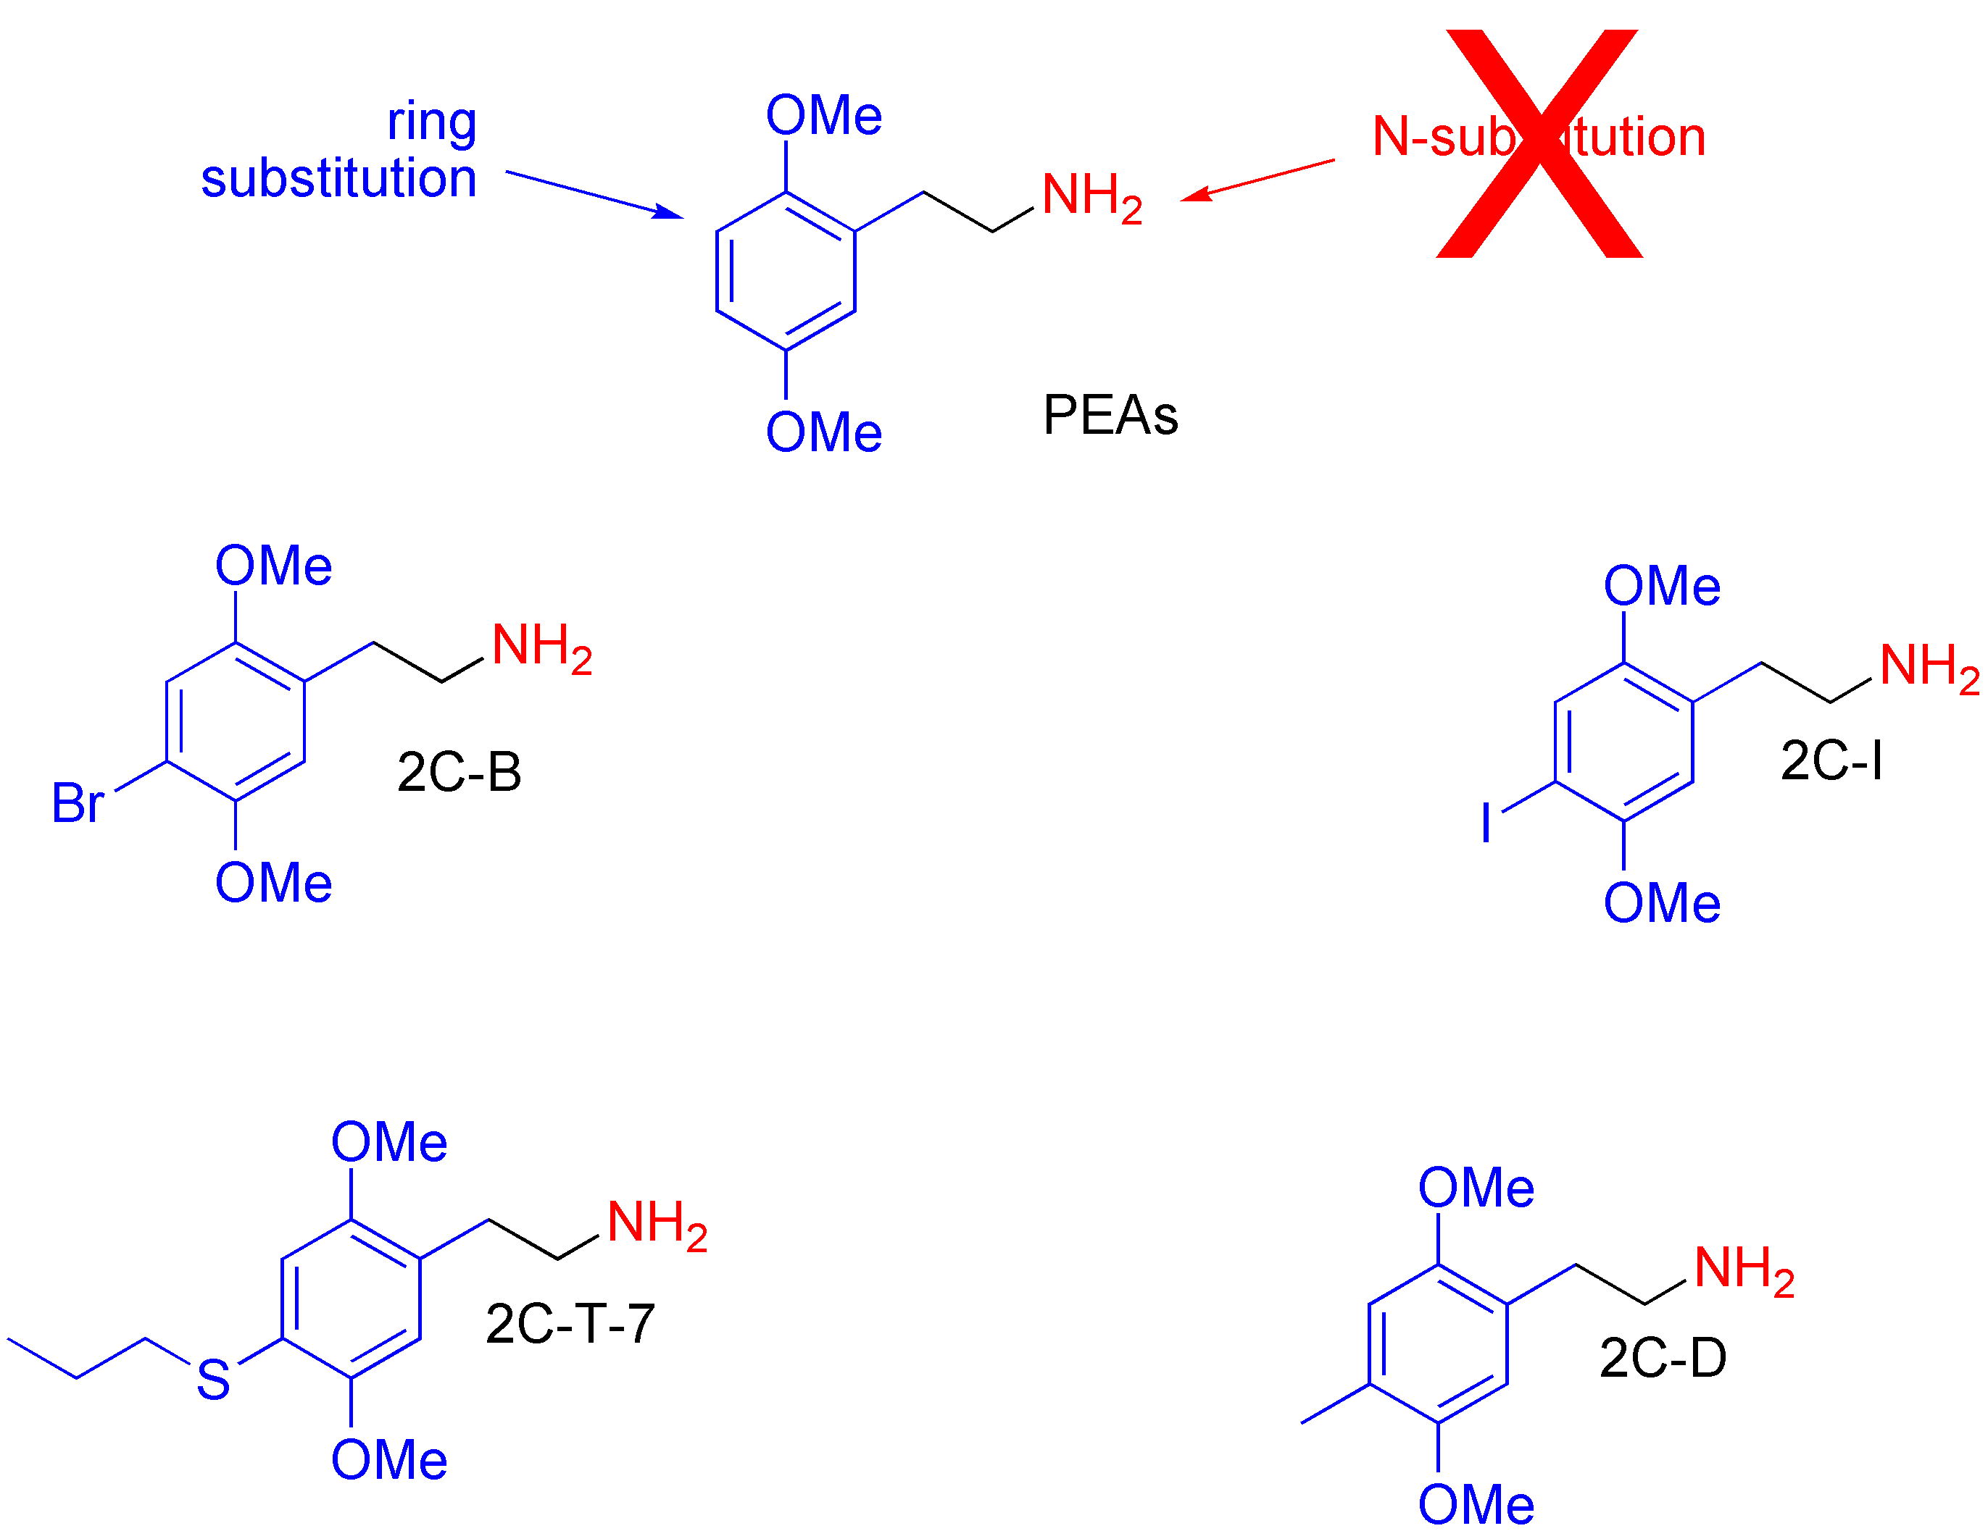

Slide 7
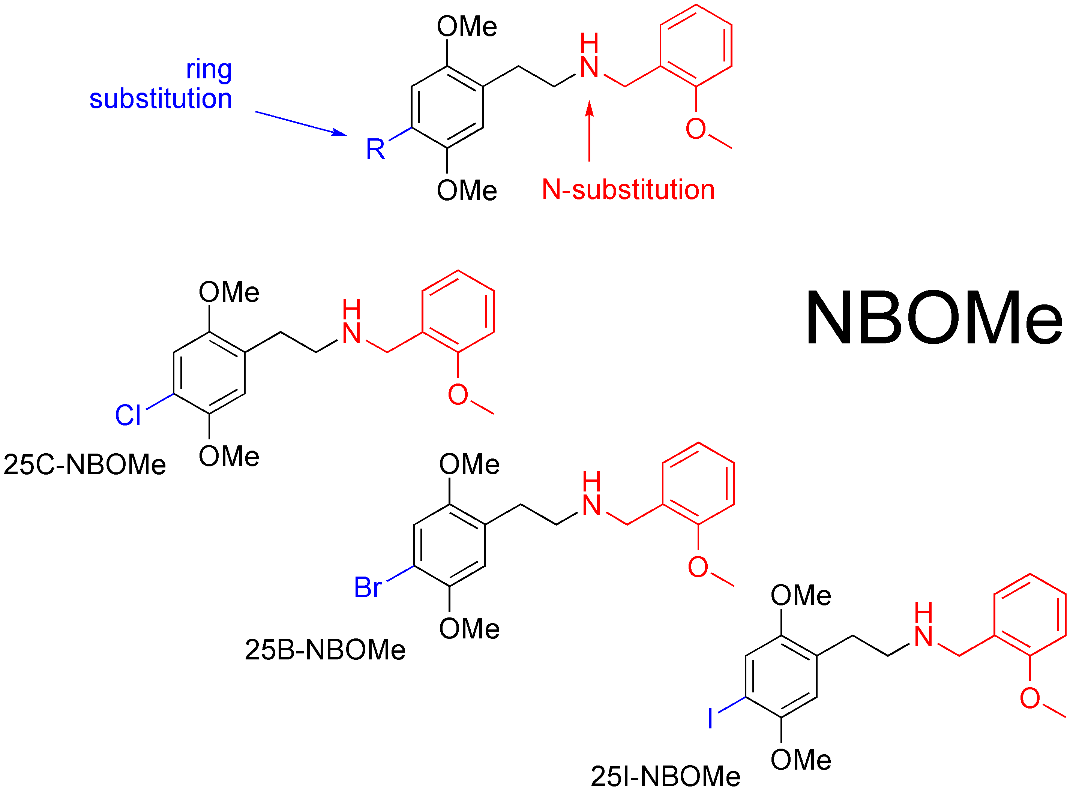

Slide 8
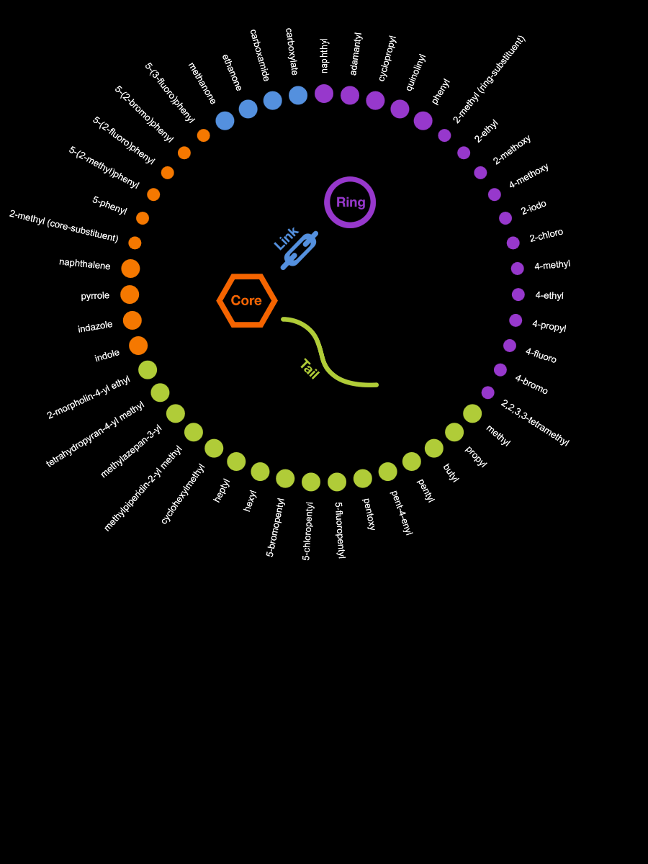
Synthetic cannabinoids
Source: EMCDDA

Slide 9
Pre-precursors: what type of chemicals?
Purpose of their use
Location of their use
Timeline of their use (trends)
Recognizability and Risks
Occurrence: general and specific

Slide 10
Purpose of their use
Reagents: methylamine, formamide, hydrochloric acid, sodium hydroxide, acetic anhydride, sodium borohydride, hydrogen, argon, bromine, …
Solvents: acetone, ether, benzene, toluene, alcohol, methyl-ethyl ketone, tetra-hydrofuran, hexamethylphosphoramide, glycerol, …
Catalysts: platinum dioxide, Raney-nickel, palladium, Al-amalgam, …
Drug-specific chemicals: methanol, acetone, ether, formic acid, sodium hydroxide, …

Slide 11
Location of their use
Synthesis labs: speed, MDMA, NPS, …
Kitchen labs: GBL → GHB, …
Extraction labs: cocaine, …
Conversion labs type 1: pre-precursor → precursor: APAAN to BMK precursor → NPS: 2C-B to 25B-NBOMe
Conversion labs type 2: medicine → NPS pseudo-ephedrine to methamphetamine; fentanyl to NPS benzodiazepine to NPS (trendy!)
Biotech labs: growth media

Slide 12
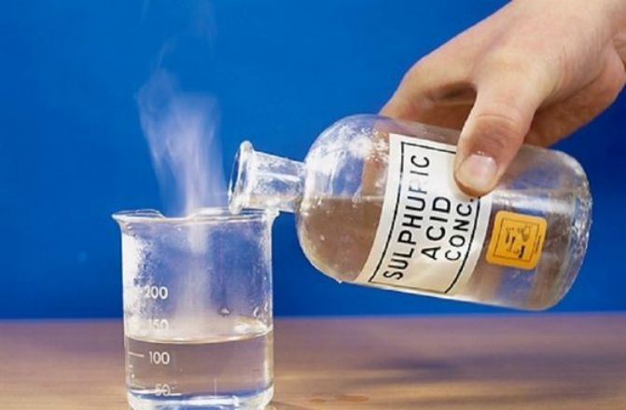
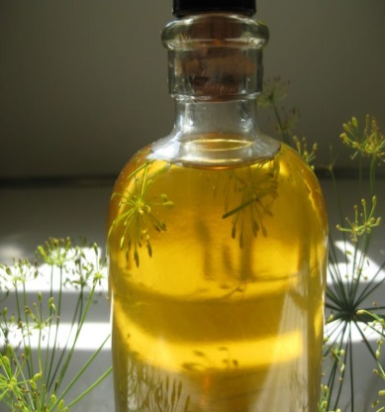
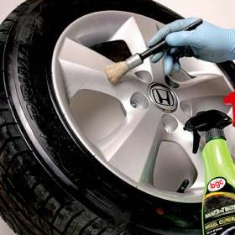
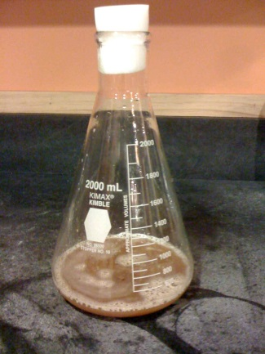
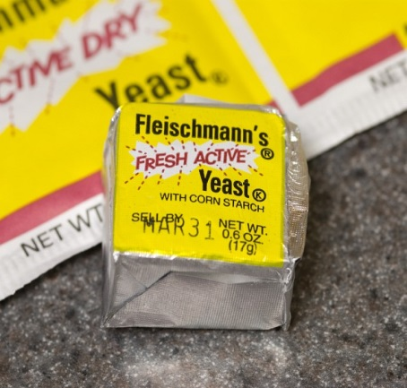
Timeline of their use (trends)
Historical: classical chemicals
Under the radar: oils/plants & solvents
Newest biological substances: growth media

Slide 13
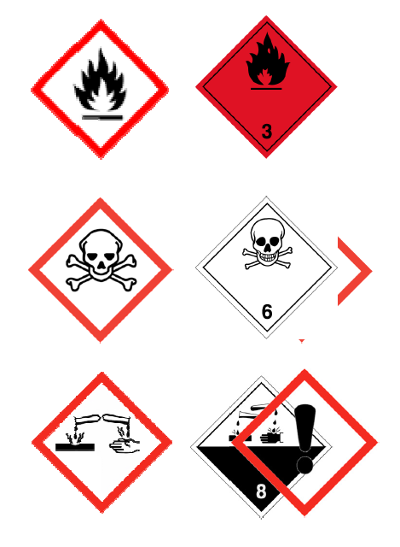
Recognizability and Risks
Inflammable
Toxic
Corrosive

Slide 14
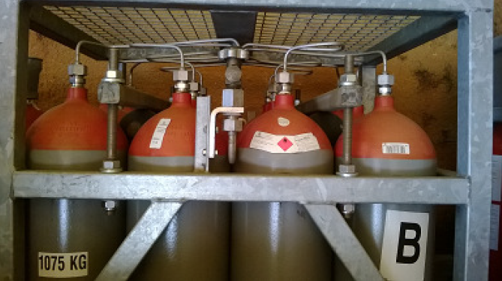
Inflammable
Natural gas, propane/butane gas
Hydrogen gas (H₂), Bromine (Br₂), …
Solvents: acetone, ether, methanol, isopropylalcohol

Slide 15
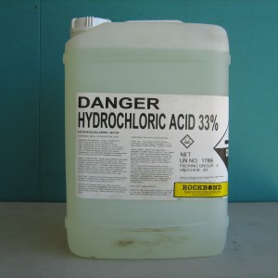
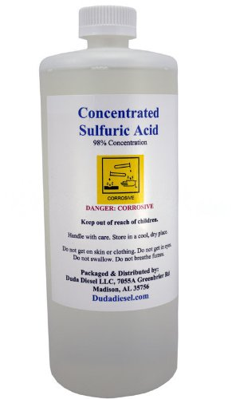
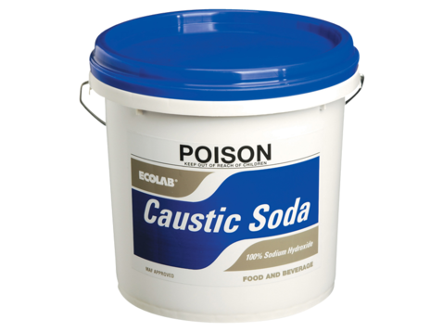
Corrosive
Hydrochloric acid (HCl)
Sulfuric acid (H₂SO₄)
Sodium hydroxide (NaOH)

Slide 16
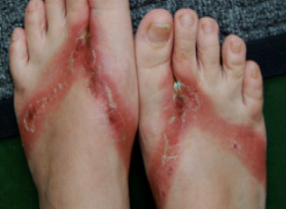
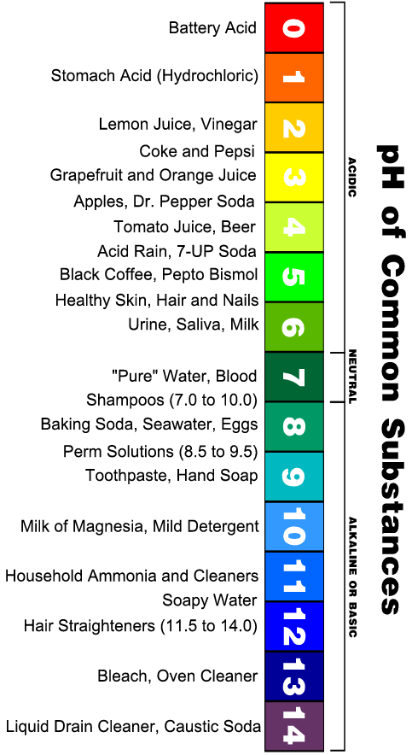
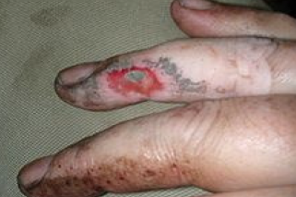

Slide 17
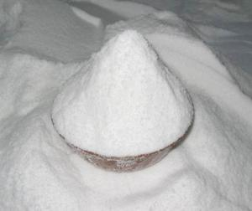
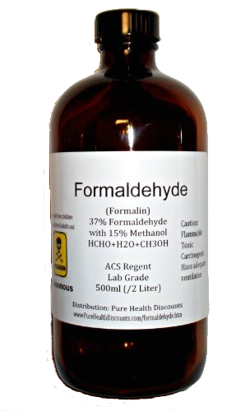
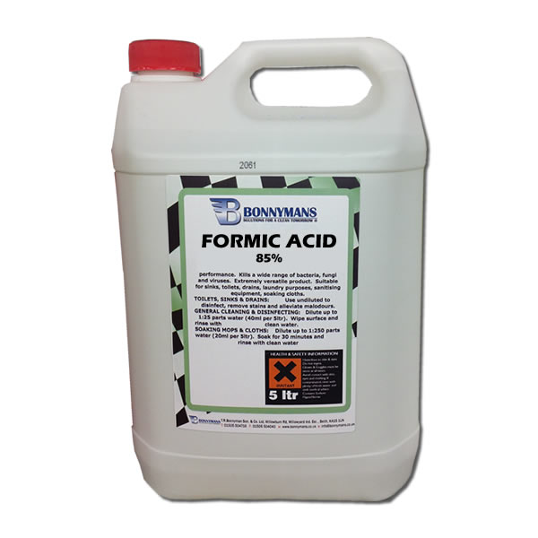
Inflammable and Corrosive
Methylamine
Formaldehyde
Formic acid

Slide 18
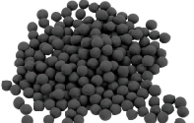
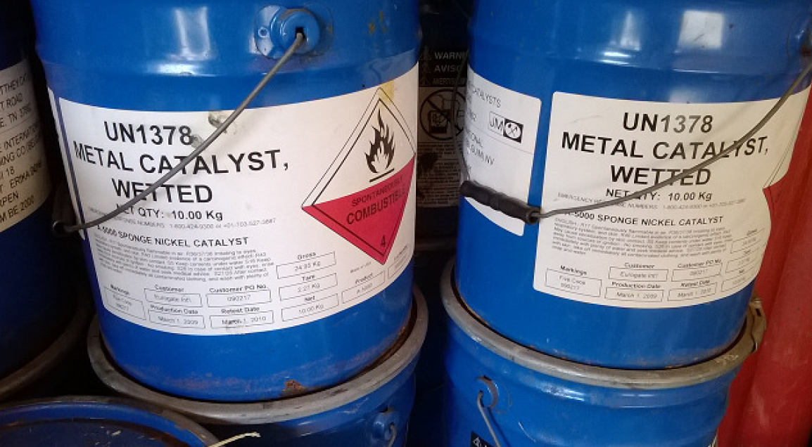
Self inflammable

Slide 19
Occurrence: general and specific
Historical: classical chemicals

Slide 20
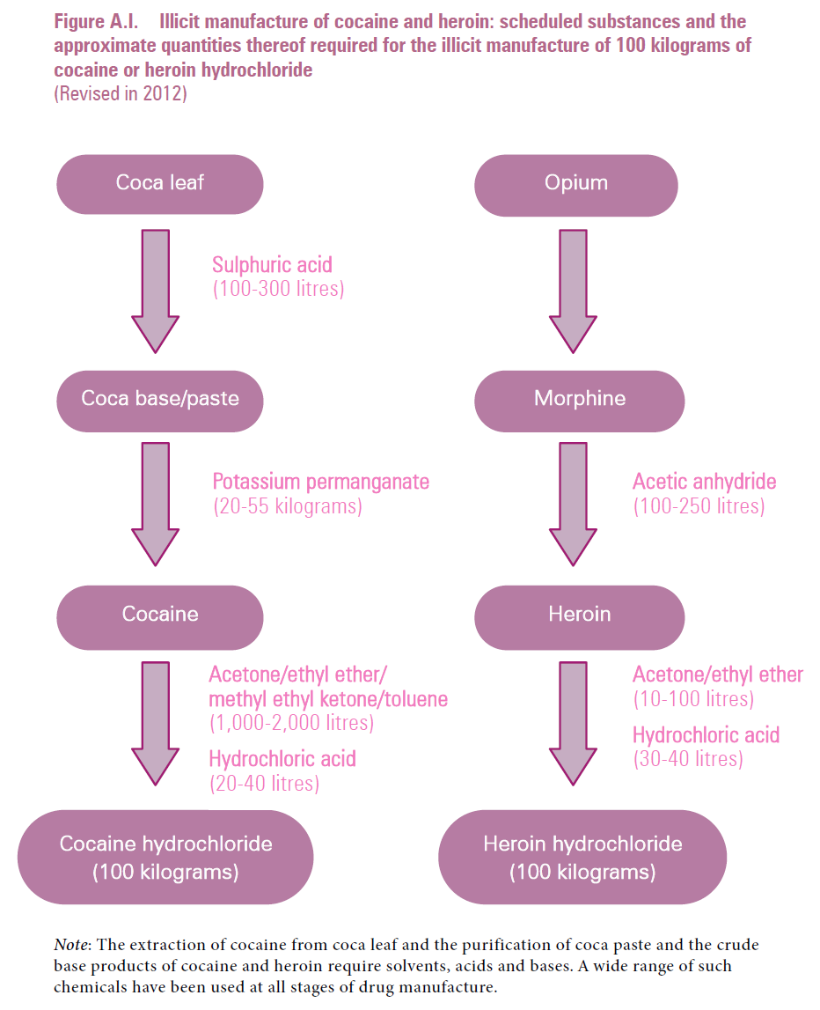
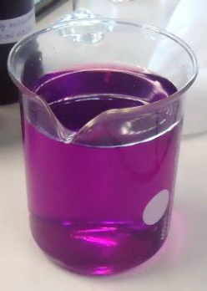
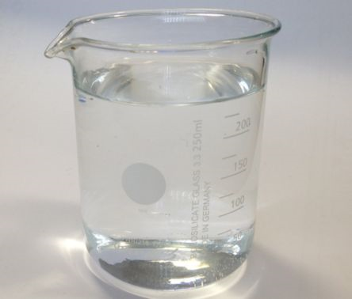
Source:
Precursors (2013)
www.incb.org

Slide 21
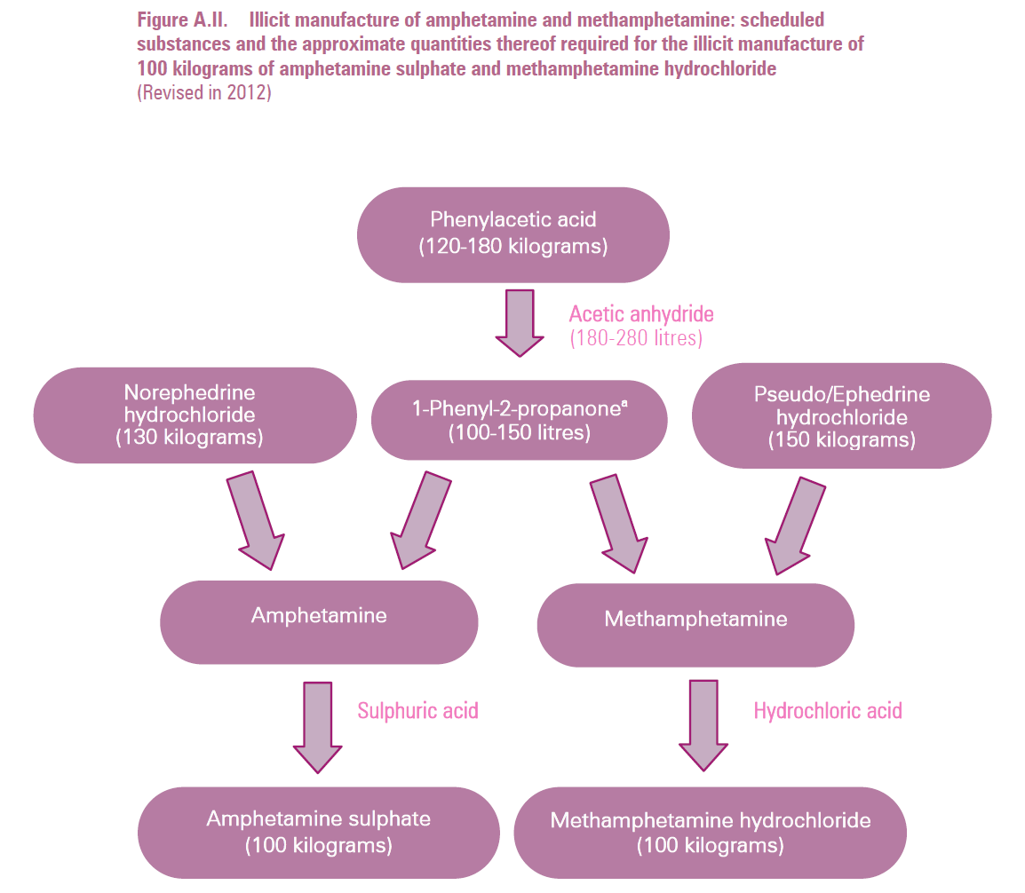
Source:
Precursors (2013)
www.incb.org

Slide 22
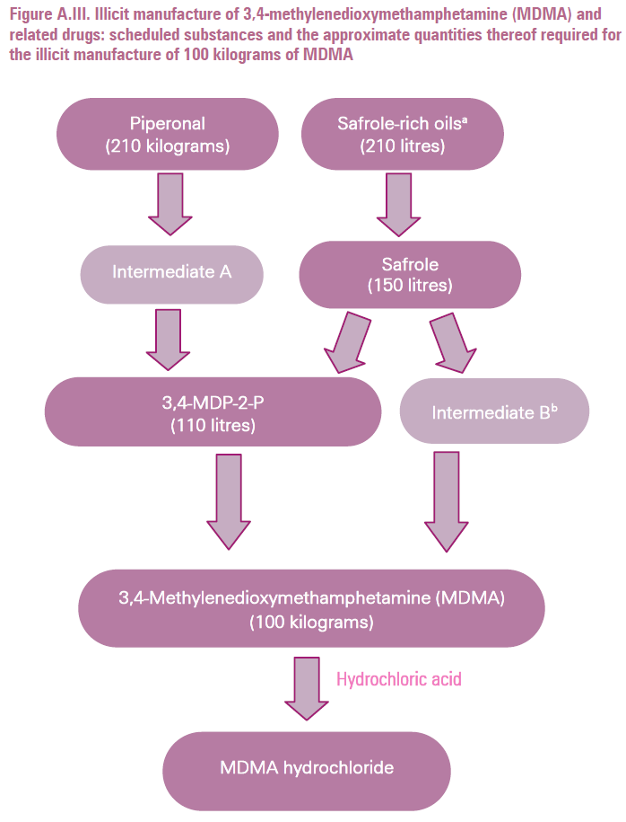
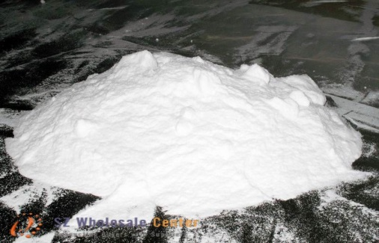
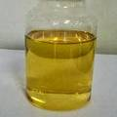
Source:
Precursors (2013)
www.incb.org

Slide 23
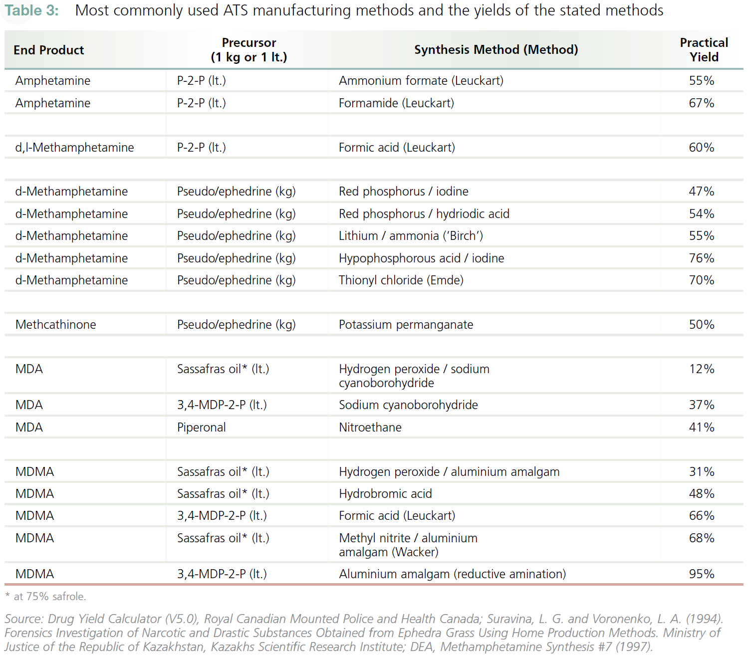

Slide 24
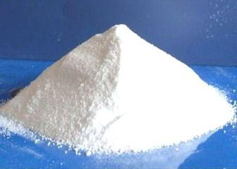

Slide 25
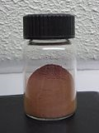

Slide 26
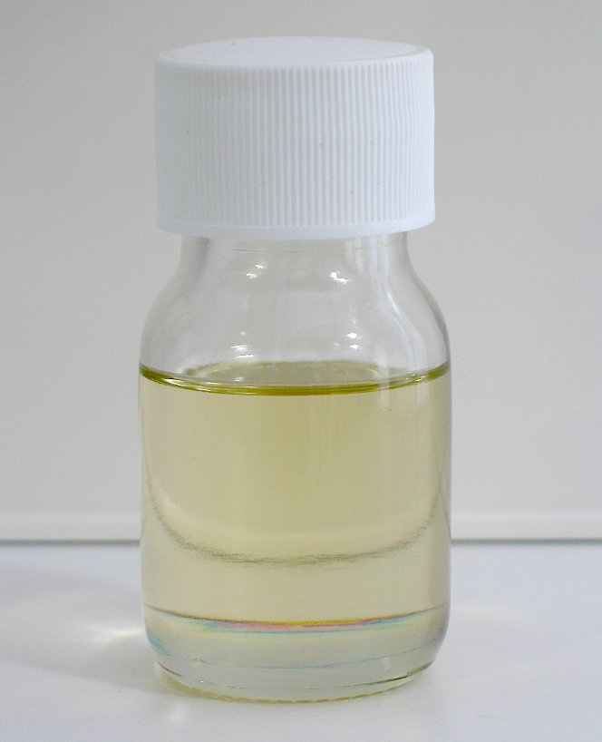

Slide 27


Slide 28
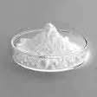

Slide 29
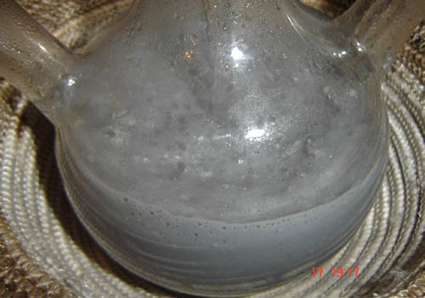

Slide 30
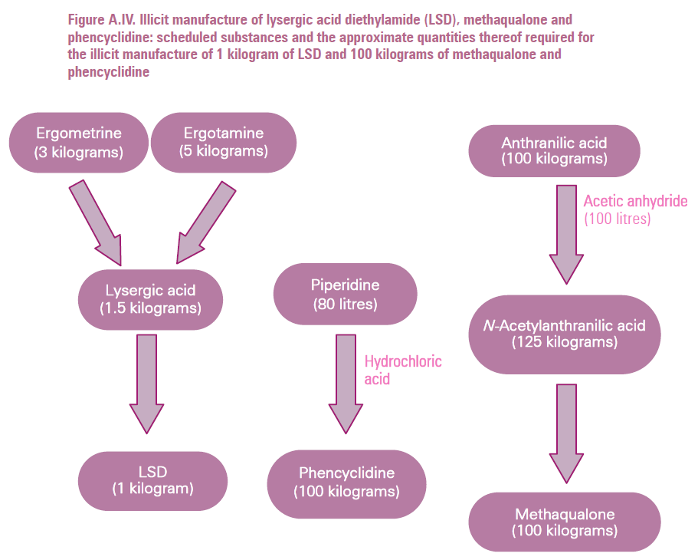
Source:
Precursors (2013)
www.incb.org

Slide 31
Under the radar: oils/plants & solvents

Slide 32
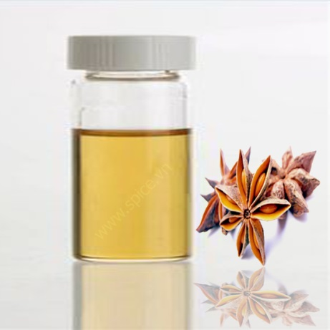
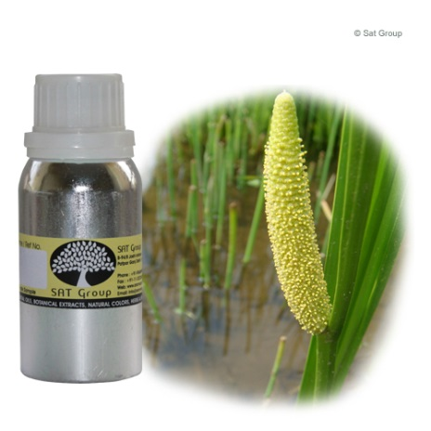
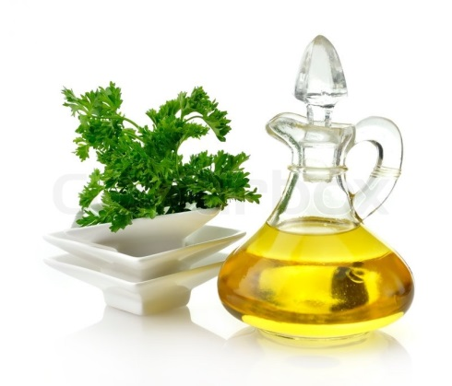
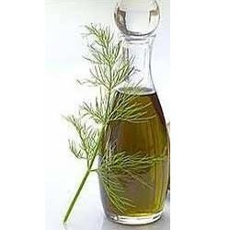
AMPHETAMINES derived from natural sources
most commonly from essential oils:
- MDA/MDMA from “Sassafras oil”
- PMA/PMMA from Anise oil
- TMA-2 from Calamus oil
- DMMDA, MMDA from Parsley oil
- DMMDA-2 from Indian dill oil

Slide 33
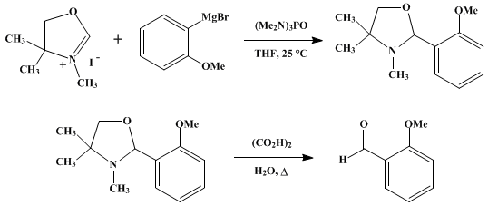
Organic Syntheses, Coll. Vol. 6, p.64 (1988); Vol. 54, p.42 (1974)
o-Anisaldehyde (2-methoxy-benzaldehyde): precursor for NBOMe series

Slide 34
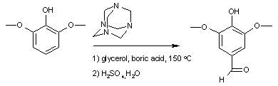
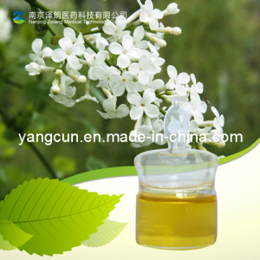
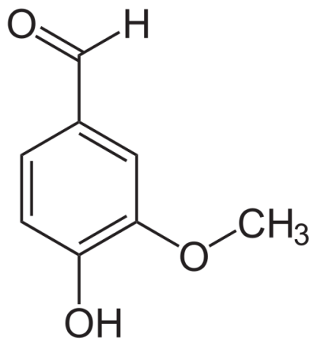
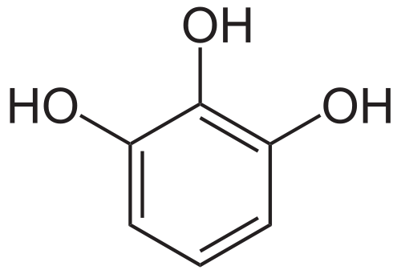
from plant extract
from vanillin
from pyrogallol
Syringaldehyde: precursor for mescaline series

Slide 35
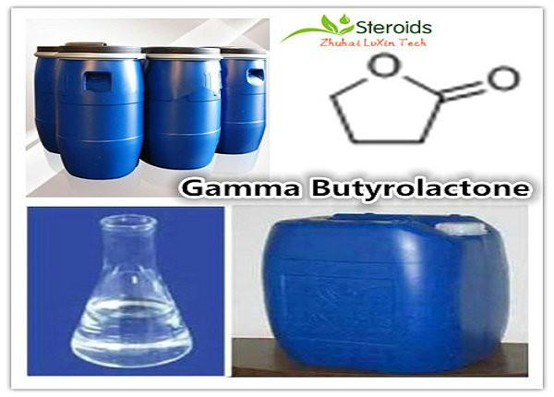

Slide 36
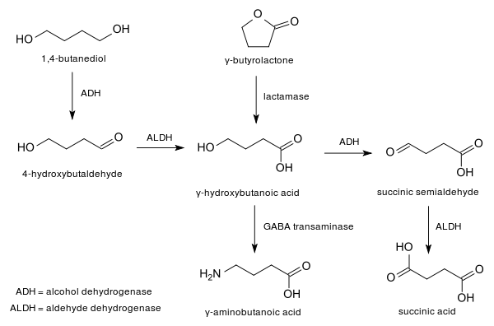

Chemical route
GBL
NaOH
GHB

Slide 37
Newest Biological Substances: yeast and growth media

Slide 38




Slide 39

August, 2015

Slide 40





Slide 41



Growth media: trendy!

Slide 42


Growth media: trendy!

Slide 43


Questions?
Thanks for your attention!

