Slide 1



Internet, Broadcast tool for the NPS supply and prevention tool for the NPS demand
Magali Martinez,
Agnès Cadet-Taïrou
TREND UNIT, OFDT
Venice, 15/11/2016,
2016 Pompidou Group Symposium on NPS

Slide 2



www.i-trend.eu
Co-funded by
The European Union
European project JUST/2012/DPIP/AG/3641 co-financed by the Drug Prevention and Information Program of the European Union.
www.ofdt.fr

Slide 3

Digital monitoring – The I-TREND project
Online Shops
Supply is expressed through
Demand is expressed through
Both monitored on the surface
web by dedicated programs
Online
Forums
www.ofdt.fr

Slide 4

Surface web
Referenced by search engines
Deep web
Not referenced and not intended specifically for illegal purpose
Dark web
Anonymity tools and illegal purpose

Slide 5
Online Supply

Slide 6
584 web shops were monitored between November 2013 and May 2014
www.ofdt.fr

Slide 7
Learning
Different national situations in a global and interconnected market
www.ofdt.fr

Slide 8
Learning – distribution of web shops per country
The number of web shops per national languages varies a lot
FR= 96 / The NL = 22
Web shops in English are predominant
The UK = 244
www.ofdt.fr

Slide 9
Learning – web shops and IP geographic location
Some countries have more than other websites with an IP address located on their own territory

Slide 10
Breakdown of active online shops by IP location in May 2014
www.ofdt.fr

Slide 11
Learning – web shops and IP geographic location
American IP address are well represented in each national online market

Slide 12
Breakdown of active online shops by IP location in May 2014
www.ofdt.fr
Notes:
It is important to note that the US localisation is well represented in all countries, notably in the british market.
To conclude,

Slide 13
Learning – web shops and IP geographic location
Transborder links exist between the observed IP address and the targeted country

Slide 14
Breakdown of active online shops by IP location in May 2014
www.ofdt.fr

Slide 15
Breakdown of active online shops by IP location in May 2014
www.ofdt.fr

Slide 16
Breakdown of active online shops by IP location in May 2014
www.ofdt.fr

Slide 17
Type of web shops per country
Market is segmented between two main types
“RC shops” / Research Chemical shops
Commercial shops,
also called smart, head or herbal shops

Slide 18
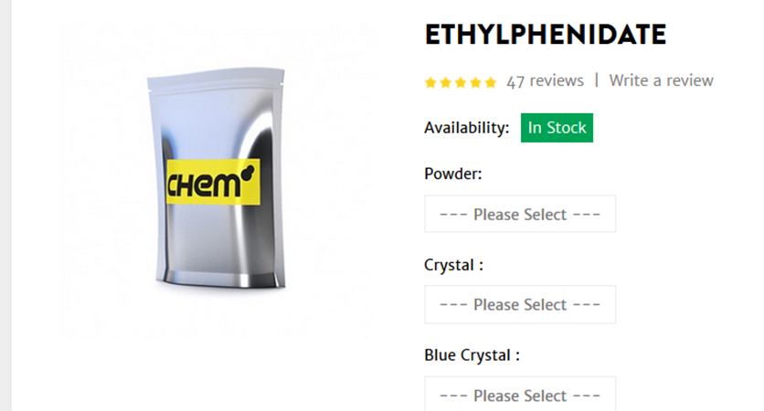
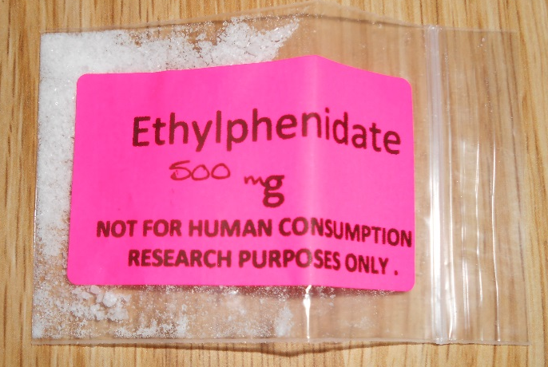
Research Chemical shops
Serious-looking, display NPS by their chemical names and offer them mainly with powder form
Intended to experienced users

Slide 19
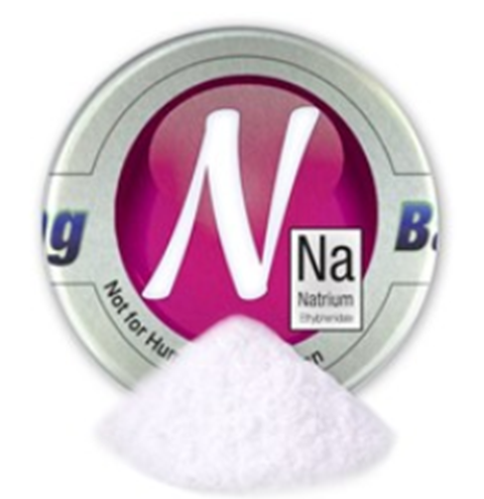
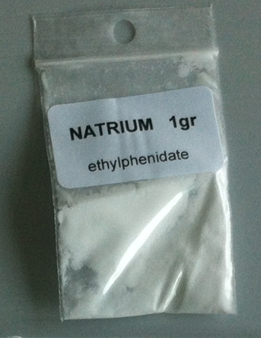

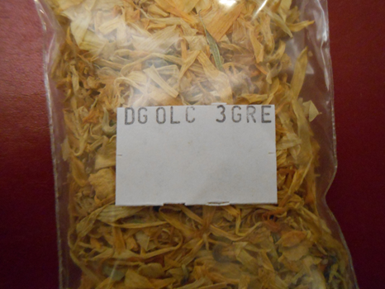
Commercial shops (smart, herbal, ….)
Seductive layouts and packaging, NPS sold under trade names and in familiar forms (tablets, herbs)…
Intended to naïve users

Slide 20
Type of online shops by country
www.ofdt.fr

Slide 21
Type of web shops per country
It is possible that retailers adapt their online presence to “national drug preferences”
Besides remember,
Countries used to have brick-and-mortar shops are likely to have high prevalence of NPS,
The United Kingdom, Poland

Slide 22
Online Demand or The digital audience of NPS

Slide 23
Monitoring of 12 national forums (FR, NL, PL, UK) between October 2013 and October 2014
The number of views of 5,169
online discussions
related to one or several NPS
were monthly collected

Slide 24
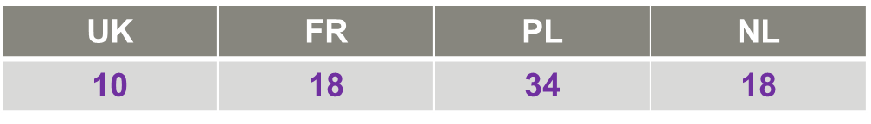
Learning
Very few NPS are discussed
Eg. 112 cathinones at EU level,
Only one or two NPS per family really attract users' interest

Slide 25
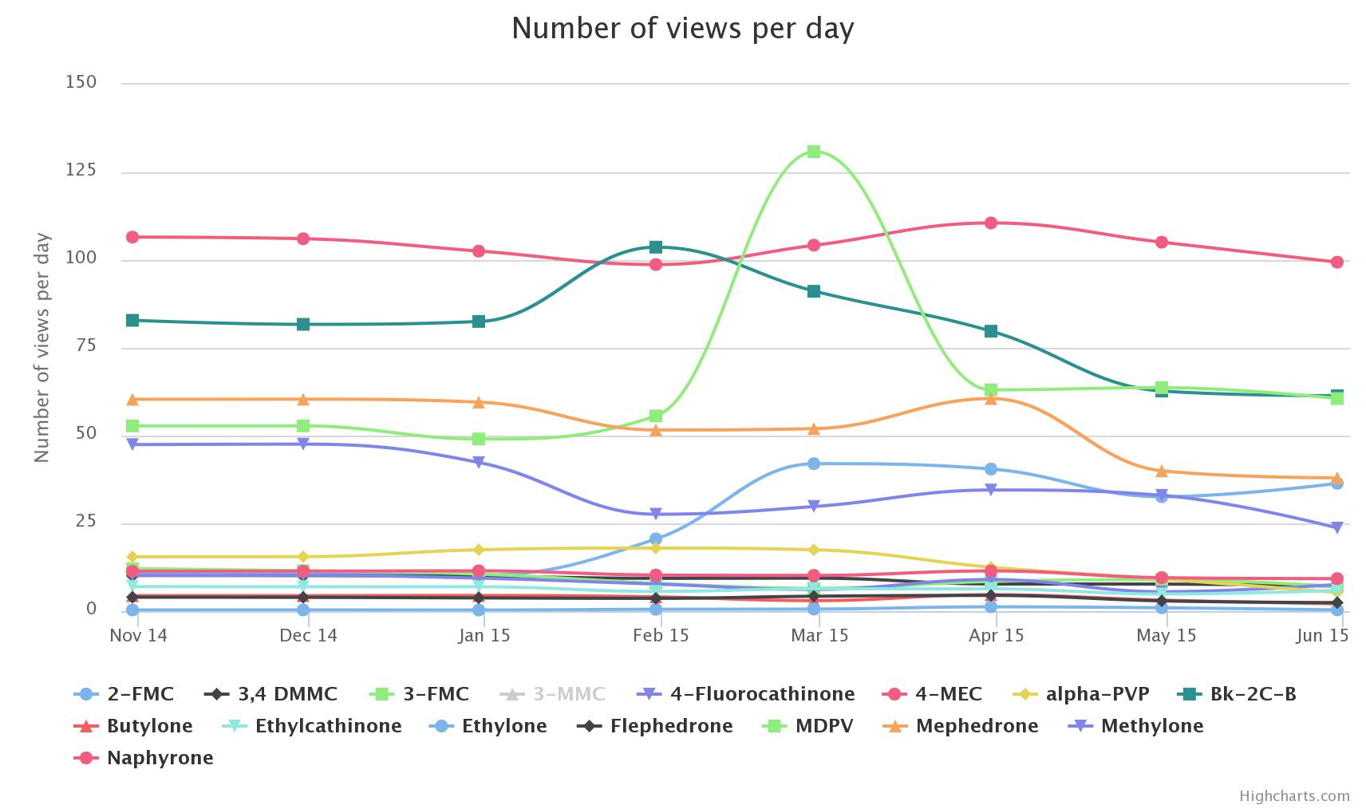
Cathinones in France
2nd Group < 100 views
1st Group < 25 views

Slide 26
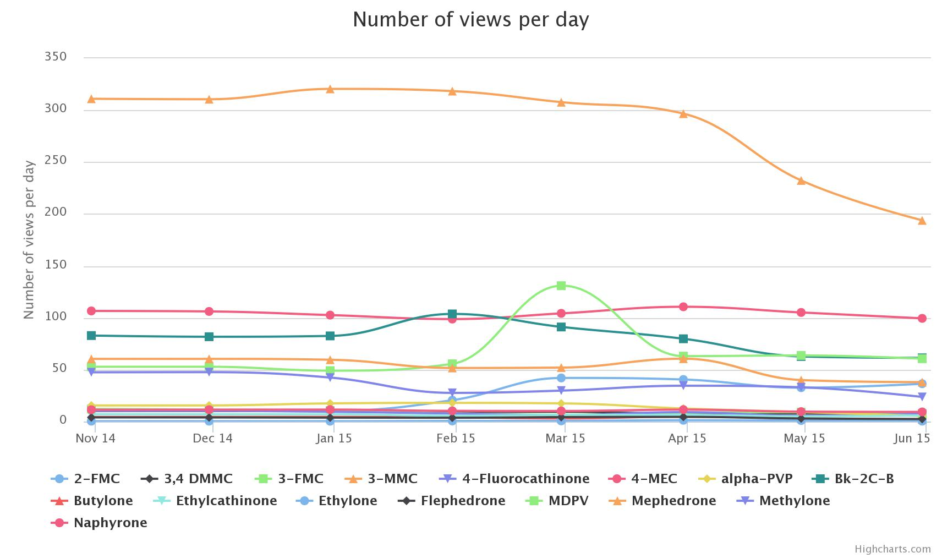
Cathinones in France, plus 3-MMC
3rd Group > 100 views

Slide 27
Learning
Each country has its “ NPS national preferences” – often according to prior national problematics
UK, Branded Products, etizolam, ethylphenidate, AL-LAD, LSZ.
NL, 4-FA, 6-APB and 2C-B.
PL, 4-MMC and 3-MMC, Branded Product and blend of synthetic cannabinoids.
FR, 3-MMC and synthetic cannabinoids - with e-liquid form.
www.ofdt.fr

Slide 28
Learning
Users’ interest is very steady along time

Slide 29
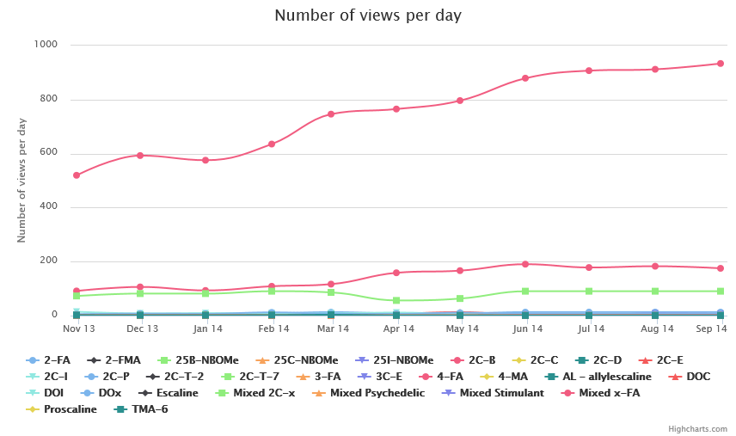
In the Netherlands – Phenethelamines
Threads of 4-FA

Slide 30
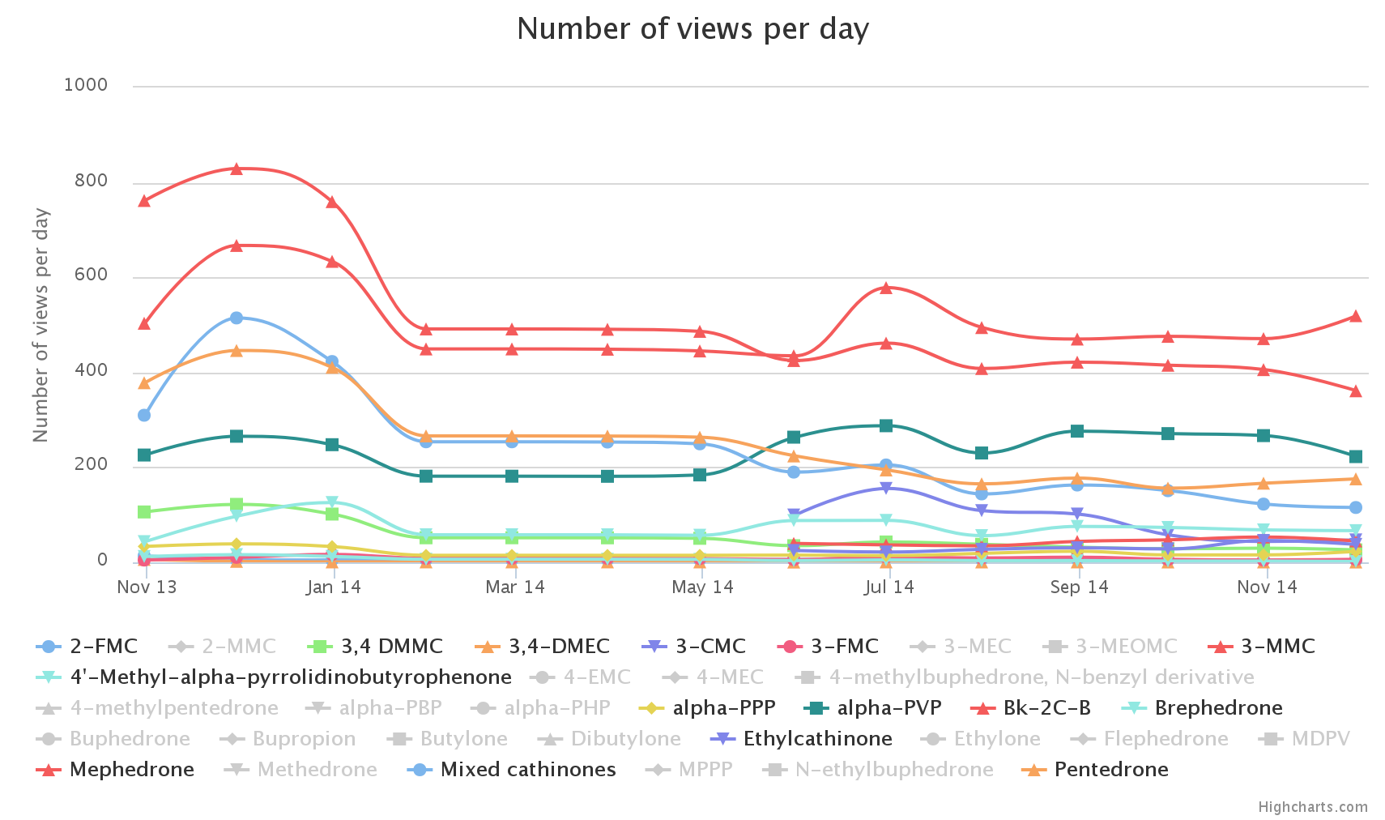
In Poland - Cathinones
Threads of 4-MMC
Threads of 3-MMC

Slide 31
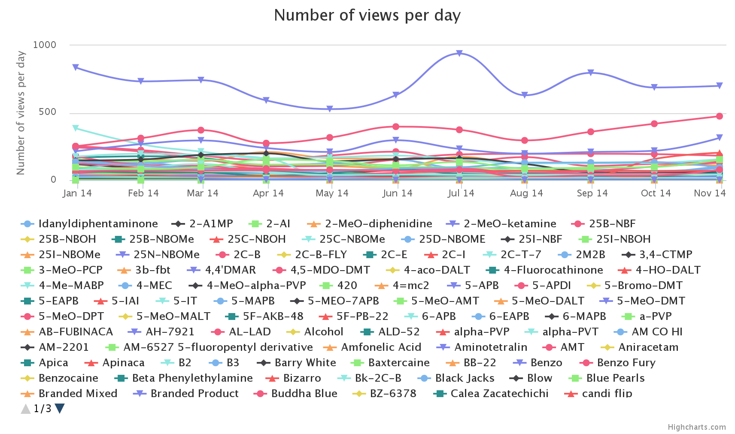
In The United Kingdom – All substances
Threads of Branded products
Threads of Etizolam

Slide 32
Learning
Noticeable changes do not necessarily happen:
when a new compound is launched on the market or
when a legal ban is announced
But changes are likely to be driven by other factors
E.g. Users ’opinion about the NPS itself
Estimate online or offline accessibility

Slide 33
Internet as a prevention tool against NPS

Slide 34
The NPS demand has a different dynamic from the NPS supply
Supply dynamic is very offensive
Demand dynamic is steady, focus on very few compounds / brand names

Slide 35
What is your national situation regarding NPS ?
Who is the targeted user of your online prevention action ?
www.ofdt.fr

Slide 36


None or very few experiences
Long term addictive behaviour

Slide 37
None or very few experiences
Surface Web
Does not need information about products
General program on the use of the Internet
Long term addictive behaviour

Slide 38
None or very few experiences
Surface Web
Does not need information about products
General program on the use of the Internet
Surface / Deep / Dark Web
Specialised forums / peer to peer environment
Harm reduction intervention
Long term addictive behaviour

Slide 39

None or very few experiences
Long term addictive behaviour
Several experiences of several drugs

Slide 40
Internet as a prevention tool
Each type of user
Browses the Internet(s) with a specific way
Needs a specific message, in terms of style and content
Regarding youth generation
Should online prevention be only focused on products or also on the user’s capacity to check the online information ?
www.ofdt.fr

Slide 41

Thanks for your attention
magali.martinez@ofdt.fr
www.i-trend.eu
Co-funded by The European Union
European project JUST/2012/DPIP/AG/3641 co-financed by the Drug Prevention and Information Program of the European Union.
The author declares no conflicts of interest.
www.ofdt.fr

