Slide 1
New psychoactive substances – demand reduction, harm reduction and treatment
2016 Pompidou Group Symposium on NPS
15 November 2016
Rosanna O’Connor
Director- Alcohol, Drugs & Tobacco Division
Public Health England

Slide 2
Overview
Prevalence & vulnerable groups
Reducing demand
Reducing supply – the Psychoactive Substances Act
Preventing harm
      Drug treatment
NPS in Prisons

Slide 3
How many people are using NPS?
Compared to ‘traditional’ drug use, NPS use is low
The Crime Survey for England and Wales gives us some insight.
NPS use is low (0.7% adults used them in the past year)
Use is mainly among young adults (2.6% in the past year)
For young people (English schools survey):
Half of school students have heard of ‘legal highs’
6% had been offered ‘legal highs’
2.5% had taken them (2% in the last year; 0.9% in the last month)
Notes:
the latest Smoking, Drinking and Drug Use survey

Slide 4
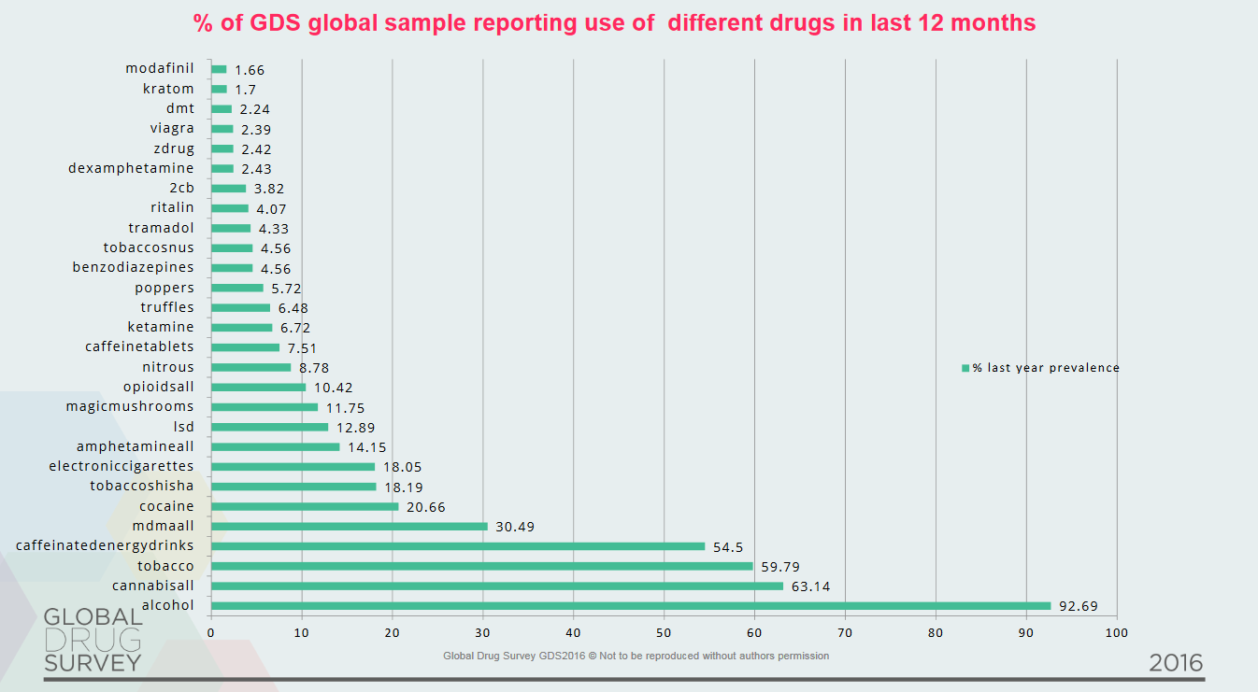
Even among regular drug users, NPS use is low
Overall, GDS reported 4.8% NPS use in 2016, compared to 4.2% in 2015
Notes:
Can we highlight which of these are NPS?

Slide 5

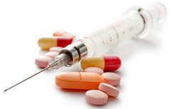

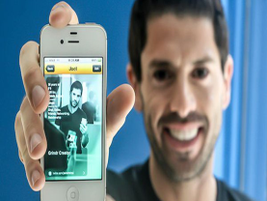
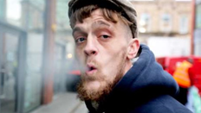
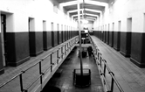
Who uses NPS?
Young men: 3.6% of men aged 16 to 24 report using NPS in the last year (almost half of all last year NPS users)
People who use other drugs: 85% NPS users had used another drug in the last year
Clubbers: people who visit a nightclub, pub or bar; people who have consumed alcohol are more likely to use NPS
Men who have sex with men (MSM): evidence of high levels of NPS and traditional drug use. Within certain subgroups of MSM, drugs are associated with risky sexual practices
Homeless people: high levels of synthetic cannabis use – stronger & cheaper than cannabis, and no legal sanctions for personal possession.
Prisoners: significant increases in use of synthetic cannabis use reported by both staff and prisoners (Spice & Black Mamba)
(CSEW; Home Office NPS Review; Drugscope Street Drug Survey)
Notes:
CSEW tells us that 3.6% of men aged 16 to 24 had used an NPS in the last year.
Home Office’s New Psychoactive Substances in England: A review of the evidence (2014)
Homeless people
“It’s a nightmare with our clients. When they come in for opiate treatment it’s hard to deal with them after they’ve smoked it [SCRAs]. They are collapsing in the street… Some of them have been hospitalised several times. They are using it because it’s cheap, it’s strong and because those who are out on license will not go back to jail if they are caught taking them because they’re legal.”
DrugScope, Street Drug Survey 2014

Slide 6
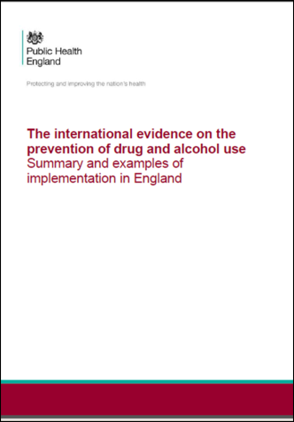
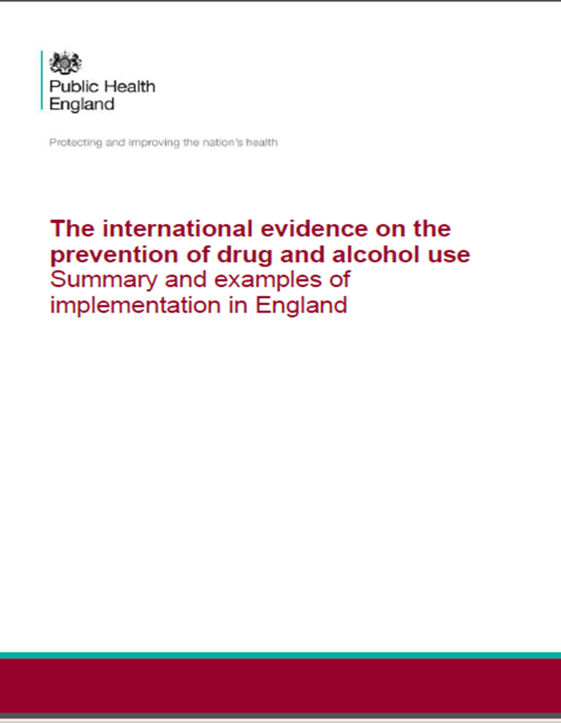
  Prevention
  What works?
  Evidence for ‘risk and resilience’ factors
  Generic pre-school programmes, improving literacy and numeracy
  Personal and social skills education
  School environment improvement programmes: positive ethos; disaffection; truancy; participation; academic and social-emotional learning
  Multi-component programmes, involving parenting interventions
  Accurate, relevant, accessible information
  What doesn’t?
  Scare tactics and images
  Knowledge-only approaches
  The police as drug educators without a programme
  Ex-users without a programme
  (Summary of UNODC systematic review)

Slide 7
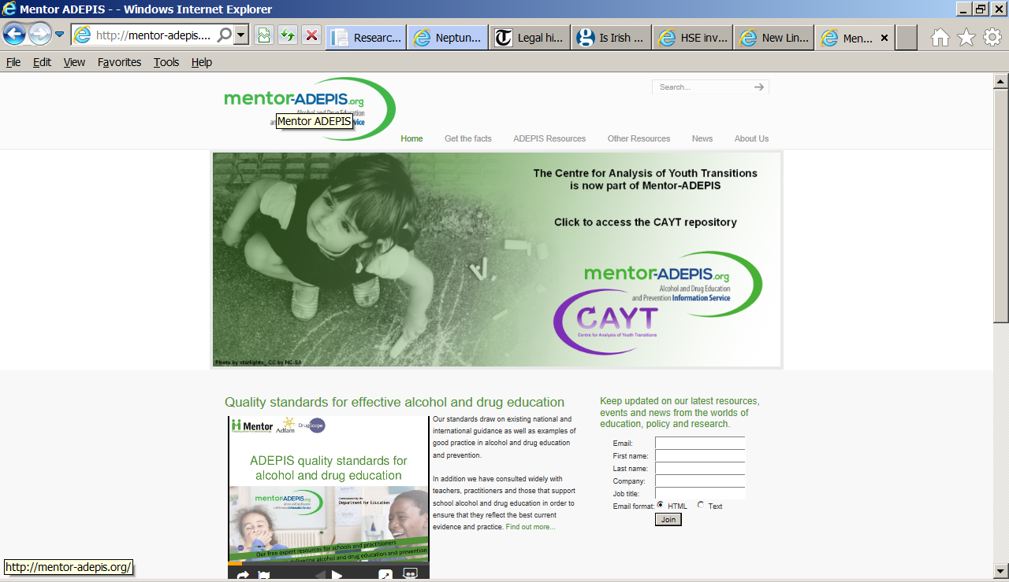
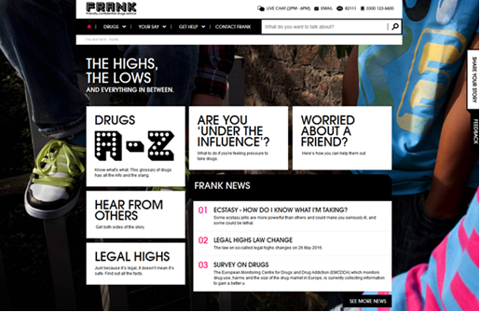
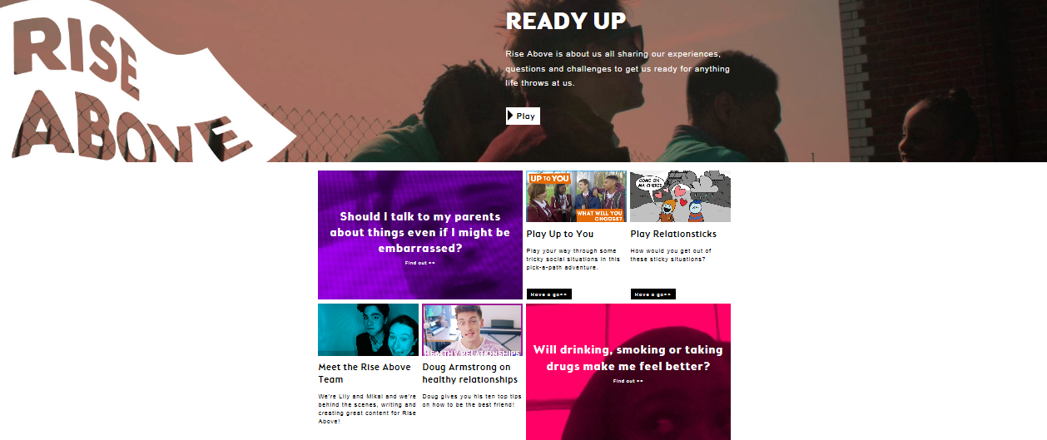

Slide 8
Psychoactive Substances Act 2016
Previously, all drugs controlled under the Misuse of Drugs Act 1971 as individually named substances
Home Office Expert Panel (December 2013) recommended the creation of a blanket ban on the production and distribution of psychoactive substances.
Psychoactive Substances Act came into effect in May 2016, making it an offence to
  Produce
  Supply
  Possess with intent to supply
  Import or export
  Possession in a custodial institution

Slide 9
Psychoactive Substances Act (cont)
Early indications of impact:
Widespread closure of high street headshops (there were approximately 450-500)
Large volumes of NPS seized
Over 200 arrests, far fewer prosecutions but early days
UK based websites complying with the new legislation
Monitoring:
Statutory review of effectiveness by Autumn 2018
‘The actions recommended by the panel will not resolve the NPS problem faced in the UK fully but are likely to change its nature.’
(Home Office NPS Expert Panel, December 2013)

Slide 10
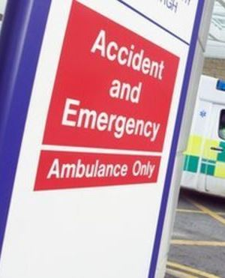
What happens when people get into trouble with NPS?
Accident & Emergency
Primary care
Sexual health services
Mental health services
Drug treatment services
Notes:
The dependence-forming potential of NPS is still largely unknown
If people do need help, it’s most likely acute NPS-related problems like agitation, palpitations, and seizures
They will probably go to A&E first
A&E staff need to be armed with better knowledge about NPS and know where to go for further information
Needs to be good pathways to help people to get further help for NPS problems if they need it
Areas with good clinical networks will be able to respond more effectively to acute NPS problems

Slide 11
New psychoactive substances intelligence system
PHE is developing a system to allow information on adverse reactions to NPS to be collected from a number of diverse sources
The overall aim is to reduce the length of time between drug-related health harm emerging and effective treatment responses
This involves 2 key developments:
      A pilot of a system for reporting the adverse effects of NPS and other drugs, using a system similar to the UK’s system for reporting of adverse reactions to pharmaceutical products (the Yellow Card Scheme)
      A NPS clinical network to analyse the data coming from this and other existing drugs intelligence systems, to identify harms, patterns and agree appropriate clinical responses

Slide 12
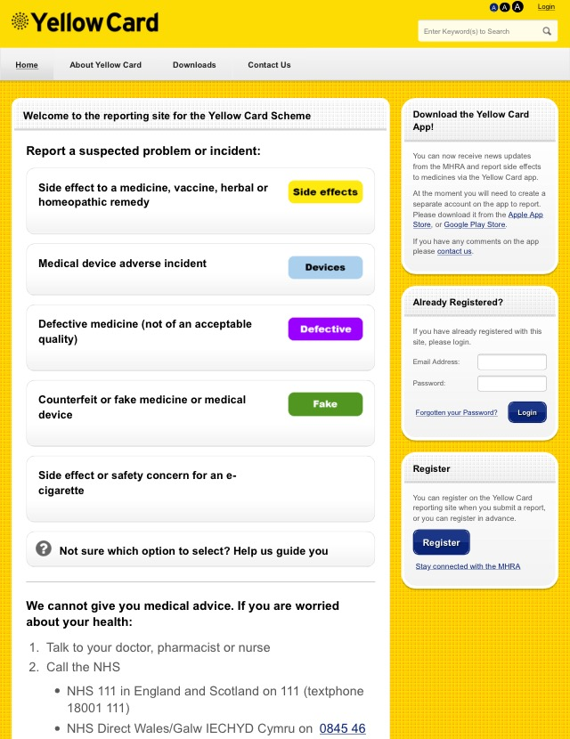
RIDR
Report Illicit Drug Reactions
Uses the architecture of the Yellow Card Scheme, but separately branded
Piloting for a year from December
Information inputted by front line clinicians in all settings, collated and analysed
Alerts flagged
About to launch proof of concept pilot in December
Feeds into NPS clinical network for reporting back to the frontline

Slide 13
NPS clinical network
Set up by PHE in early 2015
Brings together clinicians, other front-line experts and policy makers from across government. Specialisms include:
      Psychiatrists
      Psychologists
      Toxicologists
      A&E doctors
      CAMHS specialists
      Sexual health doctors and experts
      Homelessness experts
      GPs
Meets every two months
Discusses new information about NPS and its relevant for frontline practice

Slide 14
Specialist drug treatment- new presentations

Slide 15
Breakdown of NPS presentations

Slide 16
NPS treatment numbers: low but going up
Number of new presentations for NPS has risen sharply in the three years they have been reported
Latest figures show a 77% increase in numbers in treatment since the previous year
However, this only made up 1.5% of the total number of treatment presentations in the year
Just over a quarter of NPS presentations in 2015-16 were alongside opiates (546 people)
Half of this group reported housing problems at the point of starting treatment and 41% had been referred to community treatment from prison or probation
The two bullets above suggest that there are likely to be some differences between the NPS group and the rest of the club drugs group – NPS users include some of the most vulnerable, socially excluded and entrenched drug users

Slide 17
Treating NPS problems
Numbers in treatment are low, but have increased sharply in recent years
Club drug users respond well to treatment and successful completion rate is relatively high
Drug services need to be competent treat and provide harm reduction for specific health problems
They also need to make themselves accessible to new groups of NPS users, and to develop good care pathways
In the main, adapt current approaches to existing drugs rather than invent new ones. Core competencies are thereofore vital
The key is to focus more on the individual and their symptoms than the specific drugs they are taking

Slide 18
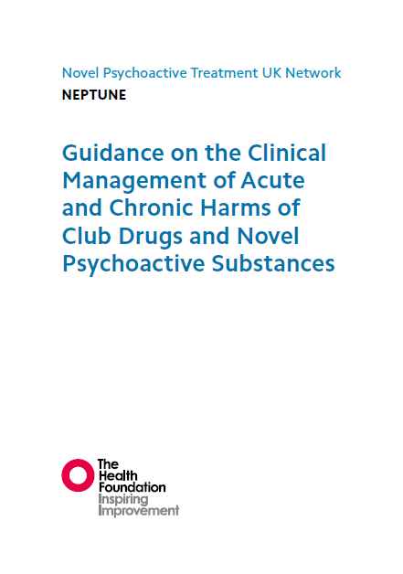
Neptune
Aims to raise standards in clinical management of club drugs including NPS across the health system (includes non-specialists)
A comprehensive review of treatment research literature for NPS and club drugs
Evidence-based clinical guidance
Where evidence is lacking, uses expert consensus
Neptune II is producing a range of clinical tools to support the main guidance

Slide 19
NPS in prisons
Prevalence:
High rates of synthetic cannabinoid use (Spice and Black Mamba), including by prisoners with no prior history of drug misuse
Two-thirds of prisons reported significant issues with NPS in 2014-15 compared to one third in 2013-14
Seizures of Spice increased from 15 in 2010 to 430 in first 7 months of 2014. At the same time, positive urine tests for ‘traditional’ cannabis fell by 59%
Impact
Associated with high levels of violence, suicide, self-harm and physical and mental health harms
Significant impact on day-to-day workload of both security and healthcare staff.

Slide 20
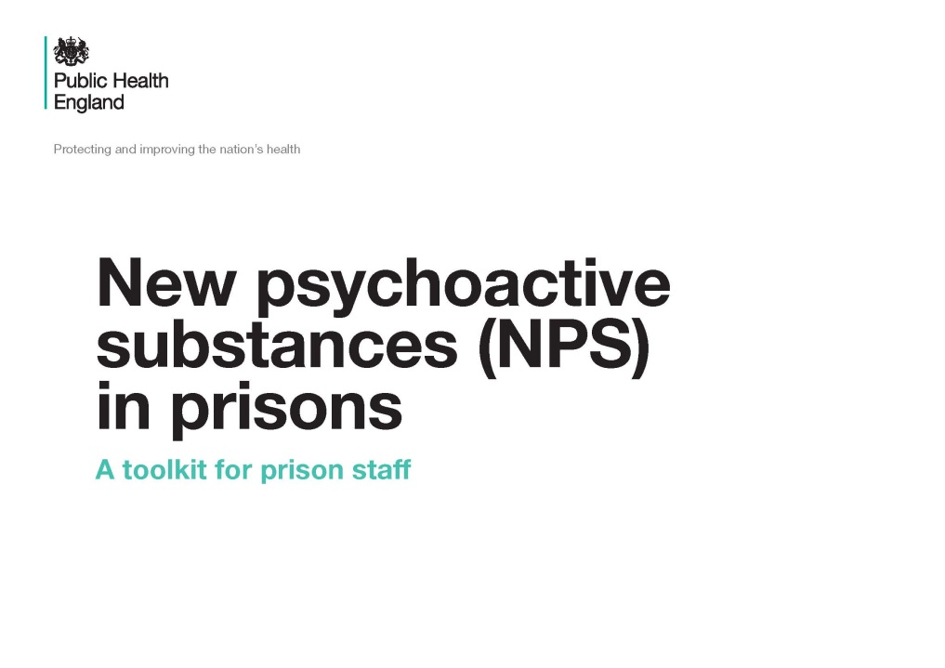
PHE Toolkit - NPS in Prisons
For custodial, healthcare and substance misuse staff
Provides information about:
  extent of use
  properties of various NPS
  how to manage from clinical, psychosocial and regime perspectives
  Psychoactive Substances Act 2016 makes possession of NPS in prison and offence
  Ministry of Justice introducing targeted testing for NPS and measures to combat supply (drones and phones)

Slide 21
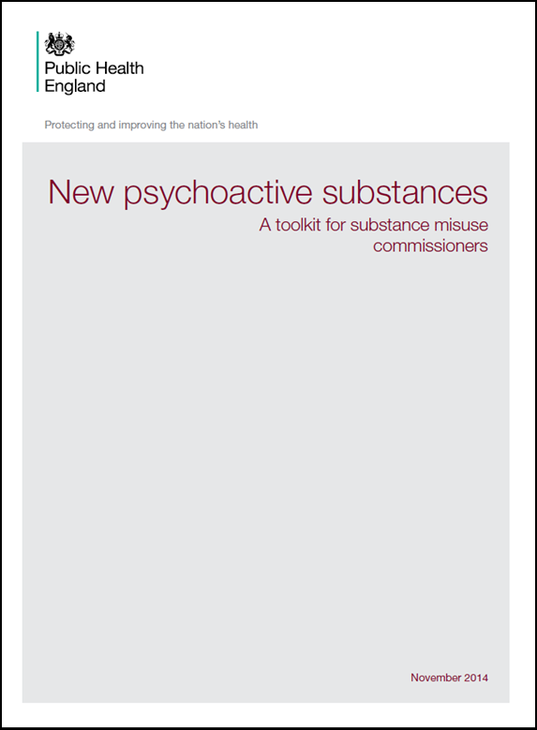
Supporting local authorities
    PHE NPS toolkit for treatment commissioners in local authorities
      tackling supply
      prevention, monitoring and information sharing
      responses to acute NPS problems
      treatment and other interventions
      workforce competence
      Prisons
      Partnerships and information sharing are key

Slide 22
Finally
‘The future…….
the future is already here,
it’s just not evenly distributed’
William Ford Gibson
Thank you.
Rosanna.O'Connor@phe.gov.uk

