Slide 1
Overview of European NPS situation and legal responses
Pompidou Group Symposium on NPS, Venice, 15 Nov 2016
Dr Roumen Sedefov

Slide 2


Slide 3
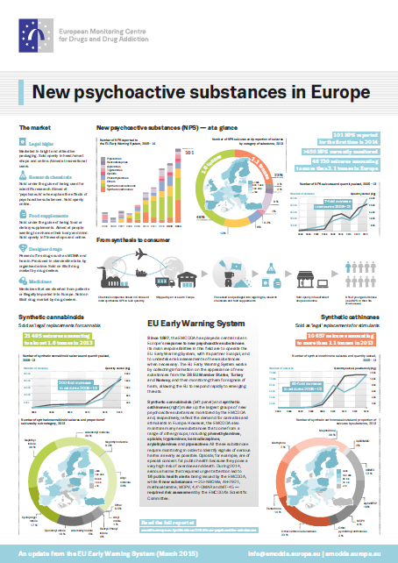
I will cover…
NPS phenomenon
Legal responses
Challenges

Slide 4
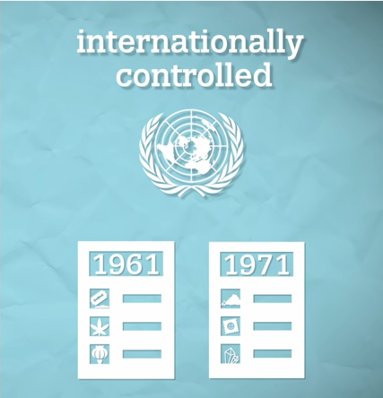
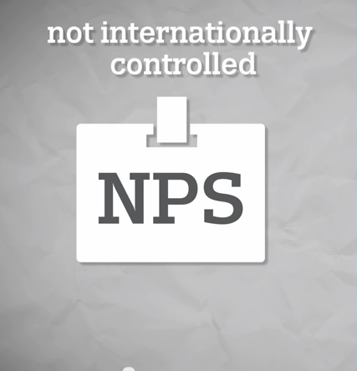
The distinction between old & new drugs may be becoming blurred …
250 substances scheduled
600+ NPS monitored by the EMCDDA

Slide 5
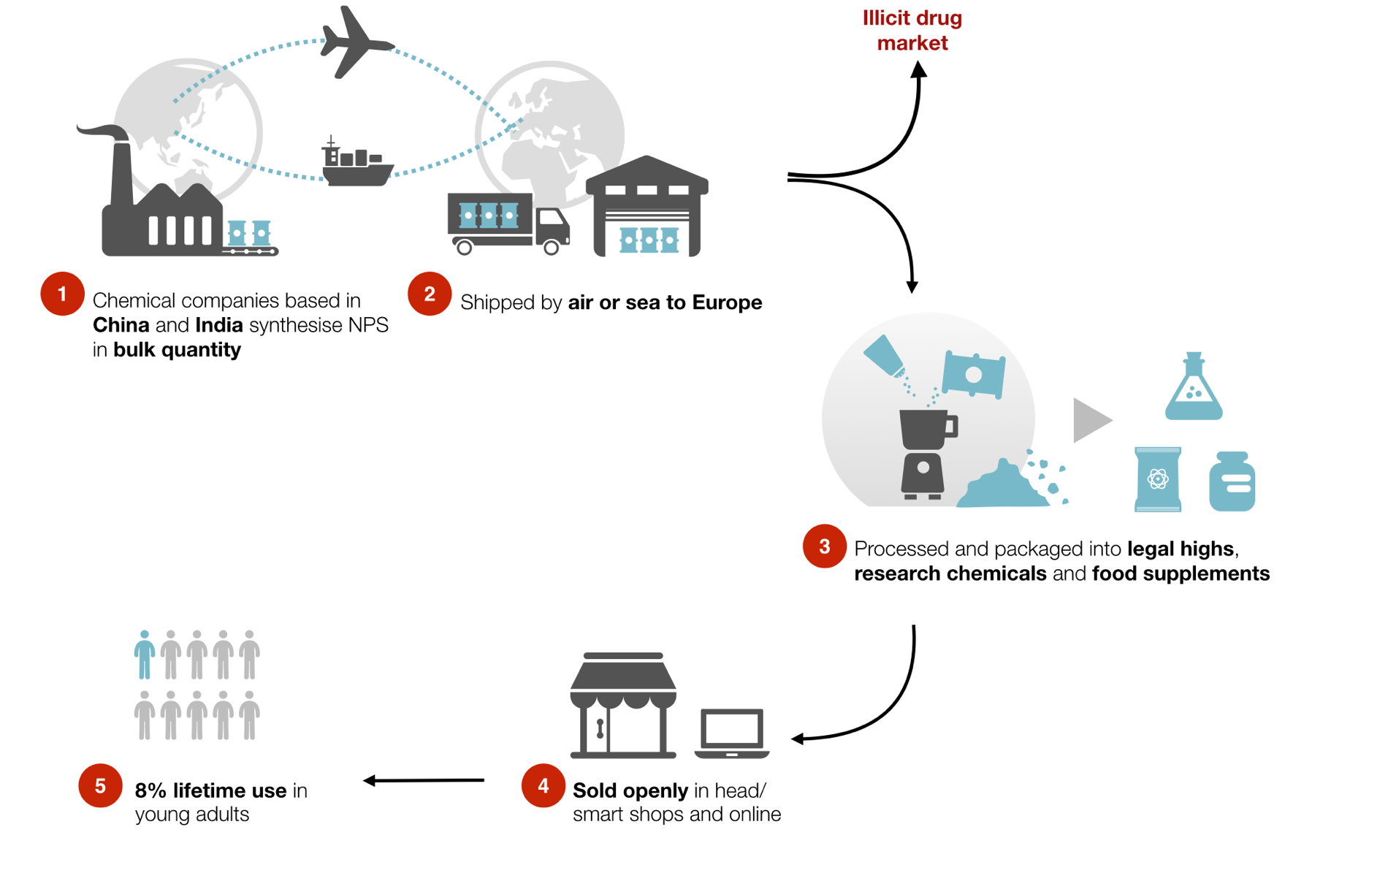
Global phenomenon
5
Notes:
OPRN MARKET Eurobarometer: 8% lifetime use in young adults (16-24 y.o)
Legal Highs, Medicines, Research chemicals, Designer drugs Food suplements

Slide 6
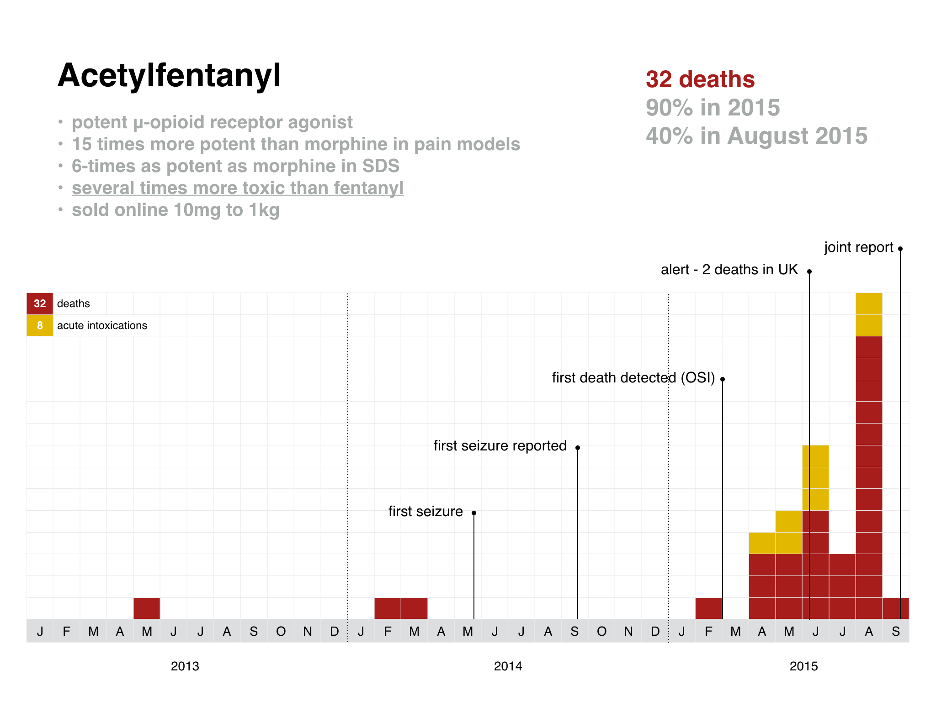
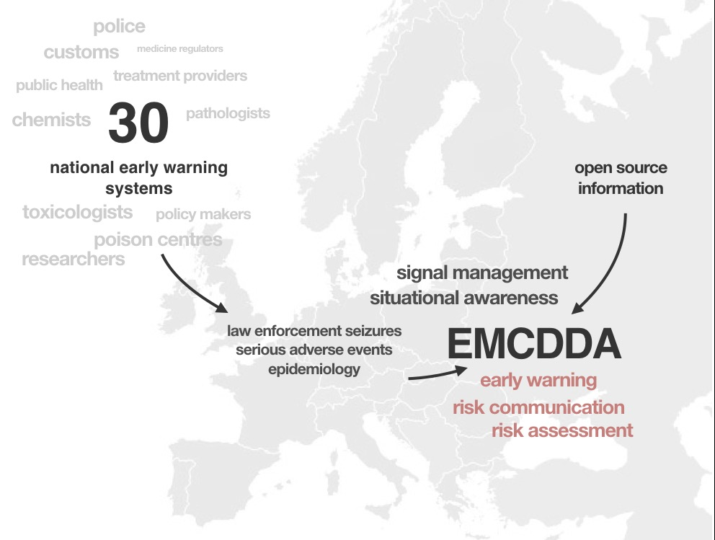
Notes:
The Greatest response so far,,

Slide 7
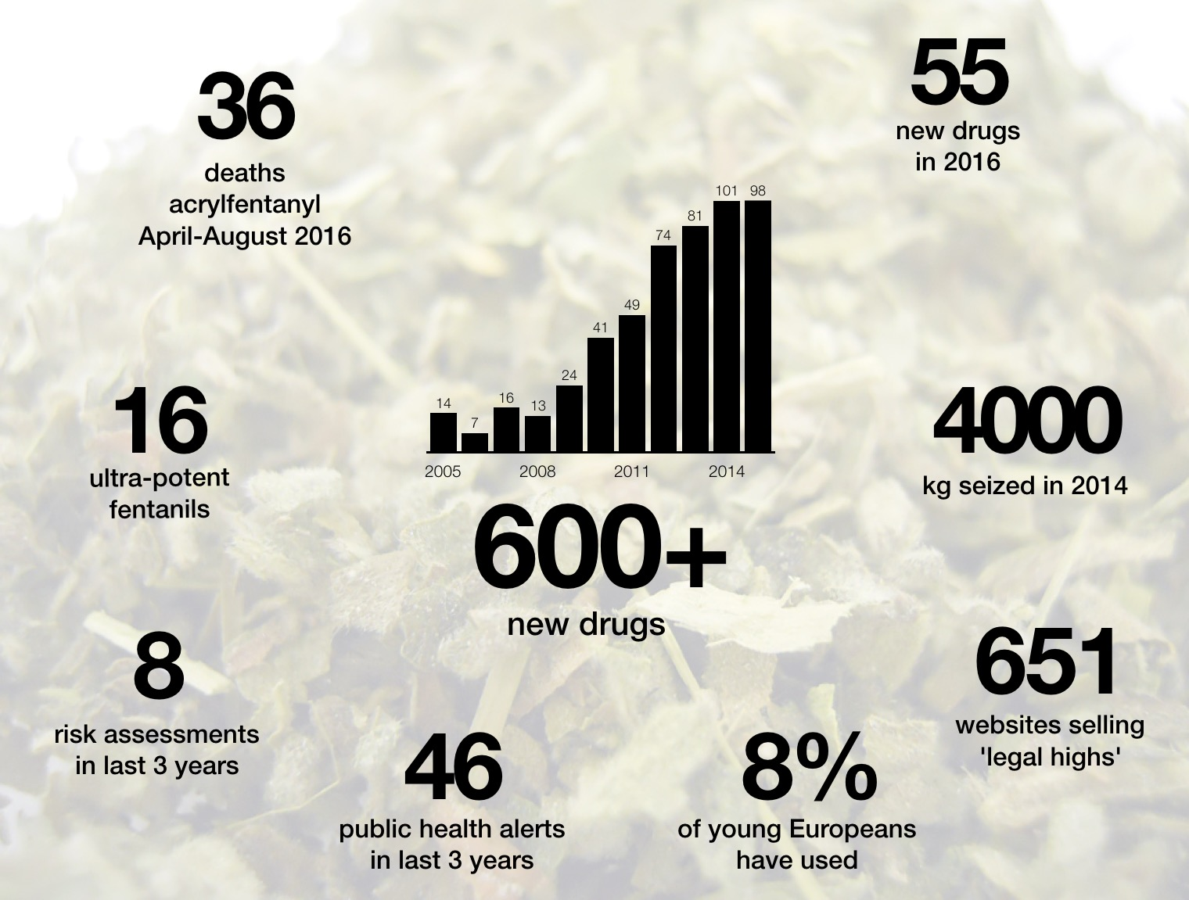
59
Speed of change
42
22
4000
8
651
49
8%
Notes:
Over the past few years the huge growth in availability of new psychoactive substances on Europe’s drug market has driven greater complexity into the drug problem and led to major new challenges for public health. The EMCDDA now monitors just over 600 new substances, with 83% (498) detected since 2010. This explosive growth in their availability is not driven by clandestine labs, but by legitimate chemical and pharmaceutical companies operating from China. These companies churn out vast quantities of legal replacements to controlled drugs — opioids, cannabinoids, benzodiazepines, stimulants — and ship them cheaply and quickly to Europe. From here they end up as 'legal highs', 'research chemicals', or 'food supplements' which are sold openly in the high street and online. They are also sold on the illicit drug market, either under their own name or passed off to unsuspecting users as heroin, cocaine, or ecstasy.
As a result of these changes we are now seeing major new challenges emerge that can rapidly threaten public health in Europe. These include both an increase in the number of serious poisonings presenting to hospital emergency departments as well deaths reported by coroners and medical examiners. Changes in the patterns of drug injection are also being driven by new substances; the fallout from this includes the further spread of HIV, hepatitis C, as well as bacterial infections — which have sometimes manifested as outbreaks. One particularly striking development linked to these changes is the emergence of outbreaks of mass poisonings.

Slide 8
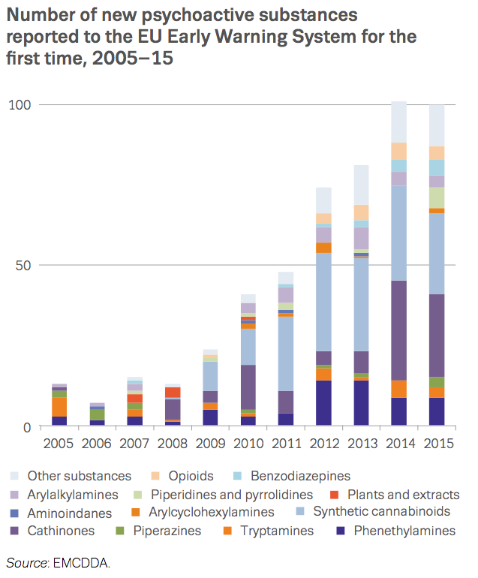
Diversity and numbers
An increasing range of substances
In 2015, 98 NPS were detected for the first time, bringing the total number of NPS monitored to more than 600
More than 80% of these detected since 2010
More than 140 public health related alerts issued
Notes:
The EMCDDA monitors more than 600 new substances which have appeared on the drug market since 1997; more than 80% (498) of these have been detected since the beginning of 2010.
Most are manufactured and sold openly, and many are high potent substances.
These substances have been linked to hundreds of serious poisonings, including deaths.
Since 2005, the EMCDDA has issued more than 140 public health alerts on serious and urgent issues to help Member States prepare at national-level.

Slide 9
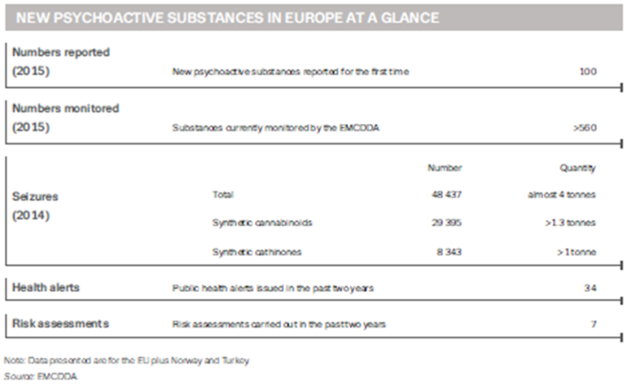
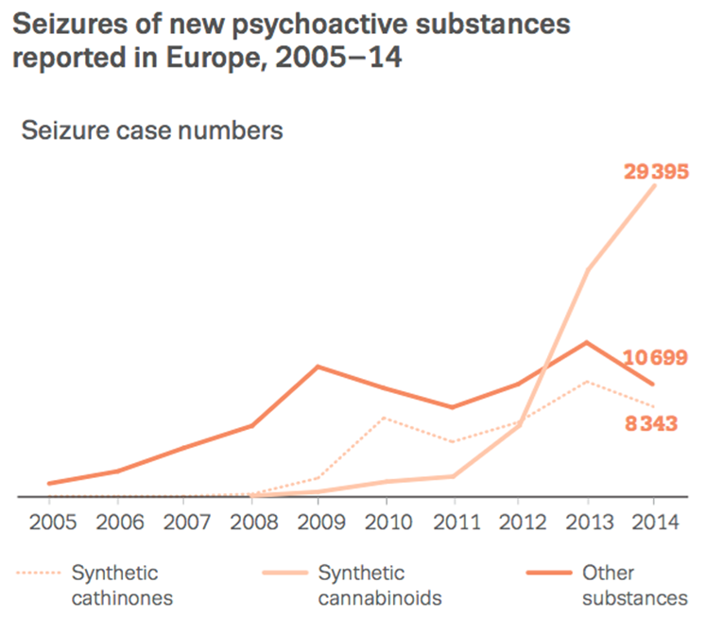
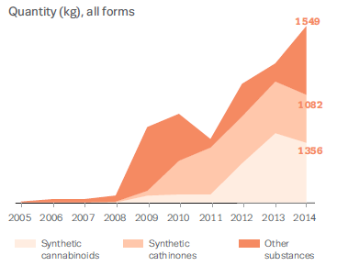
Synthetic Cannabinoids in the EU NPS Market
Source: European Drug Market Report 2016 (2014 data)
Notes:
In 2014, almost 50 000 seizures of new substances, amounting to almost 4 tonnes, were made across Europe — many of these substances are vastly more potent than their controlled counterparts.
Synthetic cannabinoids, which are sold as replacements for cannabis, accounted for the majority of these seizures, almost 30 000, and weighing more than 1.3 tonnes.
Together with cathinones, the two categories accounted for almost 80 % of the total number of seizures and over 60 % of the weight seized during 2014.

Slide 10
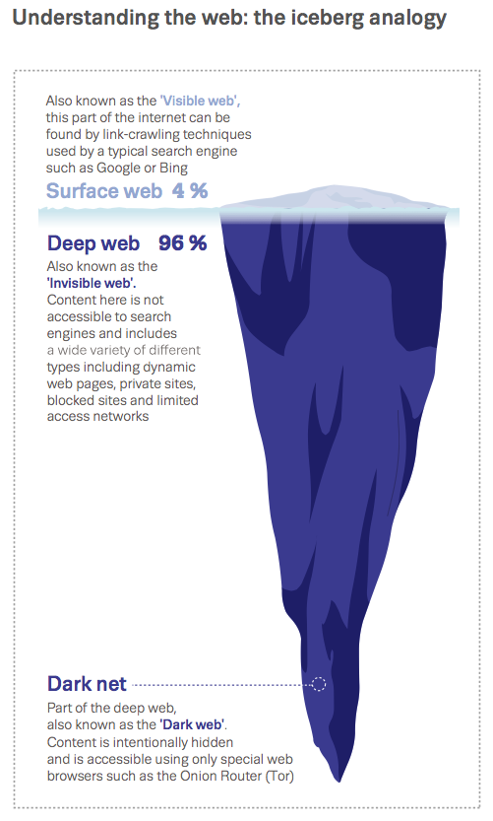
Information Technology a driver of drug market developments
Expanding influence of the internet
As a marketplace that is difficult to regulate & is quick to adapt
A catalyst for the more rapid diffusion of innovation & new trends
Provides access to research data & the back catalogue of the pharmaceutical industry
Notes:
Large increase in the speed and volumes that goods move at world level
Air, sea, land, freight, passengers
Facilitates and intensifies drug supply
Makes drug law enforcement more difficult
Globalisation in the chemical industry
Facilitates sourcing of NPS & new precursors
Makes diversion prevention more difficult

Slide 11
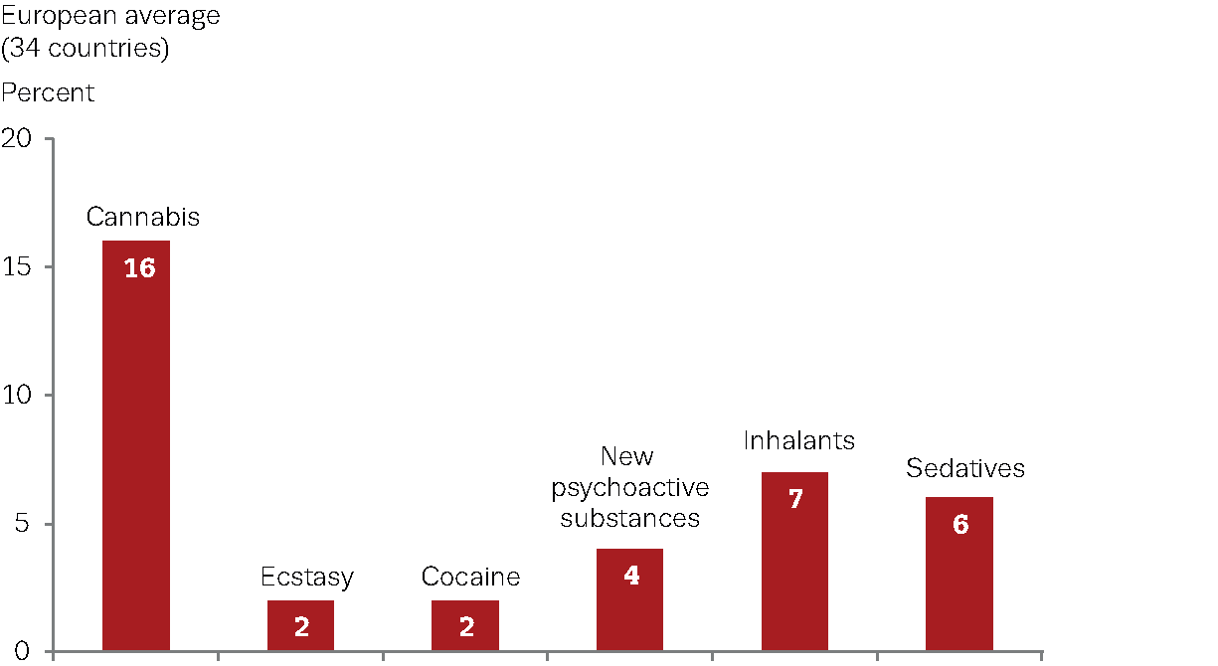
ESPAD lifetime prevalence of selected substances (15-16 year olds)

Slide 12
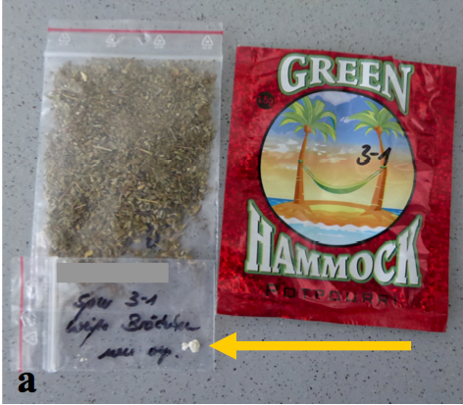
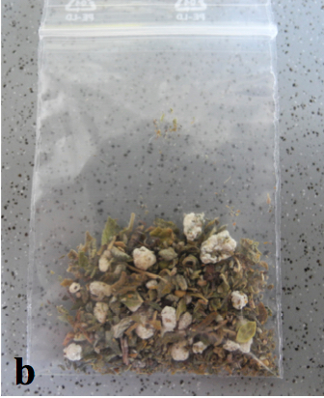
MDMB-CHMICA: highly potent - high risk of toxicity
Notes:
NPS products – a complicating factor HARMS sugar packet
The high potency of MDMB-CHMICA and the highly variable amounts of the substance in products constitute a high risk of acute toxicity
Example: Mocarz product in Poland – In 2015, more than 350 people were hospitalised over a few days in Poland after smoking a product called 'Mocarz‘ due to the high potency of synthetic cannabinoids
Composition(source M. Kidawa, Polish NFP):
2010 - JWH-203, JWH-081, JWH-019,
2014 - UR-144 and 5F-AKB-48
2015 – UR-144 and 5-FUR-144, BB-22, 5F-PB22, MDMB-CHMICA

Slide 13
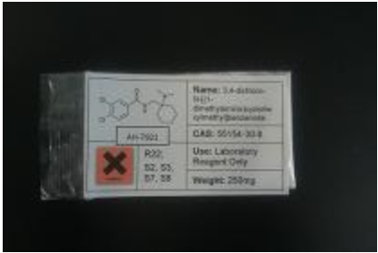
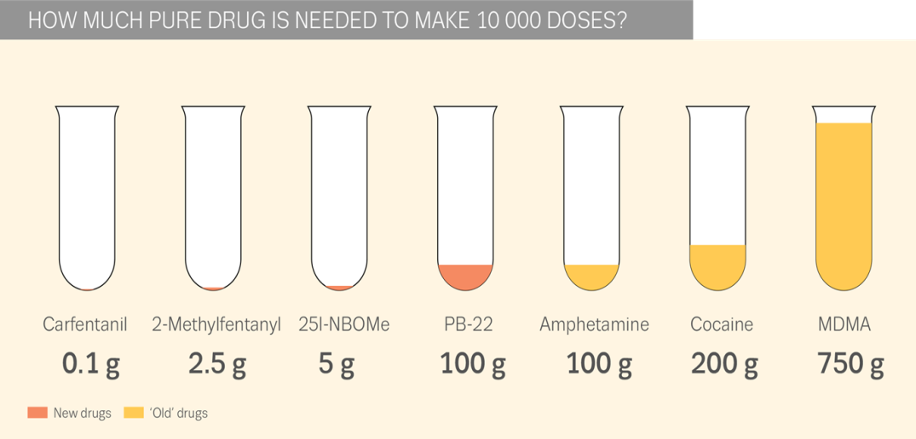
NPS opioids
Notes:
HARMS
Seizures
Incomplete list
Cases not a registry
Need to consider potency
Potency injecting
Reduction in treatment demand for heroin, but increase in treatment demand for other opioids
Being used as substitutes for heroin/morphine – change in type of users attracted to NPSSome are extremely potent (e.g. fentanyls)
Unknown ‘safety margin’ (effective dose/lethal dose)
Clusters of serious adverse events in short periods of time
AH-7921 15 deaths (3 countries) 6 NFIs (1 country)
MT-45 28 deaths (1 countries) 18 NFIs (1 countries)
Acetylfentanyl 32 deaths(4 countries) 8 acute intoxications (1 country)

Slide 14



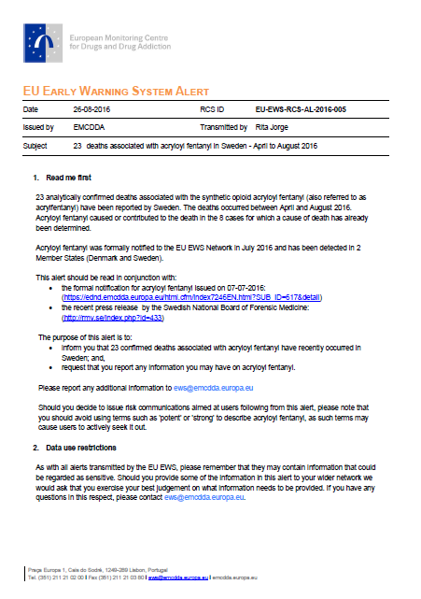
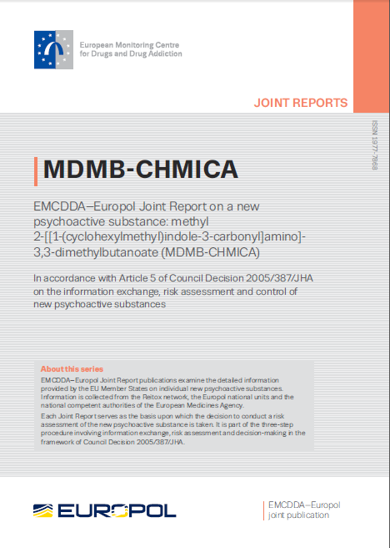

EU response: early warning and risk assessment
Signals
Information exchange
Early Warning System (EWS)
Pull information
II. Risk Assessment
Push information
Notes:
L’EMCDDA exist pour servir:
Les intitiutions europeénes;
Les deciseurs nationales;
Les professionales qui travaille sure les drogues

Slide 15

Changes in national legal responses since 2009:
New NPS laws:
Catch-all
Lists or group definitions.
Supply
Modifying drug laws:
Risk assessment
Group definitions
Temporary controls.
Use or supply
Existing non-drug (other) laws:
Consumer health/safety
Medicinal products (not since June 2014).
Supply
Notes:
3 types of response – using existing laws, modifying drug laws, using NPS laws. Various combinations which means classification is not simple or clear, but we try. The distinction we use is a lot based on whether the offence is supply-related only, or if people commit an offence in possession for personal use.

Slide 16
Timeline of innovations in NPS control in EU:
Law:
NPS
Drug
Other
IE
UK
RO
AT
HU
PT
SK
LV
LV
FI
PL
UK
LU
PL
IT
CY
LT
DK
FR
NO
HR
HU
FI
CZ
UK
AT
NL
IT
PL
RO
SE
PT
EU
2009
10
11
12
13
14
15
16
Notes:
Various have used medicinal products laws or types of consumer safety laws (hygiene, labelling, etc) to stop sale of individual products or to raid shops generally. RO advised mixed teams (consumer safety, medicines, tax inspectors) to check no laws were being broken. Sweden is a bit different as it gave enforcement powers to seize substances that were likely to be soon controlled.
8 countries made one innovation, then made another within the period. Could be for reasons of effectiveness or responding to public pressure.
Poland passed a law that combined the consumer safety law with the drug law, to control supply only.
LU, IT, CY introduced wider definitions, that they hadn’t used before (analogue/generic). HU and FI brought in a RA system to help add substances to the drug laws. CZ have drafted a law to move substances from parliamentary law to a government decree, so adding new substances will be faster in future.
UK, SK and HU now have a temporary classification in the drug law that will apply to supply-related offences only. FI expanded its drug law to be two-part psychoactive substances law, one for drugs, the other for NPS (“substances banned from the consumer market”). IE, RO and UK devised completely new laws with “catch-all” definitions for most psychoactive substances. AT also but with substances or substance groups to be listed in Ministerial regulation. These only apply to supply-related offences.

Slide 17
NPS specific laws – how specific?
 | AT | FI | HU | IE | LV | PL | PT | RO | SK | SE | UK TCDO | UK PSA
Defining psychoactive effects | █ |  | █ | █ |  |  | █ | █ |  |  |  | █
Motive (abuse or intoxication) | ► | ► |  |  |  | ► |  |  | ► |  | ► | ►
Harm or threat to health | X | X | X | Add |  | X | X | Dep | X |  | X
General laws may exclude products (alcohol, tobacco, medicines, food…)
Precise laws may exclude purposes (industrial, pharmaceutical, research…)

Slide 18
Definitions of “psychoactive”…
Stimulate or depress (AT,IE,RO) / affect (HU, PT) the CNS
Resulting in (AT), provoking (RO), it affects (UK) / it can (HU), capacity to (IE), ability to (PT)
Size qualifiers – as serious as (HU), comparable to (PT), similar to (RO), significant (IE,PT)
Behaviour (AT, HU, IE, PT, RO)
mental function (PT, UK) / mental processes (RO) / thinking (IE) / mental state (HU)
hallucinations (AT,IE,PT)
motor functions (AT,IE,PT)
perception (AT,IE)
mood (AT,IE), emotional state (UK)
Dependence (IE, PT, RO)

Slide 19
NPS specific laws – who updates the list?
Ministry of Health or similar | Government or similar | Other | No list
AT – Health FI – Social Affairs and Health HU – Human Capacities PT – Health SK – Health | UK (TCDO) – Home Office approved by Parliament | LV – Centre for Disease Prevention and Control SE – Medical Products Agency, NIPH | IE PL RO UK (PSA)

Slide 20
NPS specific laws – what (supply) penalties?
10
Years in prison
8
6
4
2
Fine €
250k
45k
332k
Confisc.
UK AT HU UK IE LV RO FI PL SK PT SE
(TDCO) (PSA)
Usually lower than drug laws…

Slide 21

CHALLENGES
Global dimension
Speed of change
Diversity/versatility
Detection/reference samples
Definitions
Internet market place
Lack knowledge
Poly-drug use
High risk of harms
Control

Slide 22
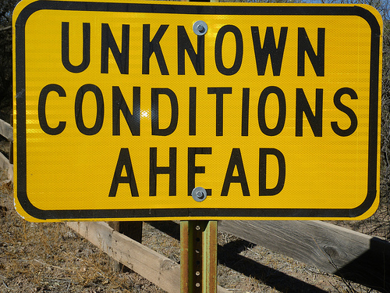
OPPORTUNITIES
EWS (EMCDDA)
Risk communication
Risk assessments
Prevalence
Prevention
Harm reduction
Emergency care
Control…

Slide 23
Thank you http://www.emcdda.europa.eu/

