Slide 1


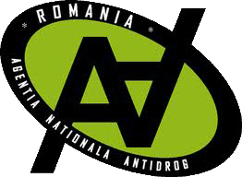

NEW PSYCHOACTIVE SUBSTANCES ROMANIA’s Experience
Notes:
Your excellencies, dear friends and colleagues,
I am honored to welcome you to our side-event and share with you the Romania’s experience with the NPS, virtual darknet drug markets and crypto-currencies as Bitcoin.
First of all let me introduce you the speakers for today ….

Slide 2
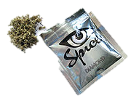
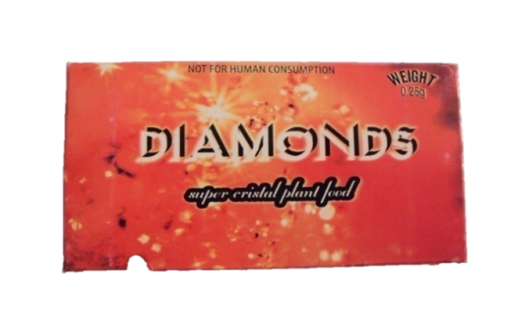

Romania – country profile
What are the NPS?-
NPS– brief history in Romania
WHY IS THIS A PROBLEM?
Strategic responses
MAIN OUTCOMES
limits & mutations
DARK NET
BITCOIN
Conclusions & Future developments

Slide 3
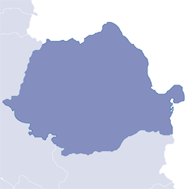
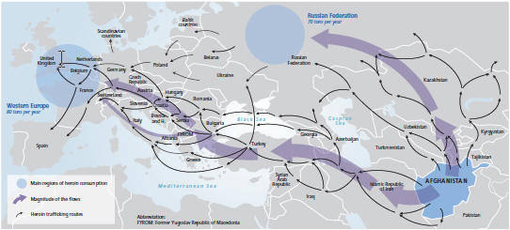
Country profile -
among the European countries with the lowest drug consumption rates –
below average for the most drugs
NPS – a maximum was registered during 2009-2010, then the trend went down. Slight increases of prevalence are observed in 2014 among users accessing the Emergency Units and Drug Treatment Facilities.
component of the northern part of the traditional Balkan route - the key rute of heroin trafficking.
Notes:
Located in the southeast of Europe, with a population of about 20 mil. inhabitants in 2014, Romania became a member of the European Union in 2007.
As it concerns the drug situation:
Romania continues to be among the European countries with the lowest drug consumption rates being below average for most of the drugs.
Cannabis recorded the most significant increase lately, but still, Romania shows low prevalence of this type of use (27th place of 29 EU member states reporting, 2013) . Opioids, mainly injected , continues to be observed especially among the drug users in Bucharest. We see also low but increasing rates of use of other illegal drugs in recent years - ecstasy, amphetamine-type stimulants and, to a lesser extent, cocaine.
Regarding the NPS – a maximum was registered during 2009-2010, then the trend went down. Slight increases of prevalence are observed in 2014 among users accesing the Emergency Units and Drug Treatment Facilities.
Romania is positioned on the main route of heroin to Europe (component of the northern part of the traditional Balkan route), and also located on the main routes used by traffickers for different drugs: canabis (from Spain), cocaine (from South America), synthetic drugs (from Western Europe, mainly the Netherlands) and NPS (from Asia).

Slide 4
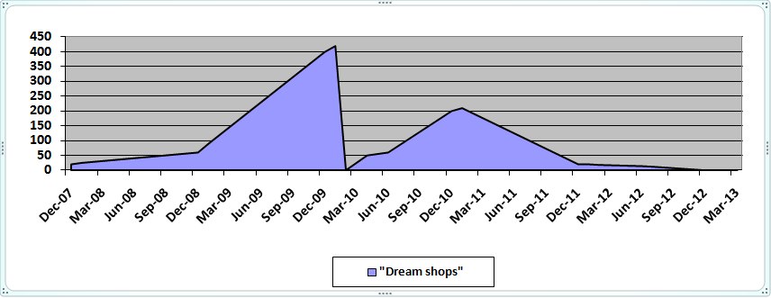
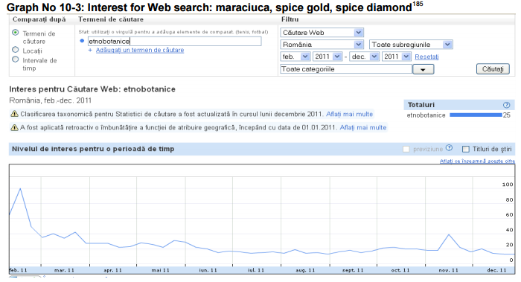
Brief history
NPS on the open market
2007-2010 => 450 SPICE SHOPS
The dynamic of the “Dream Shops” in Romania, 2007-2013
Notes:
The first occurrence of psychoactive substances in Romania was in 2007, when the unclassified drugs were reported. Exploiting the gap in the legislation, from 2008 to 2010, the NPS flooded the open market in Romania. The marketing strategy was an aggressive one, promoting the “legal high” mainly to a younger audience. The adverse effects immediately started to be noticed, as many users have sought medical attention.
Between 2007 and 2010, the so-called SPICE SHOPS/ DREAM SHOPS emerged in almost every city of Romania.
In 2009, an “online snapshot study” of the EMCDDA placed Romania on the fourth place (7%) considering the number of the NPS online whole sellers, after UK (37%), Germany (15%) & Netherlands (14%).
The NAA' specialists have developed an indicator to monitor the interest for "ethno-botanical plants", the term used then for the NPS. This indicator describes the global interest for the "legal drugs" based on the researches/queries done through the online "search engines“. The indicator has shown that the interest in the new psychoactive substances decreased in time similar to the number of specialized Spice shops.

Slide 5
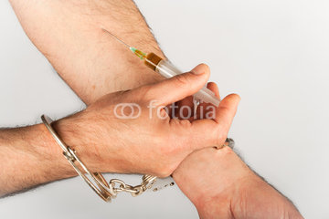
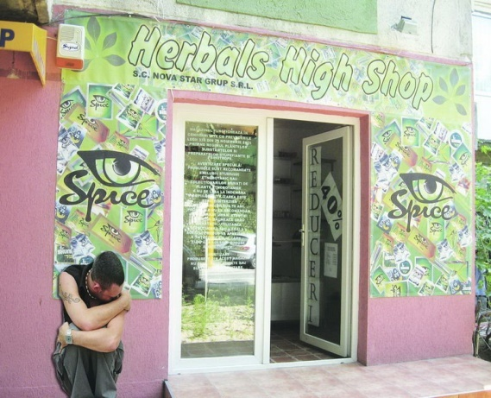
NPS–why is this a PROBLEM?
All studies and indicators show a PROBLEM
High prevalence and increasing dynamic, geographically widespreaded
Specific pattern of use (injecting drugs)
Harmful for IDU’s
Public health risk
Difficulties in knowledge and low possibilities of specific treatment
Insufficient impact of public policies’ controlling measures
Notes:
Beyond the obsessive mass-media signals, during 2009-2011, all of the NAA's routine monitoring systems and targeted studies indicated a new FORM OF PROBLEM DRUG USE – the NPS use.

Slide 6

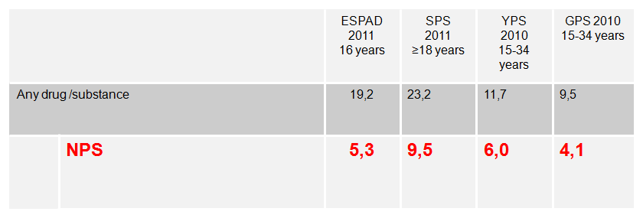
Data from studies – target populations
GPS 2010 (national level/15-64 years) –
NSP: LTP 2%, LYP 1,1%, LMP 0,6%
NPS use - popular among the youngster populations
Notes:
The NPS use seems to be popular among the youngster populations at national level, as shown by the lifetime prevalence recorded by all our targeted studies.
The NAA’ study -Risks Assessment of the use of new psychoactive substances among children and young people in Romania” - 2011 indicated the high epidemiological risk because of the widespread of NPS use among the highly educated users, very well skilled in using new web-based communication media (forums, blogs, chats etc.) and able to share their own experiences or simply order “take-away” doses of NPS advertised within the on-line shops.

Slide 7
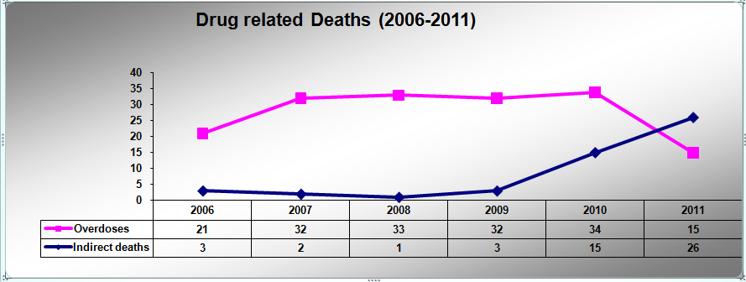
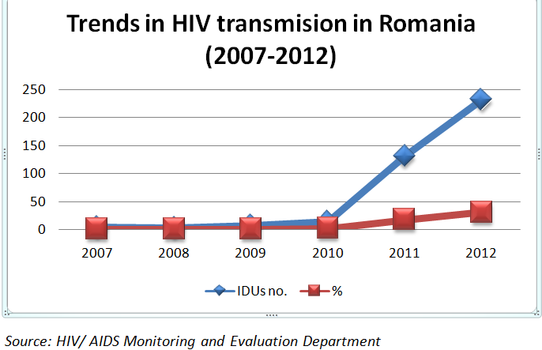
explosive growth of
indirect death cases
HIV+ OUTBREAK among IDUs from Bucharest!!!
Notes:
A joint risk assessment mission of ECDC and EMCDDA conducted in Romania and Greece in 2012 have confirmed the detection of a strong increase of newly reported HIV infections among IDUs in 2011 by the Romanian HIV surveillance system.

Slide 8

STRATEGIC RESPONSE
main strategic actions :
Monitoring, systematic surveillance and risk assessment
Prevention and harm reduction interventions
Control – legal responses
International cooperation
Notes:
In order to reduce the availability and use of the NPS in Romania, main strategic directions were engaged:
Monitoring, systematic surveillance and risk assessment
Prevention, treatment and harm reduction interventions
Control – legal responses
International cooperation within the framework of the UN Narcotics Conventions and at the EU level

Slide 9
Monitoring, systematic surveillance and risk assessment – main tools
surveillance and ad-hoc specialized studies
GPS- 2010, 2013
ESPAD -2011,2013
KEY Indicators
TDI, DRID, DRD
routine monitoring systems
Drug related medical emergencies(2010)
BSS-2010, 2012
Other ad-hoc studies
Government Action Plan to counter the trade and use of new psychoactive substances/ products that are health damagingNeedle & syringes programs (2012)
On-line interest for NPS
Notes:
In order to provide to the policy makers systematic monitoring and surveillance data on the NPS, three main tools were used:
surveillance and ad-hoc specialized studies – from which we have to mention the two General Population Surveys from 2010 & 2013; the two ESPAD studies from 2011, 2013 and the Behavioral Surveillance Surveys from 2010 and 2012.
Key –epidemiological indicators – statistics from the Treatment Demand Indicator (TDI), Drug Related Infectious Diseases (DRID) and Drug Related Deaths (DRD) have been constantly used to assess the extent and the specific patterns of the NPS.
routine monitoring systems –
Drug related medical emergencies (developed in 2010 by the NAA);
Needle & syringes exchange Programs (set up by the NAA in 2012);
On-line interest for NPS (developed in 2011)

Slide 10
Prevention& Harm reduction
PREVENTION
Campaigns
Training
OST
1200 slots available in Bucharest
NPS
2 mil. syringes /year since 2012
GIRRAD
HIV/HCV&HVB Testing
scaling up the screening for HIV& HVC)
National Antidrug Strategy
(2013-2020)
setting up an informal group of consultation
dedicated measures of harm-reduction (syringe vending machines, consumption rooms.)
Notes:
An important role was played by the prevention services, provided mainly by the NAA territorial network of specialists.
With a clear focus on the most at risk population (youngsters) the prevention national – level campaigns have successfully completed the integrated approach of public policy for NPS control.
Training activities enhanced the preventive interventions, targeting some professional categories (psychologists, traffic police officers, volunteers, journalists) and parents.
Harm reduction:
Since November 2011, when the HIV outbreak among IDUs was declared, together authorities and civil society have made incredible efforts to sustain the harm-reduction services, in order to limit the extention of the above mentioned HIV outbreak.

Slide 11
legal responses:
Using existing laws focused on consumer and health protection (administrative measures)
Using & updating the anti-narcotic conventional legislation
Innovative legal responses (substances defined by its effects rather then chemical structure)
Notes:
Three main methods for legal response were enacted:
updating the anti-narcotic conventional legislation
using existing laws focused on consumer and health protection
innovative legal responses
Thee first responses to the NPS proliferation were to enact two legal documents, which laid the grounds for placing 73 new psychoactive plants and substances under national control.
More specific, have foreseen a special category - “products/ substances under national control“, speeding up the process of placing under control the NPS identified as such.

Slide 12
Innovative legal responses
National NPS Regulation
“substitute”
psychoactive effect
authorization
defining substance by its effects rather then chemical structure
Notes:
Laying down rules to counter operations with products likely to generate psychoactive effects, others than provided by the effective law established the legal provisions applicable to preparations, substances, plants, mushrooms or combinations of the such, that are likely to yield psychoactive effects similar to drugs, and provides measures to prevent, control and counter the use of such products out of public health reasons.

Slide 13
International cooperation
EWS
UNODC
EMCDDA
REITOX
Notes:
International cooperation proved an important tool in our fight to identify, risk assessing and control of the NPS and it was focused on 3 main directions:
Cooperation at the EU level on the information exchange, risk assessment and control of new psychoactive substances (setting up an working Early Warning System on NPS ).
Cooperation with the UN bodies within the framework of the International Narcotic Conventions

Slide 14
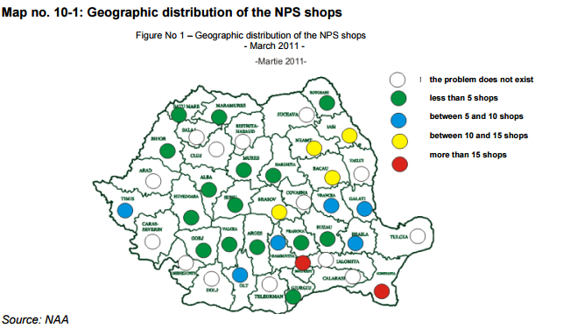
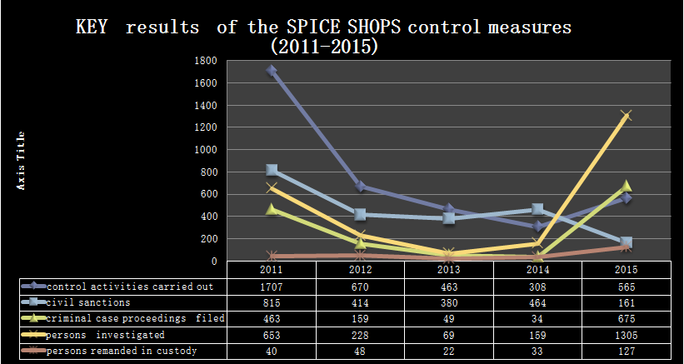
NO more STREET SPICE/DREAM SHOPS
1.188.184 euro (fines) / 138.340 NPS envelopes confiscated !
2015 – intense activity for the law enforcement representatives
Notes:
Routine monitoring of the government controlling measures indicates that by the end of March 2011, 158 “dream-shops” selling NPS were still functioning. The immediate effect of the government controls was the closure of all street Spice/ Dream Shops by the end of 2012.

Slide 15
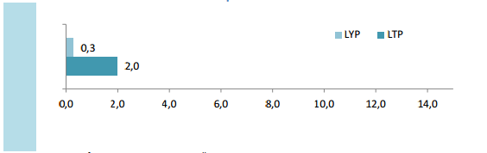
GPS 2013- NPS use is declining
The prevalence of NPS use in General Population
(15-64 years)
 | LTP(%) | LYP(%) | LMP(%)
GPS 2010 | 2 | 1.1 | 0.6
GPS 2013 | 2 | 0.3 | 0
Notes:
If we consider the GPS as a relevant indicator for the progress of the NPS use in Romania we can see that according to GPS 2013 - 2% of the sampled general population aged 15-64 years have experienced NPS use, while only 0,3% from the interviewed have declared NPS use in the last year (recent Use). No current use (last month) was registered for NPS, meaning that this pattern of use is declining.

Slide 16
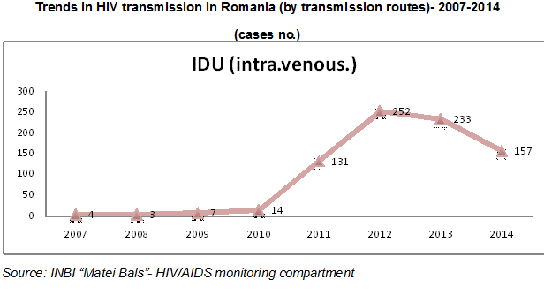
HIV+ epidemic – steadily decreasing
stabilization and slightly decreasing trend for the new diagnosed cases of HIV+ IDUs
Notes:
HIV trends:
stabilization and slightly decreasing trend for the new diagnosed cases of HIV positive IDUs
significant decrease of the HIV positive prevalence among IDUs in treatment

Slide 17
Organized
Crime
Group
-NPS
online advertising
MLM
DARKNET
surface web
Notes:
All the efforts made to counter the NPS phenomenon, even effective, however forced the distribution on to the black market.
Organized Crime Groups (OCG) are now involved in NPS distribution all over the country. Several methods are used:
The classic distribution on the street (MLM - multi level marketing networks of peers or trusted clients, following the same pattern as the illicit drugs)
Distribution on the internet (surface web or dark net crypto-markets)
Advertising on the on-line publications

Slide 19
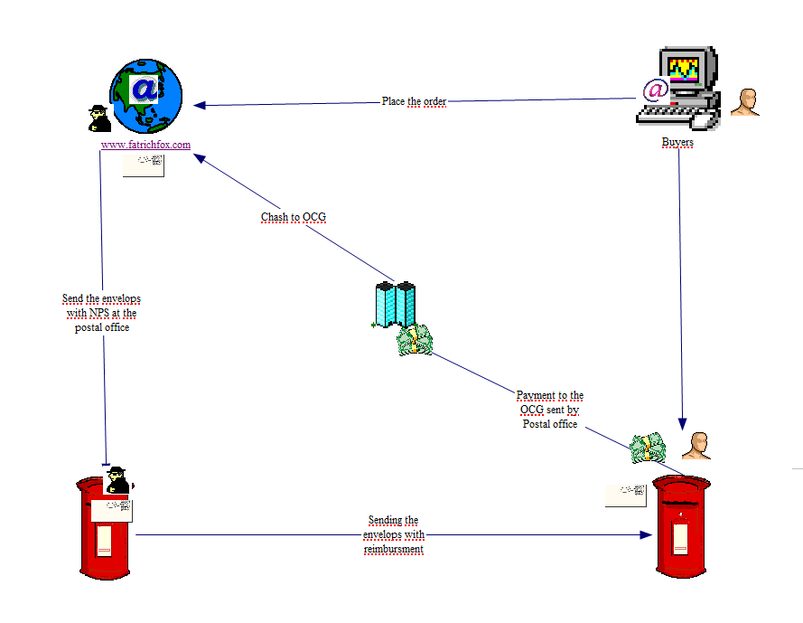
^{CASE STUDY >} ^{Operation SmartFox}
^{- Typical scenario of NPS} ^{distribution}
MODUS OPERANDI
Notes:
I will further show you a case study of an operation undertaken by the Romanian Police, a typical scenario of NPS distribution.
MODUS OPERANDI
the OCG ( Organized Crime Group) used an open source site – www.fatrichfox.com- to sell uncharted NPS
the organization imported substances from outside Europe and proceeded mixing the compounds on the continent
to conceal their activity, menial tasks were conducted by “ straw men”
they used fake identities to send envelopes containing NPS to the whole Romania using the Romanian Post Service
products were paid by reimbursement
the money was eventually collected in just one bank account, belonging to another “ straw man”
RESULTS:
-2300 envelopes sent from 15 feb. to 8 may 2015 (200kg) of NPS
- 100.000 euro in cash
- 20 people arrested in Romania
- OCG – strong connections in Hungary & Czech Republic

Slide 20

^{CASE STUDY >} ^{Operation SmartFox}
^{- Typical scenario of NPS} ^{distribution}

Slide 21
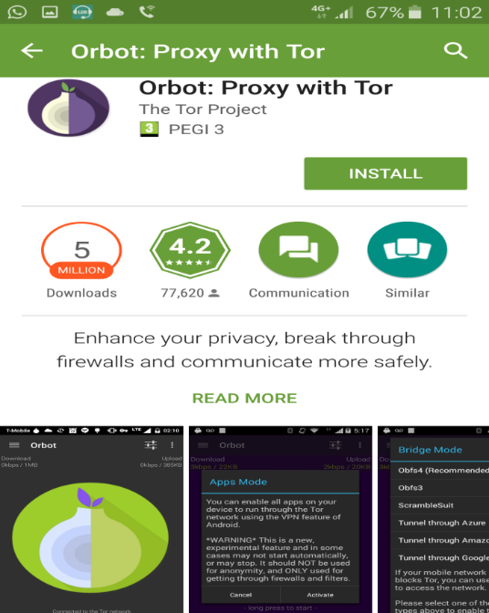
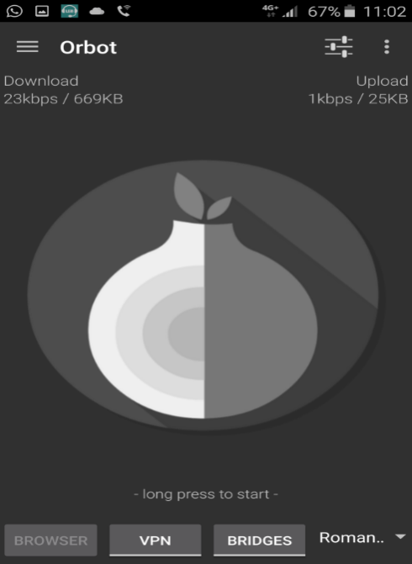
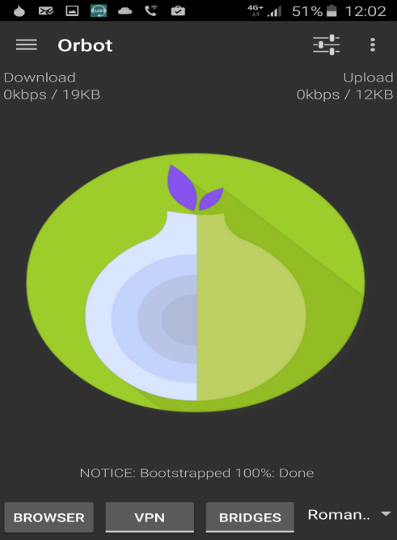
Accessing DarkNet - Easy on any ^{platform}
^{Accessing DarkNet From} ^{Your} ^{Mobile}
1.Install the dedicated application for mobile (For example ORBOR or others)
^{2.Connect to TOR}
^{Time: 10 min.}
You can now access any dedicated sites.
Notes:
The users connect with a fake IP (complete anonymity). Products delivered are mainly illegal on the open market (drugs, fire arms, illegal software and so on).
Currently this problem has not been properly addressed & the platforms offer a thriving illegal setting.
Big concern about the distribution of narcotics through the Dark Web.

Slide 22
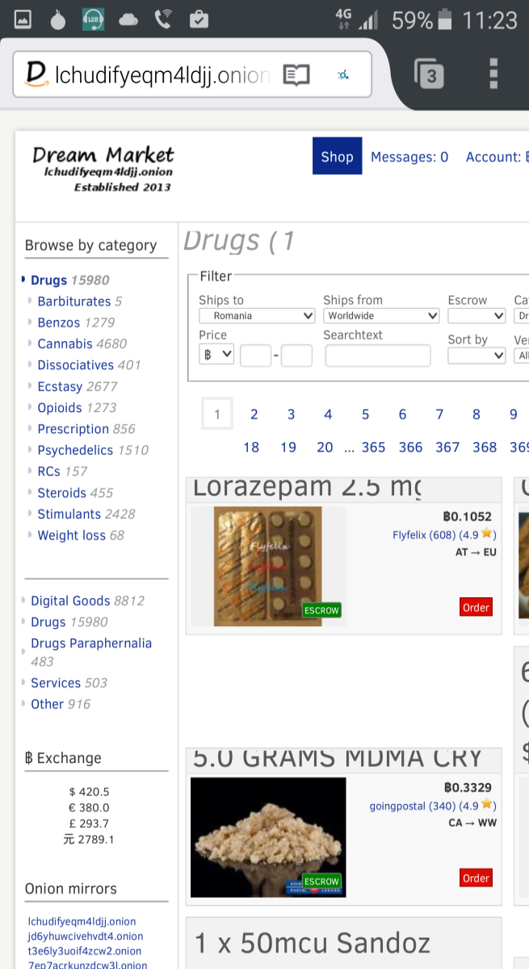
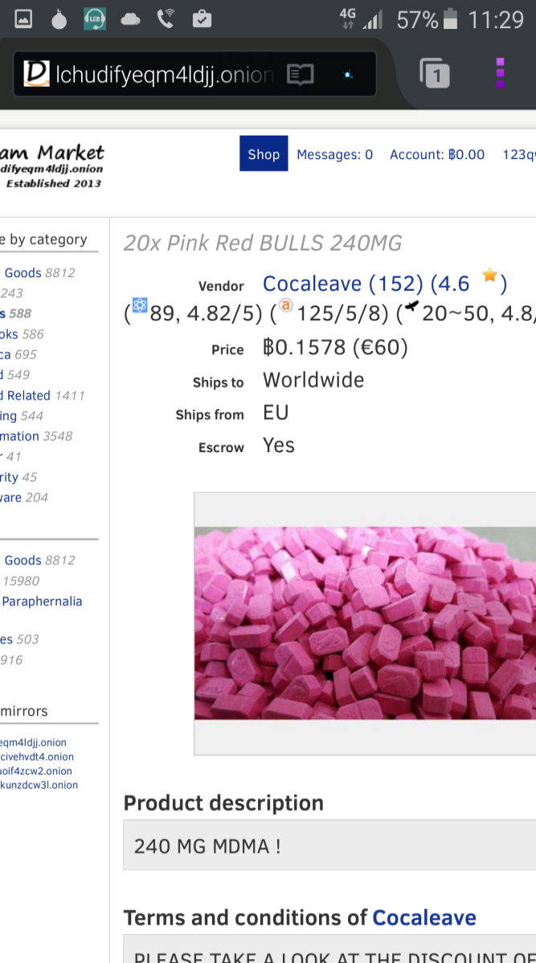
Access a dedicated site. In this case we show Dream Market.
A plethora of products are listed.
^{The offers are wide.}
^{Payment is made in Bitcoins.}

Slide 23
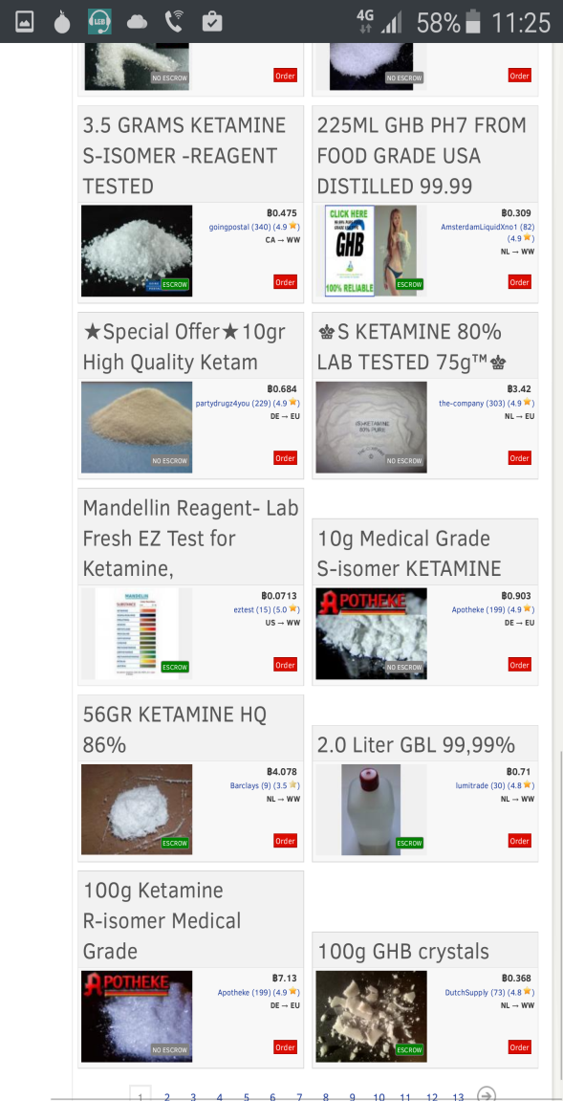
The users connect with a fake IP and complete anonymity.
Products advertised are mainly illegal on the open market, such as drugs, fire arms, illegal software, hardware connected to criminal activity and so on.
Currently, this problem has not been properly addressed and the platforms offer a thriving illegal setting.
Specifically, we are concerned about the distribution of narcotics through the Dark Web.

Slide 24

^{Bitcoin}
^{Characteristics:}
Bitcoin is a form of digital currency, created and held electronically.
No Government authority controls it.
It’s the first example of a growing category of money known as cryptocurrency.
Only 21 million bitcoins can ever be created by miners. However, these coins can be divided into smaller parts.
^{It's anonymous}
Notes:
Bitcoin a new challenge for investigating criminal cases
Bitcoin spread all over the world
Bitcoin a new digital currency that can not be supervised
For converting Bitcoins into real currency there are several dedicated sites with exchange rates.
There are also dedicated sites that help you locate Bitcoins ATM.
There are also either persons or companies wiling to do the converting process in all the country.

Slide 25
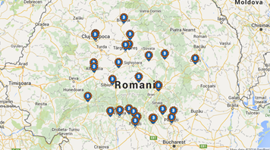
Threats regarding BITCOIN:
Bitcoin offers anonymity
Large amounts of money can be transferred under the radar
Lack of means &infrastructure to locate & seize Bitcoins
Can be used to pay on Darknet
Strongly advertised
drugs transactions paid with Bitcoins

Slide 26
Conclusions
Romania – among European countries innovative responding to the NPS challenge
NPS phenomenon mutations generate different problems which need to be addressed by new solutions and new dedicated resources.
The interventions have notably reduced the NPS related problems in Romania, but also forced up some mutations and readjustments of the markets for these substances (newly emerged on-line markets).
Notes:
At the beginning ( 2008-2010), due to the rapid growth of the NPS phenomenon, the authorities have provided an integrated, coherent and effective control system of the NPS. The NPS use recorded accelerated increase and diversification during 2009-2011, with downfalls and comebacks determined by the legal measures of controlling implemented.
Romania is considered since then then among the European countries which provided an innovative response to the NPS challenge.
The new NPS phenomenon mutations generates different problems which need to be addressed by new solutions and new dedicated resources (not available at the moment)

Slide 27
Future developments
strengthen monitoring & surveillance systems
constant knowledge &
resources development
for on-line NPS’ monitoring
international cooperation
strengthening of dedicated resources for countering NPS illicit trafficking
Notes:
Maintain and strengthen all the monitoring and surveillance systems operating now
Strengthening of dedicated resources for countering NPS illicit trafficking
3. Scaling-up prevention & harm-reduction interventions in order to copy the HIV positive epidemic among IDUs
4. Constant knowledge & resources development regarding on-line NPS’ monitoring and combat interventions (cybercrime, IT, intelligence and strategic analyze)
5. Further developing of the international cooperation at all levels

Slide 28


Thank you for attention!
http://www.ana.gov.ro
http://politiaromana.ro

