Slide 1

STREAM Stage 1 Preliminary Efficacy and Safety Results
December 2017

Slide 2
STREAM Stage 1 design
STREAM is a randomised controlled trial with a non-inferiority design
The control regimen is the locally used 2011 WHO recommended regimen in the participating countries
The study regimen is closely similar to the regimen used in Bangladesh with the exception that high dose moxifloxacin replaces high dose gatifloxacin
Participants were seen every four weeks to 132 weeks post randomisation

Slide 3
Key eligibility criteria
Eligible patients were adults with bacilli resistant to rifampicin but sensitive on line probe assays to fluoroquinolones and aminoglycosides
Patients with pre-existing QT prolongation (QTc > 500 ms) or evidence of liver abnormality (AST or ALT > 5*ULN) were excluded as were pregnant or breast feeding women

Slide 4
Total enrolled by site
Country | Site | Study | Control | Total
Ethiopia | Addis Ababa: AHRI | 38 | 17 | 55
 | Addis Ababa: St Peter’s | 47 | 24 | 71
Mongolia | Ulaanbaatar | 22 | 11 | 33
South Africa | Durban | 60 | 30 | 90
 | Johannesburg | 41 | 20 | 61
 | Pietermaritzburg | 8 | 6 | 14
Vietnam | Ho Chi Minh City | 66 | 34 | 100
Total |  | 282 | 142 | 424

Slide 5
Population
 | Study | Control | Total
Total randomised | 282 | 142 | 424
Exclusions from mITT population
No positive culture | 20 | 8 | 28
RIF sensitive on phenotypic test | 5 | 3 | 8
XDR-TB on phenotypic test | 1 | 1 | 2
Randomised in error | 2 | 1 | 3
Modified ITT population | 254 | 129 | 383

Slide 6
Efficacy analysis population
 | Study | Control | Total
Modified ITT population | 254 | 129 | 383
Excluded from efficacy analysis
Randomised after 3rd Dec 2014 | 34 | 16 | 50
Reinfection | 6 | 0 | 6
Not seen after 76 wk but last culture negative | 4 | 5 | 9
Modified ITT efficacy analysis population | 210 | 108 | 318

Slide 7
Baseline characteristics (1)
 | Study | Control | Total
Age in years: 18-24 | 22% | 31 24% | 87 23%
25-34 | 35% | 45 35% | 134 35%
35-44 | 58 23% | 33 26% | 91 24%
45 or more | 20% | 20 16% | 71 19%
Gender: Male | 152 60% | 82 64% | 234 61%
Female | 102 40% | 47 36% | 149 39%
Weight band (kg): < 33 | 1 <1% | 0 0% | 1 <1%
33 – 50 | 116 46% | 59 46% | 175 46%
> 50 | 137 54% | 70 54% | 207 54%
HIV status: Negative | 168 66% | 89 69% | 257 67%
Positive | 86 34% | 40 31% | 126 33%
Total | 254 100% | 129 100% | 383 100%

Slide 8
Retention
Week |  | Study | Control
 |  | N % | N %
76 | Expected | 282 100% | 100%
 | Seen now or later | 248 88% | 89%
 | Died | 19 7% | 6 4%
 | Not seen | 1 <1% | 1 <1%
 | Discontinued study | 14 5 | 8 6%
132 | Expected | 100% | 130 100%
 | Seen now or later | 218 84% | 82%
 | Died | 22 8% | 7 5%
 | Not seen | 1 <1% | 2 2%
 | Discontinued study | 20 8% | 14 11%

Slide 9
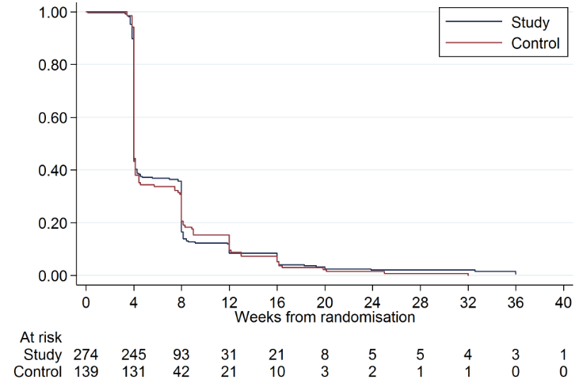
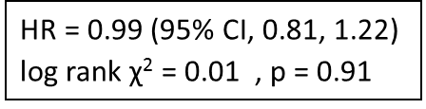
Time to smear conversion
HR = 0.99 (95% CI, 0.81, 1.22) log rank χ² = 0.01 , p = 0.91

Slide 10
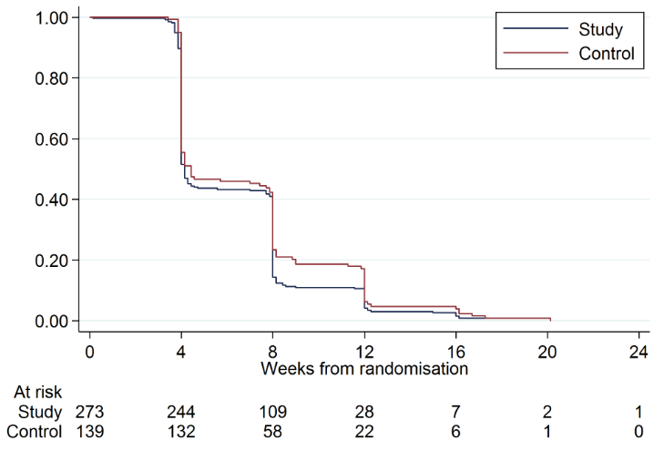
Time to culture conversion
HR 1.14 (95% 0.93, 1.40) log rank χ² = 2.51 p = 0.11
HR 1.14 (95% 0.93, 1.40) log rank χ² = 2.51 p = 0.11

Slide 11
Unfavourable outcome definition
A patient’s outcome is classified as unfavourable if:
started > 2 additional drugs (includes change of regimen)
treatment extended beyond permitted duration
death at any point up to 132 weeks post-randomisation
positive culture result at 132 weeks post-randomisation or when last seen
not seen at 76 weeks or later

Slide 12
Favourable outcome definition
A patient’s outcome is classified as favourable if culture negative at 132 weeks and at the previous occasion they were seen unless the patient had already been classified as unfavourable

Slide 13
Primary efficacy result (1)
 | Study | Control
 | N % | N %
Total assessed | 100.0 | 108 100.0
Favourable | 164 78.1 | 87 80.6
Unfavourable | 46 21.9 | 21 19.4
Difference in response (crude) | 2.5%
95% confidence interval | -6.9%, 11.8%
Difference in response (standardised) | 2.1%
95% confidence interval | -6.9%, 11.2%

Slide 14
Primary efficacy result (2)
 | Study | Control
 | N % | N %
Total assessed | 100.0% | 108 100.0%
Unfavourable | 46 21.9% | 21 19.4%
Started > 2 additional drugs | 24 11.4% | 6 5.5%
Extended treatment beyond allowed | 4 1.9% | 0 0.0%
Died during treatment or follow-up | 12 5.7% | 6 5.5%
Not seen at or after 76 wk | 6 2.9% | 7 6.5%
Culture positive at 132 wk | 0 0.0% | 2 1.9%
Difference in response (crude) | 2.5%
95% confidence interval | -6.9%, 11.8%
Difference in response (standardised) | 2.1%
95% confidence interval | -6.9%, 11.2%

Slide 15
Primary efficacy result (3)
 | Study | Control
 | N % | N %
Total assessed | 100.0% | 108 100.0%
Unfavourable | 46 21.9% | 21 19.4%
Change: never converted/reverted | 12 5.7% | 2 1.9%
relapse | 7 3.3% | 2 1.9%
toxicity | 3 1.4% | 1 0.9%
other | 6 2.9% | 3 2.8%
Died | 12 5.7% | 6 5.6%
Lost to follow-up | 6 2.9% | 7 6.5%

Slide 16
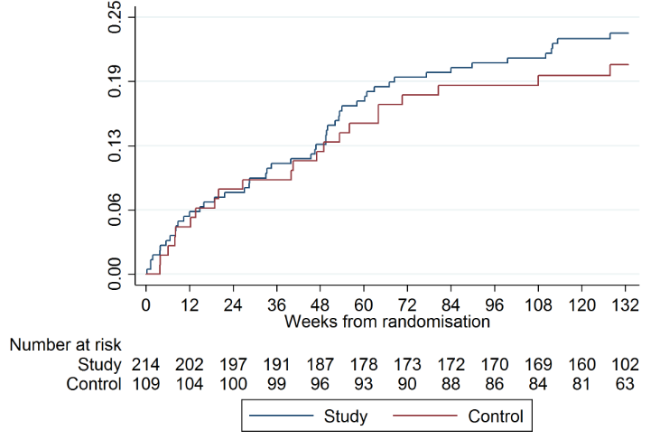
Time to unfavourable outcome
HR 1.14 (95% 0.70, 1.85) log rank χ² = 0.34 p = 0.56

Slide 17
Unfavourable outcome by subgroups
Study Control
Overall 21.9% of 210 v 19.4% of 108
HIV status
Positive 31% of 70 v 35% of 34
Negative 17% of 140 v 12% of 74
Country
Ethiopia 13% of 69 v 8% of 36
Mongolia 27% of 11 v 0% of 4
S Africa 31% of 75 v 37% of 38
Vietnam 20% of 55 v 13% of 30
Control better ->
Ethiopia (n = 105) 4.7% (-7.3%, 16.7%)
Vietnam (n = 85) 6.7% (-9.4%, 22.8%)
South Africa (n = 113) -6.2% (-24.7%, 12.4%)
Mongolia (n = 15) 27.3% (1.0%, 53.6%)
AHRI (n = 47) 2.3% (-19.0%, 23.6%)
St. Peters' (n = 48) 6.0% (-7.5%, 19.6%)
HCMC (n = 85) 6.7% (-9.4%, 22.8%)
Durban (n = 56) 5.1% (-17.4%, 27.6%)
Johannesburg (n = 42) -23.0% (-53.7%, 7.8%)
Ulaanbaatar (n = 15) 27.3% (1.0%, 53.6%)

Slide 18
Summary and conclusions: Efficacy
Control regimen 80.6% favourable
9-month regimen 78.1% favourable
Adjusted difference 2.1% (95% CI -6.9%, +11.2%),
i.e. failed to formally demonstrate non-inferiority
Control arm performed better than expected; likely to be due in part to choice of centres, patient selection and trial setting
9-month regimen performed well, similar to the cohorts, despite stricter criteria and longer follow-up

Slide 19
Safety analysis population
All randomised patients that have taken at least one dose of treatment
 | Study | Control | Total
Total randomised | 282 | 142 | 424
Total in safety analysis population | 282 | 141 | 423
Excluded: Didn’t start treatment | 0 | 1 | 1
Notes:
Almost everyone has completed treatment.

Slide 20
Primary safety outcome
The proportion of patients experiencing a grade 3 or greater adverse event (AE) during treatment or follow-up.
At any time during treatment or follow-up up to 132 weeks from randomisation
Includes all AEs, irrespective of whether considered related to treatment
Grades defined according to DAIDS grading

Slide 21
Secondary safety outcome
 | Study | Control | Total
Safety analysis population | 282 | 141 | 423
Patients with any grade 3-5 AE | 129 45.7% | 63 44.7% | 192 45.4%
Patients with any Serious AE (SAE)* | 91 32.3% | 53 37.6% | 144 34.0%
Deaths | 24 8.5% | 9 6.4% | 33 7.8%
*An AE is Serious if it: results in death, is life-threatening, requires hospitalization or prolongation of existing hospitalization, results in persistent or significant disability or incapacity, consists of a congenital anomaly or birth defect, or is other medically important condition.
Notes:
No statistical evidence of a difference in mortality, although more deaths were observed on the study arm.

Slide 22
Safety analysis by HIV status
HIV Negative
HIV Positive
 | Study | Control | Total | Study | Control | Total
Safety analysis population | 179 | 91 | 270 | 103 | 50 | 153
Patients with any grade 3-5 AE | 78 43.6% | 41 45.1% | 119 44.1% | 51 49.5% | 22 44.0% | 73 47.7%
Patients with any Serious AE (SAE) | 45 25.1% | 33 36.3% | 78 28.9% | 46 44.7% | 20 40.0% | 66 43.1%
Deaths | 6 3.4% | 5 5.5% | 11 4.1% | 18 17.5% | 4 8.0% | 22 14.4%
Notes:
More SAEs in HIV positive because AE more often resulted in hospitalisation

Slide 23
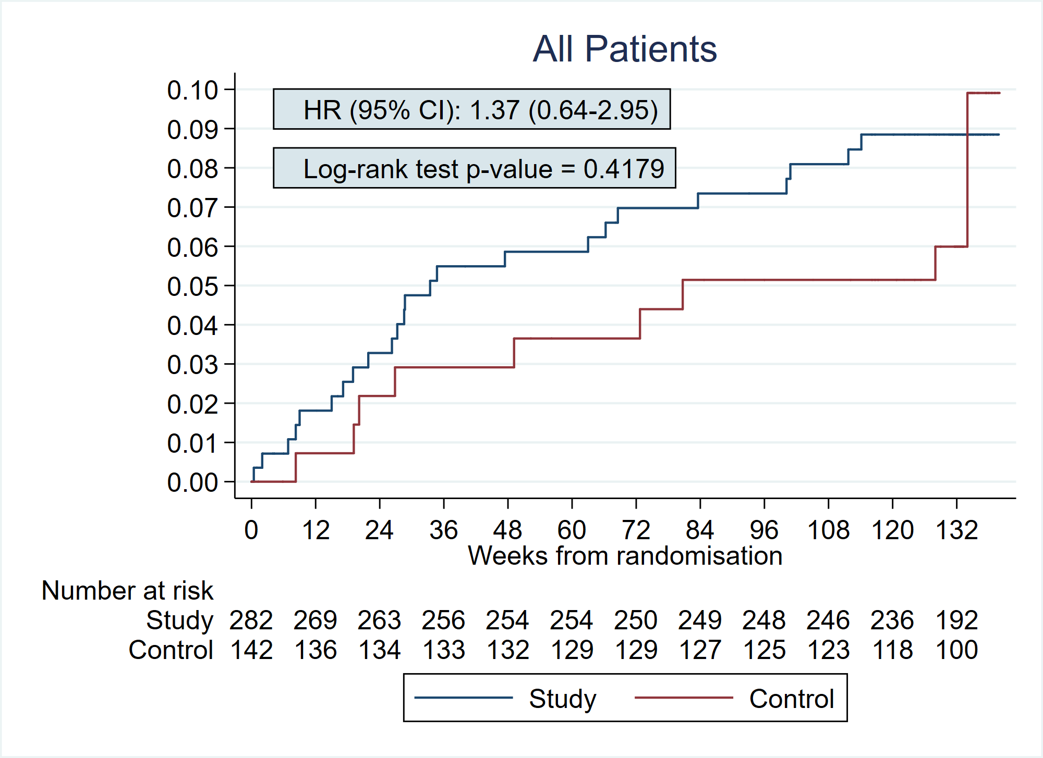
Time to death
Probability of death

Slide 24
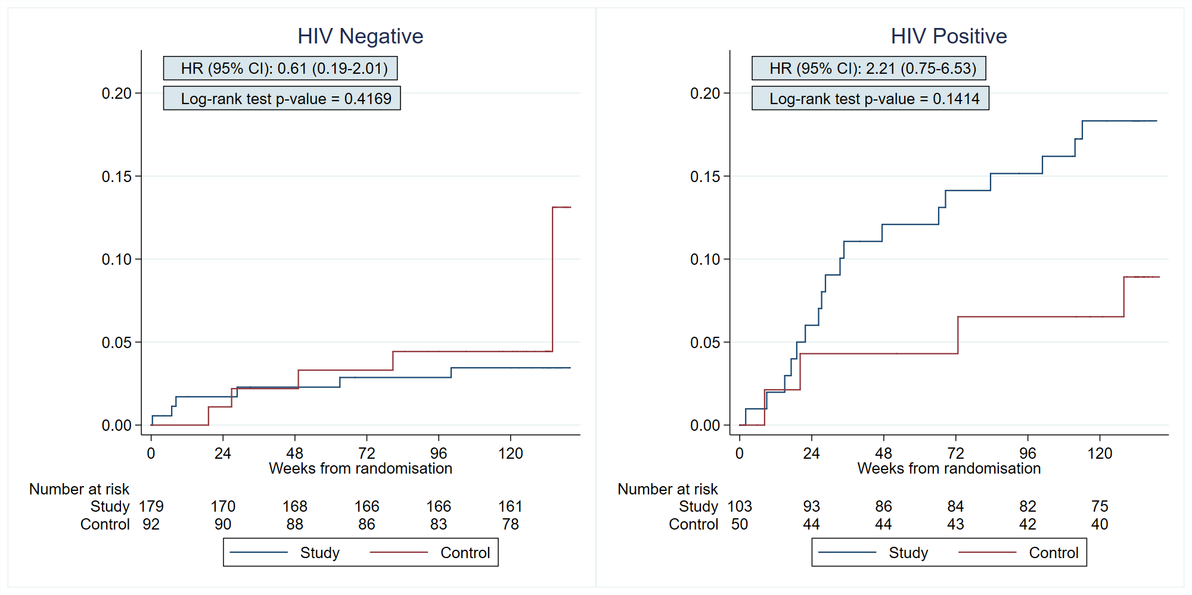
Time to death by HIV status
Probability of death
Probability of death
Notes:
This could be a chance finding in a sub-group analysis, but this is something we are looking at in more detail.

Slide 25
Independent death review committee
We convened an independent committee to review all deaths in STREAM Stage 1
Two independent experienced MDR-TB clinicians
Met 3-4 times during the study
Classified all deaths as having as primary cause:
HIV or HIV treatment
TB
TB treatment
Other

Slide 26
Cause and timing of death
HIV Negative
HIV Positive
Time from randomisation | Study | Control | Study | Control
<16wks | 2 TB 1 Pancreatitis | 0 | 1 HIV 1 Suicide 1 Sepsis | 1 HIV
16- <40wks | 1 Hypoglycaemic seizure/alcoholic liver disease | 1 TB treatment 1 Renal failure | 2 TB 2 TB treatment 1 HIV 1 Diabetic ketoacidosis 1 Liver failure drug-induced 1 Sudden death | 1 HIV
40- <76wks | 1 Cerebral infarct | 1 Liver failure herbal medicine induced | 1 HIV 1 Cervical cancer 1 Diabetic ketoacidosis | 1 HIV
76- <140wks | 1 TB | 2 TB | 2 TB 2 HIV | 1 Gunshot injury
Total deaths | 6 3.4% | 5 5.5% | 18 17.5% | 4 8.0%
Safety population | 179 | 91 | 103 | 50

Slide 27
Most common grade 3-5 AEs by MedDRA Preferred Term (PT)
Numbers of patients with AE | Study | Control | Total
Weight decreased | 28 10% | 15 11% | 43 10%
Conduction disorder QTcF ≥500ms | 28 10% | 7 5% | 35 8%
Deafness | 11 4% | 3 2% | 14 3%
Ototoxicity | 4 1% | 2 1% | 6 1%
Hypokalaemia | 3 1% | 10 7% | 13 3%
Drug-induced liver injury | 9 3% | 2 1% | 11 3%
Hepatic function abnormal | 6 2% | 4 3% | 10 2%
Hepatitis | 5 2% | 1 1% | 6 1%
Anaemia | 10 4% | 0 | 10 2%
Hyperglycaemia | 7 2% | 3 2% | 10 2%
Renal impairment | 9 3% | 1 1% | 10 2%
Vomiting | 2 1% | 5 4% | 7 2%
Depression | 4 1% | 2 1% | 6 1%
Any grade 3-5 AEs | 129 46% | 63 45% | 192 45%
Notes:
Differences here, numbers small, possibly due to chance.
Conduction disorders cardiac disorder. QTcF prolongation >500ms.
Doesn't necesssary mean a clinically notable event.
Hypokalaemia

Slide 28
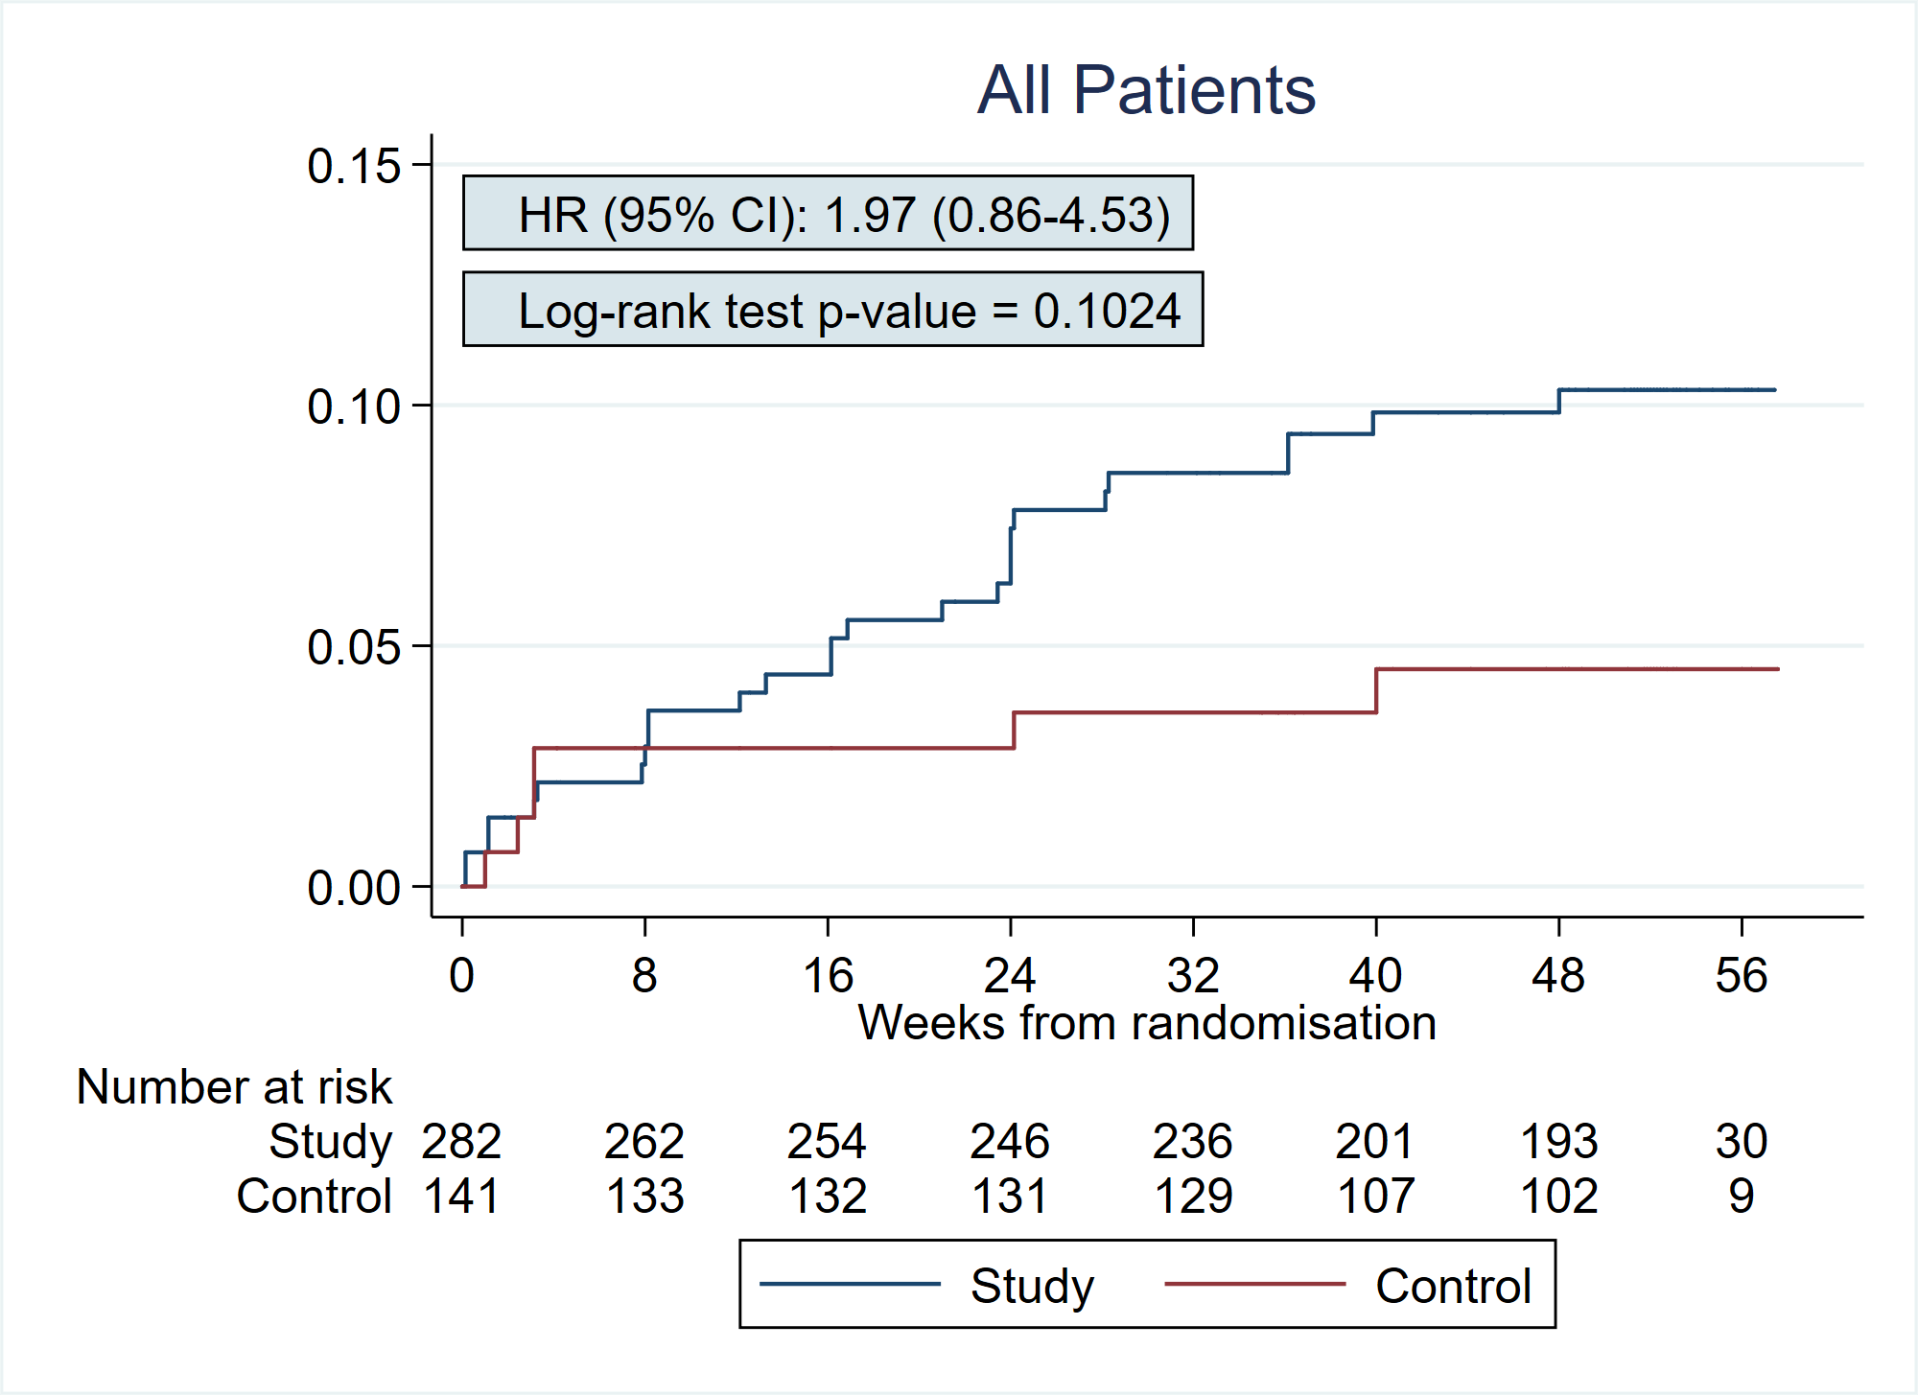
Time to QTcF exceeding 500ms
Notes:
Suggestion, p=0.1, of a difference in QTcF > 500ms
Events continued throughout treatment
Events on both arms
Patients were allowed up to 5xULN ALT/AST

Slide 29
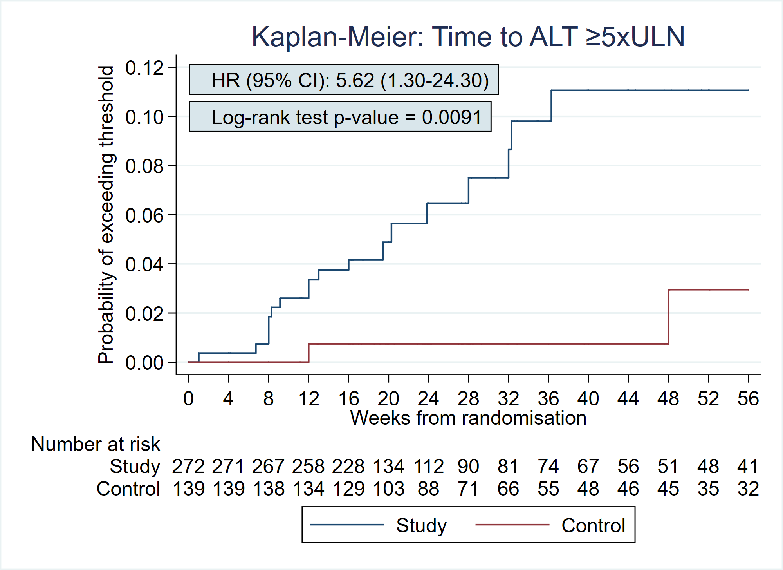
Time to ALT exceeding 5xULN (Grade 3 laboratory abnormality)

Slide 30
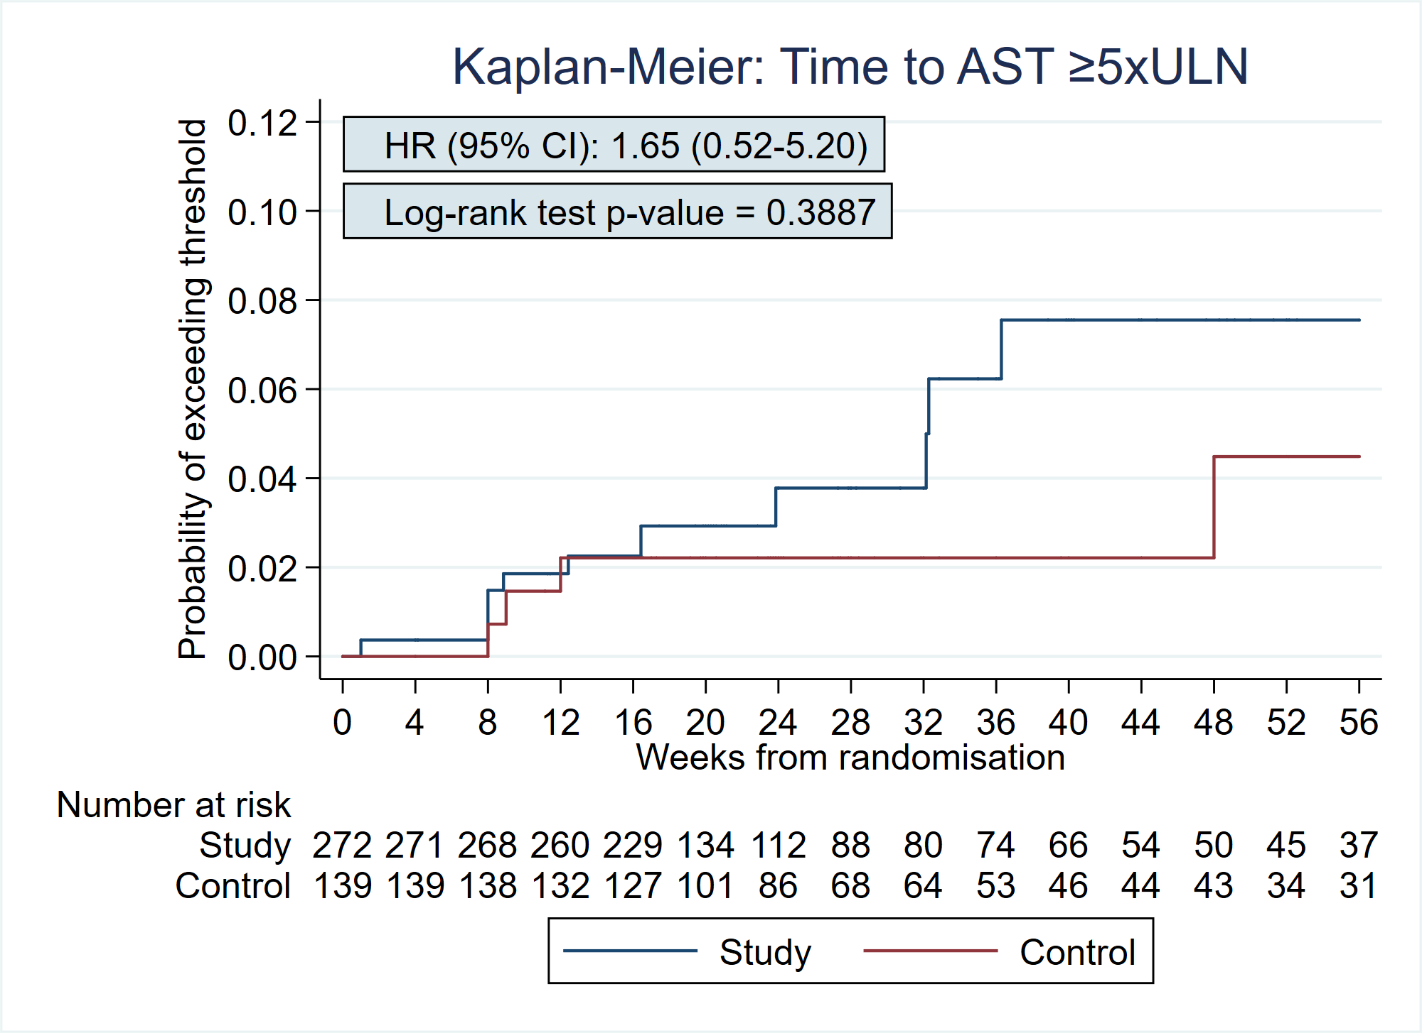
Time to AST exceeding 5xULN (Grade 3 laboratory abnormality)

Slide 31
Summary and conclusions: Safety
There was no difference between treatment arms in severe (grade 3-5) adverse events (45.7% vs 44.7%), our primary safety outcome.
There was no statistically significant difference in mortality between arms, although more deaths were observed on the study arm (8.5% vs 6.4%), particularly in those HIV coinfected (17.5% vs 8.0%).
There was more QT prolongation in the study arm, with events of QTcF ≥500ms (on automated measurement) occurring throughout treatment.
ALT laboratory abnormalities were more common in the study arm, but this didn’t appear to translate into significantly more clinically important hepatic events.
Further analyses of the safety data are ongoing.

Slide 32


Acknowledgements
We wish to thank all those involved in the conduct of STREAM Stage 1
The funders USAID and Medical Research Council, UK
The site investigators, staff and patients at
Armauer Hansen Research Institute, Addis Ababa;
Doris Goodwin Hospital, Pietermaritzburg;
King Dinuzulu Hospital, Durban;
National Centre for Communicable Diseases, Ulaanbaatar;
Pham Ngoc Thach Hospital, Ho Chi Minh City;
Sizwe Hospital, Johannesburg;
St Peter’s Hospital, Addis Ababa
Institute of Tropical Medicine, Antwerp
Liverpool School of Tropical Medicine
STREAM Trial Management Team (MRC Clinical Trials Unit at UCL and Vital Strategies)
Trial Steering Committee & Independent Data Monitoring Committee
Technical Advisors

