Slide 1

Methodology for Assessing Socio Economic Conditions of Socially Vulnerable Families and Its Usage.
Social Service Agency
Tbilisi, 2019

Slide 2
The Previous System of Social Assistance
Until 2006 the social assistance was provided only to individual categories of the population:
Single pensioners
Disabled persons belonging to the first group of blindness;
Children with disabilities
children growing without parents/orphan children
Families with many children

Slide 3
Current System of Social Assistance.
Help those who are needed our support more – to the extremely poor people.
Who is considered as a poor person?
How can we reach to them?

Slide 4
Who may be considered as a poor?
Welfare Indicator.
Welfare indicator is based on the assessment of consumer expenditure and household needs.
The lower family welfare level, the poorer it is.

Slide 5
Assessment of Consumer Expenditure
The assessment questionnaire of real consumer expenditure is a great volume.
Consumer expenditure is differ in seasons.
Likelihood, that population will hide the real consumer expenditure - is high.

Slide 6
Welfare Assessment
Current Methods of Family Welfare Assessment
The Indicators closely related to household welfare level are measured by small volume questionnaires (family declaration).
Verifying the indicators by social workers and database is relatively easier.
The weight (indicator’s influence level) of selected indicators is determined. Each selected indicator is assigned a certain numeric value in accordance to its influence on the family welfare level.

Slide 7
Welfare Index
Calculation of family welfare index is formulated:
C - is a household consumer index (assessment of the real consumer expenditure of family)
N - is a household needs index; while calculating the household needs index the cohabitation effect and equivalent coefficient is taken into the consideration.
The less welfare index, the lower household welfare level.

Slide 8
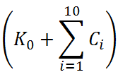


Consumer Index
The structure of consumer index
Family Consumer Index:

Slide 9
Consumer Index
The Structure of Consumer Index
Ко – Constant Coefficient
Cl- Agricultural Property (Land) Index;
C2- Agricultural Property (Cattle) Index;
C3- Personal Property Index
C4- Income Index
C5- Utility cost index;
C6- Utility cost index;
С7- Education and Employment Index
С8- Territorial Index
С9- Basic living Condition Index
С10- Other Real Estate Index.
С0 – is a monetary social assistance – ‘’Subsistence Allowance’’ issued (or would be issued) to the family or any member of the family in the recent past; Or - other social monetary subsidy which will be terminated in accordance with the applicable legislation in the case of receiving the ‘’subsistence allowance’’. Or other monetary assistance which is issued to the beneficiaries is depend on the rating score.

Slide 10
Needs index
The structure of needs index
The household needs index is formulated:
n -is the number of household members
b =0.2 – cohabitation effect indicator
E –the number of adults living in household
B – cost of the minimum consumer package. (175 GEL)
N – the needs index is the minimum amount of money that is required for family existence being above of the demographic composition of the family above the poverty line.

Slide 11
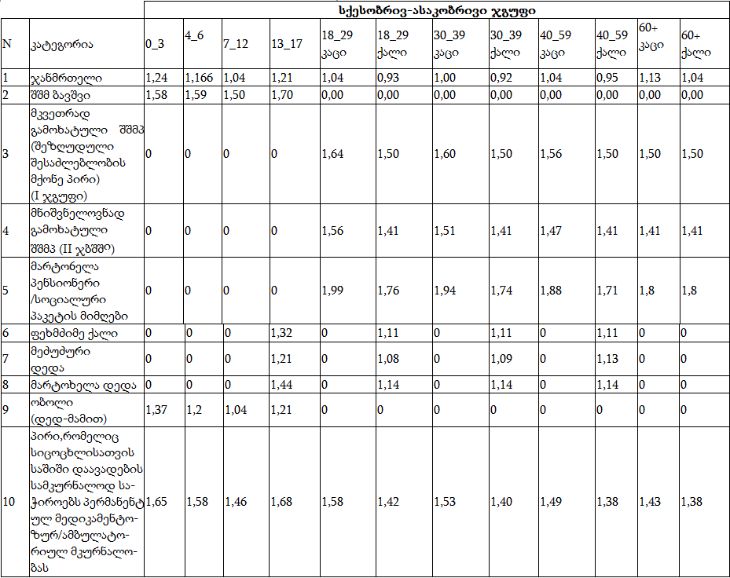
Equivalent coefficients

Slide 12
Model Selection
Country is divided in for Zones:
Tbilisi
Big Cities (Kutaisi, Rustavi, Batumi, Poti, Gori, Zugdidi, Sokhumi).
Administrative centers of Self-government unites;
other settlements/populates areas ( villages).
Indicators and coefficients are different in other types of populated areas in the welfare index formula. Accordingly, the formula of welfare assessment is different.

Slide 13
Methodology Assessment
positive effects
making the decisions and doing the family assessment operatively
ranking the houshold according to their walfare condition.
Minimizing of making biased decisions
instantly selection of beneficiaries for various social programs.
Negative effects
This above mentioned welfare assessment method has some statistical inaccuracy as well as any other statistical model.
Due to the complexity of the methodology the understandings on the made decision is difficult for some parts of population.
It is impossible to make dynamic changes in the methodology. It is related to long and expensive research.

Slide 14
The options used in the welfare assessment method
Territorial indicator:
Tbilisi
Big cities
list of durable goods/items:
Car (non-Soviet production)
incomes:
salary
pension
Municipal centers
Assistance and other incomes
villages
Tractor, combine
Agricultural indicators:
land, (owned or cultivated)
Annual expenses/fee on:
Electricity
Living conditions:
Area for living
Animals and birds
Gas
Water
Cleaning
Number of rooms

Slide 15
New structure and formula of beneficiaries
Previous methodology
ზღვარი | first member of the family | the following member | additional disbursement for children
<57 000 | 60 | 48 | 0
New methodology
ზღვარი | Any member of the family | additional disbursement for children
<30,000 | 60 | 50
30,000-57,000 | 50 | 50
57,000-60,000 | 40 | 50
60,000-65,000 | 30 | 50
65,000-100,000 | 0 | 50

Slide 16
The coverage of the population by the new schemes of benefits

Slide 17
Other usage of the unified database of socially vulnerable families
Social Service Agency
Universal Health care Program
Families whose rating score is less than 70 001 are eligible to receive fully funded services within the universal health care programme.
Auxiliary means
Prosthetic orthopedic remedies- less than 100 001 rating score
Wheelchairs - less than 100 001 rating score
Chronic medications - less than 100 001 rating score

Slide 18

Other usage of the unified database of socially vulnerable families
Tbilisi City Hall
social benefits package on: – rating score < 70 001
On transportation fee.
Allowance for Utility expenses ( electricity, cleaning, water)
Allowance for families with many children (3 children and more)
financing art teaching programs at school
financing the teaching programs at sport schools and swimming pools
financing the funeral ceremony of homeless deceased persons.
Financing the medical examination to the people suffering from Hepatitis C
Financing medical and other services.
Social assistance package – rating score < 100 001
500 GEL for all newborns
800 GEL for the third newborn baby
1000 GEL for the fourth newborn baby
1500 GEL for the fifth and for every next newborn baby
Social assistance package - rating score < 150 001
800 GEL to persons with disabilities under the age of 18. (400 GEL twice a year)
(900 GEL to persons with blind disability status (300 GEL three times in a year)

Slide 19



Other usage of the unified database of socially vulnerable families
Minister of Education, Science, Culture and Sport of Georgia
Teaching books – rating score < 70 001
special Schools - (Musical Schools, Sports Schools, etc.) - rating score<70 001
students granted < 70 001 rating score are financed.
United Telecom of Georgia (SILKNET)
Families whose rating score is <57001 and includes a blind or first group of disabled person, an unemployed single pensioner , a person who lost a breadwinner - are financed 50 % of Subscription fees.
Ministry of Justice of Georgia
Issue of IDs – rating score <70 001
Financing of court fees – rating score < 57 001

Slide 20
Thank You for Your Attention!

