Slide 1
“History and Overview of the HCV Elimination Program”
Minister Of Labour Health and Social Affairs of Georgia
Dr. David Sergeenko

Slide 2
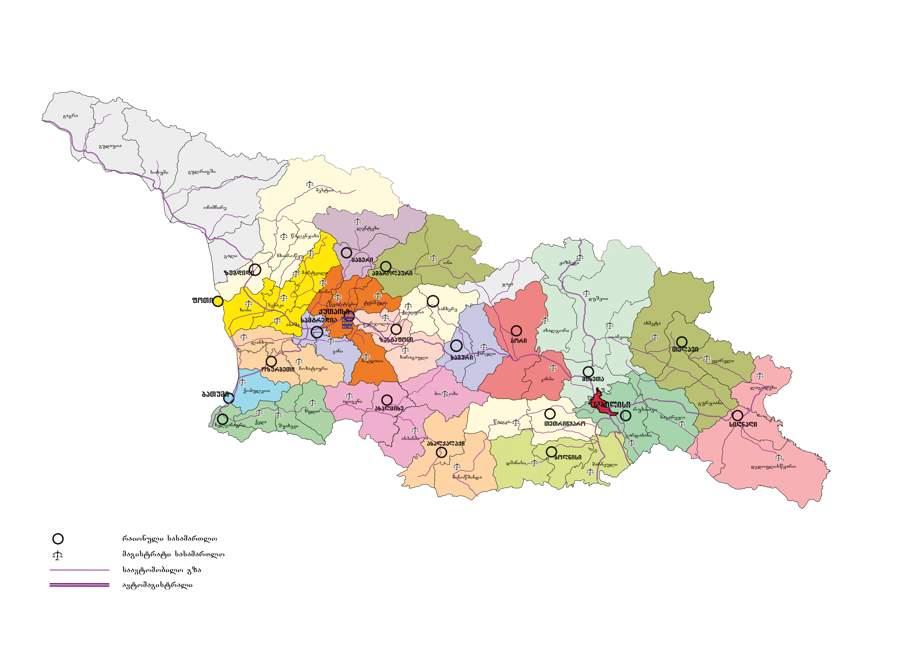
Population – 3,7 million
7.7% – Anti-HCV+
GDP per capita (USD) in 2015 - $3743.1
5.4% – HCV RNA+

Slide 3

Hepatitis C under the Global Fund project free of Charge Hepatitis C treatment with Peg/Riba regimens for HIV/HCV co-infected patients with Peg/Riba
Free of Charge Hepatitis C treatment with Peg/Riba regimens for prisoners.
10 000 Patients from civil sector were offered a 60% discount for medicines (Peg/Riba)
We began negotiations with US CDC, Gilead Sciences, Inc and other US partners
1st National Workshop on Hepatitis C, March 12-14, 2014
National Committee for HCV elimination program was established

Slide 4


APRIL 21th
Memorandum of Understanding between Georgian Government and Gilead Sciences, Inc was signed

Slide 5

Large-scale PR campaigns have been launched with multi-sectorial approach and awareness rising in the population
External Hepatitis Technical Advisory Group (TAG), to meet in Tbilisi, Georgia, on 3-4, November
Free screening was introduced
The initial phase included the prioritizing of patients
Project „ECHO” in the framework of L.I.F.E.R. was implemented

Slide 6

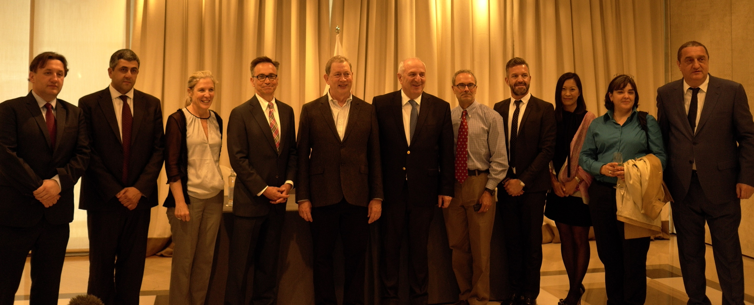
Clinical group was established
In February 2016 we have received first stock of „Harvoni“
3rd National Workshop on HCV was held main objective was the summarizing of long-term elimination plan
April EASL conference and a side session for Georgia
Long term agreement between Company Gilead Sciences, Inc and Georgia Government was signed
Regulations oblige all inpatient institution to screen all hospitalized patients Screening guidelines have been developed

Slide 7

New service center was for management was opened and Eligibility criteria were removed
“ECHO” was implemented in local facilities
On august 18th long term action plan strategy was approved by government of Georgia
Georgia HCV Elimination Scientific Committee was established
Second TAG meeting was held on October 24-25

Slide 8
Georgia’s HCV Elimination Program Treatment Database
(Apr 2015 – June 2017)
Screened | 650 000
Started treatment | 40 000
Completed treatment | 30 000
Ongoing treatment | 10 000
Treatment outcomes - Sofosbuvir | 80 %
Treatment outcomes - Sofosbuvir/Ledipasvir | 98.2 %

Slide 9

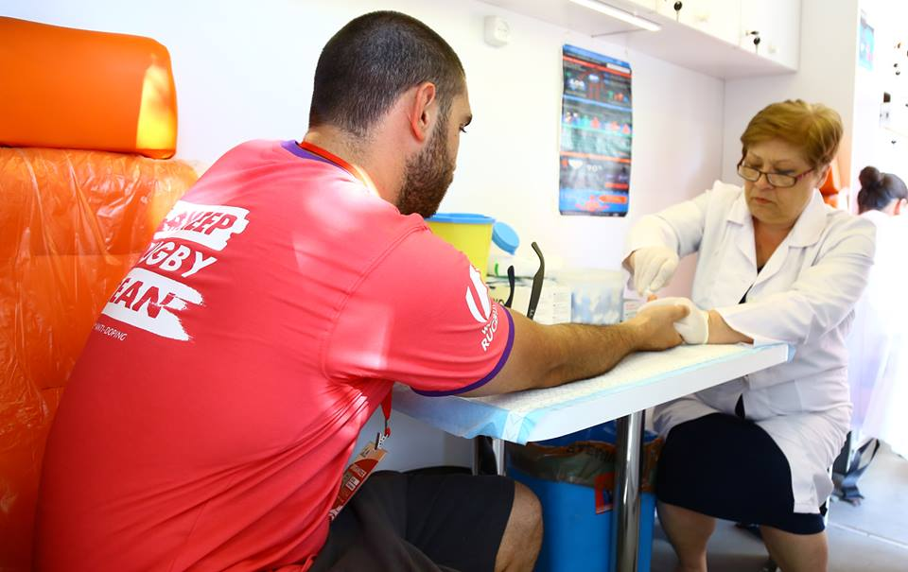
4th National Hepatitis C Elimination Workshop
Opening of Zugdidi screening and management Center
EASL Special Session for Georgia
Donation of “Sovaldi” to Belarus and Armeia
Increasing access on screening:
Maintain routine screening of target population
Obligation for some groups
Involvement of primary health care sector in the screening program
Engagement of regions and further expansion of screening activities
Regional Center and mobile laboratories for geographical accessibility

Slide 10
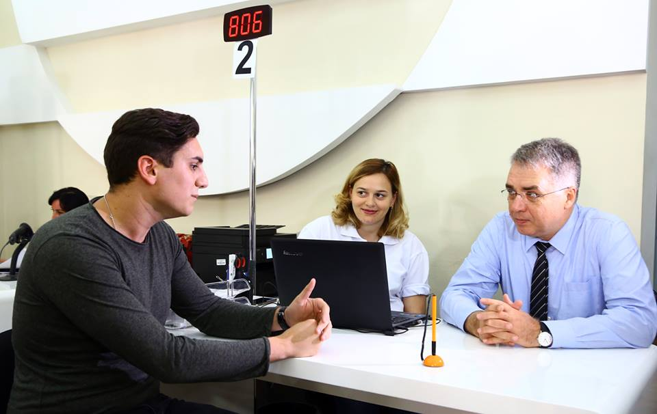


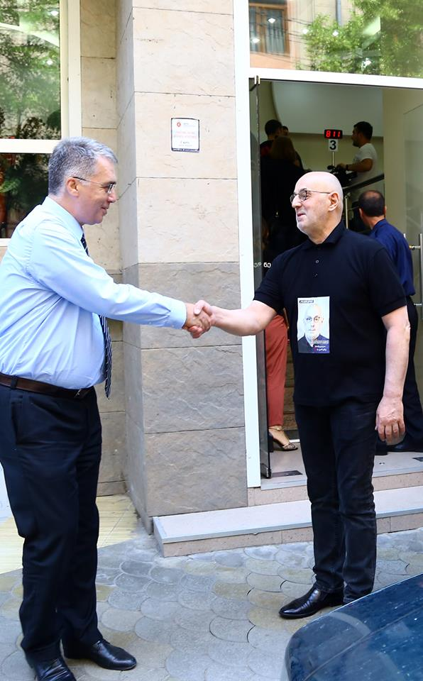
Raising awareness of population New PR Campaign

Slide 11
Acknowledgements
Ministry of Labour, Health and Social Affairs
Gilead Sciences, Inc
US Centers for Disease Control and Prevention (CDC)
TAG Members
State, Clinical and scientific committee of Hepatitis C Elimination Program
Clinics

Slide 12


