Slide 1

Progress toward Hepatitis C Elimination in the Country of Georgia
Dr. David Sergeenko
Minister of Labour, Health and Social Affairs of Georgia

Slide 2
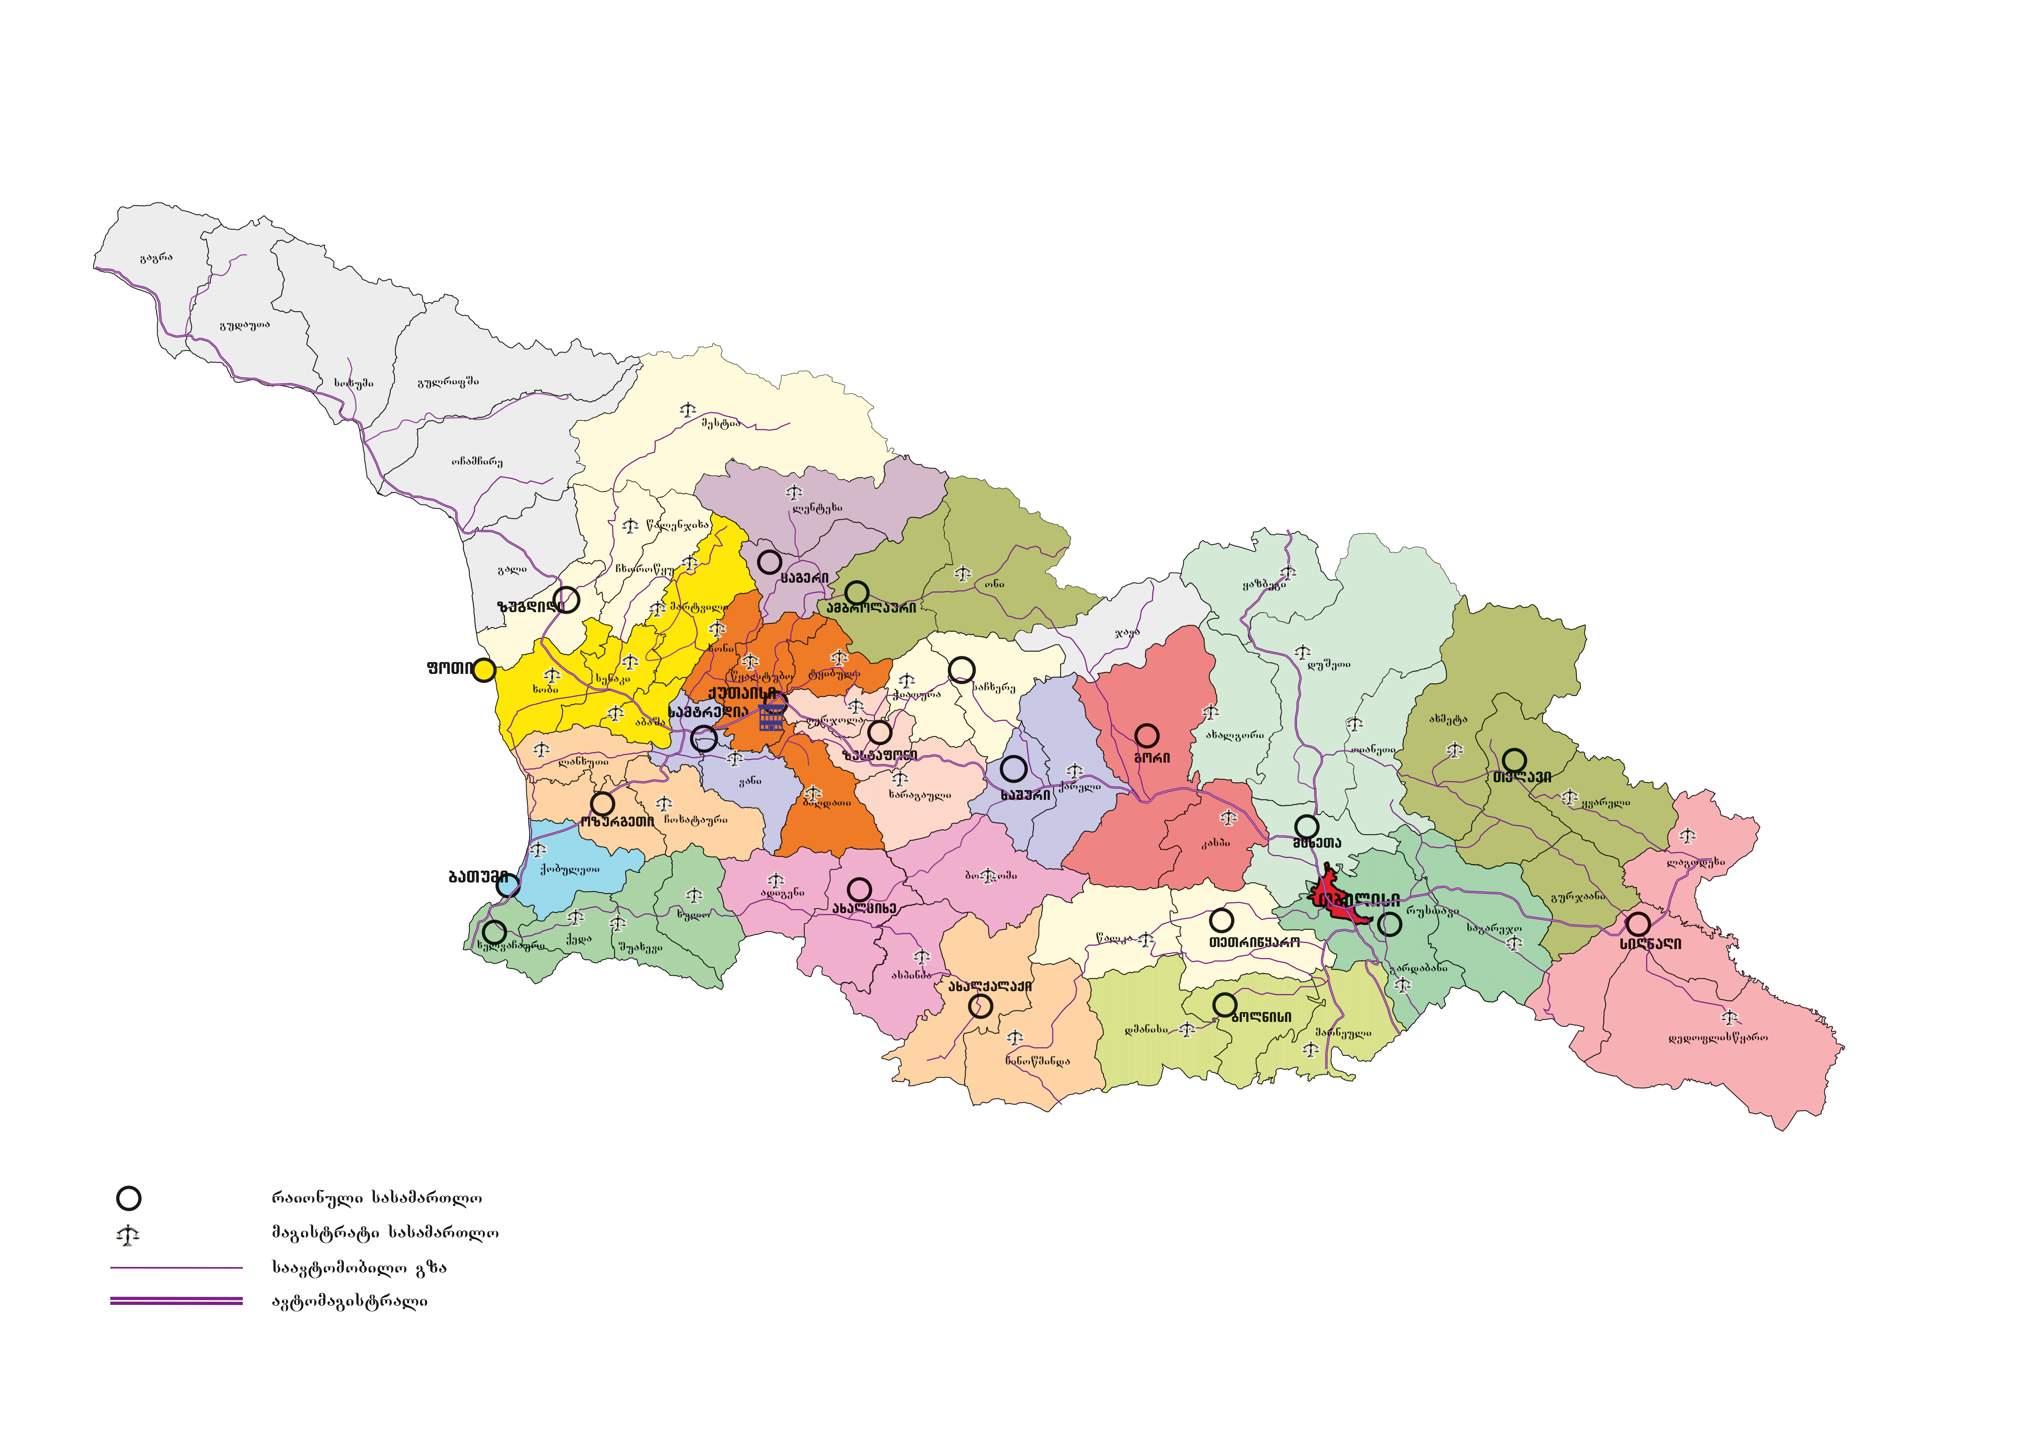
Population – 3,7 million
7.7% – Anti-HCV+
GDP per capita (USD) in 2015 - $3743.1
5.4% – HCV RNA+

Slide 3
Why Georgia is an appropriate model country for HCV elimination
High prevalence of HCV infection in general population;
Small size of the country (69,700 km²) with population of 3.7 million people;
Strong Governmental commitment towards elimination of HCV;
Availability of all modern HCV diagnostic and treatment methods;
Strong human resource capacity in the field of viral hepatitis, and particularly in hepatitis C;
Adherence to principles of evidence-based medicine for hepatitis C;
Existence of effective systems for implementing large-scale national and international health programs, including through multi-sectoral approach;
Availability of logistic and control mechanisms within existing national HIV/AIDS, Tuberculosis and hepatitis C treatment programs;

Slide 4
HCV Epidemiology in Georgia

Slide 5
HCV Burden in Georgia - Background
Georgia is among the countries with the highest hepatitis C prevalence
Prevalence among different population groups:
PWID: 66.2% (Bio-Behavioral Surveillance Survey, 2015)
TB Patients: 21% (Lomtadze et al, 2013)
MSM: Tbilisi – 7.1%, Batumi – 18.9% (BSS, 2015)
Old Estimate of prevalence among general population – 6.7% (population-based survey in the capital city Tbilisi, 2001-2002)
Notes:
However, the previous estimate of the prevalence was outdated. The population-based national prevalence estimate was necessary in order to obtain baseline information at the beginning of elimination program

Slide 6
HCV Burden in Georgia
2015 National seroprevalence survey
Number of interviews - 6330
Number of blood samples - 6011
Characteristic | n | % | Estimated number of adults >18
Anti-HCV+ | 425 | 7.7% | 215,000
HCV RNA+ | 311 | 5.4% | 150,300

Slide 7
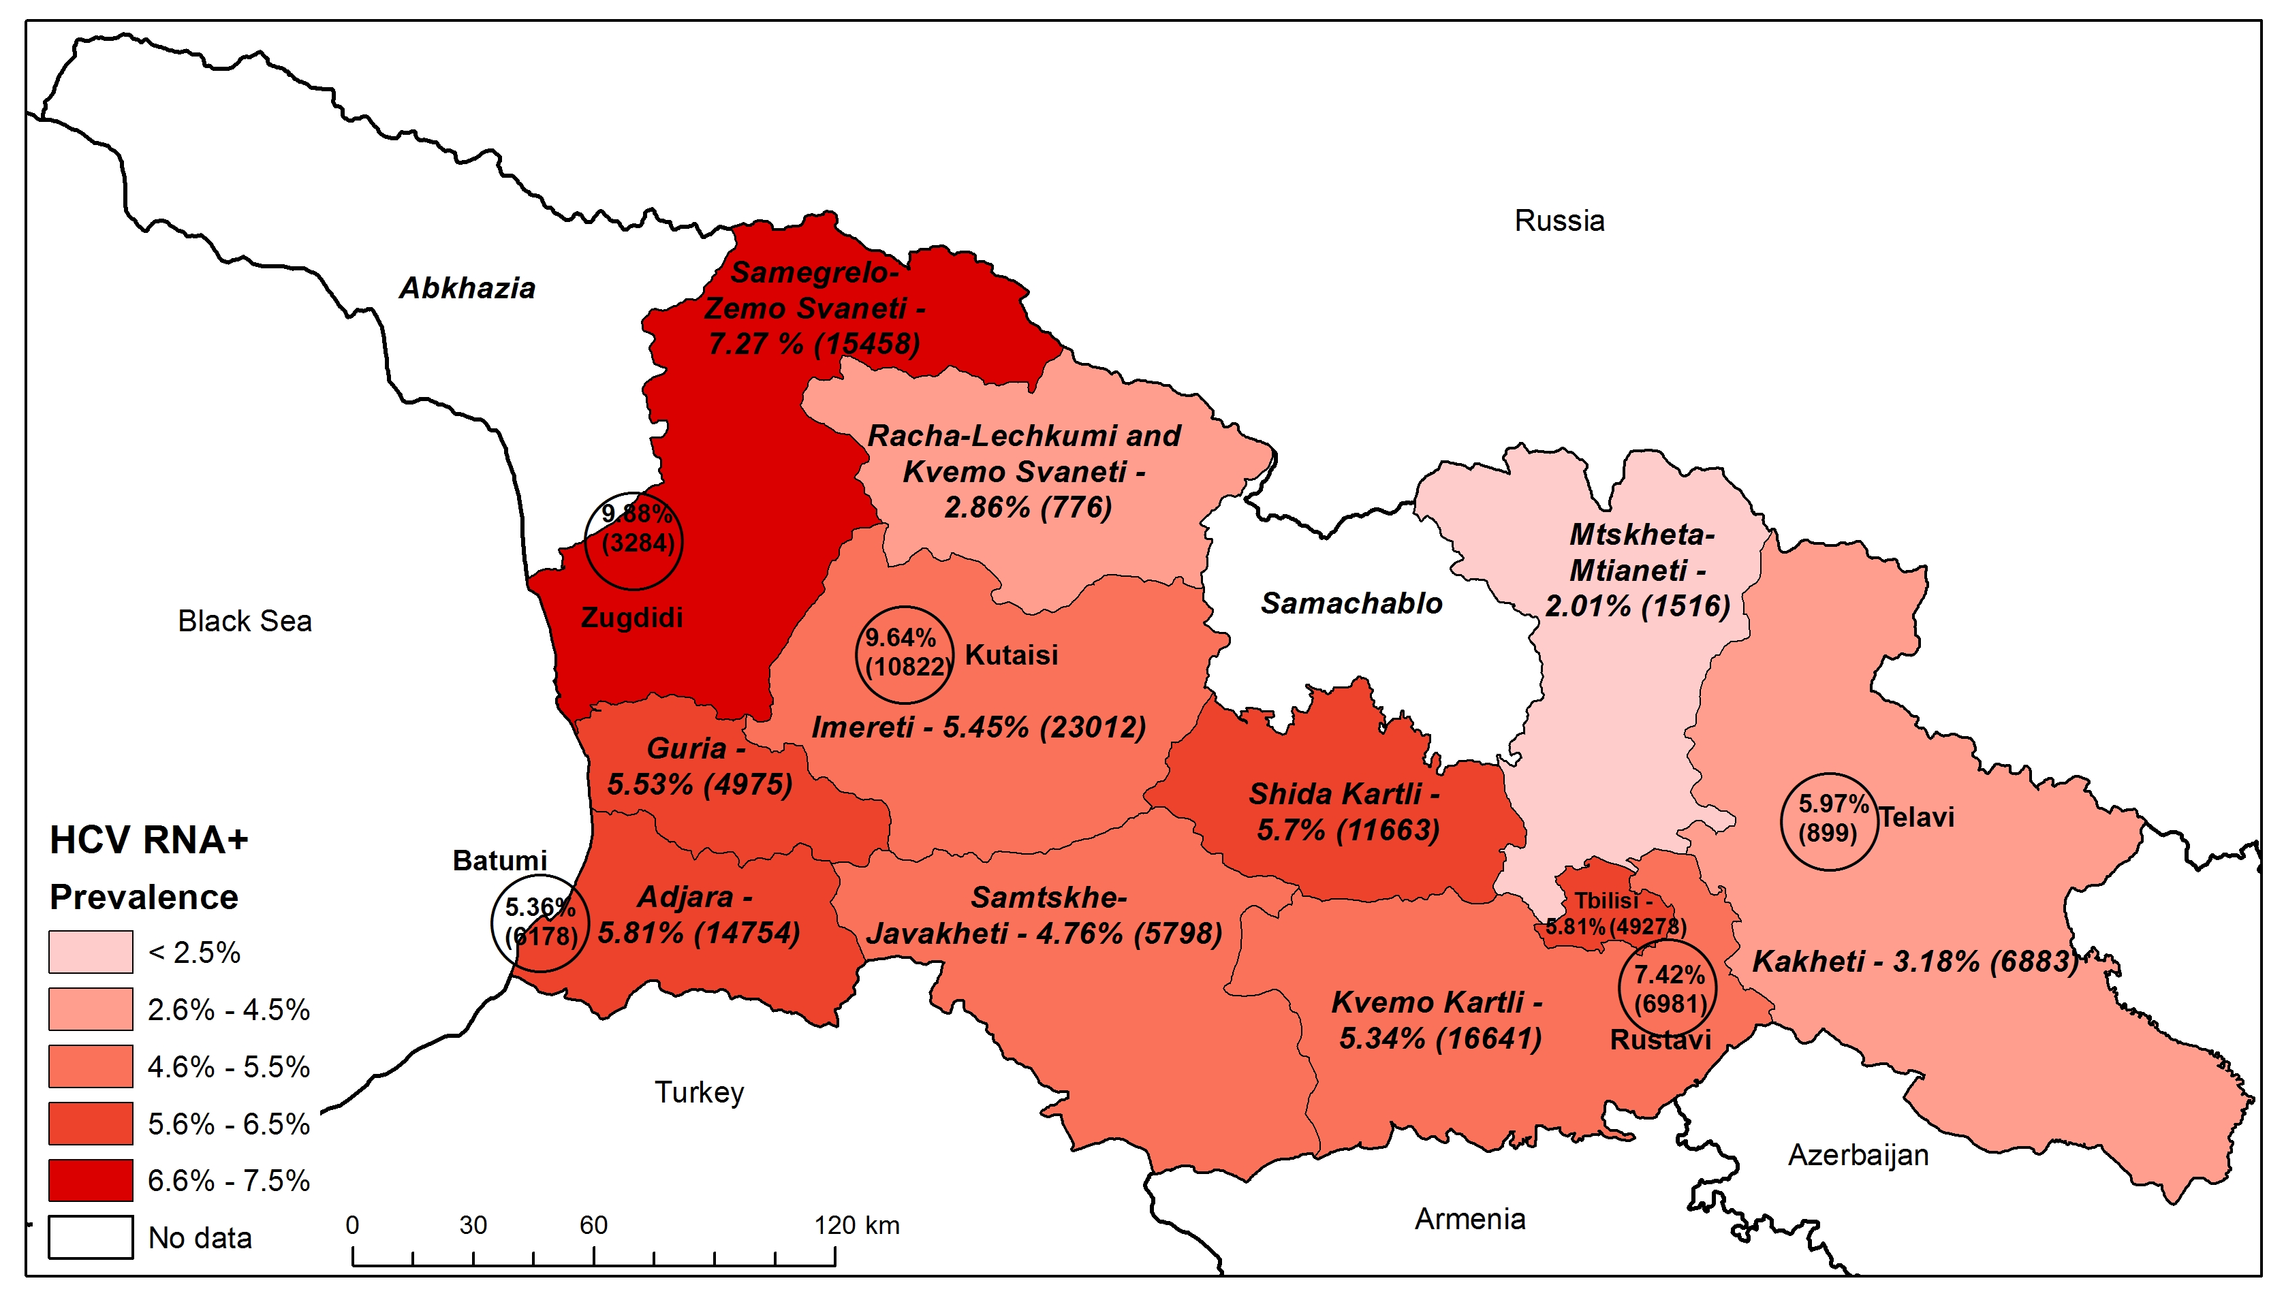
Prevalence and Estimated Number of HCV RNA+ Individuals by Regions and Cities
Note: Estimated numbers for regions include cities
Notes:
Estimates for Mtskheta-mtianeti, Samtskhe, Racha-Lechkhumi, Guria are indeterminate due to low sample size

Slide 8
HCV Prevalence by Age and Gender
Females
HCV Prevalence
(n=3,662)
Males
(n=2,334)
Notes:
Age and gender distribution of HCV shows that HCV prevalence is higher among males, especially among age groups 30-39 and 40-49

Slide 9
Anti-HCV risk factors, 2015 survey

Slide 10
Self-reported HCV care among anti-HCV positive respondents, 2015 survey
Only approximately 1/3 of anti-HCV positive survey participants knew about their status
36.7%
32.1%
64%
18.8%
Notes:
As you see, by summer 2015, only about one third of anti-HCV positive individuals knew their status

Slide 11
Progress Towards Elimination

Slide 12

Under the Global Fund project free of Charge Hepatitis C treatment with Peg/Riba regimens for HIV/HCV co-infected patients with Peg/Riba
Free of Charge Hepatitis C treatment with Peg/Riba regimens for prisoners.
10 000 Patients from civil sector were offered a 60% discount for medicines (Peg/Riba)
We began negotiations with US CDC, Gilead and other US partners
1st National Workshop on Hepatitis C, March 12-14, 2014
National Committee for HCV elimination program was established

Slide 13


APRIL 21th Memorandum of Understanding between Georgian Government and Gilead Sciences was signed GS agreed to donate treatment for elimination program, initially for 5000 with most sever liver disease

Slide 14


Large-scale PR campaigns launched with multi-sectorial approach and awareness raising
Initially 4 provider clinics were selected to provide treatment; a multi-sector committee reviewed records for eligibility for treatment (initially limited to patients with severe liver disease)
On May 1 Georgia received initial stock of “Sovaldi”

Slide 15

On May 15th the first patient received treatment “Sovaldi”
The initial phase included prioritizing patients with severe liver disease.
Free screening
US CDC published an article in the MMWR on World Hepatitis Day: “The Launch of a Hepatitis C Elimination Program in the Country of Georgia”

Slide 16




Project „ECHO” (Extension for Community Healthcare Outcomes) in the framework of L.I.F.E.R. (Liver Institute and foundation for education and research) was implemented
External Hepatitis Technical Advisory Group (TAG) formed, first meeting in Tbilisi, Georgia, 3-4 November
AASLD 2015 WHO symposium Georgia had presentation about hepatitis C elimination Program
Assessment of Stop C was performed and considering gaps the decision was made to create new electronic system

Slide 17

Regulations oblige all inpatient institution to screen all hospitalized patients. Screening protocol was developed
Gilead Sciences Inc. supported and approved grant for development of new electronic program Elimination C
Treatment Guidelines updated
First stock of Ledipasvir/Sofosbuvir received
Core antigen study protocol was approved and has been launched

Slide 18
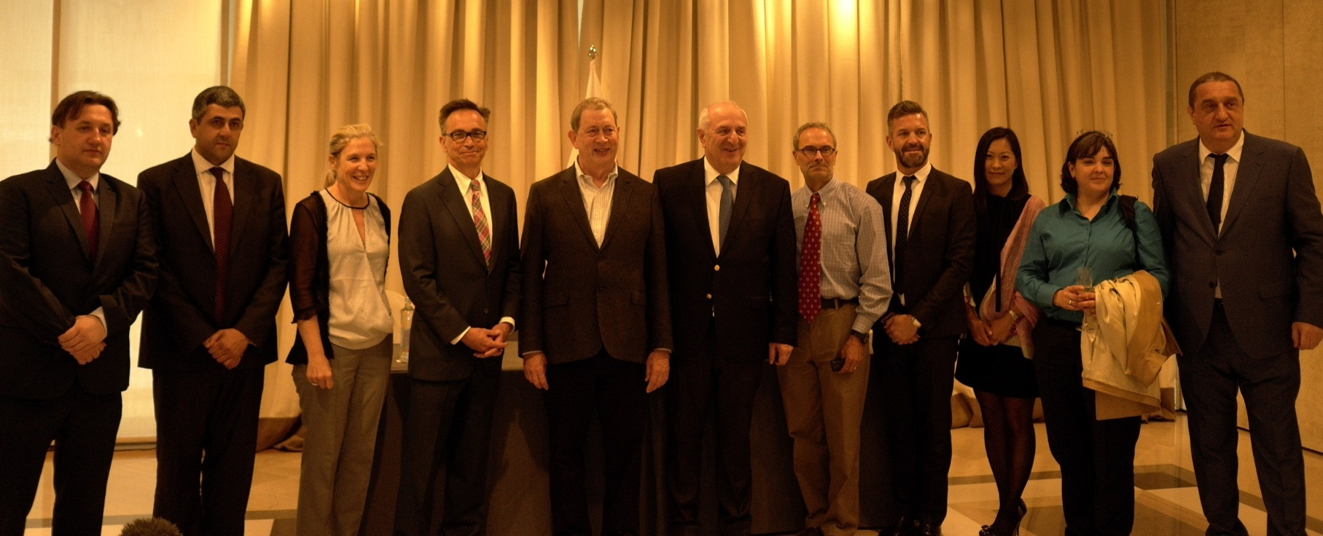
Clinical group was established
3rd National Workshop on HCV was held main objective was the summarizing of long-term elimination plan
April EASL conference and a side session for Georgia
Long term agreement between Gilead Sciences and Georgia Government was signed at EASL

Slide 19
„ECHO” was expanded with Georgian Centers serving as “Hubs” supporting local facilities
Symposium for National Guidance and Education By Lifer and Project “ECHO”
On 18 August long term action plan strategy was approved by government of Georgia
Second TAG meeting was held on October 24-25
Georgia HCV Elimination Scientific Committee was established.

Slide 20
HCV Elimination Strategy 2016-2020
Approved by the government of Georgia on 18 August, 2016
Strategy 1 – Promote Advocacy, Awareness and Education, and Partnership for HCV-associated resource mobilization
Strategy 2 – Prevent HCV Transmission
Strategy 3 – Identify Persons Infected with HCV
Strategy 4 – Improve HCV Laboratory Diagnostics
Strategy 5 – Provide HCV Care and Treatment
Strategy 6 – Improve HCV Surveillance

Slide 21
HCV Screening – Current Status
*data are available through September 30, 2016
November 2016 - February 2017s
November 2016 - February 2017s
Since May, 2015, Through April, 2017, approximately 720,000 screening tests were performed

Slide 22
Georgia’s HCV Elimination Program Care Cascade (Apr 28, 2015 – Dec 31, 2016)
HCV RNA + | 36 322
Started treatment | 27 595
Completed treatment | 19 778
Ongoing treatment | 7280
Not completed treatment | 537
Treatment outcomes - Sofosbuvir | 80 %
Treatment outcomes - Sofosbuvir/Ledipasvir | 98.2 %
Preliminary data, Apr 28, 2015 - June 1, 2017
Registered in the program - 38 400
Started treatment - 35 100
Completed treatment - >22 000

Slide 23
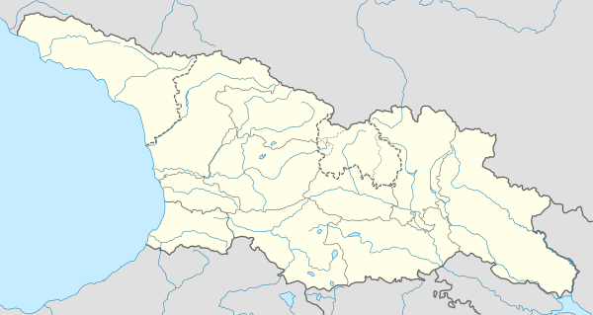
Georgia’s HCV Elimination Program Service Providers
April, 2015
4 medical facilities in Tbilisi
December, 2016
27 medical facilities in 8 cities of Georgia
ZUGDIDI
KUTAISI
LANCHKHUTI
GORI
GURJAANI
TBILISI
BATUMI
RUSTAVI

Slide 24

Future Goals
Negotiations are ongoing to attract partners in order to increase access to screening
Unified Screening database was created and launched on May 26, 2017. Every HCV screening service provider will enter the data to this electronic system
Georgia HCV elimination website is under development
Strategy for inclusion of target Groups as PWID
Annual report is under development

Slide 25
Acknowledgements
Ministry of Labour, Health and Social Affairs
National Center for Disease Control and Public Health
Gilead Sciences, Inc
US Centers for Disease Control and Prevention (CDC)
TAG Members
State, Clinical and scientific committee of Hepatitis C Elimination Program
Elimination program service provider clinics
LIFER

Slide 26


