Slide 1
Universal health coverage in Turkey: eight lessons Learned and worth sharing
Enis Barış, Practice Manager, ECA, HNP GP, World Bank

Slide 2
Universal Health Coverage in Turkey: Eight lessons learned and worth sharing
Political commitment and leadership are not just buzzwords. They do matter!
So do macroeconomics and fiscal space!!
Visionary Big Bang reform needs to be complemented by incremental changes.
Increased demand should be matched.
A balancing act between breadth, depth and scope to show results.
Perseverance is key to sustainability; reform fatigue should be avoided.
Financial and fiscal sustainability is important, but should not be traded off at the expense of reaching the ultimate goal of improvement in the level and distribution of health outcomes.
UHC is not meant to be about consuming healthcare, but about producing health!

Slide 3
Political commitment and leadership are not just buzzwords. They do matter!
Context
Context
Content
Actors
Actors
Process
Content
Process
Source: Walt G: Health Policy; An Introduction to Process and Power, Zed Books, London, 1994, pp 226.
Walt and Gibson, Reforming the Health Sector in Developing Countries
Notes:
Political commitment and leadership are not just buzzwords. They do matter!
Five attempts to establish UHI, first in 1967, 1969, 1974, 1992 the last being in 1998
SSK established in 1945 transferred to SGK in 2006
Emekli Sandigi: 1954 transferred to SGK in 2006
BagKur:1972 transferred to SGK in 2006
and Green Card 1992, with MOH
First White Paper 1993
New constitution in 1982 refers to right to social security and states that UHI could be established (Article 56)
End of almost two decades of coalition governments
Explicit interest in the health sector
Issuance of post-election Urgent Action Program (UAP) with explicit reference to health sector
Issuance of Gov’t Program for Transformation in Health based on objective assessment of the health status and sector

Slide 4
Macroeconomics matter
Public Sector Net Debt Stock
GDP Growth
(Real, seasonally adjusted, 2000 Q1=100)
(2000 – 2016, Ratio to GDP, percent)
Source: World Bank database

Slide 5
So does the fiscal space
Source: WHO, Global Health Expenditure Database (2015)
Notes:
Total health expenditure as % of GDP for Turkey is 4.9% in 2000, 6.03% in 2007, and 5.59% in 2013
Government health expenditure as % of general government health expenditure is 9.76% in 2000, 11.8% in 2007, and 10.74% in 2013.

Slide 6
Annual average growth in per capita health expenditures in OECD, 2005-2015
Source: WHO, Global Health Expenditure Database (2015)

Slide 7
Anticipating future Public health spending growth with or without reform
Projected Costs of UHI (in trillion TL)
Projected Government Spending (% of GDP)
Source: World Bank, Preparing for Universal Health Insurance in Turkey and WHO Global Health Expenditure Database 2015

Slide 8
From Big Bang to Incremental changes
Vertical
Integration
Horizontal
Segmentation
Vertical
Segmentation
Horizontal
Integration
Vertical &
Horizontal
Integration
Vertical &
Horizontal
Segmentation
Revenue
Collection
Explicit benefit package
Performance based payment for hospitals
Capitation payment for PC
IT platform
Others…
Fund
Pooling
Purchasing
Provision
Adapted from Murray JL, Frenk, J: A framework for assessing the performance of health systems. WHO Bulletin, 2000: 78(6); 717-731.

Slide 9
Responding to increased demand for health care
Productivity in MOH Hospitals (2002-2014)
Productivity in PHC
(2002-2014)
66 % increase in # of specialists
217 % increase in # of visits
26 % increase in # of GPs
193 % increase in # of visits
Source: Health Statistics Yearbook 2014, MOH

Slide 10
Increasing role of private sector in service provision
Source: MoH General Directorate of Health Research Turkish Health Statistics 2013

Slide 11
A balancing act between breadth, depth and scope to show results!
Before
After
Costs
Costs
Services
Services
Population
Population
Notes:
Breadth: Population coverage from 64% in 2003 to 94% in 2008
Scope: cost sharing: 2 YTL per visit, 10 to 20% of pharmaceuticals
Depth: almost all services, except IVF and a few others.

Slide 12
Evolution of Health Outcomes…
Main Indicators | Turkey, 2000 | Turkey, latest | Lowest, latest | Highest, latest | Average Comparator Countries, latest
One-year-olds immunized with MCV (%) | 87 | 98.0 | 66.0 | 99.0 | 90.7
Diphtheria tetanus toxoid and pertussis (DTP3) immunization coverage among 1-year | 85 | 98.0 | 65.0 | 99.0 | 89.5
Infant mortality rate (per 1 000 live births) both sexes | 33.7 | 16.5 | 3.8 | 32.8 | 10.9
Under-5 mortality rate (probability of dying by age 5 per 1000 live births) both sexes | 41.7 | 19.2 | 4.5 | 43.9 | 12.9
Maternal mortality ratio | 33 | 20.0 | 3.0 | 140.0 | 44.6
Life expectancy at birth (years) both sexes | 70 | 75.2 | 56.7 | 79.8 | 73.9
Total expenditure on health as percentage of gross domestic product | 5 | 5.6 | 3.4 | 10.6 | 6.9
General government expenditure on health as percentage of total government expenditure | 9.8 | 10.7 | 4.3 | 31.8 | 13.0
Per capita government expenditure on health (PPP int. $) | 436.5 | 1053.5 | 655.9 | 1724.6 | 1149.2
GNI per capita, PPP (constant 2011 international $) | 12807.3 | 18356.0 | 11,585.26 | 22,614.65 | 16,705.79
Female adult literacy rate | 79.6ª | 91.6^{c} | 91.6 | 99.7 | 96.0
Gini index | 41.4^{b} | 40.0^{d} | 27.2 | 65.0 | 45.1
Total fertility rate | 2.4 | 2.0 | 1.3 | 2.4 | 1.8
Note: The following sixteen countries were used as reference: Argentina, Brazil, Bulgaria, Chile, Colombia, Croatia, Malaysia, Mexico, Poland, Romania, the Russian Federation, Serbia, South Africa, Thailand, Ukraine and Venezuela.
a-2004; b-2002; c-2012, d-2011
Source: WHO, Global Health Expenditure Database (2015) and World Development Report, 2015
Notes:
Latest year is 2013.

Slide 13
….of Financial Protection
Source: WHO, Global Health Expenditure Database (2015)
Notes:
OOP as percent of total health expenditure is 14.98% in 2013. It was 29.1% in 1999
In 2013, government health expenditure is 4.3% of GDP. In 1999, it was 2.9%.
In 1999 it was 14.6%

Slide 14
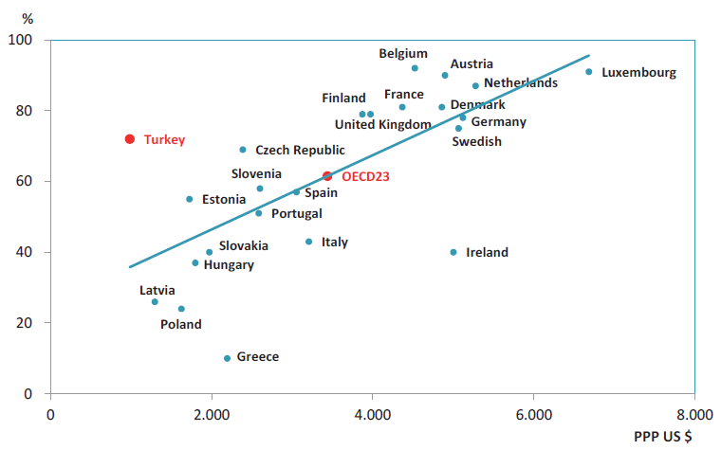
…..And of Patient Satisfaction.
Satisfaction with Health Care Services, (%) and per Capita Total Current Health Expenditure, (PPP US $), 2014
Source: Health Statistics Yearbook 2015, MOH
Notes:
Patient satisfaction in Turkey is 71%.

Slide 15
Is Turkey there Yet (2)?
Health Expenditure Efficiency Frontier
Health Expenditure Efficiency Score
Turkey
Source : IMF; Central, Eastern and Southeastern Europe; Reconciling fiscal Consolidation and Growth, Nov 2015.
Notes:
Health spending in CESEE countries is less efficient than in advanced Europe. HE efficiency in CESEE countries is at the l9ower end of emerging market economies. Some SEE countries have higher efficiency with a very low level of expenditure. CIS countries have the most room for improved efficiency.

Slide 16
Financial Risk Protection has levelled off…..
 | 2002 | 2003 | 2004 | 2005 | 2006 | 2007 | 2008 | 2009 | 2010 | 2011 | 2012 | 2013 | 2014 | 2015
Proportion of households with catastrophic health expenditures | 0.81 | 0.75 | 0.84 | 0.64 | 0.59 | 0.68 | 0.36 | 0.48 | 0.37 | 0.17 | 0.14 | 0.22 | 0.31 | 0.30
Incidence of household impoverishment due to health expenditures | 0.43 | 0.25 | 0.28 | 0.23 | 0.34 | 0.19 | 0.17 | 0.22 | 0.15 | 0.15 | 0.07 | 0.15 | 0.12 | 0.13
Source: TURKSTAT

Slide 17
…..So has Satisfaction
Satisfaction from Public Services (%)
Source: TURKSTAT

Slide 18
Source: OECD
Notes:
Even if cost-containment efforts are put in place, the Organization for Economic Co-operation and Development (OECD) still predicts that public spending on health in its member states will rise from an average of 6% of GDP across its member states in 2006-10 to around 9.5% of GDP in 2060. With no cost containment, that proportion would reach 14%.

Slide 19
What is Next?
Efficiency Frontier (EF)
    Highest Life Expectancy at the Lowest Cost
      Avoidable mortality (NCDs)
      Amenable to prevention (NCDs)
      Investment in Early Childhood
Value-based healthcare (VBH)
    Incentivizing value – production of health vs. volume – consuming healthcare
    Performance vs Productivity
Notes:
Simply put, efficiency frontier refers to achieving best possible health outcomes for the lowest cost, the former measured in LE at birth. Needless to say, we could make it more meaningful by also measuring at the age of 65, for instance, or even better, in terms of Healthy LE, or HALE. There are really two components to it, one addressing risk factors amenable to prevention and effectively managing and treating conditions to avoid mortality.
Value based health care is the ends to avoidable mortality, by focussing on the value we get for our Kums or dollars rather than how much services we produce, so much as less about productivity, and more about performance. I would like to note here that performance is often understood in terms of health outcomes, which is indeed a very large part of it. But in reality it is more than that, and includes to social and academic functions for instance that the healthcare system plays in a given society.

Slide 20
Health Expenditure Efficiency in Turkey
Health Expenditure Efficiency
Health Expenditure Efficiency Frontier
Healthy Life Expectancy and Health Expenditure per capita
Healthy Life Expectancy and Health Expenditure per capita
Source : IMF; Central, Eastern and Southeastern Europe; Reconciling fiscal Consolidation and Growth, Nov 2015.

Slide 21
Source: World Health Organization

Slide 22
Rapid Decline in Mortality Amenable to Healthcare
Source: Nolte, Ellen, and Martin McKee. "Variations in amenable mortality—trends in 16 high-income nations." Health policy 103, no. 1 (2011): 47-52.

Slide 23
Coverage of Early Childhood Development Programs in Turkey
Child Development Phase
Intervention
Coverage of Age Group
Notes:
This combines new data from Levent and data from old slide

Slide 24
Value Based Healthcare in the Era of NCDs
Universal Health Coverage
Health in All Policies
Individual-level
Population-level
Notes:
The first is about equitable coverage, but not only in the health sector and at the individual level and not only for cure, but rather prevention.

Slide 25
Towards Value-based health system

Slide 26
Modalities of payment and health outcomes

Slide 27
Characteristics of high performing chronic care system
Universal coverage
Equity in access (free at point of service)
Prevention of ill health
Self management support
Primary care
Population risk management
Integration (PC and specialist)
Information technology
Coordination of care
Physician leadership
Measuring patient outcomes
Alignment of incentives
Community engagement
SYSTEM
DESIGN
Source: Ham C: The ten characteristics of high performing chronic care system. Health Economics, Policy and Law. 2010; 5:71-90

Slide 28
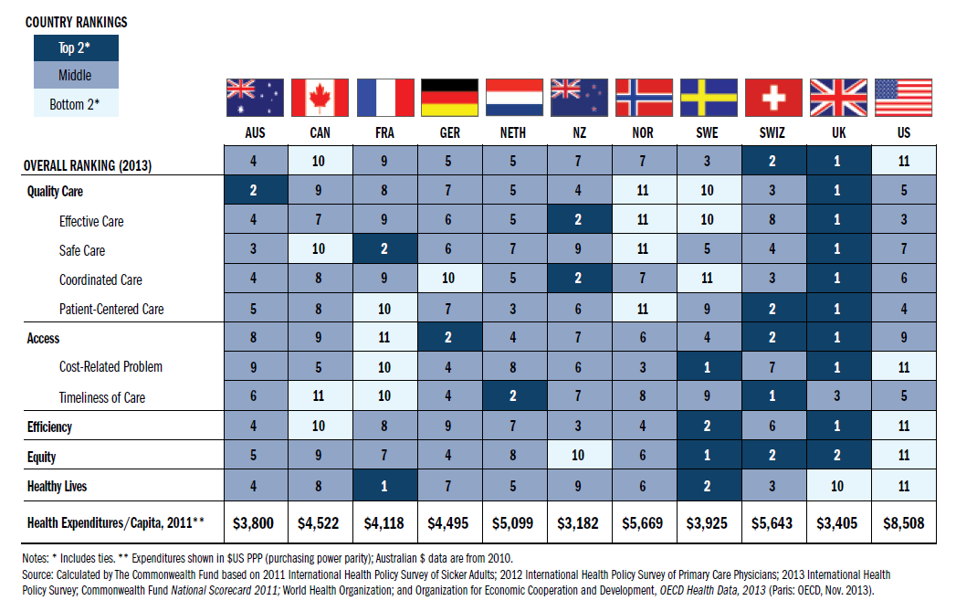
Concluding Remarks
Davis K et al: Mirror Mirror on the Wall – 2014 update, Commonwealth Fund, 2014
Lessons learnt &
recommendations
Notes:
N.B. THE COMMONWEALTH FUND SHOULD HAVE THE LATEST ON THIS ONE AS THIS IS UPDATED ON A YEARLY BASIS.
Alessia: it seems that 2014 is the latest year for country-level scorecards; I find that the commonwealth fund published US state-level scorecards in 2015 and US local-level scorecards in 2016 only?

Slide 29
THANK YOU!

