Slide 1

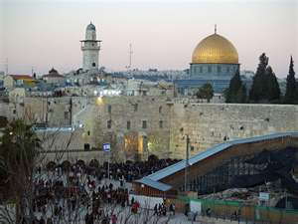
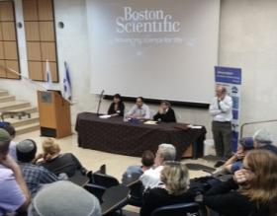
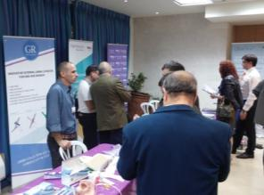
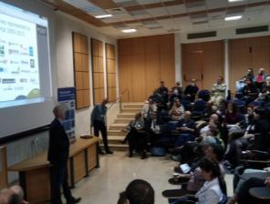
JLM-Bio
*
Accelerating the Bio-Ecosystem of Jerusalem
*Previously known as Jerusalem Business Networking Forum (JBNF)-BioMed

Slide 2
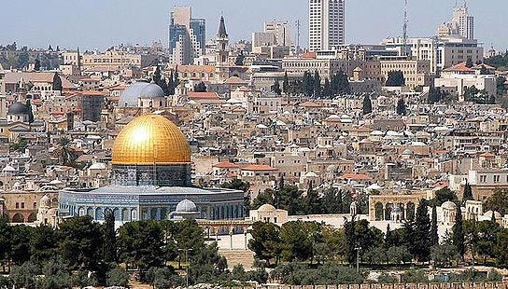

JLM-Bio Strategic Goals
To transform Jerusalem to the Bio-startup Capital
To create a strong & functional Bio-ecosystem
To strengthen the Bio-startups with professional support
To leverage our networking platform for deal-making

Slide 3
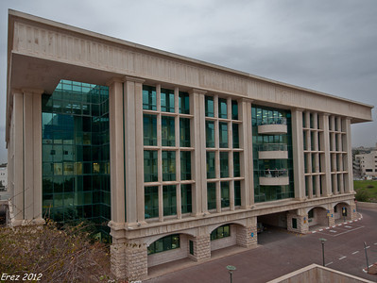
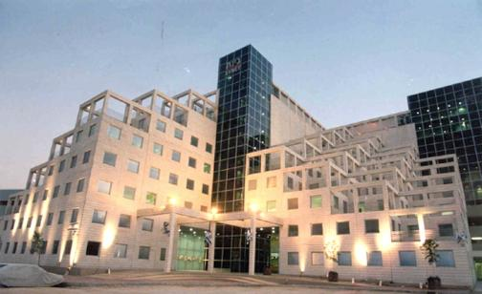
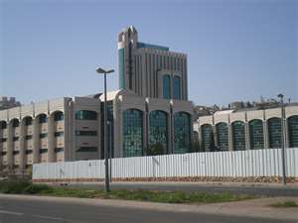
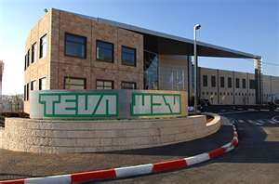
Jerusalem’s current
BioMed potential
Strong academic institutes
Significant qualified manpower (PhDs, MScs & BScs)
>165 Bio-companies
Most life science startups in Israel
Numerous VCs
Professional Bio-infrastructure
Various professional accompanying entities

Slide 4

Jerusalem’s Bio-problem
Academic institutes
Hospitals
Bio-start-ups
Investing entities
Big Bio-Pharma
Bio-facilities
Bio-consultants
Lack of interaction & collaboration prevent Jerusalem from fulfilling its potential as a strong Bio-Ecosystem

Slide 5

Jerusalem’s Bio-Need
Academic institutes
Hospitals
Bio-start-ups
Investing entities
Big Bio-Pharma
Bio-consultants
Bio-facilities
Evolving JLM’s Bio-Ecosystem requires a platform for bringing Bio-players together → building a better future

Slide 6
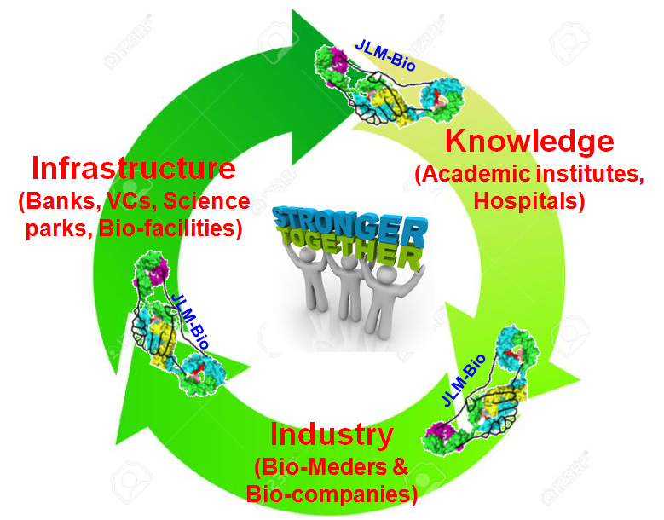
JLM-Bio is the Solution
JLM-Bio brings Bio-Meders together!!!
JLM-Bio initiates and maintains the
Bio-Ecosystem’s circle of life!!!

Slide 7

JLM-Bio is the Solution
  “Networking is the to success”
  We Build JLM’s Bio-Med community
√ Academia-Industry events
√ Startups-investors Pitch-nights
√>600 members
√ Foreign delegations
& businessmen
√ >5 annual meetings
√ Professional education & brain storming nights

Slide 8

JLM-Bio is the Solution
  “Networking is the to success”
  We Build JLM’s Bio-Med community
JLM-Bio was founded 4 years ago
(http://meetup.com/JBNF-Biomed/**)
> 20 meetings in various subjects for differing target audience
Utilizing personal interactions to promote, excel and develop JLM’s bio-companies & Bio-Meders
**The new site is under constructions

Slide 9





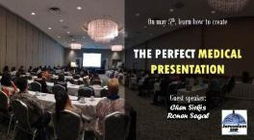



JLM-Bio Meetings
2015’s Events

Slide 10
Current & Future JLM-Bio Initiatives*
Professional & Pitch-Night Events √
Networking Boost – Events’ Welcoming/Network Committee √
Academia & Hospitals to Industry Bridging Events √
Promotion of JLM Bio-Facilities √
Internship for Life Science Graduates in JLM’s Bio-Industry
Strengthening the JLM Bio-Business Eco-System by Further Involving Investors, Legal and Financial Institutions
* All current activities are executed by volunteers; activities in according to the strategic plan

Slide 11
Roadmap – Thinking Forward
Make JLM-Bio the hub of the JLM-Bio Ecosystem while making it financially sustainable
Timeline
Milestones
Budget ($)
Q1-Q2 2016
Launching the new JLM-Bio Website
Hire Office Administrator (first employee)
JLM-Bio Blog
Branding & Promotion - JLM-Bio
$ 10 K
$ 25 K
$ 10 K
$ 20 K
Q3-Q4 2016
Bio graduate student internship in JLM industry
Bring the JLM-Bio experience online to our + 650 community
Jerusalem Bio professional & Corporate directory
Marketing JLM Bio Infrastructure to Industry
75% JLM-Bio paid membership of JLM Life Sc. Companies
$ 45 K
$ 10 K
$ 15 K
$ 25 K
income
2017
Launching the Montefiore program
JLM-Bio accelerator and start-up mentorship program
Establishment of an International Advisory Board
Help create 30 new Bio-Jobs in Jerusalem
$ 100 K
$ 25 K
-------
Income $ 75 K
Sustainable
2018 - 2019
JLM-Bio Membership - 1,500
Annual JLM-Bio Conference
Help create 25 new Bio-start-ups in Jerusalem annually
Annual Income $ 150 K

Slide 12
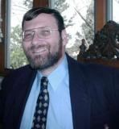
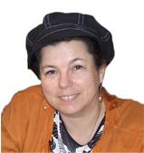
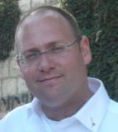
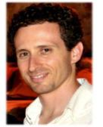
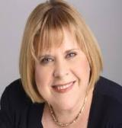
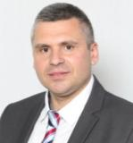
JLM-Bio Organizing Team
Joe van Zwaren,
JBNF, JLM-Bio
Yaron Suissa,
CSO, Molecular Detection
Avigail Frij,
JBNF, JLM-Bio
Shai Melcer, Hd
Bio-Jerusalem
Tamar Tennenbaum,
CEO, Tencure
Vitali Shilo, PhD.
Hebrew University

Slide 13



Thank You
JLM-Bio
Previously known as Jerusalem Business Networking Forum (JBNF)-BioMed
M: 972-(0)54-973-0029
Address: POB 18289, Jerusalem 91181
    http://meetup.com/JBNF-Biomed/ JBNF-Bio-Med = (Life Science)
      http://www.facebook.com/JerusalemBusinessNetworkingForum
https://www.linkedin.com/company/jerusalem-business- networking-forum-jbnf-
Website: www.jlm-bio.org

