Slide 1
Improving and using metrics for action
ENAP Metrics Group meeting, Ferney Voltaire, 3-4th December 2014
Professor Joy Lawn
London School of Hygiene & Tropical Medicine
& Dr Mathews Mathai, WHO
On behalf of ENAP Metrics Group
@joylawn
Notes:
For more information contact Joy Lawn or Matthews Matthai

Slide 2





Every Newborn Series
5 papers
6 comments
55 authors from 18+ countries
60+ partner organisations
Main funders: Bill & Melinda Gates Foundation, USAID, Children’s Investment Fund Foundation
Every Newborn Action Plan
Based on the evidence from the Series
Co-led by UNICEF & WHO, Launch June 2014
Consultation >60 country governments
>80 organisations, >1000 individuals
World Health Assembly 2014 resolution
Now to action in many countries
Closely linked to post-2015 action
Eg A Promise Renewed
@joylawn
Notes:
Strong evidence base in Lancet
Wide ownership and UN leadership in ENAP
Now moving to country implementation and a key issue is to have the right metrics

Slide 3
ENDING PREVENTABLE CHILD AND MATERNAL DEATHS
@joylawn

Slide 4

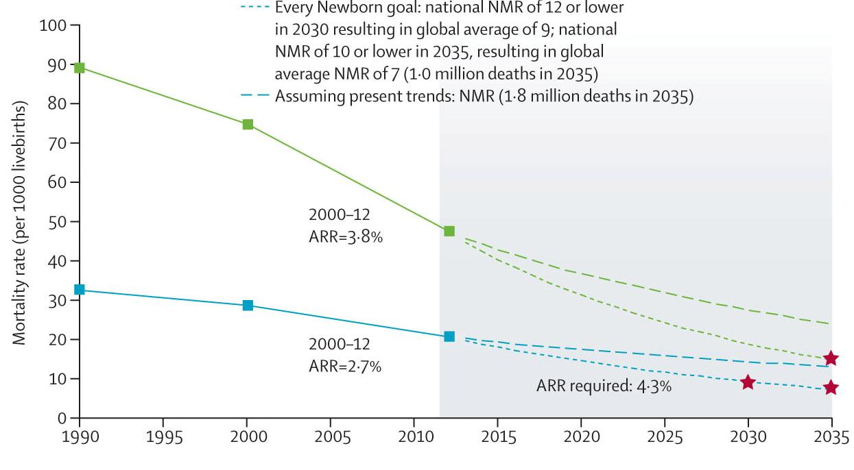


Ending preventable child deaths
A Promise Renewed target:
National U5MR of 20 or less
Every Newborn target:
National NMR of 10 or less
From 2.9 to 0.8 million neonatal deaths
About 29 countries will have to more than double their rates of progress Sub national equity goals also to be set
Source: Lancet Every Newborn series, paper 2

Slide 5
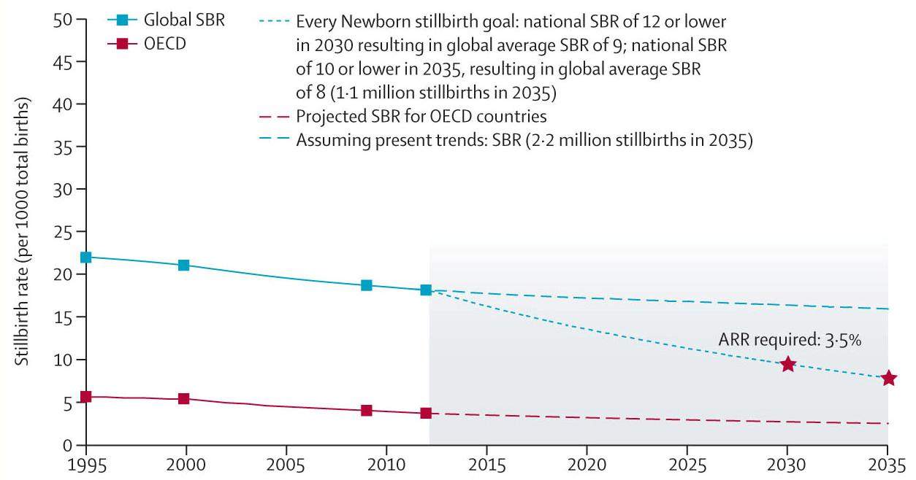

Also ending preventable stillbirths
2035
Every Newborn target
National stillbirth rate of 10 or less
From 2.6 to 1.1 million stillbirths
Aligned with NMR target but more ambitious change needed
Sub national equity goals also to be set
Source: Lancet Every Newborn series, paper 2

Slide 6
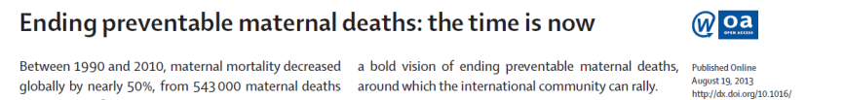
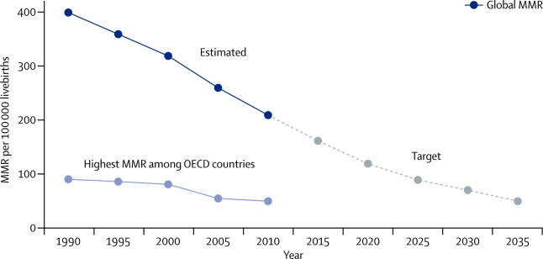
AND ending preventable maternal deaths Maternal mortality target included in Every Newborn Action Plan
Global average MMR of 70 per 100,000
With different targets for different countries
Lancet GH Sept 2013 : The Lancet Global Health 2013; 1:e176-e177 (DOI:10.1016/S2214-109X(13)70059-7)

Slide 7
ACTING ON THE ACTION PLAN

Slide 8
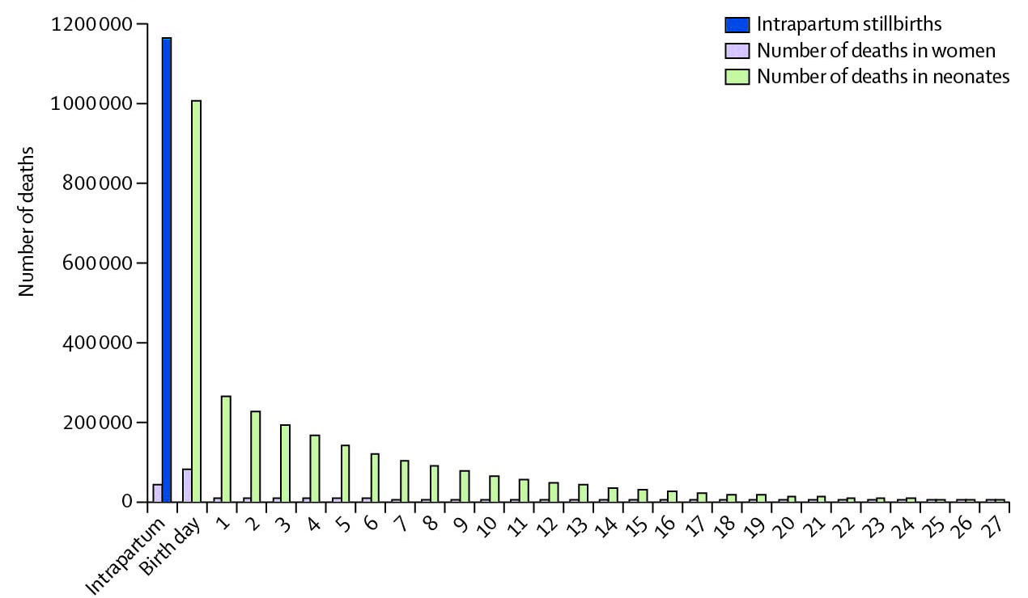
When? For women, stillbirths, newborns, highest risk is at same time
Birth day
1.2 million intrapartum stillbirths
>1 million neonatal deaths
~113,000 maternal deaths
75% neonatal deaths
Birth is the time of greatest risk of death and disability
TRIPLE return on investment – quadruple if count development outcomes
Source: Lancet Every Newborn series, paper 2

Slide 9
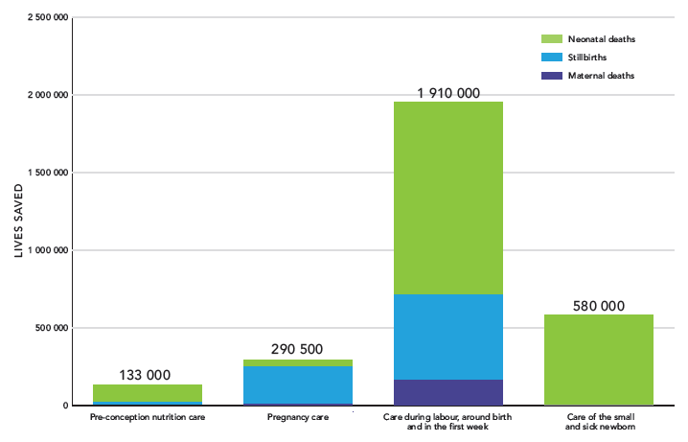
Why? 3 million lives could be saved per year with universal coverage
2 of the 3 MILLION
LIVES SAVED PER YEAR
Running cost $1.15 per person
Source: The Lancet Every Newborn series, paper 3

Slide 10
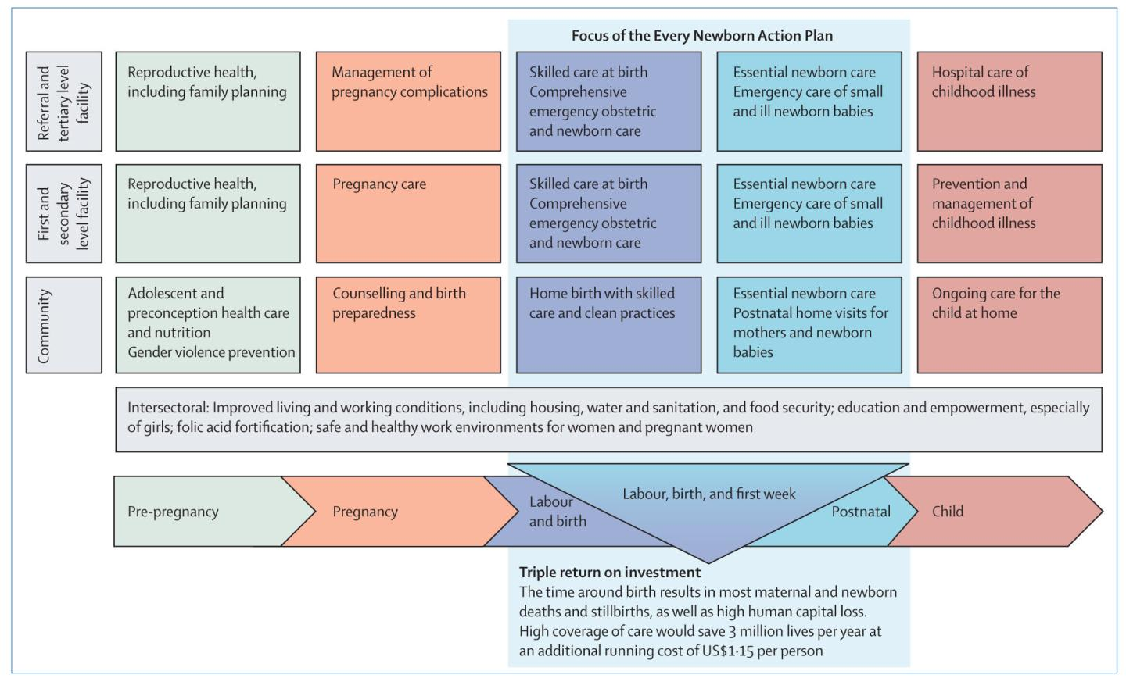
What? Packages of integrated care for women & children
CARE AT BIRTH, TRIPLE RETURN
Highest impact, cost effective
Yet lowest coverage, widest inequity and weakest data
Source: Lancet Every Newborn series, paper 5

Slide 11

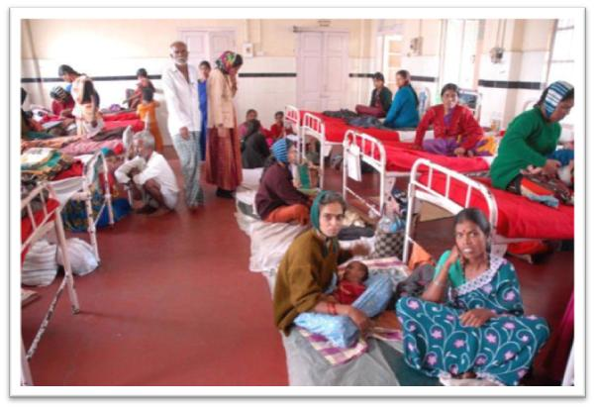
Care at birth, and care of small and sick newborns First opportunity is the QUALITY gap for facility births
Could save 2 million lives a year by closing this quality gap
Particular focus on health workers especially midwives
“Every Mother Every Newborn” quality initiative
Source: Lancet Every Newborn series

Slide 12



Slide 13


Slide 14


Slide 15


Slide 16


Slide 17


5 things to do differently
Investment for impact
Governance, community participation, partner alignment
Integrated Plans
Integrated service delivery, continuum of care, coordination
Intentional leadership development
Especially in countries with highest burden
Implementation & Innovation
Address health system bottlenecks, Every Mother Every Newborn initiative
Indicators & metrics
Targets in post 2015
Measurement of progress and impact
AMBITIOUS MEASUREMENT CHANGE IS CRITICAL TO EVERY STEP
Notes:
The action plan relies on five guiding principles:
Country leadership: Countries have the primary ownership and responsibility for establishing good governance and providing effective and good-quality reproductive, maternal and newborn health services. Community participation is a key feature of such leadership as it is one of the most effective transformational mechanisms for action and accountability for newborn health. Development partners should align their contributions and harmonize action.
Integration: Providing every woman and every newborn with good-quality care requires integrated service delivery with coordinated health system approaches between multiple programmes, stakeholders and initiatives across the continuum of reproductive, maternal, newborn and child health are essential, without losing visibility for newborn specific content.
Equity: Equitable and universal coverage of high-impact interventions, and a focus on reaching the most vulnerable and poorest population groups are central to realizing the right of every woman and every newborn, girl and boy, to health.
Accountability: Transparency, oversight and accountability are prerequisites for equitable coverage, quality of care and optimal use of resources.
Innovation: Evidence has been accumulating over the past decade of strategies that broaden the coverage of interventions for newborns and reduce mortality. Nevertheless, innovative thinking is needed about ways to reach the poorest and most underserved populations. Optimizing the application of knowledge of which interventions and strategies are most effective still needs more research and development.

Slide 18

GLOBAL LEVEL
EVERY NEWBORN ACTION PLAN MILESTONES
NATIONAL LEVEL
2035
2035 Assessment of progress to national targets of <10 for newborn deaths & stillbirths
Global NMR target of 7 per 1,000 lives births and SBR of 8 per 1,000 total births
Coverage goals assessment:
Universal coverage for all packages
2030
2030 Review of progress to national mortality targets of <12 for newborn deaths & stillbirths
Global NMR milestone of 9 per 1,000 lives births and SBR of 9 per 1,000 total births
2025 coverage goals assessment:
[1] Care at birth: 95% of births receive quality care.
[2] Care of small and sick newborns: >75% KMC; >75% sepsis management; Comprehensive neonatal intensive care: (country specific targets).
[3] Community care: 90% coverage for postnatal care; 50% at 6 months for exclusive breastfeeding.
2025 Review of progress to national mortality targets
Global NMR milestone of 12 per 1,000 lives births and SBR of 11 per 1,000 total births
2025
By 2020
ENAP milestone to ensure 10 core indicators and linked metrics are defined institutionalised in national metrics platforms and widely used for programmatic change
2020 coverage goals assessment:
[1] Care at birth: 90% of facility births receive quality care.
[2] Care of small and sick newborns: >50% KMC; >50% sepsis management; Comprehensive neonatal intensive care: (country specific targets).
[3] Community care: 20% increase in postnatal care.
2020 Review of progress to national mortality targets
Global NMR milestone of 15 per 1,000 lives births and SBR of 14 per 1,000 total births
2020
EMEN adaptation
>50% of 75 Countdown countries adapted/ adopted Mother-baby friendly package. Standards, policies, training, indicators updated for care at birth and for small and sick newborns.
National data tracking
>50% of 75 Countdown countries are collecting and using data for minimum perinatal dataset metrics.
2017
Stillbirths
Stillbirth interventions and strategies of the Every Newborn Action Plan more clearly delineated.
Minimum perinatal dataset
Outcome metrics developed and to include stillbirths and development outcomes. Simple and standardised measurement methods across different health system contexts. Improvement of accuracy and quality of key data.
EMEN
Coverage indicators for Mother-baby friendly package. Coverage indicators for care of small and sick newborns.
National RMNCH plans sharpened
>50% of 75 Countdown countries have sharpened and costed RMNCH strategies to address newborn health.
National finance tracking
>50% of 75 Countdown countries tracking and reporting national expenditures for RMNCH, with specific line item for care at birth.
2016
Key Mile-stones in 1st yr
Monitoring & data improvement plan
Develop a plan for tracking impact, coverage and quality, including addressing priority metrics gaps.
Accountability
Tracking linked to Every Woman Every Child and other established accountability mechanisms.
Every Mother Every Newborn (EMEN)quality of care initiative
Package defined, encompassing high quality and respectful care at birth, notably workforce and commodities standards, plus maternal and perinatal mortality surveillance and response (audit).
Essential commodities
>50% of 75 Countdown countries have included all 4 newborn commodities of the 13 RMNCH commodities on EML and designed systems to track progress.
Community voice esp women
>50% of 75 Countdown countries with national policy enabling community voice e.g. village committees, local champions, religious leaders, women’s & parent groups.
2015
All items in red text depend on improved metrics methods, tools, and use at scale
Notes:
Makes the point that ENAP will stand or fall on better measurement
And that many of the milestones are related to metrics or require better metrics to track progress

Slide 19

Core indicators selection during ENAP development
Step 1: Developed matrix of the relevant indicators
According to ENAP Impact FW from impact (mortality) down to inputs including financial such as ODA (>120 rows!)
Step 2: Graded each indicator as follows:
Direct relevance to ENAP 5 objectives and focus (from A to C)
Current availability of the data (from 1 to 3)
Step 3: Ranked indicators
By A to C, with A being closest match to ENAP focus.
By 1 to 3 where 1 is most currently available
Ambition to count what matters
Indicators prioritised by importance (category A)
Then develop an urgent programme of work to improve the input data for those not currently available or only for a few countries.
eg HIV ART coverage data was lacking at the start of 3x5 but was quickly scaled up.
eg Malaria ITN data was also lacking but was addressed urgently
Ref: Every Newborn: From evidence to action to deliver a healthy start for the next generation. Mason et al for the Lancet Every Newborn Study Group. Lancet 2014.

Slide 20


Every Newborn action plan core indicators
Text = WHO 100 indicators core list.
Text = WHO indicators additional list
 | Core Indicators | Additional Indicators
Impact | 1. Maternal Mortality Ratio
 | 2. Stillbirth Rate | Intrapartum Stillbirth Rate
 | 3. Neonatal Mortality Rate | Low birth weight rate
 |  | Preterm birth rate
 |  | Small for gestational age
 |  | Neonatal morbidity rates , eg infection
 |  | Disability after neonatal conditions
Coverage: Care for all mothers & newborns | 4. Skilled attendant at birth | Immediate breastfeeding
 | 5. Early postnatal care for mothers and babies
 | 6. Exclusive breast feeding to 6 months
Coverage: Complications and extra care | 7. Antenatal corticosteroid use | Caesarean section rate
 | 8. Newborn resuscitation
 | 9. Kangaroo mother care, feeding support
 |  | Chlorhexidine cord cleansing
 | 10. Treatment of neonatal sepsis
Counting | Birth registration | Death registration, plus cause of death
ENAP service delivery packages | "MotherBaby" high quality care at birth
 | Care of small and sick newborn
Ref: Every Newborn: From evidence to action to deliver a healthy start for the next generation. Mason et al for the Lancet Every Newborn Study Group. Lancet 2014.

Slide 21

Every Newborn action plan core indicators
 | Core ENAP Indicators | Additional Indicators
Impact | 1. Maternal Mortality Ratio
 | 2. Stillbirth Rate | Intrapartum Stillbirth Rate
 | 3. Neonatal Mortality Rate | Low birth weight rate
 |  | Preterm birth rate
 |  | Small for gestational age
 |  | Neonatal morbidity rates , eg infection
 |  | Disability after neonatal conditions
Coverage: Care for all mothers and newborns | 4. Skilled attendant at birth | Immediate breastfeeding
 | 5. Early postnatal care for mothers and babies
 | 6. Exclusive breast feeding to 6 months
Coverage: Complications and extra care | 7. Antenatal corticosteroid use | Caesarean section rate
 | 8. Newborn resuscitation
 | 9. Kangaroo mother care, feeding support
 |  | Chlorhexidine cord cleansing
 | 10. Treatment of neonatal sepsis
Counting | Birth registration | Death registration, cause of death
ENAP service delivery packages | "MotherBaby" high quality care at birth
 | Care of small and sick newborn
Focus on Thurs-day
Shaded = not currently routinely tracked.
Bold = indicator requiring additional evaluation for consistent measurement
All indicators to be tracked so that they can be broken down to assess equity, e.g. urban/rural, regional, wealth quintile
Ref: Every Newborn: From evidence to action to deliver a healthy start for the next generation. Mason et al for the Lancet Every Newborn Study Group. Lancet 2014.
Notes:
Main point is that these 10 indicators are critical – need others and need details of content but if do not have these measured as a start everywhere then will fail so they are the top priority – can add quality and content but need to have coverage first
DETAILS OF PROCESS OF SELECTION –background to selection as described in Lancet Every Newborn paper 5 and web annex
Step 1: Developed matrix of the relevant indicators
According to ENAP Impact FW from impact (mortality) down to input level including financial such as ODA.
Step 2: Graded each indicator as follows:
Direct relevance to ENAP five obj and focus (from A to C)
Current availability of the data (from 1 to 3)
Step 3: Ranked indicators
By A to C, with A being closest match to ENAP focus.
By 1 to 3 where 1 is most currently available
It was agreed to prioritise indicators based on match/importance (category A) and then develop an urgent programme of work to improve the input data for those that are currently not available or only for a few countries.
eg HIV ART coverage data was lacking at the start of 3x5 but was quickly scaled up.
eg Malaria ITN data was also lacking but was addressed as a matter of urgency

Slide 22
Every Newborn action plan core indicators
 | Core ENAP Indicators | Additional Indicators
Impact | 1. Maternal Mortality Ratio
 | 2. Stillbirth Rate | Intrapartum Stillbirth Rate
 | 3. Neonatal Mortality Rate | Low birth weight rate
 |  | Preterm birth rate
 |  | Small for gestational age
 |  | Neonatal morbidity rates , eg infection
 |  | Disability after neonatal conditions
Coverage: Care for all mothers and newborns | 4. Skilled attendant at birth | Immediate breastfeeding
 | 5. Early postnatal care for mothers and babies
 | 6. Exclusive breast feeding to 6 months
Coverage: Complications and extra care | 7. Antenatal corticosteroid use | Caesarean section rate
 | 8. Newborn resuscitation
 | 9. Kangaroo mother care, feeding support
 |  | Chlorhexidine cord cleansing
 | 10. Treatment of neonatal sepsis
Counting | Birth registration | Death registration, cause of death
ENAP service delivery packages | "MotherBaby" high quality care at birth
 | Care of small and sick newborn
ENAP Coverage task teams
Shaded = not currently routinely tracked.
Bold = indicator requiring additional evaluation for consistent measurement
All indicators to be tracked so that they can be broken down to assess equity, e.g. urban/rural, regional, wealth quintile
Ref: Every Newborn: From evidence to action to deliver a healthy start for the next generation. Mason et al for the Lancet Every Newborn Study Group. Lancet 2014.
Notes:
Main point is that these 10 indicators are critical – need others and need details of content but if do not have these measured as a start everywhere then will fail so they are the top priority – can add quality and content but need to have coverage first
DETAILS OF PROCESS OF SELECTION –background to selection as described in Lancet Every Newborn paper 5 and web annex
Step 1: Developed matrix of the relevant indicators
According to ENAP Impact FW from impact (mortality) down to input level including financial such as ODA.
Step 2: Graded each indicator as follows:
Direct relevance to ENAP five obj and focus (from A to C)
Current availability of the data (from 1 to 3)
Step 3: Ranked indicators
By A to C, with A being closest match to ENAP focus.
By 1 to 3 where 1 is most currently available
It was agreed to prioritise indicators based on match/importance (category A) and then develop an urgent programme of work to improve the input data for those that are currently not available or only for a few countries.
eg HIV ART coverage data was lacking at the start of 3x5 but was quickly scaled up.
eg Malaria ITN data was also lacking but was addressed as a matter of urgency

Slide 23
ENAP treatment coverage indicators Task Teams
Tasks
DEFINITON of the intervention
NUMERATOR as simple as possible and for now safer to avoid compound versions
DENOMINATOR
Given issue of measuring “at risk” group eg babies (neonates <2000 gms)
consider alternatives such as used by EPI eg per 100 live births
OUTPUTS
“ACCURATE” indicator based
POTENTIALLY MEASURABLE indicator
SHORT LIST OF QUALITY /PROCESS indicator
Some examples
Treatment completion rate
Drug commodity stock out
4 of the 5 interventions are primarily implemented at facility level and are challenging to collect through maternal recall in surveys so facility focus for validation initially more efficient

Slide 24

Every newborn management including ENAP Metrics
ENAP Metrics group:
Every Newborn Steering Group
CO CHAIRS | WHO: Matthews Mathai LSHTM: Joy Lawn
COORDINATION GROUP (purpose to link to existing metrics work, and institutionalise) | UNICEF: Holly Newby plus alternate UNFPA: Sennen Hounton SNL/NBITWG: Lara Vaz CIFF: Suzanne Fournier Gates: John Grove USAID: Allisyn Moran
TASK TEAMS (working on specific metrics, linked with existing initiatives) | Task teams Initial focus on the 4+1 specific newborn care interventions
WIDER INTEREST GROUP Very inclusive | >100 people drawn from wider metrics community including Newborn indicators technical working group
INSTITUTIONAL PARTNERS to build capacity especially Africa & Asia | Aim to have 2-4 academic institutional partners in high burden countries linked to EMEN pilot sites (Ghana, Tz, Bangladesh, Kenya)
Every Newborn Management team
work streams
1. Country Implementation
UNICEF & WHO
2. ENAP Metrics group
WHO & LSHTM
3. Advocacy & mobilisation
UNF/PMNCH &
Save the Children
Research working group (Cross cutting)
Light touch secretariat at UNICEF
Notes:
ENAP 3 streams of implementation
Each has a group with 2 co chairs and a coordination group and then wider team
This slide focuses on the structure for the ENAP metrics gp

Slide 25


Improving, institutionalising & using ENAP metrics for action
ENAP Milestones by 2020
Count births and deaths in CVRS (women, newborns and stillbirths)
Minimum perinatal dataset & perinatal mortality audit being widely used in countries
ENAP core indicators to be defined , incorporated in national metrics platforms and widely used
x
2020
Metrics testing and use in countries
for programme improvement and accountability
June 2015 - May 2018
Testing indicators and tools in limited number of countries
June 2018 - May 2020
Wide use in many countries
CVRS, facility HMIS, surveys
Jan- May 2015
Refining and consulting on metrics plan
& ENAP monitoring FW
Dec 2014
Meeting
To scope
ENAP Metrics
improvement plan
World Health Assembly
May/June 2014

Slide 26

Three tracks of work for ENAP metrics
Initial focus testing 4 + 1 ENAP specific intervention coverage
KMC (coordinated with KMC acceleration gp and LSHTM with SNL)
Resuscitation (USAID/MCS, SNL Bangladesh, WHO, HBB, UNCoLSC, etc)
Antenatal Corticosteroids (WHO and UNCoLSC TRT etc)
Sepsis case mx (WHO, UNCoLSC etc)
CHX cord cleansing (UNCoLSC, SNL etc)
Coverage/ content maternal & newborn care (with NBITWG & ICM)
Impact indicators including disability (LSHTM & WHO)
Priority research agenda for HMIS, surveys, and related tools, work in progress and gaps (LSHTM & WHO)
1
Technical mapping & planning
of indicators, tools & work in progress
2
Birth and perinatal death certificates, coverage & quality
Develop and test Minimum Perinatal Dataset
Perinatal Mortality audit tool, to link to maternal death surveillance and response, led by WHO
Household surveys modules and Verbal autopsy tools (eg birth/pregnancy history, improved birthweight and GA assessment)
Standard data collection in facility HMIS and facility assessments (eg SPA,SARA)
Improving birthweight and GA assessment tools
Improve & institutionalise
tools in national data collection platforms & global metrics architecture, accountability
3
User friendly formats, intentional links to accountability and parent voices (eg partnerships with E4A and WRA)
Testing linked to EMEN work (~4 countries)
Southern institutions & INDEPTH as centres of excellence
Integrated l oversight especially with maternal community
Capacity development
to improve & use the data for action

Slide 27

Data Action messages
Ensure post 2015 targets
Neonatal and maternal targets likely in SDGs
Stillbirth counting needs major push! And more data
Improve and use the data
Some metrics ready for wider scale use now
Many need strategic plan for technical advances and linked tools
Intentional capacity development
to improve, use and further improve the data
1
2
3
We have the potential to transform
survival and health for EVERY newborn EVERY mother
including for the world’s poorest families –
Acting on the plan depends on better data
@joylawn

Slide 28
IMPACT
EVERY NEWBORN
Every Woman Every Child
Ending preventable deaths for women, stillbirths, newborns and children
Improving child development and human capital

OUTCOMES
Care
at birth & care of small or sick newborns
1
ENAP 5 Strategic objectives
Pregnancy Care
Postnatal Care
Child health care & development
Reproductive health care
OUTPUTS
Adolescent health care
Universal Coverage
3
Quality of care with innovation
2
Health workforce
Commodities & technologies
Health Information Systems
4
INPUTS
Community
empowerment & healthy home behaviours
Count every woman, every newborn, every child,
Accountability and data for action to achieve equity
5
Leadership, governance, partnerships and financing
Contextual factors: epidemiological, environmental, economic and socio-cultural

