Slide 1



Georgia Health Use, Expenditure and Satisfaction Survey 2014
Key Results
May 29, 2015

Slide 2
The universal health coverage (UHC) reform implemented in 2013 has led to a major expansion in population entitlement to publicly financed health services
Percentage of population covered by health insurance (government, private, or employer), %
 |  | Consumption Quintile
Year | Total | Poorest | Second | Third | Fourth | Richest
2007 | 14.1 | 18.5 | 14.8 | 12.5 | 14.4 | 8.6
2010 | 29.5 | 39.84 | 31.06 | 26.6 | 23.7 | 26.21
2014 | 99.9 | 100 | 99.98 | 99.86 | 99.8 | 99.9

Slide 3
Most of those benefiting from the UHC reform are being covered for the first time
Coverage of Health Insurance (government or private), 2014
Yes, beneficiary of Universal Health Care Program (formerly uninsured) | 51.4%
Yes, beneficiary of Universal Health Care Program (Insurance Program of formerly living below poverty line, teachers, children under foster care, refugees | 17.6%
Yes, beneficiary of Universal Health Care Program (Insurance Program of formerly pensioners, children of 0-5 years age, and students) | 23.7%
Yes, health insurance program of military personnel | 0.7%
Yes, corporate health insurance program (when employer/employee/employer pay at the same time | 5.1%
Yes, individual private insurance | 0.5%
No | 0.1%

Slide 4
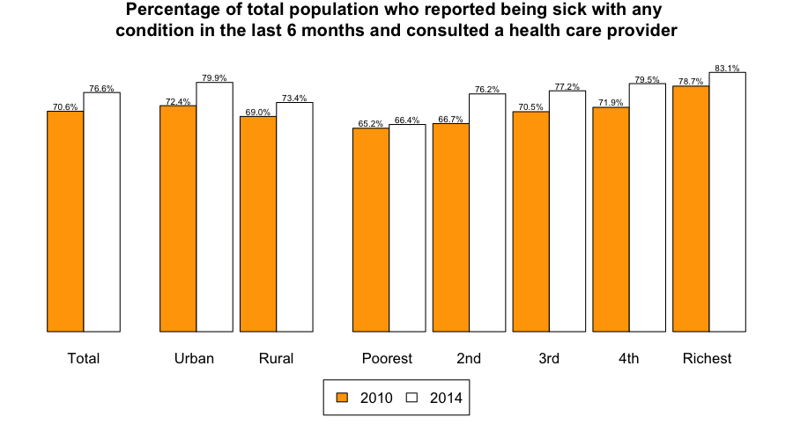
More people consult a health care provider when they are sick

Slide 5
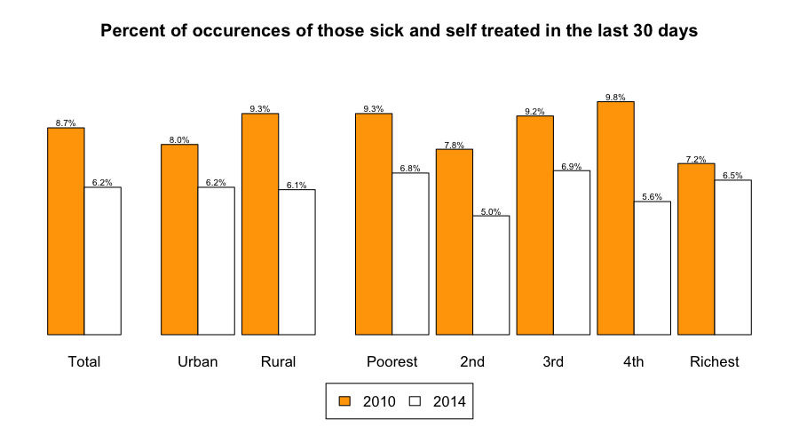
Fewer people self-treat when sick

Slide 6
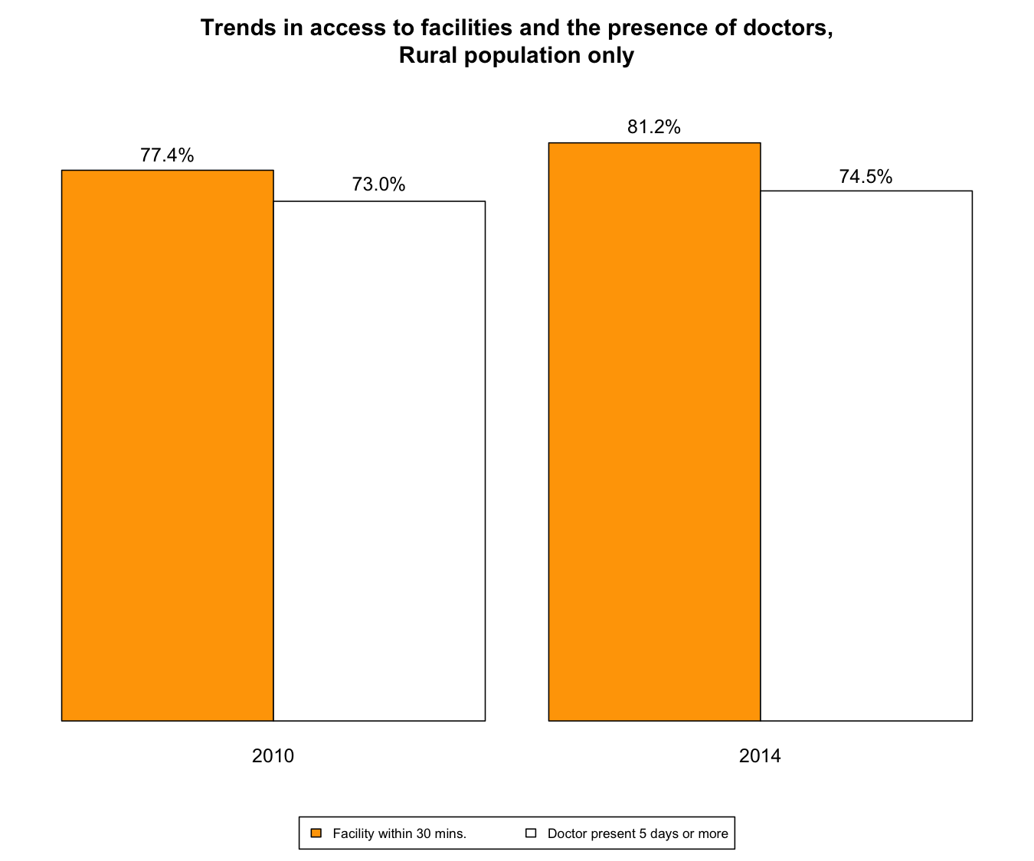
Physical access and service availability have improved.

Slide 7
Access to lab tests and medicines has improved, but mostly for urban
Percentage of patients who were able to obtain medications prescribed by doctor during last consultation
Year | Total | Urban | Rural
2010 | 82.1 | 81.5 | 82.6
2014 | 85.3 | 86.7 | 83.9
Percentage of patients who were able to get needed lab tests at the same place they went for last consultation
Year | Total | Urban | Rural
2010 | 85.4 | 88.5 | 82.4
2014 | 89.2 | 91.9 | 85.6

Slide 8
Financial barriers to access have declined, especially for outpatient visits and hospital care…
Percentage of occurrences of acute sickness in last 30 days, where no consultation was undertaken because it was too expensive/not enough money (% of all reasons)
Year | Total | Urban | Rural | Poorest | 2 | 3 | 4 | Richest
2010 | 16.7 | 14.3 | 18.9 | 25.3 | 17.7 | 17.3 | 16.7 | 5.3
2014 | 10 | 9.6 | 10.4 | 18.7 | 10.8 | 6.2 | 9.9 | 4.9
Percentage of total population who reported needing hospitalization in the last year but were not hospitalized because it was too expensive/ they did not have enough money
Year | Total | Urban | Rural | Poorest | 2 | 3 | 4 | Richest
2010 | 2.6 | 2.6 | 2.5 | 3.4 | 1.8 | 2.3 | 2.8 | 2.6
2014 | 1.2 | 1.1 | 1.3 | 1.4 | 1.4 | 1.1 | 0.7 | 1.2

Slide 9
…, but also for medicines and lab tests.
Percentage of consultations where medicine was prescribed but not purchased because it was too expensive (base: all consultations)
Year | Total | Urban | Rural | Poorest | 2 | 3 | 4 | Richest
2010 | 13.1 | 12.6 | 13.6 | 21.7 | 14.2 | 11.1 | 9.4 | 10.3
2014 | 10.2 | 8.5 | 12.1 | 18.6 | 11.9 | 9.7 | 7.6 | 5.6
Percentage of consultations where a lab test was prescribed but not done because it was too expensive (base: all consultations)
Year | Total | Urban | Rural | Poorest | 2 | 3 | 4 | Richest
2010 | 4.2 | 3.6 | 4.8 | 6.3 | 4 | 4.2 | 4.2 | 2.9
2014 | 2.9 | 2.3 | 3.6 | 5.1 | 3.6 | 3.2 | 1.3 | 1.9

Slide 10
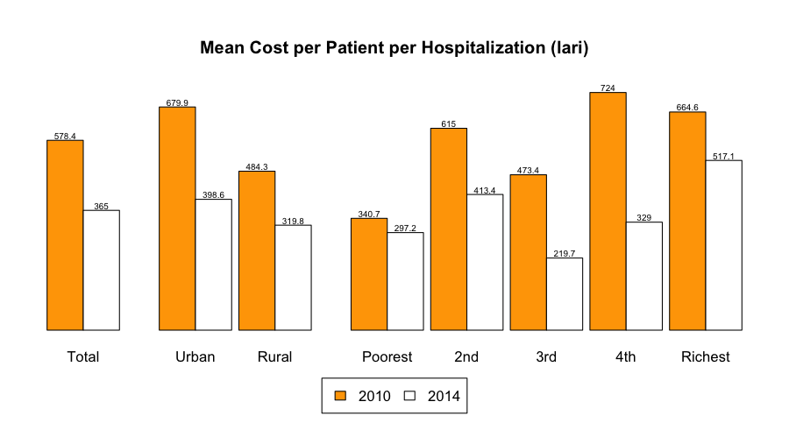
The cost to households of paying for treatment has fallen, especially for hospital care

Slide 11
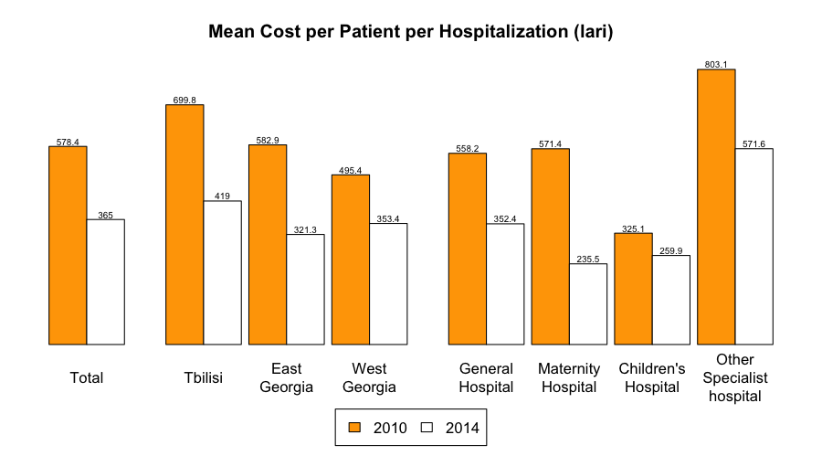
…including across all regions

Slide 12
Average out-of-pocket costs of prescribed medicines has increased for the poorest quintile
Population groups | OOP cost per utpatient visit (GEL) |  | OOP cost of prescribed medicines (GEL) (per prescription)
 | 2010 | 2014 | 2010 | 2014
Urban | 43.4 | 49.7 | 30.8 | *26.9
Rural | 47.4 | 43.2 | 25.8 | *28.0
Poorest | 28.9 | 21.7 | 20.2 | **23.7
Second | 36.1 | 36.4 | 25.8 | 24.8
Third | 45.9 | 46.6 | 25.7 | *29.5
Fourth | 53.6 | 51.8 | 33.3 | 28.1
Richest | 57.3 | 67.9 | 33.1 | 29.8

Slide 13
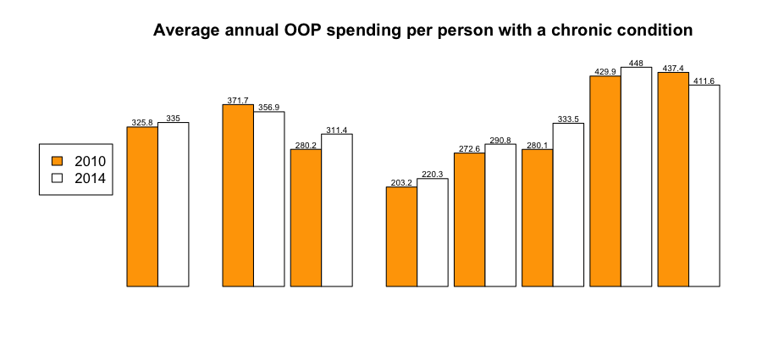
OOPs remain high among people with chronic illness
 | Total |  | Urban | Rural |  | Poorest | 2nd | 3rd | 4th | Richest
Diff. in Cost | 9.2 |  | -14.8 | 31.2 |  | 17.1 | 18.2 | 53.4 | 18.1 | -25.8
% Change | 2.8 |  | -4.0 | 11.1 |  | 8.4 | 6.7 | 19.1 | 4.2 | -5.9

Slide 14
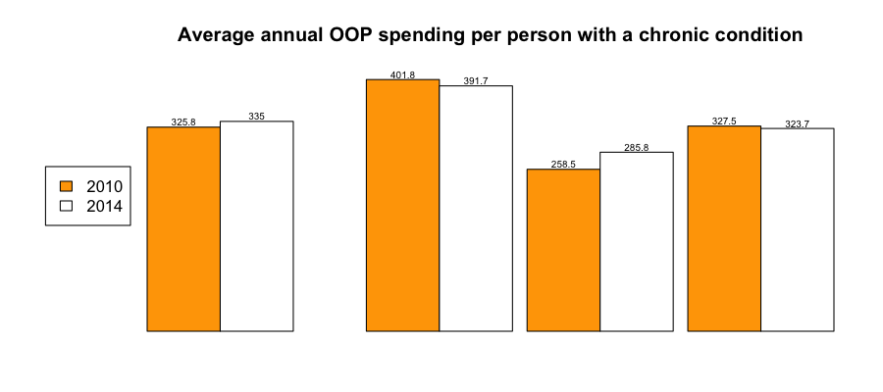
OOPs remain high among people with chronic illness
 | Total |  | Tbilisi | East Georgia | West Georgia
Diff. in Cost | 9.2 |  | -10.1 | 27.3 | -3.8
% Change | 2.8 |  | -2.5 | 10.6 | -1.2

Slide 15
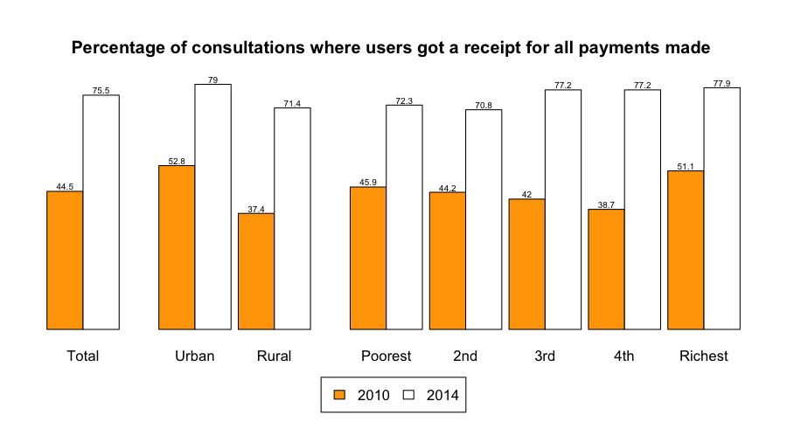
User experience of the health system has improved

Slide 16
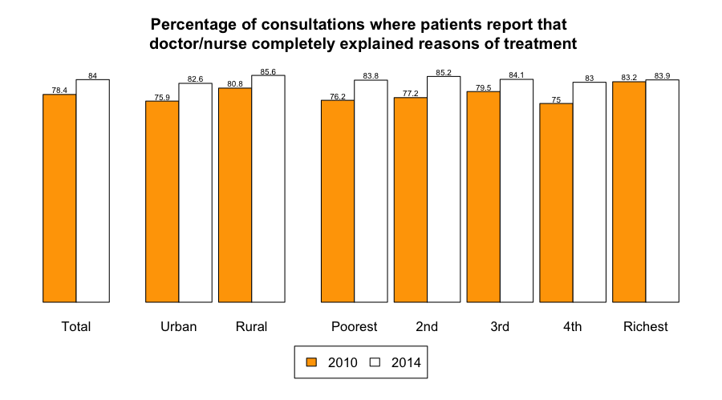
User experience of the health system has improved

Slide 17
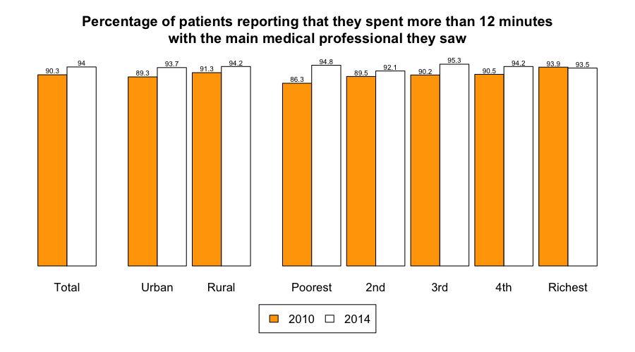
User experience of the health system has improved

Slide 18
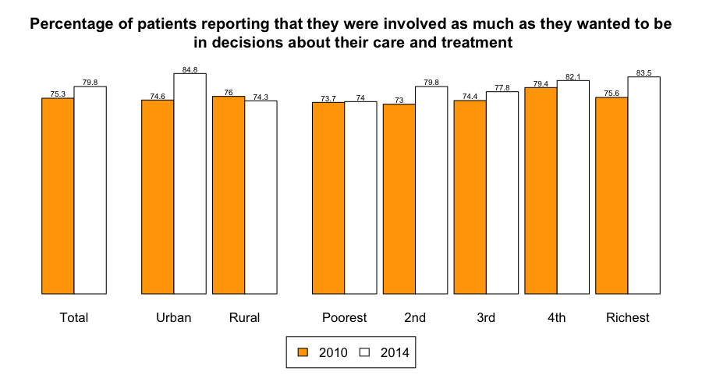
User experience of the health system has improved

Slide 19
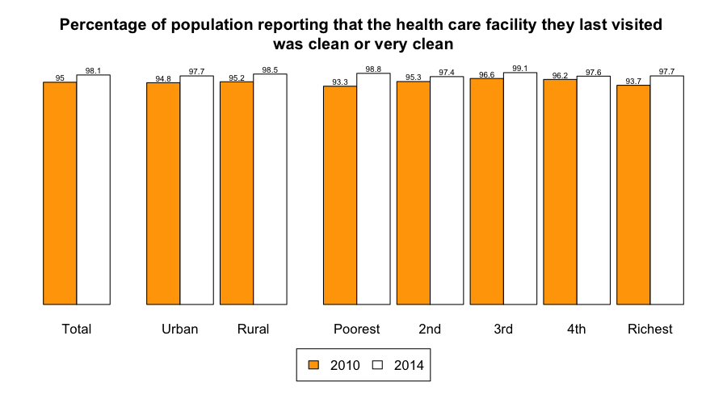
User experience of the health system has improved

Slide 20
People are not sufficiently aware of the range of benefits to which they are entitled
Knows about UHC
Yes | No | Not sure/don’t know/refuses to answer | Not applicable
74.10% | 14.10% | 2.50% | 9.50%
Among those who know about UHC, knows about medical services covered
Yes | No | Not sure/don’t know/refuses to answer | Not applicable
29.50% | 43.50% | 1.10% | 25.90%

Slide 21
Summary
Key successes: significant reduction in unmet need in a short space of time:
  Expanded coverage
  More people using services when sick
  Reduced financial barriers to access
Making further progress towards UHC implies addressing:
  persistent inequalities in use of services
  financial risk associated with the use of prescription drugs

Slide 22
Acknowledgements
Davit Sergeenko, Minister of labour, Health and Social Affairs
Ketevan Goginashvili , Ministry of Labour, Health and Social Affairs
Rouselle Lavado,the World Bank
Susanna Hayrapetyan, the World Bank
Aparnaa Somanathan, the World Bank
Mamuka Nadareishvili – local expert
Sarah Thomson – WHO
Matthew Jowett – WHO
Rusudan Klimiashvili – WHO
George Khechinashvili – USAID
Alexander Turdziladze – Abt Associates Incorporated - Georgia
Peter Cowley - Abt Associates Incorporated – Georgia
Ketevan Tatoshvili - Abt Associates Incorporated - Georgia
Tengiz Tsekvava – GeoStat

