Slide 1

A Proposal for Municipality-level Estimations of Poverty in Georgia
The World Bank
Cesar A Cancho
Economist
Poverty and Equity GP

Slide 2
A Municipality-level Poverty Map for Georgia
Rationale: Why do we need it?
Method: How do we do it?
Possible Applications: What can be used for?

Slide 3
Rationale: Considerable reduction of poverty in recent years across all regions…
Since 2010 poverty has fallen from 36 to 21 percent
Decrease across regions has not been homogeneous, for instance:
      Kvemo Kartli and Kakheti are not any more the poorest regions
      Samtskhe-Javakheti surpassed Tbilisi as the least poor
Source: World Bank staff elaboration based on IHS 2010-2016

Slide 4
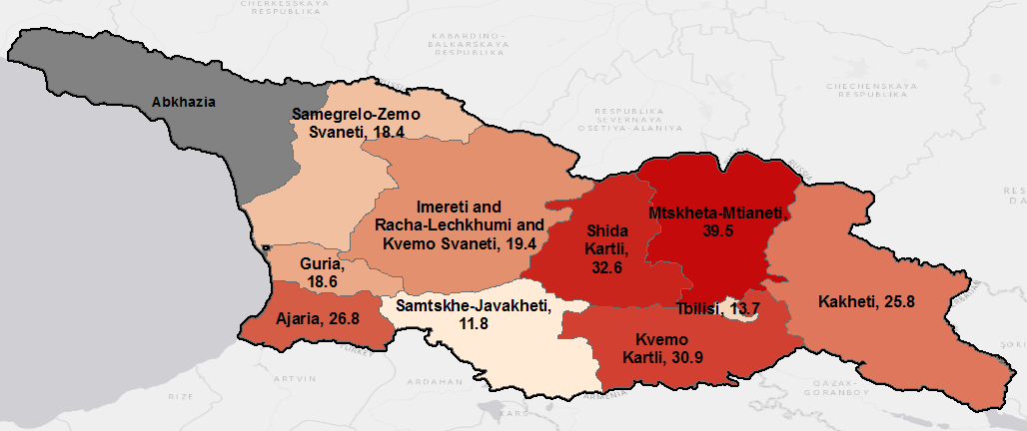
… but incomplete welfare information below regional level (1)
Census 2014 provides critical information at municipality level:
      Housing and access to services
      Living conditions
      Demographics
    However, information on consumption, income or poverty is not collected in Census
      Available only at statistical regions level.
National Poverty – Georgia 2016
Source: World Bank staff elaboration based on IHS 2016

Slide 5
… but incomplete welfare information below regional level (2)
    It is important to understand heterogeneities below the regional level, for instance:
      How is poverty in Racha-Lechkhumi and Kvemo Svaneti?
      Are some parts of Mtskheta-Mtianeti doing worse than the average for the region?
      Do all municipalities in Samtskhe-Javakheti report a low poverty estimate?
National Poverty – Georgia 2016
Source: World Bank staff elaboration based on IHS 2016

Slide 6
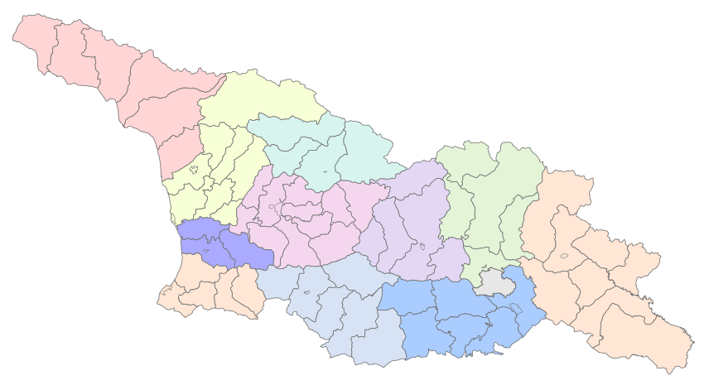
Method: Imputations IHS → Census (1)
    Joint elaboration Geostat-World Bank
    Data requirements
      Census 10% sample
      IHS income and consumption
      Regional level information (e.g. GDP)
      Available municipality-level administrative information
? ? ?

Slide 7
Method: Imputations IHS → Census (2)
    Imputations based on
      Household observable characteristics
        Demographics
        Dwelling conditions
      Regional and sub-regional available indicators
    Output
      Map and database
      To be available from Geostat website
    Expected delivery
      Summer 2018
? ? ?

Slide 8
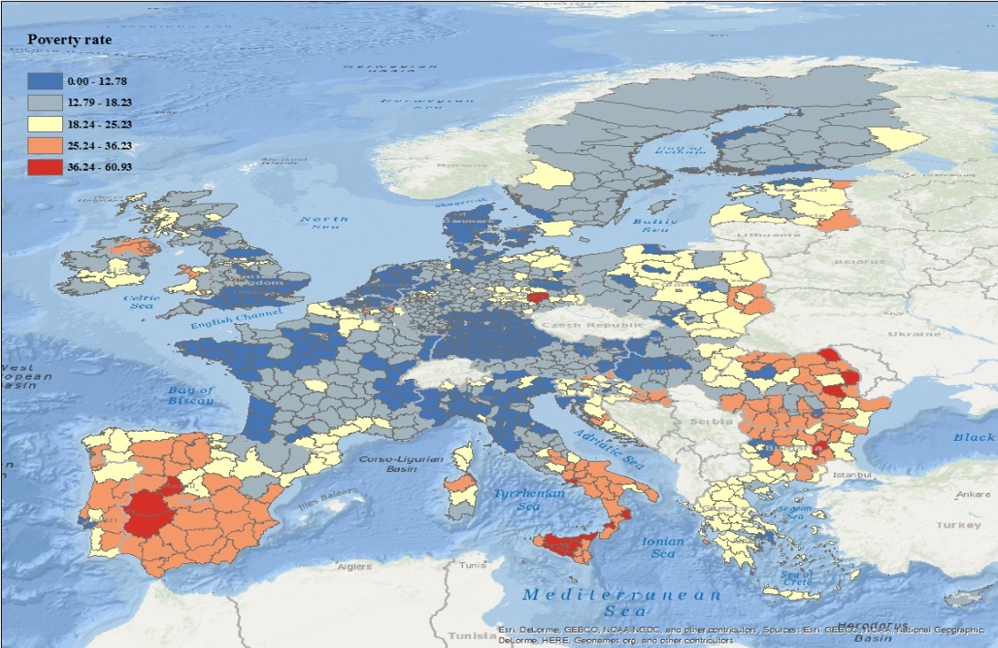
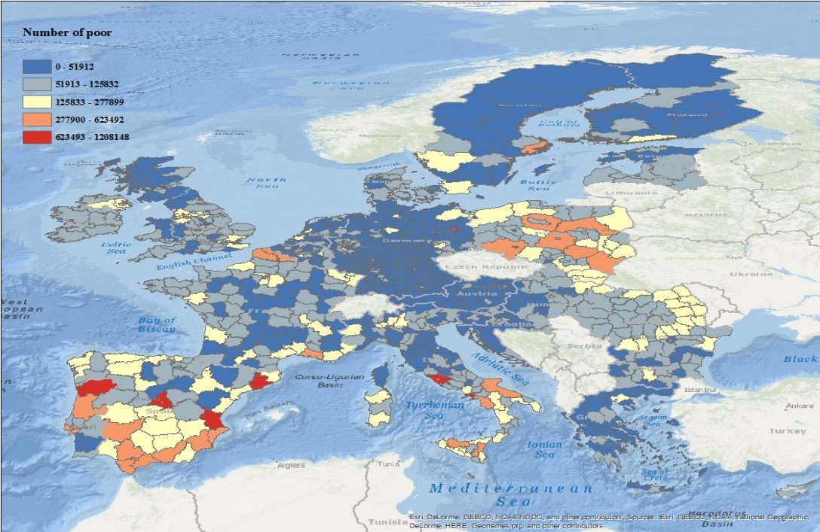
Possible Applications (1): Identify if poverty rate and density of poverty are aligned
EU At-Risk-of-Poverty at NUTS3
EU Number of Population At-Risk-of-Poverty at NUTS3
Areas with the highest poverty rates are not necessarily where most the poor are concentrated.

Slide 9
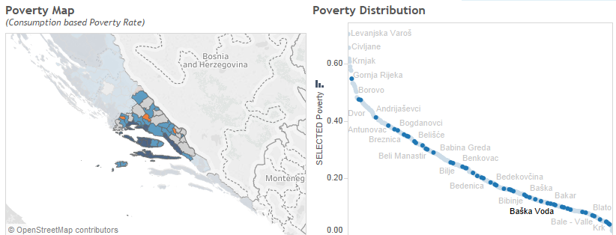
Possible Applications (2): Poor municipalities in well-off regions can be identified and mapped against the rest of the country
Estimations of poverty for municipalities in
Split-Dalmatia (Croatia), show pockets of poverty…
… and those poor municipalities are among the
poorest in the country

Slide 10
Possible Applications (3): Analysis of progressivity of spending by municipality
Analysis at municipality level shows better progressivity of municipal transfers
NUTS 3 (county) and NUTS 2 (region) are too coarse measures and may be misleading
Note: Municipalities, NUTS2 and NUTS3 are ordered from poorest to least poor along the horizontal axis. Vertical axis shows the cumulative spending by respective area.

Slide 11
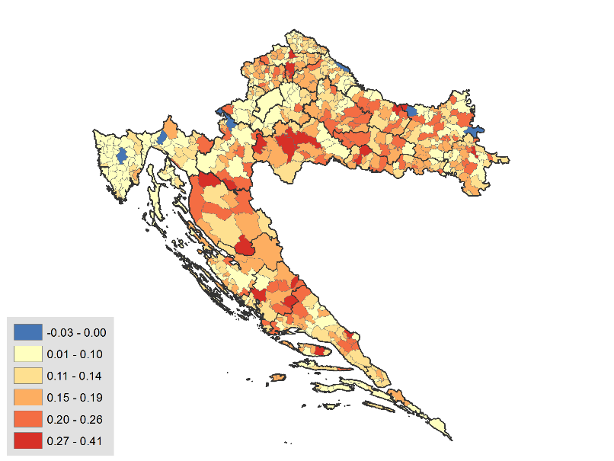
Possible Applications (4): Assessing the spatial impact of public transfers
Difference in Poverty Rate
(Before Transfers- After Transfers)
One further area of work is the measurement of the spatial impact of public transfers on poverty.
The comparison between the full household income poverty map, with partial income poverty map (all but public transfer) can show the parts of the country in which public transfers have the largest first order impacts on poverty.

Slide 12
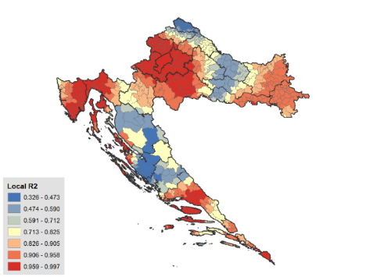
Possible Applications (5): Analysis of policy blind spots
The results of the poverty map can be complemented with public spending data at the municipal level to better understand what is the spatial correlation of those expenditures with poverty.
The example on the right shows in dark red the areas in which public spending on social assistance is highly correlated with poverty, and in dark blue the areas in which this social spending is poorly correlated.
GWR of Number of Poor and Number of Beneficiaries
OLS R2: 0.93
OLS Adjusted R2: 0.931
GWR R2: 0.97
GWR Adjusted R2: 0.96

Slide 13
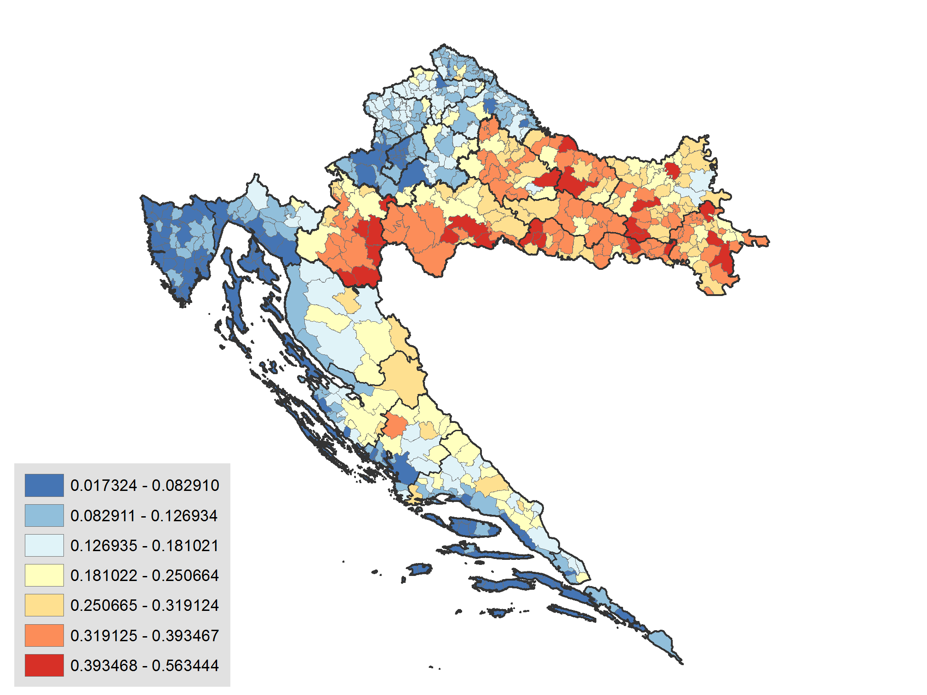
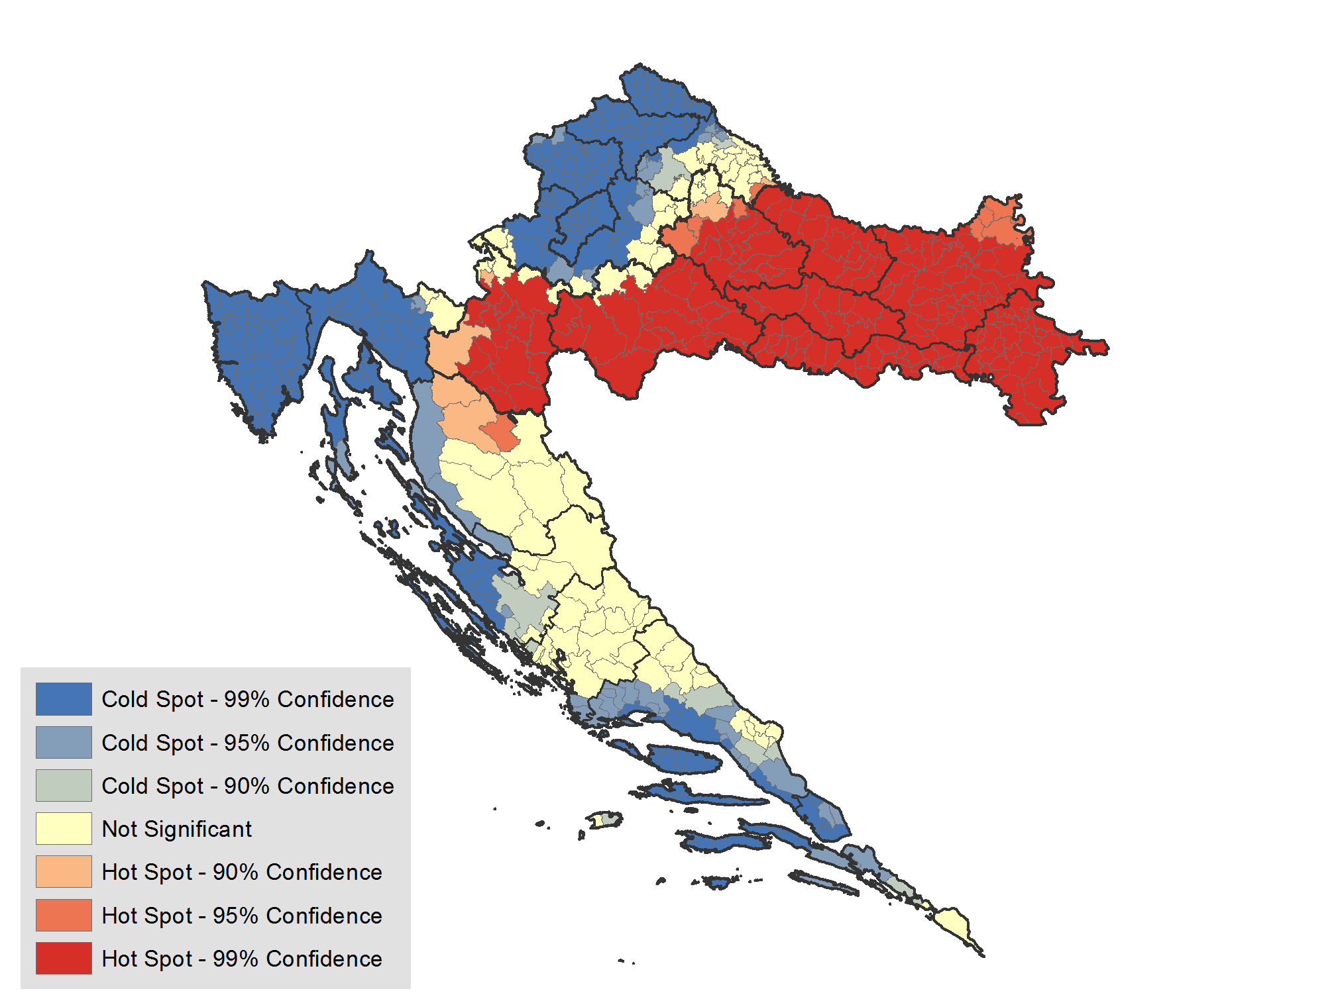
Possible Applications (6): Identification of clusters of poor locations – Hot Spots
Croatia Poverty Rate
Hot Spot Analysis
Croatia Poverty Rate (HBS)
Hot Spots allows researchers to detect where poverty is concentrated
Using our poverty estimates for Croatia, the Hot Spot analysis identified statistically significant clusters of high poverty in the country’s east and low poverty clusters around Zagreb and the coasts
*Red indicates a cluster of high values (Hot spot)
Blue indicates a cluster of low values (Cold spot)

Slide 14
Possible Applications (7): Complementing Other Products
    With infrastructure in place for producing poverty maps, national poverty is not the only possibility.
    Other applications:
      Non-monetary poverty indicators
      Nutrition in Indonesia, Cambodia
      HIV/AIDS prevalence in Malawi using DHS
      Obtain poverty statistics for population sub-groups not representative in household surveys

Slide 15
Thanks!
Cesar A Cancho
Economist
Poverty and Equity GP

