Slide 1
Treatment Outcomes in Patients with Complete SVR Data Receiving Sofosbuvir-Based Regimens Apr 28, 2015 – Dec 31, 2016 (n=4774)
 | SVR Rate
 | G1 | G2 | G3 | G4 | TOTAL
12 weeks IFN/SOF/RBV | 80.3% (724/902) | 95.4% (230/241) | 96.2% (1099/1143) | 66.7% (2/3) | 89.8% (2055/2289)
12 weeks SOF/RBV | 27.3% (3/11) | 77.3% (273/353) | 0% (0/1) | − | 75.6% (276/365)
20 weeks SOF/RBV | 33.3% (1/3) | 75.7% (296/391) | 0% (0/2) | − | 75% (297/396)
24 weeks SOF/RBV | 53.9% (382/709) | 36.4% (4/11) | 81.6% (579/710) | 50% (2/4) | 67.4% (967/1434)
48 weeks SOF/RBV | 61.2% (85/139) | 77.2% (44/57) | 73.4% (69/94) | − | 68.3% (198/290)
TOTAL | 67.8% (1195/1764) | 80.4% (847/1053) | 89.6% (1747/1950) | 57.1% (4/7) | 79.5% (3793/4774)

Slide 2
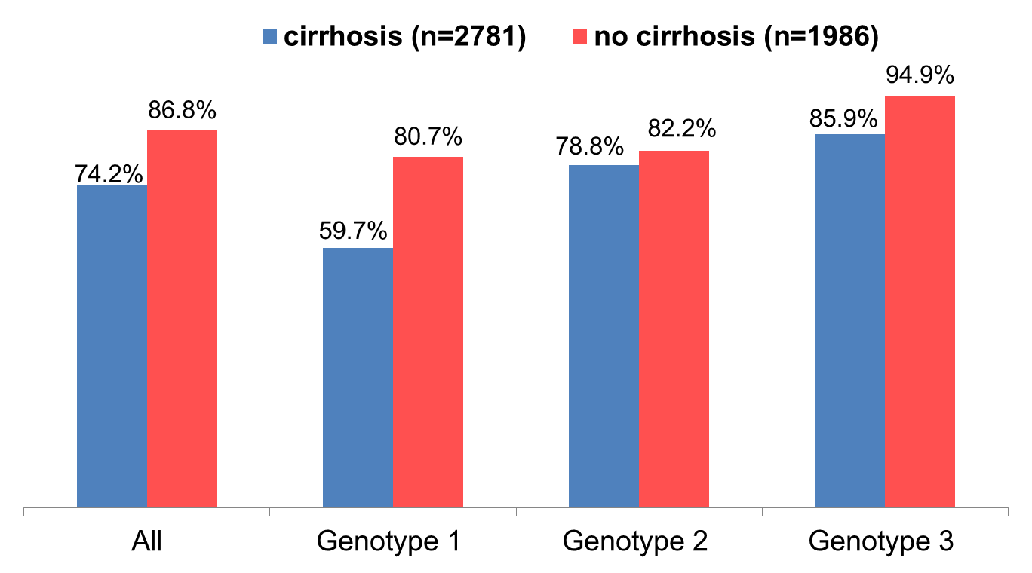
Treatment Outcomes of SOF-based Regimens by Cirrhosis Apr 28, 2015 – Dec 31, 2016

Slide 3
Impact of 2k/1b Recombinant on Treatment Outcomes (n=136)

Slide 4
Treatment Outcomes in Patients with Complete SVR Data Receiving Sofosbuvir/Ledipasvir Based Regimens March, 2016 – December 31, 2016 (n=1592)
 | SVR Rate
 | G1 | G2 | G3 | G4 | TOTAL
12 weeks SOF/LDV | 98.5% (824/837) | 100% (8/8) | 100% (1/1) | − | 98.5% (833/846)
24 weeks SOF/LDV | 98.9% (88/89) | − | − | − | 98.9% (88/89)
12 weeks SOF/LDV/RBV | 95.3% (143/150) | 99.2% (248/250) | 97.5% (232/238) | 100% (4/4) | 97.7% (627/642)
24 weeks SOF/LDV/RBV | 100% (4/4) | − | 100% (11/11) | − | 100% (15/15)
TOTAL | 98.1% (1059/1080) | 99.2% (256/258) | 97.6% (244/250) | 100% (4/4) | 98.2% (1563/1592)

Slide 5
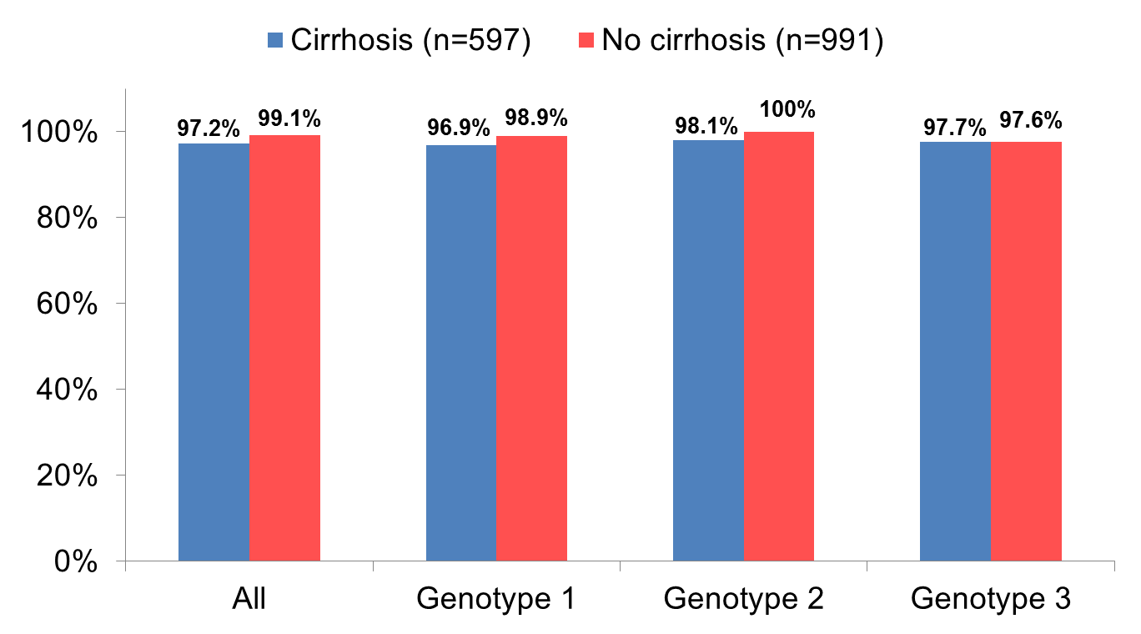
Treatment Outcomes of LDV/SOF-based Regimens by Cirrhosis March, 2016 – December 31, 2016 (n=1588)

Slide 6
Re-Treatment of patients with Ledipasvir/Sofosbuvir-based regimens who failed prior Sofosbuvir-based therapy March, 2016 – December 31, 2016
808
Started re-treatment
23
307
478
Not completed
Ongoing
Completed
16
4
1
2
170
308
Death
Adverse
event
Self-
discontinuation
Other
SVR eligible
Not eligible for SVR
47
117
6
Source: Georgia’s HCV Elimination Program Treatment Database
Complete
SVR
No lab
12-24 wk
No lab
>24 wk
46
Achieved SVR (97.9%)

