Slide 1
Healthcare Management Information System (HMIS)
Regulation Module
Ministry of Labor, Health and Social Affairs of Georgia
Notes:
1

Slide 2
Part 1: Description of Ongoing Business Procedures
        General Description of Ongoing Business Procedures
        Revealed Problems
Part 2: E-Operating System – Regulation Module
        Optimized Business Procedures
        System Components
          Registration, Authorization and Authentication of Users
          Determine Virtual Working Groups and Assign Roles to Them
          Document Construction and Management System
          Seeker’s Web Interface
          Web Interface of the Regulatory Agency
          Logical Structure of the System
          Analysis and Control
          Publicity of Information and Transparency of Processes
        General Scheme of Integration of System into the Common Structure
        Project Implementation Phases
        Potential Benefits

Slide 3

Activities of State Regulatory Agency for Medical Activities
Notification
Certification
Accreditation
Regulation
Licensing
Permits

Slide 4
Description of Ongoing Business Procedures
Licensing...
Permits ...
Accreditation
Submission of documents by the seeker
Determination of a performer
Studying and reviewing of documents
Consultations to correct inaccurate documents
Refusal due to inaccurate documents

Slide 5

Description of Ongoing Business Procedures
Licensing...
Permits ...
Accreditation
Discussions with management
Results of discussions
  Decision on extension of deadline
  Informing of the seeker
Preparation of the documents for a business trip
Informing of the seeker
Business trip
Discuss results of the business trip

Slide 6
Description of Ongoing Business Procedures
Licensing...
Permits ...
Accreditation
A decision on issuing the license
Information of the seeker
Printing the license (non-automatized)
Recording in the register
Issuing the license
Publishing the license

Slide 7
Description of Ongoing Business Procedures
Certification of Medical Personnel
Discussing issues at the board meeting
Establishment of a commission and publishing a relevant act
Meeting of an examination commission
Submission of documents by the seeker
Document revision
  Positive
  Negative – informing the seeker
  Request for expertise – informing the seeker

Slide 8

Description of Ongoing Business Procedures
Certification of Medical Personnel
Reviewing of the documents at the board meeting
Providing information of revision results
Approving of examination rules, a schedule and branch commissions
Organization of exams
Systematization of exams results

Slide 9
Description of Ongoing Business Procedures
Certification of Medical Personnel
Approving exam results at the board meeting
Printing the certificate (non-automatized)
Recording in the register
Issuing the certificate

Slide 10
Description of Ongoing Business Procedures
Revealed Problems
Majority of documents are submitted in hard copies that impedes comprehensive analysis
Paper documents require manual processing
Licensing and certification procedures take too long and are impeded by bureaucratic barriers. It is caused by frequent discussions at commission meetings and necessity of physical contact in accordance with business procedures.
There is a lack of complete histories of healthcare facilities.
There is a lack of information on medical graduates (information from the Ministry of Education)

Slide 11
Description of Ongoing Business Procedures
Revealed Problems
The register of certified medical personnel contains out-of-date information, which makes it impossible to identify potential, active (employed) and passive (among them dead) medical personnel. Active and passive certificates cannot be also revealed.
There is a lack of certified medical staff’s personal histories
Non-optimized and out-of-date databases impedes its integration with other systems
The level of publicity and transparency of information is unsatisfying
We do not use such a strong resource, such as intradepartmental relations, due to which there are lots of paper documents and they cannot be identified in a timely manner

Slide 12





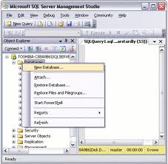

E-Operation System- Regulation Module
Optimized Business Processes
Licensing
Commencement of the procedure
End of the procedure
Submission of documents by
the seeker
Suspending a case per
seeker’s request
To Do Module
(selecting a performer)
Documented refusal
in case of incomplete
documents
Studying / reviewed
of documents
Issuing and publishing
the license
Virtual Conference
Publishing a notification
to ensure publicity
Submitting an opinion
Business trip for
determination compliance
Virtual Conference
Discuss results of
the business trip
E-Register
Administrative legal act /
Printing the license
(automatized)
Decision on extension
of deadline
Informing of the seeker

Slide 13


E-Operating System- Regulation Module
Optimized Business Processes
Certification of Medical Personnel
Commencement of the procedure
End of the procedure
Automatic printing and
issuing the certificate
Discussing an issue about conducting an
exam at the board meeting
E-Register
Adopting and publishing
an act
Approving exam results
at the board meeting
Information on discussion
results are provided
Examination commission
Systematization of
exams results
Virtual Conference
Reviewing of documents
Positive
Reviewing documents
at the board meeting
Approving of examination
rules, a schedule and
branch commissions
Organization of exams
Negative
Additional expertise
in the examination
commission

Slide 14
E-OperatingSystem- Regulation Module
System Components
I. Management System
V.
Analysis and Control
VI.
Ensure Publicity of Information
II.
Document Management
III.
User interfaces
VII.
E-notification Component
VIII.
Intradepartmental
Services
IV.
Logical Structure

Slide 15




E-Operating System- Regulation Module
System Components: Administration System (Authorization Module)
User
Rights and responsibilities
Registration, Authorization and Authentication of Users
This system is one of the HMIS components. All general attitudes for the system are also used for this component:
Users authorization
Principles of system safety
Platform
Ensure integration into the common system
Common standards for data exchange
Management System
Accessibility levels
Roles

Slide 16
E-Operating System- Regulation Module
System Components: Administration System (Authorization Module)
Virtual Working Group
(working group, commission, etc.)
Group ID
Name
Function
Activity status (Date)
User
Rights and responsibilities
Management System
Working Group Members
(performers, commission members, etc.)
Full Name
Position
Working group ID
Function
Activity status (Date)
Note
Accessibility levels
Roles

Slide 17

E-OperatingSystem- Regulation Module
System Components: Document Management Component
  Functional for developing e-documents
  Functional for linking criteria for analysis to the paper document
  Functional for identification by service
  System of archive of paper documents

Slide 18
E-OperatingSystem- Regulation Module
System Components: Document Management Component
Document Construction and Management
Upload Electronic Original
Licensing Permits Notification Accreditation Certification Reporting
User: <Full Name>
New
Edit
Delete
Index | Document | Type | Activation Date | Basis | Deactivation Date | Basis for Deactivation | Regulation/ Procedure
Up Down | Document1 Annotation Pattern Document2 Document3 Document N | Upload Electronic Electronic, upload | Date Date Date | Law Decree Law | Date | Amendments to the law | Licensing, permits Reporting Certification

Slide 19


E-OperatingSystem- Regulation Module
System Components: Seeker’s Web Interface
Licensing, Permits, Notification, Reporting
Facility: <Identification Code><Name> User: <Full Name>
New
View/Edit
Send
Suspend Procedure
Category | Medical Activity | Case # | Date of Commencement | Status | Status Date | Comment | Print/ Copy
Reporting |  |  | 05.12.2011 | New | 05.12.2011
License | Ambulance |  |  | New
Permit | In-patient facility | N 0123456789 | 10.05.2011 | Positive | 10.06.2011
Notification | Dermatovenerology | N 2345678901 | 25.07.2011 | Determine compliance | 05.08.2011

Slide 20
E-OperatingSystem- Regulation Module
System Components: Seeker’s Web Interface
Facility: <Identification Code><Name> User: <Full Name>
New
View/Edit
Send
Suspend Procedure
Category | Medical Activity | Case # | Date of Commencement | Status | Status Date | Comment | Print
License | Ambulance | N 1234567890 | 28.08.2011 | Refused | 30.08.2011
Ambulance |  | 25.08.2011 | Sent | 25.08.2011
License | Pathologanatomical activity | N 7894504668 | 15.08.2011 | Positive | 15.08.2011
Pathologanatomical activity | N 7894504668 | 15.07.2011 | Determine compliance | 05.08.2011
Pathologanatomical activity | N 7894504668 | 15.07.2011 | Approved | 18.07.2011
Pathologanatomical activity |  | 15.07.2011 | New | 15.07.2011

Slide 21


E-OperatingSystem- Regulation Module
System Components: Seeker’s Web Interface
Process of Record keeping Implemented by Seeker
Document | Type | Validation | Comment | Copy
Document 1 | Upload | Approved
Document 2 | Electronic, Upload | Not approved
Document 3 | Original | Approved
Types of documents:
Uploaded (electronic, scanned)
Electronic (submitted in a pattern form)
Material (original)
Fill out File
Paragraph 1 ............................ Paragraph 2 ........................... Paragraph 3 ............................ Paragraph 4 ............................ Paragraph 5 ............................ Paragraph 6 ............................ Paragraph 7 ............................ Paragraph 8 ............................ Paragraph 9 ............................ Paragraph 10 .......................... Paragraph 10 ..........................
Upload
Cancel
Comment
Agency: Document 1 : Date Text text text text Seeker: Document 1: Date Text text text text
Send
Text text text
Cancel
Save
Print
Cancel

Slide 22




E-OperatingSystem- Regulation Module
System Components: Web Interface of Regulatory Agency
Licenses/Permits
Initial Discussion Group
Staff member 1
Staff member 2
Staff member 3
Public Discussion Group
Staff member 1
Staff member 2
Staff member 3
User: <Full Name>
Send
Category | Medical Activity | Seeker | Commencement Date | Status | Status Date | Performer | Visa with Comment | Deadline
Reporting |  | Healthcare facility | 05.12.2011 | New | 05.12.2011
License | Ambulance | Healthcare facility | 25.08.2011 | New | 25.08.2011 | Staff member 1 |  | 27.08.2011
Permit | In-patient facility | Healthcare facility | 20.08.2011 | In the process of revision | 21.08.2011 | Staff member 3 |  | 25.08.2011
Notification | Forensic medical expertise | Healthcare facility | 15.07.2011 | Refused | 30.07.2011 | Staff member 2 |  | 30.07.2011
License | Forensic medical expertise | Healthcare facility | 01.06.2011 | Positive | 22.07.2011 | Full Name |  | 20.08.2011

Slide 23


E-OperatingSystem- Regulation Module
System Components: Web Interface of Regulatory Agency
Licenses/Permits
Public Discussion Group
Staff member 1
Staff member 2
Staff member 3
User: <Full Name>
View/Edit
Send
Category | Medical Activity | Seeker | Commencement Date | Status | Status Date | Performer | Visa with Comment | Deadline
Reporting |  | Healthcare facility | 05.12.2011 | New | 05.12.2011 | Full Name
License | Ambulance | Healthcare facility | 25.08.2011 | New | 25.08.2011 | Full Name |  | 27.08.2011
Permit | In-patient facility | Healthcare facility | 20.08.2011 | Being reviewed | 21.08.2011 | Full Name |  | 25.08.2011
Notification | Forensic medical expertise | Healthcare facility | 15.07.2011 | Refused | 30.07.2011 | Full Name |  | 30.07.2011
License | Forensic medical expertise | Healthcare facility | 01.06.2011 | Positive | 22.07.2011 | Full Name |  | 20.08.2011

Slide 24
E-OperatingSystem- Regulation Module
System Components: Web Interface of Regulatory Agency
Licenses/Permits
Public Discussion Group
Staff member 1
Staff member 2
Staff member 3
User: <Full Name>
View/Edit
Send
Category | Medical Activity | Seeker | Commencement Date | Status | Status Date | Performer | Visa | Deadline
License | Ambulance | Healthcare facility | 20.08.2011 | Refused | 22.08.2011 | Full Name | X | 22.08.2011
Ambulance | Healthcare facility | 20.08.2011 | Refused | 22.08.2011 |  |  | 22.08.2011
Ambulance | Healthcare facility | 20.08.2011 | New | 20.08.2011 |  |  | 20.08.2011
Permit | In-patient facility | Healthcare facility | 20.08.2011 | Being reviewed | 21.08.2011 | Full Name |  | 25.08.2011
Notification | High | Healthcare facility | 15.07.2011 | Review/ business trip | 30.07.2011 | Full Name |  | 30.07.2011
License | Forensic medical expertise | Healthcare facility | 01.06.2011 | Positive | 22.07.2011 | Full Name |  | 20.08.2011

Slide 25


E-OperatingSystem- Regulation Module
System Components: Web Interface of Regulatory Agency
Process of Document Revision
Document | Type | Validation | Comment | Copy
Document 1 | Uploaded | Approved
Document 2 | Electronic, uploaded | Not approved
Document 3 | Original | Approved
Types of documents:
Uploaded (electronic, scanned)
Electronic (submitted in a pattern form)
Material (original)
Uploaded file
Text Text text text text text Text text text text text Text text text text text Text text text text text
Filled out file
Paragraph 1 ............................ Paragraph 2 ........................... Paragraph 3 ............................ Paragraph 4 ............................ Paragraph 5 ............................ Paragraph 6 ............................ Paragraph 7 ............................ Paragraph 8 ............................ Paragraph 9 ............................ Paragraph 10 ..........................
Comment
Agency: Document 1 : Date Text text text text Seeker: Document 1: Date Text text text text
Send
Text text text
Cancel
Print
Cancel
Print
Cancel

Slide 26
E-OperatingSystem- Regulation Module
System Components: Logical Structure of the System
Licensing
Review Stages
Business procedure
Seeker
First Stage | Second Stage | Third Stage | Fourth Stage
Decisions
Status with a comment
Receiving documents
Organizing
business trip
Adoption of administrative act
Determining
performer
Publishing a notification
to ensure publicity
Developed a document on results
Printing License / permit
Studying documents
Oral hearing
Recording in the register
Decision
(with relevant status and comment)
New
Refusal
Positive
Extension of deadline
Business trip
Register
Notification
Publish
Status and Comments
Incomplete documents
Per the seeker’s request
Prepare documents for submission

Slide 27
E-OperatingSystem- Regulation Module
System Components: Analysis and Control

Slide 28

E-Operating System- Regulation Module
System Components: Publicity and Transparency
Business procedures, intermediary and final decisions reflection on the seeker’s web interface in a real-time
Results reflection on the Ministry, SSA and “Common State Information Register” (Ministry of Justice) websites
Maintaining access of healthcare facilities and medical personnel's e-registers to interested parties (provide necessary services)
Activation of e-notification service

Slide 29
E-Operating System- Regulation Module
General Scheme of Integration of System into the Common Structure

Slide 30
E-Operating System- Regulation Module
Project Implementation Phases
Finish working on the concept
Develop certification module
Test
Convert, correct and migrate data
Arrange services with external bodies
Introduction and implementation of the system
Integration with the common information system
Qrt. 1
2012
Qrt. 2 2012
Qrt.3
2012
Qrt. 4
2012
Qrt. 1
2013
Qrt. 2
2013
Qrt.3
2013
Qrt. 4
2013
Develop technical specifications
Develop database architecture
Develop analytical module
Generate statistical forms
Develop licensing, permit, notification, accreditation modules
Test

Slide 31

Potential Benefits
Most documents are provided in electronic format and systematized way to avoid manual processing and analyze the data
Procedures necessary for consultations and document refinements are followed in distance, real-time regime

Slide 32

Potential Benefits
Many-sided analysis of e-information, among them quality evaluation of submitted reports, and their comparative analysis are made, discrepancies are revealed in order to make relevant changes
Managed e-register and timely access to public information
Information received timely through intradepartmental relations (Civil Registry, Public Registry, Ministry of Education, Ministry of Environmental Protection, Chamber of Notaries) and correct and timely reaction

Slide 33
Potential Benefits
Complete histories of healthcare facilities are created taking into consideration legal succession
Analysis of healthcare facilities according to medical activities taking into consideration their histories
Improved register of accredited healthcare facilities
Access to the information about distribution of medical personnel in the healthcare facility (administration, specialist doctors, junior doctors and middle medical personnel)
Received reliable and timely information about potential, active (employed) and passive (among them dead) medical personnel and revealed active and passive certificates through the complete e-register of certification
Access to the information about personnel with medical background through intradepartmental relations

Slide 34
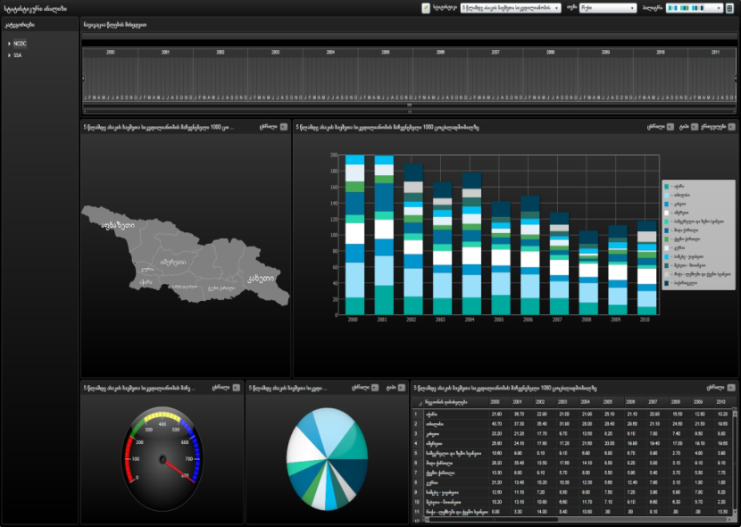
Potential Benefits
Access to personal histories of the medical personnel, among them about trainings they have attended, their certificates, employment and experience
The analysis component also includes cross-sectional analysis of medical activities and employed medical staff
All healthcare facilities where the person might work are informed if his/her right to practice medicine is suspended

Slide 35

Thank you for your attention!

