Slide 1

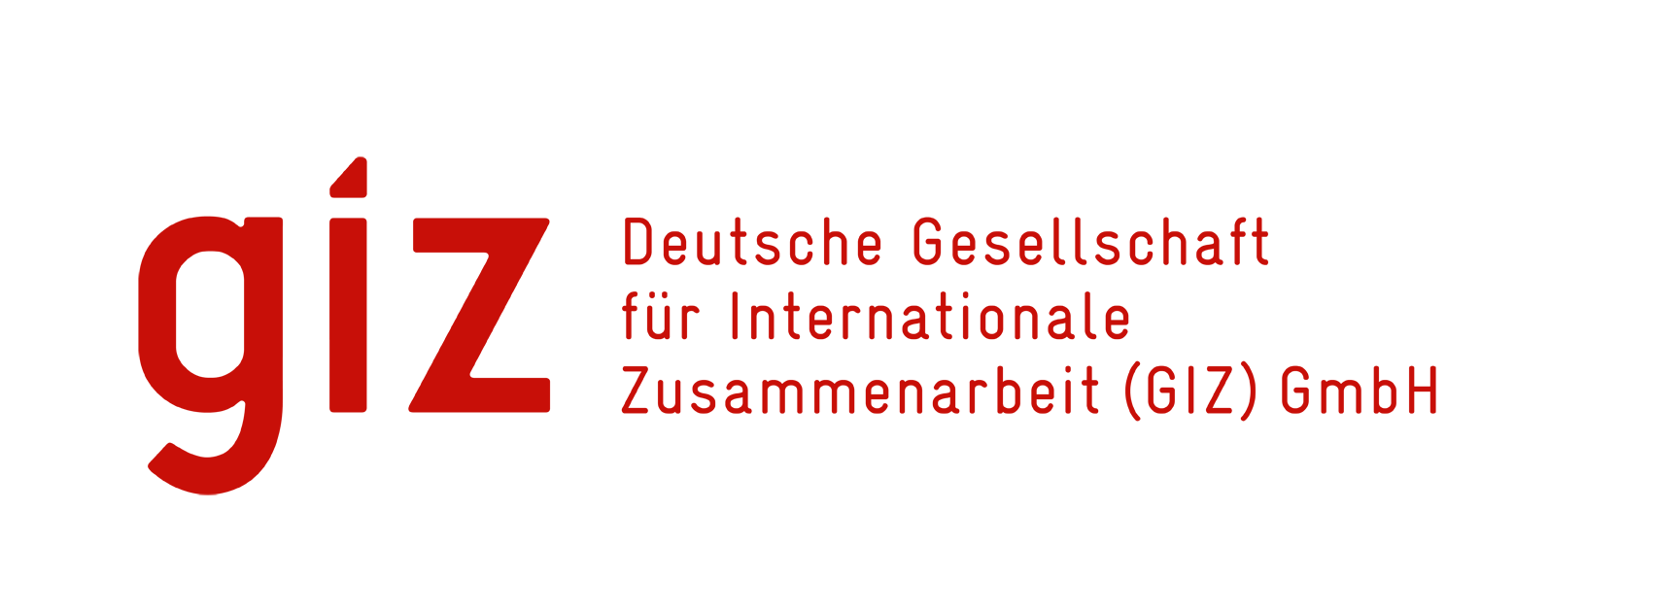
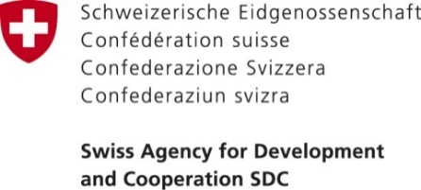
Global Fund CCM Evolution
Implemented by
Sanja Matovic-Miljanovic and Tim A. Clary
G-CCM Meeting
December 11, 2019

Slide 2
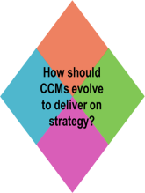
Country Coordination Mechanism (CCM) Evolution Aims to Strengthen Four Key Areas
TNCM Functioning (incl. TNCM Secretariat)
Oversight
To maximize impact on grant performance.
Oversight function better integrated with portfolio management
To improve CCM functioning (i.e. Ethics and CCM Code of Conduct, how to elect members)
CCM Functioning
Oversight
Sample text
Linkages
Engagement
Maximizing the collaboration and coordination between the CCM and the other forums.
On a case by case basis, evaluating opportunities to integrate CCM into national structures.
Stimulate a strong and committed CCM leadership.
Ensuring better communication between CCM members and their constituency members
Linkages
Engagement
The 4 Areas of focus are linked to the Global Fund’s 4 Strategic objectives

Slide 3
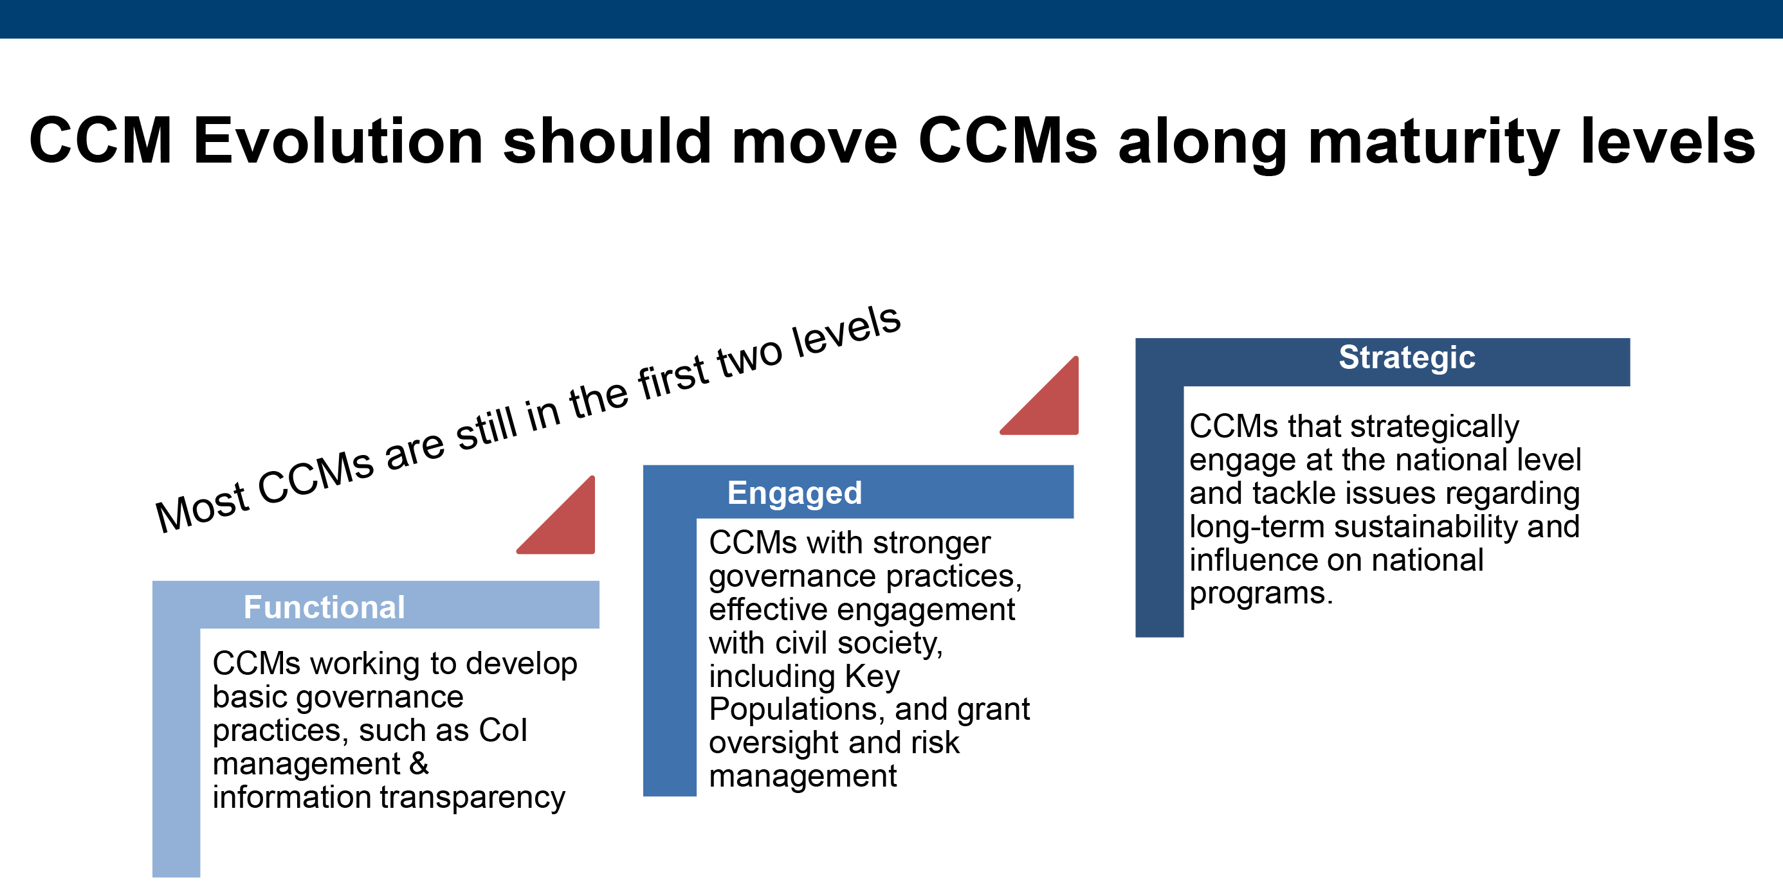
‘working towards functional’ (the lowest rating)

Slide 4
The Process
Piloted in 18 countries in 2019; results presented to GF Board in November 2019
Key interventions will be differentiated across 115 CCMs globally in the next allocation cycle (2020-2022)
Launching in 90 countries in 2020 - subject to the amount of funding available for catalytic investments
Support for discrete activities defined in partnership with the pilot CCMs, per the original pilot design and budget

Slide 5

Thank you!
გმადლობთ
Questions

