Slide 1


Slide 2
UPDATE: Hepatitis B Abstracts from AASLD 2019
Robert G Gish, MD
Medical Director Hepatitis B Foundation
Robert G Gish Consultants LLC

Slide 3
Disclosures
Please see www.RobertGish.com

Slide 4
Background
HBV infects 292 M people WW
There are about 600,000 deaths per year attributed to HBV
#1 cause of liver cancer in the world
#2/3 cause of cancer related mortality
Not curable, but is controllable by oral therapies

Slide 5
HBV Tests and Concepts Part I
+HBsAg = infection
+Anti-HBc = exposure = cccDNA = persistence
  Risk for reactivation
  Do not vaccinate, boosters have no clinical use
  Evaluate for Occult HBV in clinically appropriate pateints if anti-HBc only
+Anti-HBs = immunity, if anti-HBc is negative
HBV is incurable, “functional cure”: loss of HBsAg
There is no “natural immunity”

Slide 6
HBV Tests part II
For all HBsAg + patients we need these blood tests
  HBeAg
  Anti-HBe
  HDV antibody total (not IgM) (IF total +)>> qHDV RNA reflex
  HCV antibody
  qHBsAg
  Do not order anti-HBc IgM unless clear clinical signs
US doppler
  Measure Spleen and PV size/diameter
HBV DNA quant
HAV antibody total
HIV antibody
Evaluate all patients for NASH
AFP/ DCP/ AFP-L3%
  Calculate GALAD score

Slide 7
What’s Hot at the Liver Meeting
Basic immunology & virology of HBV
Natural history studies
  Benefit of HBsAg loss
Current HBV treatments
  Is risk for HCC lower with TDF than ETV?
  NUC Stop studies
  Bone and Renal data on TAF
New HBV therapies
  Clinical studies
  Early development
HBV Forum 6, Boston Nov 2019

Slide 8
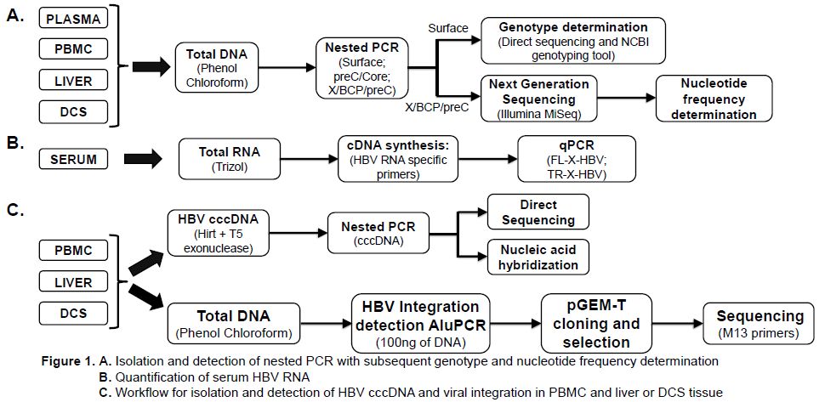
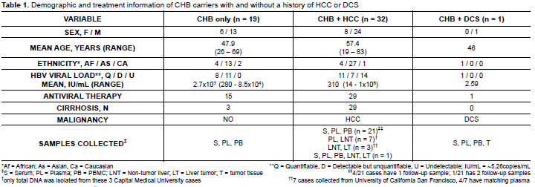
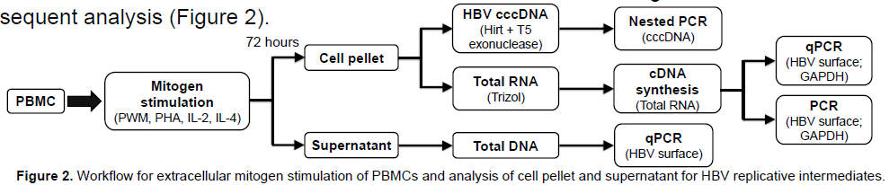
Pathogenicity of HBV in hepatic & extrahepatic malignancies in chronic hepatitis B : Dendritic Cell Sarcomas
HBV genomes, genetic variants, and integration are present within the PBMCs of CHB carriers with or without a history of HBV-related HCC
Aim 1: Assess for the presence of HBV genomes in plasma, PBMC, and liver/tumor tissue of CHB carriers with or without malignancy (HCC or dendritic cell sarcoma, DCS).
Aim 2:Identify HBV genomic integration sites within liver and PBMC.
Aim 3: Evaluate the effect of extracellular mitogen stimulation of PBMCs on HBV replication.
Serum/plasma, PBMC, and liver were collected from CHB carriers with and without HBV-related HCC as well as biological samples from a CHB carrier with DCS (Table 1).
Total protein was isolated from DCS tissue for HBsAg and HBcAg western blot.
PBMCs from 7 additional CHB carriers were used for extracellular mitogen stimulation and subsequent analysis (Figure 2).
Lau KCK et al, Poster #1011, AASLD 2019

Slide 9
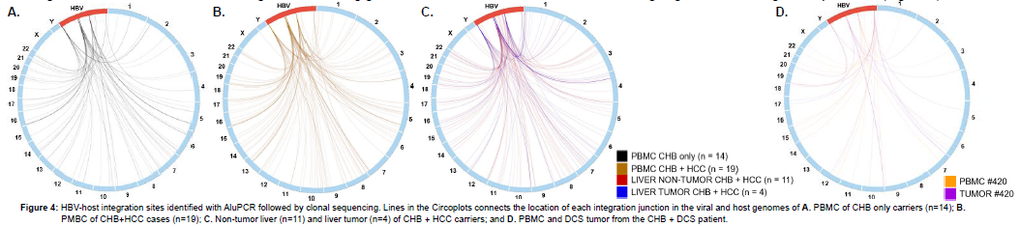
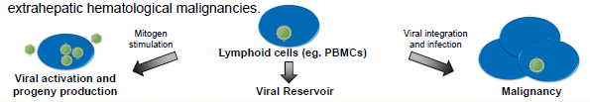
Pathogenicity of HBV in hepatic & extrahepatic malignancies in chronic hepatitis B
HBV replicative intermediates and integration found within the PBMCs strengthens current evidence
of a persistent HBV reservoir in lymphoid cells.
HBV in PBMCs can activate and produce viral progeny when stimulated by mitogens.
The data collected (i.e., markers of HBV infection and integration within DCS tissue) suggest a possible link between the presence of HBV in PBMC and pathogenesis of HBV-related extrahepatic hematological malignancies.
Lau KCK et al, Poster #1011, AASLD 2019

Slide 10
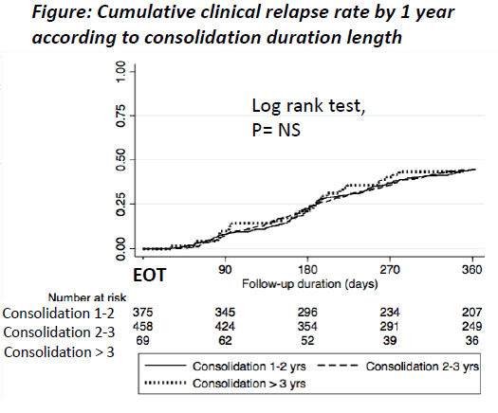
The optimal duration of consolidation treatment prior to cessation of Nuc therapy in HBeAg negative patients after HBsAg Loss
By year group
Wen-Juei J et al, Poster #0469, AASLD 2019

Slide 11
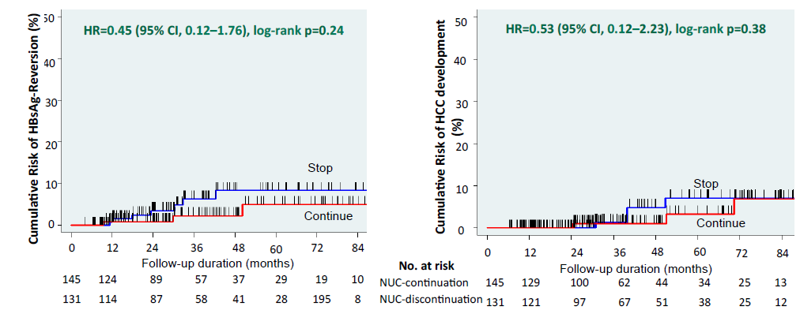
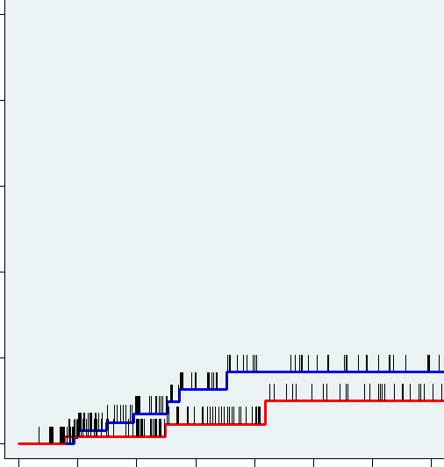
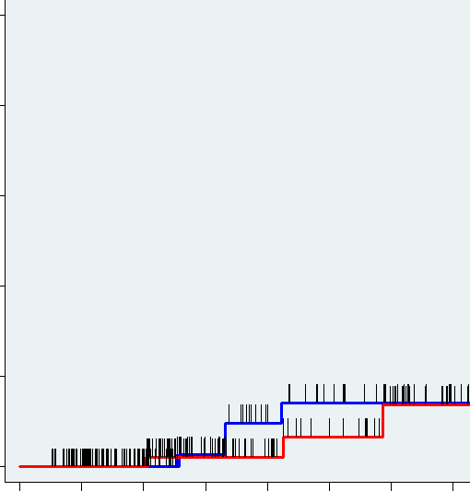

NA-Induced HBsAg Loss is Durable
Retrospective analysis of patients who stopped or continued NA after HBsAg loss Evaluated incidence of HBsAg sero-­‐reversion and HCC
Cumulative Risk of HBsAg-­‐Reversion (%)
50
50
HR=0.45 (95% CI, 0.12–1.76), log-­‐rank p=0.24
Cumulative Risk of HCC development (%)
HR=0.53 (95% CI, 0.12–2.23), log-­‐rank p=0.38
40
40
30
30
20
20
Stop
10
10
Stop
0
Continue
72 84
0
Continue
0
12
24 36 48 60
Follow-up duration (months)
12
24 36
48 60
72
84
145 124
131 114
89
87
57
58
37
41
Follow-up duration (months)
100
97
62
67
44
51
34
38
25
25
13
12
Implications for clinical practice: HBsAg loss is a durable and safe endpoint for stopping therapy
Kim et al Abstract 0198
Courtesy of Marc Ghany, MD

Slide 12
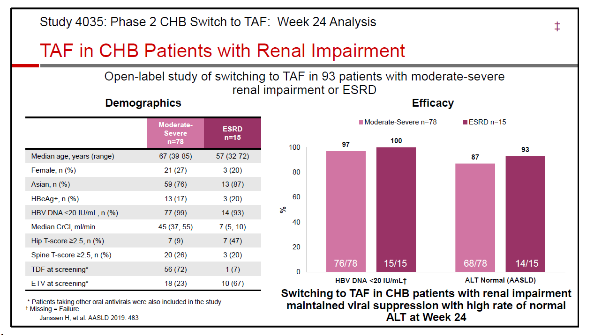

Slide 13
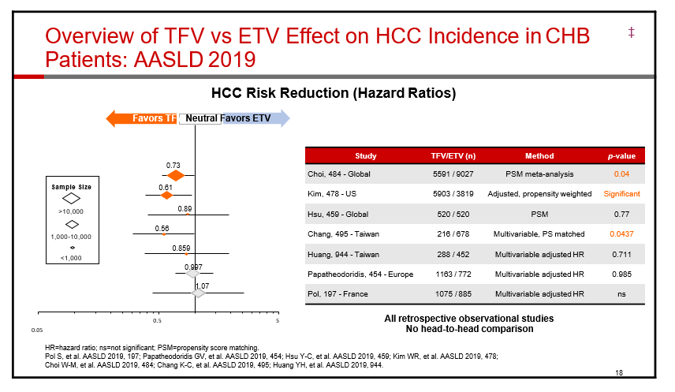

Slide 14
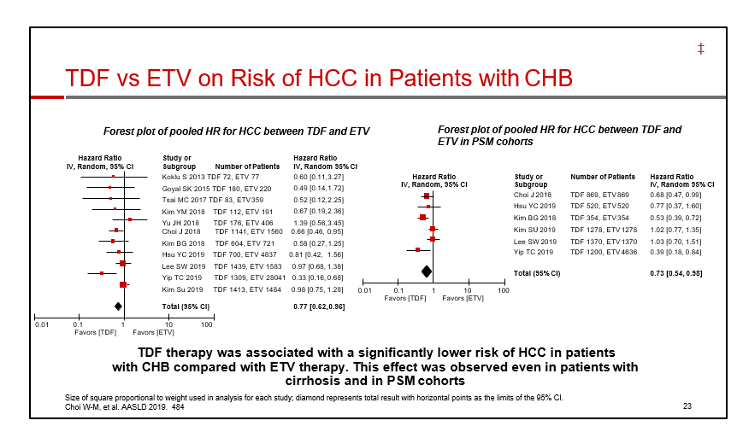
PSM propensity score matched

Slide 15
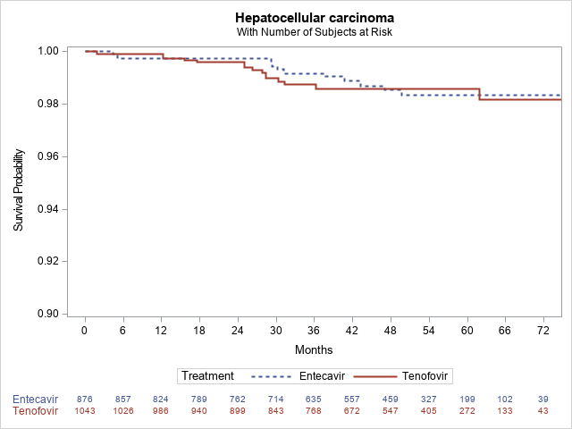
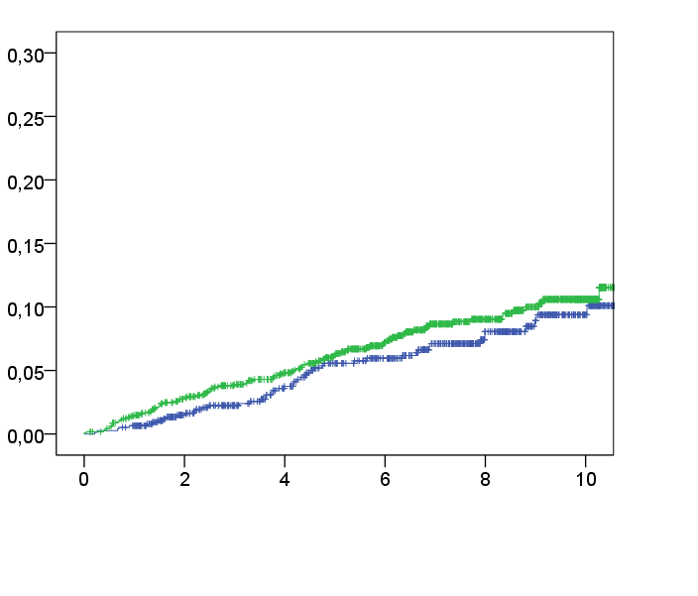
Is There a Difference in HCC Risk between Tenofovir and Entecavir?
ANRS CO22 Cohort:1960 (all races) HBeAg+/- patients who received tenofovir (1075) or entecavir (885) followed-up for a mean of in 45 months
PAGE-­‐B Cohort: 1935 Caucasian adults HBeAg
+/-­‐with or without compensated cirrhosis on
ETV (n=772) or TDF (n=1163)
Log-rank, P=0.321
HCC incidence
TDF
0.086
ETV
0.077
Years
Papatheodoredis et al Abstract 0454
Pol et al Abstract 0197
No difference in HCC risk between tenofovir and entecavir
Courtesy of Marc Ghany, MD

Slide 16
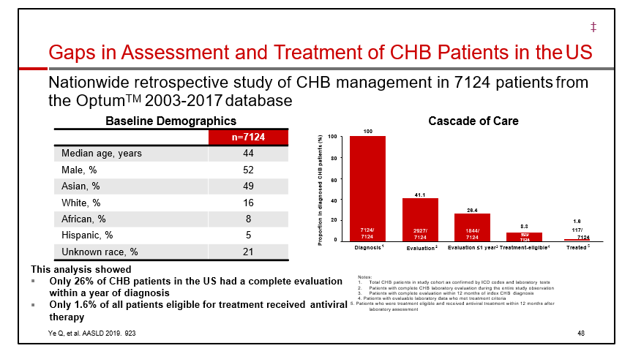

Slide 17
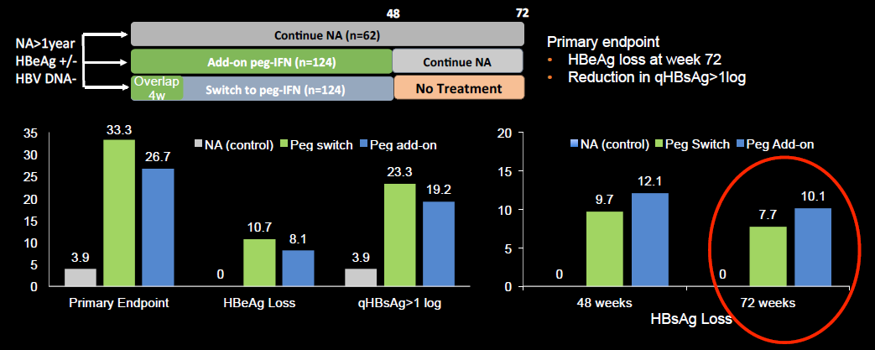





Switch or Add-on Peginterferon to NA Therapy
48
72
NA>1year HBeAg +/-­‐ HBV DNA-­‐
Continue NA (n=62)
Primary endpoint
Add-­‐on peg-­‐IFN (n=124)
Continue NA
No Treatment
HBeAg loss at week 72
Reduction in qHBsAg>1log
Overlap 4w
Switch to peg-­‐IFN (n=124)
35
30
25
20
15
10
5
0
33.3
20
of
26.7
NA (control)
Peg switch
Peg add-on
NA (control) Peg Switch
Peg Add-on
23.3
15
12.1
19.2
9.7
10.1
10
7.7
10.7
8.1
3.9
3.9
5
0
0
0
0
Primary Endpoint
HBeAg Loss
qHBsAg>1 log
48 weeks
72 weeks
Implications for clinical practice: Little benefit to add-on or sequential IFN NUC approach to induce HBsAg loss
Lim et al Abstract 0193
Courtesy of Marc Ghany, MD
Farag et al Abstract 0195

Slide 18
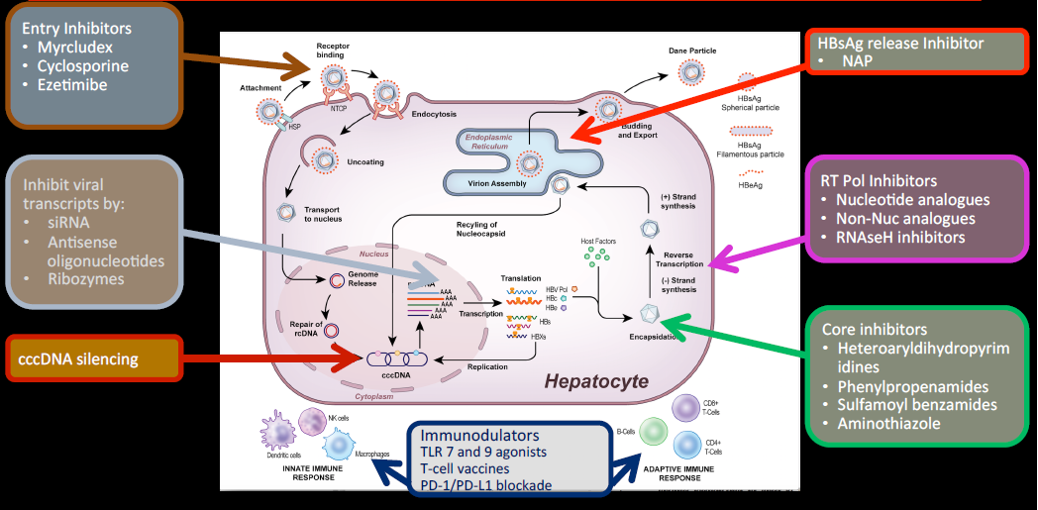
HBV Lifecycle and Many Drug Targets
Entry Inhibitors
HBsAg release Inhibitor
Myrcludex
Cyclosporine
Ezetimibe
NAP
Inhibit viral transcripts by:
RT Pol Inhibitors
Nucleotide analogues
Non-­‐Nuc analogues
RNAseH inhibitors
siRNA
Antisense oligonucleotides
Ribozymes
Core inhibitors
Heteroaryldihydropyrim idines
Phenylpropenamides
Sulfamoyl benzamides
Aminothiazole
cccDNA silencing
Immunodulators TLR 7 and 9 agonists T-­‐cell vaccines
PD-­‐1/PD-­‐L1 blockade
Courtesy of Marc Ghany, MD

Slide 19
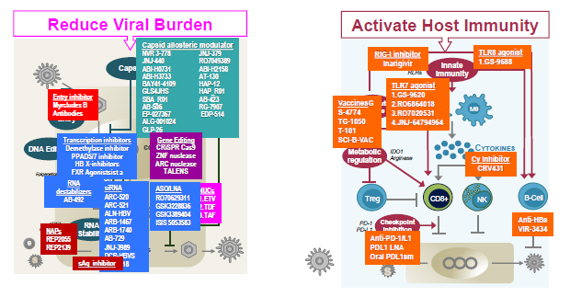















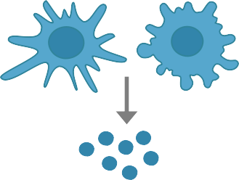



















































HBV CURE Targets
Activate Host Immunity
Capsid allosteric modulator
TLRs
TLR8 agonist
NVR 3-778 JNJ-440 ABI-H0731 ABI-H3733 BAY41-4109 GLS4JHS SBA_R01 AB-506
EP-027367 ALG-001024
JNJ-379 RO7049389 ABI-H2158 AT-130 HAP-12 HAP_R01 AB-423
RG-7907
EDP-514
RIG-I inhibitor
Inarigivir
RLRs
1.GS-9688
Cap
sid
HEPATOCYTE
Innate
Immunity
c
DC
TLR7 agonist
Entry
1.GS-9620
Entry inhibitor
Therapeuti Vaccin
Myrcludex B
Antibodies
VaccinesG
2.RO6864018
3.RO7020531
4.JNJ-64794964
Mθ
S-4774
e
TG-1050
GLP-26
T-101
iting
ccDNA
SCI-B-VAC
Transcription inhibitors
Gene Editing
CYTOKINES
DNA Ed
Demethylase inhibitor PPAD5/7 inhibitor HB X-inhibitors FXR Agonistsist a
c CRiSPR Cas9 ZNF nuclease ARC nuclease
TALENS
Metabolic regulation
IDO1
Arginase
Cy Inhibitor
CRV431
Epigenetics
HBx ↓Transcription
RNA
ability
Viral Proteins
NUCs 1.
Viral RNA ^{2.}
3.
destabilizers
siRNA
ASO/LNA
AB-492
ARC-520 ARC-521 ALN-HBV ARB-1467 ARB-1740 AB-729 JNJ-3989 DCR-HBVS
RO70629311 GSK3228836 GSK3389404 ISIS 5053583
ETV TDF TAF
Treg
CD8+
NK
B-Cell
siRNA ethylation
RNA
St
PD-1
Checkpoint inhibition
Anti-HBs VIR-3434
^{m} NAPs
PD-L1
e
e
REP2055
Anti-PD-1/L1 PDL1 LNA
Oral PDL1sm
REP2139
VIR-22
sAg inhibitor
18
HBV Forum 6, Boston Nov 2019

Slide 20
Compounds Use or In Development for Chronic Hepatitis B
FAMILY/DRUG NAME | MECHANISM | COMPANY | WEBSITE | USA STATUS
Nucleos(t)ide Analogues: Interfere with viral DNA polymerase used for HBV replication
Epivir (Lamivudine) *Generics available | Inhibits viral DNA polymerase | GlaxoSmithKline (GSK) | gsk.com | Approved 1998
Hepsera (Adefovir dipivoxil) *Generics available | Inhibits viral DNA polymerase | Gilead Sciences, USA | gilead.com | Approved 2002
Baraclude (Entecavir) *Generics available | Inhibits viral DNA polymerase | Bristol-Myers Squibb, USA | bms.com | Approved 2005
Tyzeka (Telbivudine) *Generics available | Inhibits viral DNA polymerase | Novartis, USA | novartis.com | Approved 2006
Viread (Tenofovir) *Generics available | Inhibits viral DNA polymerase | Gilead Sciences | gilead.com | Approved 2008
Vemlidy (TAF or tenofovir alafenamide) | Prodrug of tenofovir | Gilead Sciences | gilead.com | Approved 2016
Levovir (Clevudine) | Inhibits viral DNA polymerase | Bukwang, S. Korea | bukwang.co.kr | Approved 2006 in S. Korea
Besivo (formerly ANA 380/LB80380) | Inhibits viral DNA polymerase | Ildong Pharma, S. Korea | ildong.com | Approved 2017 in S. Korea
Zadaxin | Immunomodulator | SciClone, USA | sciclone.com | Approved outside USA
Hepatitis B Foundation

Slide 21
Compounds in Development for Chronic Hepatitis B
FAMILY/DRUG NAME | MECHANISM | COMPANY | WEBSITE | USA STATUS
DIRECT ACTING ANTIVIRALS: Targets the virus and interferes in the HBV replication process
Silencing RNA’s (siRNAs): Interferes and destroys viral RNA
VIR-2218 | RNAi gene silencer | Alnylam and Vir Biotech, USA | alnylam.com | Phase II
RG6004 | RNAi gene silencer | Roche, Switzerland | roche.com | Phase I/II
ARO-HBV | RNAi gene silencer | Arrowhead Pharma with Janssen, USA | arrowheadpharma.com | Phase I/II
AB-729 | RNAi gene silencer | Arbutus Biopharma, USA | arbutusbio.com | Phase I
DCR-HBVS | RNAi gene silencer | Dicerna, USA | dicerna.com | Phase I
BB-103 | RNAi gene silencer | Benitec, Australia | benitec.com | Preclinical
Lunar-HBV | RNAi gene silencer | Arcturus with Janssen, USA | arcturusrx.com | Preclinical
Hepatitis B Foundation

Slide 22
Compounds in Development for Chronic Hepatitis B
FAMILY/DRUG NAME | MECHANISM | COMPANY | WEBSITE | USA STATUS
DIRECT ACTING ANTIVIRALS: Targets the virus and interferes in the HBV replication process
Entry Inhibitors: Interferes with HBV getting into liver cells
Bulevirtide (Myrcludex B) | Entry inhibitor | Hepatera, Russia with MYR GmbH, Germany | myr-pharma.com | Phase IIb
Capsid Inhibitors: Interferes with the viral DNA protein shield
Morphothiadin | Capsid inhibitor | HEC Pharma, PR China | pharm.hec.cn/en | Phase II
JNJ 56136379 | Capsid inhibitor | Janssen, Ireland | janssen.com | Phase II
ABI-H0731 | Capsid inhibitor | Assembly Biosciences, USA | assemblybio.com | Phase II
ABI-H2158 | Capsid inhibitor | Assembly Biosciences, USA | assemblybio.com | Phase I
RG7907 | Capsid inhibitor | Roche, Switzerland | roche.com | Phase I
QL-007 | Capsid inhibitor | Qilu, PR China | qilu-pharma.com | Phase I
EDP-514 | Capsid inhibitor | Enanta Pharma, USA | enanta.com | Phase I
GLP-26 | Capsid inhibitor | Emory University, USA | emory.edu | Preclinical
ABI-H3733 | Capsid inhibitor | Assembly Biosciences, USA | assemblybio.com | Preclinical
CB-HBV-001 | Capsid inhibitor | ZhiMeng Biopharma, PR China | core-biopharma.com | Preclinical
Hepatitis B Foundation

Slide 23
Compounds in Development for Chronic Hepatitis B
FAMILY/DRUG NAME | MECHANISM | COMPANY | WEBSITE | USA STATUS
DIRECT ACTING ANTIVIRALS: Targets the virus and interferes in the HBV replication process
HBsAg Inhibitors: Interferes with production of HBV surface antigen (sAg)
REP 2139 | sAg inhibitor | Replicor, Canada | replicor.com | Phase II
REP 2165 | sAg inhibitor | Replicor, Canada | replicor.com | Phase II
Antisense Molecules: Binds to the viral mRNA to prevent it from turning into viral protein
IONIS-HBVRx | Viral protein inhibitor | Ionis with GSK, USA | ionispharma.com | Phase II
IONIS-HBVLRx | Viral protein inhibitor | Ionis with GSK, USA | ionispharma.com | Phase II
Hepatitis B Foundation

Slide 24
Compounds in Development for Chronic Hepatitis B
FAMILY/DRUG NAME | MECHANISM | COMPANY | WEBSITE | USA STATUS
INDIRECT ACTING ANTIVIRALS: Targets the human immune system to attack the HBV virus
Therapeutic Vaccines: Vaccine technology used to stimulate the immune system as a treatment
AIC 649 | Therapeutic vaccine | AiCuris, Germany | aicuris.com | Phase I
INO-1800 | Therapeutic vaccine | Inovio, USA | inovio.com | Phase I
HB-110 | Therapeutic vaccine | Ichor Medical Genexine, USA | ichorms.com | Phase I
TG1050 | Therapeutic vaccine | Transgene, France | transgene.com | Phase I
HepTcell | Therapeutic vaccine | Altimmune, USA | altimmune.com | Phase I
JNJ 64300535 | Therapeutic vaccine | Janssen, Ireland | janssen.com | Preclinical
HBV | Therapeutic vaccine | GeoVax, USA | geovax.com | Preclinical
VBI-2601 | Therapeutic vaccine | VBI Vaccines, USA | vbivaccines.com | Preclinical
Chimigen HBV | Therapeutic vaccine | Akshaya, Canada | akshayabio.com | Preclinical
CARG-201 | Therapeutic vaccine | CaroGen, USA | carogencorp.com | Preclinical
Hepatitis B Foundation

Slide 25
Compounds in Development for Chronic Hepatitis B
FAMILY/DRUG NAME | MECHANISM | COMPANY | WEBSITE | USA STATUS
INDIRECT ACTING ANTIVIRALS: Targets the human immune system to attack the HBV virus
Innate Immune Defense Pathway: Compounds that activate the innate immune system
Inarigivir | RIG -1 and NOD2 agonist | Spring Bank with Gilead Sciences, USA | springbankpharm.com | Phase II
GS9688 | TLR-8 agonist | Gilead Sciences, USA | gilead.com | Phase I
RG7854 | TLR-7 agonist | Roche, Switzerland | roche.com | Phase I
Host Acting Pathway: Compounds that target cell functions needed by the hepatitis B virus
APG-1387 | Apoptosis Inducer | Ascentage Pharma, PR China | ascentagepharma.com | Phase I
CRV 431 | Ciclofillin inhibitor | Hepion, USA (formerly ContraVir) | hepionpharma.com | Phase I
AB-452 | RNA destabilizer | Arbutus Biopharma, USA | arbutusbio.com | Preclinical
Gene Editing
EBT106 | CRISPR/Cas 9 | Excision Bio, USA | www.excisionbio.com | Preclinical
HBV | ARCUS platform | Precision Bio with Gilead, USA | precisionsciences.com | Preclinical
Hepatitis B Foundation

Slide 26
Compounds in Development for Chronic Hepatitis B
FAMILY/DRUG NAME | MECHANISM | COMPANY | WEBSITE | USA STATUS
INDIRECT ACTING ANTIVIRALS: Targets the human immune system to attack the HBV virus
Other
GC1102 | sAg monoclonal antibody | Green Cross, South Korea | www.globalgreencross.com | Phase II
EYP001 | FXR agonist | Enyo Pharma, France | enyopharma.com | Phase I
RG6084 | Host targeting antisense (LNA) | Roche, Switzerland | roche.com | Phase I
RG6217 | Host targeting antisense (LNA) | Roche, Switzerland | roche.com | Phase I
LTCR-H2-1 | T Cell immunotherapy | Lion TCR, Singapore | www.liontcr.com | Preclinical
HBV | MicroRNA | Regulus, USA | regulusrx.com | Preclinical
Hepatitis B Foundation

Slide 27
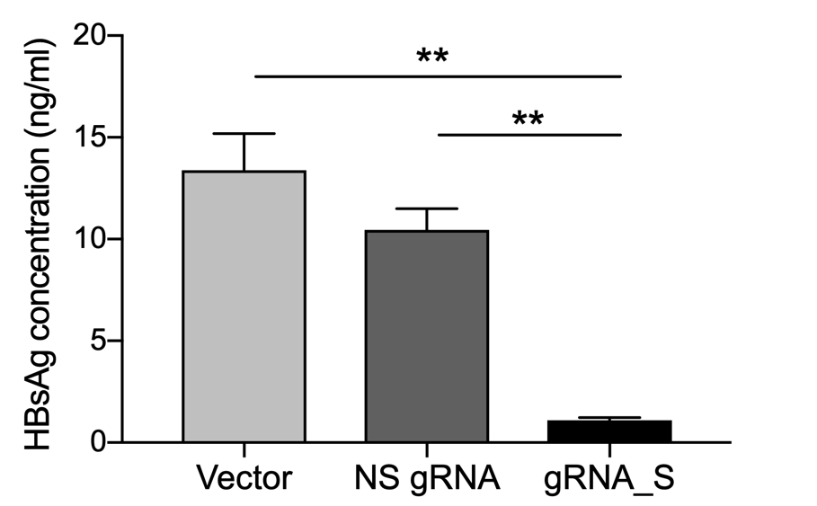
CRISPR-STOP induced a premature stop codon and suppress HBsAg production in vitro
Example sequencing profiles of integrated HBV S gene
71% of cells transduced with lentivector encoding gRNA_S developed a premature stop codon
CRISPR-STOP led to a reduction of HBsAg in the supernatant by 92%
Vector
Gln
NS gRNA
Gln
gRNA_S
STOP
Zhou H, Abstract #0086, AASLD 2019

Slide 28


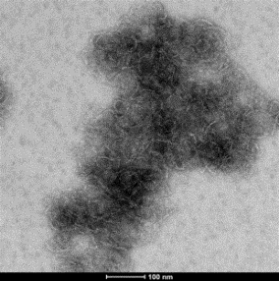
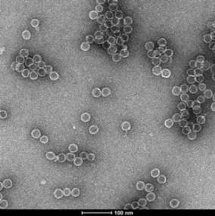
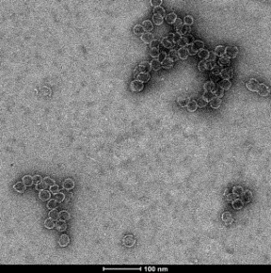
Capsid Allosteric Modulators (CAMs)
HBV core protein dimers
Class I CAM Class II CAM
pgRNA·RT
CAM-I or A Class
Heteroarylpyrimidine derivatives
Phenylpropenamide derivatives Sulfamoylbenzamide derivatives
CAM-II or N Class
RO7049389 BAY41-4109¹ HAP-12 GLS4JHS HAP_R01 SBA_R01
RG-7907
NVR 3-778 JNJ-379²
JNJ-440³ AT130
AB-506⁴ GLP-26
ABI-H0731⁵ ABI-H2158⁶
ABI-H3733
ALG-001024⁷ ALG-001075⁸ TBA #701⁹
Aberrant core protein
aggregates
Functional
nucleocapsids
Empty
capsids
Capsid assembly in vitro (electron microscopy)
1.Fukutomi K, et al. Oral #90
2.Yuen M-F, et al. Poster #LP4 3.Gane E , et al. Oral #89
4.Yuen M-F, et al. Poster #LP7
5.Sulkowski M , et al. Poster #LP1
6.Yuen M-F, et al. Poster #LP14 7.Debing Y, et al. Poster #699 8.Jeckle A, et al. Poster #703
HBV Forum 6, Boston Nov 2019
9.Mani N, et al. Poster #701

Slide 29




Oral HBV capsid assembly modulator (CAMs)
Antiviral effect during 28 days dosing on qHBV DNA
1. NVR3-778 2. JNJ-379 3. RO7049389 4. ABI-H0731
0
0
0
0
200 mg QD
400 mg BID
600 mg QD
1000 mg QD
200 mg QD
PBO
100 mg QD
Δ HBV DNA (log₁₀ IU/mL)
PBO QD
–1
-1
25 mg QD
75 mg QD
-1
-1
200 mg BID
150 mg QD
300 mg QD
–2
100 mg QD
200 mg QD
400 mg QD
600 mg BD
-2
250 mg QD
-2
-2
PBO
–3
-3
-3
-3
–4
-4
-4
-4
1 2 3
Time (weeks)
Zoulim F, et al. EASL 2018, Paris. #LBO-004
4
0
1
2 3
Time (weeks)
4
0
1 2 3
Time (weeks)
4
0
1
2 3
Time (weeks)
4
Yuen M-F, et al. EASL 2016, Barcelona. LBO6
Gane E, et al. EASL 2018, Paris. #LBO-003 Yuen M-F.EASL 2019, Vienna., #FRI-219
Yuen M-F, et al. AASL D2016, San Francisco
1200mg⇨2log reduction
No effect on HBsAg
Skin rash
250mg⇨2.9 log reduction
No effect on HBsAg
Occ ALT elevation
200mg⇨3.2 log reduction
No effect on HBsAg
ALT elevation in 20%
400mg⇨3.9 log reduction
No effect on HBsAg
Skin rash
HBV Forum 6, Boston Nov 2019

Slide 30
























Oral HBV capsid assembly modulator (CAMs)
Antiviral effect during 28 days dosing
1. NVR3-778 2. JNJ-379 3. RO7049389 4. ABI-H0731
0
0
0
0
200 mg QD
400 mg BID
100 mg QD
Δ HBV DNA (log₁₀ IU/mL)
PBO QD
2-3 log reduction in HBV DNA aft
er 28 days
200 mg BID
–1
-1
25 mg QD
-1
600 mg QD
-1
75 mg QD
300 mg QD
2 log reduction
25i0 n HBV
1000 mg QD
150 mg QD
RNA after²⁰2^{0 m}8^{g QD}da⁻²ys
–2
100 mg QD
200 mg QD
400 mg QD
600 mg BD
-2
mg QD
-2
PBO
NO change in HBsAg levels after 28 days
PBO
–3
-3
-3 -3
Will increased
po² ten³ cy/dura
tion achieve this 2
_{o}3
–4
-4
-4
-4
’ M² A⁴ ?
1
2 3 4
1
4
0
1 2 3 4
0 1
0
Time (weeks)
Time (weeks)
Time (weeks)
Time (weeks)
Yuen M-F, et al. EASL 2016, Barcelona. LBO6
Zoulim F, et al. EASL 2018, Paris. #LBO-004
Gane E, et al. EASL 2018, Paris. #LBO-003 Yuen M-F.EASL 2019, Vienna., #FRI-219
Yuen M-F, et al. AASL D2016, San Francisco
1200mg⇨2log reduction
No effect on HBsAg
Skin rash
250mg⇨2.9 log reduction
No effect on HBsAg
Occ ALT elevation
200mg⇨3.2 log reduction
No effect on HBsAg
ALT elevation in 20%
400mg⇨3.9 log reduction
No effect on HBsAg
Skin rash
HBV Forum 6, Boston Nov 2019

Slide 31
Oral HBV capsid assembly inhibitor (CpAMs)
AASLD 2019, Abstract #LP1: Longer Duration of 1st Gen CAMs
Study #211: Open label ETV+ ABI-H0731 for 52 weeks in patients who
have completed Studies #201 and #202 (24 weeks ETV + ABI-H0731/Plac)
- Interim results for HBeAg+ completed ≥ 32 wks ETV + ABI-H0731
27 patients from Study #201 (DNA suppressed on NUCs at Baseline)
→ 11 (41%) are HBV DNA TND, RNA <35 iu/mL and HBeAg <1 IU/mL
22 patients from Study #202 (Rx-naïve, DNA> 5 log iu/mL at Baseline)
Mean HBV DNA decline 6.1 log₁₀
→ Mean HBV RNA decline 3.0 log₁₀
→ Mean HBcrAg decline 0.8 log₁₀ (7 pts ≥1.0)
→ Mean HBeAg decline 0.6 log₁₀ (4 pts ≥1.0)
Sulkowski M , et al. AASLD 2019,. #LP1

Slide 32
Oral HBV capsid assembly inhibitor (CpAMs)
AASLD 2019, Abstract #LP14: Increased potency of 2nd Gen CAMs
ABI-H2158 >10-fold in vitro potency for inhibition of capsid assembly
and cccDNA synthesis compared to 1st Gen CAMs _{Colonno R, et al. EASL 2019}
ABI-H2158 100mg OD for 14 days in Rx-naïve HBeAg-positive CHB
  Safe and well tolerated, with no Grade ≥2 ALT elevations
  Mean HBV DNA decline 2.3 log10 IU/mL [range 1.7 – 3.0]
  Mean HBV RNA decline 2.0 log10 IU/mL [range 1.5 - 2.6]
Next cohort of ABI-H2158 300mg OD for 14 days in progress
Yuen M-F, et al. AASLD 2019,. #LP14

Slide 33




Oral HBV capsid assembly inhibitor (CpAMs)
AASLD 2019, Abstract #LP1: Longer Duration of 1st Gen CAMs
Study #211: Open label ETV+ ABI-H0731 for 52 weeks in patients who
have completed Studies #201 and #202 (24 weeks ETV + ABI-H0731/Plac)
- Interim results for HBeAg+ completed ≥ 32 wks ETV + ABI-H0731
27 patients from Study #201 (DNA suppressed on NUCs at Baseline)
→ 11 (41%) are HBV DNA TND, RNA <35 iu/mL and HBeAg <1 IU/mL
22 patFieinrtsstfroemviSdtuedyn#c2e02o(Rfx-cncaïcveD, DNNAA>p5 ologoilu/dmeL patlBeatsieolinne)
First evidence of cccDNA pool decrease?
Will CAM-NUC achieve Functional Cure?
⇨ Mean HBV RNA decline 3.0 log₁₀
→ Mean HBcrAg decline 0.8 log₁₀ (7 pts ≥1.0)
→ Mean HBeAg decline 0.6 log₁₀ (4 pts ≥1.0)
 Mean HBsAg decline 0.4 log₁₀ (7 pts ≥0.5, 3 pts ≥1.0)
Sulkowski M , et al. AASLD 2019,. #LP1

Slide 34
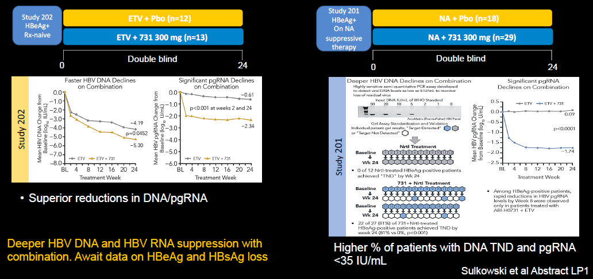
Dual Therapy CAM (ABI-H0731) plus NA
Courtesy of Marc Ghany, MD

Slide 35
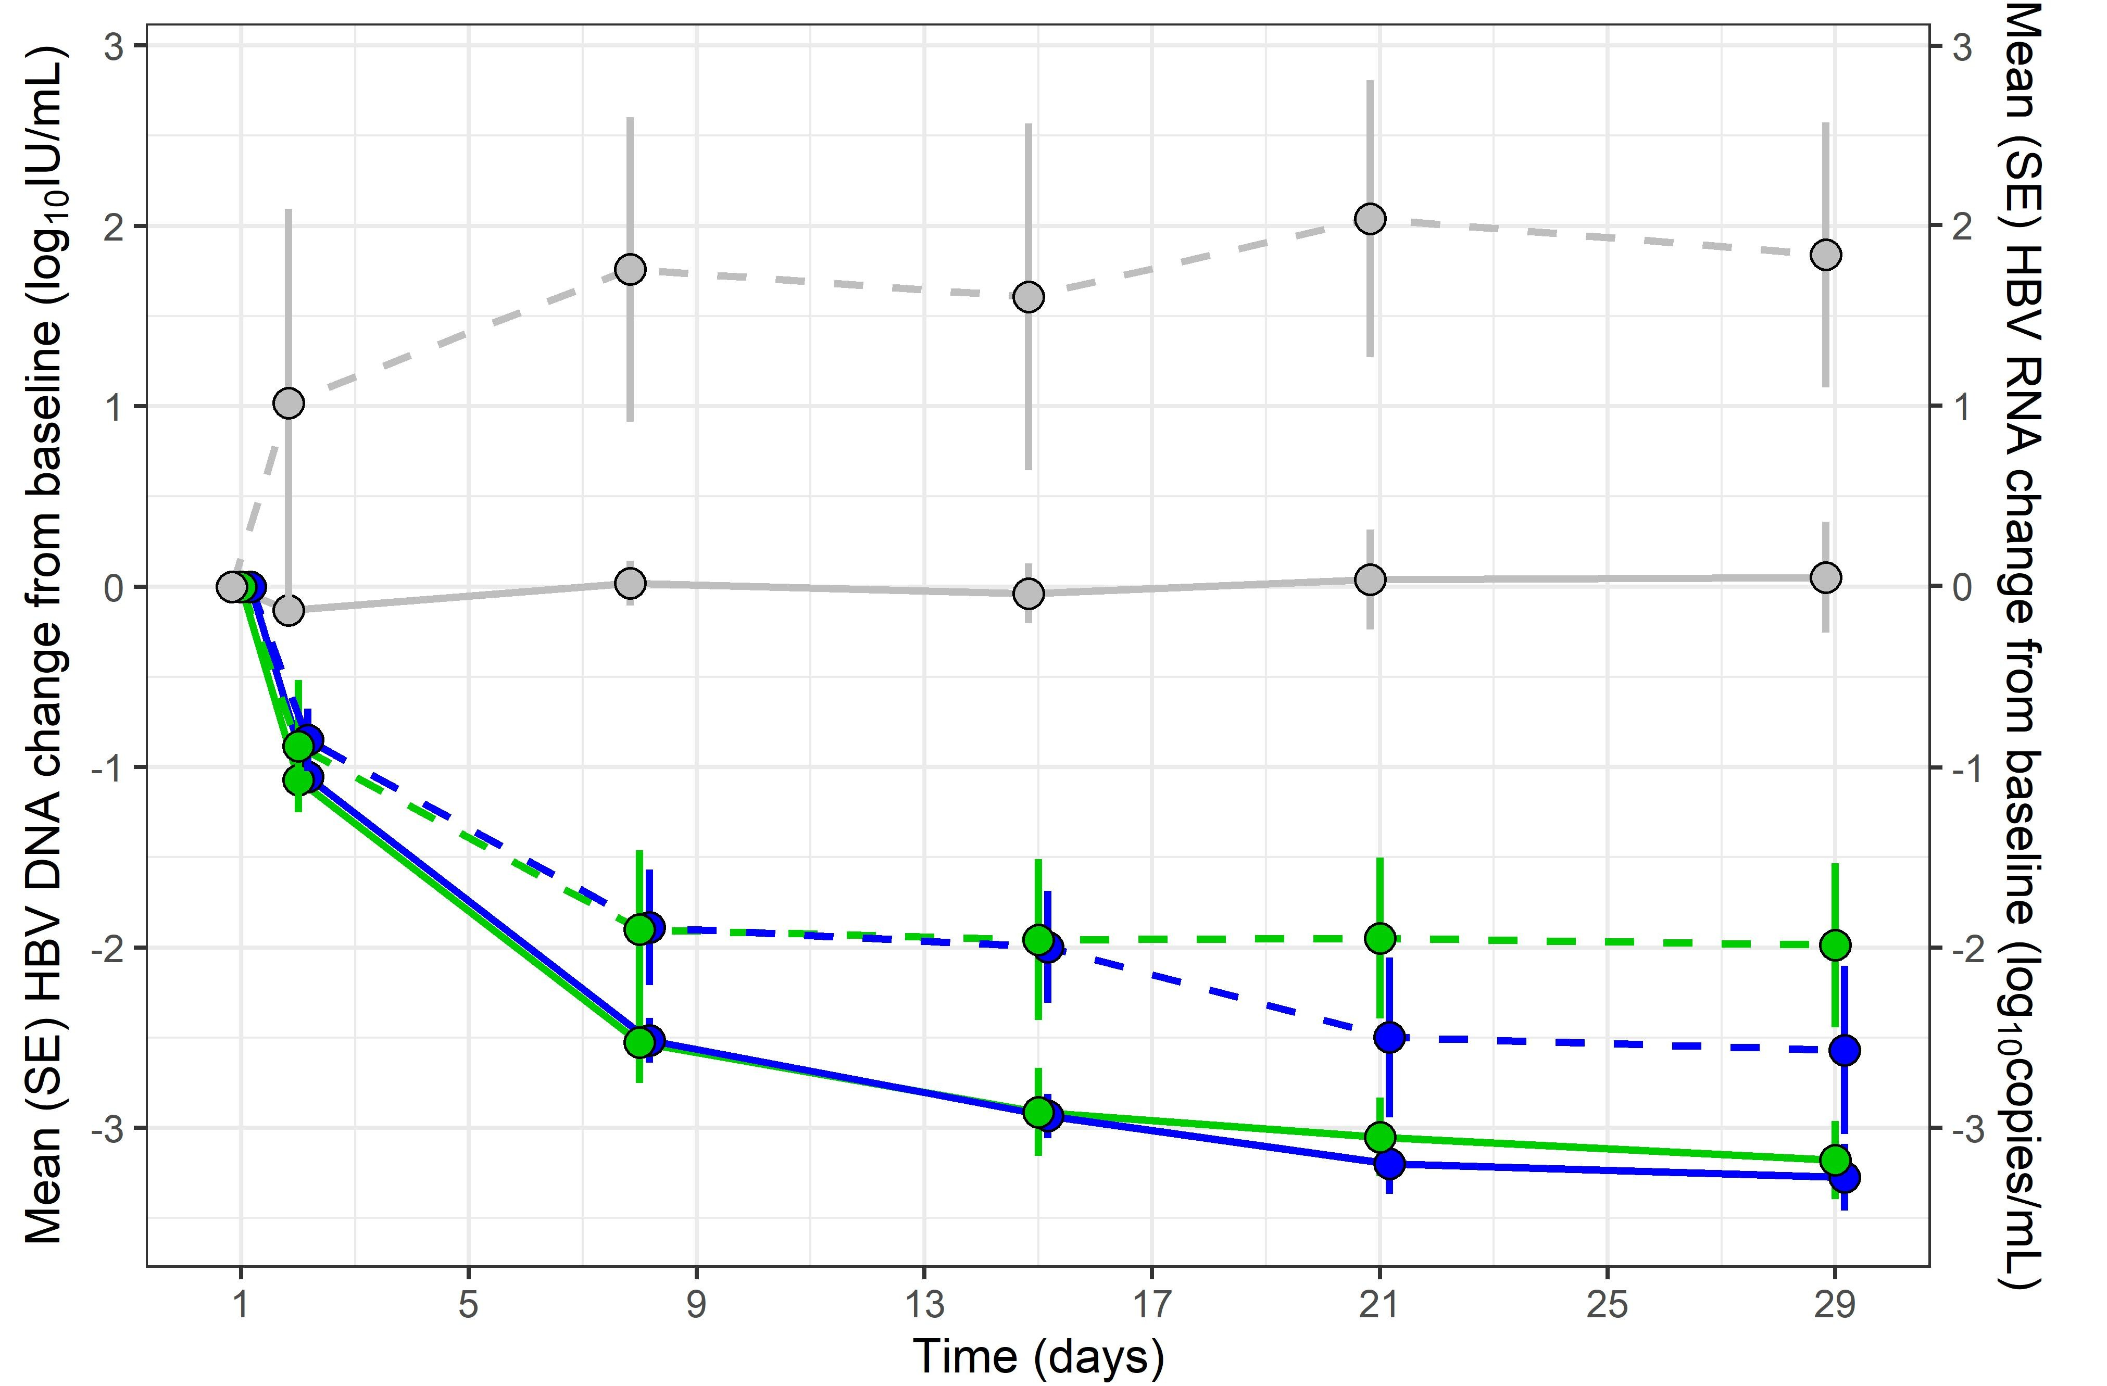
Core Assembly Modulator (CAM) JNJ-0440
Two cohorts of 10 treatment-naïve HBeAg +/- patients randomized to JNJ-0440 or placebo x 28 days
Efficacy
 | 750 mg QD | 750 mg BID
Mean change in HBV DNA vs. BL log₁₀ IU/mL | -­‐3.2 | -­‐3.3
Mean change in HBV RNA vs. BL log₁₀ copies/mL | -­‐2.0 | -­‐2.6
HBV RNA
HBV DNA
Mean change in HBeAg vs. BL log₁₀ IU/mL -0.2
No relevant changes in HBsAg levels
DNA LEVELS
RNA LEVELS
Placebo 750 mg QD
750 mg BID
Placebo 750 mg QD
750 mg BID
Safety
No treatment discontinuations/serious AEs
Gane et al Abstract 0089
Potent inhibition of viral replication ? functional cure
Courtesy of Marc Ghany, MD

Slide 36
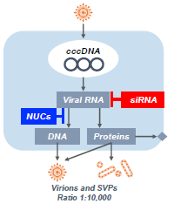
Mechanism of Translation Inhibitors
▪Inhibition of virion and SVP production
Inhibition of HBV antigen expression could stimulate endogenous immune responses AND increase effectiveness of immunotherapies
Viral RNA
siRNA
NUCs
DNA
Proteins
ASO/LNAs
siRNAs
ARC-520
ARC-521
ARB-1467
ARB-1740
AB-729
ARO-B/JNJ-3989^{4,5}
RO7062931
1
GSK3228836 GSK3389404²
ISIS 505358³
Gane E, et al. Poster #698
Yuen M-F, et al. Poster #695
Yuen-M-F, et al. Poster #700
GalXC-HBVS/DCR-HBVS
ALN HBV02/VIR-2218
HBV Forum 6, Boston Nov 2019
Gane E, et al. Poster #696
Yuen M-F, et al. Poster #LP4

Slide 37
Challenges of Translation Inhibitors in CHB
1. What HBV targets are most effective
First gen siRNA (ARC-520) had little effect in HBeAg negative patients
 target sequences downstream from DR1-DR2 region to silence integrated S
Wooddell C, et al. Sci Transl Med 2017; eaan0241
Are multiple targets needed to prevent resistance?
Should “X” be targeted as well as “S”?
2. What is best delivery system to hepatocytes
1st Gen NAG-MLP siRNAs (ARC-520/521); LNP siRNAs (ARB-1467/1740)
required weekly intravenous dosing, infusion reactions and premeds
Gal-NAC conjugated: subcutaneous , monthly dosing, no premeds
xyz-GalNAc binds to the Asialoglycoprotein receptor that is highly expressed on hepatocytes resulting in rapid endocytosis
HBV Forum 6, Boston Nov 2019

Slide 38
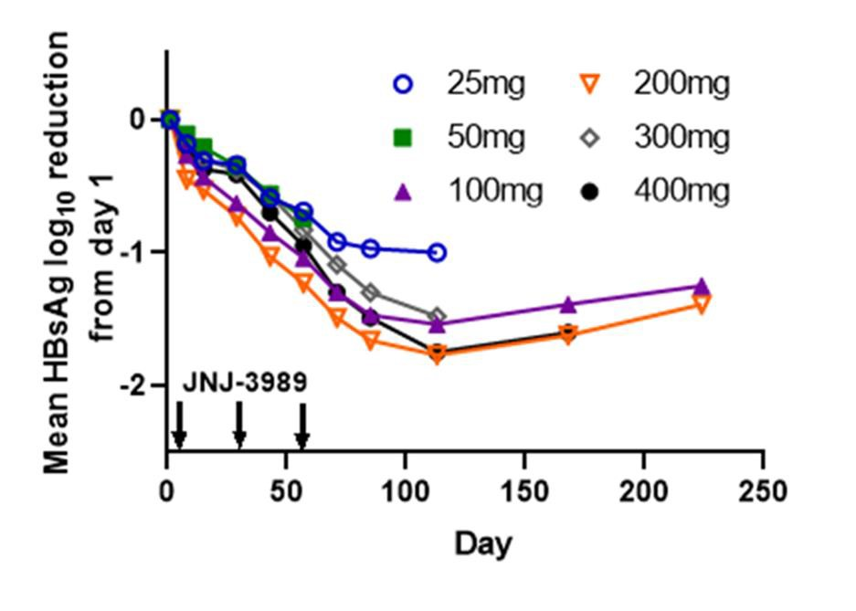
JNJ-3989 (ARO-HBV dual iRNA) in eAg pos and eAg neg CHB
MAD Ph1b (AASLD 2018; EASL 2019) ▪ Phase 1b (AASLD 2019 #PS-080)
Cohorts 1-6: 3 doses Q4W
Cohorts 7-8: 3 doses QW or Q2W
Expanded 100–400 mg cohorts
Added low-dose 25, 50mg cohorts
Longer follow-up
0 . 0
1 0 0 m g ( C 2 b )
L o g H B s A g f r o m D a y 1
2 0 0 m g ( C 3 b )
- 0 . 5
3 0 0 m g ( C 4 b )
- 1 . 0
4 0 0 m g ( C 5 b )
3 0 0 m g E + ,
N U C n a ï v e ( C 8 )
- 1 . 5
3 0 0 m g E + ,
- 2 . 0
N U C e x p ( C 9 )
- 2 . 5
0
1
2
3
4
5
6
7
8
M o n t h s
HBsAg declined by 1 log in all patients
No dose-response from 100-400mg
1 Gr 2 ALT elevation, 3 months post-Rx,
Yuen M-F, et al. EASL 2019, Vienna, Austria. #PS-080
Doses < 100mg less effective
No more ALT elevations
HBV Forum 6, Boston Nov 2019
Gane E, et al. AASLD 2019; #696

Slide 39

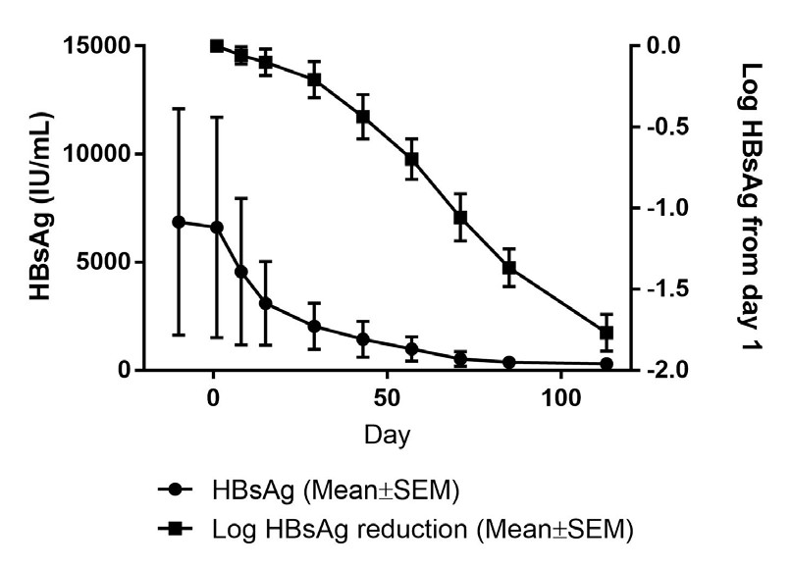
TRIPLE COMBO HBV CURE Combination Studies
NUC
▪Triple therapy: siRNA plus CAM plus NUC (Yuen #LP4)
–12 eAg+/eAg- CHB patients in open label POC study
JNJ-3989 200 mg subcut on Days 1, 28 and 56
JNJ-6379 250mg OD for 12 weeks
ETV/TDV OD
▪ Well tolerated, few Gr1 ALT increases
▪Robust antiviral activity
–HBsAg decline 1.8 log by Day 111
–Robust declines in other viral parameters
6th ANRS HBV Cure Workshop 2019
Michler T, et al. EASL 2018, Paris. #PS-025

Slide 40
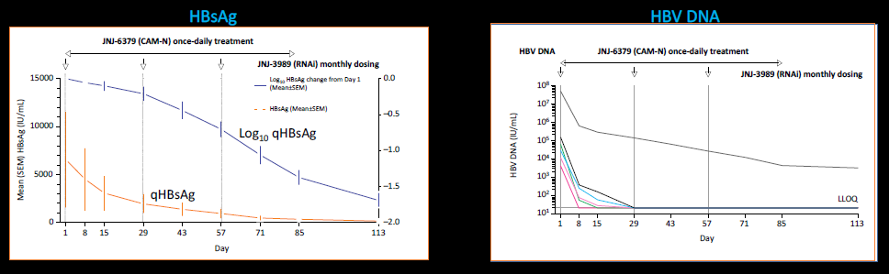
Triple Therapy: RNAi + CAM + NA
HBeAg+ n=4 / HBeAg- n=8, NA-naïve n=5 / experienced n= 7, All 12 Asian
Three 200 mg JNJ-3989 subcutaneous doses on Days 1, 29 and 57
Oral JNJ-6379 250 mg once daily for 12 weeks (until Day 85)
Started or already on ETV or TDF treatment on Day 1 to beyond the end of JNJ-6379 dosing
Response rates similar between HBeAg+ and HBeAg-
Triple therapy resulted in marked decline in HBsAg levels …?Functional cure
Yuen et al Abstract LP4

Slide 41
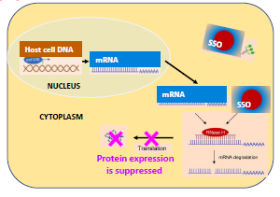


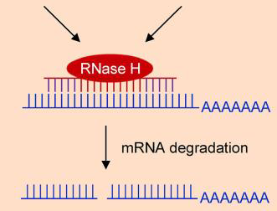


Translation Inhibition: other approaches at AASLD
1. Antisense oligonucleotides
ASOs silence HBV gene expression by hybridising to HBV mRNA and activating host RNAse H mediated degradation (not RISC)
Gal-Nac-conjugation should reduce ASO toxicities of renal dysfunction, low platelets
mRNA
SSO
CYTOPLASM
Protein expression is suppressed
1. RO7062931: Phase 1a in HVs (Gane #704)
- Safe, no toxicity
GSK3389404: Phase 1b in NUC-suppressed CHB patients (Yuen #695)
  12 week dosing 120mg - HBsAg decline 0.75 log
ISIS505358: Phase 1b in treatment naïve-CHB patients (Yuen #700)
  3 week dosing 300mg - HBsAg decline 1.6 log ; HBV DNA decline 1.7 log
  HBsAg and HBV DNA <LLOQ in 2 pts maintained for 1-4 months post-treatment
HBV Forum 6, Boston Nov 2019

Slide 42
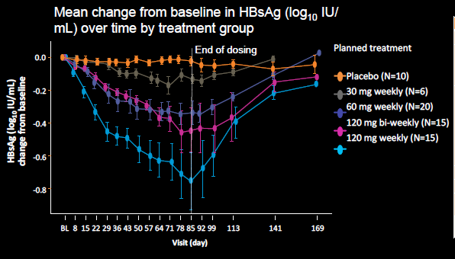
GSK3389404 (antisense oligonucleotide) in NUC Suppressed Patients
Phase 2a, multicenter, randomized, double-blind, placebo-controlled study in HBeAg+/-, n=66
Mean change from baseline in HBsAg (log₁₀ IU/ mL)
over time by treatment group
Table 1. Summary of AEs
 |  | GSK3389404
 | Placebo (N=10) | 30 mg weekly (N=6) | 60 mg weekly (N=20) | 120 mg weekly (N=15) | 120 mg bi-­‐ weekly (N=15) | Total GSK338940 4 (N=56)
Any AEs, n (%) | 8 (80) | 3 (50) | 15 (75) | 11 (73) | 8 (53) | 37 (66)
Mild (Grade 1) | 2 (20) | 2 (33) | 7 (35) | 4 (27) | 4 (27) | 17 (30)
Moderate (Grade 2) | 4 (40) | 0 | 8 (40) | 6 (40) | 2 (13) | 16 (29)
Severe (Grade 3) | 0 | 1 (17) | 0 | 1 (7) | 2 (13) | 4 (7)
Potentially life-­‐threatening (Grade 4) | 2 (20)ª | 0 | 0 | 0 | 0 | 0
Treatment-­‐related AEs, n (%) | 4 (40) | 3 (50) | 10 (50) | 8 (53) | 7(47) | 28 (50)
Serious AEs, n (%) | 0 | 0 | 0 | 0 | 1 (7) | 1 (2)
AEs leading to study withdrawal or treatment discontinuation, n (%) | 0 | 0 | 0 | 0 | 1 (7)^{b} | 1 (2)
ªBoth Grade 4 lab abnormality of creatine kinase increase attributed to physical activity. ^{b}Grade 1 pruritus on the neck. AEs, adverse events.
0.0
End of dosing
Planned treatment
HBsAg (log₁₀ IU/mL) change from baseline
Placebo (N=10)
30 mg weekly (N=6) 60 mg weekly (N=20)
120 mg bi-­‐weekly (N=15) 120 mg weekly (N=15)
-­‐0.2
-­‐0.4
-­‐0.6
-­‐0.8
BL 8 15 22 29 36 43 50 57 64 71 78 85 92 99 113
Visit (day)
141
169
Yuen et al Abstract 0695
Proof of principle that antisense oligonucleotides can decrease HBsAg levels
Courtesy of Marc Ghany, MD

Slide 43
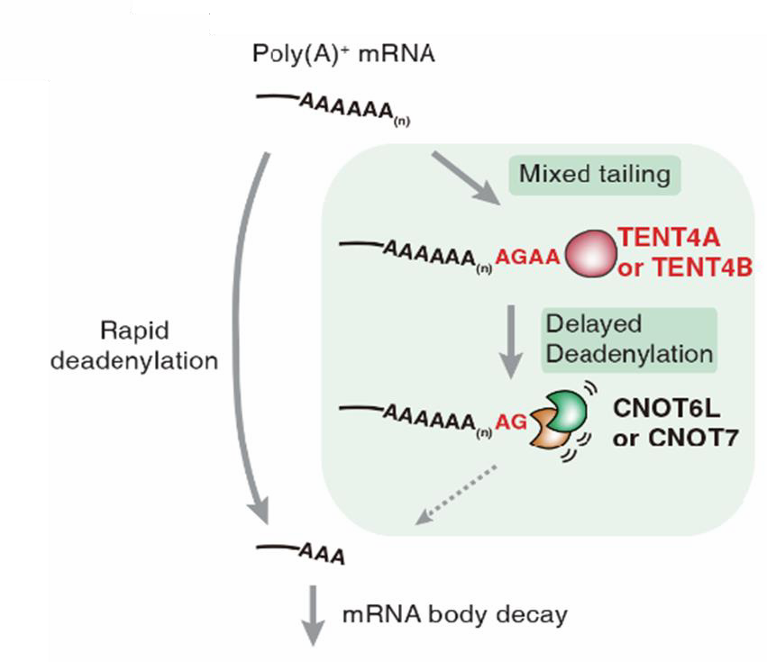
Translation Inhibition: other approaches at AASLD
2. mRNA destabilisers
Mixed tailing by PPAD5/PPAD7 shields mRNA from rapid deadenylation and decay¹
▪ Small molecules target host poly-A polymerases PAPD5/7 (TENT4A/4B) which destabilise HBV transcripts from both integrated and cccDNA _{Mueller Hepatol 2019; 69: 1398}
- Initial compounds associated with preclinical toxicity
▪Gal-NAC LNA ASOs targeting host PAPD5/7
POC study in AAV-HBV mouse model (Poster #704)
- Subcut injection Q2 weekly x3
decrease HBsAg in all animals - mean 2.3 log₁₀
4/8 mice had sustained HBsAg loss with anti-HBs, i.e.
achieved functional cure
Mueller H, et al. AASLD 2019; #704
HBV Forum 6, Boston Nov 2019

Slide 44

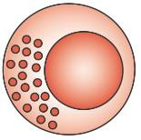
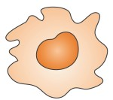
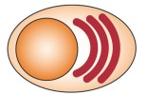













Ways to activate Antiviral Immunity against HBV
1. Stimulate Antiviral Effector Cells
TLR-7, TLR-8, RLRs, CLRs, NLRs
DNA sensors
CD8⁺
NK
Mφ
pDC
B
2. Generate New T cells
CD8⁺
Therapeutic vaccines
“Rescue” Exhausted T cells
  Reduce viral antigens
  Modulate immune receptors (PD-1)
CD8⁺
Relieve suppression of T cells
Inhibit T regs
HBV Forum 6, Boston Nov 2019

Slide 45
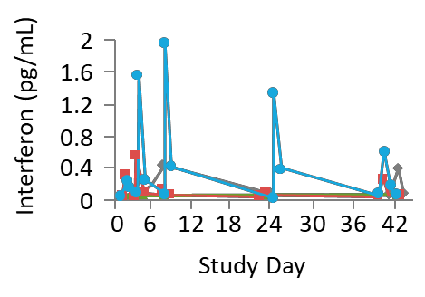
TLR-7 agonist RO7020531
Liver targeting specific TLR-7
- 150 mg QOD dosing for 6 weeks in NUC-suppressed CHB patients at AASLD 2018
PD activity in patients with flu-like symptoms
Relationship between exposure and PD activity
(maximum fold of change in individual patients)
Serum IFNα
Serum IP-10
 | Fraction responding | Geometric mean fold change (range)
Neopterin | 6/8 | 3.13 (1.86–6.08)
IP-10 | 7/8 | 3.55 (1.37–36.43)
ISG15 | 8/8 | 11.21 (2.31–270.26)
OAS-1 | 8/8 | 4.85 (1.71–41.45)
MX1 | 8/8 | 6.78 (2.16–87.43)
TLR7 | 7/8 | 3.46 (2.04–6.84)
40
30
20
10
0
0 6 12 18 24 30 36 42
Study Day
At AASLD this year, additional 150 and 170 mg cohorts (Yuen #692)
  full virologic results included a HBsAg decline in qHBsAg
  Next year planned Phase II platform studies with other agents
Gane E, et al. AASLD 2018, San Francisco, USA. #LB-33 Yuen M-F, et al. AASLD 2019, Boston, USA. #692
HBV Forum 6, Boston Nov 2019

Slide 46
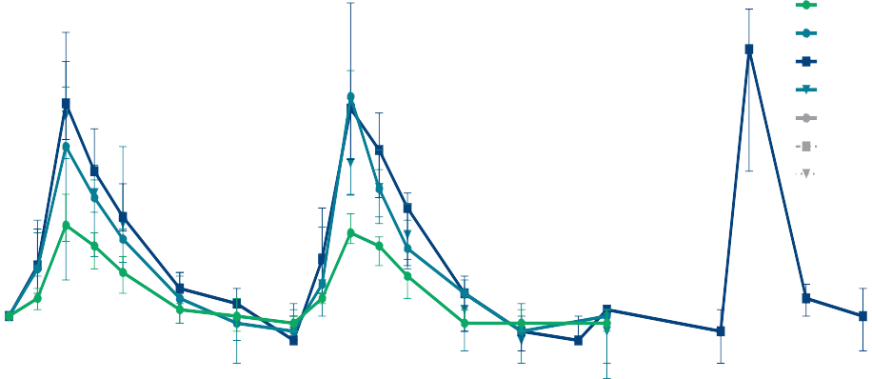
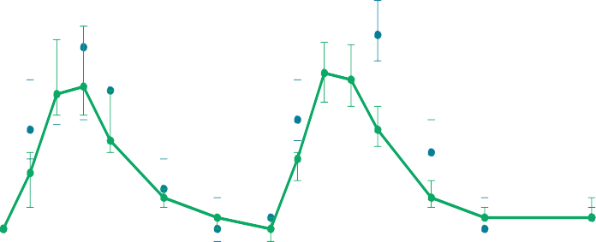
TLR-8 agonist GS-9688
EASL 2019: Phase 1b: 4 weekly doses in NUC suppressed CHB
Serum IL-12p40 changes
Serum IL-RA changes
16
Cohort 1 (1.5 mg x 2)
Cohort 2 (3 mg x 2)
Cohort 5 (3 mg x 4)
Cohort 4 (3 mg x 2)
Cohorts 1-2 Placebo
Cohort 5 Placebo
Cohort 4 Placebo
128
Cohort 1 (1.5 mg x 2)
Cohort 2 (3 mg x 2)
Cohort 5 (3 mg x 4)
Cohort 4 (3 mg x 2)
Cohorts 1-2 Placebo
Cohort 5 Placebo
Cohort 4 Placebo
Median fold change (Q1, Q3)
Median fold change (Q1, Q3)
64
8
32
16
4
8
4
2
2
1
1
0.5
Pre 2 h 4 h 8 h 12 h
Pre 2 h 4 h 8 h 12 h
Pre
Pre 4 h
0.25
Pre 2 h 4 h 8 h 12 h
Pre 2 h 4 h 8 h 12 h
Pre
Pre 4 h
Day Day | Day Day | Day | Day | Day Day | Day | Day
₂ ₄ | Day 8 ₉ ₁₁ Day 15 | Day 22 ₂₃ | ₂₉ Day 1 Day 2 Day 4 Day 8 ₉ ₁₁ Day 15 |  | Day 22 ₂₃ | 29
Day 1
Reyes M, et al. AASLD 2018, San Francisco, USA. #390 Khanam A, et al. AASLD 2018, San Francisco, USA. #550 Amin AE, et al. EASL 2019, Vienna, Austria. #FRI-132
At this meeting, results of Phase II study in NUC suppressed CHB (Gane #697)
  24 HBeAg pos and 24 HBeAg neg CHB patients on NUCs
  Safe and well tolerated
  HBsAg loss (Week 24)
HBV Forum 6, Boston Nov 2019

Slide 47











TLR-8 agonist GS-9688
EASL 2019: Phase 1b: 4 weekly doses in NUC suppressed CHB
Serum IL-12p40 changes
Cohort 1 (1.5 mg x 2)
Cohort 2 (3 mg x 2)
Cohort 5 (3 mg x 4)
Cohort 4 (3 mg x 2)
Cohorts 1-2 Placebo
Cohort 5 Placebo
Cohort 4 Placebo
Serum IL-RA changes
Cohort 1 (1.5 mg x 2)
Cohort 2 (3 mg x 2)
Cohort 5 (3 mg x 4)
Cohort 4 (3 mg x 2)
Cohorts 1-2 Placebo
Cohort 5 Placebo
Cohort 4 Placebo
16
128
Median fold change (Q1, Q3)
Median fold change (Q1, Q3)
64
8
32
16
4
8
4
2
2
1
1
Dose-related PD wit^{0.5}hout tachyphylaxis
Activated mDCs, NK, MAIT, CD4, CD8 T cells
Pre 2 h 4 h 8 h 12 h
Pre 2 h 4 h 8 h 12 h
0.25
Day Day
2 4
9▪ 11
Pre Pre 4 h Pre 2 h 4 h 8 h 12 h Pre 2 h 4 h 8 h 12 h
Pre Pre 4 h
Day 1
Day 8
Day Day
Day 15 Day 22 ^{Day}
Day Day Day
Day 29
Day 1 Day 2 Day 4 Day 8
Day 15 Day 22 ^{Day}
safe and well tolerated, no systemic IFN-
α
23 29 9 11
23
NO change in HBsAg after 4 weeks
Reyes M, et al. AASLD 2018, San Francisco, USA. #390
Khanam A, et al. AASLD 2018, San Francisco, USA. #550
Amin AE, et al. EASL 2019, Vienna, Austria. #FRI-132
At this meeting, results of Phase II study in NUC suppressed CHB (Gane #697)
  24 HBeAg pos and 24 HBeAg neg CHB patients on NUCs
  Safe and well tolerated
  HBsAg loss (Week 24)
HBV Forum 6, Boston Nov 2019

Slide 48
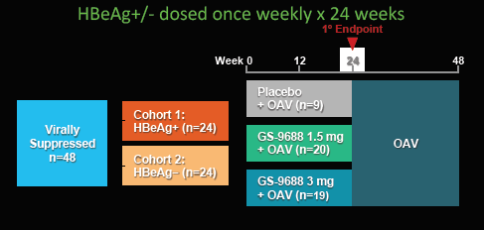
Toll-Like Receptor 8 Agonist (TLR8)
GS-9688 in NA Suppressed Patients
HBsAg Change from Baseline
3 mg
1.5 mg PBO 3 mg 1.5 mg
PBO
0.2
0.2
0.1
0.1
0.0
0.0
-0.1
-0.1
-0.2
-0.2
-0.3
-0.3
HBeAg−
HBeAg+
-1.4
Week 12 Week 24
Cytokine Induction With GS-9688
Placebo GS-9688 1.5 mg GS-9688 3 mg
IL-12p40 IL-1RA IFNγ
p <0.001 p <0.001 p <0.001 p <0.001 p <0.001
HBsAg loss in 2 HBeAg-­‐ patients (one from each treatment arm at Weeks 24, 48)
HBeAg loss in 1 patient (Week 24)
Dose-­‐dependent increases in serum cytokines observed in GS-­‐9688 treatment groups
p <0.001 p <0.01
p <0.001 p <0.001
p <0.001 p <0.001
p <0.001 p <0.001
p <0.01
p=0.04
Median Fold Change From Baseline (Q1, Q3)
15
60
15
p=0.02
p=0.11
p=0.17
10
40
10
5
20
5
0
0
0
Promising approach, await further studies
Day 1 + 4 h Week 23 + 4 h Day 1 + 4 h Week 23 + 4 h Day 1 + 4 h
Week 23 + 4 h
Gane et al Abstract 0697
Courtesy of Marc Ghany, MD

Slide 49
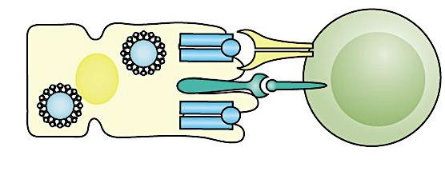
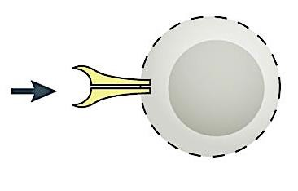
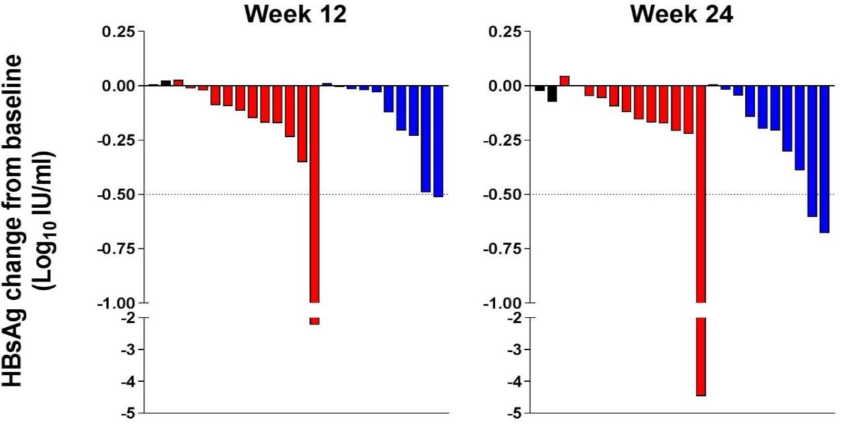
PD1 blockade
HLA+HBV peptide TCR
CHB characterized by immune exhaustion
PDL1 blockade should restore effective intra-hepatic HBV-specific T-cell responses
Hepatocyte
HBV
PD-L1
PD-1
Exhausted HBV-specific T cell
Single dose IV nivolumab 0.3mg/kg in CHB
  20/22 had reduction in HBsAg
  One functional cure
  Overall effect was small
Gane E, et al. J Hepatol 2019; 71: 900–7
Dose will be limited by IR-AEs which can be
prolonged and life-threatening
  ACTG study exploring repeated doses
  Need new approaches to PD1/PDL1 blockade
Anti-PD1
Anti-PD1+GS-4774
Anti-PD1
Anti-PD1+GS-4774
-0.30
-0.16
-0.48
-0.25
HBV Forum 6, Boston Nov 2019

Slide 50
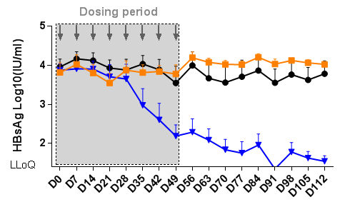
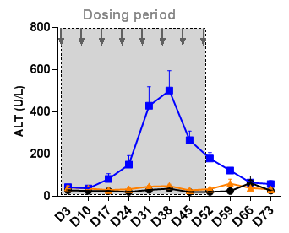
PD1/L1 blockade: new approaches at AALSD 2019
Inhibition of PD-L1 synthesis by LNA (Abstract #691)
Control
Anti-PD-L1 mAb
GalNAc PD-L1 SSO
GalNAc-conjugated LNA ASO directed against PD-L1
- Mice received 5 weekly subcut doses 5 mg/kg
50% reduction in PD-L1 maintained for 8 weeks
40-fold increase in liver HBV specific IFN-γ cells
2.4 log reduction in HBsAg which was sustained
Luangsay S et al. #691
Inactivation of PD-L1 by small molecule inhibitors
- Several small molecules can bind to and dimerise PD-L1 and inactivate the receptor
 short lived PD effect improving safety if IR-AEs develop
Ganesan A, et al. Nature (Scientific Reports). 2019; 9:12392,
HBV Forum 6, Boston Nov 2019

Slide 51






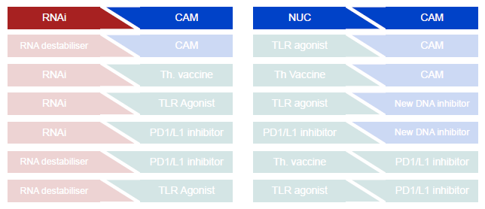
HBV CURE Combination Studies
Replication inhibition
Antigen reduction
Immune stimulation
±
±
RNAi
CAM
NUC
CAM
6th ANRS HBV Cure Workshop 2019

Slide 52
Compounds Historical for Chronic Hepatitis B
FAMILY/DRUG NAME | MECHANISM | COMPANY | WEBSITE | USA STATUS
Interferons: Mimic infection-fighting immune substances naturally produced in the body.
Intron A (Interferon alfa-2b) | Immunomodulator | Merck, USA | merck.com | Approved 1991
Pegasys (Peginterferon alfa-2a) | Immunomodulator | Genentech, USA | gene.com | Approved 2005
Hepatitis B Foundation

Slide 53
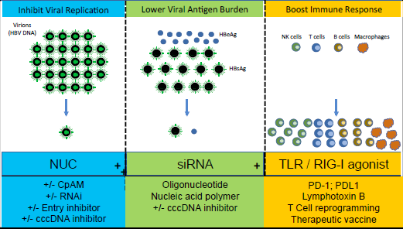
Pathways to Achieving Functional Cure
Courtesy of Marc Ghany, MD

Slide 54
Steatohepatitis Worsens HBV Liver Injury
Liver biopsies from 420 adults enrolled in North American cohort study scored for inflammation, fibrosis and NAFLD
Fibrosis stage by severity of NAFLD
 |  | Advanced Fibrosis (score≥3)
Variables | N | Unadjusted Risk Ratio (95%CI) N=366 | P | Adjusted Risk Ratio (95%CI) N=342 | P
No steatosis | 249 | 0.6 (0.3, 1.1) | 0.003 | 0.5 (0.3, 0.9) | 0.002
Steatosis | 71
Steatohepatitis | 55 | 1.7 (1.1, 2.5) |  | 1.6 (1.1, 2.4)
Age, per 10 years | 375 | 1.1 (1.0, 1.3) | 0.1 | 1.2 (1.1, 1.4) | 0.003
Sex (versus Female) Male | 141 234 | 1.7 (1.1, 2.6) | 0.02 | 1.4 (1.0, 2.1) | 0.08
HBV DNA, per log10 IU/mL | 375 | 1.1 (1.0, 1.2) | 0.02 | 1.2 (1.1, 1.3) | 0.004
ALT, per log2 U/L | 342 | 1.3 (1.2, 1.5) | <0.001 | 1.3 (1.1, 1.5) | <0.001
Perisinusoidal Fibrosis Score
2
Ishak Fibrosis Score
P=0.08
6 3 17
5 and 6
3 and 4
1 and 2
0
2
P<0.001
1
1
0 100%
100%
44
9
80%
16
23
80%
16
19
60%
60%
55
70
40%
32
82 76 25
40%
52
20%
20%
23
0%
0%
19
12
No steatosis Steatosis Steatohepatitis
No steatosis Steatosis Steatohepatitis
n=238 n=79 n=58
n=238 n=79 n=58
Implications for clinical practice: Important to screen and manage
metabolic abnormalities to prevent liver disease progression
Courtesy of Marc Ghany, MD
Khalili et al Abstract 0162

Slide 55
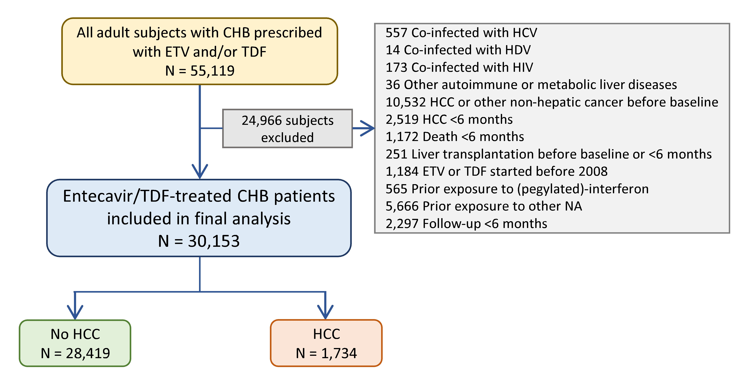
Association Between Anti-Platelet
Therapy and HCC Risk in HBV patients
Retrospective cohort study in patients receiving entecavir or tenofovir for ≥6 months
Parameters | Multivariable analysis^
 | Adjusted HR | 95% CI | P value
Antiplatelet# | 0.83 | 0.72 – 0.95 | 0.007
Aspirin monotherapy# |  | Referent
Non-user# | 1.12 | 0.96 – 1.30 | 0.152
DAPT# | 0.72 | 0.54 – 0.97 | 0.029
Yip et al Abstract 0934
Implications for clinical practice:
Provocative findings, need further confirmation
Courtesy of Marc Ghany, MD

Slide 56
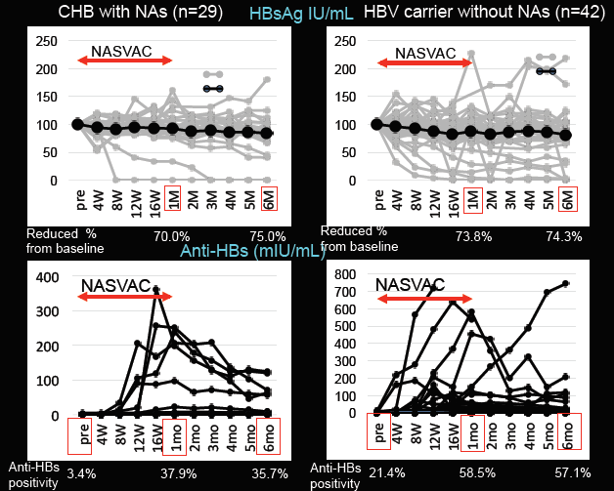
Therapeutic HBV Vaccine
NASVAC: contains HBsAg and HBcAg
Administered intranasally 10 times, bi- weekly to NA-suppressed patients and inactive carriers
Efficacy
~3/4 had 20% decline in HBsAg
~1/3 developed anti-HBs
2 patients in each group lost HBsAg
Promising immune therapy for achieving functional cure
Courtesy of Marc Ghany, MD
Yoshida et al Abstract 0088

Slide 57
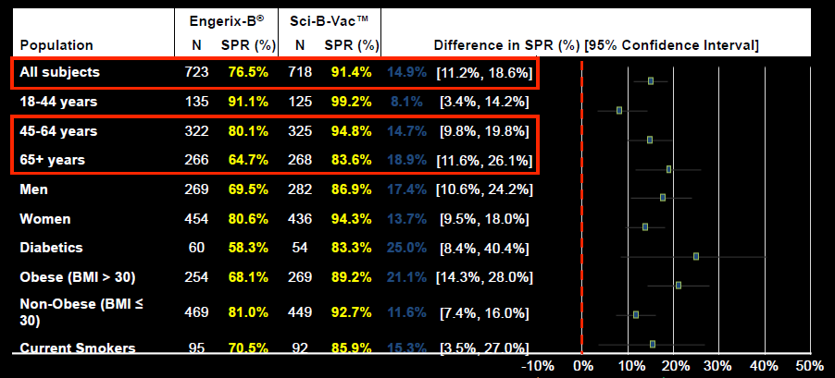

Trivalent HBV Vaccine Superior to
Monovalent Vaccine
Promising HBV vaccine with higher response rates in diﬃcult to vaccinate populations
Courtesy of Marc Ghany, MD
Langley et al Abstract LP13

Slide 58

Impact of Regular Follow-­up on Liver Cancer
Mortality in Patients with Chronic Hepatitis B
National Health Insurance Cohort Study in Korea
Implications for clinical practice: Reinforce need to screen patients with chronic hepatitis B
Shim et al Abstract 0159
Courtesy of Marc Ghany, MD

Slide 59
Delta Hepatitis
Test all HBsAg + for anti-HDV
70% risk of cirrhosis, HCC, liver failure, liver transplant or death in < 10 years
Best treatment now is PEG INF with durable viral response at 20%
(HDV RNA negative) off treatment

Slide 60

Bulevirtide (Myrcludex B) plus Peginterferon alfa-2a or Tenofovir for Delta Hepatitis
Promising results; May require long-term administration
Courtesy of Marc Ghany, MD
Wedemeyer et al Abstract 0085

Slide 61

Lonafarnib, Ritonavir and Peginterferon Lambda for Delta Hepatitis
Phase 2a, open-label, prospective treatment trial x 24 weeks
Efficacy
At the end of therapy (n=19), median HDV RNA decline was 3.4 log IU/mL (p<0.0001) 10/19 (53%) patients achieved HDV RNA undetectable or below LLOQ in serum
Safety
GI symptoms most common AEs
Hyperbilirubinemia
Dose reduction occurred in 3 patients
Discontinuation of therapy occurred in 4 patients
Promising results, await longer follow-up
Courtesy of Marc Ghany, MD
Koh et al Abstract L08

Slide 62
AASLD 2019 Conclusions On New Medications
Several promising candidates already in Phase II
  Will CAMs + NUC be enough to clear HBsAg?
  Will siRNAs achieve off-treatment HBsAg loss?
  Will reports of ALT elevations with some CAMs and siRNAs be deemed agent specific or become a class dose-limiting effect
  How should the immunomodulators be used?
  Will PD1 blockade be safe at the dose needed to clear HBsAg?
  Which combinations should be prioritized in Platform studies and in which patient populations?
HBV Forum 6, Boston Nov 2019

Slide 63
HBV Summary
Steatohepatitis worsens HBV liver disease
Many promising therapeutic approaches to achieve functional cure
  Combination therapy will be needed
    First Triple in combo is iRNA CpAMs and Nucs
  Optimal combination unknown
    iRNAs and CpAMS are the backbones
HCC surveillance reduces HCC mortality
  US quality with triple biomarker panels is best using GALAD score (RGG)
Antiplatelet therapy may lower HCC risk in NA-suppressed patients
  Double or triple ?
More effective vaccine for difficult to vaccinate populations
Dynavax ! HEPLISAV-B !
Promising therapies for delta virus

Slide 64
Special thanks to:
CLDF, PACE Med, SCSG leaders
HBV Forum
Dr Ed Gane, New Zealand Liver Transplant Unit
Dr Marc Ghany, NIH Liver Diseases Branch
Dr Anuj Gaggar, Audrey Lau, Gilead Sciences
Dr Anna Maria Geretti, Cynthia Wat, Roche
Dr Anna Bakardjiev, VIR Technology
Drs Uri Lopatin, Rich Colonno, Assembly Bio
Bruce Given, Arrowhead Pharmaceuticals and the JNJ Janssen Team

Slide 65
687
COMBINATION TREATMENT OF LIVER-TARGETED HBV LOCKED NUCLEIC ACID ANTISENSE OLIGONUCLEOTIDE AND TLR7 AGONIST RO7020531 LEADS TO PROLONGED OFF-TREATMENT ANTIVIRAL EFFECT IN THE AAV-HBV MOUSE MODEL
ANALYSIS OF FACTORS INFLUENCING THE EFFICACY AND SAFETY OF GLS4 TREATMENT IN PATIENTS WITH CHRONIC HEPATITIS B
A NOVEL LIVER-DIRECTED LOCKED NUCLEIC ACID TARGETING PD-L1 EXPRESSION REVERTS HBV-SPECIFIC IMMUNE TOLERANCE AND INDUCES SUSTAINED CLEARANCE OF HBV INFECTION
SAFETY, PHARMACOKINETIC, PHARMACODYNAMIC AND VIRAL DATA AFTER 6-WEEKS OF DOSING WITH TLR7 AGONIST RO7020531 IN CHRONIC HEPATITIS B DUAL AGONIST OF FARNESOID X RECEPTOR AND G PROTEIN-COUPLED RECEPTOR TGR5 INHIBITS HEPATITIS B VIRUS INFECTION
RESULTS AFTER 12 WEEKS TREATMENT OF MULTIPLE DOSES OF GSK3389404 IN CHRONIC HEPATITIS B (CHB) SUBJECTS ON STABLE NUCLEOS(T)IDE THERAPY IN A PHASE 2a DOUBLE-BLIND, PLACEBO-CONTROLLED STUDY
DOSE RESPONSE WITH THE RNA INTERFERENCE (RNAi) THERAPY JNJ-3989 COMBINED WITH NUCLEOS(T)IDE ANALOGUE (NA) TREATMENT IN EXPANDED
COHORTS OF PATIENTS (PTS) WITH CHRONIC HEPATITIS B (CHB)
EFFICACY AND SAFETY OF ORAL TLR8 AGONIST GS-9688 IN VIRALLY-SUPPRESSED ADULT PATIENTS WITH CHRONIC HEPATITIS B: A PHASE 2, RANDOMIZED, DOUBLE-BLIND PLACEBO-CONTROLLED, MULTI-CENTER STUDY
INTERIM RESULTS OF A PHASE 1 STUDY OF RO7062931, A NOVEL LIVER-TARGETED SINGLE-STRANDED OLIGONUCLEOTIDE (SSO) WITH LOCKED NUCLEIC ACID (LNA) THAT TARGETS HBV TRANSCRIPTS.
PRECLINICAL ASSESSMENT OF A NOVEL CAPSID ASSEMBLY MODULATOR, ALG-001075, DEMONSTRATES BEST-IN-CLASS IN VITRO POTENCY AND IN VIVO ANTIVIRAL EFFICACY
PHASE 2a, RANDOMIZED, DOUBLE-BLIND, PLACEBO-CONTROLLED STUDY OF AN ANTISENSE INHIBITOR (ISIS 505358) IN TREATMENT-NAÏVE CHRONIC HEPATITIS B (CHB) PATIENTS: SAFETY AND ANTIVIRAL EFFICACY
A NOVEL HBV CAPSID INHIBITOR COMPOUND SERIES DEMONSTRATES IMPROVED INHIBITION OF HBV WT AND T33N CORE PROTEIN VARIANT AND SHOWS A UNIQUE BINDING MODE TO CORE PROTEIN
PRECLINICAL ASSESSMENT OF POTENCY AND EFFICACY OF A NOVEL CLASS-II CAPSID ASSEMBLY MODULATOR ALG-001024 LIVER-TARGETED INHIBITION OF PAPD5 AND PAPD7 LEADS TO SUSTAINABLE HBsAg REDUCTION IN THE AAV-HBV MOUSE MODEL.
ONGOING ANALYSIS OF FUNCTIONAL CONTROL / CURE OF HBV AND HDV INFECTION FOLLOWING REP 2139-CA AND PEGYLATED INTERFERON ALPHA-2a THERAPY IN PATIENTS WITH CHRONIC HBV / HDV CO-INFECTION: 3-YEAR FOLLOW-UP RESULTS FROM THE REP 301-LTF STUDY
PERIPHERAL IMMUNE RESPONSES TO TOLL-LIKE RECEPTOR 8 AGONIST GS-9688 IN PATIENTS WITH CHRONIC HEPATITIS B
ANTI-HBV ACTIVITY OF 7-DEAZAADENINE RIBONUCLEOSIDE DERIVEATIVE IN IN VITRO AND IN VIVO
AN IN-SILICO DISEASE MODEL FOR THE DEVELOPMENT OF FXR AGONIST EYP001 AS A THERAPY FOR HBV INFECTION
SAFETY AND ANTIVIRAL EFFECT OF THE FARNESOID X RECEPTOR AGONIST EYP001 IN CHRONIC HEPATITIS B PATIENTS: A RANDOMISED PHASE 1b STUDY
META-ANALYSIS OF TWO PHASE 1b RANDOMIZED, DOUBLE-BLIND, PLACEBO CONTROLLED CLINICAL TRIALS OF THE HBV THERAPEUTIC VACCINES TG1050 AND T101 DEVELOPED IN EUROPE/CANADA OR CHINA.
IDENTIFICATION OF MIRNAS THAT REGULATE HEPATITIS B VIRUS REPLICATION IN VITRO
CLINICAL FEATURES OF HEPATITIS B PATIENTS AT IMMUNE-TOLERANCE PHASE WITH BASAL CORE PROMOTER AND/OR PRECORE MUTATIONS
SERUM IMMUNOLOGICAL PROFILE ASSOCIATED WITH HBEAG SEROCONVERSION IN CHRONIC HEPATITIS B PATIENTS.
688
691
692
694
695
696
697
698
699
700
701
703
704
705
706
707
708
709
710
1032
1036
1039

Slide 66
85
SAFETY AND EFFICACY OF 10mg (HIGH-DOSE) BULEVIRTIDE (MYRCLUDEX B) IN COMBINATION WITH PEG-INTERFERON ALPHA 2a OR TENOFOVIR IN PATIENTS ITH CHRONIC HBV/HDV CO-INFECTION: WEEK 24 INTERIM RESULTS OF THE MYR203 EXTENSION STUDY.
EFFICIENT SILENCING OF HEPATITIS B VIRUS S GENE THROUGH CRISPR-MEDIATED BASE EDITING
IN VITRO CHARACTERIZATION OF EYP001 A NOVEL, POTENT AND SELECTIVE FXR AGONIST ENTERING PHASE 2 CLINICAL TRIALS IN CHRONIC HEPATITIS B
INDUCTION OF ANTI-HBS AND REDUCTION OF HBSAG BY NASAL ADMINISTRATION OF A THERAPEUTIC VACCINE CONTAINING HBSAG AND HBCAG (NASVAC) IN
PATIENTS WITH CHRONIC HBV INFECTION
JNJ-64530440 (JNJ-0440), A NOVEL CLASS N CAPSID ASSEMBLY MODULATOR (CAM-N): SAFETY, TOLERABILITY, PHARMACOKINETICS (PK), AND ANTIVIRAL ACTIVITY OF MULTIPLE ASCENDING DOSES IN PATIENTS (PTS) WITH CHRONIC HEPATITIS B (CHB)
COMBINATION THERAPY WITH CAPSID ALLOSTERIC MODULATOR AND INTERFERON ALPHA PROMOTES INNATE IMMUNE RESPONSE IN HBV-INFECTED HEPATOCYTES
SYNERGISTIC SUPPRESSION OF HDV PERSISTENCE IN VITRO BY CO-TREATMENT WITH INVESTIGATIONAL DRUGS TARGETING BOTH EXTRACELLULAR AND CELL DIVISION MEDIATED SPREADING PATHWAYS
A PHASE 2 STUDY OF LONAFARNIB, RITONAVIR AND PEGINTERFERON LAMBDA FOR 24 WEEKS: INTERIM END-OF-TREATMENT RESULTS FROM THE LIFT HDV
STUDY
CONTINUED THERAPY WITH ABI-H0731+NRTI RESULTS IN SEQUENTIAL REDUCTION/LOSS OF HBV DNA, HBV RNA, HBeAg, HBcrAg AND HBsAg IN HBeAg POSITIVE PATIENTS
FIRST CLINICAL EXPERIENCE WITH RNA INTERFERENCE [RNAi]-BASED TRIPLE COMBINATION THERAPY IN CHRONIC HEPATITIS B (CHB): JNJ-73763989 (JNJ-3989), JNJ-56136379 (JNJ-6379) AND A NUCLEOS(T)IDE ANALOGUE (NA)
SAFETY, TOLERABILITY, PHARMACOKINETICS (PK), AND ANTIVIRAL ACTIVITY OF THE CAPSID INHIBITOR (CI) AB-506 IN HEALTHY SUBJECTS (HS) AND CHRONIC HEPATITIS B (CHB) SUBJECTS
CHARACTERIZATION OF HDV, HBsAg AND ALT KINETICS UNDER PEGINTERFERON-LAMBDA MONOTHERAPY: THE PHASE 2 LIMT STUDY
RAPID INCREASE IN ANTI-HBsAg TITERS AND HIGHER SEROPROTECTION RATES IN ADULTS IMMUNIZED WITH SCI-B-VAC COMPARED TO A MONOVALENT HEPATITIS B VACCINE: RESULTS FROM PROTECT — A DOUBLE-BLIND, RANDOMIZED, CONTROLLED, PHASE-3 STUDY
THE SECOND-GENERATION HEPATITIS B VIRUS (HBV) CORE INHIBITOR (CI) ABI-H2158 IS ASSOCIATED WITH POTENT ANTIVIRAL ACTIVITY IN A 14-DAY MONOTHERAPY STUDY IN HBeAg-POSITIVE PATIENTS WITH CHRONIC HEPATITIS B (CHB)
86
87
88
89
90
273
LO8
LP1
LP4
LP7
LP12
LP13
LP14

