Slide 1
Preliminary findings and recommendations

Slide 2
Finding on Palliative care
Good bases in the country:
PC development since 15 years
Soon new decree and new technical guidance
PHC development program
opportunity for rapid success !
Challenges:
Limited access to opioids (4.1mg per capita vs. 403mg in Germany), restrictive regulation
Limited training for doctors and nurses, opiophobia
No real multidisciplinary team (psy, physio, nutritionist)
Too limited funding, especially for home care and tertiary care

Slide 3
Recommendations on Palliative care
Improve access to opioids
Prescription for 1 (or 2) months
No restriction on type of patient (any disease/condition, even if not life-strengthening)
Extend range of opioids (pediatric, patches, fentanyl…)
WHO can assist in reviewing new decree and technical regulation
Develop PC capacities
At PHC level, including for home care
Include PC in training of nurses, extend training for all clinicians
Invest funds in PC → save money elsewhere (oncology treatment, emergencies, etc.)

Slide 4
Finding on diagnosis & treatment
Facility, equipment and human resources are adequate (under-utilization of treatment equipment and HR)
Essential list of medicine not updated, lack of national guidelines for treatment
HR: good level, need for training for onco-nurse and RTT
Multidisciplinary team (MDT) is not standard practice
Too high out-of-pocket expenditure for diagnosis
→ contribute to late diagnosis

Slide 5
Recommendations for diagnosis & treatment
Decrease out of pocket expenditure for diagnosis
Encourage centralization of care to improve quality
Accreditation of centers for cancer care (with MDT and PC)
Develop financing scheme that promote centralization and quality
Update EML based on new WHO EML
Adapt and translate resource-stratified guidelines (ASCO, NCCN)
Encourage formal training for oncology nurses and technicians

Slide 6
Finding on early detection
Low awareness about “early diagnosis” at all levels

Slide 7
Early diagnosis program
1st symptoms
1st visit to doctor
1st treatment
Diagnosis
time
“Access delay”
“Diagnosis delay”
“Treatment delay”
Poor cancer awareness
Poor performance
Referral issues
Waiting lists
Financial barriers
Logistic barriers
Psycho-social barriers

Slide 8
Early diagnosis need to be in place before introducing screening
EARLY DIAGNOSIS (improve from stage 3 & 4 → to stage 2)
SCREENING
First symptoms appear
First visit to Doctor
diagnosis
treatment
Time
Initial Screening test
diagnosis
treatment
Time
Notes:
To introduce screening help to reduce the first delay on the slide (between first symptoms

Slide 9
Finding on screening
Investments in screening programs for cervix, breast, colorectal, prostate and thyroid (current cost 2.5M GEL)
Fragmented funding streams for screening, gap in funding for the diagnosis path, inefficiencies in test purchasing & commissioning
Coverage remains low
Very promising information system but with a key gap regarding people screened in private sector and screened-positive people followed-up in the private sector

Slide 10
Finding on screening
Cervical cancer screening:
Important quality improvement since 2015 in the NSC facility, unclear for others (centralization of laboratories?)
Colposcopy capacities remain low
Sabotaging of the screening because 40% of positive women refuse treatment of pre-cancer because too expensive
High incidence in Georgia (2 time more than W. Europe)
Breast cancer screening in the national center
Subsidized in women 40-70 every 2 years
Impressive effort in quality assurance and training
Issue with follow up of positive women because of cost of diagnosis procedures → inadequate (harmful) follow-up
Low incidence in Georgia (3 time less than W. Europe)

Slide 11
Finding on screening
Colorectal cancer screening
Too many steps in the screening algorithm (for iFOBT and for colonoscopy)
No full understanding that polyps removal prevent cancer. No reduction in mortality if this removal is not ensured (sabotage)
Low incidence in Georgia (4 time less than W. Europe)
Prostate cancer “management”
Unclear/inadequate criteria to perform management
Too many steps because of out-of-pocket payment
Low incidence in Georgia (5-6 time less than W. Europe)

Slide 12
Finding on thyroid cancer
Thyroid cancer “management”
For women only, aged 25-70. Unusual growing incidence (compare to W. Europe incidence)
Sex ratio 1:6 compared to 1:3 in the rest of the world
Inadequate criteria to perform management
High risk of overdiagnosis and overtreatment
80% of the case are managed in a single center
Many speculations about causes of “high incidence”

Slide 13
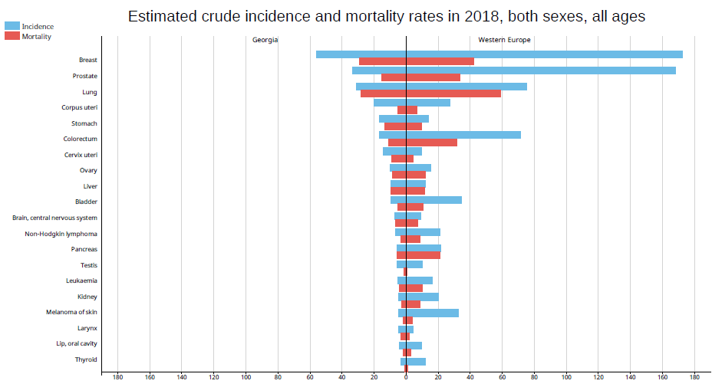
Crude incidence measured in Georgia: 15/100,000 (female)

Slide 14
Recommendation on early detection
Develop an early diagnosis program (good timing!)
Develop PHC capacity in identifying early cancer symptoms and refer adequately (clear pathways + training)
Ensure full access to diagnostic (part of UHC, fast access, reduce other barriers)
→ WHO can assist in setting up early diagnosis program
TO SAVE MONEY:
Shift from screening to early diagnosis - except for cervical cancer.
Consolidation of laboratory services and bulk purchasing of tests (PSA, iFOBT → for triage of symptomatic patients)

Slide 15
Where to save money (cont’)
Thyroid cancer
De-reimburse for diabetic, obese patients and other indications
De-reimburse surgery if prescribed out of international / new national guidelines to decrease unnecessary surgery rate
No expansion of thyroid U/S, particularly in PHC
Prostate cancer
De-reimburse in asymptomatic patients, but ensure free PSA and follow up in symptomatic patients
Encourage active surveillance practices to decrease unnecessary surgery rate

Slide 16
Where to save money (cont’)
Breast cancer
De-reimburse in asymptomatic patient (option: except women 50-70 years every 3 years)
Ensure full reimbursement of mammo, U/S and biopsy for all symptomatic patients (in chosen facilities to ensure quality)
Colorectal cancer
Ensure full reimbursement of diagnosis procedures
Single colonoscopy to remove polyps
When scaling-up screening :
Streamline pathway
Ensure endoscopy capacity

Slide 17
Recommendation on cancer screening
Prioritize cervical cancer screening
Ensure quality
Governance: screening management team (full time)
Consider accreditation of centers
Robust M&E (without key gaps → link with funding mechanisms), adequate quality indicators, regular analyses
Benchmarking and feedback, external & internal Q/A
Continuous training
HPV testing (pilot)
Algorithm to use: - HPV → ablative treatment
- HPV + PAP smear for triage → abv. Trt.

Slide 18
Recommendations (end)
Consider research on causes of increasing thyroid cancer incidence (role of risk factors and screening by U/S)
→ IARC can assist

Slide 19
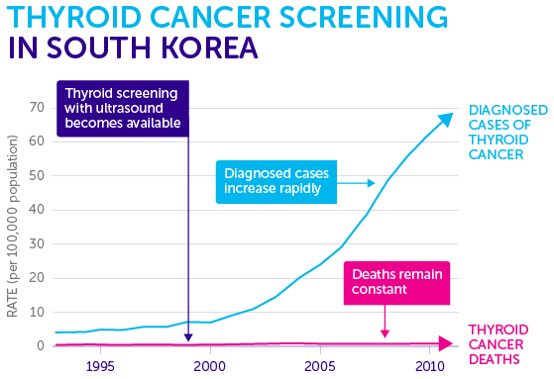
Recommendations (end)
Consider research on causes of increasing thyroid cancer incidence (role of risk factors and screening by U/S)
→ IARC can assist

Slide 20
Thanks for your attention

Slide 21
Preliminary recommendations

Slide 22

Secondary prevention of cancer
Two approaches to early detection:
Screening aim at identifying the disease before symptoms appears by applying a test to healthy populations.
Early diagnosis: aims at identifying the disease in patients through its very first symptoms.
WHO cancer control module on early detection

Slide 23
Screening v.s. early diagnosis

Slide 24
Understand the causes of delay
1st symptoms
1st visit to doctor
1st treatment
Diagnosis
time
“Access delay”
“Diagnosis delay”
“Treatment delay”
Poor cancer awareness
Poor performances
Lack of resources
Waiting lists
Referral issues
Financial barriers
Logistic barriers
Psycho-social barriers
Ask patients ! (interview 100 to 200 cancer patients)
→ Frequency of the barriers
→ Relative importance of each barrier

Slide 25
Address the causes of delay
1st symptoms
1st visit to doctor
1st treatment
Diagnosis
time
“Access delay”
“Diagnosis delay”
“Treatment delay”
Poor cancer awareness
Poor performances
Lack of resources
Waiting lists
Health education
Media campaigns
Increase resources (facilities, human resources)
Re-organize
Referral issues
Financial barriers
Training for professionals
Logistic barriers
Referral guidelines
Psycho-social barriers
Facilitate access:
transports, longer opening hours, etc
Make health services “patient friendly”
Health insurance, special programs

Slide 26





Screening : the importance of follow-up
Initial Screening test
Recall (inadequate test)
Screened positive
diagnosis
treatment
Time
$?
$?
Health system will deal with it…
→ Clear paths and procedures need to be established at all steps

Slide 27
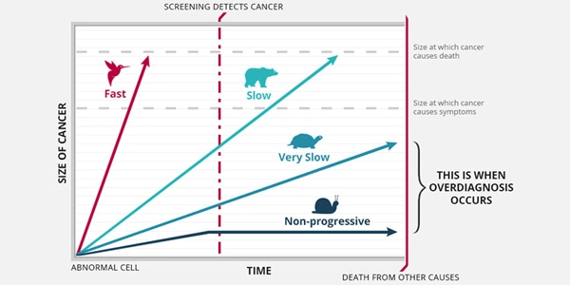
What is over-diagnosis ?
To be screened with PSA between 50 and 74 almost double your chance to be diagnosed with prostate cancer

Slide 28
Thyroid cancer screening :

Slide 29
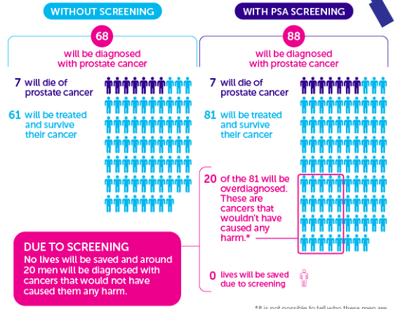
Prostate cancer screening : NOT recommended

Slide 30



WHO guidance on cancer early diagnosis and screening
Guide to cancer screening
(to be published)
Notes:
To help countries implementing early diagnosis programs. WHO has recently issued a “guide to cancer early diagnosis” that exists also in Russian.
Soon a similar guide on screening will be published that will help countries to decide when to screen and when not to screen.
In the meantime you can find WHO recommendation on mammography screening and cervical cancer screening in those 2 publications (the green for mammography and the pink for cervical cancer )

Slide 31
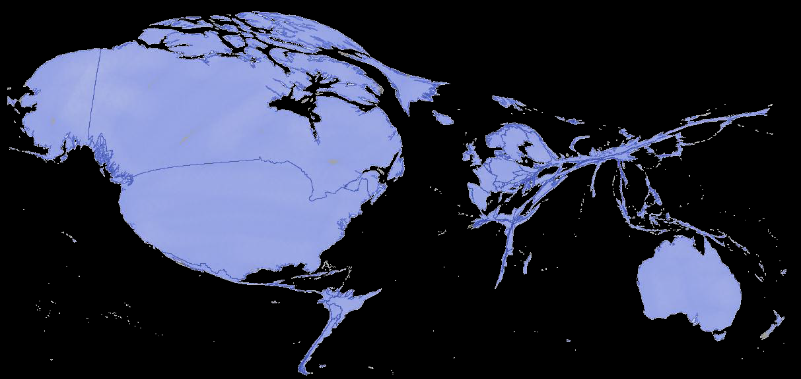
Country size based on oral opioid consumption per death from cancer or HIV in pain
Notes:
Here is a figure (from the Lancet Commission on Palliative Care and Pain Relief) that illustrate clearly the lack of access to opioid in the world and notably in eastern Europe
Source: Knaul FM, Farmer PE, Krakauer EL, De Lima L, Bhadelia A, Jiang Kwete X, Arreola-Ornelas H, Gómez-Dantés O, Rodriguez NM, Alleyne GAO, Connor SR, Hunter DJ, Lohman D, Radbruch L, Del Rocío Sáenz Madrigal M, Atun R, Foley KM, Frenk J, Jamison DT, Rajagopal MR; Lancet Commission on Palliative Care and Pain Relief Study Group. Alleviating the access abyss in palliative care and pain relief-an imperative of universal health coverage: the Lancet Commission report. Lancet. 2018 Apr 7;391(10128):1391-1454.

Slide 32
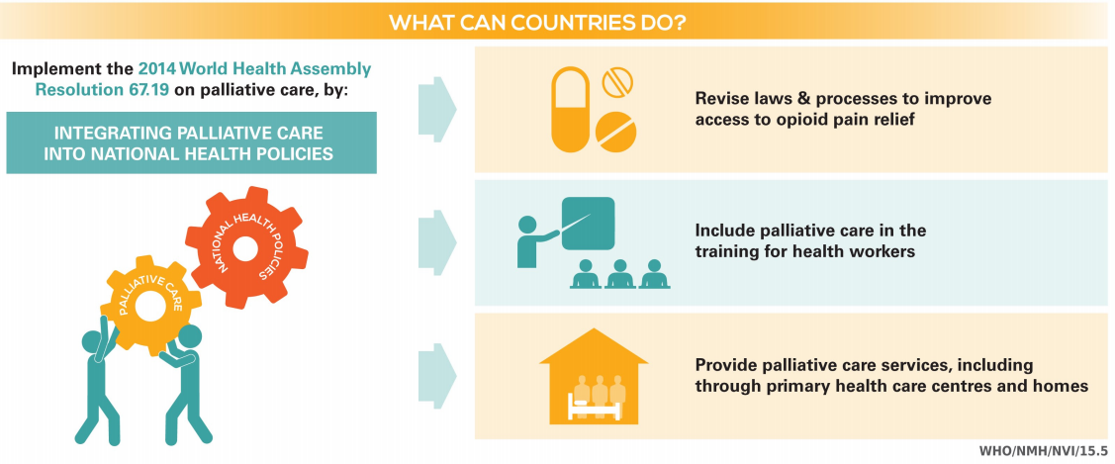
2014 WHA Resolution on Palliative Care
Notes:
In 2014 the member stated of WHO adopted a resolution on palliative care and committed to:
Integrating palliative care into national health policies
Revise laws & prcesses to improve access to opioids
Include palliative care in traning for health staff
Develop palliative care services, notably at PHC level

Slide 33








WHO guidance on palliative care
Armenian
Bulgarian
Georgian
Hungarian
Polish
Russian
Serbian
Slovak
Slovenian
Turkish
Notes:
Since the 2014 resolution, WHO has issued a lot of new guidelines and tools to help countries developing palliative care which are presented here. (the one in blue in the middle is translated in Russian and the others will be translated as soon as funding is available)

Slide 34
Prostate cancer screening
3000 men screened with PSA:
90-120 men: Trt result in erectile / urinary pbs
6 men: Serious CVD event
3 men: Blood clot in leg/lung
1 man die from surgery
2 men, maybe 3 avoid death from prostate cancer
Source: USPSTF
Benefits
Reducing cancer deaths
Identifying cancer early
Harms
False positives
sequelae
Overdiagnosis
Health service prioritization
Notes:
Most of the trials were performed be- fore widespread use of anti-estrogens and modern chemo- therapy with the exception of the Canadian National Breast Screening Study and the age trial [10,11].

Slide 35
Benefits & harms of cancer screening
Benefits
Reducing cancer deaths
Identifying cancer early
Harms
False positives
False negative
Overdiagnosis
Health service prioritization
False positives
With/without invasive procedures:
Cancer that won’t kill the patient
Cancer missed by screening
Costs, human ressources not used for more efficient programs
Overdiagnosis
False negative
Health service prioritization

Slide 36






Breast Cancer Screening in a Central Asian Country
~110 women won’t have their prognosis changed
150 with confirmed cancer found on screening
~10 women avoid death from breast cancer thanks to screening
population
1 million
50,000 women screened with mammography
5,000 with abnormal screening test
150 women will require treatment
4,850 require follow-up & found to have no abnormality
30 women will be overdiagnosed !
Breast ca screening costs in US: ~$15mil per 1mil population
Breast treatment costs in US: ~ $20mil per 1mil population
Notes:
http://www.cdc.gov/nccdphp/publications/factsheets/Prevention/pdf/cancer.pdf
http://www.ncbi.nlm.nih.gov/pubmed/23303200

Slide 37
Key points about screening
Clinicians, politicians and the public generally overestimate the benefits of screening and largely underestimated its harms, especially in case of suboptimal quality
Quality assurance is a must in any screening program to limit harms and ensure minimal benefit → Monitoring & evaluation is very important, despite it is not easy.
The need of early diagnosis is generally underestimated. In a certain extend it is also a matter of quality.
Improvement in treatment make screening (i.e. “very early” detection) of some cancer (breast cancer) less and less needed

