Slide 1
ISSA Technical Commission on Health Meeting – Healthcare System in Indonesia
dr. Maya Amiarny Rusady
Director of Health Care Security
Geneva, June 2019

Slide 2
TODAY’S AGENDA
BRIEF INFTRODUCTION TO INDONESIA’S HEALTH SYSTEM
CURRENT STATUS OF JKN
JKN CHALLENGES

Slide 3
BRIEF INTRODUCTION TO INDONESIA’S HEALTH SYSTEM
Notes:
re

Slide 4
Indonesia’s Health System
Pres. Reg. No 72/2012
Demand↑
JKN improves financing capacity
Programme + Strategic Purchasing
Health Research & Development
Individual & Public Health
Health Human Resources
Regulation and Information Management
Public Empowerment
Drugs, Medical Devices, Food
Health Financing
Individual Health
Contribution
Ability + Willingness to Pay
Multiplier Effect
The need to develop other sub-system to achieve effectiveness, efficiency, and health financing sustainability
Effectiveness, efficiency and sustainability
Central + Local Budget
Programme + Strategic Purchasing
National Health System →
Integration between sub-systems
Focuses on revitalising basic healthcare
Adaptive & Innovative
Support from Central & Local Government
Public Health
Supply

Slide 5








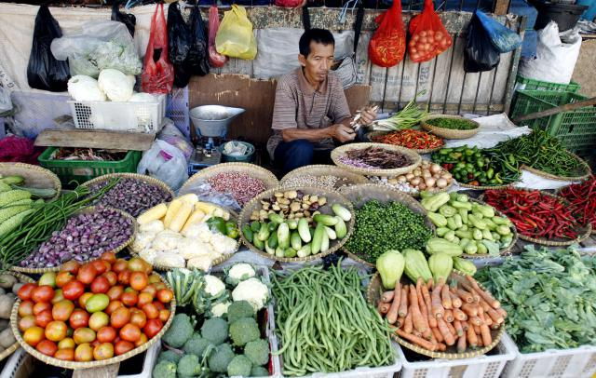

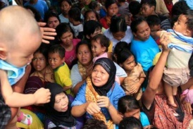
JKN integrates health insurance schemes into a single program
Social health insurance for civil servants
Social health insurance for military
and police personnels
Social health insurance run by
local government
Social insurance for private sector workers
National Health Security
Social health insurance for the poor
The uninsured (informal workers)

Slide 6
Health care system & payment under JKN scheme
Tertiary care
Type A & B hospitals
Secondary care
Type C & D hospitals
Primary care
Public health centers, GP, clinics
Diagnosis-Related Groups
(Indonesia Case-Based Groups/INA-CBGs)
On medical indications
Commitment-based capitation
Package tariff for certain services

Slide 7
CURRENT STATUS OF JKN

Slide 8
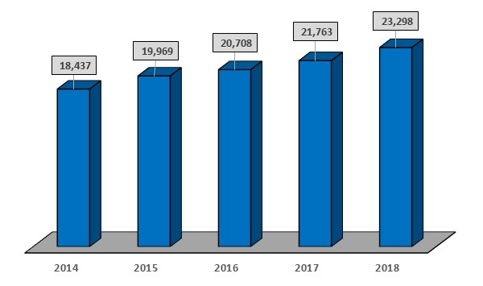
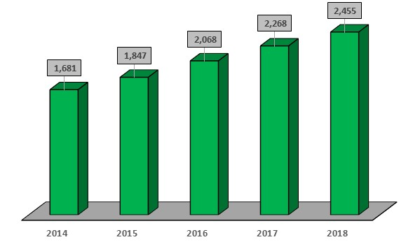
JKN health care facilities 2014-2019
Primary care facilities
Secondary care facilities
23,019
2,489
Source: BPJS Kesehatan per March 31st 2019
Source: BPJS Kesehatan per March 31st 2019
20.708
Number of primary care facilities
Number of secondary care facilities
Source: Deputy of Planning & Evaluation, BPJS Kesehatan
Notes:
Primary care facilities include public health centers (Puskesmas), general practitioner, clinics, type D primary hospital and dentists
2018 figure unaudited

Slide 9
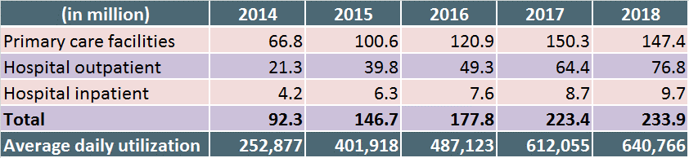
Healthcare utilization
874,1
Avg. 2018 utilization
Total 5 year healthcare utilization
million
640.766
Per Day
Source: Deputy of Planning and Evaluation BPJS Kesehatan
Note: 2018 figure unaudited

Slide 10
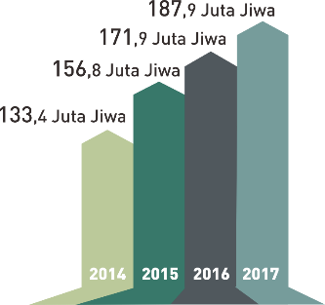
JKN membership per June 1st 2019
222.002.996 members
*Indonesia population per 1st semester 2018 is 263,950,794
Source: Ministry of Home Affairs
187.9 million
171.9 million
156.8 million
133.4 million
100% population (11.4 mil.)
85% population (80.6 mil.)
Source: BPJS Kesehatan

Slide 11
JKN membership per segment
Segment | Membership (in million)
 | 2014 | 2015 | 2016 | 2017 | 2018*
The poor | 86.4 | 87.8 | 91.1 | 92.3 | 92.1
Formal workers | 24.3 | 37.9 | 41.0 | 44.9 | 49.8
Informal | 9.0 | 15.1 | 19.3 | 25.4 | 31.1
Local schemes | 8.8 | 11.2 | 15.4 | 20.3 | 29.9
Non-workers | 4.8 | 4.8 | 5.1 | 5.1 | 5.1
Total | 133.4 | 156.8 | 171.9 | 187.9 | 197.3
Source: BPJS Kesehatan Annual Report
*Unaudited
Note: quota for the poor in 2019 is 96.6 million members

Slide 12






JKN contribution structure
Type of membership Contribution Source
23,000 IDR (1.62 USD)
per member
per month (pmpm)
Central & local
government
Government Subsidy for poor & near poor
% of salary:
3% employer
2% employee
Employer &
Employee
Soldiers, police, civil servants, retirees
% of salary:
4% employer
1% employee
Employer &
Employee
Private workers
3rd class: 25,500 IDR (1.8 USD) pmpm
2nd class: 51,000 IDR (3.59 USD) pmpm
1st class: 80,000 IDR (5.64 USD) pmpm
Out-of-pocket
Informal workers

Slide 13
JKN CHALLENGES

Slide 14
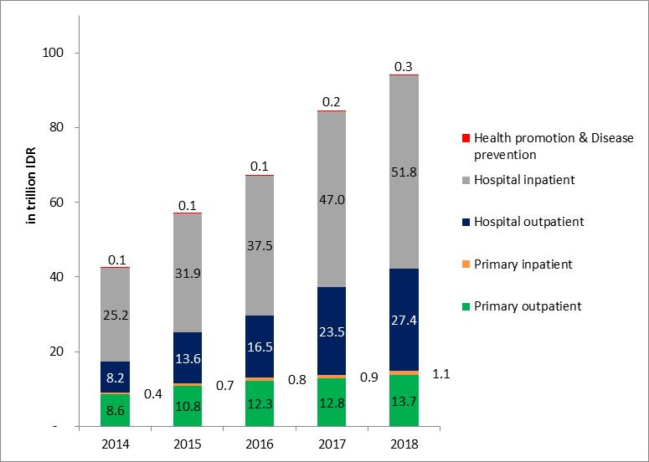
Financial sustainability
JKN health expenditure 2014-2018
94.3 T
84.4 T
67.2 T
57.1 T
42.7 T
*unaudited
40.7 T
Source: BPJS Kesehatan Financial Report
Income
52.7 T
67.4 T
74.2 T
82.0 T

Slide 15
Financial sustainability
No | Segments | Premium (per member per month)
 |  | Actuary | Government | Difference
1 | The poor | 36.000 | 23.000 | -13.000
2 | Informal
 | a. 1st class | 80.000 | 80.000 | -
 | b. 2nd class | 63.000 | 51.000 | -12.000
 | c. 3rd class | 53.000 | 25.500 | -27.500
3 | Formal
 | a. % deduct | 6% | 5% | -1%
 | b. Upper limit | 6 x non-taxable income | 8 million IDR
 | c. Lower limit | Local minimum wage | None
2016 (per member per month)
Premium | Cost
33.776 | 35.802
-2.026
2017 (per member per month)
Premium | Cost
34.119 | 39.744
-5.625
2018 (per member per month)
Premium | Cost
35.771 | 43.241
-7.470
Source: Social Security Council Policy Brief, May 2015
MAIN ROOT CAUSE

Slide 16
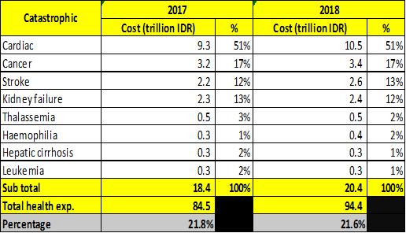
Morbidity and demographic transition
7%
9%
9%
8%
27%
Ageing Society
56%
37%
49%
33%
58%
66%
43%
Injuries Noncommunicable Communicable
Source: Indonesia Health Financing System Assessment-spend more, right and better, 2016, Policy Brief World Bank
Catastrophic expenditure January - December 2018 reached 20.4 trillion IDDR
Sub-optimal health promotion and disease prevention programs

Slide 17
Key for sustainability
Premium-side:
Actuarial soundness
is a must
Expenditure-side:
JKN benefit management, agreement on the definition of 'basic health need' while considering financial affordability
Trade-offs are inevitable, and decisions will need to strike the right balance between the proportion of the population covered, the range of services included, and the costs to be covered (Margaret Chan, 2010)
WHO, 2010, The World Health Report: Health System Financing, the Path to UHC, Switzerland

Slide 18
Conclusion
JKN is a strategic program set by the government proven to increase quality of life by increasing access to formal healthcare, protecting the population from catastrophic health expenditure and poverty
JKN requires continuous support from all stakeholders to achieve universal health coverage towards a robust health development
We look forward to inputs and constructive critics to improve the quality of care and the sustainability of JKN

Slide 19






Thank you
Now, JKN is in your hands!
www.bpjs-kesehatan.go.id

