Slide 1



National Statistics Development Strategy 2020-2023 of Georgia
Alper Gucumengil, International Expert
Governance Reform Fund (GRF)
United Nations Development Programme (UNDP)

Slide 2
Outline
Why Statistics?
Challenges in Official Statistics
NSDS Overview
Why is NSDS approach needed?
International Frameworks and Requirements
Draft Concept of 2020-2023 NSDS Georgia
Mission and Vision, Values
Strategic Directions and Objectives
Working Groups concept

Slide 3
Why Statistics?
Statistics:
Crucial in the fight against poverty, economic inequality, environmental problems etc.
Indispensable tool for evidence-based decision making
“Indispensable Tool”
“Better Data Better Lives”, UN
“If you can’t measure it, you can’t manage it”, R. Kaplan-D. Nort
‘Statistics is the key of understanding the past, governing today and planning the future’, TurkStat

Slide 4
Challenges in Official Statistics
Changing Conditions:
NSOs’ Position:
NSOs of all countries: under intense pressures
limited resources
changing needs and users
growing demands
Official statisticians need adequate competencies
Decision makers: under much more pressure
‘User Profiles’: different than before
Needs about comparable data among countries

Slide 5
NSDS Overview
Mission
Vision
Values
Monitoring and Evaluation Plan
Strategic Directions
Objectives
Action Plan

Slide 6
Mission-Vision-Values
Mission
Vision
“What can we do”? How ?”
“Where do we want to go”?
Why ?”
Concise and positive statements
Inspiring common vision of the future
Values
Creating a set of values

Slide 7



Mission-Vision-Values (cont.)
Mission of the NSO: reflect of the entire NSS
A vision statement: what an organization wants to become
Strategic vision: the desired future of system
Some examples:
Mission of Statistics Lithuania: ”To prepare and disseminate official statistics necessary for decision-making and to inform the public about issues relevant to the country”
Mission of CSO of Ireland: “Provide high quality information, both for evidence-based decision-making and to support accountability”
Vision of Statistics Denmark: “We envisage that in 2020 Statistics Denmark is transformed into a "generator of data and knowledge”…

Slide 8
Strategic Directions and Objectives
A results-based management approach:
Not reflect what is “desirable”
but
What is “absolutely important & feasible”.
strategic results we are aiming at
products needed to obtain these results
corresponding capacities to deliver these products

Slide 9
Action Plan
Who is going to do what
When – estimating the schedule
In what order – determining the sequence
What for – identifying and selecting indicators
How – defining resources needed

Slide 10
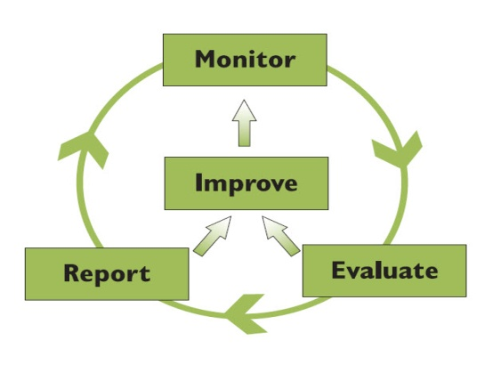
Monitoring and Evaluation Plan
Incorporate effective monitoring, evaluation and reporting mechanisms
Setting out the medium-term goals
developing appropriate indicators
establishing baselines, milestones and targets

Slide 11

Why is NSDS approach needed?
International approach developed by PARIS21 for developing countries
NSDSs provide a robust framework and action plan for the capacity development
Assess all statistical sectors and user needs
Provide a vision and strategic plan
Serve as a coherent framework for international support

Slide 12


International Frameworks and Requirements
UN Fundamental Principles of Official Statistics
Sustainable Development Goals (SDGs) Monitoring Process

Slide 13




International Frameworks and Requirements
European Neighborhood Policy (ENP)
The EU-Georgia Association Agreement (AA)
entered into force in July 2016
Harmonization Studies for EU Process
EU Methodologies/Classifications
ES Code of Practice
Global Assessment Recommendations

Slide 14

Draft Concept of NSDS 2020-2023 of Georgia

Slide 15
Mission and Vision
Mission
Vision
To produce and disseminate in effective manner high-quality official statistics based on user needs to inform good decision making
To establish open and transparent system, which promotes trust in users that the statistics, which is produced by Geostat are reliable, objective and free from any political interference.

Slide 16
Values
Our values are:
Professional Independence
Objectivity
Reliability
Data confidentiality and security
Efficiency
User focus

Slide 17
Strategic Directions
DIRECTION I: High quality official statistics to support good decision-making based on user needs
DIRECTION II: Effective statistical production processes
DIRECTION III: Building the statistical infrastructure and capacity development

Slide 18
Objectives under Direction I
DIRECTION I: High quality official statistics to support good decision-making based on user needs
Objective 1.
Production of reliable statistics, based on user needs
Objective 2. Improvement of methodology
Objective 3.
Data quality
Objective 5. Promote using statistics-
statistical literacy
Objective 4. Dissemination

Slide 19
Objectives under Direction II
Objective 5.
Policy for dissemination and communication…
Objective 4.
New data sources
Objective 3.
Use of administrative data
Objective 2.
Data collection system
Objective 1. Modernization of production process
DIRECTION II: Effective statistical production processes

Slide 20
Objectives under Direction III
DIRECTION III: Building the statistical infrastructure and capacity development
Objective 1. Amendment of the LOS
Objective 2. Sustainable IT systems
Objective 3. Human resource management
Objective 5. Registers and sampling frames
Objective 4. Attractive environment for personnel
Objective 7. Good image and trust in Statistics
Objective 6. Modern classification systems

Slide 21

Working Groups Concept

Slide 22
Rationale
Unified NSS in the country
A national policy document-NSDS
The Working Groups under High-Level Interagency Council
The draft NSDS including the tasks and action plan
give the feedback to finalize Strategy, Action Plan and M&E plan

Slide 23
Approach
Member Institutions: Geostat and Ministries/NBG/AoG
Working Group Members:
Head of Departments/Divisions of Geostat
Middle level Managers/Experts at Ministries/NBG/AoG
Period: 15 July-01 October 2019
At least two workshops (end of July and end of August)
Focus on detailed discussion of drafted action plan and M&E plan
Council Members will nominate their representatives for working groups

Slide 24
Tasks for WG Members
Participation in the Workshops
Providing the inputs to prepare the NSDS
Involvement in the development of working documents
Reporting/providing information to High-Level Interagency Council and project team
Support the work of financial expert

Slide 25
Thank you!
“Coming together is a beginning. Keeping together is progress. Working together is success.”
Henry Ford
American industrialist and pioneer of the assembly-line production method, 1863-1947
Alper Gucumengil, International Expert
Governance Reform Fund (GRF)
United Nations Development Programme (UNDP)
alpergucumengil@hotmail.com

