Slide 1
Report from the Technical Commission on Medical Care and Sickness Insurance
Technical Commission on Health
Mr. Fachmi Idris President Director, BPJS Kesehatan, Indonesia
13th ISSA Forum for Technical Commissions
26-27 June 2019 | Geneva, Switzerland

Slide 2
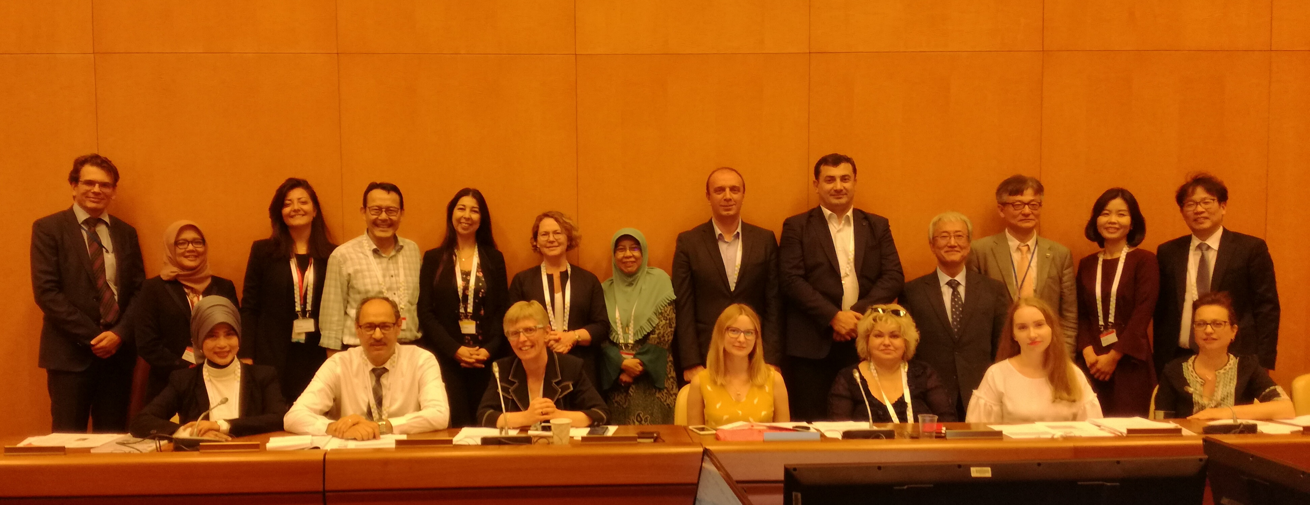

Slide 3
Agenda
Opening and welcome
Technical Report on ‘Aging –in-place and LTC’
Confirmation of work plan completion
Brainstorming on the next triennium work-plan
Overview presentation by BPJS-Kesehatan on the healthcare system in Indonesia
Any other business (AOB)
Big data event
Others

Slide 4
Discussion on the Technical Report
Agreement from the countries’ represented in the report on their respective section based on final round of consultation
Technical report endorsed by TC Health and to be released in the coming WSSF

Slide 5
Work-plan updates (1/3)
Contribution to ISSA Centre for Excellence
ISSA Guidelines (Almost Completed)
Participate in the preparation of new ISSA Guidelines on Error, Evasion and Fraud
Provide input for the review of the following ISSA Guidelines
Service Quality
Work Place Health Promotion
Information and Communication Technologies (contribute a new chapter on E-health to the ICT Guidelines)

Slide 6
Work-plan updates (2/3)
Contribution to the ISSA Research & Innovation (Completed)
Addressing the Global Challenges
Priority 1: Coverage extension
Good practices and innovative approaches
Priority 2: Long-term care and chronic diseases
Innovative approaches
Seminar in Oct 2017 by NHIS, Korea on LTC
Long-term care Webinar for Latin America, Nov 2018
Technical Report on Aging-in-place and LTC
( A total of 35 Innovative approaches were shared to date)

Slide 7
Work-plan updates (3/3)
C. Contribution and participation to ISSA conferences/events (almost Completed)
Regional Seminar in Korea, Oct 2017
ICT Conference in Casablanca, April 2018
LTC Webinar, Nov 2018
Contributions to Regional Social Security Fora
(Asia Pacific, Oct 2018 and Europe, May 2019)
World Social Security Forum Oct, 2019

Slide 8
On the Status of the implementation of the 2017-2019 Work Plan
TC Health
Acknowledges the completion of the work-plan for the triennium 2017-2019, and grant a project closure approval; and
Concur that all outstanding items have been appropriately addressed.

Slide 9
Brainstorming on the next triennium work-plan
Extension of coverage and contribution collection in the informal sector
Supply side and facilitating access to services:
Medical service provision in rural areas (e.g. availability of doctors)
Reducing access barriers (e.g. language barriers for refugees, migrants)
Shortage of nurse personnel
Rational use of medical devices, technologies and drugs
Improving integrity in the health care sector
Exchange of best practice and scientific researches

Slide 10
Overview presentation by BPJS-Kesehatan on the healthcare system in Indonesia
Major progress in coverage extension
Challenges regarding demography, financing and morbidity
Discussion
Any-other-business
Big data event
Others

Slide 11
Thank You

