Slide 1
COVID-19 update
4 March 2020

Slide 2
Current Situation (As of 04 Mar, 6AM Geneva Time)
Updates from last 24 hours
China:
120 new confirmed cases: 96 % (115) cases from Hubei
38 new deaths: Hubei(37), Inner Mongolia(1)
143 new suspected cases
Outside China:
2,075 new confirmed cases: Iran (Islamic Republic of)(835), Republic of Korea(516), Italy(466), United States of America(44), Germany(38), Spain(37), France(21), Japan(19), The United Kingdom(12), Netherlands(10), Sweden(9), Switzerland(7), Norway(7), Iceland(7), United Arab Emirates(6), Oman(6), Austria(6), Iraq(5), Denmark(3), Canada(3), Singapore(2), Israel(2), Czech Republic(2), Ukraine(1), Romania(1), Qatar(1), Pakistan(1), New Zealand(1), Ireland(1), India(1), Estonia(1), Ecuador(1), Croatia(1), Chile(1), Argentina (1)
49 new death: Italy (28), Iran (Islamic Republic of)(11), United States of America(5), Republic of Korea(4), France(1)
Globally, between 31 Dec 2019 - 04 Mar 2020
93,062 confirmed cases
3,198 deaths
China
80,422 confirmed cases
6,416 severe cases
2,984 deaths: Hubei(2871), Henan(22), Heilongjiang(13), Beijing(8), Guangdong(7), Hebei(6), Anhui(6), Shandong(6), Chongqing(6), Hainan(5), Hunan(4), Tianjin(3), Shanghai(3), Sichuan(3), Xinjiang(3), Guangxi(2), Guizhou(2), Yunnan(2), Gansu(2), Hong Kong SAR(2), Inner Mongolia(1), Liaoning(1), Jilin(1), Zhejiang(1), Fujian(1), Jiangxi(1), Shaanxi(1), Taipei and environs(1)
Outside China
12,640 cases from 75 countries
214 deaths: Italy (80), Iran (Islamic Republic of)(77), Republic of Korea(32), International conveyance (Diamond Princess)(6), Japan(6), United States of America(6), France(4), Australia(1), Philippines(1), Thailand(1)

Slide 3
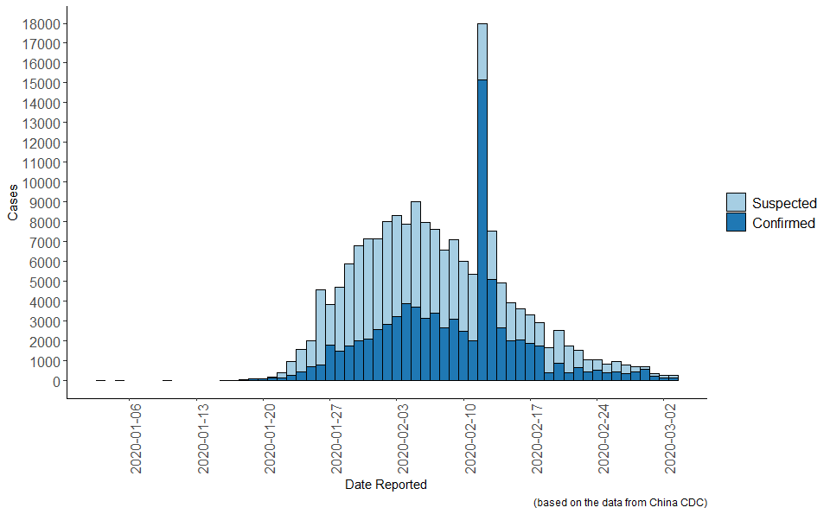
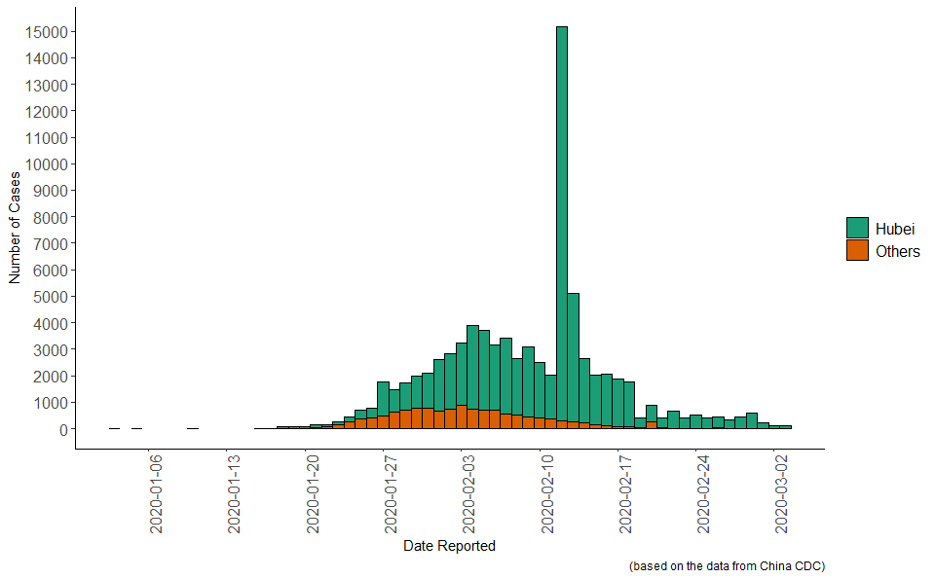
Number of cases by date of report in China
Number of cases (suspected and confirmed)
Number of confirmed cases (Hubei province vs. others)

Slide 4
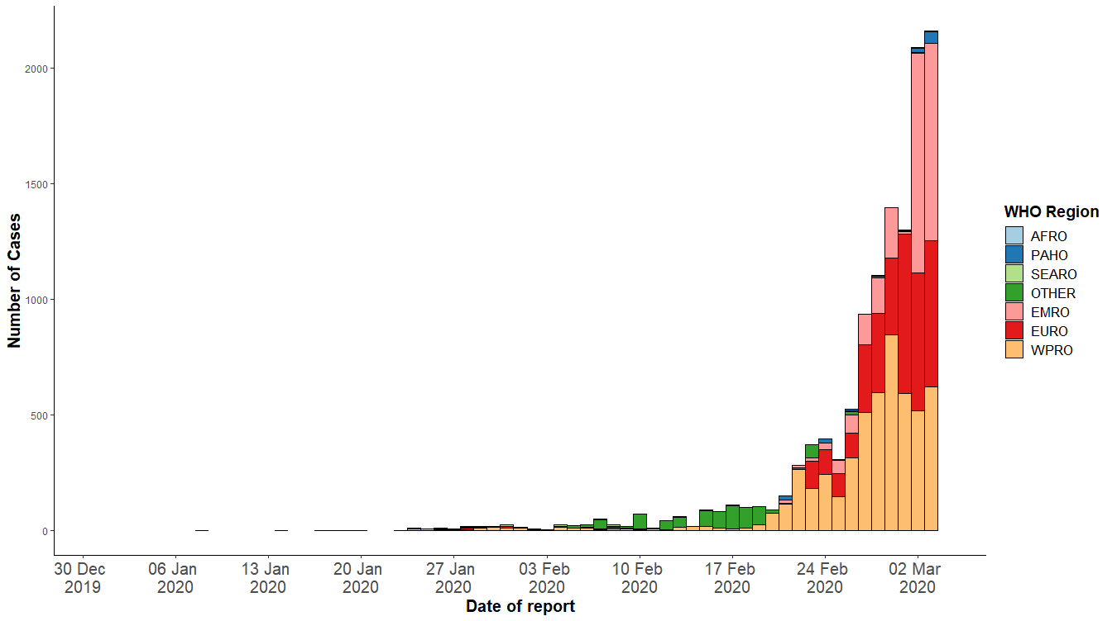
Confirmed cases outside China by date of report as of 04 Mar 6AM

Slide 5
Confirmed cases outside China notified under IHR or from official government sources (WPRO and SEARO, as of 04 Mar 6AM)
Region | Country | Cumulative Cases (03-Mar) | Cumulative Cases (04-Mar) | Cumulative Deaths (03-Mar) | Cumulative Deaths (04-Mar)
WPRO | Republic of Korea | 4812 | 5328 | 28 | 32
WPRO | Japan | 268 | 287 | 6 | 6
WPRO | Singapore | 108 | 110 | 0 | 0
WPRO | Australia | 33 | 33 | 1 | 1
WPRO | Malaysia | 29 | 29 | 0 | 0
WPRO | Viet Nam | 16 | 16 | 0 | 0
WPRO | Philippines | 3 | 3 | 1 | 1
WPRO | New Zealand | 1 | 2 | 0 | 0
WPRO | Cambodia | 1 | 1 | 0 | 0
SEARO | Thailand | 43 | 43 | 1 | 1
SEARO | India | 5 | 6 | 0 | 0
SEARO | Indonesia | 2 | 2 | 0 | 0
SEARO | Nepal | 1 | 1 | 0 | 0
SEARO | Sri Lanka | 1 | 1 | 0 | 0
OTHER | International conveyance (Diamond Princess) | 706 | 706 | 6 | 6
Republic of Korea 516 additional cases and 4 new deaths. 90% of total cases from Daegu/Gyeongbuk
Japan 16 new cases.
International conveyance – Diamond Princess Cruise Ship No new cases reported since 2 March.
Singapore 2 new cases (1 linked to existing cluster, 1 with no epi-link)
New Zealand 1 new case (ex-Italy)
India 1 new case from Jaipur (detail pending)

Slide 6
Confirmed cases outside China notified under IHR or from official government sources (EURO, as of 04 Mar 6AM)
Region | Country | Cumulative Cases (03-Mar) | Cumulative Cases (04-Mar) | Cumulative Deaths (03-Mar) | Cumulative Deaths (04-Mar)
EURO | Italy | 2036 | 2502 | 52 | 80
EURO | France | 191 | 212 | 3 | 4
EURO | Germany | 158 | 196 | 0 | 0
EURO | Spain | 114 | 151 | 0 | 0
EURO | United Kingdom | 39 | 51 | 0 | 0
EURO | Switzerland | 30 | 37 | 0 | 0
EURO | Norway | 25 | 32 | 0 | 0
EURO | Netherlands | 18 | 28 | 0 | 0
EURO | Austria | 18 | 24 | 0 | 0
EURO | Sweden | 15 | 24 | 0 | 0
EURO | Iceland | 9 | 16 | 0 | 0
EURO | Israel | 10 | 12 | 0 | 0
EURO | Croatia | 8 | 9 | 0 | 0
EURO | Belgium | 8 | 8 | 0 | 0
EURO | Denmark | 5 | 8 | 0 | 0
EURO | San Marino | 8 | 8 | 0 | 0
EURO | Finland | 7 | 7 | 0 | 0
EURO | Greece | 7 | 7 | 0 | 0
Italy: 466 new cases and 28 new deaths. Lombardy region counts for 61% (1520) of the cases.
France: 21 new cases and 1 new death. Auvergne-Rhone-Alpes accounts for 19% of all cases
Germany: 39 more cases. 52% of the cases have been reported from North-Rhine Westphalia.
Spain: 37 new cases (all with clear epi-link)
United Kingdom: 12 additional cases and the first case reported from Gibraltar (UK overseas territory). Total case count excludes Gibraltar case at the moment
Switzerland: 7 new cases. (1 contact, 6 detail pending)
Norway: 7 new cases (all with clear epi-link). In total, 22 cases have travelled abroad (20 to northern Italy, 1 to Iran and 1 to China) and 11 are close contacts of confirmed cases in Norway.
The Netherlands; 10 more cases (some cases don’t have clear epi-link)
Austria: 6 new cases. Total: Vienna (14), Lower Austria (3), Tyrol (2), Salzburg (2), Styria (3).
Sweden: 9 new cases (8 ex-Italy, 1 close contact)
Iceland: 7 new cases. All cases reported so far are ex-Italy or Austria
Israel: 2 new cases (ex-Italy)
Croatia: 1 new case (ex-Italy).
Denmark: 3 new cases (all ex-Italy)

Slide 7
Confirmed cases outside China notified under IHR or from official government sources (EURO, as of 04 Mar 6AM)
Region | Country | Cumulative Cases (03-Mar) | Cumulative Cases (04-Mar) | Cumulative Deaths (03-Mar) | Cumulative Deaths (04-Mar)
EURO | Czech Republic | 3 | 5 | 0 | 0
EURO | Romania | 3 | 4 | 0 | 0
EURO | Azerbaijan | 3 | 3 | 0 | 0
EURO | Georgia | 3 | 3 | 0 | 0
EURO | Russian Federation | 3 | 3 | 0 | 0
EURO | Estonia | 1 | 2 | 0 | 0
EURO | Ireland | 1 | 2 | 0 | 0
EURO | Portugal | 2 | 2 | 0 | 0
EURO | Andorra | 1 | 1 | 0 | 0
EURO | Armenia | 1 | 1 | 0 | 0
EURO | Belarus | 1 | 1 | 0 | 0
EURO | Latvia | 1 | 1 | 0 | 0
EURO | Lithuania | 1 | 1 | 0 | 0
EURO | Luxembourg | 1 | 1 | 0 | 0
EURO | Monaco | 1 | 1 | 0 | 0
EURO | North Macedonia | 1 | 1 | 0 | 0
EURO | Ukraine |  | 1 | 0 | 0
Czech Republic 2 new cases (ex-Italy). 1 among them is Ecuadorian (Milan resident)
Romania 1 new case (ex-Italy)
Estonia 1 new case (ex-Italy, Latvia)
Ireland 1 new case (ex-Italy)
Ukraine 1st case reported (ex-Italy, direct contact of a confirmed case)
18 EURO countries with no cases

Slide 8
Confirmed cases outside China notified under IHR or from official government sources (EMRO, as of 04 Mar 6AM)
Region | Country | Cumulative Cases (03-Mar) | Cumulative Cases (04-Mar) | Cumulative Deaths (03-Mar) | Cumulative Deaths (04-Mar)
EMRO | Iran (Islamic Republic of) | 1501 | 2336 | 66 | 77
EMRO | Kuwait | 56 | 56 | 0 | 0
EMRO | Bahrain | 49 | 49 | 0 | 0
EMRO | Iraq | 26 | 31 | 0 | 0
EMRO | United Arab Emirates | 21 | 27 | 0 | 0
EMRO | Lebanon | 13 | 13 | 0 | 0
EMRO | Oman | 6 | 12 | 0 | 0
EMRO | Qatar | 7 | 8 | 0 | 0
EMRO | Pakistan | 5 | 6 | 0 | 0
EMRO | Egypt | 2 | 2 | 0 | 0
EMRO | Afghanistan | 1 | 1 | 0 | 0
EMRO | Jordan | 1 | 1 | 0 | 0
EMRO | Morocco | 1 | 1 | 0 | 0
EMRO | Saudi Arabia | 1 | 1 | 0 | 0
EMRO | Tunisia | 1 | 1 | 0 | 0
6 EMRO Members with no cases: Djibouti, Libya, Somalia, Sudan, Palestine, Yemen
Islamic Republic of Iran
835 new cases and 11 new deaths. Gilan, Teheran and Qom are the provinces reporting the most cases. no breakdown by province available.
Iraq
I5 new cases: Baghdad(1), Wasit(1), Najaf(1), and Karbala(1).
Oman
6 new cases (all ex-Iran)
Pakistan
1 new case (detail pending)
Qatar
1 new case (repatriate from Iran)
United Arab Emirates
6 new cases with 4 different nationalities (Russian (2), Italian (2), German (1), and Colombian (1). All contacts of the two previously reported cases linked to the Emirates Bicycle Tour (UAE tour).

Slide 9
Confirmed cases outside China notified under IHR or from official government sources (PAHO and AFRO, as of 04 Mar 6AM)
Region | Country | Cumulative Cases (03-Mar) | Cumulative Cases (04-Mar) | Cumulative Deaths (03-Mar) | Cumulative Deaths (04-Mar)
PAHO | United States of America | 64 | 108 | 1 | 6
PAHO | Canada | 27 | 30 | 0 | 0
PAHO | Ecuador | 6 | 7 | 0 | 0
PAHO | Mexico | 5 | 5 | 0 | 0
PAHO | Brazil | 2 | 2 | 0 | 0
PAHO | Argentina |  | 1 | 0 | 0
PAHO | Chile |  | 1 | 0 | 0
PAHO | Dominican Republic | 1 | 1 | 0 | 0
AFRO | Algeria | 5 | 5 | 0 | 0
AFRO | Nigeria | 1 | 1 | 0 | 0
AFRO | Senegal | 1 | 1 | 0 | 0
USA 44 additional cases and 4 new deaths
Canada 3 additional cases (2 in Ontario – 1 ex-Egypt, 1 ex-Iran; and 1 in B.C)
Ecuador 1 new case (contact of case #1)
Argentina 1st case (a 43-year-old male, ex-Italy, Spain)
Chile 1st case (a 33-year-old male, ex-Southeast Asia including Singapore)

Slide 10
Update on COVID-19 Country Preparedness and Response
4 March 2020

Slide 11
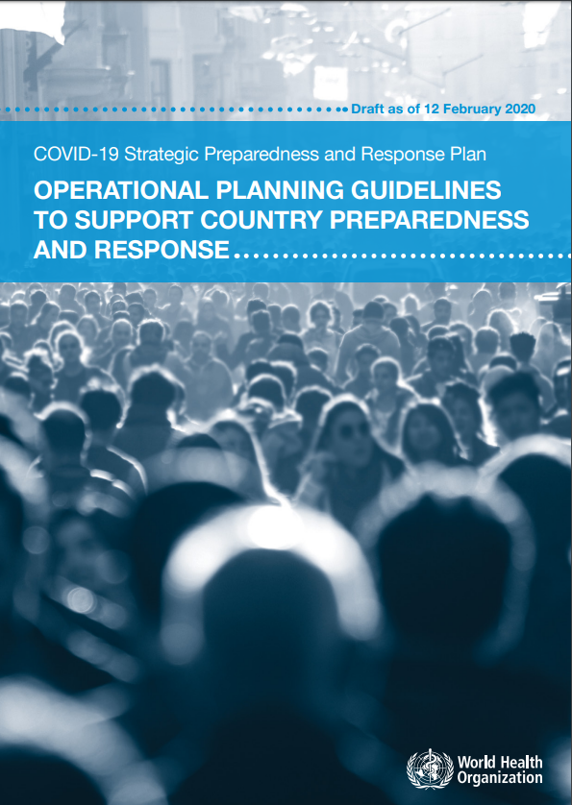
Supporting country preparedness and response
Country operational planning guidelines:
Country-level coordination
Risk communication and community engagement
Surveillance and points of entry
Rapid response teams
National laboratory system
Infection prevention and control
Case management
Logistics and supply management

Slide 12
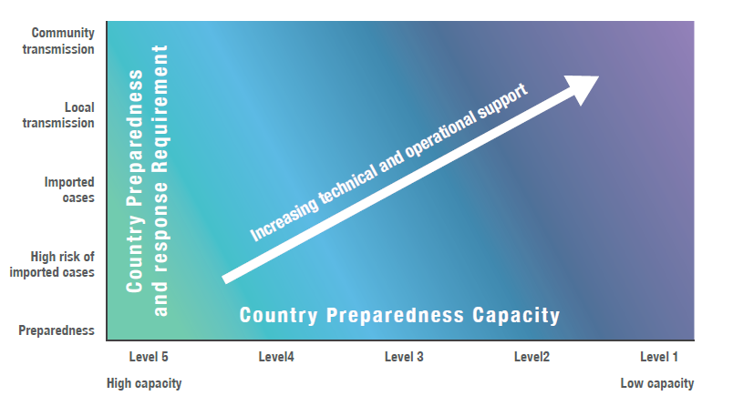
Scaling country preparedness and response
Work with national governments through UNCT to:
Engage with national authorities to identify appropriate coordination mechanism and key technical/operational partners
Map existing preparedness and response capacity and identify key gaps
Engage with national authorities and partners to assign roles and responsibilities to address key gaps
Engage with local donors and existing programmes to mobilize resources and capacities
Establish monitoring mechanisms based on key performance indicators to track progress and adjust the plans as outbreak evolves

Slide 13
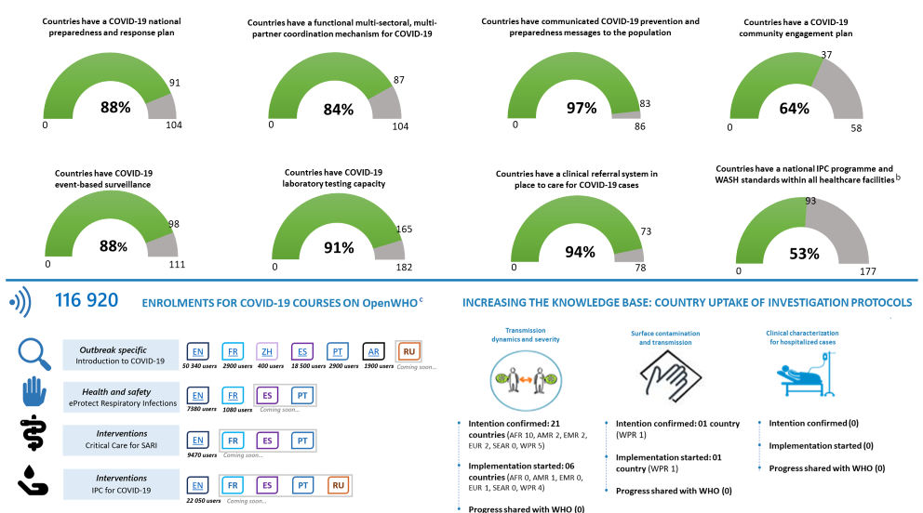
Monitoring country preparedness and response

Slide 14
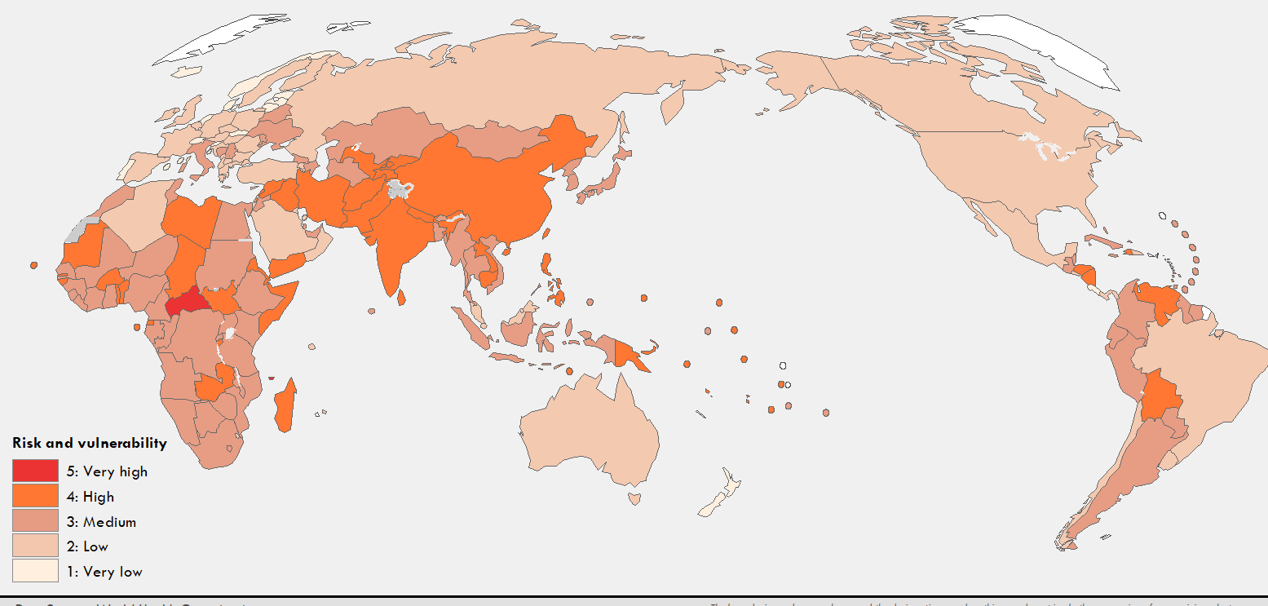
Tracking country risk and vulnerability

Slide 15
Scaling support to countries
Increasing support according to capacity:
Technical guidance & tools
Technical expertise
Supplies & equipment
Training & capacity building
In-country technical & operational support
No regrets support:
Level 5
Current risk
Support Provided
Imported Cases
Local Transmission
Local Transmission
Community Transmission
Level 1

Slide 16
Immediate response and support to countries
Technical support missions:
China
Iran
Italy
Algeria
Nigeria
Afghanistan/Pakistan
Many newly affected countries are asking for support
WHO Regional Offices together with GOARN partners to provide support
Emergency Medical Teams
Support hospitals and health centres in triage, case detection, temporary isolation and infection prevention and control measures, including the transfer of suspect cases.
Countries EMTs are currently operating in
Australia, Cambodia, China (Guangdong, Shanghai, Sichuan, and Tianjin), China (Macao SAR), Democratic Republic of Congo, Ghana, Japan, Italy, Malaysia, Mongolia, Philippines, Marshall Islands, South Africa, New Zealand
Countries EMTs will potentially be operating in within the next two weeks
Albania, Azerbaijan, Bosnia and Herzegovina, Kazakhstan, Montenegro, Nigeria, Papua New Guinea, Lao People’s Democratic Republic, Serbia, Tonga, Tuvalu

Slide 17
Personal Protective Equipment Shipments
 | Mask, Surgical | Mask, N95 | Gloves, Examination | Gown | Goggles | Alcohol hand rub, 100mL
SHIPPED
WPRO | 152,000 | 5,095 | 301,700 | 3,200 | 10,840 | 4,080
SEARO | 165,000 | 13,525 | 90,000 | 6,000 | 3,250 | 1,500
EMRO | 62,000 | 1,400 | 61,000 | 65,000 | 1,400 | 980
AFRO | 2,710 | 1,200 | 4,200 | 954 | 60 | 60
TOTAL | 381,710 | 21,220 | 456,900 | 75,154 | 15,550 | 6,620
SHIPPED: Regional Breakdown
WPRO | 12 | Cambodia, Fiji, Kiribati, Lao PDR, Mongolia, Nauru, Papua New Guinea, Samoa, Solomon Islands, Tonga, Vanuatu and the Philippines
SEARO | 5 | Bhutan, Maldives, Myanmar, Nepal and Timor-Leste
EMRO | 6 | Afghanistan, Djibouti, Lebanon, Somalia, Pakistan and Sudan
AFRO | 19 | Ethiopia, Togo, Côte d’Ivoire, Mauritius, Nigeria, Uganda, Tanzania, Algeria, Angola, Ghana, Kenya, Zambia, Equatorial Guinea, Gambia, Madagascar, Mauritania, Mozambique, Seychelles and Zimbabwe
TOTAL COUNTRIES | 42

Slide 18
Platform for supporting country preparedness and response plans
COVID-19 Partners Platform
Overview of needs and requirements by country, pillar, implementing partner
Financial contribution tracking by donor and gap analysis
Overview of progress against Strategic Preparedness and Response Plan
Needs and gap analysis
Resource requirements by implementing partner
Requests for technical support
Requests for supplies & equipment
Monitoring of progress against steps and actions
Reporting against KPIs
Country Plan B
Country Plan C
Country Plan A
Country Plan D

Slide 19

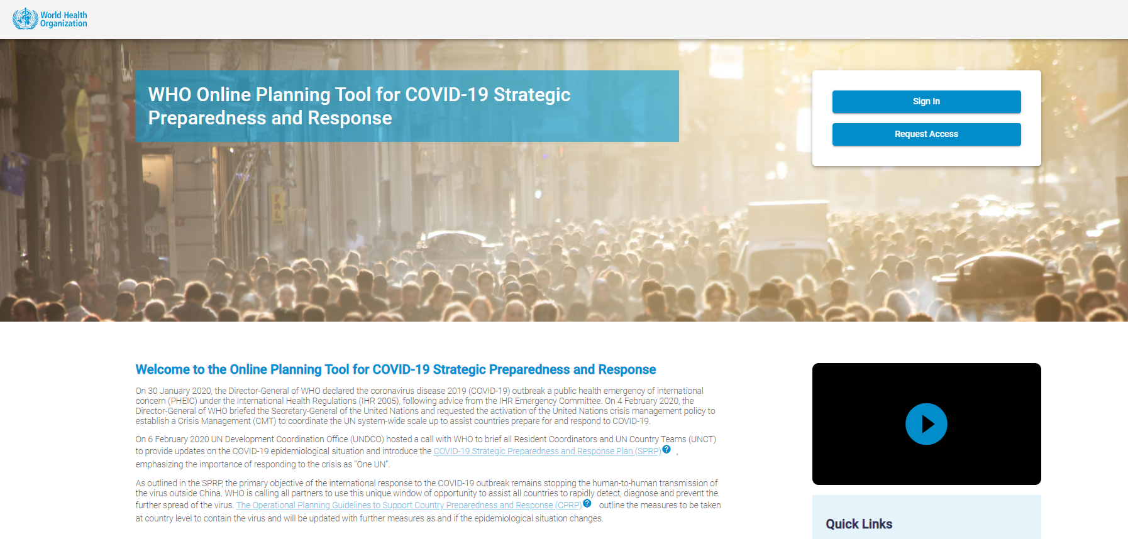
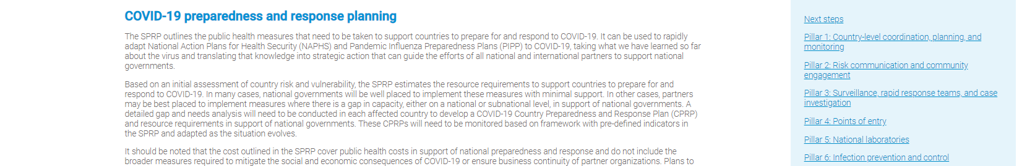
COVID-19 Partners Platform
Online Tool is now available to:
Report progress of the activities under each pillar of the response
Request support when resources are not available at country level
https://www.who.int/emergencies/diseases/novel-coronavirus-2019/
technical-guidance/country-readiness

Slide 20
Overall estimated resources required February-April 2020
Strategic preparedness and response pillars | Estimated requirement (USD)
A) Rapidly establishing international coordination and operations | 30,577,500
B) Scaling up country preparedness and response operations | 640,361,927
C) Accelerating priority research and innovation | 4,741,000
Total estimated resource requirement | 675,680,427
Funding status | Funding (USD)
Funding received | 21,450,148
Funding pledged | 289,381,852
Gap | 386,298,575

Slide 21
Established UN Crisis Management Team
Align whole of UN effort for coherent and coordinated action
Communication of key information
Development of strategies, policy & plans
Analysis & prioritization of key issues
Joint action where synergies exist
Support to country’s
UN coordination, resourcing & oversight
Public health preparedness & response
Assess/address social & economic impact
UN operations
UN staff communication & safety
UN business continuity
Global Issues
Advocacy & resource mobilization
Supply chain monitoring & intervention
Travel, trade & mass gatherings
Global public health
Coordination & technical guidance
Epidemiological analysis & risk communications
Accelerated research & innovation

Slide 22
Thank you

