Slide 1
SESA – Website
Attachment to the ToR

Slide 2
Information Structure
SESA Homepage
About us
Services and Programs
Services
Public Information
FAQ
Request for Service
Application Form Jobseeker
Programs
Legal Information
Public Information
Contact
Application Form Employer
Hierarchy Level 1 – 1 Side
Hierarchy Level 2 – 6 Sides
Hierarchy Level 3 – 6 Sides
In total:
13 Sides

Slide 3
Homepage – Hierarchy Level 1

Slide 4
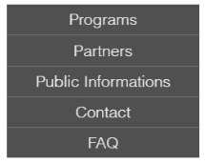
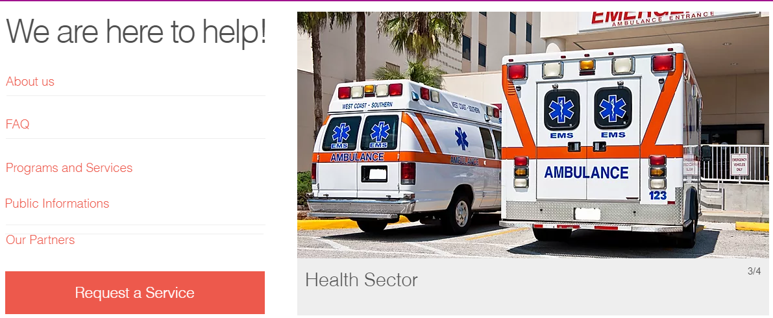
Header
Top Navigation
Top Navigation
Folding Menu Bar
Body
Margin
Navigation
Hierarchy Level 1
Moving Pictures
Jump to Webform

Slide 5
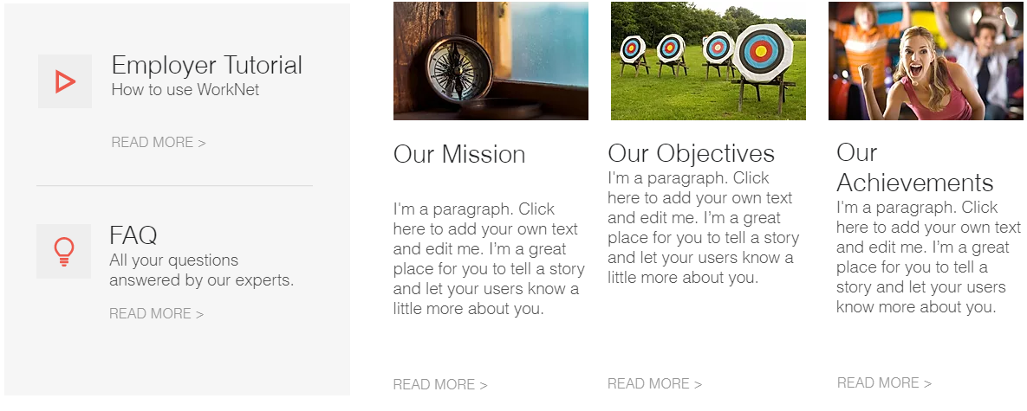

Body
Jump to Hierachy Level 2
Jump to Hierachy Level 2
Jump to Hierachy Level 2
Hierarchy Level 1
Push the Picture and you land at the Website of the Partner Hierarchy Level 2

Slide 6
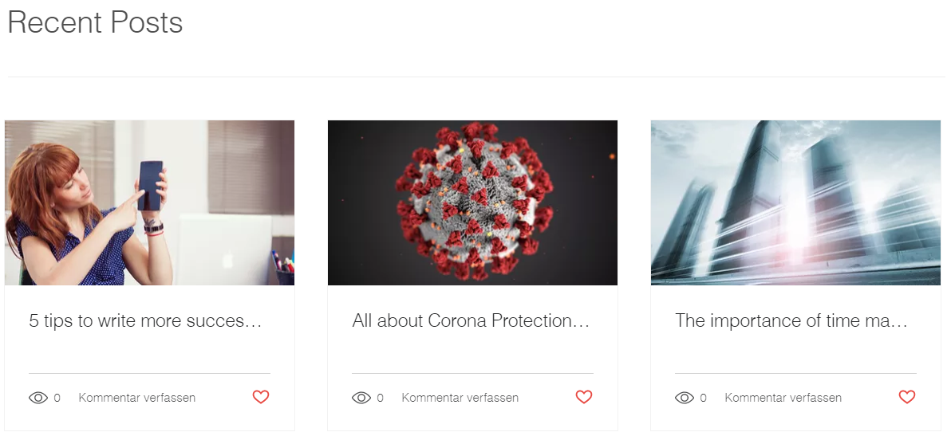

Body
Hierarchy Level 1
Push and jump to the Content – Hierarchy Level 2
Footer
Sitemap
Push and jump to the Content – Hierarchy Level 2

Slide 7
Request a Service Hierarchy Level 2

Slide 8

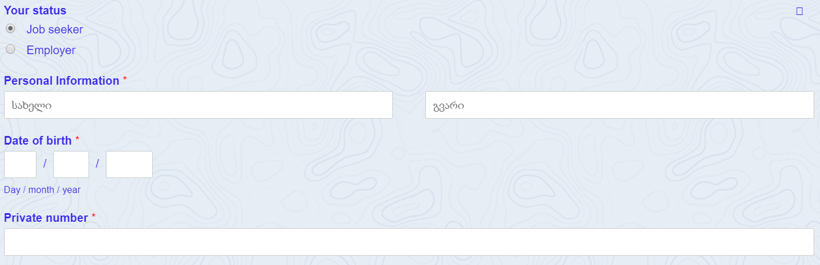
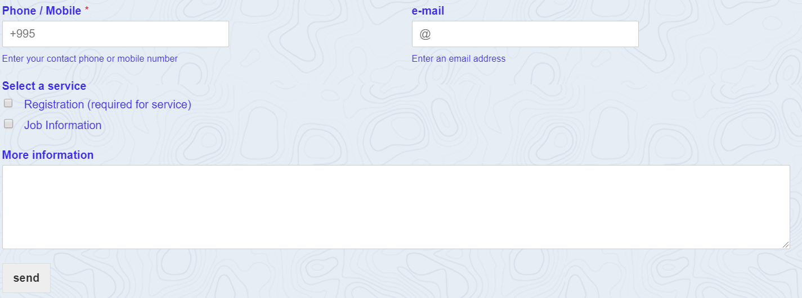
Job Seeker Form
Body
Hierarchy Level 2
The Message get´s routed to the responsible branch.

Slide 9
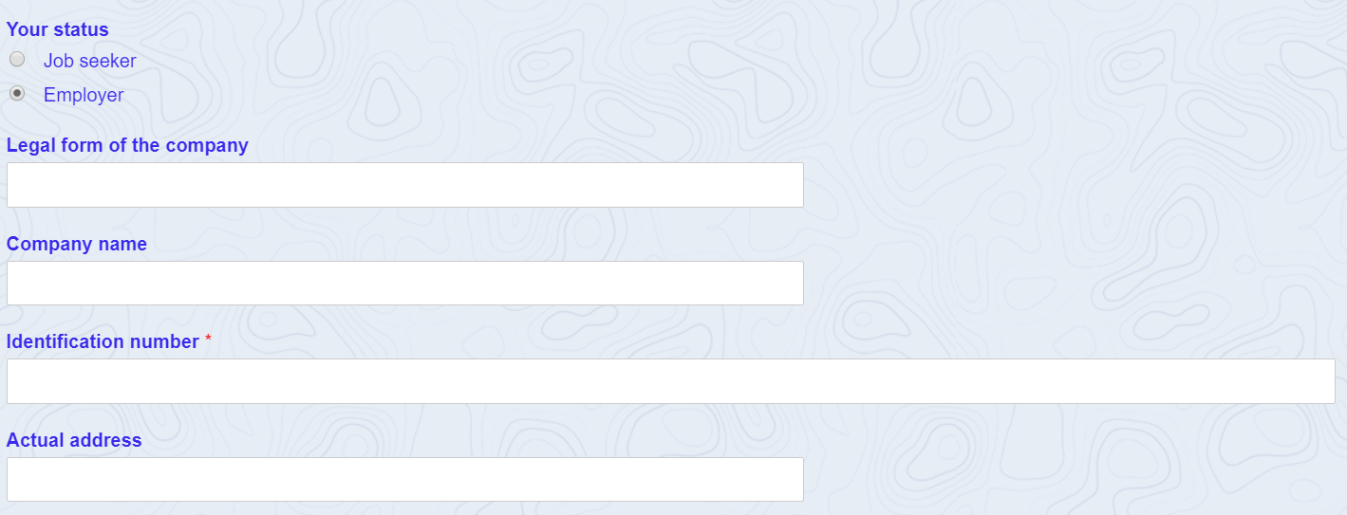
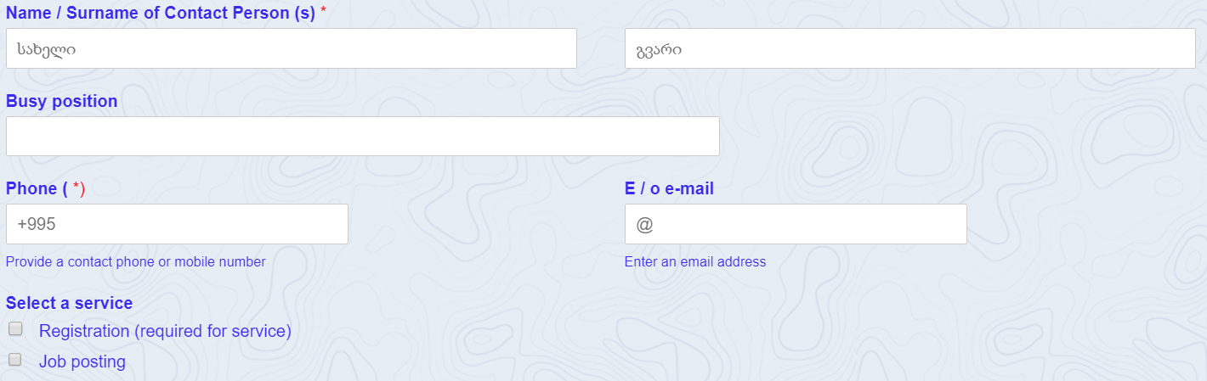
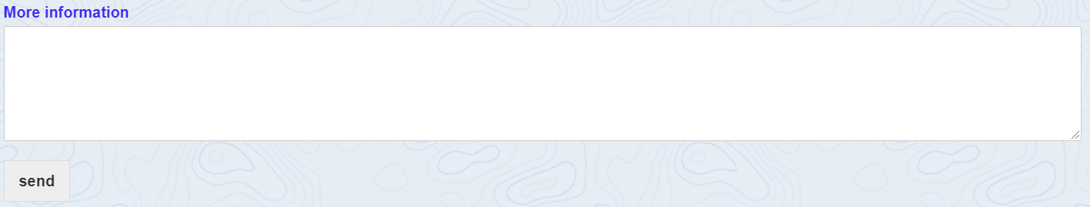
Employer Form
Body
Hierarchy Level 2
The message get´s routed to the responsible Office

Slide 10
About us – Hierarchy Level 2

Slide 11

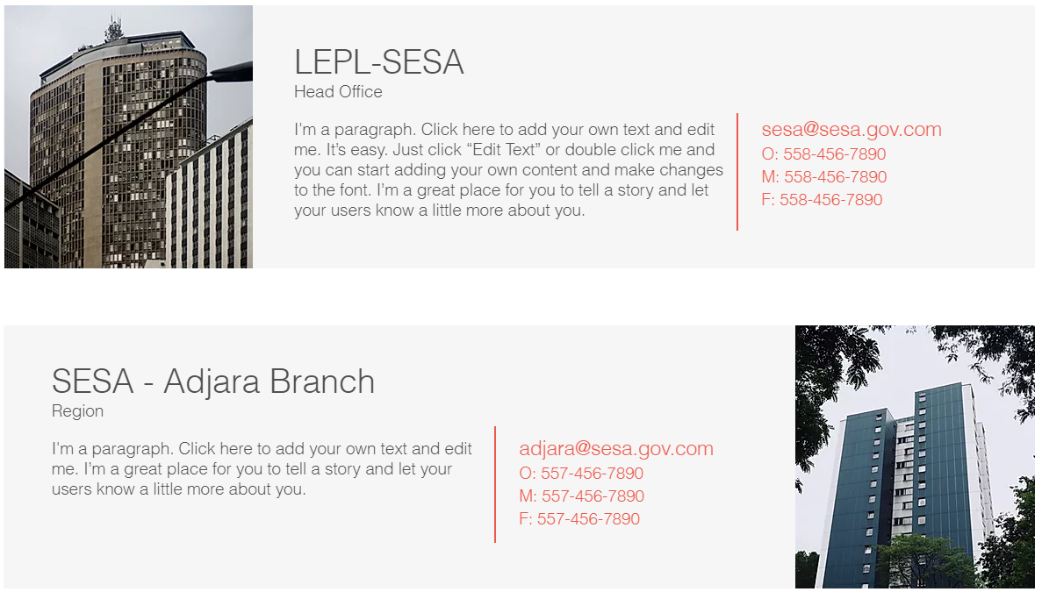
About us
Body
Scroll down to see more offices
Hierarchy Level 2
A Picture of each branch gets presented

Slide 12
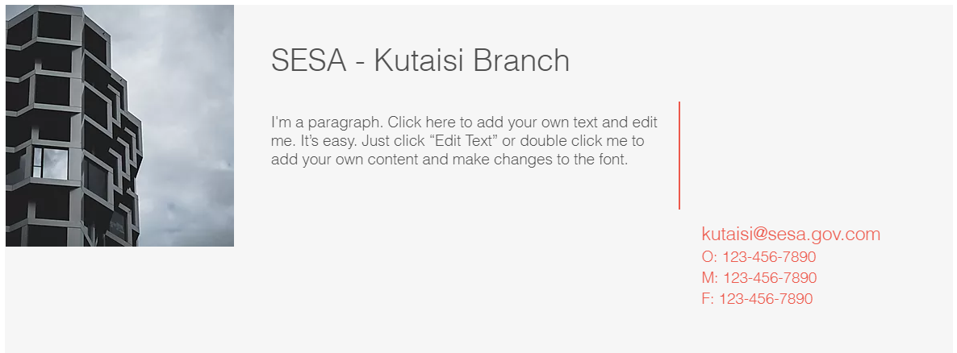
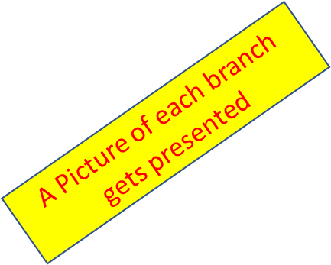
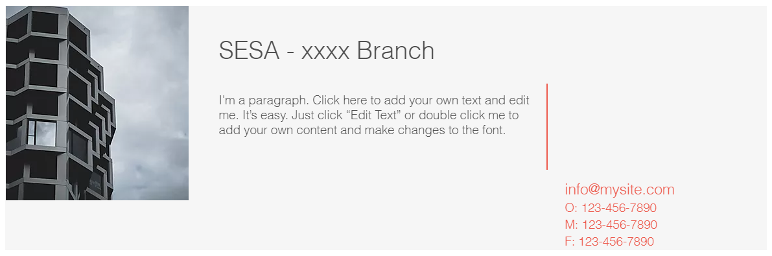
About us
Body
Hierarchy Level 2

Slide 13
Programs and Services – Hierarchy Level 2

Slide 14
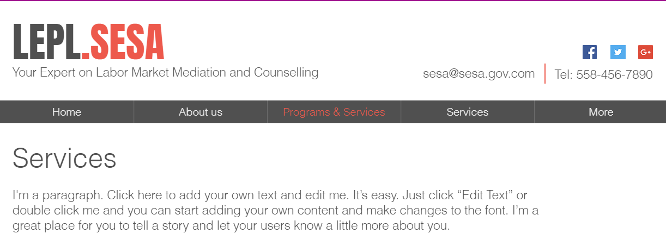

Programs and Services
Body
Programs and Services
Hierarchy Level 2
Link to WorkNet
Read more…

Slide 15
Programs and Services
Body
Hierarchy Level 2
Link to WorkNet
Read more…

Slide 16
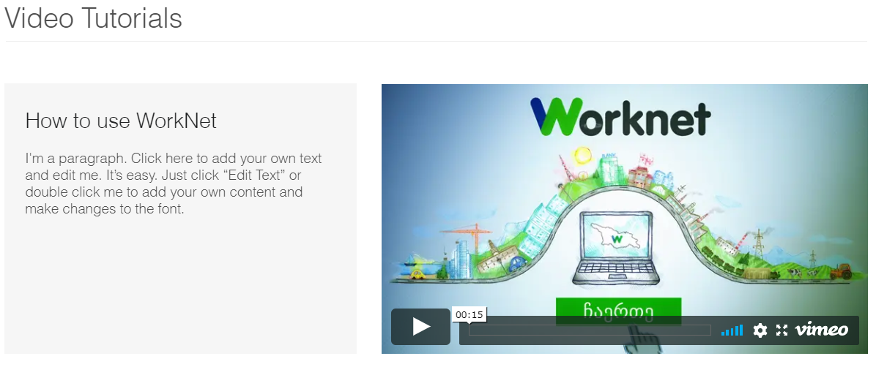
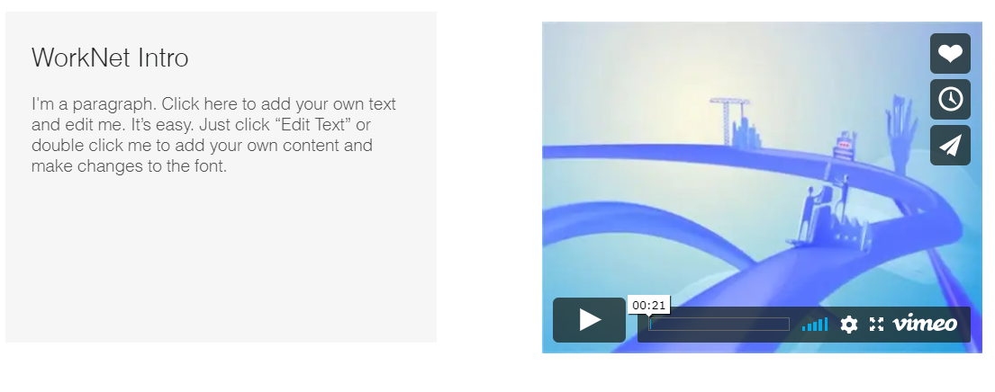
Programs and Services
Scroll Down to the next Tutorial
Body
Hierarchy Level 2

Slide 17
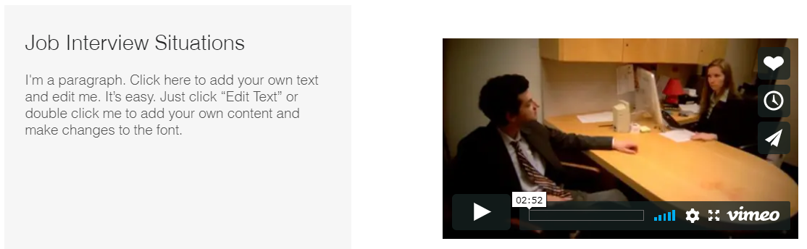
Programs and Services
Body
Hierarchy Level 2

Slide 18
Services – Hierarchy Level 3

Slide 19
Services
Add Content on available Services
Body
Hierarchy Level 3

Slide 20
Programs – Hierarchy Level 3

Slide 21


Programs
Body
Scroll Down to the Content of the programs
Hierarchy Level 3
Each picture has a Mouse Over function

Slide 22
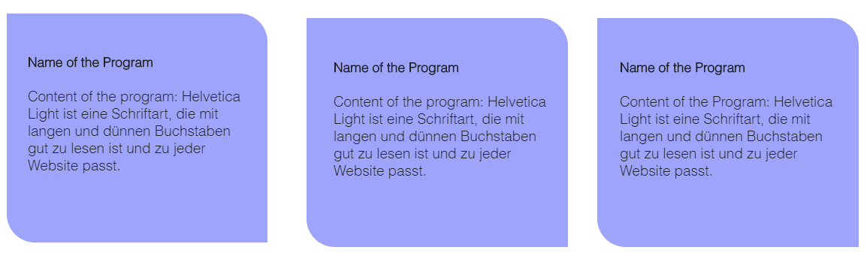
Programs
Body
Hierarchy Level 3

Slide 23
Public Information – Hierarchy Level 2

Slide 24
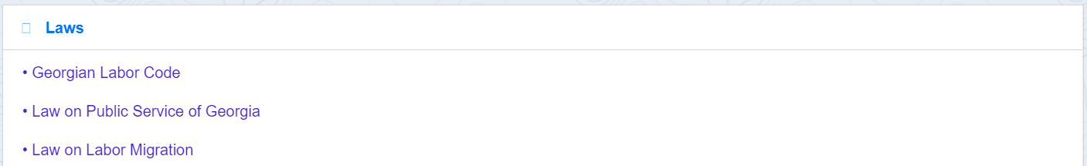
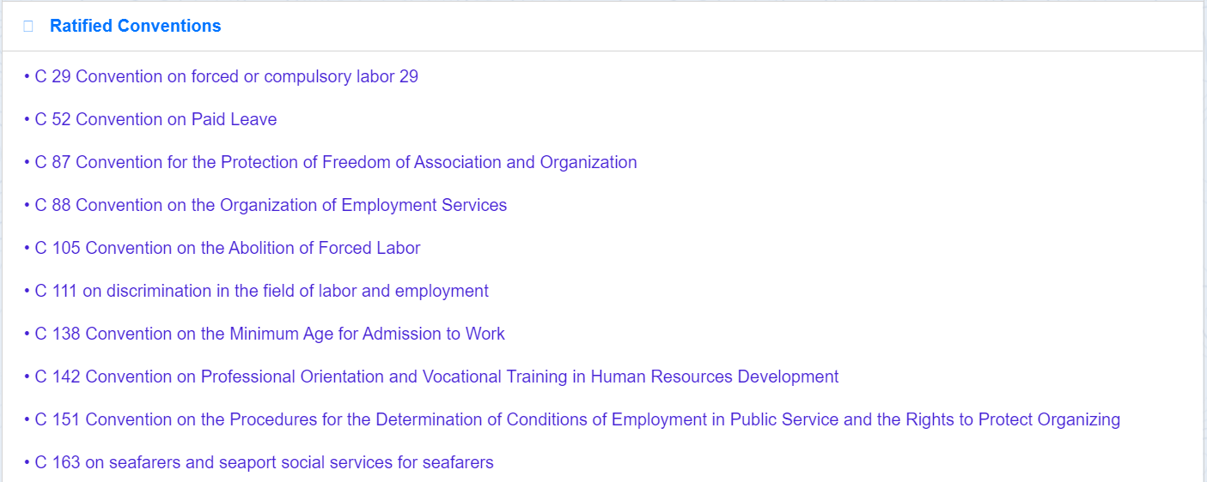
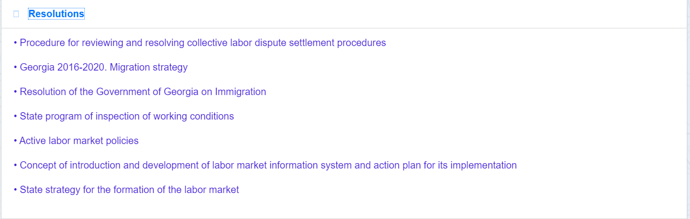
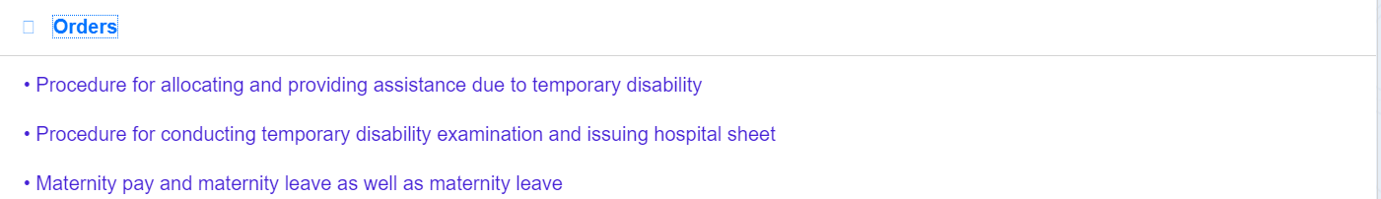
Public Informations
Legal Information
Hierarchy Level 2
Body

Slide 25
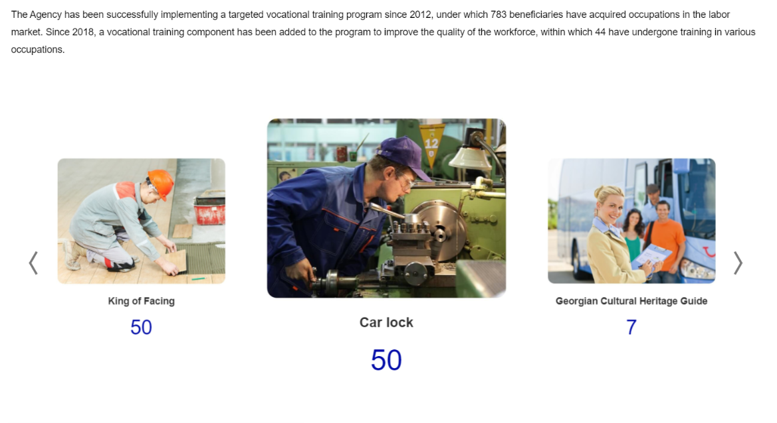
Public Informations
Public Information
Kind and Number of promoted vocational trainings
Hierarchy Level 2
Body
Slider
Slider

Slide 26
FAQ – Hierarchy Level 2

Slide 27
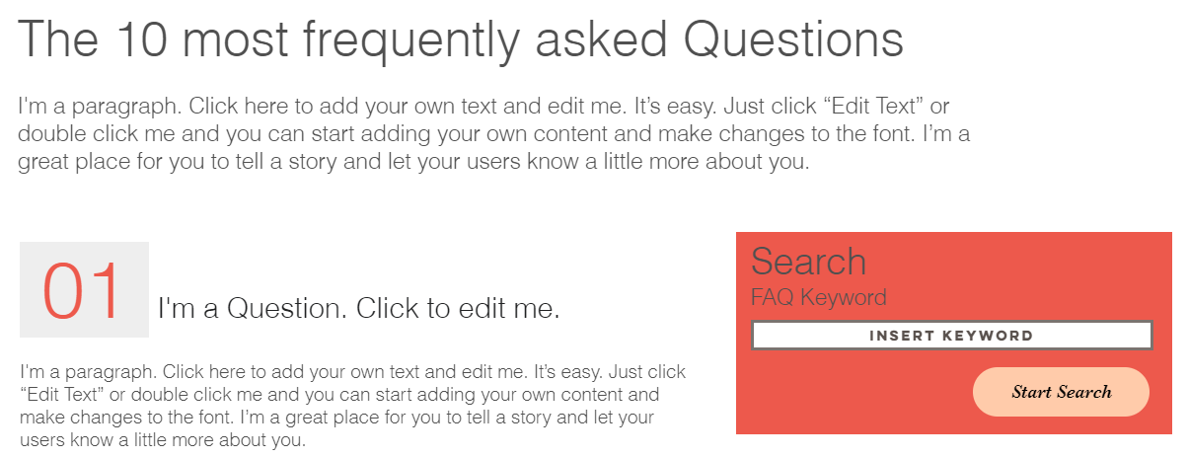
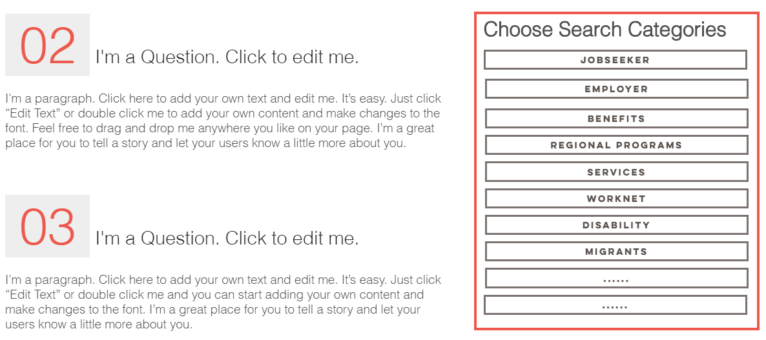
FAQ
Scroll to the end of the website to reach question 10
Hierarchy Level 2
Search function
Body
Accordion Functionality
Press the category Jobseeker and you will see all the questions belonging to that category.

Slide 28
Contact – Hierarchy Level 2

Slide 29
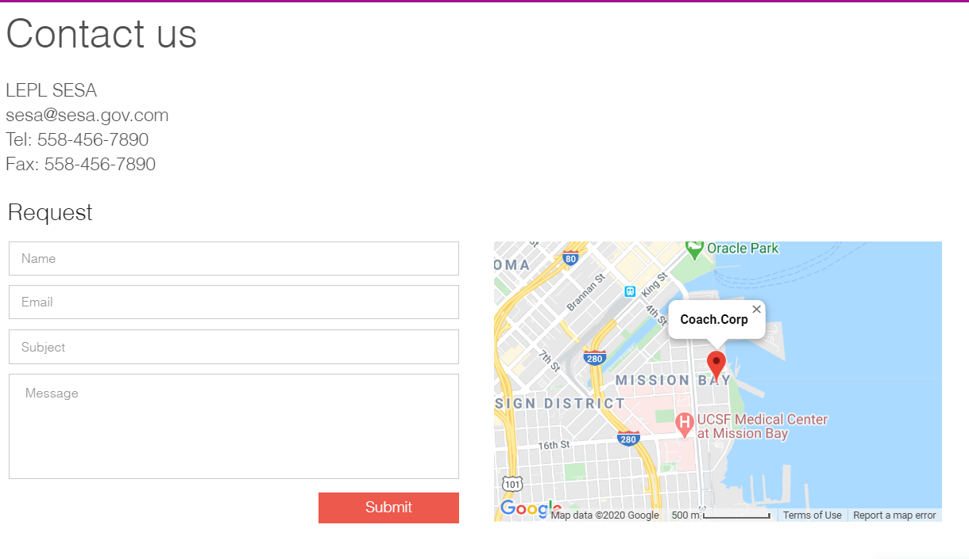
Contact
Hierarchy Level 2
Body

