Slide 1

Transforming the Social protection system for people with disabilities in Georgia
Joint SDG Programme

Slide 2
the Joint programme
Six UN agencies: OHCHR, UNICEF, WHO, UNDP, UN Women, UNFPA
Duration: 2 years (Jan 2020 – Jan 2022)
A total value of US$2 million
Purpose - To address key factors leading to social exclusion of people with disabilities in society
Strategies: Intensive cooperation with persons with disabilities (PwDs) and civil society organizations led by PwDs, as well as with a range of national, local institutions and private-sector employers.

Slide 3
OHCHR will facilitate the process of bringing Georgian legislation in compliance with UNCRPD standards and supporting elaboration of the state monitoring mechanism;
UNICEF will contribute to improvement of the legal framework for children with disabilities in line with UNCRPD; address negative and stigmatizing social norms towards people with disabilities; support the Government to transition to the social model of disability assessment and status determination system; and revise the social assistance entitlements for children with disabilities and PwDs including cash assistance and social programs.
WHO will conduct the Model Disability Survey (MDS) to better understand the situation of people with disabilities, including their prevalence, and what needs to be done to ensure they can enjoy their human rights on an equal basis with others.
Programme strategy per UN Agency

Slide 4
UNDP will support the development of a national regulatory framework and policy on accessibility that complies with international standards; and will build knowledge among employers concerning reasonable workplace accessibility standards.
UN Women will mobilize a network of CSOs to effectively monitor and lobby for the implementation of the UNCRPD in the context of national and international commitments to gender equality and women’s empowerment. UN Women will further work with data producers to strengthen data collection, analysis and dissemination from the gender and disability perspective.
UNFPA will support an enabling legislative and policy environment by (1) conducting an assessment of the legal environment and health programmes with regard to SRHR of PwDs; (2) introducing legislative provisions to comply with CRPD obligations for making SRH services and information accessible for PwDs; and (3) updating relevant national policies and plans to guarantee access to SRHR for PwDs.
Programme strategy per UN Agency

Slide 5
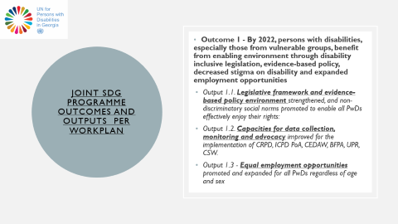
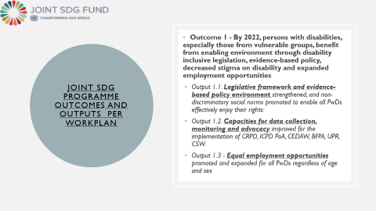
Joint sdg programme outcomes and outputs per workplan
Outcome 1 - By 2022, persons with disabilities, especially those from vulnerable groups, benefit from enabling environment through disability inclusive legislation, evidence-based policy, decreased stigma on disability and expanded employment opportunities
Output 1.1. Legislative framework and evidence-based policy environment strengthened, and non-discriminatory social norms promoted to enable all PwDs effectively enjoy their rights:
Output 1.2. Capacities for data collection, monitoring and advocacy improved for the implementation of CRPD, ICPD PoA, CEDAW, BFPA, UPR, CSW.
Output 1.3 - Equal employment opportunities promoted and expanded for all PwDs regardless of age and sex

Slide 6
Joint sdg programme outcomes and outputs per workplan
Outcome 2 - By 2022, the social protection system, health and social services are transformed in line with the social model of disability to ensure social inclusion and equal rights for people with disabilities.
Output 2.1 - Gender-sensitive disability assessment and status determination system transformed based on social model
Output 2.2 - Systems strengthened to enable quality integrated services for PwDs, including revised social system entitlements, especially for children, women and young people

