Slide 1

State Electronic Prescription System

Slide 2
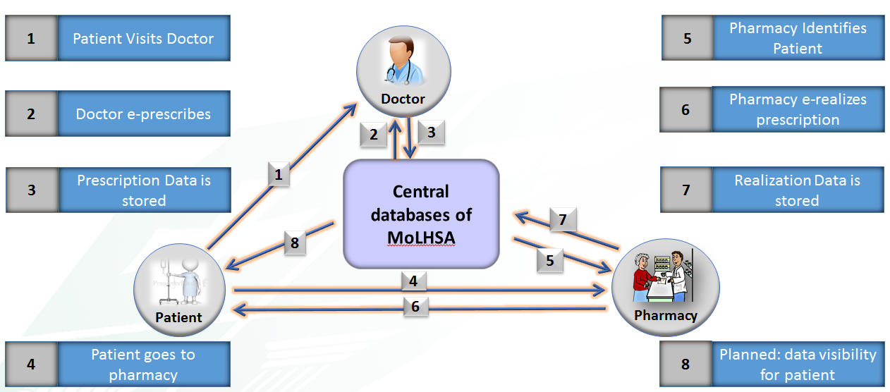
Electronic recipe involves electronic information through bilateral exchanges between the doctor and the distributor, either directly or through an intermediate network.

Slide 3

Patients’ benefits:
• Reduces the risk of getting the wrong medication, which itself increases the level of patient safety;
• Reduces the risk that the doctor will prescribe the drug, inappropriate and inconsistent with patients’ previous treatment (as the doctor sees the patient's treatment history), which excludes the prescription of inconsistent mediations;
• Patients spent less time to visit the doctor, since electronic system enables doctors to quickly and easily write a prescription;
• Reduce the costs for the patient, as the doctor usually indicates generic mane of drugs (except the case, when the doctor will specify the trade name), which is cheaper than branded ones;
• Prescriptions are automatically, instantly reflected into pharma institutions;
• Resets the risk of losing the recipe;
• Resets the discomfort related to the paper recipe.

Slide 4

Physicians’ benefits:
• Access to the patient's medication history is increasing physicians’ awareness and reduces the risk of incorrect treatment;
• Possibility to check drug addiction;
• Chance to control if the patient has purchased the drug.
• Doctor do not need to check if prescribed drug do need a form #3 recipe, because e-prescription system automatically generates all necessary forms.
• Increases efficiency of doctors, since they need less time to prescribe and do not spends time in responding phone calls from pharmacists and patients, who used to have problems in reading doctor’s handwriting.
• Easiness to extend validation period of prescription.
• Multiple possibilities to search correct drug, and/or its analogue.
• Reduce paper costs by reducing turnover of paper based prescription.

Slide 5

Pharmacy benefits:
• Elimination of all problems related to unclear abbreviations and transcripts by doctors.
• Simplicity of electronic prescription services.
• Reduction of Call back to doctors, to specify the prescriptions.
• Freedom to choose the generic drug prescription and tool, to make drug comparison and selection.

Slide 6
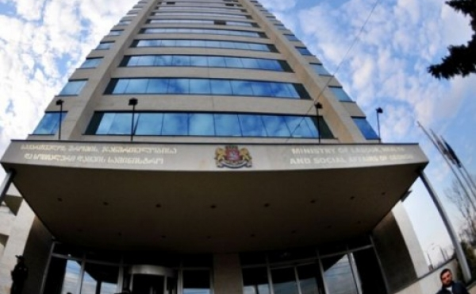
Powerful tool for policy making:
• Medication consumption data availability gives an opportunity to optimize the use of medical products.
• Medical care quality control: the relevant agencies will be able to look on the list of medicines prescribed and monitor its compliance with the diagnosis and compatibility with other medicines prescribed, in order to monitor doctor's competence and professionalism.
• The system makes it possible to control the pharmacy institutions, who realizes medicine electronically, since prescription and realization data is pooled to governmental servers. Thus, control department can save time and money, if they will be able to use the realization data.
• Statistical data, generated into the system, is a very strong tool for decision makers, to create and implement successful, evidence based policy.

Slide 7
Situation Analysis
Statistics
Technical activities
Integration
Pilot phase of ePrescription project has been started by 1st of Agust 2016 in Tbilisi.
During 2016, MoLHSA gave training to more than 1000 physicians in Tbilisi.
Every big and middle size pharma chains (Aversi, PSP, GPC, Pharmadepot, Pharmaboom, Gea, Pharmhouse, Impexpharm, Mermisi, Peoples Pharma…) and 15 small private pharma companies and solo proprietors, have been informed about eprescription project and more than 1000 their representatives have been trained.
Electronic and Video instructions for system usage have been created.
By 2nd February 2018, in Tbilisi, 2665 physicians and 620 pharma companies are. registered into the ePrescrition system.
System has served 19,177 patients.
There are 57,339 recipes, prescribed by eprescription system.
Pharma companies have already realised 5,485 electronic prescription.

Slide 8
ePrescription System Utilization Statistics

Slide 9
Situation Analysis
Statistics
Technical activities
Integration
Eprescription System have been improved and became more user friendly
Patients' Page has been created, which enables them to see prescribed medications online,
Patient have possibility to see and control who have seen their personal data (Log Control System)
User management system have been improved
Pharmacist can see his/her realization history via Pharma’s Page.
Physicians can choose the clinic, under which he/she works by certain moment of time.
Now phisicians are able to electronically prescribe to non-citizen.

Slide 10
Situation Analysis
Statistics
Technical activities
Integration
MoLHSA prepared integration services for pharma companies, which enables them to integrate their own internal systems with state electronic prescription system, and get and send information about el-prescription with their own system, without opening state ePrescription system.
MoLHSA has prepared service descriptions for Pharma companies and has actively communicated with them, in order to push system integration. As a result, almost all big pharma companies have already integrated their internal systems, with State ePrescription system.
MoLHSA also had communication with medical facilities, in order to integrate their internal electronic medical record systems (EMR) with state ePrescription system. As a result, MoLHSA has achieved agreement with the biggest medical corporation in Georgia, “EVEX”, which has already integrated its EMR system with state ePrescriontion system through its branches in Tbilisi.

