Slide 1


Maintaining Essential Services at the Primary Care Level during COVID-19 Pandemic
Please introduce yourself in the chat as you join.
June 16th
Notes:
Welcome to the first webinar of the Primary Health Care Performance Initiative (PHCPI) and Joint Learning Network (JLN) working groups exploring primary health care-related topics related to COVID-19 response and recovery. The webinar today is on Maintaining Essential PHC services during COVID-19 pandemic

Slide 2




Zoom Functionality
All users have been set to mute audio and video on entry
  Please make sure your video is turned off in plenary
  Please remain on mute unless speaking
Please use the group chat feature to introduce yourself and submit questions

Slide 3
Short Term Working Groups
Maintaining Essential Services at the Primary Care Level during the Pandemic
Understanding and utilizing data to inform COVID-19 response and recovery
Ensuring PHC serves as a cornerstone for health system future planning
Notes:
In the recent Lancet Global Health issue (May 12, 2020) Roberton et al had estimated that with a 45% reduction in coverage of MCH services over 6 months, as can be seen during outbreaks, there would be an additional over 1 million child deaths and more than 55,000 maternal deaths across 118 countries. In a commentary in the same issue, it is noted that public health measures, when not tailored to a given context, can lead to unintentional harm that is potentially greater than the one it is intended to avoid.
Realising the crucial role played by PHC not only in responding to COVID-19, but now that most countries are exiting the lockdown measures, also in ensuring non-COVID health services continue to be accessed, the Primary Health Care Performance Initiative (PHCPI) and Joint Learning Network (JLN) have initiated 3 short-term working groups over the course of 3-4 weeks to further explore primary health care-related topics related to COVID-19 response and recovery.
Today this webinar is discussing (i) Maintaining Essential Services at the Primary Care Level during the Pandemic and in the following weeks will discuss the following 2 topics of (ii) Ensuring PHC serves as a cornerstone for health system future planning and (iii) Understanding and utilizing data to inform COVID-19 response and recovery

Slide 4
What are the most pressing barriers to maintaining essential services during the COVID-19 pandemic?
What is needed to overcome these barriers?
Today’s meeting
Introductions
Country experiences
Discussion & brainstorming
Synthesis & next steps
Notes:
How do these working groups operate?
We first have an in-person meeting, like this webinar today, where we share country experiences. After the country sharing, we will have breakout groups to discuss further: questions you’d like to explore further in a learning collaborative.
The objective of today’s session facilitate joint learning on how countries are maintaining essential PHC services while responding to COVID-19, focused on two questions:
What are the most pressing barriers to maintaining essential services during the COVID-19 pandemic?
What is needed to overcome these barriers?
After this webinar, we hope to deepen dialogue around major themes emerging through the webinar, surfacing countries’ priority challenges and promising approaches to maintaining essential PHC services in the midst of COVID. We hope participants will be able to draw 2-3 practical lessons that can be useful across countries in overcoming barriers to maintaining essential services.

Slide 5
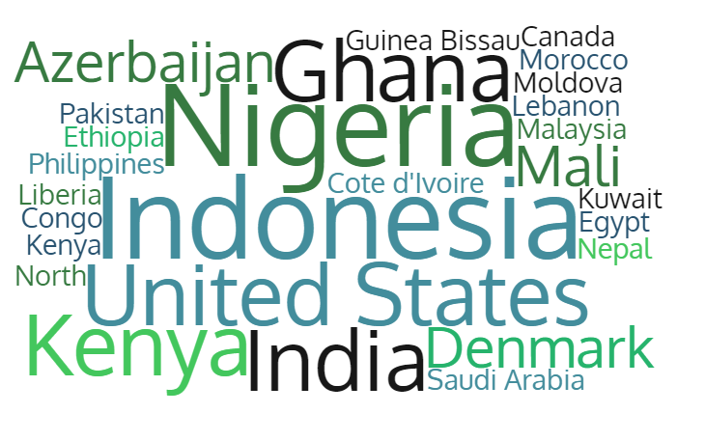
Who’s in the room?

Slide 6



Dr. Agatha Olago
Physician/Head: Primary Health Services & Family Medicine
Dr. Nazrila Hairizan bt. Nasir
Deputy Director (Primary Care Section), Division of Family Health Development, Ministry of Health Malaysia

Slide 7
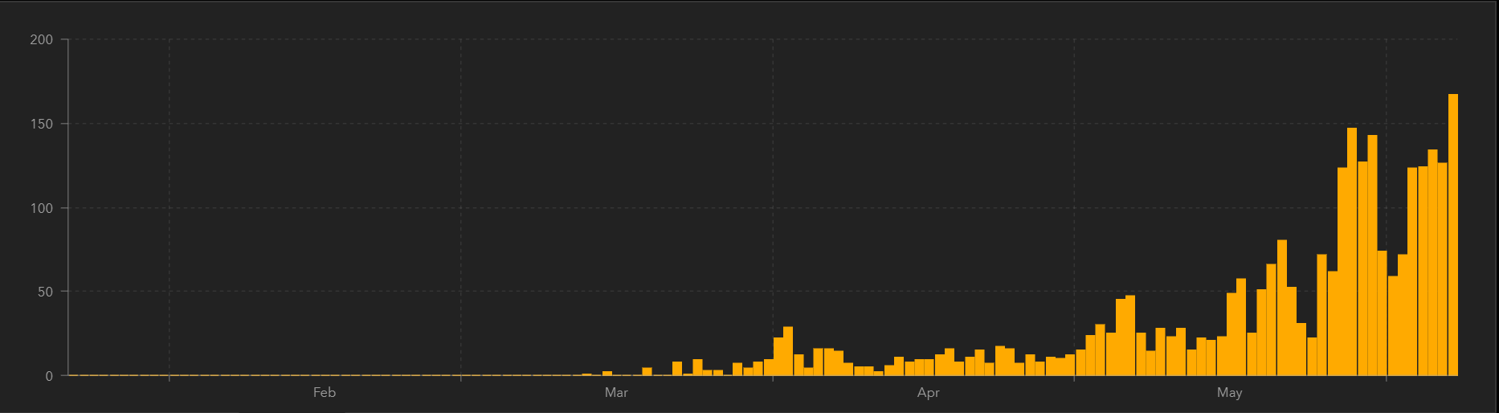
COVID-19 in Kenya
14th June
Control measures taken-Multi-agency Taskforce, Flights stopped, Enforced quarantine, Restricted movements, Elective surgeries stopped, Call center
Impact on PHC services-Reduction in utilization of health services, COVID fear- public and HCW
3,594
Confirmed Cases
103
Deaths
1,253
Daily Cases
Recovered
www.moh.go.ke COVID Situation report; https://coronavirus.jhu.edu/map.html accessed 6/8/20
Notes:
Data Sources-MOH Kenya Website: www.moh.go.ke COVID Situation report;
https://coronavirus.jhu.edu/map.html accessed 6/8/20
The data sources include the World Health Organization, the U.S. Centers for Disease Control and Prevention, the European Center for Disease Prevention and Control, the National Health Commission of the People’s Republic of China, 1point3acres, Worldometers.info, BNO, state and national government health departments, local media reports, and the DXY, one of the world’s largest online communities for physicians, health care professionals, pharmacies and facilities.

Slide 8
What are the barriers to maintaining essential services?
  Restricted movement especially at night reduces access to emergency health services
  Fear by the HCW due to lack of adequate PPE
  Fear of facilities due to COVID and lack of awareness by the public that services still available
  Closure of some Facilities-private , public-HCWs got COVID, designation of some facilities for COVID Isolation
  Concern- availability of essential medicines
  Finances, Increased transport costs

Slide 9
Drop in utilization of health services
The decline is particularly pronounced in the following health services:
  OPD attendance by general population
  OPD attendance by children under five years of age
  Antenatal care attendance by pregnant women
  Routine vaccination of children
  Vitamin A supplementation
  Identification and treatment of communicable diseases particularly malaria and TB, and enrolment of new HIV patients for ART treatment
  Identification and treatment of NCDs (hypertension and diabetes)
  Screening for Cervical Cancer
Some health services are found to be more resilient and remain less affected during the outbreak so far (as of April 2020)

Slide 10
Drop in utilization of health services
Almost all counties experienced a significant drop in OPD visits since COVID was reported in Kenya
Comparison of average OPD attendants between the pre-COVID 19 period (March 19-Feb 20) and the COVID 19 period (March-April 20)

Slide 11
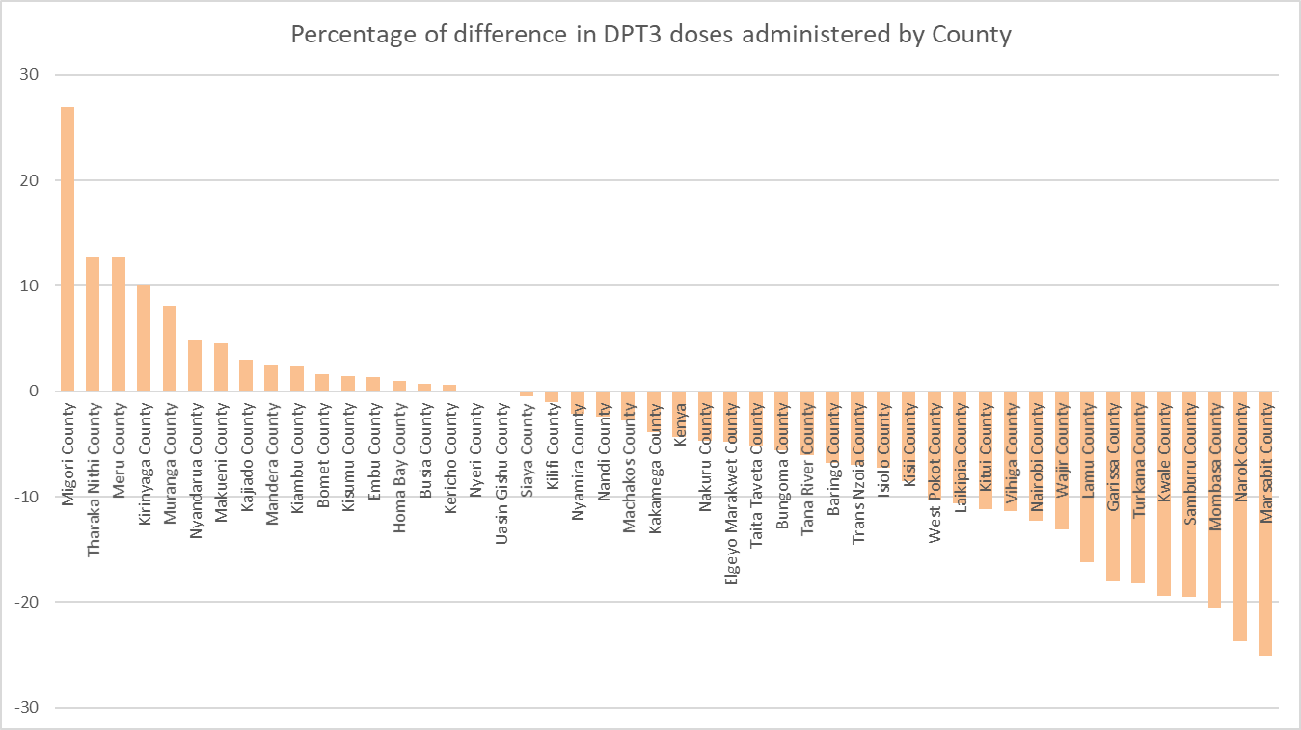
Drop in utilization of health services
Many counties had a decline in DPT3 doses administered—
Marsabit, Narok, Mombasa worst hit

Slide 12
How is Kenya overcoming these barriers?
  Formed a TWG- Maintaining essential services
    Discussed barriers and solutions and advice the COVID Task force accordingly
  Guidance and Circulars given on continuity of services; resumption of elective procedures
  Communication- continuity of services and safety of clients in hospitals
  Prioritise certain services- ANC, Immunization, Delivery, Child health services
  Primary health care facilities designated for certain services e.g. ANC, Child health services
  Innovations in service delivery- contacting clients to come back, safety
  Home isolation and care for COVID patients

Slide 13
What lessons have been learned to date?
Ensure resilient public health system able to respond to outbreaks
Continuity of essential services should be considered during planning of the outbreak response
Fast response to incoming data needed
Need to improve on communication channels with counties
Investment in Public health, Primary health care a must!

Slide 14

Malaysia

Slide 15
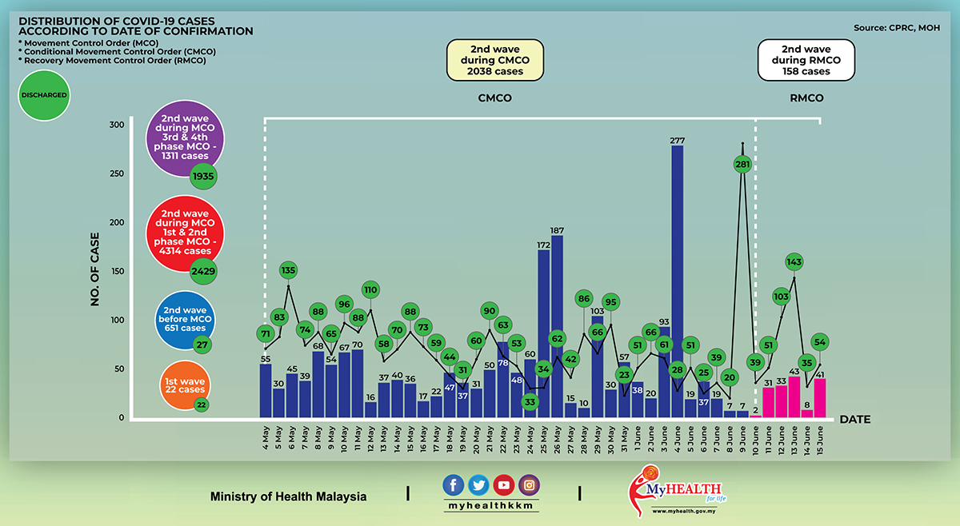
COVID-19 in Malaysia
15th June
8,474
Confirmed Cases
121
Deaths
7,400
Recovered
Source: CPRC MOH
Notes:
Data source: CPRC MOH
Recovered : 7400 (87.1%)
Death : 121 (1.42%)

Slide 16
What are the barriers to maintaining essential services?
  Demand
    Low: MCO
    Fear of the public going to hospitals or clinics
  Human resource
    Control and preventive measure
    Targeted screening
    Deployment
  Supply chain
    PPE
    Equipment for screening

Slide 17
How is Malaysia overcoming these barriers?
  Prioritising our services
    Essential services; antenatal care/ vaccination/ emergency
    Protect the vulnerable
  Innovations in service delivery: digital health
    Virtual clinics
    Online appointments
    Virtual health advisory: information and triaging
    Webinars
    Facebook live

Slide 18
How is Malaysia overcoming these barriers?
  Business process re-engineering
    Screening all patients outside the main building
    Separate symptomatic patients
      Fever area
    Separate the MCH and co-morbid patients from the general outpatient
    SOP for house visits
    Relook at criteria for house visit
  Public Private partnership
    CSR : digital health initiative
      Virtual Health Advisory (VHA)
      Webinars
      Online appointment
    Increase capacity of testing
      Labs
      Drive through services
      Home sampling

Slide 19
What lessons have been learned to date?
Private Public partnership
  Private sectors keen to contribute
  Facilitate the process: win- win situation
Risk communication
  Public understands and comply
  New SOPs: understand and follow the new SOPs

Slide 20
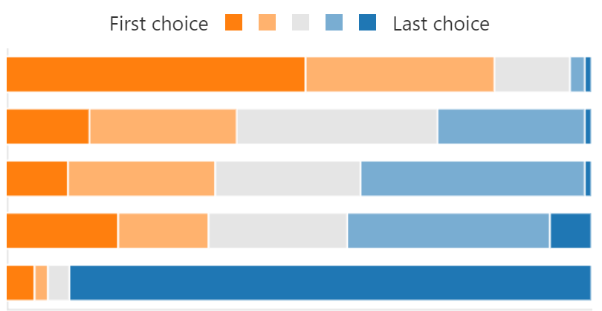
What are the most pressing barriers to maintaining essential services in your context?
Human Resources
Supply chain
Patient/Client demand
Financing
Other

Slide 21
Human Resources
There are a limited number, and limited competency of the medical employees, who are not well distributed among Indonesian Regions. It is happened not only the COVID-19 era but it was happened since several decades ago.
In this pandemic situation COVID-19 virus infected a number of medical and hospital staffs; then they had to stay at homes or died.
COVID-19 has exacerbated the existing gap in skilled human resource.
Coupled to PPE shortages and poor infection control and prevention at primary health care, HR would hesitate to be in direct contact with patients.
The Pandemic has resulted in the reassignment of different cadres of healthcare workers from their primary roles to other duties related to caring for patients with SARS-COV-2 infection.
HR issues are further exacerbated by fear of exposure to Covid, lack of PPE and of PPE/ IPC training, unwell health workers, and physical and mental exhaustion.
Health workers are asked to focus on test and trace Covid19 cases and contacts and have insufficient time for providing essential services to the population. Outreach services for immunization is also impacted by both health workers availability and the concerns over safety by families

Slide 22
Supply chain
Supply chains lack the resiliency to sustain system shocks, risk mitigation measure need to be in place.
Lack of essential IPC supplies, including PPE for health workers
Lack of mechanism to distribute to the users in PH institutions
Shortage of commodities and regular stockouts as the supply chain system is often disrupted from the manufacturers through the wholesalers to the retailers.

Slide 23
Patient
Demand
Telemedicine is not developed to allowed the doctors to follow patients at home especially those with NCD
I anticipate new challenges after Covid - complications, mental health issues
Client demand for immunization is weak. The ongoing pandemic has further weakened the feeble appetite in community.
The emergence of Covid-19 has made it scarier for clients to avail themselves for normal treatment with the fear that it could be attributed to Covid-19 and/or be exposed to the infection of Covid-19. This has made patients who are in dire need of medical attention to stay home and not to visit any health center for treatment
The measures imposed to curb the spread of COVID including the curfews, partial lock downs have also restricted use of services.

Slide 24
Finance
These lean resources have been over-stretched as a result of the pandemic with the resultant reallocation of resources previously allocated for primary healthcare services.
Insufficient allocation to health, even before COVID-19
The impact on the economy means reduced revenue and limited fiscal space. Therefore, the country is challenged to raise the much-needed resources to provide primary healthcare.
In addition, provider payment methods can exacerbate the issue, in contexts where health workers are overly dependent on fee-for-service payments as opposed to global budgets, capitation or fixed payments from the government.
The allocated budget is not sufficient particularly at sub-national government to respond COVID-19 in line with WHO general principles and guidelines.
The load of patients decreased significantly, and with it the income to the center. In addition, the country is facing the worst financial crisis in its recent history. This has further discouraged people from seeking care and hence reduced the center's income.

Slide 25
Breakout Groups: Question for Discussion
What questions or themes are most important for continued joint learning on maintaining essential PHC services during COVID?
Notes:
Considering the challenges to maintaining essential PHC services,

Slide 26
Next steps
MyJLN Maintaining Essential Services at the Primary Care Level during the Pandemic Group
Facilitated discussion June 17th-26th to dig deeper on the topics surfaced today, identify related promising strategies
Notes:
The discussion continues!

Slide 27
Kenya Data Annex
Drop in utilization of health services

Slide 28
Drop in utilization of health services
Out Patient attendance by under five children declined significantly representing a net drop of 1.2 million from February to April 2020 which is 66% drop

Slide 29
Drop in utilization of health services
Comparison of the average under-five OPD attendants between the pre-COVID 19 period (March 19-Feb 20) and the COVID 19 period (March-April 20)
Almost all Counties recorded a decline in children under five attending hospitals, with the worst hit being Homa Bay which experienced a decline of 76%

Slide 30
Drop in utilization of health services

Slide 31
Drop in utilization of health services

Slide 32
Drop in utilization of health services

Slide 33
Drop in utilization of health services

Slide 34
Drop in utilization of health services

Slide 35
Drop in utilization of health services

Slide 36
Drop in utilization of health services
Total Deliveries in facilities
120,000
100,000
80,000
Deliveries
60,000
40,000
20,000
0
Jan
Feb
Mar
Apr
2018
86,735
78,707
91,600
91,643
2019
97,322
83,879
98,891
98,034
2020
96,260
90,563
100,040
96,437
Deliveries in Health Facilities remained fairly constant over the COVID period

