Slide 1
Update on COVID-19
12 March 2020

Slide 2
Current Situation (As of 12 Mar, 6AM Geneva Time)
Updates from last 24 hours
Outside China:
6,487 new confirmed cases
4 countries and territories reported cases for the first time:
Turkey (1), Honduras (2), Côte d’Ivoire (1), French Polynesia (1)
306 new deaths
3 countries reported fatal cases for the 1st time: Indonesia (1), Ireland (1), Bulgaria (1)
China:
25 new confirmed cases: 6 newly diagnosed imported cases (3 in Guangdong, 2 in Gansu, and 1 in Henan), 19 local cases (Hubei 8, Shandong 1, Taipei 1, Hong Kong SAR 9)
11 new deaths: Hubei(10), Shaanxi(1)
Globally, between 31 Dec 2019 - 12 Mar 2020
124,727 confirmed cases
4,608 deaths
Outside China
43,747 cases (36% of cases globally)
117 countries/states/territories
1,435 deaths
No cases within past 14 days: Nepal
China
80,980 confirmed cases
3,173 deaths
Countries with no cases reported: AFRO (42), AMRO (36), EMRO (6), EURO (11), SEARO (3), WPRO (28)

Slide 3
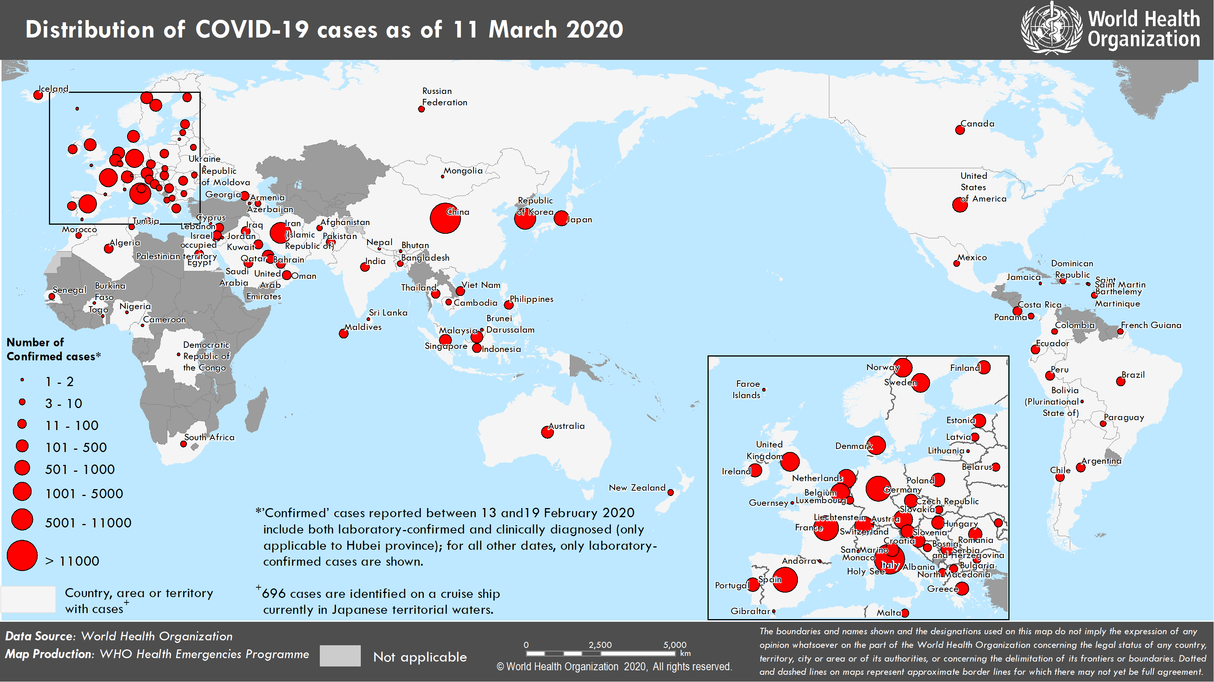

Slide 4
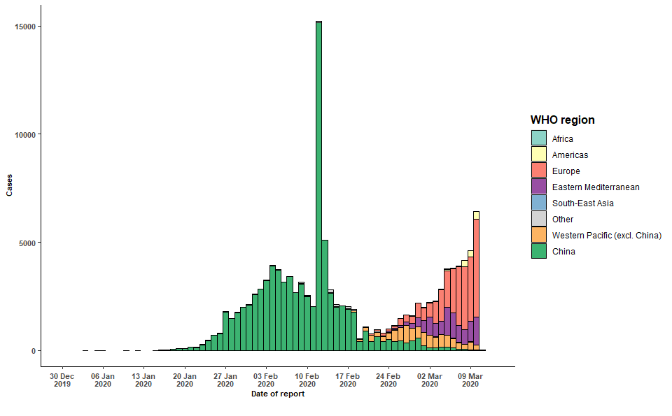
Number of confirmed cases notified under IHR or from official government sources as of 12 Mar 6AM

Slide 5
World scientists and researchers on COVID-19
met at WHO, 11- 12 Feb 2020
To assess level of knowledge about COVID-19
To agree on critical research questions
To define ways to work together to accelerate and fund priority research

Slide 6
A research roadmap with clearly defined priorities and governance framework to accelerate research that can contribute to contain the spread of the epidemic
A To ensure that those affected are promptly diagnosed and receive optimal care; while integrating innovation fully within each research thematic area,
B To support research priorities in a way that leads to the development of global research platform(s) pre-prepared for the next disease X epidemic (an unexpected epidemic by a known or previously unknown pathogen); thus, allowing for accelerated research, R&D for diagnostics, therapeutics and vaccines and their timely access.

Slide 7
An imperative for research to focus on actions that can save lives now.
Mobilize research on rapid point of care diagnostics for use at the community level
Immediately assess available data to learn what standard of care approaches from China and elsewhere are the most effective
Evaluate as fast as possible the effect of adjunctive and supportive therapies
Optimise use of protective equipment and other infection prevention and control measures in health care and community settings
Review all evidence available to identify animal host(s), to prevent continued spill over and to better understand the virus transmissibility, the severity of disease and who is more susceptible to infection
Accelerate the evaluation of investigational therapeutics and vaccines by using “Master Protocols
Maintain a high degree of communication and interaction among funders so that critical research is implemented
Broadly and rapidly share virus materials, clinical samples and data

Slide 8
Key components for successful implementation
of the Global Research Roadmap
A defined Global Research Roadmap
(with defined timelines and accountability)
National research plans at the core of research agenda
Coordinated implementation of critical research
(using core generic protocols when possible)
Developers and manufacturers engaged
(on research and fair and equitable allocation decisions)
Funders aligned to support research priorities
Harmonized plans for scale up manufacturing of products
(speed, access, cost)

Slide 9
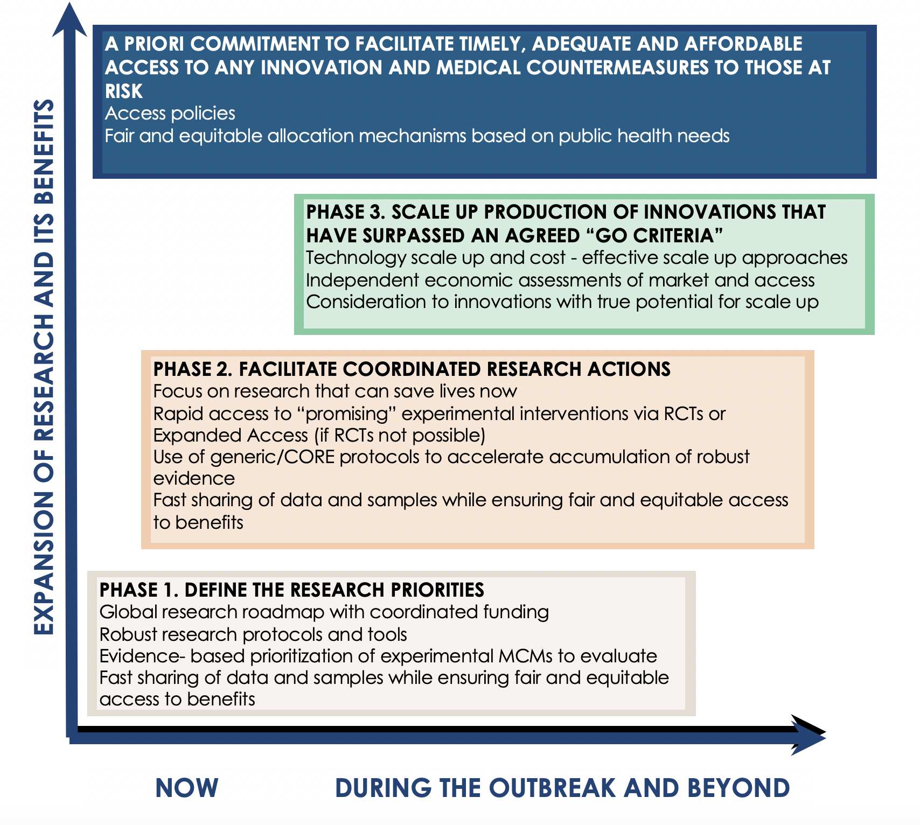
Scaling up research and innovation actions
Notes:
Beyond the identification of critical research actions presented in this Roadmap, a coordinated end-to-end phased approach is needed to promote that any effective innovation can be scaled up and be available as soon as possible

Slide 10
Public health emergency
Solidarity core protocol
An international study of treatments
for COVID-19 in hospitalized patients
The main objective of this study is to provide reliable estimates of the effects of antiviral treatments on in-hospital mortality.
The secondary objectives are to assess the effects of such antivirals on duration of hospital stay and, on receipt of ventilation or intensive care.

Slide 11
Randomisation
Adults (age ≥18 years) recently hospitalised or already in hospital for COVID-19 who have given informed consent are randomly allocated between up to five treatments.
Patients will be randomly allocated between up to five study arms:
1 - the usual standard of care in each hospital.
2 - Remdesivir
3 - Lopinavir/Ritonavir
4 - Lopinavir/Ritonavir plus Interferon (β1b)
5 - Further anti-viral drugs or combinations may well emerge that require evaluation. Chloroquine is among those being considered.

Slide 12
Simplicity of procedures
1 | Start enrolment via study website - Global enrolment and randomisation center. Hospital, the ID of the randomising health staff
2 | Obtain informed consent
3 | Enter registration information Patient ID, age, sex Patient characteristics (diabetes, heart disease, chronic pulmonary disease, asthma, tuberculosis, HIV infection, current smoking) COVID severity at entry (shortness of breath, administration of oxygen, provision of ventilation and, if already imaged, any major radiological abnormality).
4 | Proceed with randomisation
5 | Initiate administration of drug allocated
6 | At the end of hospitalization, enter information on 3 main patient outcomes (while in hospital) Provision of ventilation or intensive care Duration of hospital stay Mortality
Notes:
To facilitate collaboration, even in hospitals that have become overloaded, patient enrolment and randomisation (via the internet) and all other trial procedures have been greatly streamlined, and no paperwork at all is required.
Once a hospital has obtained approval to participate, informed consent is simple and electronic entry then takes only a few minutes.
At the end of this, the randomly allocated treatment is displayed on the screen and is simultaneously confirmed by electronic messaging.

Slide 13
Adaptive design
Extra arms (additional treatments) may be added while the trial is in progress.
Interim analyses will be monitored by a Global Data and Safety Monitoring Committee.
In the light of these, and any other evidence they seek, the committee will advise if in their view, be discontinued
Add-on studies - Particular countries, or particular groups of hospitals, may want to collaborate in adding further measurements or observations, such as serial virology, serial blood gases or chemistry, serial lung imaging, or serial documentation of other aspects of disease status (e.g. through linkage to electronic healthcare records and routine medical databases).

Slide 14
Numbers to be randomised
No specific sample size is specified is this public health emergency core protocol.
The larger the numbers enrolled the more accurate the results will be, but the numbers that can be entered will depend critically on how large the epidemic becomes.
Notes:
If substantial numbers get hospitalised in the participating centres then it may be possible to enter several thousand hospitalised patients admitted with relatively mild disease and a few thousand with severe disease.
Realistic, appropriate sample sizes could not be estimated at the start of the trial and will depend on the evolution of the epidemic

Slide 15
Key Roles and Study Governance
Interim and final trial analyses will be monitored by an independent Global Data and Safety Monitoring Committee.
The evidence on mortality must be strong enough and the range of uncertainty around the results must be narrow enough to affect national and global treatment strategies.
The Global Data Monitoring and Safety Committee will independently evaluate these analyses and, will inform the WHO policy-making committee if at any stage the results are sufficiently robust for general release and for affecting global recommendations.

