Slide 1

Universal Health Coverage: Direct way to financial protection and satisfaction of population
Dr. David Sergeenko
Minister of Internally Displaced Persons from Occupied Territories, Labour, Health and Social Affairs of Georgia
May, 2019
Notes:
I would like to welcome all of you on behalf of the MoLHSA and Georgian society. On the side meeting during the WHA it’s a great honor for me and my country. Generally, the collaboration with the WHO is a great honor for Georgia and our health system. We are member of the Who since 1992 and the Who played and plays significant role for the Georgian health system.

Slide 2
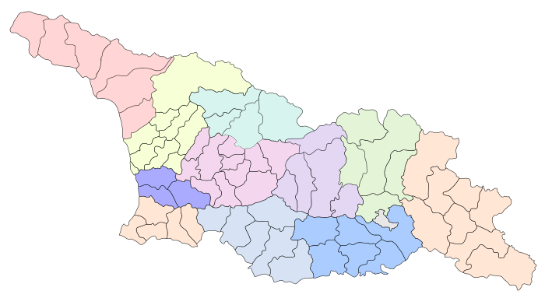




Demographic and Socio-Economic Situation
Maternal Mortality (per 100000 live birth) – 13.1 (2017)
Infant mortality (per 1000 live birth) – 8.1
Under 5 mortality rate (per 1000 live birth) – 18.7
Population – 3 726 500
Birth rate (per thousand population) – 13.7
Mortality rate (per thousand population) – 12.5
Life expectancy at birth – 74.0
GDP per capita (at current prices), (2016) – 4346 $US
GDP real growth – 4.7%
Government expenditure on health as % of GDP – 3%
General Government expenditure on health per capita (USD) – 123
Notes:
The population of Georgia has declined during the last 25 years, largely due to the outmigration and according to the census conducted in 2014, it is 3,7 mln.
Georgia has made a good progress in improving health outcomes. Life expectancy has increased by about 5 years over the few decades and currently is at 74 years.
Significant declines in under-five mortality and infant mortality and Georgia has been able to reach the Millennium Development Goal 4

Slide 3
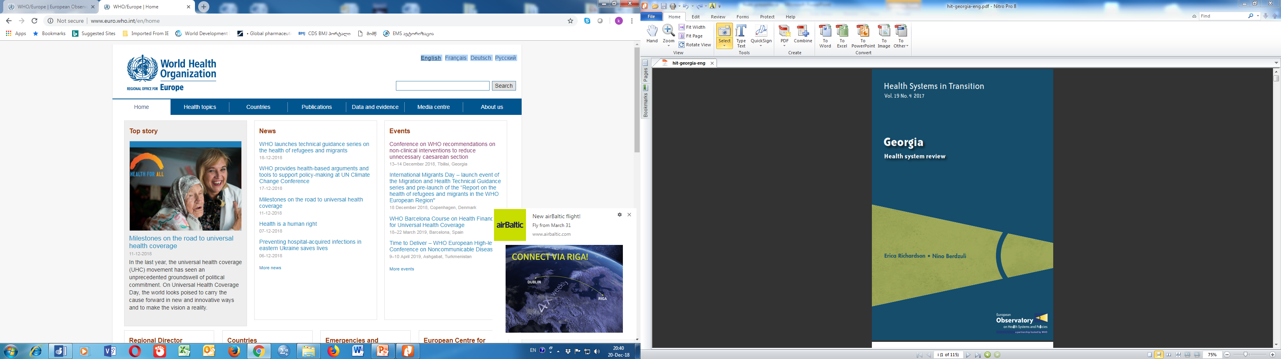


Universal Health Care – Socially Oriented Political Platform
February, 2013
WHO evaluation - Reforms have moved Georgia closer to universal health coverage
    Increased Services utilization
Increased State Budget for Health care (365 mill GEL in 2012 → 1135 Mill Gel in 2018)
    Improved financial Protection
HUES 2017
    Improved access to services
    Decreased Financial barriers
    Increased trust on state-funded health services
Notes:
The main goal of the elected government in 2012 and re-elected in 2016, is the poverty reduction and socially oriented political platform. The strong political will pledged in the election platform was translated into an unprecedented, in 2013 almost 2.5-fold expansion of budgetary allocation for health.
The second major step towards securing enjoyment of health rights in the country was the launch of a Universal Health Care Program in February 2013. Georgia now has a foundation of universal entitlements within its health system, representing a major step towards improving access to health services for the entire population.
The survey carried out by the World Bank, the World Health Organization and the US Agency for International Development showed the main achievements of the Universal Healthcare Program: increased access to medical services, increased utilization of medical services, reduced financial barriers and enhanced coverage

Slide 4
Health sector expenditures
Out-of-Pocket Payment as % of Total Health Expenditure, Georgia
Public Health Expenditure, Georgia
Source: Georgia NHA 2010-2017 (MoLHSA, 2019)
Notes:
The UHC program was accompanied with a substantial increase in the governments budget allocations. From 2012 to 2017, the health budget more than tripled, as a percentage of GDP it increased from 1.7 percent to 3% in 2017, but it’s still lower in comparison with Euro average.
The share of the out-of-pocket payments in total health expenditures has significantly decreased from 73% (in 2012) to 55% (in 2017), mainly due to the lower cost of hospitalization, which is a direct consequence of the universal healthcare program.

Slide 5
Coverage of Healthcare services
Services utilization
Hospitalization per 100 population
  UHC Program has led to a major expansion in population entitlement to publicly financed health services (HUES)
Ambulatory care visits per person per years
Notes:
The coverage of population improved as demonstrated by the series of health care utilization and expenditures surveys. Over half of the population were covered first time. We have seen a surge in utilization of the health care services. In Georgia, during last 2 decades, this indicator did not exceed 2.2. In the frame of the UHC programme the numbers of out- and in-patient encounters continued to grow due to increased accessibility of healthcare services. In 2016, the number of contacts with out-patient facilities per capita reached 3.5.0.

Slide 6



Drugs for Major Non-Communicable Diseases
  2017
    Cardio-vascular diseases
    Type 2 diabetes
    Obstructive pulmonary disease
    thyroid conditions
  2018
  Epilepsy
  Parkinson’s diseases
socially vulnerable families –Less than 1 GEL.
Pensioners and disabled persons - 50%-80% discount
Notes:
In July 2017, the Ministry of Labour, Health, and Social Affairs of Georgia introduced policies for enhanced protection for poorer and sicker people by expanding their benefit packages and included medicines for major Non-Communicable Diseases – cardio-vascular, type 2 diabetes, obstructive pulmonary disease and thyroid conditions next to cancer, epilepsy and Parkinson’s diseases which account for more than 80 percent of the burden of disease in Georgia. Over 600 000 people most in need, will receive coverage with these essential medicines through the primary health care settings. These policies support our efforts to strengthen primary health care system and improve health outcomes related to non-communicable diseases in Georgia, contribute to achieving NCD targets and SDG health goal.

Slide 7
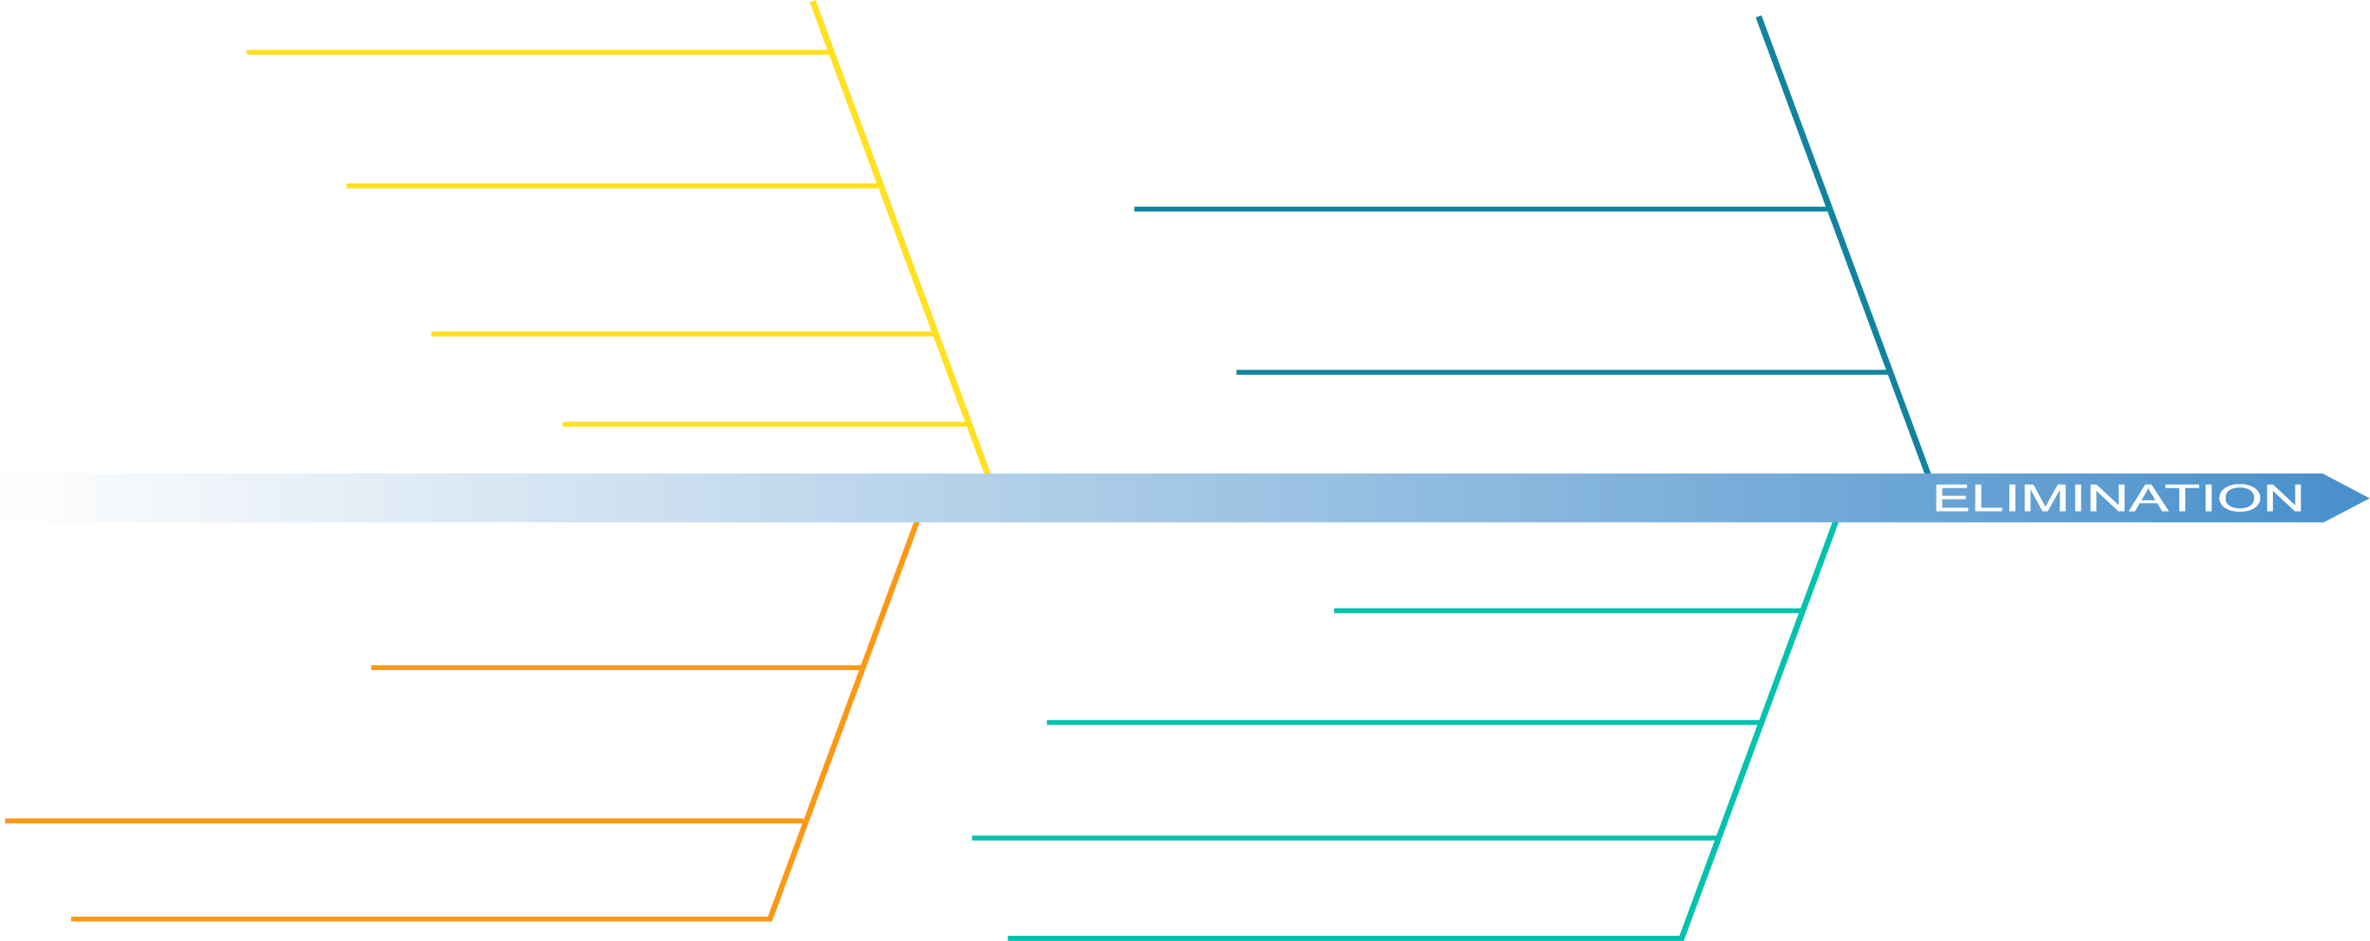

Road Towards HCV Elimination
45.5% (1,3 million) of adult population is screened for HCV
53,393 people (41.6% of the target) are enrolled in treatment
Patient inclusion criteria removed
Long-term Elimination
Strategy 2016-2020 approved
Geographic and financial access to
diagnostic services - significantly increased
2016
2018
LDV/SOF based regimens
introduced to the program
Moving from vertical to horizontal service delivery systems through active engagement of PHC centers
TAG established
Decentralization of HCV services
Overall SVR rate 98%
Elimination through Decentralization
2nd World Hepatitis Summit
First Regional Consultation on Viral Hepatitis in the WHO European Region Held in Tbilisi
World Hepatitis Summit
Enhancement of electronic information systems
6th National HCV Workshop in March
Memorandum of Understanding between Georgian Government and Gilead Sciences
2015
Expansion of HCV service decentralization
2019
HCV Screening Protocol approved by the Ministry
2017
New Medication Vosevi (SOF/VEL/VOX) to be introduced
Initial phase of HCV elimination action plan and start of the program
TAG recommendation on decentralization
Initiating integrated screening on the
whole country level
Notes:
I had an honor to present in details our flagship - Hepatitis C elimination program implemented by the Ministry with support of our international partners US CDC, WHO and pharmaceutical company Gilead Sciences Inc. Hereby I would like to share the recent progress and outcomes of the project. In last 4 years, more than 2 mill person were screened and over 68010 enrolled in the program and over 49853 completed the treatment with free high-quality Hepatitis C drugs - Harvoni, provided by the pharmaceutical company Gilead Sciences. We have over 98% treatment success rate and the best coverage - 30% when the world's rate is 7-9%.

Slide 8

Next Steps
Link universal health coverage to Sustainable Development Goal 3
WHO-EU-LUX UHC Partnership (UHCP)
  Sustainable improvement of UHC – leaving no-one behind
  Sustainable improvement of UHC – leaving no-one behind
Promote the development of PHC and Integrated care system
Improve quality of healthcare services
  Implement strategic purchasing, selective contracting and performance based financing
  Expanding the Medication for Chronic Diseases
Notes:
Our Main priority is sustainable implementation of Universal Health Coverage – a fundamental priority for all to access effective health-care services, reducing financial hardship, and improving health outcomes.
For Achievement SDG, Government annually is increase public investment in health care; Already started and is continuing expand access to outpatient drugs. We are trying to employ efficiency savings: get better value for money from existing resources. By WHO technical support, we are starting to Implement of active purchasing, selective contracting and performance based financing
I hope that active discussions and right identification of priorities in health care will significantly contribute to further development of the UHC concept in order to improve the health level of people around the world.
We would like to thank our collaborators from the WHO whose support was crucial for us to achieving the main goal: ensure healthy lives and prosperity of our population.

Slide 9
Thank you for Attention

