Slide 1
Financial Transition
Experience of Georgia
Dr. Tamar Gabunia
Deputy Minister of IDPs, Labor, Health and Social Affairs
Notes:
Since 2013 the Government of Georgia has undertaken an important reforms to expand health care coverage to the entire population and improve health care services.

Slide 2

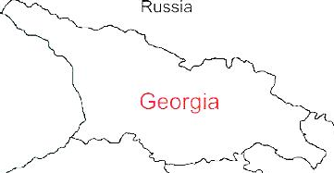



Demographic and Socio-Economic Situation, 2017
Population – 3 728 300
Birth rate (per thousand population) – 14.3
Mortality rate (per thousand population) – 12.8
Life expectancy at birth – 73.5
Maternal Mortality (per 100000 live birth) – 13.1
Infant mortality (per 1000 live birth) – 9.6
Under 5 mortality rate (per 1000 live birth) – 11.1
GDP per capita (at current prices) – 4067 $US
GDP real growth – 5.0%
Government expenditure on health per capita – 104 $US
Government expenditure on health as % of GDP – 2.8%
Government expenditure on health as % of State Budget – 8%
Government expenditure on health as % of GDP – 3.1%
General Government expenditure on health per capita (USD) – 117
Notes:
The population of Georgia has declined during the last 25 years, largely due to the outmigration and according to the census conducted in 2014, it is 3,7 mln.
Georgia has made a good progress in improving health outcomes. Life expectancy has increased by about 5 years over the few decades and currently is at 73.5 years.
Significantly has declined under-five mortality and infant mortality
In 2015 Georgia met MDGs 4th Goal: decrease under-5 mortality rate

Slide 3
ჯანდაცვის დაფინანსების სისტემის რეფორმა
1995-97 წ. - სავალდებულო სამედიცინო დაზღვევა, 3%+1% - დამქირავებლებისა და დაქირავებულების სავალდებულო შესატანი, პროგრამულ დაფინანსებაზე გადასვლა ; 1995 წ. რაიონული ორგანოები, 1997 წ. რეგიონული ორგანოები
2003-2004 წ. - სოციალური დაზღვევის გადასახადი (დასაბეგრი თანხის 31%, ამასთან, ფიზიკურ პირზე თვეში არანაკლებ 16 ლარისა)
2005 წ. - უმეტესწილად გადასახადზე დაფუძნებული ჯანდაცვის სისტემა
2007 წ. - სახელმწიფო ასიგნებებით მოსახლეობის მიზნობრივი ჯგუფების დაზღვევა კერძო სადაზღვევო კომპანიების მიერ
2009 წ. ნებაყოფლობითი დაზღვევის ე.წ. “ბაზისურ პაკეტში” სახელმწიფოს თანამომაწილეობა
2010 წ. სამედიცინო რაიონების მიხედვით სადაზღვევო ვაუჩერის ფასი, მზღვეველი კომპანიის გამოვლენა კონკურსით
2013 წ. საყოველთაო ჯანდაცვის პროგრამა

Slide 4
Financial Transition Phases
1995 – 2004 – from Semashko to Compulsary Health Insurance
  3% + 1% - Health insurance contribution of employers and employees
  Transition to program financing;
  Split the planning, procurement and delivery of medical services
  Solo-Purchaser - Health Insurance Fund
  From 2003-2004 - Social Insurance contribution

Slide 5
Financial Transition Phases
2007 – 2014 - From Bismarck model to American Mix Model
  Priority - Development of private insurance market
  General contributions
  Insurance of targeted groups of the population (under poverty line, teachers….) by private insurance companies from state budget funds
  Malty-purchasers – private insurance companies
  Social Service agency - pipeline of State budget funds
  The so-called "pre-payment" schemes and monthly premiums to the number of insured population
  2012 – Insurance of Pensioners, Children under-5, Students and disabilities

Slide 6
Financial Transition Phases
2013 - From American Mix Model to Universal Health care
  100% of population is covered by comprehensive basic package (93% - UHC Program; 7% - Private insurance)
  Strong Single purchaser
  Strategic Purchasing to active purchasing
  Selective contracting and quality
  Result based financing models; DRG

Slide 7
Universal Health Care – Socially Oriented Political Platform
Reforms have moved Georgia closer to universal health coverage
Unprecedented Expansion of State Budget for Health care
365 mill GEL in 2018 → 1138 Mill Gel in 2018
Launch of Universal Health Care Program in February 2013
Better access to care
Better user experience
Better financial protection
Notes:
The main goal of the elected government in 2012 and re-elected in 2016, is the poverty reduction and socially oriented political platform. The strong political will pledged in the election platform was translated into an unprecedented, in 2013 almost 2-fold expansion of budgetary allocation for health.
The second major step towards securing enjoyment of health rights in the country was the launch of a Universal Health Care Program in February 2013. Georgia now has a foundation of universal entitlements within its health system, representing a major step towards improving access to health services for the entire population.
Although the health impact of the UHC program remained to be seen and will be apparent in the medium to long-term, very important achievements and results are already visible, specifically with respect to the financing scheme and greater equity in the health system.
The survey carried out by the World Bank, the World Health Organization and the US Agency for International Development showed the main achievements of the Universal Healthcare Program: increased access to medical services, increased utilization of medical services, reduced financial barriers and enhanced coverage
Under the UHC program, patients have almost unlimited choice of provider. In terms of the package of benefits, benefits have been gradually increasing.
From May 2017, the highest earners are excluded from the UHC programme and expected to purchase health insurance. This reduction in coverage is counterbalanced by an expansion in the benefits package for those living below the poverty line to cover the essential outpatient pharmaceuticals for four chronic conditions.

Slide 8
Financial Flows in Health system, 2017F
Population
Patients
State Budget
International Donors
Ministry of Labour, Health and Social Affairs
Social service Agency
(Main purchaser)
National Center for Diseases and Public Health
Private Insurance Companies
X
X
Administration and functioning of the sector
Public Health
Pharmaceuticals
Autonomous republics /
Local authorities
Inpatient services
Outpatient services
Dental services
Out-of-pocket
Public funds
Prepaid schemes
Local government
International aid

Slide 9
Protect what is working well: universality backed by public investment in health through general taxes brings Georgia closer to EU countries
MoLHSA/NHA

Slide 10
Structure of Total health expenditure

Slide 11
Out-of-Pocket payment (OOP) as % of Total Health Expenditure (THE)

Slide 12
Universal Health Care Program Budget, Mill GEL

Slide 13
Beneficiaries
Persons with a document certifying Georgian citizenship
Persons with a neutral identity card
Persons with a neutral travel document
Persons with stateless persons in Georgia
Persons seeking asylum in Georgia
Persons with refugee or humanitarian status

Slide 14
Expanding benefits
I Phase - 28 February 2013 (minimum package)
  - Planned ambulatory care
  - Urgent outpatient and inpatient care
II Phase - July 1, 2013 (basic package)
  - Planned ambulatory care
  - Urgent outpatient services
  - Urgent inpatient and critical are
  - Elective surgical care
  - Chemo-, hormone- and radiotherapy
  - Maternity services
  - Basic drugs for target groups
III Phase - May 1, 2017 - Service stratification according to revenue groups using “social justice approach”
- Outpatient drugs benefit for chronic conditions
Notes:
Under the UHC program, patients have almost free choice of provider. In terms of the package of benefits, on these slide you are possible to see that, benefits have been gradually increasing.
From May 2017, have been started Service stratification according to revenue groups using “social justice approach”

Slide 15
Universal Health care Program beneficiaries
People under poverty line, teachers, public artistes, children in foster care, compactly settled IDPs (target groups)
Pensioners, 0-5 years Children, students, disabled persons (age group)
Uninsured veterans - (veterans)
Other population:
    A person with 70,000-100,000 rating scores (Target social assistance)
    6-18 year olds
    Income per year> 40,000 GEL (except pension age)
    Income per year <40,000 and monthly income ≥ 1000 GEL
    Monthly income <1000 GEL
Notes:
the highest earners are excluded from the UHC programme and expected to purchase health insurance, although for vulnerable groups the packages remained the same. This reduction in coverage is counterbalanced by an expansion in the benefits package to cover the essential outpatient pharmaceuticals for four chronic conditions, at these stage for those living below the poverty line.

Slide 16

Better user experience
80.3% beneficiaries satisfied with the outpatient service and 96.4% expressed satisfaction with hospital level emergency care
Over 77% of the population notes increased financial access to outpatient and inpatient services
Notes:
According to a survey conducted by the US Agency for International Development in 2014, 80.3% of the surveyed beneficiaries were satisfied with the outpatient service and 96.4% expressed satisfaction with hospital level emergency care within the universal health care program. In addition, according to the survey data, more than 77% of the population notes that by introduction the universal healthcare program their financial access to outpatient and inpatient services has increased.

Slide 17
“Vertical” State Health Programs
Public health Programs
Early Detection and screening of Diseases
Immunization
Epidsurveillance
Blood safety
Prevention of occupational diseases
Management Infectious diseases
Management of TB
Management of HIV
Management of Hep C
Treatment of drug abuse
Maternal and Child health
Health promotion
Health Services in priorities areas
Mental Health
Management of Diabetes
Child onco-hematology
Dialysis and kidney transplantation
Palliative care of incurable patients
Treatment of rare diseases
Ambulance and emergency care
Rural doctors
Medical screening for army recruits
Referral (individual care)

Slide 18
Coverage of Healthcare services
Services utilization
Hospitalization per 100 population
  UHC Program has led to a major expansion in population entitlement to publicly financed health services (HUES)
Ambulatory care visits per person per years
Notes:
The coverage of population improved as demonstrated by the series of health care utilization and expenditures surveys. Over half of the population were covered first time. We have seen a surge in utilization of the health care services. Utilization of outpatient and inpatient care has almost doubled since the introduction of the UHC program.
. In Georgia, during last 2 decades, this indicator did not exceed 2.2. In the frame of the UHC programme the numbers of out- and in-patient encounters continued to grow due to increased accessibility of healthcare services. In 2016, the number of contacts with out-patient facilities per capita reached 4.0.

Slide 19
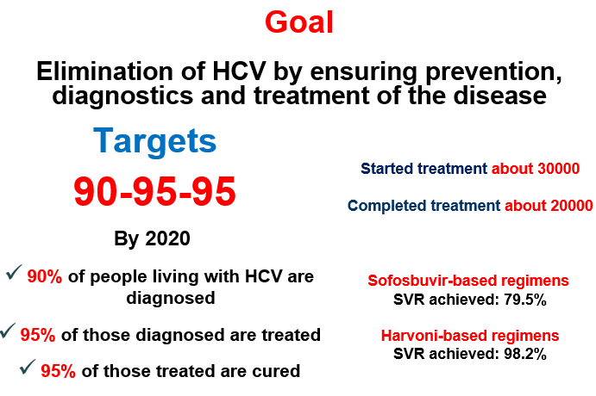
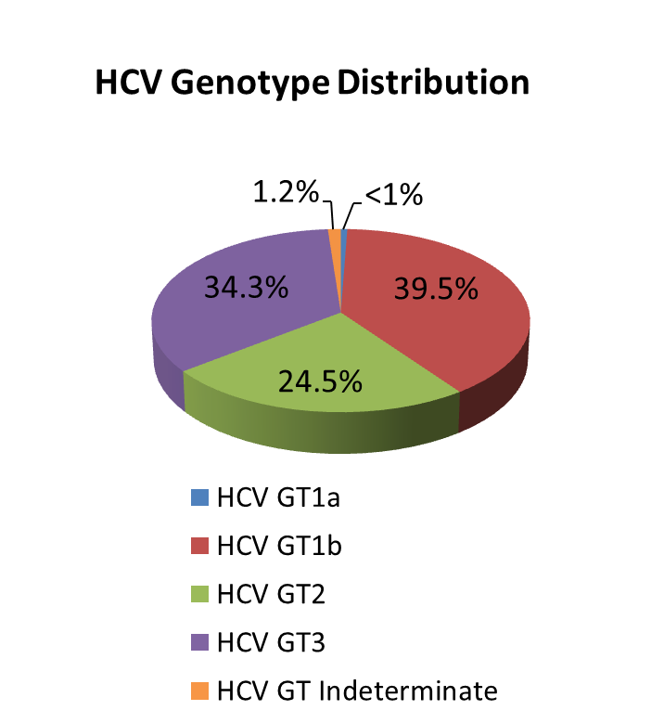
National Hepatitis C Elimination Program
Nationalwide survey, 2015
Anti-HCV+ | 7.7%
HCV RNA+ | 5.4%
Screened - 2 100 000
Started Treatment – 51 000
Completed treatment – 49 050
Sofosbuvir-based regimens
SVR achieved: 82%
Harvoni-based regimens
SVR achieved: 98.2%
Notes:
Based on available data, Georgia is among the countries with high hepatitis C (HCV) Prevalence. 2015 National survey conducted by NCDC and CDC revealed that ~150 thousand people are infected with active HCV infection and need to be treated. The survey estimated that 7.7% of population are anti-HCV positive and 5.4% are HCV RNA positive. The most prevalent genotype nationwide is genotype 1 (appx. 40%) followed by genotype 3 and 2.
Memorandum of Understanding between the Government of Georgia and US pharmaceutical company Gilead was prepared and officially signed on April 21, 2015.
Long-term elimination strategy for 2016-2020 was developed together with CDC based on WHO guidelines. Goal: Elimination of HCV by ensuring prevention, diagnosis and treatment of the disease

Slide 20
Thank you for your Attention!

