Slide 1
Adult epidemiological survey

Slide 2
End of december situation
900 interviews completed
Good participation rates: 89% on average, lower in Tblissi: 83%
Meeting with an interviewer
  Good selection
  Good training
  Good feedback from people interviewed on mental health: beginning sometime difficult but people grateful to be listened to and very open
  Importance of trauma

Slide 3
Children survey
Unicef meeting very productive
Agreement on methodoloy
They have required questions on nutrition and more details about physical exercice
Questions on school achievements to be revised and financed by unicef education branch
School interviewers probably provided by external provider
Importance of getting education ministry authorisation
They are focused on adolescents so we engage ourselves to start a feasability survey on adolescent using the same methodology

Slide 4
Suicide
Data provided by Dr Nino Makhashvili

Slide 5
Suicide in Georgia (GIF-Tbilisi, 2018)
Problems with the Data: MIA versus National Statistics Office
The difference between the statistics A taboo topic?
Data presented here are from MIA

Slide 7
Age Group | Number | rates/100000
0-14 | 3 | 0,37
15-24 | 36 | 7,98
25-54 | 172 | 10,78
55-64 | 62 | 11,77
65+ | 88 | 14,46
Georgia | 361 | 9,05

Slide 8
Males | 301 | 15,83
Females | 60 | 2,87

Slide 9
D’importantes
disparités selon les classes d’âge
Nombre de décès par tranche d’âge, en 2012 (source CépiDc)
57%
28%
Suicide des jeunes reste rare
Prévalence du suicide chez les hommes, en milieu de vie

Slide 11
Suicide rate by region
Regions | population |  | Number of suicide | Rate. /100 000
Guria | 113350 | 3% | 16 | 14,12
Adjara | 333953 | 9% | 25 | 7,49
Samtskhe-Javakheti | 160504 | 4% | 15 | 9,35
Kvemo Kartli | 423986 | 11% | 35 | 8,25
Kakheti | 318583 | 9% | 28 | 8,79
Imereti, Racha-Lechkhumi and Kvemo Svaneti | 566004 | 15% | 54 | 9,54
Shida Kartli | 263382 | 7% | 26 | 9,87
Mtskheta-Mtianeti | 94573 | 3% | 12 | 12,69
Tbilisi | 1108717 | 30% | 108 | 9,74
Samegrelo-Zemo Svaneti | 330761 | 9% | 42 | 12,70
Georgia | 3713813 | 100% | 361 | 9,72

Slide 12
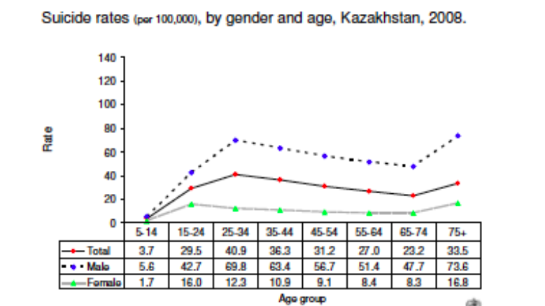

Slide 13
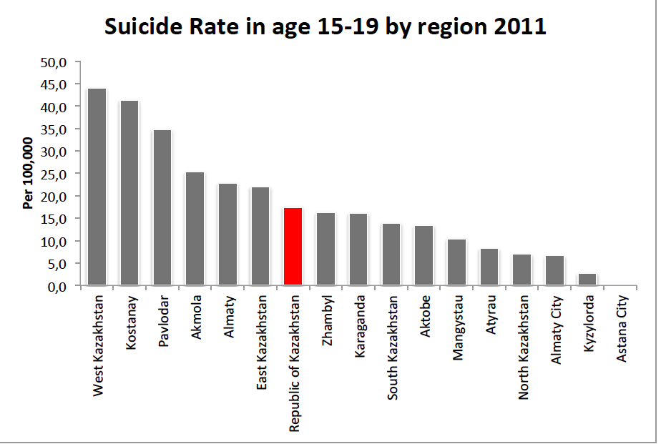

Slide 14
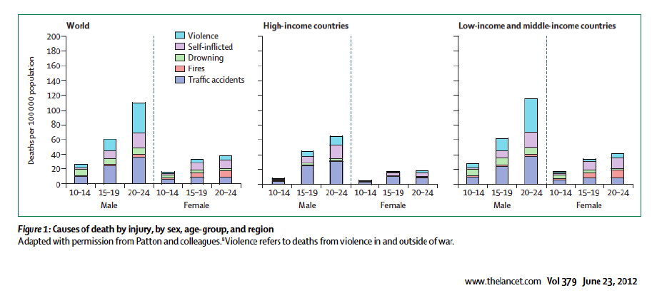

Slide 15
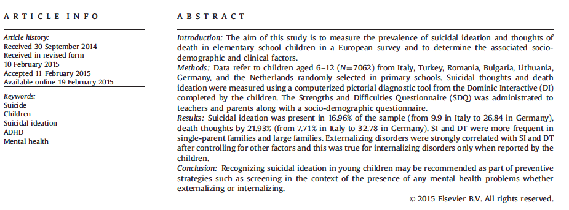
Journal ofAffectiveDisorders177(2015)28–35

Slide 16
Conclusions
More information are needed on suicide
  The adult survey will provide information on suicidal thoughts and suicidal attempts and their links with mental health disorders that could be compare with other countries including on young adults
  The child survey will provide information on suicidal thoughts on young children in a comparable manner
Actions toward youth suicide need to be done with caution
  Data are based on very low numbers: 39 cases for the country with potential regional differences and few more or less cases will be misinterpret as a change
  A lot of caution toward « suicide prevention » on youth

Slide 17
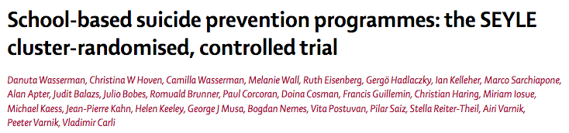
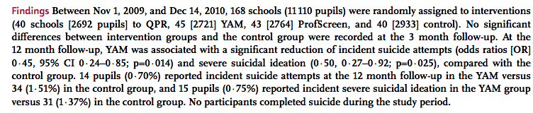

Slide 18
Accreditation
Regular in site visits (each five years by professionals: physicians, administrative and nurses in activity
Patients and family are involved
Preparation of the visit is the main point self evaluation on specific aspects to sensitize the professionals to the problems
Report is public with recommendations that will be followed

