Slide 1

COVID-19 MONITOR
Europe and central Asia
[Unless otherwise specified, data is as of June 12]

Slide 2
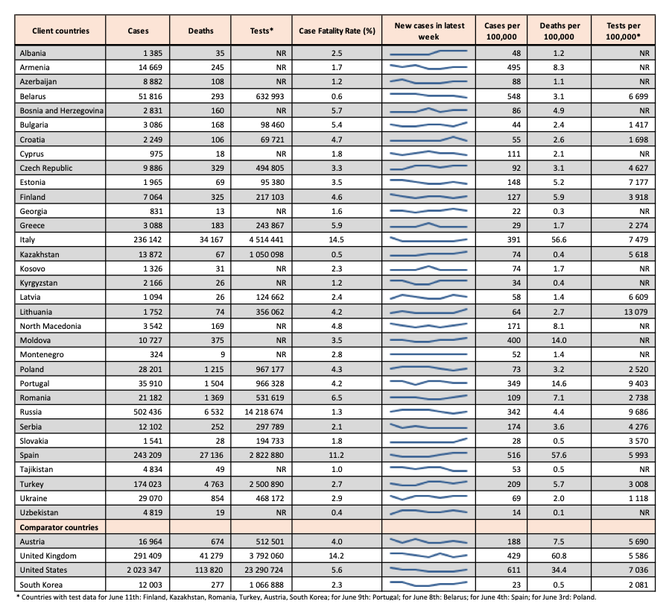
Cases, case fatality rates, and testing
•Cases per 100,000 population range from 14 in Uzbekistan to 548 in Belarus.
•Case fatality rates remain below 7% in most client countries, with higher rates in Italy (14.5%) and Spain (11.2%).
•Variation in testing rates (per 100,000) from 1,118 in Ukraine to 13,079 in Lithuania.
•A significant number of countries do not report official testing rates (NR).
•Finland, Lithuania, and Portugal report samples tested, while Croatia, Serbia, and South Korea report people tested. Other countries report number of tests conducted.
•To propose a data source for a country missing testing data, kindly fill this link.

Slide 3
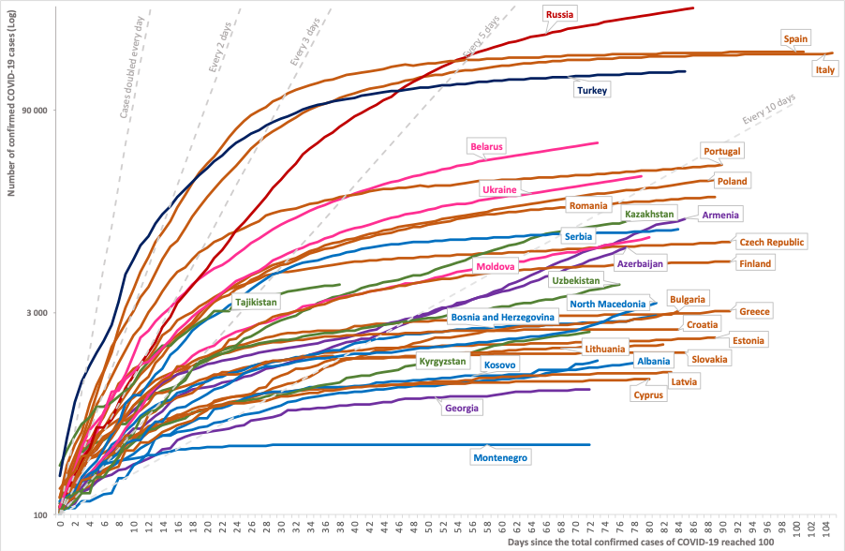
Cumulative case count in client and comparator countries
•This chart plots trajectories in reported total cases for client countries since the 100th case.
•The cumulative case count in Armenia, Azerbaijan, Czech Republic, Kazakhstan, and Moldova appears to be rising at an increasing rate.
•A lengthening of the case doubling time for other countries indicates a slowdown in spread of the virus.
Notes:
Restricted to countries with ≥ 100 cases.

Slide 4
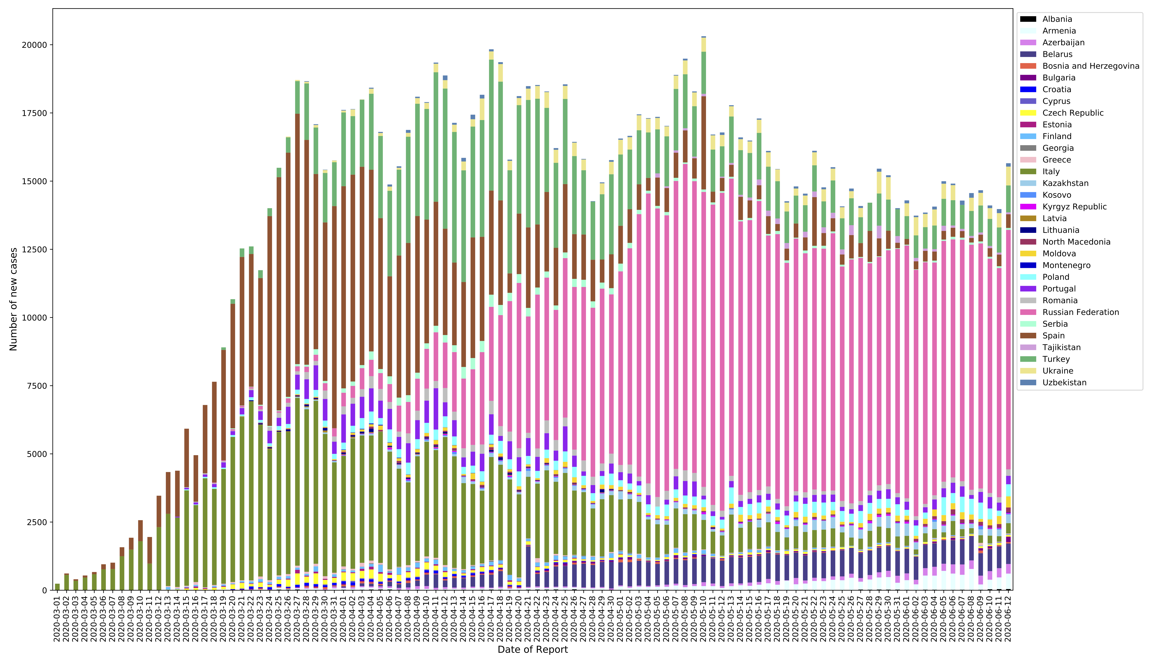
Number of new cases reported daily over the past 60 days
​This chart plots daily case incidence between March 1st to June 12th among client and comparator countries.
Overall, case incidence appears to be decreasing in most countries in the region.
Absolute case incidence is highest in the Russian Federation.

Slide 5
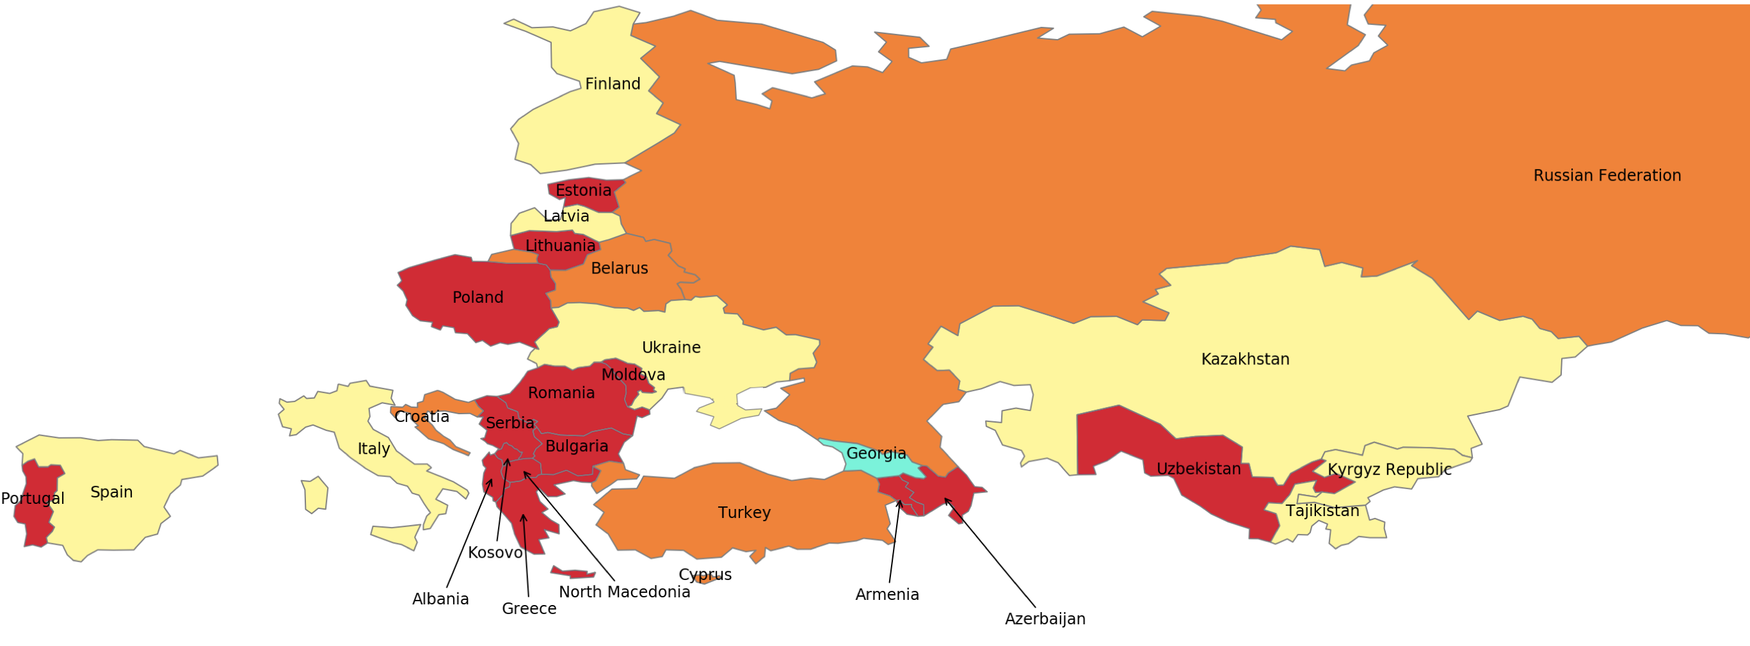
Most recent two-week span: percent change in new cases per 100,000 population
This map shows the change in the incidence of cases (in %) between the current week (June 6th to June 12th) and the preceding week (May 30th to June 5th).
The weekly number of new cases has increased in a number of countries, including Armenia, Azerbaijan, and Serbia.
These changes should be interpreted in light of the absolute case count.
Color | Key | Countries
 | -110 to – 50: Dramatic slowing of spread | Georgia
 | -50 to -5: Spread slowing | Tajikistan, Latvia, Kazakhstan, Ukraine, Finland, Spain, Italy.
 | -5 to 5: Spread contained | Russian Federation, Belarus, Cyprus, Croatia, Turkey.
 | 5 to 100: Spread accelerating | Romania, Armenia, Albania, Portugal, Uzbekistan, Moldova, Azerbaijan, Kosovo, North Macedonia, Lithuania, Greece, Bulgaria, Montenegro, Serbia.
Note: Boundaries were cleared by the World Bank Map Design Cartography and Map Clearance Teams.

Slide 6
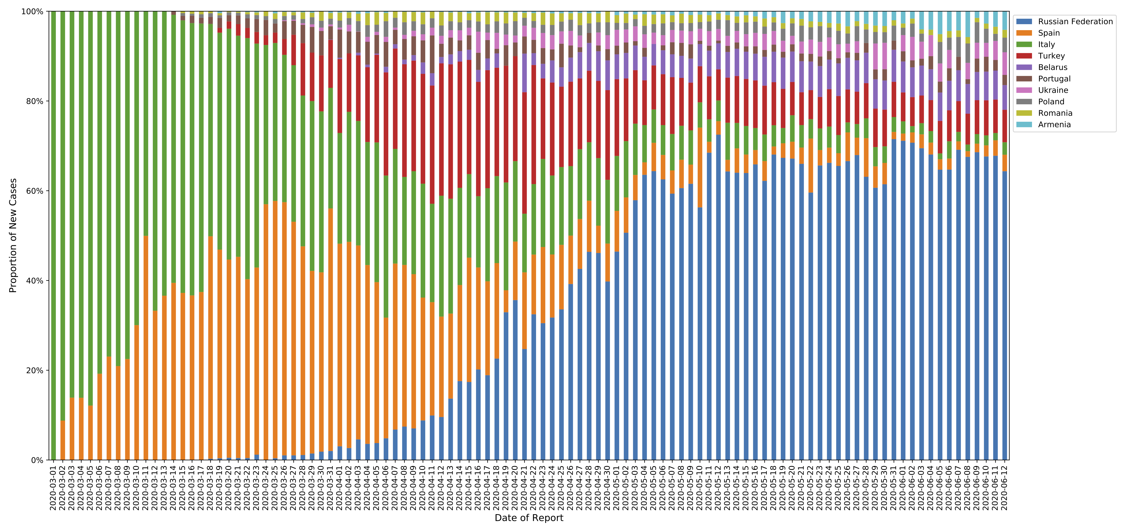
Proportion of total cases in 10 client countries with the highest positive cases
​This chart plots the proportion of total cases between March 1st to June 12th.
The proportion of cases in the 10 countries with a high case prevalence, is decreasing.
The overall contribution of Russia to case incidence remains relatively high.

Slide 7
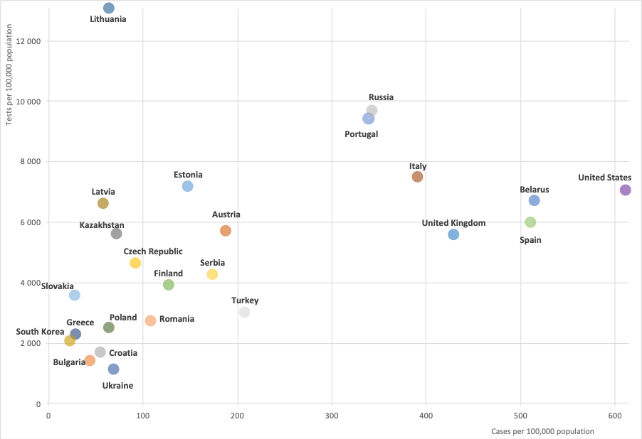
Total cases and tests per 100,000 population
Given the potential for undertesting to limit reported cases, this chart plots total cases and tests per 100,000 population for client countries and four comparators: Austria, United States, United Kingdom, and South Korea.
The cluster of countries in the bottom left-hand corner may be under-testing, including Ukraine, Bulgaria, and Croatia.
* Countries with data for June 11th: Finland, Kazakhstan, Romania, Turkey, Austria, South Korea; for June 9th: Portugal; for June 8th: Belarus; for June 4th: Spain; for June 3rd: Poland.

Slide 8
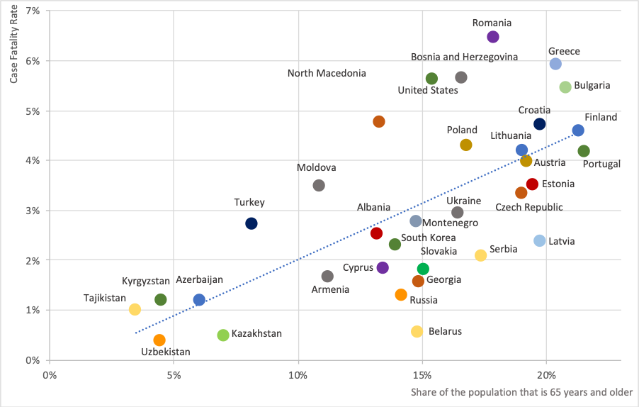
Case fatality rate and share of the population that is 65 years and older
This chart shows the correlation between the case fatality rate and population age structure in client and comparator countries.
A higher share of the population that is at or above 65 years appears to predict a higher case fatality rate, on average.
However, there is also wide variation in case fatality rate among countries with the same share of the population aged 65 years or more.
* Outliers in terms of case-fatality rate were omitted: Italy, Spain, and the United Kingdom.

Slide 9
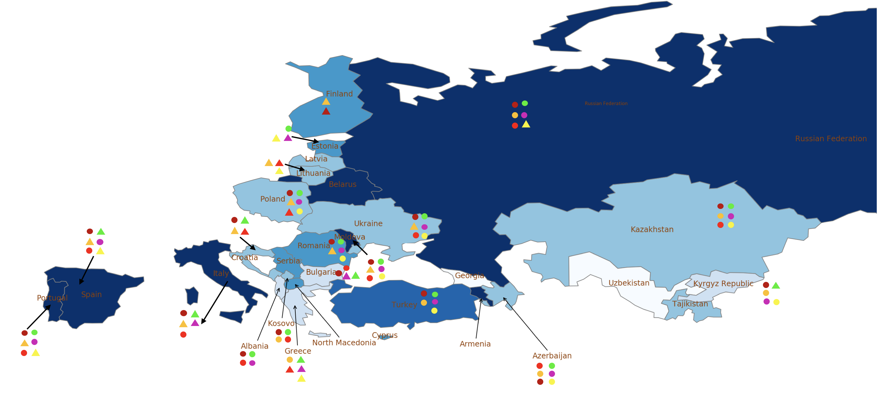
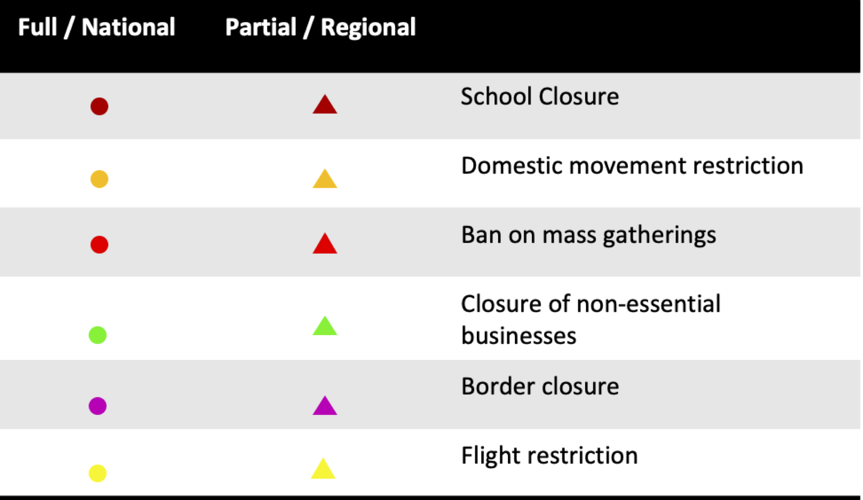
Public health and social measures implemented in the region
Color | Total cases/100,000 | Countries
 | 0-10 | -
 | 10-25 | Uzbekistan, Georgia.
 | 25-50 | Greece, Kyrgyz Republic, Bulgaria, Albania, Tajikistan.
 | 50-100 | Montenegro, Croatia, Latvia, Ukraine, Lithuania, Kosovo, Poland, Azerbaijan, Kazakhstan.
 | 100-200 | Romania, North Macedonia, Cyprus, Finland, Estonia, Serbia.
 | 200-300 | Turkey.
 | 300+ | Moldova, Armenia, Russian Federation, Portugal, Belarus, Italy, Spain.
Italy has eased up its restrictions the most, followed by Greece and Bulgaria.
​
​Kazakhstan, Azerbaijan, Albania have maximum restrictions.
Countries like Macedonia, Belarus, Georgia, and Latvia have missing data on their policy responses.
Note: Boundaries were cleared by the World Bank Map Design Cartography and Map Clearance Teams.

Slide 10
Countries and data sources
Albania | Georgia | Poland
Armenia | Greece | Portugal
Azerbaijan | Italy | Romania
Belarus | Kazakhstan | Russian Federation
Bulgaria | Kosovo | Serbia
Bosnia and Herzegovina | Kyrgyz Republic | Slovak Republic
Croatia | Latvia | Spain
Cyprus | Lithuania | Tajikistan
Czech Republic | Moldova | Turkey
Estonia | Montenegro | Turkmenistan (no cases)
Finland | North Macedonia | Ukraine
 |  | Uzbekistan
The monitor focuses on client countries in Europe and Central Asia with any lending or non-lending operations, and with available data, as in the Table.
In selected slides, comparator countries (Austria, United States, United Kingdom, and South Korea) were included because their disease trajectories are relevant reference points.
Data:
  Cases, testing, and deaths: https://ourworldindata.org/coronavirus.
  Policy responses: https://ourworldindata.org/policy-responses-covid
  Population: provided by task teams or imputed from “our world in data”.

